Slide 1
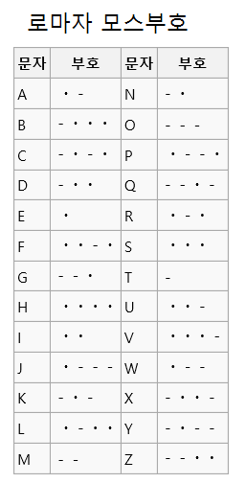
MOS CODE
dot time = 1
dash time = 3
between character = 3
between words = 7
we want to visualize it using
out plain2mos translator

Slide 2
SERVER
Are you alive? (2)
Client
ACK (2)
Then here is plain text (11)
I’m done (12)
PLAIN2MOS
Give MOS, according to time sequence (11)
VISUALIZE
(by checking timer)

Slide 3
How can we send data?
SIGNAL
DATA
2 bytes
(2, 11, 12)
MAX PACKET SIZE - 2 bytes
(plain or MOS txt)

Slide 4
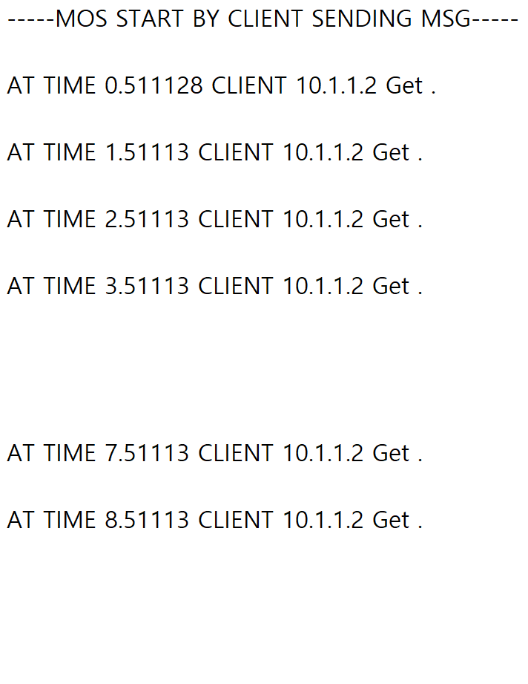
RESULT OF “hi”

