Slide 1
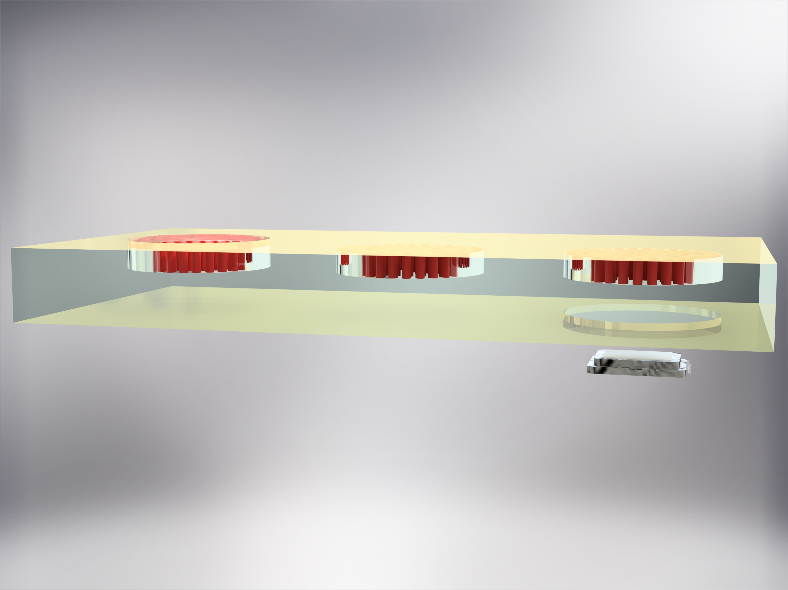
Entrance aperture
Metasurfaces
Gold reflector
Exit aperture
Image sensor

Slide 2
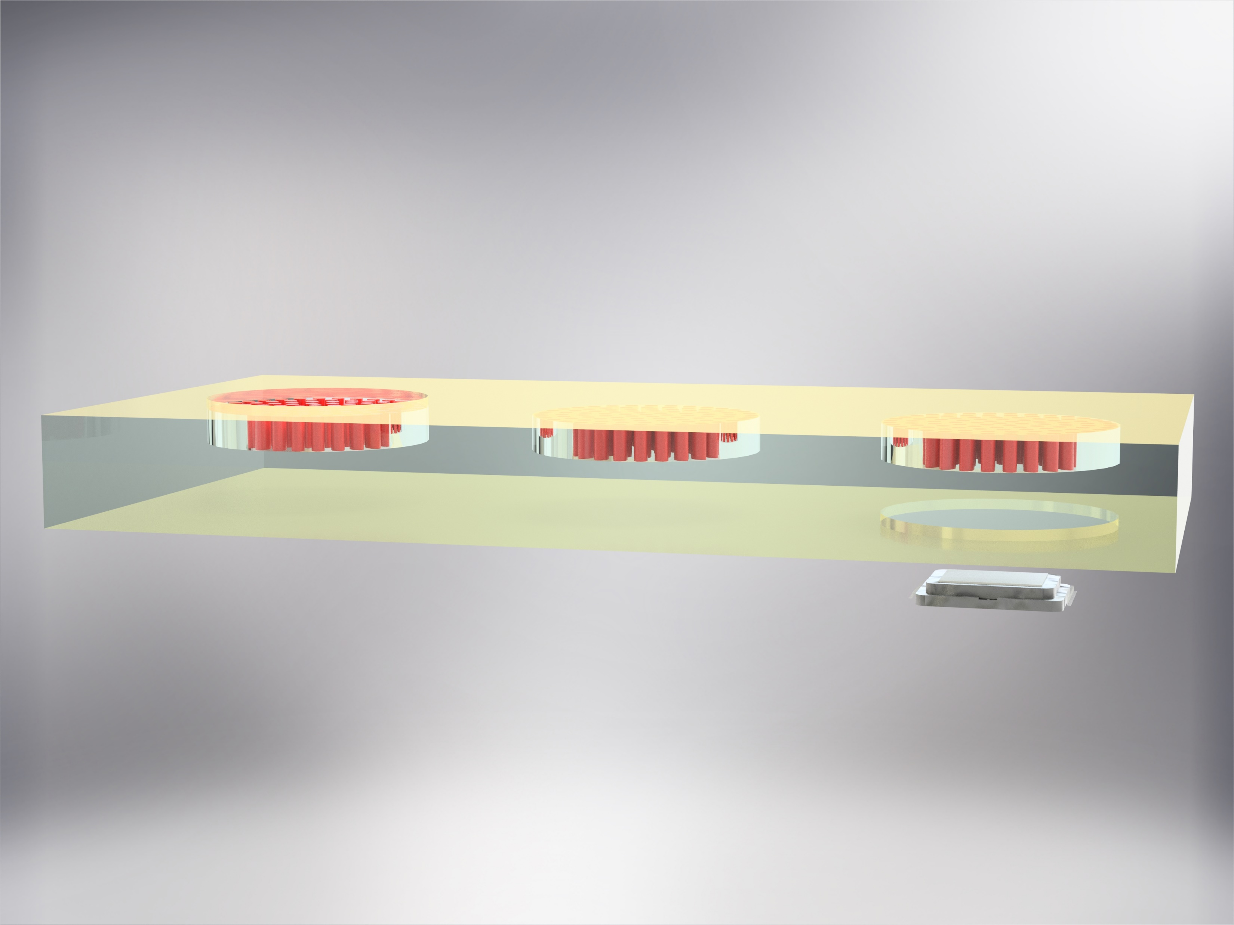
Entrance aperture
Metasurfaces
Exit aperture
Image sensor

Slide 3
Entrance aperture
Metasurface
Gold reflector
Exit aperture
Image sensor

Slide 4
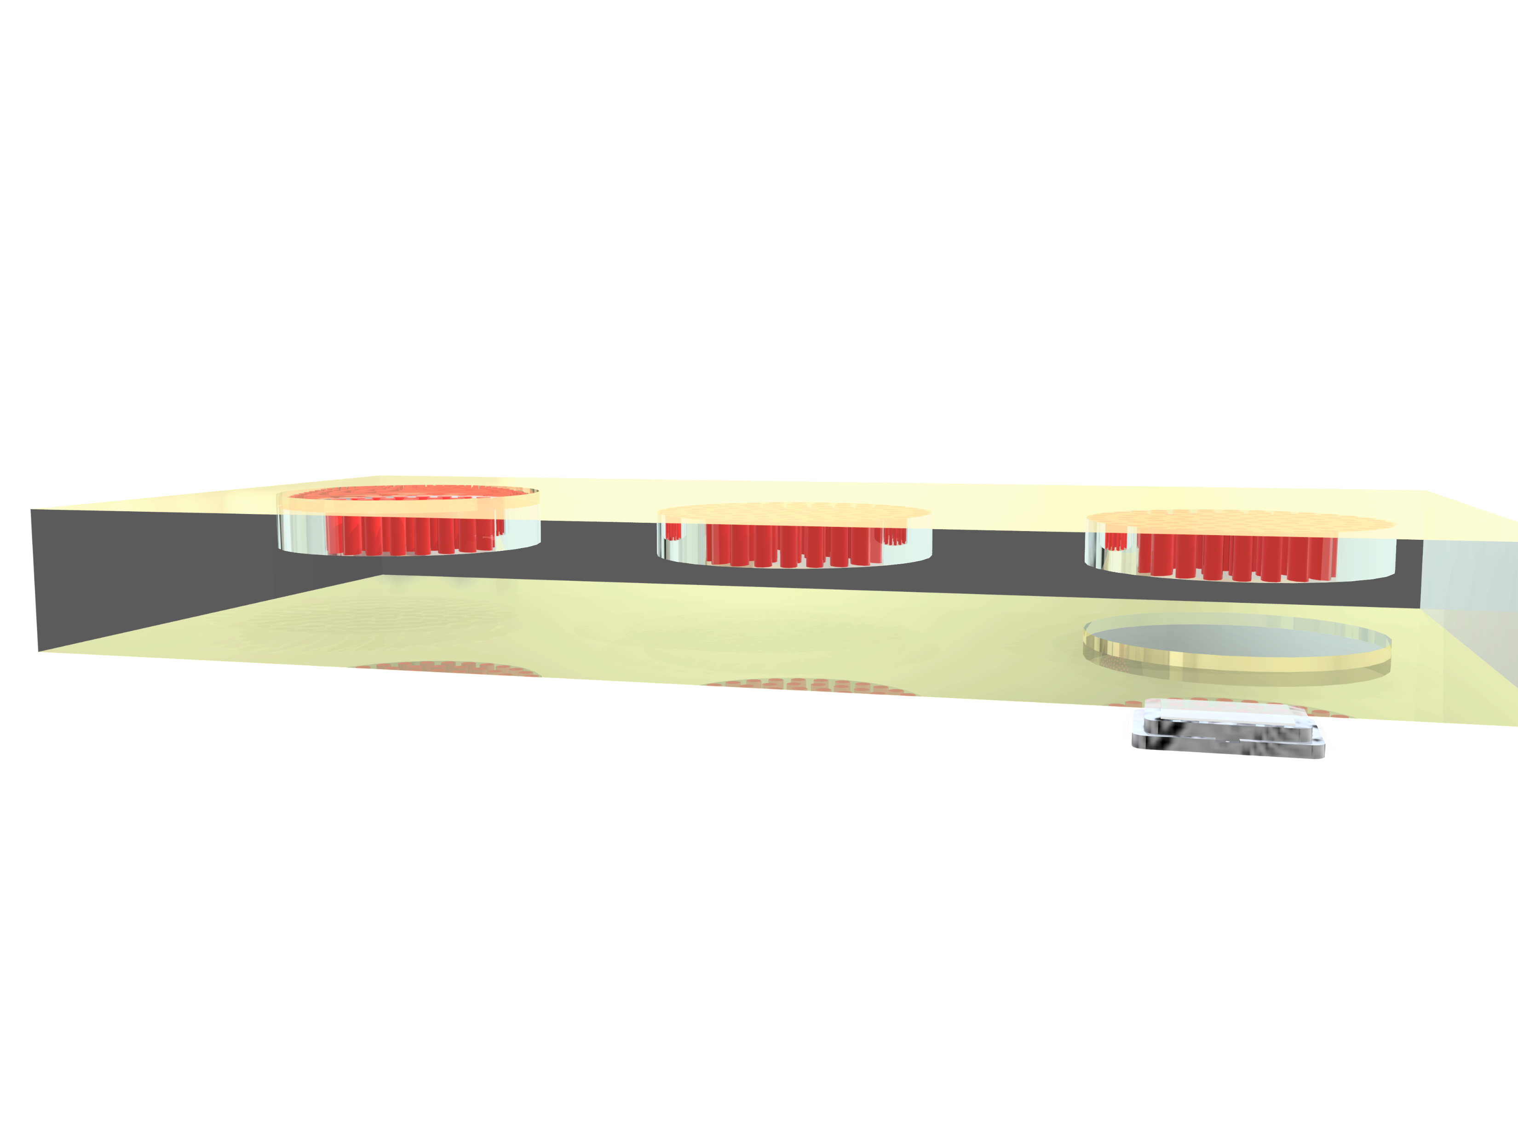
Entrance aperture
Metasurfaces
Exit aperture
Image sensor

Slide 5
