Slide 1
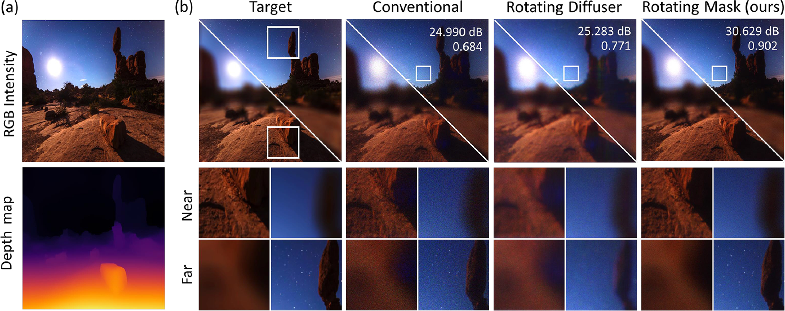
Conventional
Ours
Near
Far

