Slide 1

Quora Question Pairs
By Mo Young, and William Kluck

Slide 2
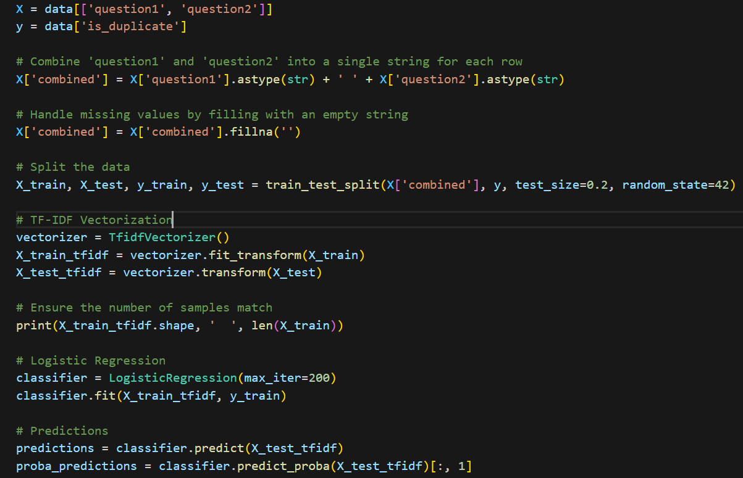
Logistic Regression
To implement this model we used:
80:20 Test Split
Stratified K-Fold (10)
Feature extraction:
TF-IDF vectors
Word2Vec

Slide 3
Logistic Regression with Word2Vec Comparing Results
Logistic Regression with Word2Vec
Average Accuracy: 0.7211560020951999
Average Precision: 0.67
Average Recall: 0.49
Average F1-Score: 0.57
Logistic Regression with TF-IDF
Average Accuracy: 0.7551262707462465
Average Precision: 0.75
Average Recall: 0.76
Average F1-Score: 0.75

Slide 4
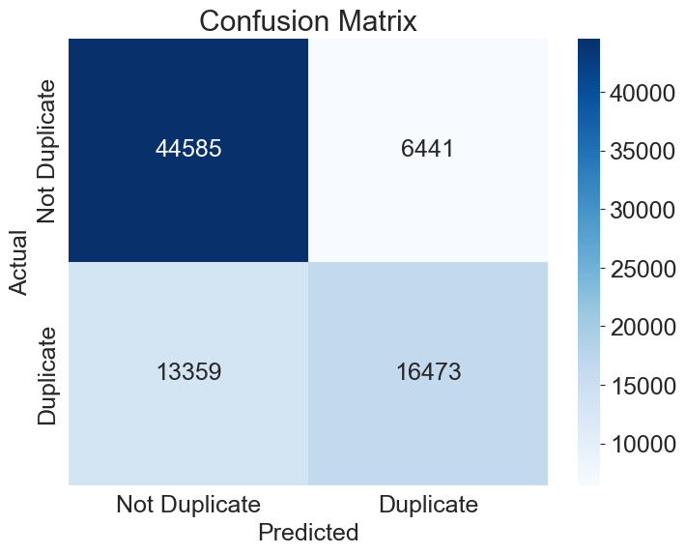
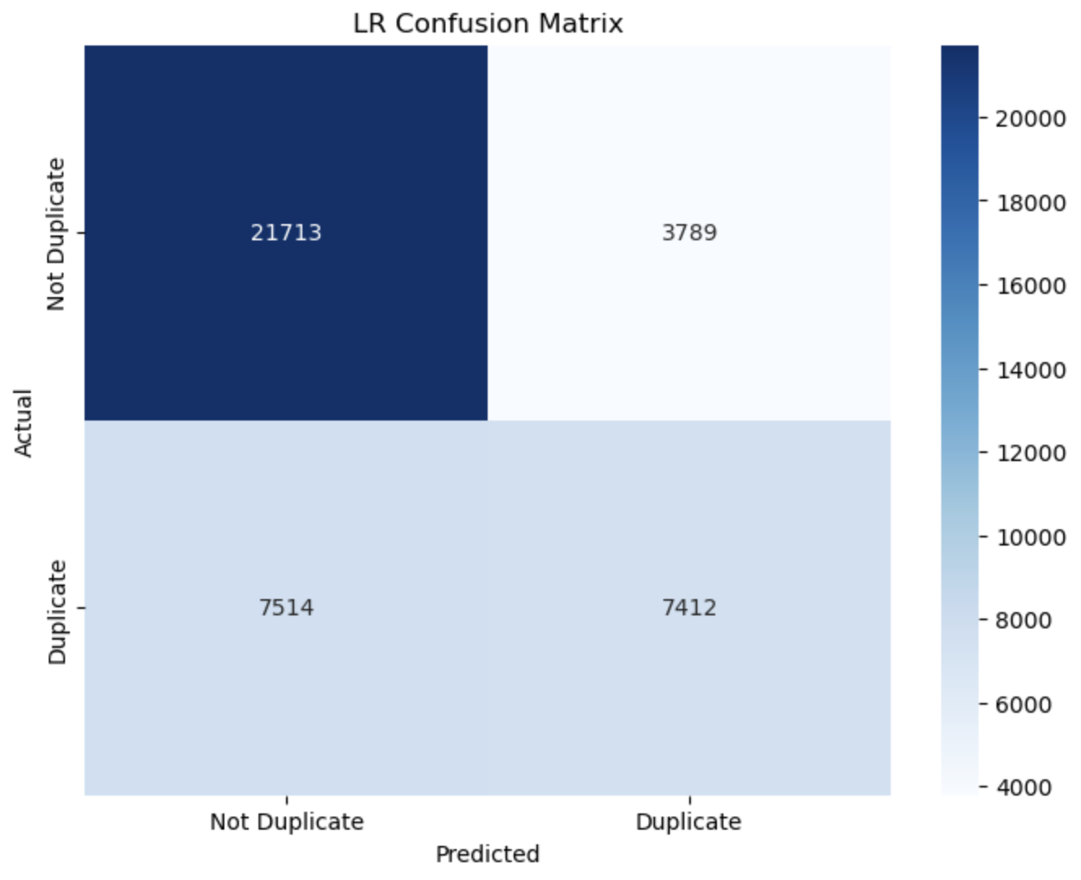
Logistic Regression
6441 False Positives
13359 False Negatives
3789 (x2) False Positives
7514 (x2) False Negatives

Slide 5
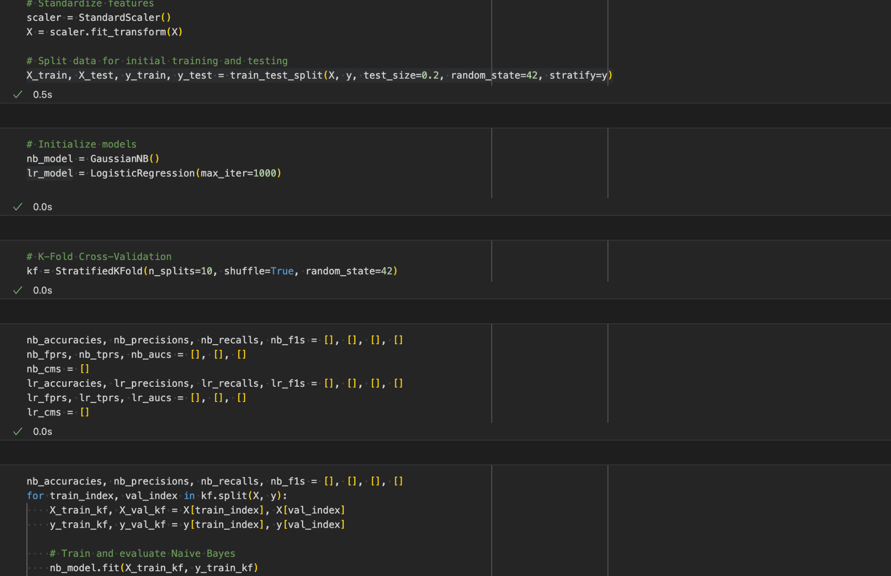
Naive Bayes Classifier
To implement this model we used:
80:20 Test Split
Stratified K-Fold (10)
Feature extraction:
Word2Vec

Slide 6
Naive Bayes Classifier with Word2Vec Encoding Results
Naive Bayes with Word2Vec:
Average Accuracy: 0.6931338354567174
Average Precision: 0.5886452018097083
Average Recall: 0.5606211890946229
Average F1-Score: 0.57428820284156
Logistic Regression with Word2Vec:
Average Accuracy: 0.7211560020951999
Average Precision: 0.67
Average Recall: 0.49
Average F1-Score: 0.57

Slide 7
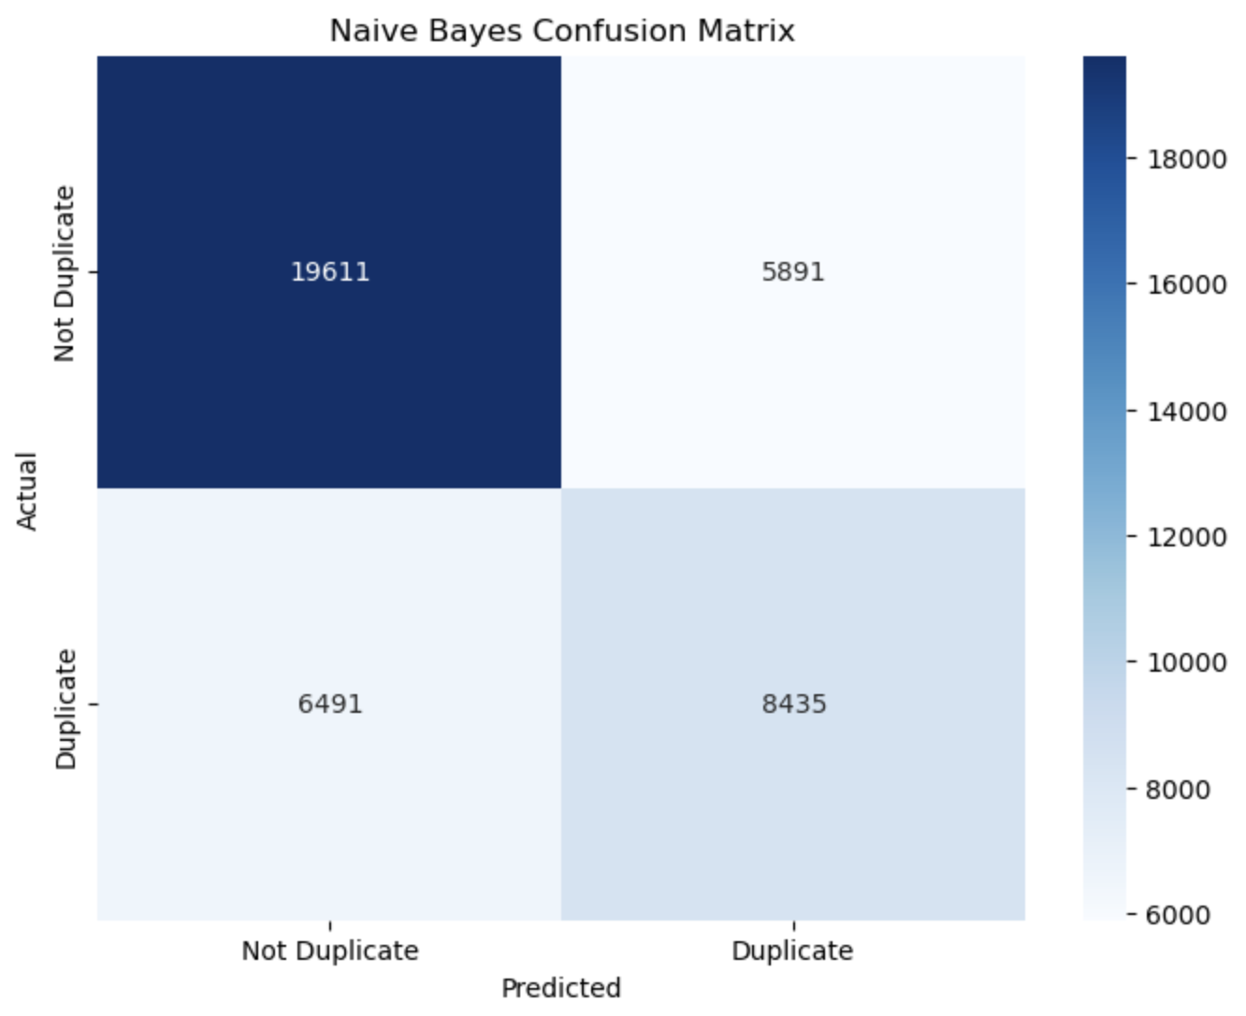
Naive Bayes Vs. Logistic Regression
5891 False Positives
6941 False Negatives
3789 False Positives
7514 False Negatives

Slide 8
Sentence - BERT A.K.A. Siamese BERT
Our initial plan was to use BERT to conduct a semantic analysis of each question and then compare the similarities between the analysis of question 1 and question 2.
Turns out SBERT does this, does it better AND does it faster (saving us critical processing time).
This approach was going to take 10 hours on Google Colab Pro, and 30 hours without it (Colab times out at 12 hours). Luckily we were able to get it working on Mo’s computer with a computation time of 2.5 hours.

Slide 9
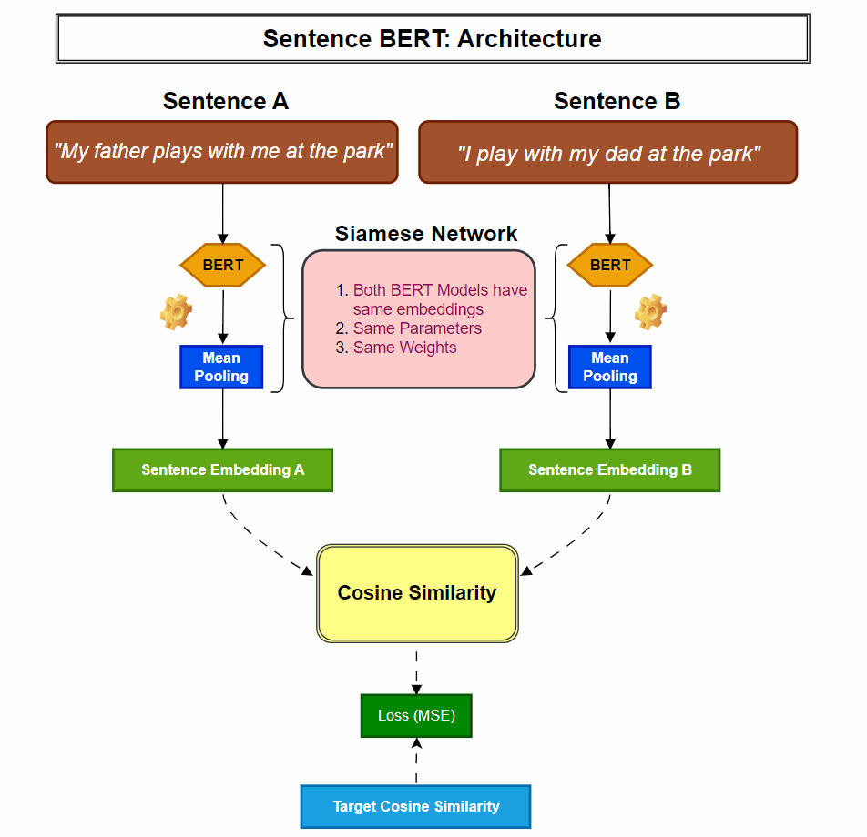
Siamese BERT
Lets go over SBERT.
IT takes 2 sentences and performs the BERT analysis and Bi-Encoding (faster that BERT’s cross encoding)
The transformation function is much better than BERT’s because while BERT grasps only topic, SBERT maps sentences into a vector space.
The pooling step is crucial to keep the the BERT output’s the same length. This allows the cosine similarity to have a more useable value.
Source:
https://www.linkedin.com/pulse/why-does-bert-stand-out-sea-sentence-embedding-models-bhaskar-t-bi6wc/

Slide 10
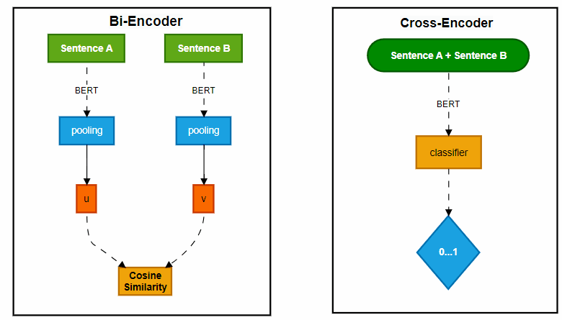
Bi-Encoding vs Cross-Encoding

Slide 11
Binary Cross Entropy Loss Function
This works well with our project because the prediction value must be 0, or 1
By using this loss function, the model is trained to minimize the difference between the predicted probabilities about the true labels (which indicate whether the questions are duplicates or not.

Slide 12
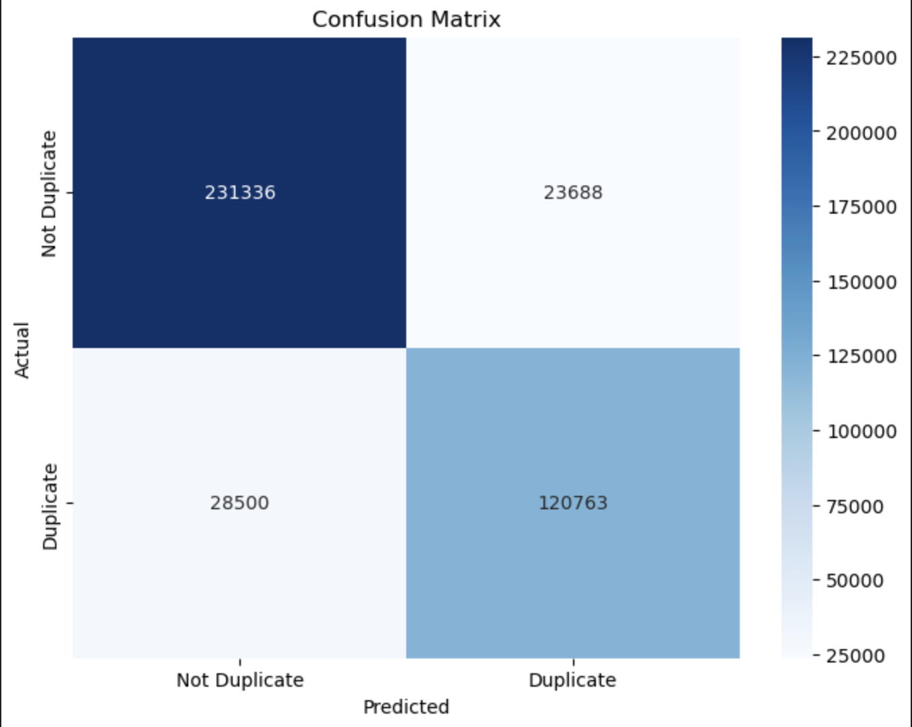
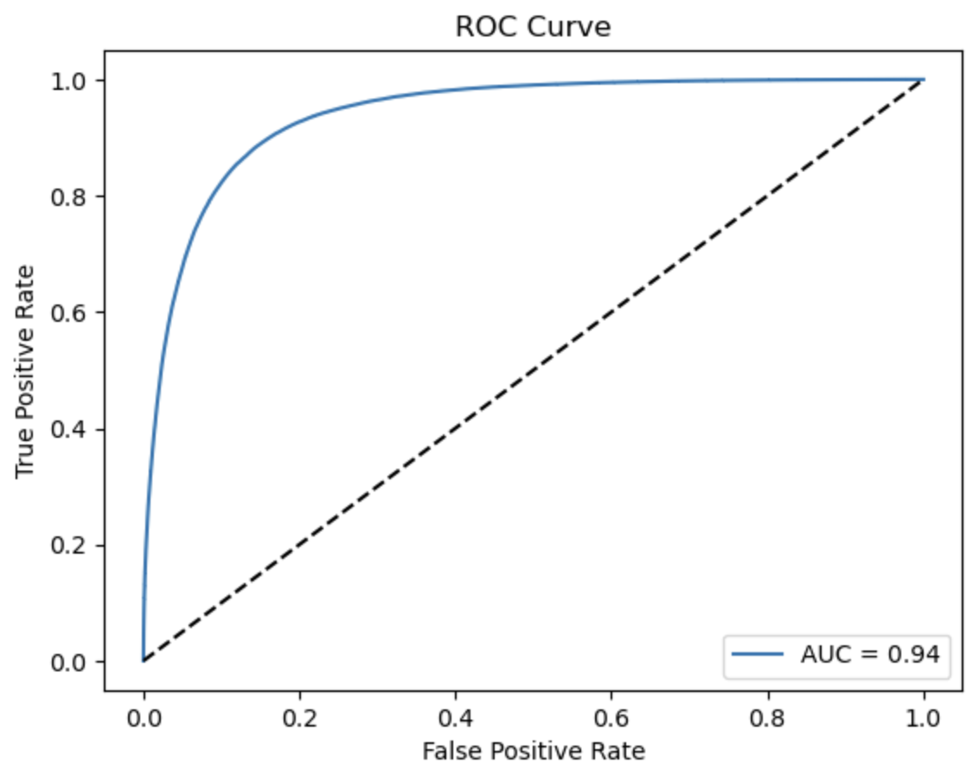
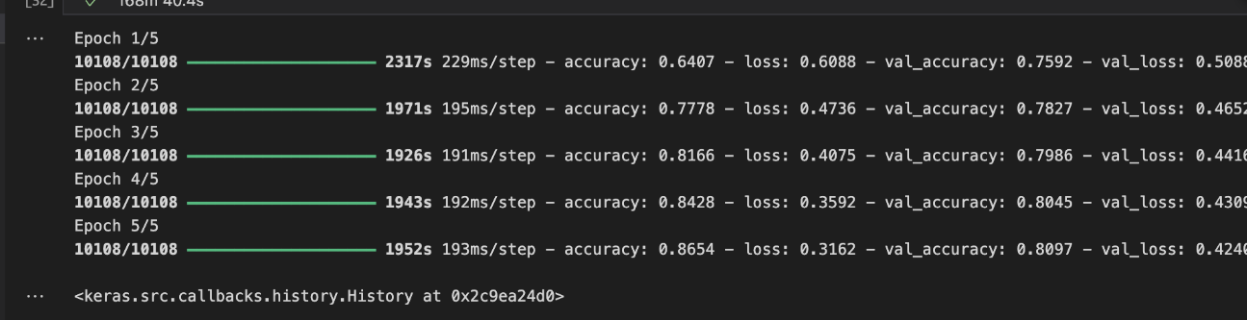
Sentence-BERT Results
Accuracy: 0.8709134847274337
Precision: 0.8360135963060138
Recall: 0.8090618572586642
F1-score: 0.822316947779132
ROC AUC: 0.940220582226047

Slide 13
Reflection
What could we have done better?
We used 5 Epoch’s for SBERT, this performed very well. It likely could have performed better if we had done a few more.
More cross-validation on the SBERT.
Our data was around 60/40 non-duplicate/duplicate, if we balanced our dataset before starting we may have found better results
What went wrong, and how can we avoid that in the future?
Google Colab has only a certain amount of computational units for free.
Because of this, if I want to be doing work like this in the future. I am going to need a better computer.

Slide 14
Resources
https://www.linkedin.com/pulse/why-does-bert-stand-out-sea-sentence-embedding-models-bhaskar-t-bi6wc/
https://www.researchgate.net/figure/Siamese-BERT-network-model_fig1_346475416

