Slide 1
Project 23
Presentent by Giovanni Esposito, Emanuele Ceglia, Paolo Lorusso, Daniele Pompilio
Notes:
The data step is where data is created, imported, modified, merged, or calculated.
We use the PROCs to analyze the data in a SAS data set, produce formatted reports or other results, or provide ways to manage SAS files

Slide 2
TABLE OF CONTENTS
01
02
AIM
DATA
03
04
SAS CODE
RESULTS
Objectives of the analysis
Description of the dataset used
Explanation regarding the SAS code developed
Interpretation of the findings of the project

Slide 3
01
AIM
Creating an RTF report by manipulating and analyzing datas stored in the Excel file Visit1

Slide 4
02
DATA
The dataset Visit1 is an Excel file containg 200 rows and 47 columns
Each row represents a unique patient
The columns contains the patient ID, demographical datas of the patients and some medical statistics

Slide 5
03
SAS CODE
Our work can be divided in 3 parts:
Importing data
The data transformation
Production of the report

Slide 6
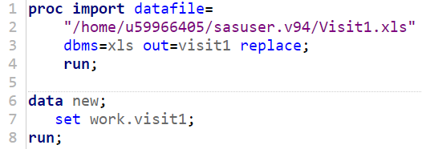
Importing data
As we know our data are stored in an Excel file called Visit1.
In order to analize data we need to import them in SAS and then to convert them into a SAS data set.
For the first task we use a proc import statement in which we specify the path, DBMS = xls which identifies the Excel type, out that is the name of the desired output and replace just in case we have already file with the same name in the system
For the second one we use a data statement in which we specify new as the name of the SAS dataset on which the excel sheet will be converted

Slide 7
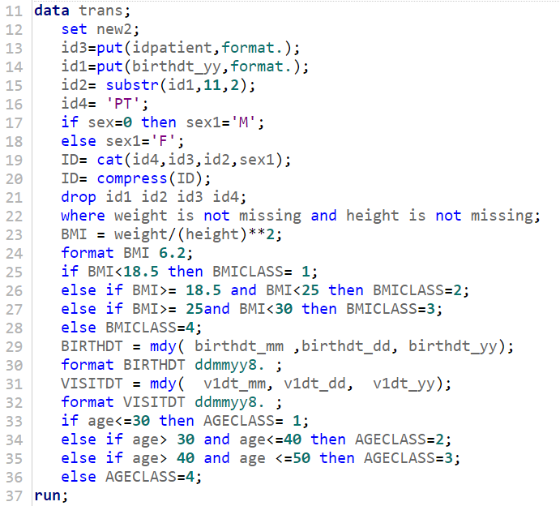
Data transformation
As we can observe our dataset has too many variables and some of the are not in the format we want.
Furthermore we also need to create new variables which are meant to be significative in our analysis.
So using the data statement we have :
Created the variable ID by using the cat function to combine the columns id1, id2, id3 and id4 previoulsy created and the compressing the resulting string with compress.

Slide 8
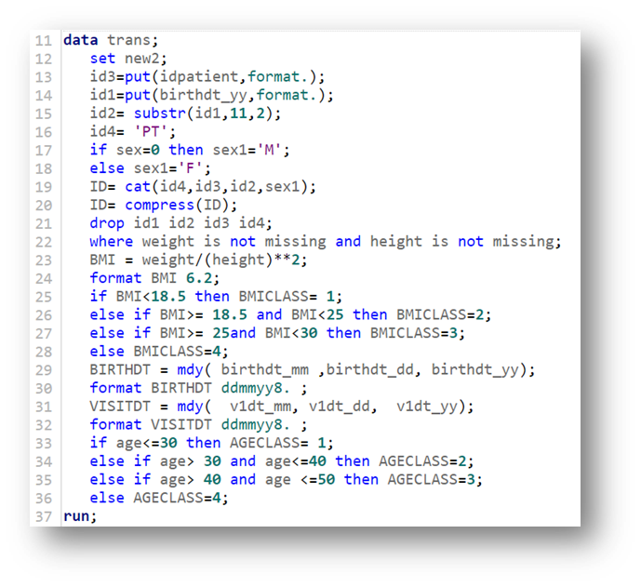
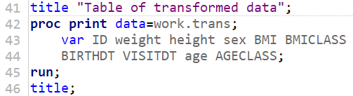
Data transformation
Then using a WHERE stetement we removed the rows with missing values for the variables height and weight.
We created a new variable BMI by applying the formula BMI=weight/(height)^2
Using the new column we created the variable BMICLASS using an IF-THEN-ELSE statement in order to divide BMI values in 4 classes
We create the variable BIRTHDT bu using the mdy functions to aggregate the day, month and year columns and the formatting it as ddmmyy8.
Using the same function we create also the variable VISITDT
With the same statement used to create BMICLASS we create AGECLASS and we divide our patient in 4 age classes
At the end we use a proc print statement to print in our report only the columns we wanted by using the keep option.

Slide 9
Report
Create a report that shows mean, min and max of BMI for the first two classes of age grouped by sex
Calculate an appropriate statistical test to analyze the relationship between BMICLASSES and AGECLASSES
Create a table with the main statistics for the variable BMI grouped by AGECLASS and sex. Then a two way table of AGECLASS and sex.
Make a report that shows the Population at risk of a cardiovascular disease
For our project we have been asked to:
1
2
3
4

Slide 10
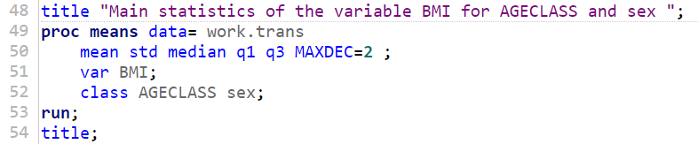
1
The main statistics needed were mean, standard deviation, median, first and third quartile
In order to satisfy the requests we used the proc means statement:
With the following syntax:
data= work.trans to select our transformed dataset for the temporary folder followed by Mean, std, median, q1 and q3 to recall the stats we need and MAXDEC = 2 to approximate to the 2nd decimal place
Var BMI; to choose the variable on which we calculate the stats
Classes AGECLASS sex; to order by them

Slide 11

1
The two-way table must have as variables AGECLASS and sex
This table can be easily obtained by using a proc freq statement:
With the following syntax
Data = work.trans; as above
Tables AGECLASS*sex; to set the two component of the table

Slide 12
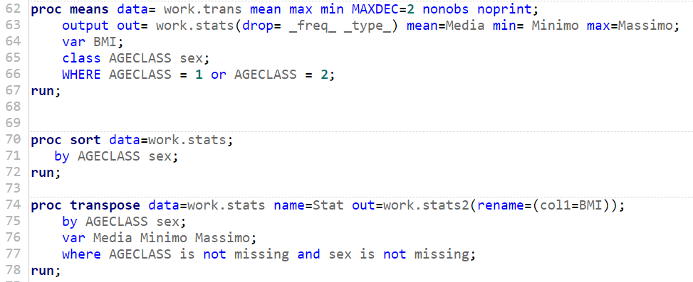
2
In this case we need to work with the output of the proc means and the transpose the table. Then we need to modify some formats to make the table more readable.
To create new columns with the needed values we use the proc means statement:
The syntax is:
data= work.trans mean max min MAXDEC =2 nonobs noprint; with the two last options used for suppressing the column which count the observation for each combination and to prevent the proc from printing.
Output out= work.stats and all the subsequent to create an output table with the computed stats.
Var BMI; to choose the variable for the analysis.
Class AGECLASS sex; to group by them.
WHERE sratement to filter by the first two age class.

Slide 13
2
The proc sort is necessary to sort by the two variables by which we will then transpose the datas
The two proc statement are written as follows:
The syntax of the proc transpose is:
data= work.stats with name = Stat to rename the column produced and out= work.stats2 used to create a new table and the rename used to give to the column the name of the variable that represents
by AGECLASS sex; to transpose by them.
Var Media Minimo Massimo; to keep the stats
WHERE statement to eliminate the rows with only one of the two grouping variables

Slide 14
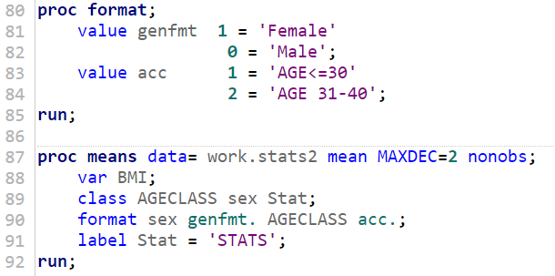
2
Once we have transposed the data we need to create new format to make them easy to read in our report
We use a proc format statement in which we create 2 formats
genfmt that converts the numbers 0 and 1 in the characters Male and Female.
acc that convert the numbers 1 and 2 into the characters AGE<=30 and AGE 31-40.
Finally a proc means statement reports the data in the desired schema:
In the class statement group by AGECLASS, sex and then by the new column Stat.
In the format statement we apply genfmt to sex and acc to AGECLASS.
We use a label statement to correctly label the column STATS.

Slide 15
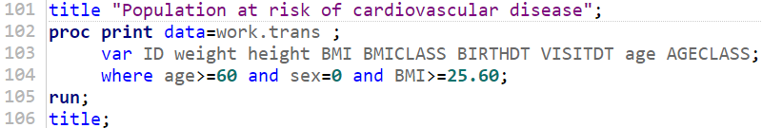
3
The population at risk of cardiovascular disease is intended as the male patients with more than 60 years and a value of BMI greater then the mean for males
We use the proc print statement to print the report and a title statement to apply a title to it:
The syntax is:
data= work.trans
Var ID weight height BMI BMICLASS BIRTHDT VISITDT age AGECLASS; to keep track of all important variables;
WHERE age>=60 and sex=0 and BMI>=25.60; to filter by the parameter established above.
The mean of BMI has been calculated before with a proc means that filtered the rows by sex=0.

Slide 16
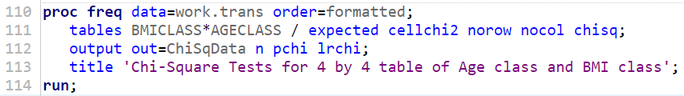
4
The statistical test which is more appropriate to analyize the relation between the classes of BMI and the classes of age is the Chi-squared Test.
We use the proc freq statement to calculate the statistical test:
The syntax is:
data= work.trans
tables BMICLASS*AGECLASS / expected cellchi2 norow nocol chisq; we use the options to recall the expected frequencies and to calculate the Chisqared.
Output out=ChiSqData n pchi lrchi; to show the results of the test and its p-value.
We add a title using the title statement

Slide 17
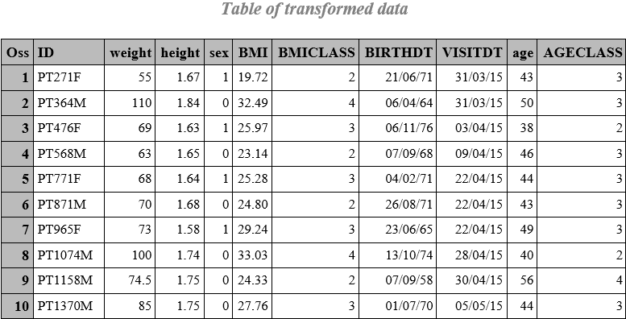
04
RESULTS
By using the global statement ods rtf file=path; we obtain a report in the RTF format in which we print all the tables obtained. The format of the transformed dataset from which we developed the analysis is (first 5 rows):

Slide 18
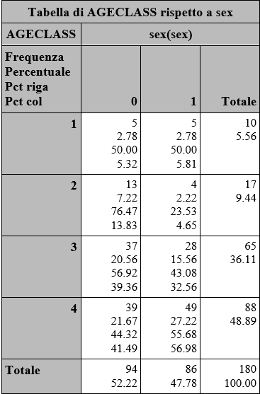
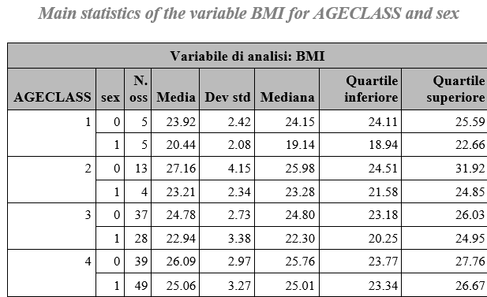
1
The proc means and the proc freq have results:

Slide 19
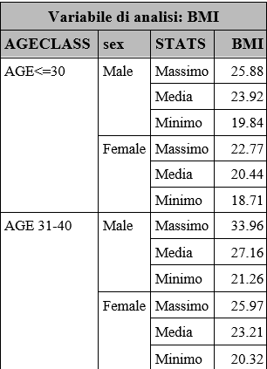
2
All our transformation lead to a table that groups by AGECLASS, sex and Stats.
From the table we can make some observations:
As observed in the previous table the age classes 0-30 and 31-40 have a lot of variability since their numerosity is low.
We can also notice that this variability is more pronounced for the male patients then for female patients

Slide 20
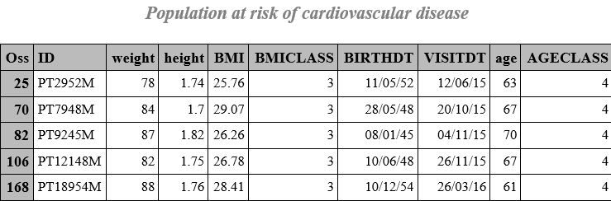
3
The patients at risk of caridiovascular disease are:
From the table we observe that:
We have 5 patients with more than 60 years and a BMI greater than the mean for males patients.
They all belong to the BMICLASS 3 so they have a BMI between 25 and 30

Slide 21
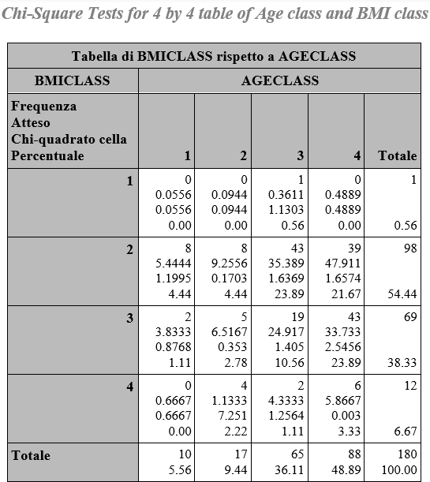
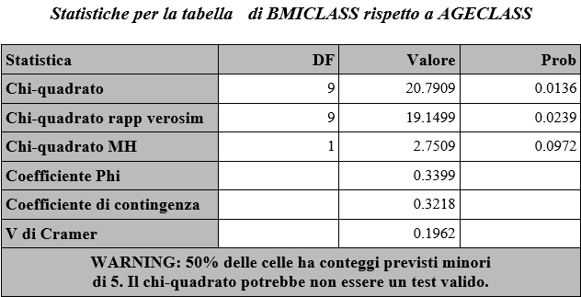
4
The Chi-Squared Statistical Test has result:

Slide 22
4
From the two tables we can observe that:
The observed frequencies for the age class less or equal 30 and the BMI classes are lower than 5
Same problem for the BMICLASS 4 except for the one related to the AGECLASS 4
For this reason in the second table the proc procedure tells us that the Chi-Squared may not be a valid test
One solution could be to take in consideration only the AGECLASS 2 , 3 and 4 and only them BMICLASS 2 and 3 in order to have significative data
Looking at the p-value of the test we can see that it is lower than 0,05 so with that alpha we can say that there is evidence that the AGECLASS and the BMICLASS are dependent
We can reach a different conclusion by choosing an alpha= 0,01

Slide 23
Thanks for the attention

