Slide 1
From Data to Decisions
How Analytics Can Help YoungXCode Scale Faster
45-Day Business Intelligence Analysis & Executive Presentation
50
Clients
80
Projects
12
Team Members
Rs21.1Cr
Revenue
54%
Collection Rate
Confidential | Prepared for Management & Stakeholder Review
March 2025

Slide 2
Executive Summary
A data-driven overview of where YoungXCode stands today
50
Total Clients
80
Total Projects
12
Team Size
Rs21.1Cr
Revenue
54%
Collection Rate
Key Business Highlights
Top Growth Opportunities
• 50 active clients across 12 industries and 15 cities generating Rs21.1Cr in total revenue
• 80 projects managed with 32 completed (40%), 28 in progress (35%), and 20 inactive/delayed
• Strong portfolio diversity: LegalTech (Rs3.6Cr), HR Tech (Rs3.0Cr), AI/ML (Rs2.5Cr) lead revenue
• Team of 12 members completed 300 of 300 tasks across all projects
• Top 5 clients contribute 18% of total revenue — healthy diversification
• Improve collection rate from 54% to 85% — unlock Rs6.2M in working capital
• Fix on-time delivery (currently 25%) to boost client satisfaction and reduce penalties
• Balance team workload — Vikram Singh at 100% utilization vs Isha Patel at 68%
• Re-engage 7 on-hold and 5 cancelled projects worth significant pipeline value
• Expand revenue concentration across cities — Noida & Ahmedabad lead with Rs2.4Cr+ each
The business is growing steadily, but analysis reveals opportunities to improve project delivery, team productivity, client retention, and revenue realization.

Slide 3
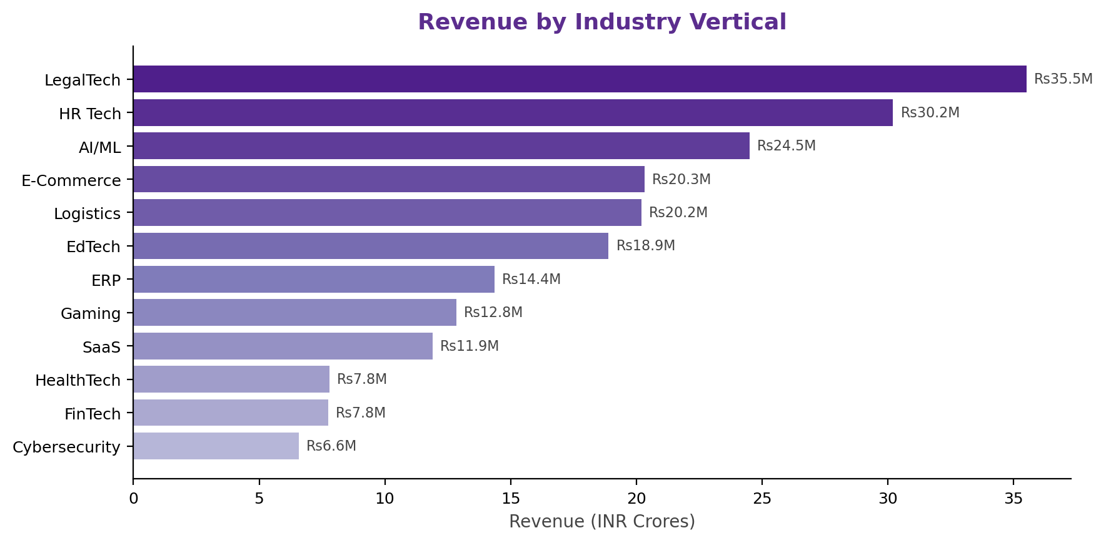
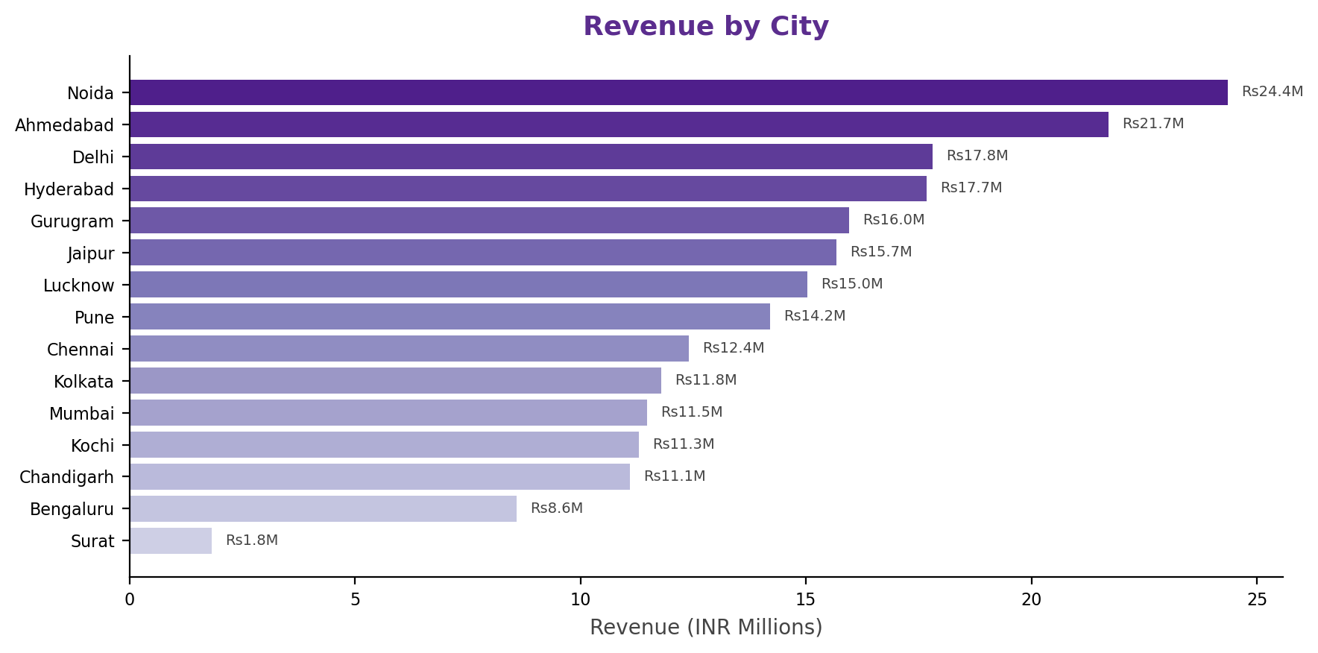
YoungXCode — Current Business Snapshot
Where are we today? A complete data-driven view of the company
Rs21.1Cr
Total Revenue
28
Active Projects
50
Client Count
85%
Team Utilization
54%
Collection

Slide 4
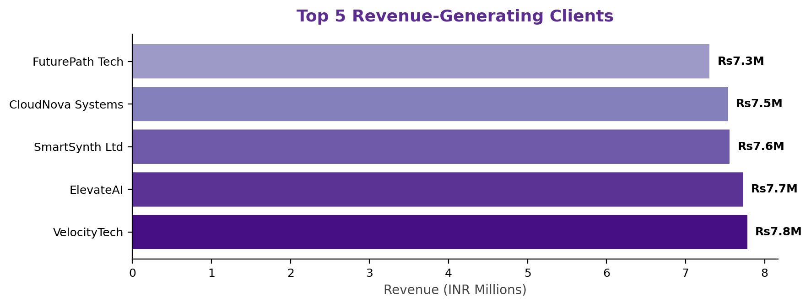
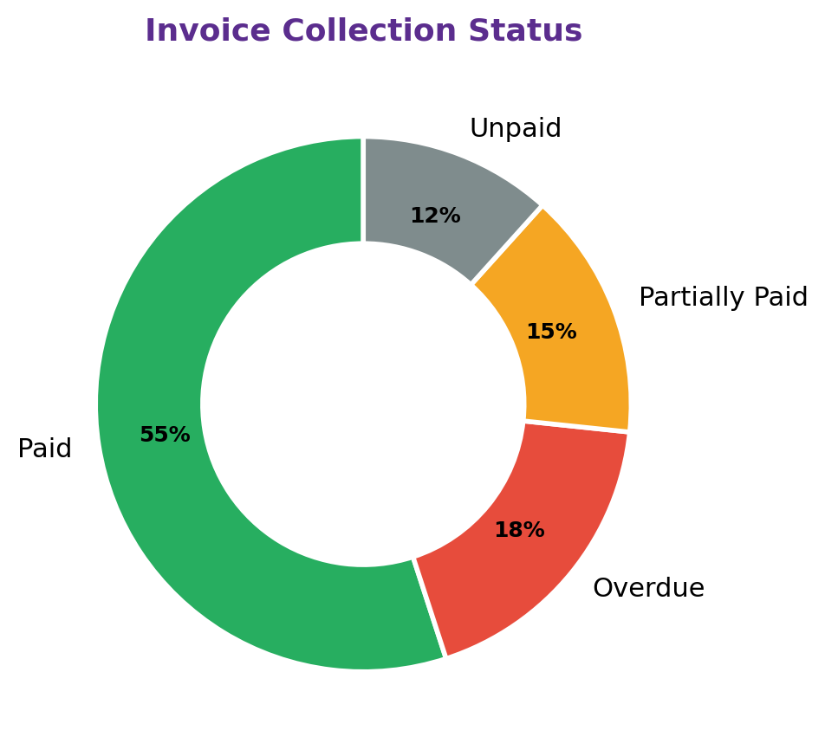
Revenue & Financial Health
Are we growing revenue and collecting payments efficiently?
Revenue Summary
Key Financial Observations
• Total Invoiced: Rs13.62M | Collected: Rs7.40M
• Collection Rate: 54% | Outstanding: Rs6.22M
• Overdue: Rs2.51M (11 invoices)
• Unpaid: Rs1.28M (7 invoices)
• Average Invoice: Rs227,005 | GST Contribution: Rs1.91M
• Top 5 clients contribute 18% of revenue — moderate concentration, but VelocityTech (Rs7.8M) leads
• LegalTech (Rs3.6Cr) and HR Tech (Rs3.0Cr) are the strongest industry verticals
• Noida and Ahmedabad account for the highest city-wise revenue at Rs2.4Cr each
• Outstanding amount of Rs6.22M represents significant working capital blockage
• Revenue is diversified across 12 industries and 15 cities — good risk distribution
Financial Health Verdict: Revenue is well-diversified, but collection efficiency needs urgent improvement. Unlocking Rs{outstanding/1e6:.1f}M in outstanding payments is the single highest-impact financial action.

Slide 5
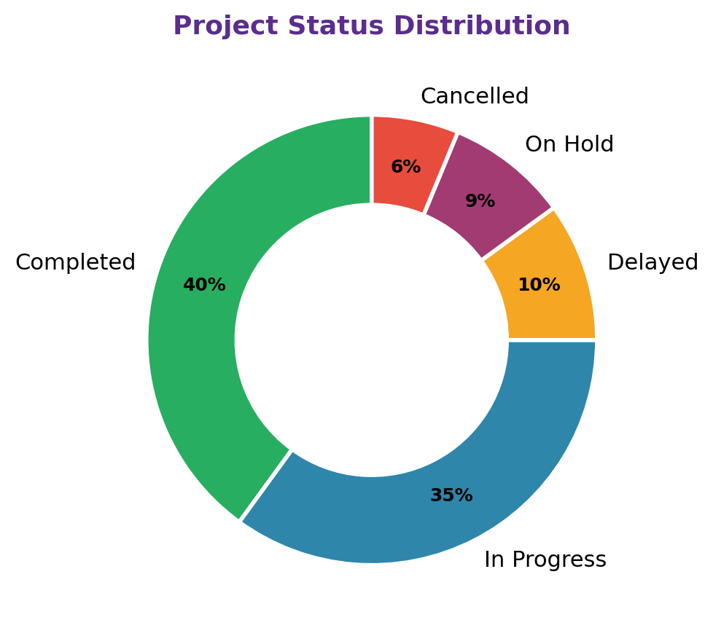
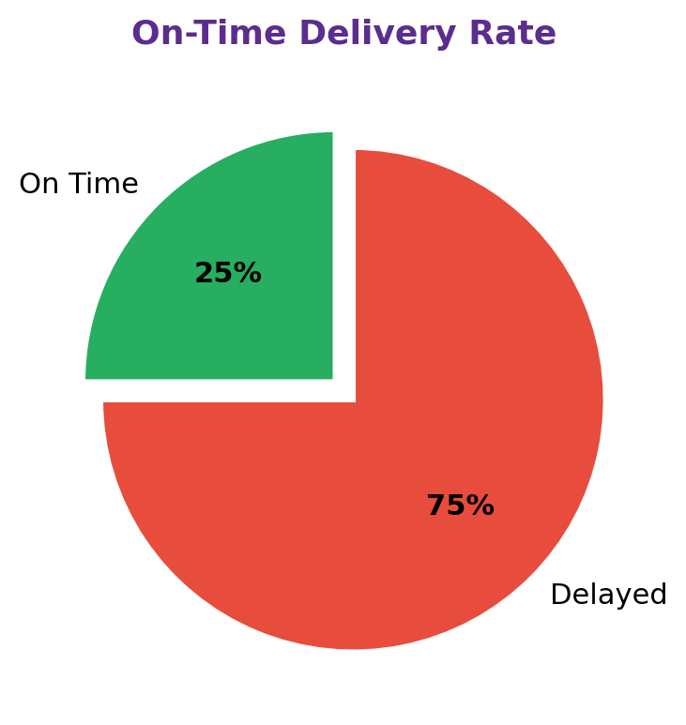
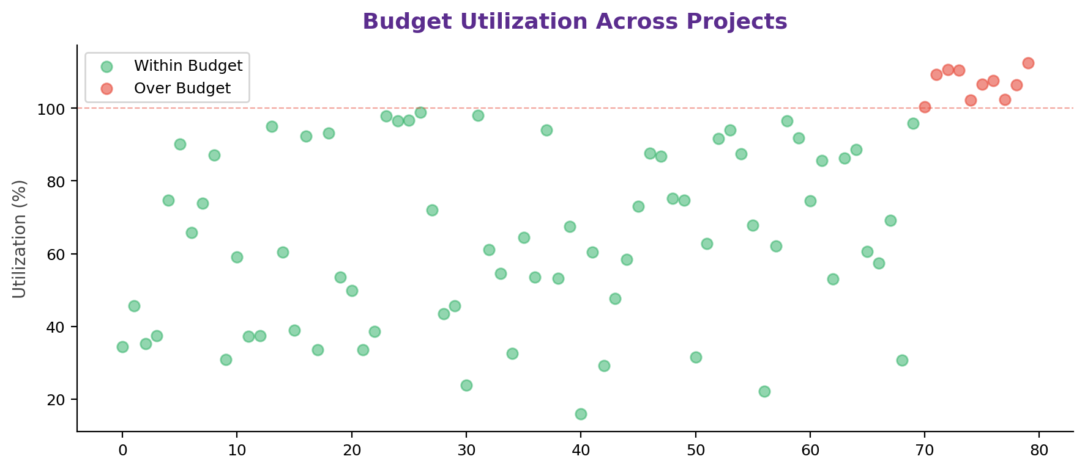
Project Delivery Performance
Projects are being delivered, but delays and budget overruns reduce profitability
32
Completed
28
In Progress
8
Delayed
5
Cancelled
25%
On-Time Rate
Business Story: Only 25% of completed projects delivered on time. 10 projects (13%) exceeded budget. Average profit margin stands at 32% — healthy, but delayed projects erode profitability through penalties and resource carryover costs. Improving on-time delivery to 70% could boost margins by 5-8%.

Slide 6
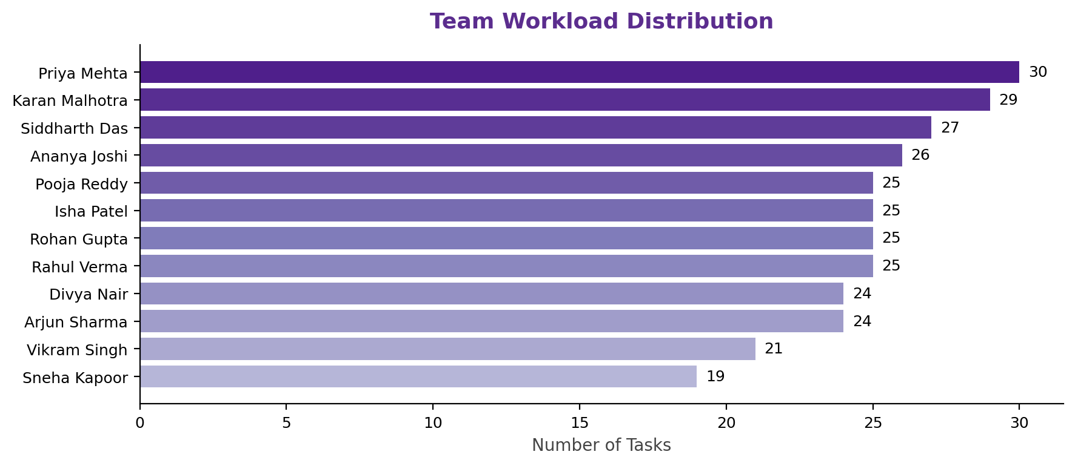
Team Productivity Insights
Who is carrying the load? Where are the gaps?
300
Total Tasks
25
Avg Task per Person
85%
Avg Utilization
100.4%
Highest Util
Team Member Performance
Priya Mehta | 30 | 1431 | 1197 | 84%
Karan Malhotra | 29 | 1628 | 1322 | 81%
Siddharth Das | 27 | 1085 | 956 | 88%
Ananya Joshi | 26 | 1094 | 915 | 84%
Rahul Verma | 25 | 1110 | 961 | 87%
Rohan Gupta | 25 | 981 | 922 | 94%
Isha Patel | 25 | 985 | 674 | 68%
Pooja Reddy | 25 | 1062 | 998 | 94%
Divya Nair | 24 | 896 | 776 | 87%
Arjun Sharma | 24 | 1016 | 868 | 86%
Vikram Singh | 21 | 861 | 865 | 100%
Sneha Kapoor | 19 | 735 | 593 | 81%
Productivity Insights
• Overloaded: Vikram Singh at 100.4% utilization — risk of burnout and quality decline
• Underutilized: Isha Patel at 68% utilization — opportunity to redistribute 5-6 tasks from overloaded members
• High performers: Rohan Gupta and Pooja Reddy both at 94% utilization with strong output
• Estimation gap: 47% of tasks (141 tasks) exceeded estimated hours — needs estimation process improvement

Slide 7
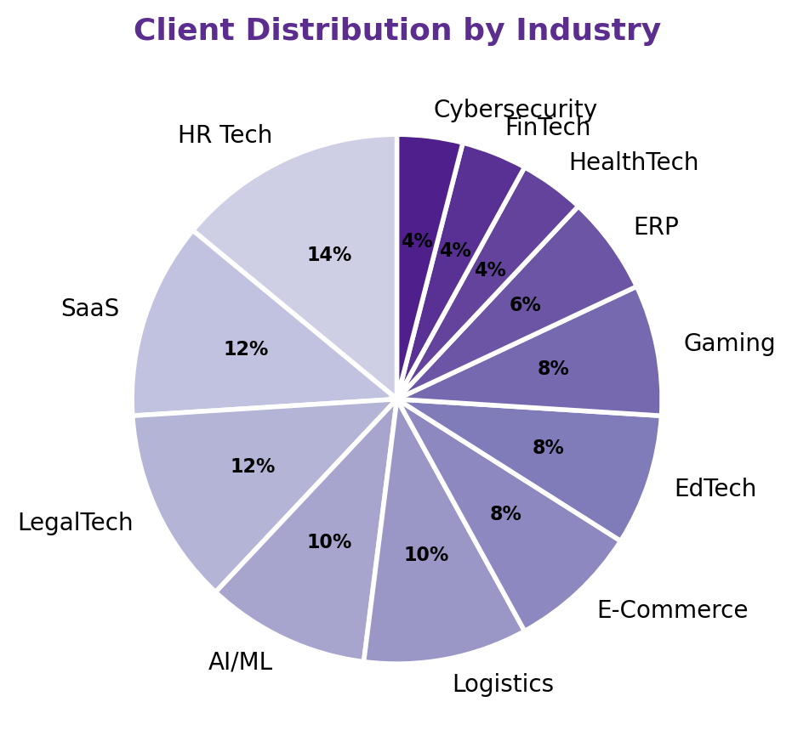
Client Analytics
A small group of clients generates a large share of revenue — retention is strategic
50
Total Clients
12
Industries Served
15
Cities Covered
Rs4.2M
Avg Revenue/Client
Top 5 Clients by Revenue
VelocityTech | Mumbai | AI/ML | Rs7.78M
ElevateAI | Noida | EdTech | Rs7.73M
SmartSynth Ltd | Gurugram | LegalTech | Rs7.56M
CloudNova Systems | Jaipur | HR Tech | Rs7.54M
FuturePath Tech | Chennai | EdTech | Rs7.30M
Client Intelligence
• Retention opportunity: 12 cancelled + on-hold projects represent re-engagement potential
• Industry leaders: LegalTech (Rs3.6Cr), HR Tech (Rs3.0Cr), AI/ML (Rs2.5Cr) — focus sales efforts here
• City expansion: Noida (Rs2.4Cr) and Ahmedabad (Rs2.2Cr) are top revenue cities
• Average 6.8 projects per client — indicates strong relationship depth
Business Insight: Client concentration is healthy (top 5 = 18% of revenue), but 12 cancelled/on-hold projects signal re-engagement opportunities worth an estimated Rs3-5Cr in pipeline value.

Slide 8
Key Problems Discovered
Six critical issues identified through data analysis — each quantified with metrics
Delayed Project Deliveries
Overdue & Unpaid Invoices
Team Workload Imbalance
• Only 25% on-time delivery rate — 75% of completed projects missed deadlines
• 8 projects currently in "Delayed" status (10% of all projects)
• Average project duration: 220 days — scope creep and poor milestone tracking are key drivers
• 11 overdue invoices worth Rs2.51M
• 7 unpaid invoices worth Rs1.28M
• Overall collection rate at only 54% — well below industry benchmark of 85%+
• Vikram Singh at 100.4% utilization — burnout risk and potential quality issues
• Isha Patel at 68% utilization — 32% underutilized capacity
• Workload ranges from 19 to 30 tasks per person across the 12-member team
Client Churn / Stalled Projects
Budget Overruns
Slow Payment Collection
• 12 projects in non-active status: 7 On Hold, 5 Cancelled (15% of portfolio)
• No formal client retention program in place
• Re-engagement of stalled projects could unlock significant revenue
• 10 projects (13%) exceeded approved budgets
• Average profit margin at 32% — overruns erode this further
• Indicates poor initial estimation and lack of real-time budget tracking
• Rs6.2M in total outstanding payments
• No automated payment reminder system in place
• Average days to pay: 13.6 days beyond due date

Slide 9
Root Cause Analysis
Why do these problems occur? Data-driven diagnosis of underlying issues
Poor Project Estimation
Lack of Milestone Tracking
Weak Payment Follow-Up
• Projects consistently underestimate timelines and budgets
• 47% of tasks exceed estimated hours — systemic estimation flaw
• 10 budget overruns confirm the pattern
• No standardized estimation framework exists
• Projects lack intermediate milestone checkpoints
• Without milestones, delays go unnoticed until deadline approaches
• 75% late delivery rate is a direct consequence
• Implement milestone-based governance
• Only 54% collection rate — no automated reminders
• 11 overdue invoices indicate no structured follow-up process
• Payments are tracked manually, if at all
• No escalation mechanism for long-overdue accounts
Resource Allocation Gaps
Inconsistent Client Communication
No Real-Time Analytics Visibility
• Workload distribution is uneven across team members
• No capacity planning tool being used
• Task assignment is ad-hoc rather than data-driven
• Vikram Singh at 100% utilization vs Isha Patel at 68%
• No formal client review cadence established
• Project status updates are not standardized
• Client approval delays contribute to project delays
• No systematic re-engagement for stalled projects
• Management lacks real-time KPI dashboards
• Decisions are based on intuition, not data
• Problems are detected only after they escalate
• Streamlit dashboard addresses this gap

Slide 10
Data-Driven Solutions
Recommended actions based on the analysis findings
Revenue & Collections
Project Delivery
Team Productivity
• Implement automated invoice reminders (7, 3, 1 day before due)
• Set up a collection escalation workflow for overdue > 30 days
• Offer early payment discounts (2% for payment within 7 days)
• Target: Increase collection rate from 54% to 85% in 90 days
• Implement milestone-based project tracking with weekly reviews
• Introduce deadline alerts at 50%, 75%, and 90% of project timeline
• Standardize project estimation framework based on historical data
• Target: Improve on-time delivery from 25% to 70% in 90 days
• Redistribute tasks: move 5-6 tasks from Vikram Singh to Isha Patel
• Implement capacity planning tool for balanced workload allocation
• Introduce sprint-based task management with 2-week cycles
• Target: Achieve 80-90% utilization across all team members
Client Retention
Budget & Cost Control
Analytics & Reporting
• Launch re-engagement campaign for 12 stalled/cancelled projects
• Establish quarterly business reviews for top 15 clients
• Create a client health score based on payment history and project status
• Target: Re-activate 40% of stalled projects within 90 days
• Implement real-time budget tracking with alerts at 80% and 100% utilization
• Require change request approval for scope changes exceeding 10% of budget
• Use historical data for more accurate project estimation
• Target: Reduce budget overruns from 13% to under 5% of projects
• Deploy Streamlit dashboard for management self-service analytics
• Set up automated weekly KPI email reports
• Create GA4 + Mixpanel dashboards for product analytics
• Target: 100% KPI visibility for management within 30 days

Slide 11
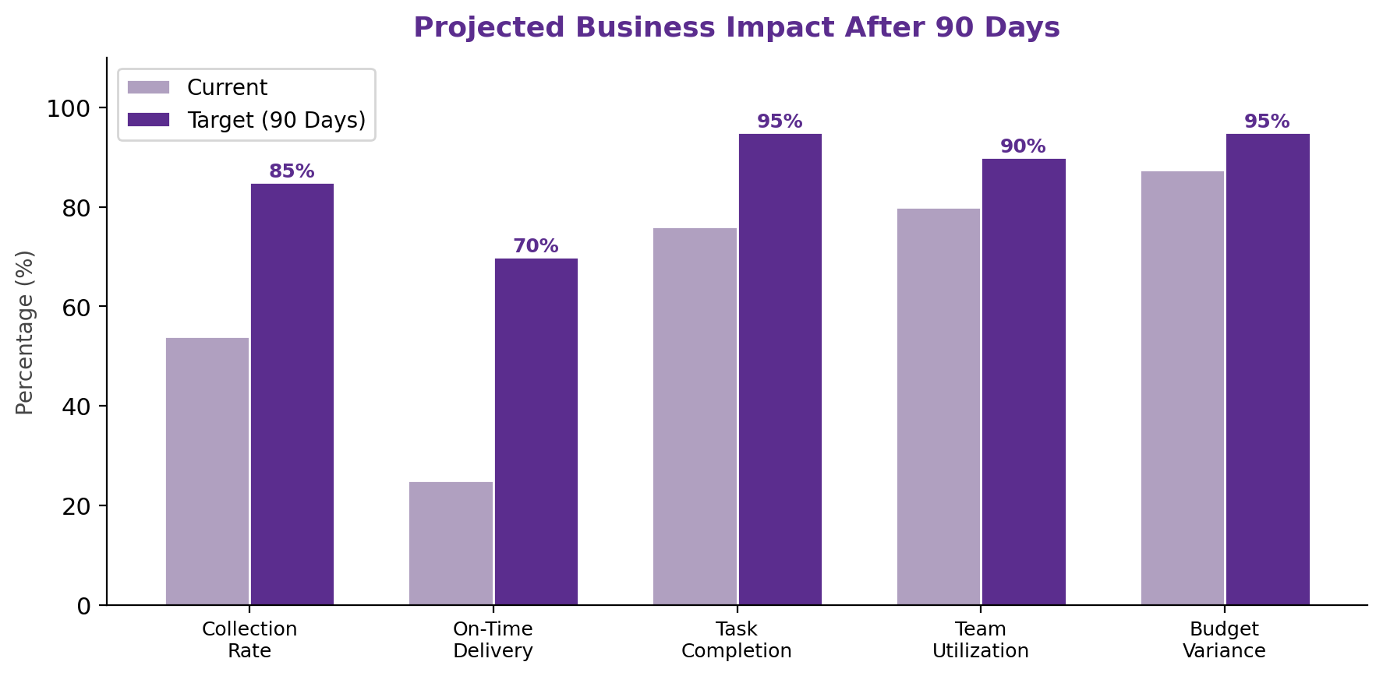
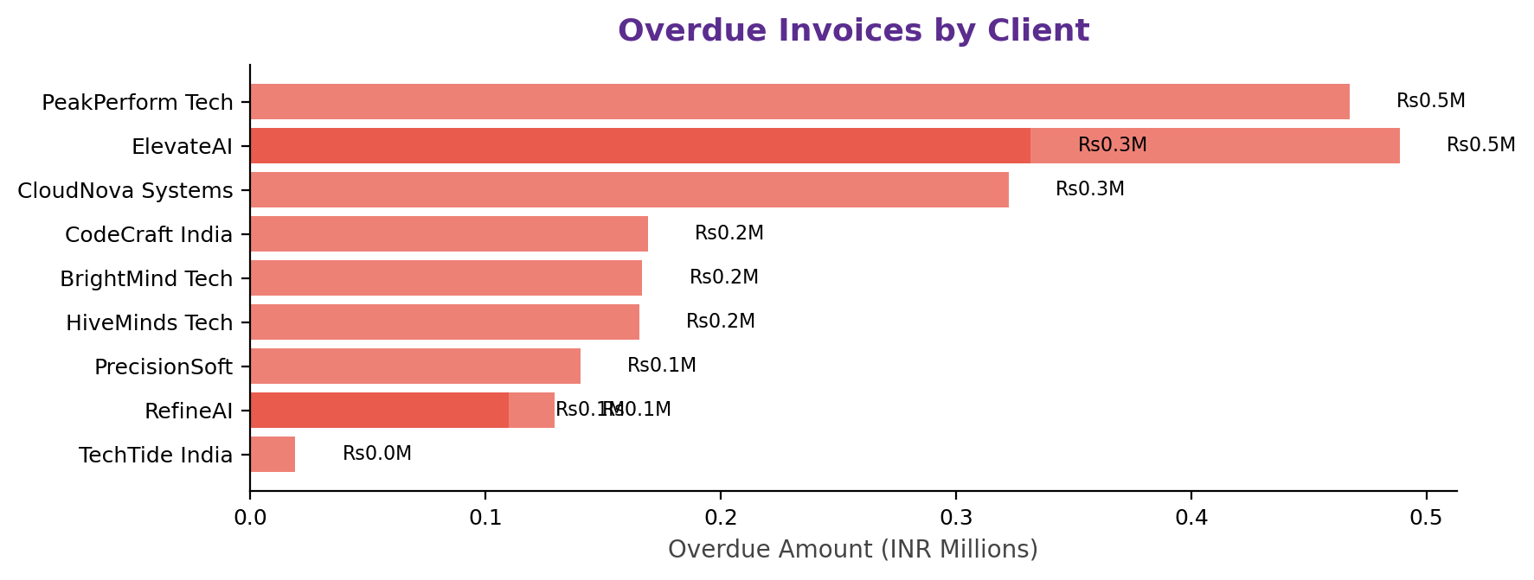
Expected Business Impact
Measurable outcomes — what success looks like in 90 days
Projected 90-Day Impact
Revenue: Collection rate 54%→85%
Impact: Unlock Rs3.7M working capital
Delivery: On-time rate 25%→70%
Impact: 45% fewer delayed projects
Productivity: Utilization balanced
Impact: Team efficiency +10-15%
Clients: Stalled projects 15%→8%
Impact: Retention +5-10% improvement
Costs: Budget overruns 13%→5%
Impact: Profit margins +3-5%

Slide 12
90-Day Action Plan
Structured roadmap: Quick wins → Process improvements → Strategic initiatives
Days 1-30: Quick Wins
Days 31-60: Process Improvements
Days 61-90: Strategic Initiatives
• Deploy Streamlit dashboard for real-time KPI visibility
• Send collection reminders for 11 overdue invoices
• Redistribute workload: move tasks from Vikram to Isha
• Review 8 delayed projects — fast-track or re-scope
• KPI target: Collection →70% | Delayed →4
• Implement milestone tracking for all in-progress projects
• Standardize project estimation framework using historical data
• Set up automated invoice reminders (7/3/1 day workflow)
• Launch monthly team capacity planning reviews
• KPI target: On-time delivery →50% | Util balance →75-95%
• Launch client re-engagement campaign for 12 stalled projects
• Establish quarterly business reviews for top 15 clients
• Implement change request process for scope/budget changes
• Build revenue forecasting model using historical trends
• KPI target: Collection →85% | On-time →70% | Churn →8%
Key Performance Targets — 90-Day Trajectory
Collection Rate | 54% | 70% | 80% | 85%
On-Time Delivery | 25% | 40% | 55% | 70%
Team Utilization | 68-100% | 75-95% | 78-92% | 80-90%
Delayed Projects | 8 | 4 | 3 | 2
Budget Overruns | 13% | 10% | 7% | 5%
Task Completion | 76% | 85% | 90% | 95%

Slide 13
From Data to Decisions
The Journey Ahead for YoungXCode
• Analytics is not just reporting the past; it is enabling YoungXCode to make smarter decisions,
• improve operational efficiency, increase profitability, and scale sustainably.
•
• The data has spoken. The path forward is clear. Now it is time to execute.
Immediate Next Steps
• Review and approve the 90-day action plan in this week's leadership meeting
• Assign owners for each phase — Finance (collections), PMO (delivery), Ops (productivity)
• Deploy Streamlit dashboard by Day 7 for management self-service analytics
• Begin collection drive for overdue invoices immediately — target Rs1.5M recovery in 30 days
Thank You | Q&A Session

