Slide 1
YoungXCode – Comprehensive BI Report
45-Day Business Performance Analysis | Q1 2025
Revenue Analytics | Project Performance | Team Productivity | Client Intelligence
Confidential | Prepared for Management Review
Report Date: March 2025

Slide 2
Executive Summary
High-level business performance overview for the 45-day analysis period
Rs21.09Cr
Total Revenue
80
Total Projects
54.3%
Collection Rate
3.1%
Avg Profit Margin
Key Achievements
Major Challenges & Risks
• Total Revenue of Rs21.09Cr generated from 50 active clients across 12 industries
• 32 out of 80 projects (40%) successfully completed during the period
• Team completed 227 out of 300 tasks (75.7% completion rate) across 12 team members
• Top 5 cities (Noida, Ahmedabad, Delhi, Hyderabad, Gurugram) contributed 51% of total revenue
• LegalTech and HR Tech are the top-performing industry verticals generating Rs3.55Cr and Rs3.02Cr respectively
• Only 25% of completed projects delivered on-time; 75% exceeded deadlines
• Collection rate at 54.3% with Rs2,509,787 in overdue invoices
• 10 projects (12.5%) exceeded approved budget allocations
• 7 unpaid invoices totaling Rs1,281,205
• Task backlog: 73 of 300 tasks (24.3%) remain incomplete
Critical Insights
Revenue concentration in top 5 clients (35% of total) poses dependency risk. Invoice collection gaps need immediate attention. On-time delivery requires process overhaul.

Slide 3
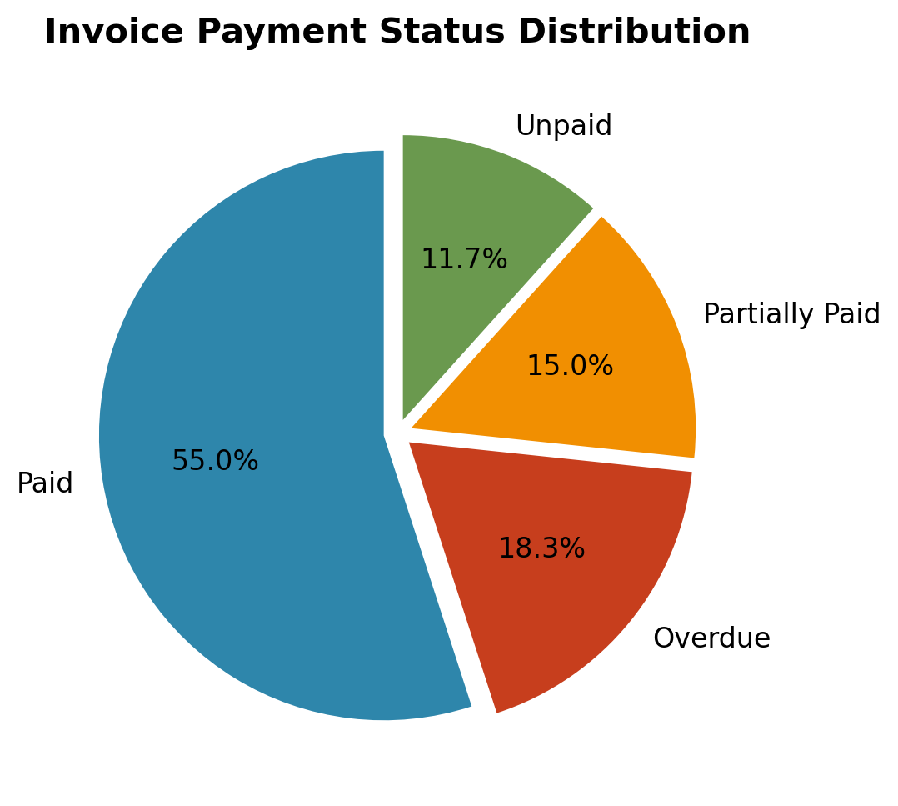
Revenue & Invoice Analysis
Financial performance, invoice status, and collection efficiency
Rs13.62M
Total Invoiced Amount
Rs7.40M
Amount Collected
Rs6.22M
Outstanding Amount
54.3%
Collection Rate
Invoice Status Summary
• Paid: 33 invoices (Rs7,397,618)
• Overdue: 11 invoices (Rs2,509,787)
• Partially Paid: 9 invoices (Rs2,431,665)
• Unpaid: 7 invoices (Rs1,281,205)
• Average invoice amount: Rs227,005
• Average days to pay (post-due): 13.6 days
• GST contribution: Rs1,906,260
Key Financial Observations
Total outstanding of Rs6.22M represents significant working capital blockage. Overdue invoices account for 18.4% of total invoiced amount. Top 5 clients contribute 35% of total revenue.

Slide 4
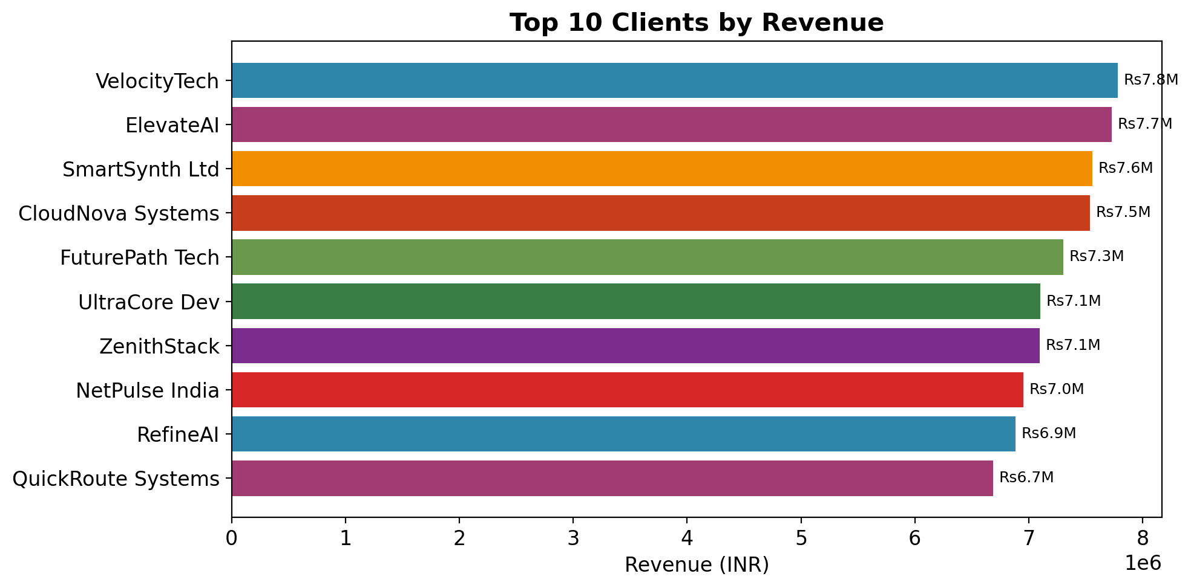
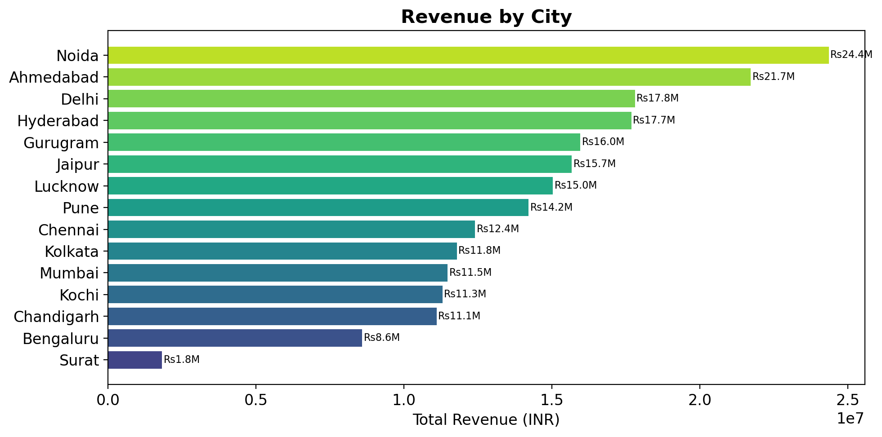
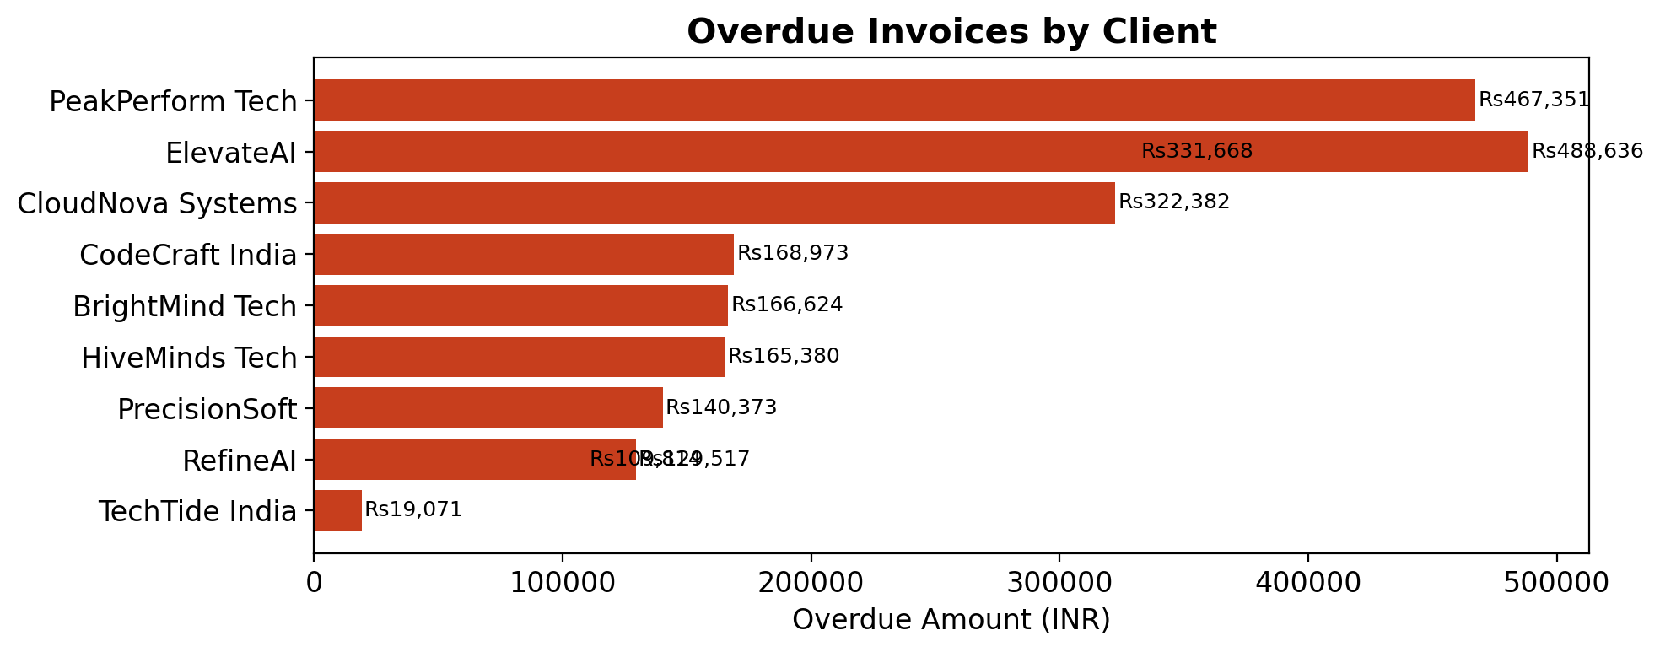
Revenue & Invoice Analysis (contd.)
Top clients, city-wise revenue, and overdue analysis
Top Revenue-Generating Clients
VelocityTech | Mumbai | AI/ML | Rs7.78M
ElevateAI | Noida | EdTech | Rs7.73M
SmartSynth Ltd | Gurugram | LegalTech | Rs7.56M
CloudNova Systems | Jaipur | HR Tech | Rs7.54M
FuturePath Tech | Chennai | EdTech | Rs7.30M

Slide 5
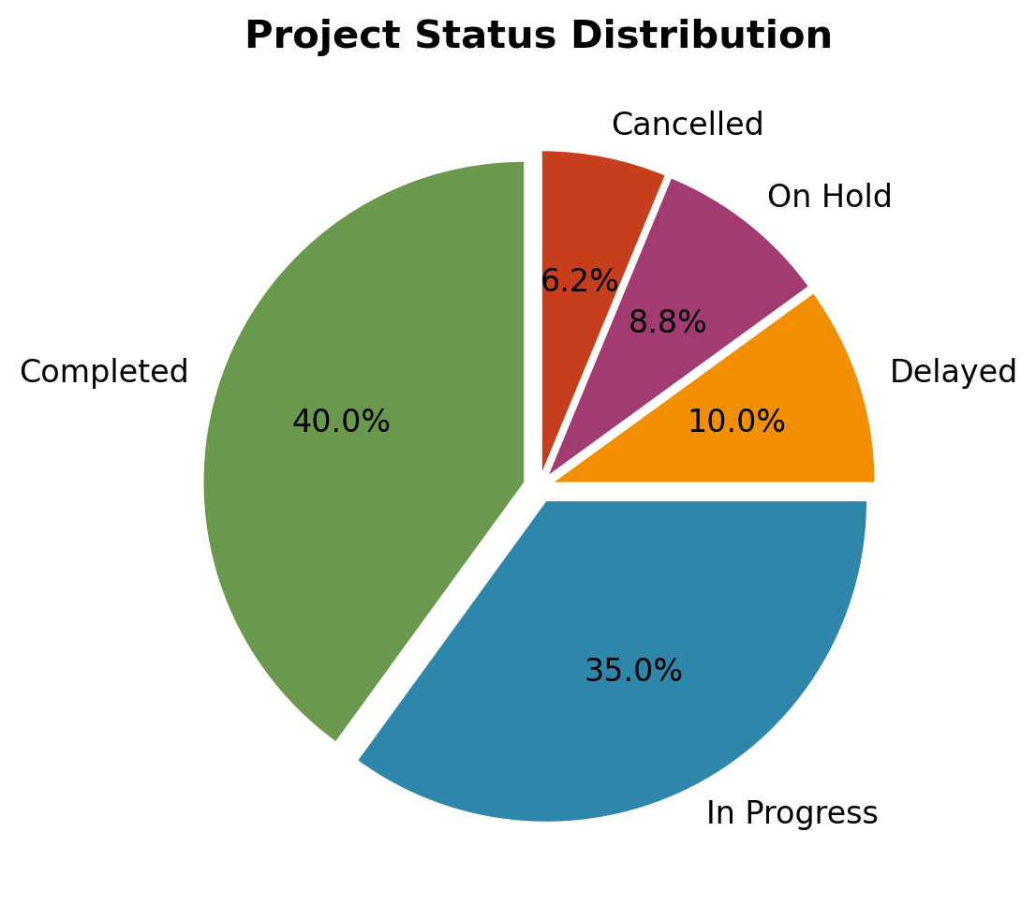
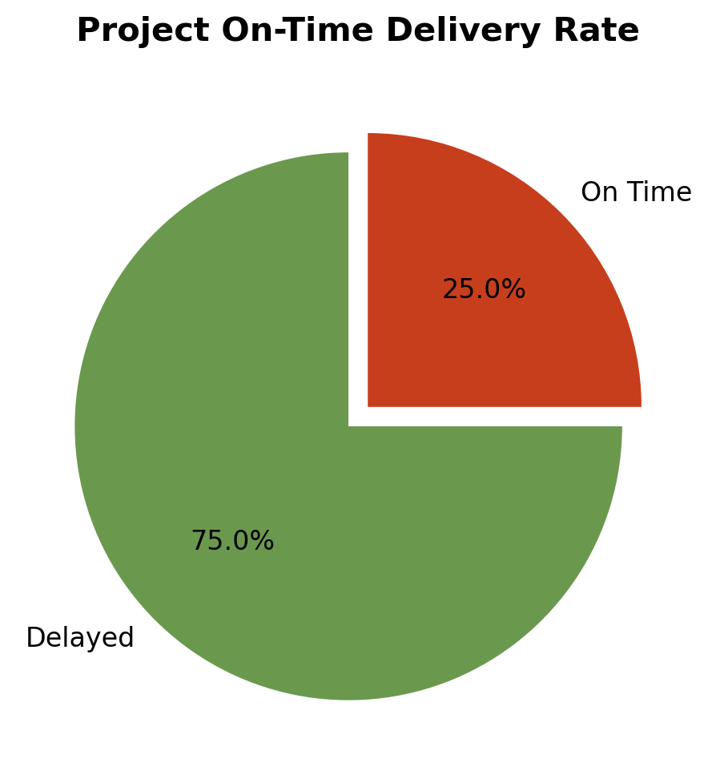
Project Performance Analysis
Project status, delivery metrics, and budget utilization
32
Completed Projects
28
In Progress
8
Delayed Projects
10
Over Budget
Project Performance Metrics
Average project duration: 220 days | On-time delivery rate: 25% | Average budget utilization: 69.2% | Average profit margin: 30.8% | Projects with budget overrun: 10 (12.5%)

Slide 6
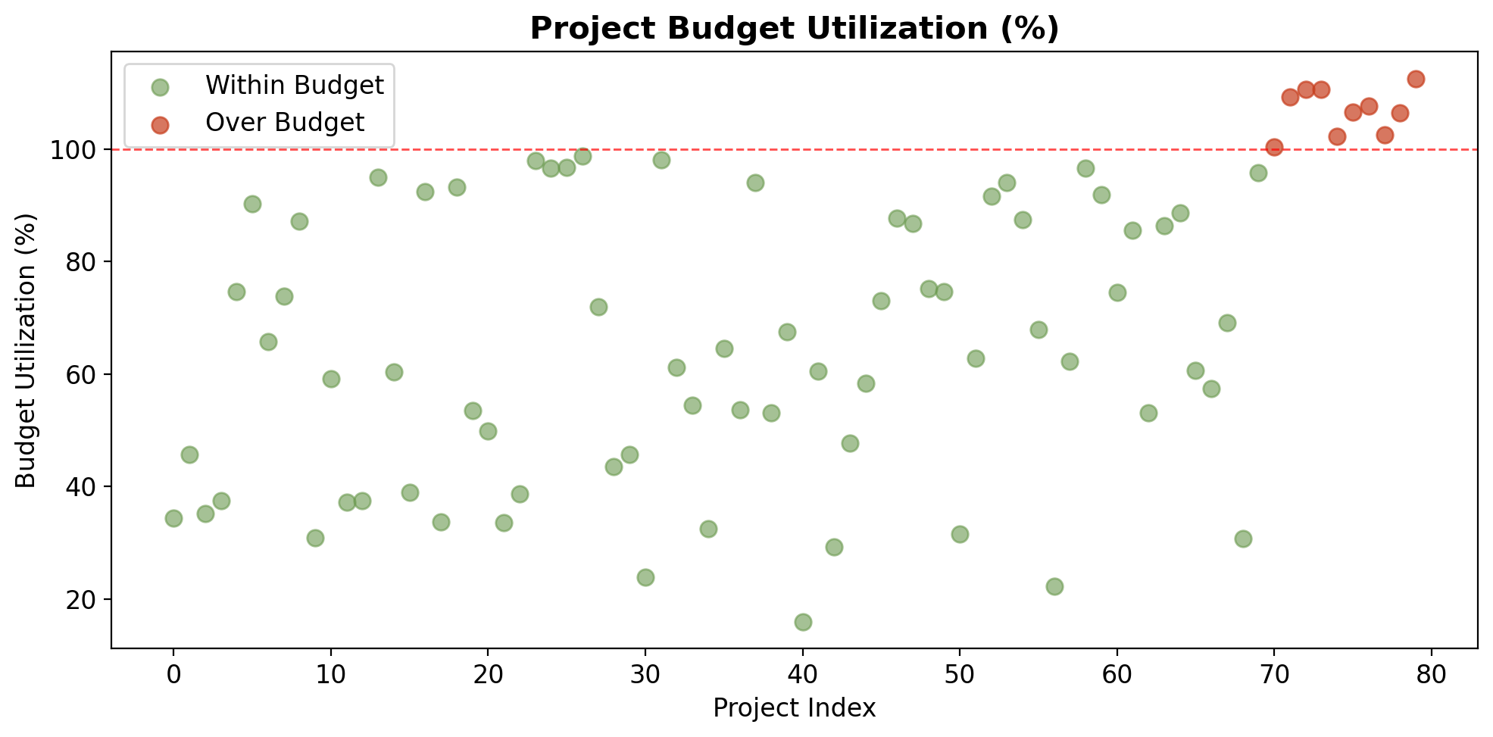
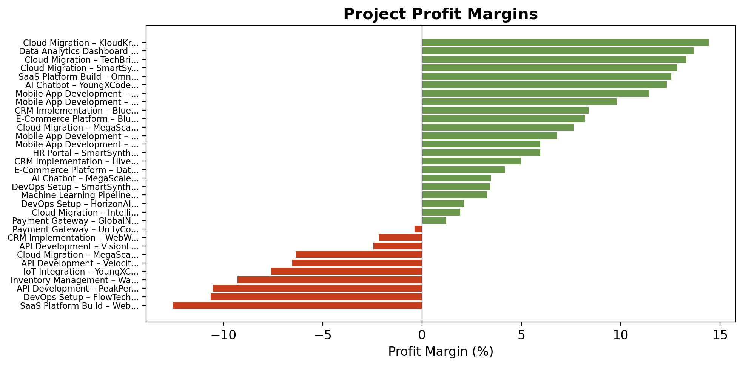
Project Performance Analysis (contd.)
Budget utilization, profitability, and project comparison
Top Performing Projects (Highest Profit Margin)
Underperforming Projects (Lowest Margin)
Cloud Migration – KloudKraft | Rs0.53M | 14.4%
Data Analytics Dashboard – QuantumLeap | Rs3.42M | 13.7%
Cloud Migration – TechBridge | Rs0.49M | 13.3%
Cloud Migration – SmartSynth | Rs2.25M | 12.8%
SaaS Platform Build – OmniSoft | Rs0.55M | 12.6%
SaaS Platform Build – WebWave | Rs4.81M | -12.5%
DevOps Setup – FlowTech | Rs1.20M | -10.6%
API Development – PeakPerform | Rs4.60M | -10.5%
Inventory Management – WarpSpeed | Rs4.49M | -9.3%
IoT Integration – YoungXCode | Rs1.22M | -7.6%
Insight: Projects with tighter budgets show higher profit margins. Scope creep and poor estimation are key drivers of budget overruns.

Slide 7
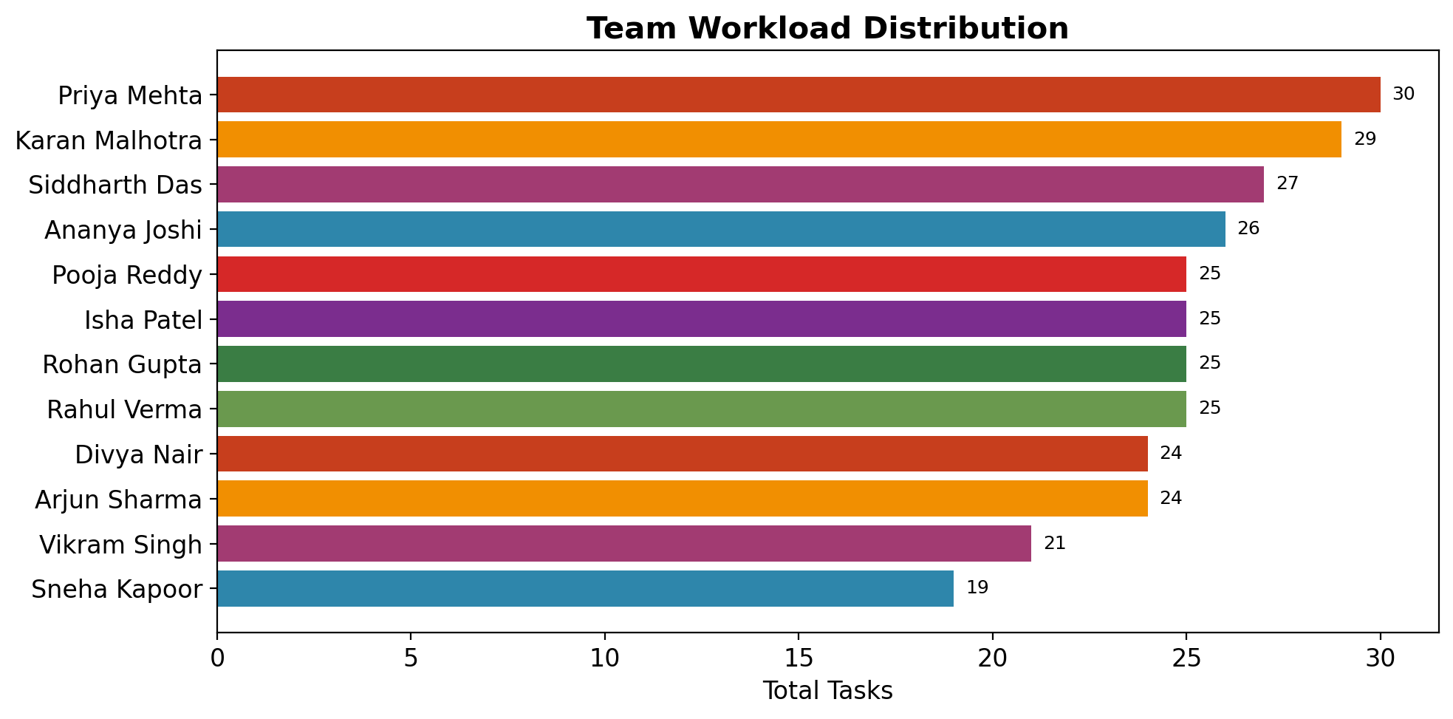
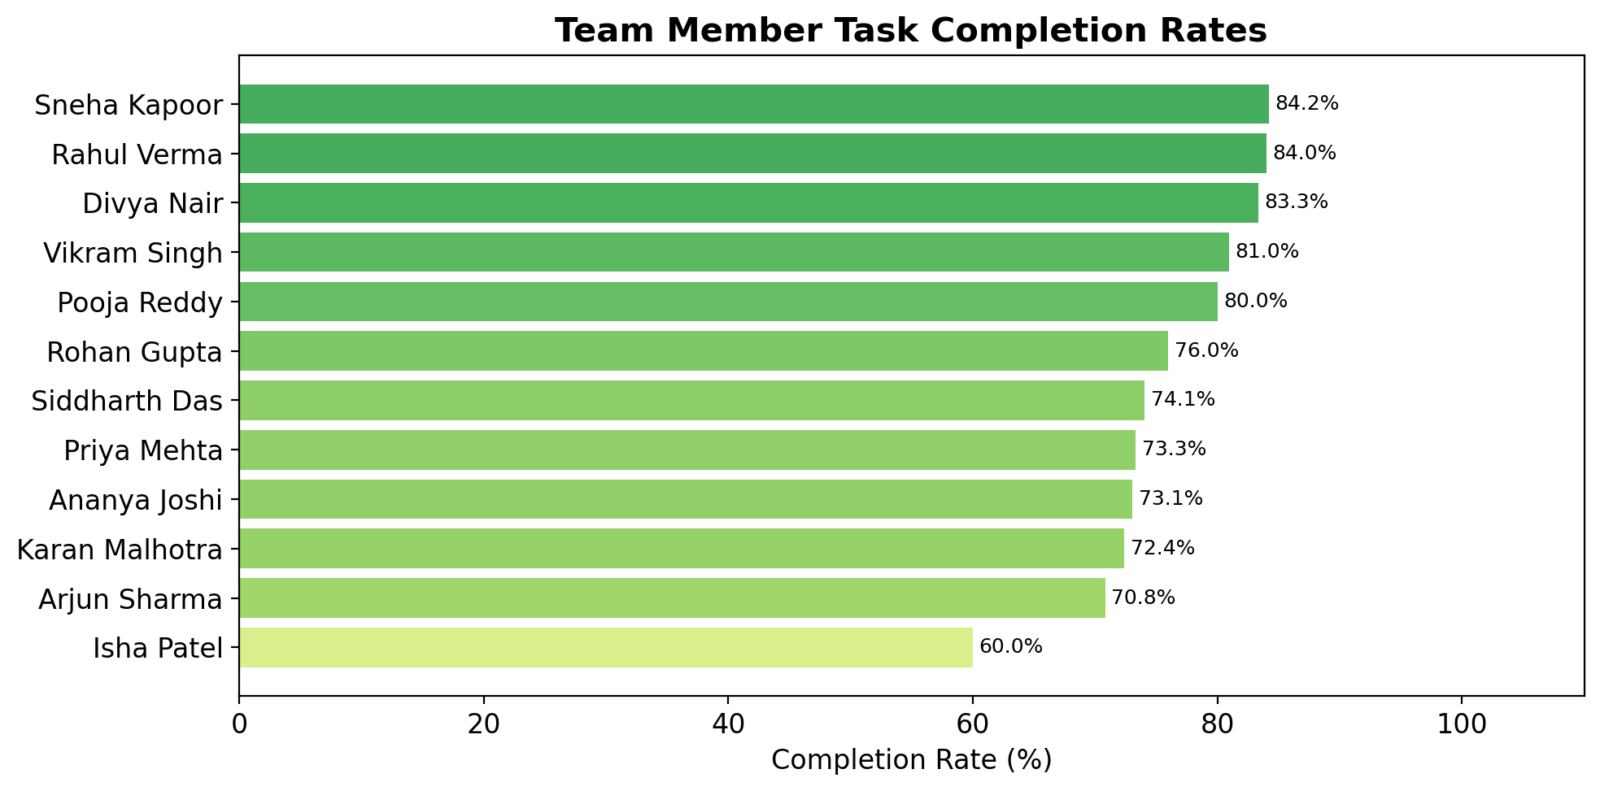
Team Productivity Analysis
Workload distribution, completion rates, and resource utilization
300
Total Tasks
227
Completed
75.7%
Completion Rate
85.8%
Avg Utilization
• Busiest members: Priya Mehta (30 tasks), Karan Malhotra (29 tasks), Siddharth Das (27 tasks)
• Highest completion rates: Rahul Verma (84.0%), Sneha Kapoor (84.2%), Rohan Gupta (76.0%)
• Lowest completion rate: Isha Patel (60.0%) – needs attention
• Total estimated hours: 12884 | Total actual hours: 11048

Slide 8
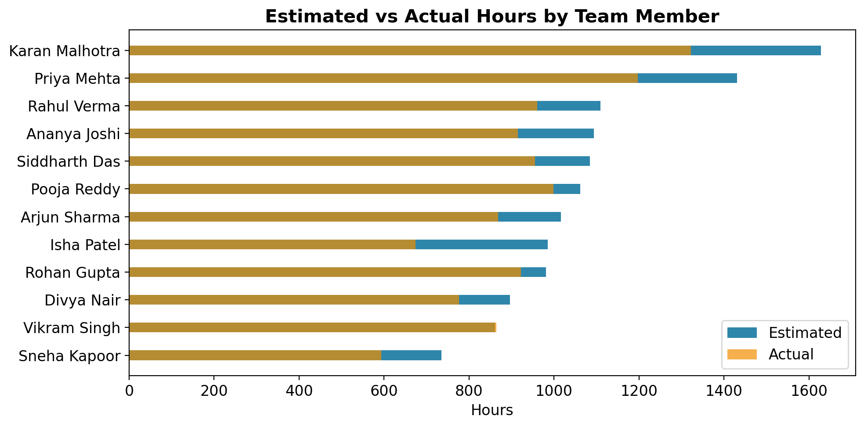
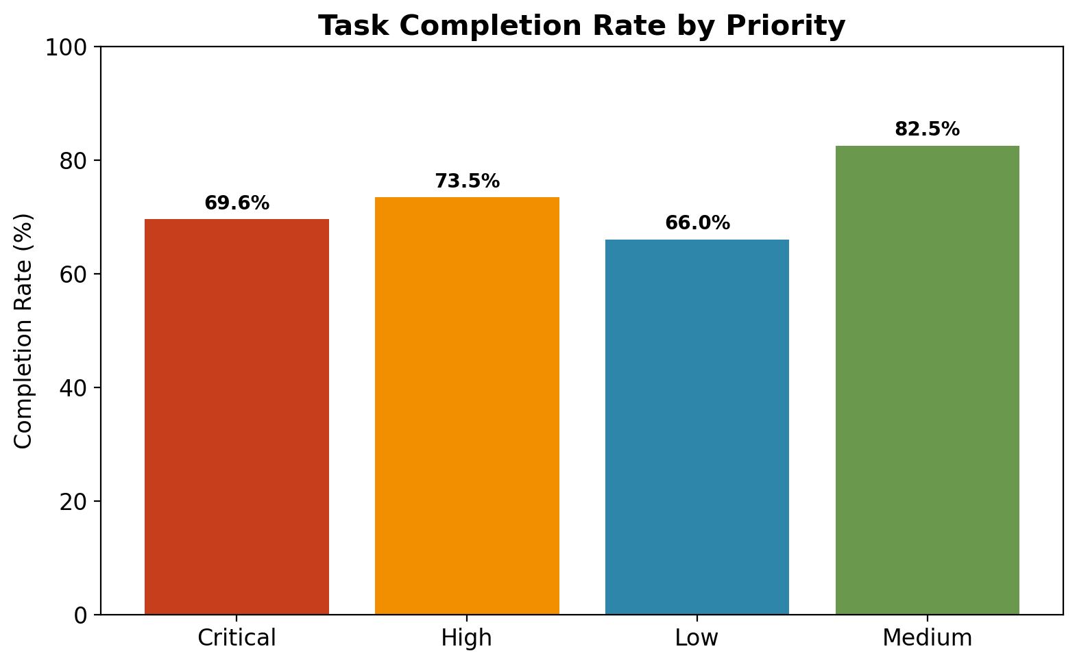
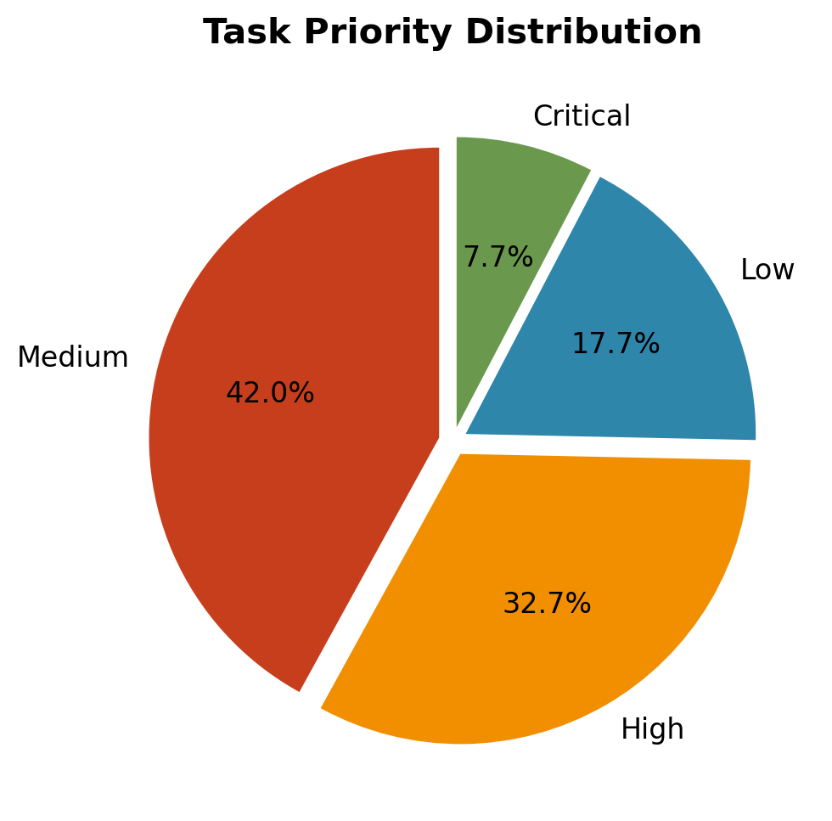
Team Productivity Analysis (contd.)
Estimated vs actual hours, priority analysis, and burnout risk assessment
Burnout Risk & Overutilization Assessment
• Vikram Singh: 100.4% utilization (actual > estimated) – HIGH BURNOUT RISK
• Rohan Gupta: 94.0% utilization – near capacity
• Pooja Reddy: 94.0% utilization – near capacity
• Potential underutilization: Isha Patel at 68.5% – may need more allocation
• 141 out of 300 tasks exceeded estimated hours (47%) indicating estimation inaccuracies

Slide 9
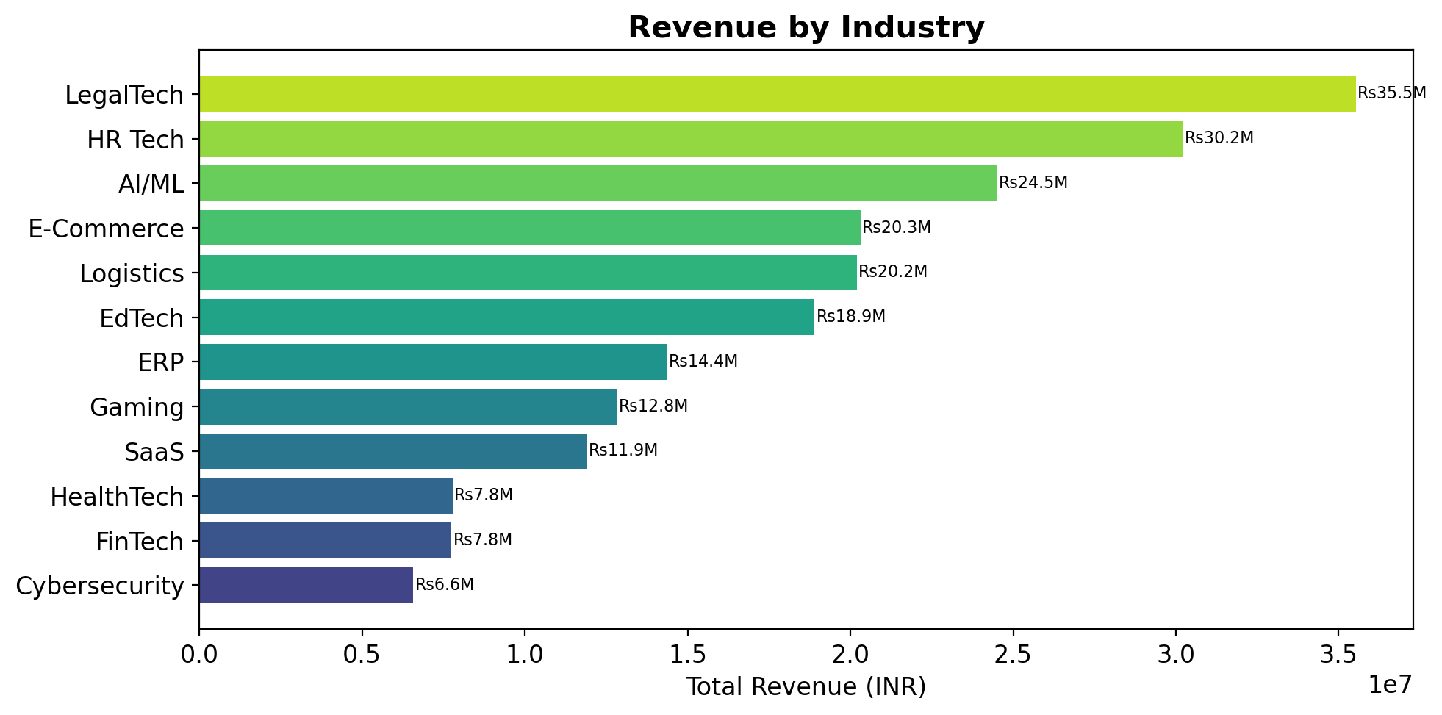
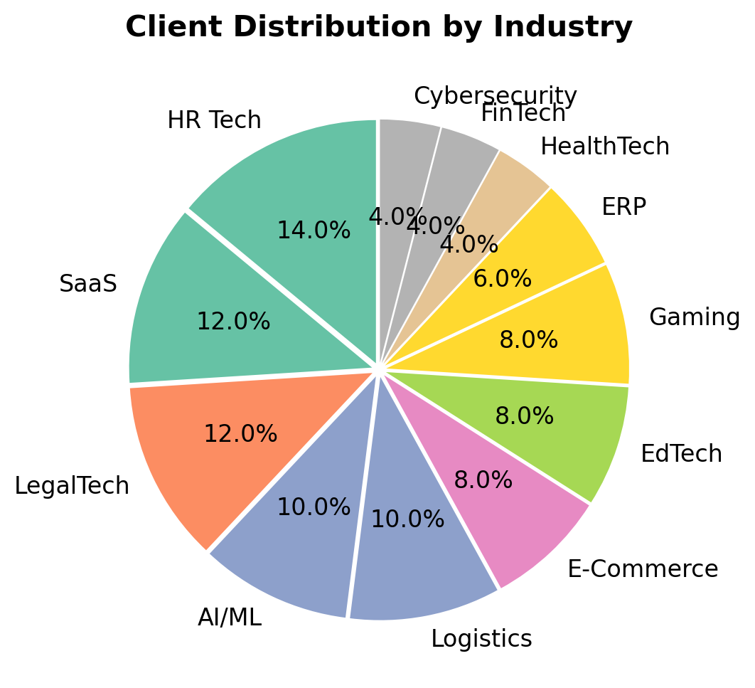
Client Analytics
Client distribution, retention, industry breakdown, and top performers
50
Total Clients
Rs4.22M
Avg Revenue/Client
6.8
Avg Projects/Client
15
Cities Covered
Client Distribution Insights
Top 5 Clients by Revenue
• Industry Leaders: LegalTech (Rs35.5M), HR Tech (Rs30.2M), AI/ML (Rs24.5M)
• City Leaders: Noida (Rs24.4M), Ahmedabad (Rs21.7M), Delhi (Rs17.8M)
• Top client: VelocityTech – Rs7.78M (AI/ML, Mumbai)
• Client retention potential: 12 distinct industries show diversification
• Re-engagement opportunities: 7 projects On Hold, 5 Cancelled
VelocityTech | Mumbai | AI/ML | Rs7.78M
ElevateAI | Noida | EdTech | Rs7.73M
SmartSynth Ltd | Gurugram | LegalTech | Rs7.56M
CloudNova Systems | Jaipur | HR Tech | Rs7.54M
FuturePath Tech | Chennai | EdTech | Rs7.30M

Slide 10
Key Bottlenecks & Business Challenges
Critical operational issues identified during the analysis period
Delayed Project Delivery
Invoice Collection Gap
• Only 25% of completed projects delivered on-time
• 8 projects currently in "Delayed" status (10% of total)
• Average project duration: 220 days vs planned deadlines
• Impact: Client dissatisfaction, penalty risks, cash flow delays
• Collection rate at only 54.3%
• Rs2,509,787 in overdue invoices
• Rs1,281,205 in unpaid invoices
• 7 unpaid invoices and 11 overdue invoices blocking working capital
Budget Overruns
Workload Imbalance
• 10 projects (12.5%) exceeded approved budget
• Average budget utilization across all projects: 69.2%
• Indicates poor initial estimation or uncontrolled scope creep
• Profit margins eroded on over-budget projects
• Task distribution varies from 19 to 30 tasks per team member
• Isha Patel: 60% completion rate (lowest in team)
• Vikram Singh: 100.4% utilization (burnout risk)
• 141 tasks (47%) exceeded estimated hours
Quantified Impact: These bottlenecks collectively result in approximately Rs6.22M in blocked revenue, 12.5% budget erosion, and 75% project delay rate requiring immediate management attention.

Slide 11
Recommendations & 90-Day Action Plan
Short-term (0-30 days) and Medium-term (31-60 days) initiatives
PHASE 1: SHORT-TERM (0-30 Days) – Immediate Actions
PHASE 2: MEDIUM-TERM (31-60 Days) – Process Improvements
• Recover overdue invoices: Initiate collection drive for Rs2.5M+ in overdue payments – Target: 60% recovery
• KPI to monitor: Collection rate increase from 54.3% to 70%
• Resource rebalancing: Redistribute tasks from Vikram Singh (100.4% util) to Isha Patel (68.5%)
• KPI to monitor: Utilization variance reduced to <20% across team
• Project triage: Review 8 delayed projects – either fast-track or re-scope with client approval
• KPI to monitor: Delayed projects reduced from 8 to 4
• Invoice follow-up automation: Implement automated payment reminders for 7 unpaid invoices
• Responsible: Finance Team, Project Managers | Priority: CRITICAL
• Project estimation overhaul: Implement standardized estimation framework to reduce budget overruns
• KPI to monitor: Budget variance reduced from 12.5% to <5%
• On-time delivery program: Introduce milestone-based tracking with weekly progress reviews
• KPI to monitor: On-time delivery rate from 25% to 50%
• Task management optimization: Clear backlog of 73 incomplete tasks with prioritization
• KPI to monitor: Task completion rate from 75.7% to 90%
• Client re-engagement: Reach out to 7 On-Hold and 5 Cancelled project clients for revival
• Responsible: Operations Head, Team Leads | Priority: HIGH
Expected Outcomes After 60 Days
• Collection rate improved from 54.3% to 75% | Delayed projects reduced by 50% | Task completion rate above 85%
• Budget variance reduced below 8% | Team utilization balanced within 75-95% range | Revenue recovery of Rs1.5M+

Slide 12
90-Day Action Plan (contd.)
Long-term (61-90 days) strategic initiatives and projected business impact
PHASE 3: LONG-TERM (61-90 Days) – Strategic Growth & Systems
• BI Dashboard Implementation: Deploy automated real-time KPI dashboards for management visibility
• KPI to monitor: Automated reporting coverage for 100% of identified metrics
• Revenue Diversification Strategy: Reduce top-5 client dependency (currently 35%) to below 25%
• KPI to monitor: Client concentration ratio reduced to 25%
• Client Success Program: Formalize quarterly business reviews for top 15 revenue-generating clients
• KPI to monitor: Client retention rate improved by 20%
• Team Productivity System: Implement OKR framework with bi-weekly sprint planning and retrospectives
• KPI to monitor: Team productivity index improved by 30%
• Financial Process Automation: Integrate invoicing with automated reconciliation and payment tracking
• KPI to monitor: Invoice-to-cash cycle reduced from 13.6 days to <7 days
Projected Business Impact (90-Day Target)
Collection Rate | 54.3% | 75.0% | 85.0% | Finance
On-Time Delivery | 25.0% | 50.0% | 70.0% | PMO
Task Completion | 75.7% | 85.0% | 95.0% | Ops Team
Budget Variance | 12.5% | 8.0% | 5.0% | Finance
Team Utilization | Variable | 75-95% | 80-90% | HR/Ops
Delayed Projects | 8 | 4 | 2 | PMO

Slide 13
Thank You
YoungXCode – 45-Day BI Analysis Complete
• Schedule management review meeting to discuss findings and approve action plan
• Assign owners for each recommendation phase with weekly progress tracking
• Implement immediate recovery actions for overdue invoices and delayed projects
• Deploy automated BI dashboard for ongoing performance monitoring
For questions or detailed data access, contact: BI & Analytics Team | YoungXCode

