Slide 1
Natural-Language Input for the Scone Knowledge-Base System
Yang Yang
Carnegie Mellon University
Master of Science in Computer Science
Fifth Year Master’s Program
Advisor: Professor Scott E. Fahlman
Committee Member: Professor Lori Levin, CMU LTI
December 9, 2021

Slide 2
Agenda
Motivation
Scone Knowledge Base
Construction Grammar
NLU Engine
Example Implementation
Conclusion

Slide 3
Motivation
Natural Language Processing
Sentiment analysis
Machine translation
Dialog
NLP
Understanding?
Notes:
Natural Language Processing (NLP) is an important and challenging area of Artificial Intelli-gence, not only because language is one of the most complicated and ambiguous components of human intelligence, but also because the development of NLP narrows the communication gap between human and computer. In recent years, with the development of deep neural net-works, NLP has shown impressive improvement in various application areas: text classification, translation, semantics analysis, etc.
However, these advances are still far from the ultimate goal of all NLP tasks is to perform a human-like understanding of text

Slide 4
Project Goals
A real Natural Language Understanding system
Goal: Prototype NLU system
How to store knowledge?
How to extract knowledge?
Text
(in context)
Language-Independent Concept-Level Representation of the Meaning
Scone Knowledge Base
Construction Grammar
Notes:
In other words, the knowledge we can get from the text
The goal of this project is to build a prototype NLU system that demonstrates the core features of this approach and to provide a foundation upon which future work in this area can build.

Slide 5
Agenda
Motivation
Scone Knowledge Base
Construction Grammar
NLU Engine
Example Implementation
Conclusion

Slide 6
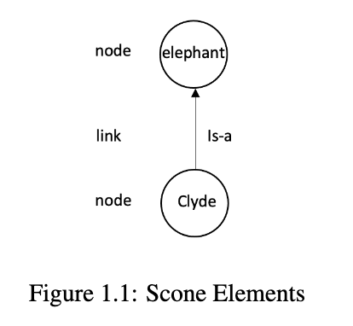
Scone Knowledge-Base System
Scone Elements: nodes and links
Notes:
Scone [4] [5] [6] is a open-source Knowledge-Base System (KBS) that has been under development by the research group lead by Professor Scott E. Fahlman since 2003

Slide 7
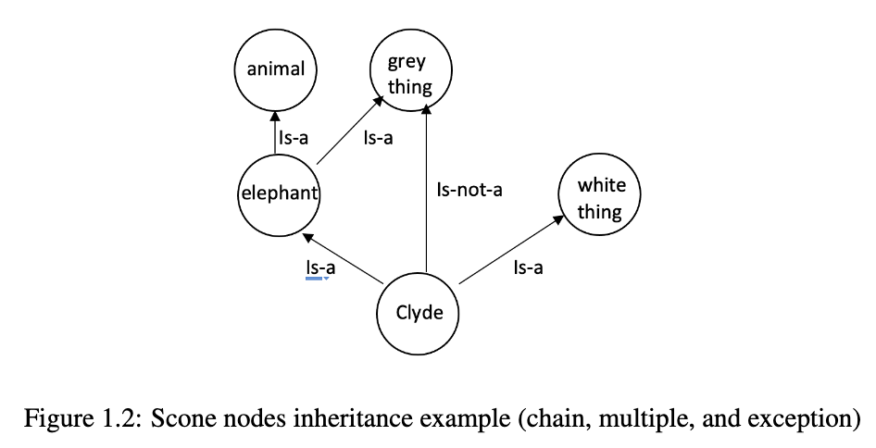
Scone Knowledge-Base System
Scone Elements: nodes and links
Semantic Network
(IS-A hierarchy as backbone)
Notes:
unlike many knowledge-representation systems, Scone is NOT based on formal first-order logic. the goal of Scone is to support human-like, common-sense reasoning, not theorem-proving (which is computationally very expensive and which severely restricts what you can say).
I don't think you need to get any deeper into this, but if anyone asks, for human-like common sense, we need to do defeasible reasoning (defaulty knowledge, but allowing explicit exceptions, as in a white elephant) and higher-order constructs (statements about other statements (e.g. "Fred thinks that John loves Mary, but that's not really true.").

Slide 8
Scone Knowledge-Base System
Symbolic knowledge representation
Store the large network of (implicit) knowledge
Support simple inference
Flexible search within Scone
Scone is a ”smart memory” component for symbolic knowledge used in AI or software applications
Notes:
Scone provides support for representing symbolic knowledge about the world including the implicit knowledge that could be deduced.
Scone also provides efficient support for simple inference: inheritance of properties in a type hierarchy, following chains of transitive relations, detection of type mismatches (e.g. trying to assert that a male person is someone’s biological mother), and so on.
Scone supports flexible search within the knowledge base. For example, we can ask Scone to return all individuals or types in the KB that exhibit some specified set of properties

Slide 9


Scone Features
Clean separation of conceptual vs. lexical or linguistic information
{animal mouse}
{computer mouse}
……
The mapping between words to concept nodes is a many-to-many
“mouse”
Notes:
These terms in curly brackets represent distinct concept-nodes in the Scone knowledge-base, even though they share the name "mouse". The mapping of words (text-strings) to concept-nodes is many-to-many: a concept-node may have many names in English, or no name; a word may refer to one unique concept-node, or to many, or to none (i.e. it's meaningless).
And when you go to another language, the nodes and links in the Scone knowledge base remain the same, but there will be a new set of names and name-node attachments.

Slide 10
Scone Features
Clean separation of conceptual vs. lexical or linguistic information
Frame-like representation with virtual-copy semantics
Notes:
Basically, a type-node like {elephant} is the anchor point for a description of the typical elephant: parts, features, relations, and so on. And when we say "Clyde is an elephant", creating an is-a link from Clyde to elephant, it causes Clyde to inherit the entire elephant description, as if we had copied it all. But we don't really copy it -- too expensive. It's all done by inheritance as query-time.
And then, for Clyde, we can add more information that is true of Clyde but not other elephants, and we can cancel some information that would otherwise be inherited.

Slide 11
Scone Features
Clean separation of conceptual vs. lexical or linguistic information
Frame-like representation with virtual-copy semantics
Multiple context mechanism
node N has a connection to a context-node C in which the entity N exists
link L has a connection to a context node C within which the statement L is valid
contexts are hierarchical
helps to support many different but overlapping world models at once
Notes:
comparing with other kb, Perhaps the most unusual aspect of Scone
a context may be a period of time (in the 1980s), a geographical area (in the U.K.), a separate world model ("the Harry Potter world" or "imagine a world without Covid"), or even a state of mind: "Holmes believes that the butler murdered the countess".

Slide 12
Scone Features
Clean separation of conceptual vs. lexical or linguistic information
Frame-like representation with virtual-copy semantics
Multiple context mechanism
Capable of scaling up to relatively large size
Notes:
it is generally accepted that our memory is capable of scaling up to a relatively large size
If anyone asks about "relatively large size". Some years ago we ran some benchmarks with dummy knowledge bases, and it scaled up to a couple of million Scone elements (nodes and/or links) without any slowdown noticeable to the human user. On a modern laptop with, say 32GB of primary memory, we should be able to get to 20M elements with no problem -- basically, we just need enough memory to hold everything without paging.
And that's just the EXPLICIT knowledge of the system. Query-time inference gives us access to much more implicit knowledge. So that should be far more explicit knowledge (entities and statements) than we need for most common-sense reasoning.

Slide 13
Scone Features
Clean separation of conceptual vs. lexical or linguistic information
Frame-like representation with virtual-copy semantics
Multiple context mechanism
Capable of scaling up to relatively large size
Capable of performing high-speed search and inference
“Clyde is an elephant”
parallelizable marker-passing algorithms

Slide 14
Scone Features
Clean separation of conceptual vs. lexical or linguistic information
Frame-like representation with virtual-copy semantics
Multiple context mechanism
Capable of scaling up to relatively large size
Capable of performing high-speed search and inference
Scone KB is a full partner in reasoning and NLU task
Notes:
Basically, we reject the one-way pipeline model of most NLP systems. The Scone KB is a full partner in the reasoning, providing knowledge to resolve ambiguities and to fill in info not explicitly stated in the text.
we don't like the traditional one-way NLP pipeline models. The knowledge base is a full partner in the language understanding task, and not just where the knowledge ends up. I think that's a key point to make -- getting background knowledge and context into the game early, to help in disambiguation and filling in the gaps in what has been said.

Slide 15
Agenda
Motivation
Scone Knowledge Base
Construction Grammar
NLU Engine
Example Implementation
Conclusion

Slide 16
Construction Grammar
Construction Grammar (CxG) is a field of cognitive linguistics that studies the pair of linguistic patterns and the underlying meaning
CxG itself is a family of theories
Embodied Construction Grammar
Fluid construction grammar
Radical construction grammar
Notes:
Construction, including morpheme, word, idiom, passive, etc, is a very broad linguistic concept, where in fact any pattern could be recognized as a con-struction as long as some aspect or its meaning cannot be predicted from its component parts or other constructions
CxG itself is a family of theories and there are a couple of existing formalized Construction grammar frameworks that are mature and have a solid implementation: Embodied Construction Grammar[1], Fluid construction grammar[13], Radical construction grammar [14] etc. At this point, our project are agnostic as to the exact type of CxG we want to use. but we will provide a rather general framework
sign-based cxg (generative)
hpsg

Slide 17
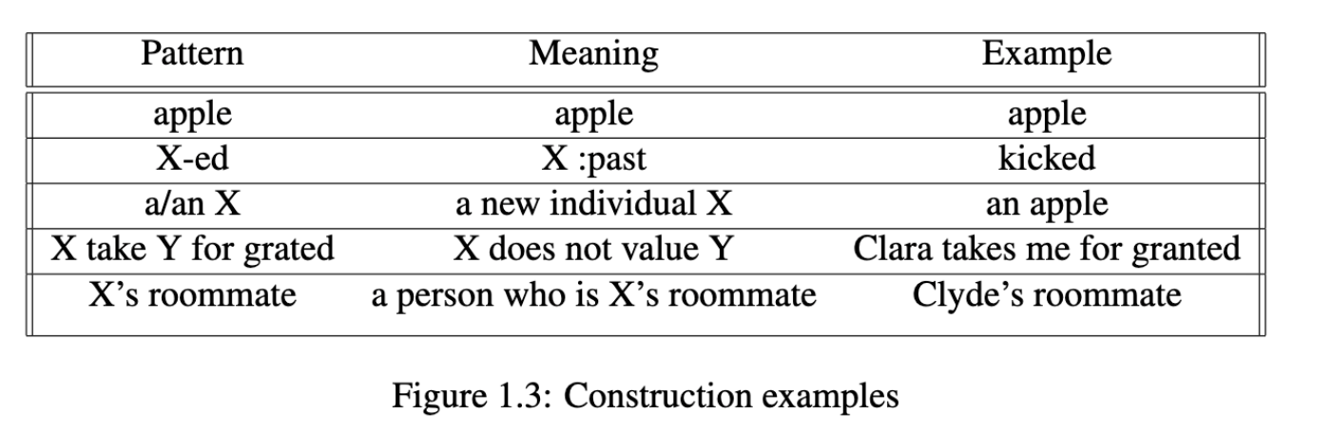
Why Construction Grammar
CxG could achieve a high level of full coverage and generalization across languages
within the scope of this project, we are only looking at whole words and phrases
Notes:
we're not looking at morphology like construction for now, though some models do use constructions for intra-word patterns.
a pre-processing module handles morphology.
about 10 min

Slide 18
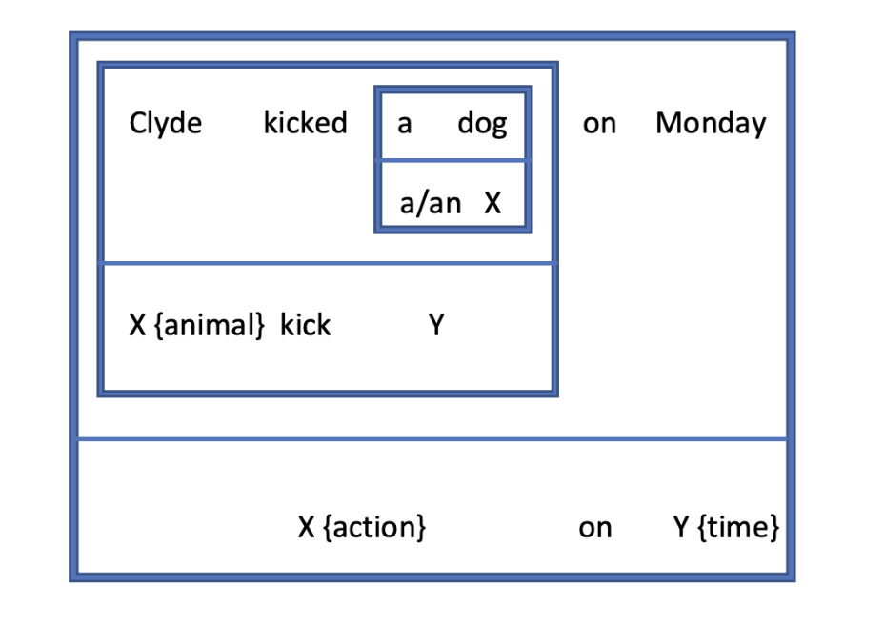
Why Construction Grammar
“Bottom-up” structure
Notes:
Unlike context-free grammar, construction grammar starts from constructing small parts that eventually meet the construction of a larger part, while context-free grammar needs to start from the whole text and recursively break up into small parts. Considering an NLU engine, such ”bottom-up” structure gives the input text more freedom and also helps the system to deal with incomplete or unstructured text.
order of composition
hpsg lsg

Slide 19
Why Scone and CxG
Construction rules try to find ”meaningful fragments”
Scone can quickly determine whether the associated new knowledge is consistent with what it already knows
Scone can build a different knowledge structure for different interpretations, each in its own context
The multiple context mechanism can represent distinct world model constructions
Notes:
Additionally, Construction Grammar is great to combine with Scone in the following aspects:
Construction rules try to find ”meaningful fragments” of language in an incoming stream of text
In construction pattern, these fragments are generally restricted to the type of entity that can fit into that part of the pattern
this gets Scone-resident background knowledge into the game early and often and simplifies the process to match text with construction pattern
If a construction pattern is matched (tentatively), Scone can quickly determine whether the associated new knowledge is consistent with what it already knows – if not, it should look for a different interpretation.
If a text is matched with multiple construction patterns, Scone can build a different knowledge structure for each meaning, each in its own context, and then keep the one that makes the most sense as later information comes in.
Contexts are generally inexpensive -- often just a few new nodes and links.
such as ”I want to stay at home tonight, but I should go to the meeting.” The two possible worlds are represented in two distinct world models that share most of their information.

Slide 20
Construction Representation
Pattern
A list of entities, where entities can be
List of strings e.g. (“a” “an”)
Variable
E.g. (?x (“like” “likes”) ?y)
“Clyde likes elephants”
?x → {Clyde}
?y → {elephant} :plural
Notes:
The Pattern of a construction is used to match with the form of some raw text. The pattern is formed by a sequence of entities, where each entity could be either a list of strings or a variable.
variable value: scone element + morphology keywords

Slide 21
Construction Representation
Pattern
Variables and Corresponding Constraints
String constraints
E.g. “kicked” can match variable with “kick” constraint
Scone element constraints
E.g. “elephant” can match variable with {animal} constraint
Syntax tag (:noun, :verb, :adj, :relation, etc.)
Individual or type(:indv, :type)

Slide 22
Construction Representation
Pattern
Variables and Corresponding Constraints
Return Tag
Modifier
Scone context node
:list
Notes:
We also give a return tag to each construction in order to make the whole CxG engine compatible with Scone knowledge base. In
Scone, the mapping of a string to an element always comes with an associated syntax tag
Modifier is used when we want to affect a certain variable before matching the text with a Scone element

Slide 23
Construction Representation
Pattern
Variables and Corresponding Constraints
Return Tag
Modifier
Action / Semantics
Lisp program that build new knowledge in Scone
Save as a lambda function

Slide 24
Construction Representation
Pattern
Variables and Corresponding Constraints
Return Tag
Modifier
Action / Semantics
Parent

Slide 25
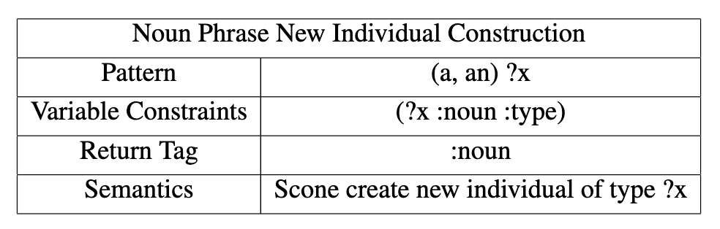
Construction Example
Clyde kicked a dog on Monday

Slide 26
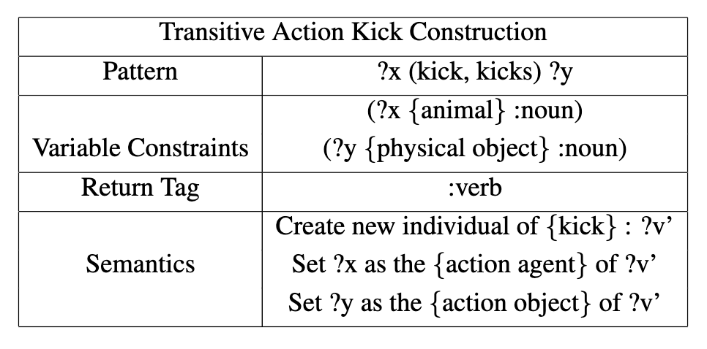
Construction Example
Clyde kicked a dog on Monday

Slide 27
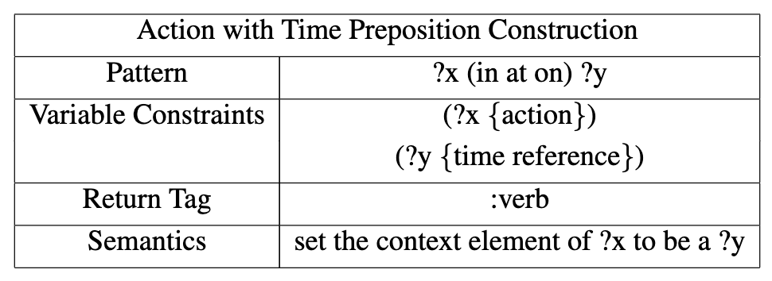
Construction Example
Clyde kicked a dog on Monday

Slide 28
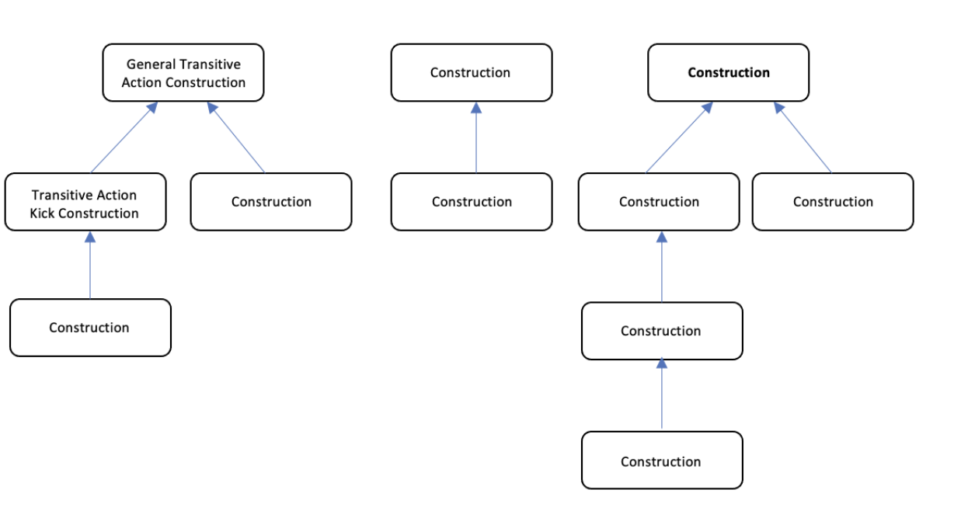
Construction Hierarchy
Notes:
If we consider the form of text as a set of texts, it is common to find that a subset of texts usually inherits semantics from the superset. For example, ”Wesley kissed the dog” and ”Wesley killed the dog” definitely have different semantics but both of them match with a general transitive action construction so we know Wesley is the agent of the action and the dog is the object of the action. Therefore, it is natural to build a hierarchy structure for the constructions.
a hierarchy of constructions allows us to build general constructions for common, regular families of expressions (transitive action verb), and to override the general patterns for any more specialized cases (kick).

Slide 29
Agenda
Motivation
Scone Knowledge Base
Construction Grammar
NLU Engine
Example Implementation
Conclusion

Slide 30
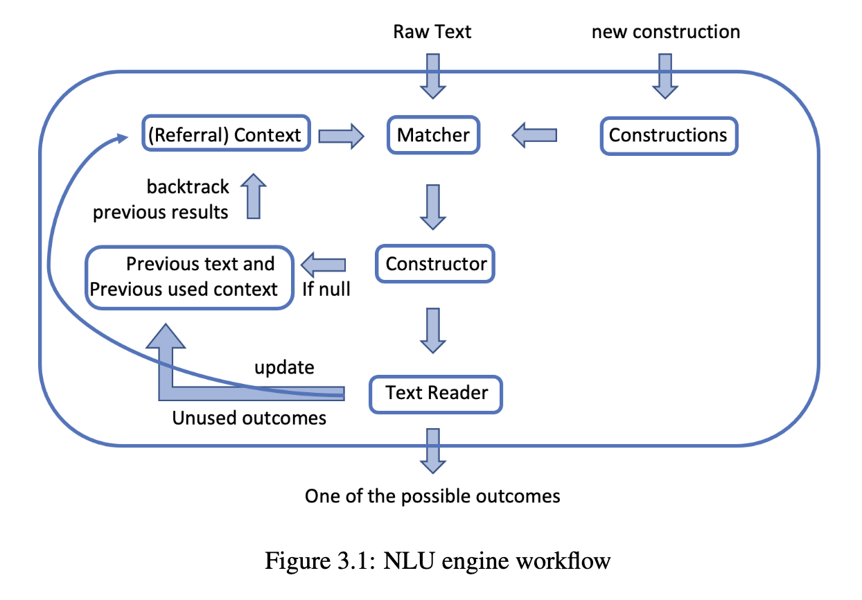
NLU Engine
Notes:
The engine consists of five major com- ponents: Constructions, Context, Matcher, Constructor, Text and Context Memory, and the Text Reader.
The five components work together to form the NLU engine. The user can input a sequence of texts into the engine, where for each text, the matcher will try to match the text with the constructions saved in the system. Then, the constructor will take all the results from the matcher and construct the semantics of the specific text. If there’s no valid semantics in the current context, the system will backtrack to the previous unused result and re-understand the current text. If there is at least one valid semantics, the text reader will take and return one of the possible results and store the unused results

Slide 31
Represent Context of Current Story
Scone Context
Represent the world model of the text
“Yang went to the bookstore on Monday”
“Yang goes to the bookstore” in a time context {Monday}
Notes:
20 min

Slide 32
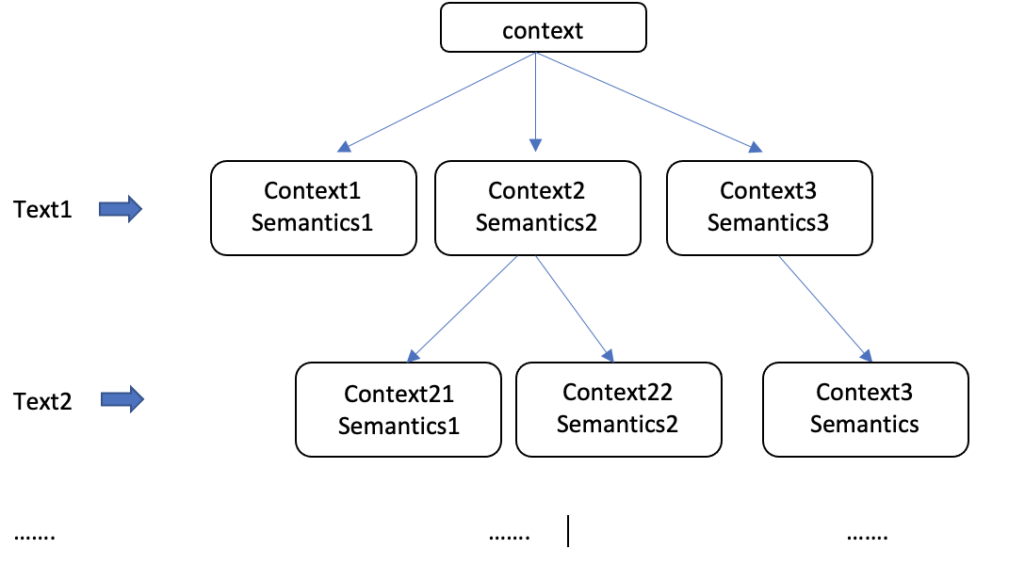
Represent Context of Current Story
Scone Context
Represent the world model of the text
Manage different interpretations
“Clyde is a mouse” in context {general}
{Clyde} is a {animal mouse} in context {general 0-4164}
{Clyde} is a {computer mouse} in context {general 0-4165}

Slide 33
Represent Context of Current Story
Scone Context
Represent the world model of the text
Manage different interpretations
Referral Context
Stack that saves previously mentioned information
Referral context: NIL
“Clyde is an elephant”

Slide 34
Represent Context of Current Story
Scone Context
Represent the world model of the text
Manage different interpretations
Referral Context
Stack that saves previously mentioned information
Referral context: ({Clyde})
“Clyde is an elephant”
“he met a dog”

Slide 35
Represent Context of Current Story
Scone Context
Represent the world model of the text
Manage different interpretations
Referral Context
Stack that saves previously mentioned information
Referral context: ({Clyde} {dog 0-1})
“Clyde is an elephant”
“he met a dog”

Slide 36
Represent Context of Current Story
Scone Context
Represent the world model of the text
Manage different interpretations
Referral Context
Stack that saves previously mentioned information
Referral context: ({Clyde} {dog 0-1})
“Clyde is an elephant”
“he met a dog”
“the elephant” = {Clyde}

Slide 37
Matcher
Preprocessing: morphology
Root text + morphology tags
“kicked”

Slide 38
Matcher
Single Entity Match
String Pattern
Return
(“kick” “kicked”)
“kick” :past
Text
Preprocessing
“kicked”
“kick” :past
Variable Pattern
Return
(?x :verb {action})
{kick} :past
Notes:
determine if a single piece of text matches one pattern component

Slide 39
Matcher
Main Matcher algorithm
Basic Idea: the first component of the pattern should always be matched with a “prefix” of text, recursively call Matcher on the rest of text
Example:
Text: “Clyde is a mouse” Construction: ((?x :noun) ("is a" "is an") (?y :noun :type))
One-entity-Match (“Clyde”, (?x :noun)) → {Clyde}
Matcher (“is a mouse”, (("is a" "is an") (?y :noun :type)))
One-entity-Match (“is”, ("is a" "is an")) ❌
One-entity-Match (“is a”, ("is a" "is an")) ✔️
Matcher (“mouse”, (?y :noun :type)) → ({animal mouse} context1) ({computer mouse} context2)
Return ({Clyde} {animal mouse} context1) ({Clyde} {computer mouse} context2)
Notes:
Note in the Matcher algorithm, the components are matched sequentially from left to right and the context is also updated accordingly. The reason we choose to do matching in this way is that we want an AI system that could imitate human behaviors especially in the task of natural language understanding. Human normally read the text from left to right despite of its syntactic structure. After a part of the text (prefix list of the token list) is read, humans will naturally process the text (match the semantics and update context) and keep on reading (recursively call the Matcher)

Slide 40
Matcher
Special case: Names
What if we encounter new names?
For example: “Clyde hates mouses” (?x {animal} :noun)(?v "hate")(?z :noun))
First, determine if the text could be a name
Capitalize, :noun, :indv, {tangible}
Second, create a new node with that name under a new Scone context
Create new individual node {Clyde} under context {general 0-1}
Third, assume the node meets the Scone element constraints
Assert {Clyde} is a {animal}

Slide 41
Matcher
Special case: Pronouns
"Tony and Ellis went to the park yesterday. He bought an ice-cream in the park.”
“Tony is a girl”
“He”
Check the referral context and look for elements that could be a {male}
Keep all possibilities with multi-context
Assert the selected one is a {male} and move on

Slide 42
Partial Matching
Texts are often not well formalized
Clyde kicked a dog Monday
Clyde kicked a dog on Monday
Yang, Jack, Eric went to the concert
Yang, Jack and Eric went to the concert
Notes:
Partial matching is exciting since, in the real world, texts are often not well formalized, especially in dialogues. In the process of matching text with patterns, if the system has a well-built partial matching mechanism, the text could be much less restricted.

Slide 43
Constructor
Main function to manage single text input
Coordinate text, constructions and Matcher
Loop through construction tree, and traverse based on DFS
Apply Matcher on the input text and the construction
If matched, collect the variable values
Use dummy child context to manage different interpretation
Apply construction action and collect results
Notes:
Constructor serves as a central unit in processing the most recently input text. It collects the output of the Matcher and parses the final construction results to the Core Engine.

Slide 44
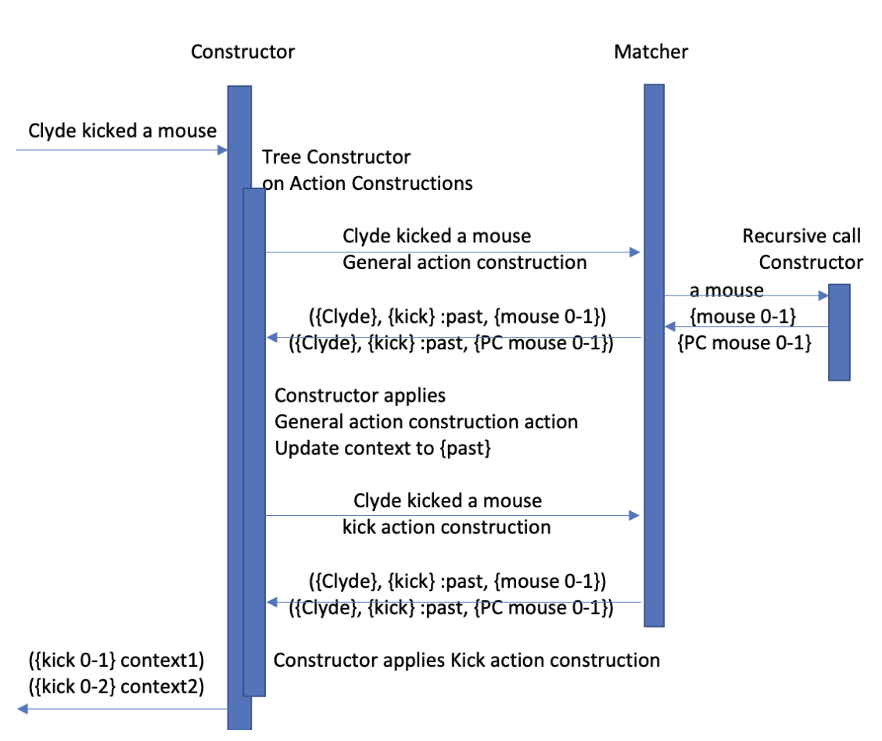
Constructor Example

Slide 45
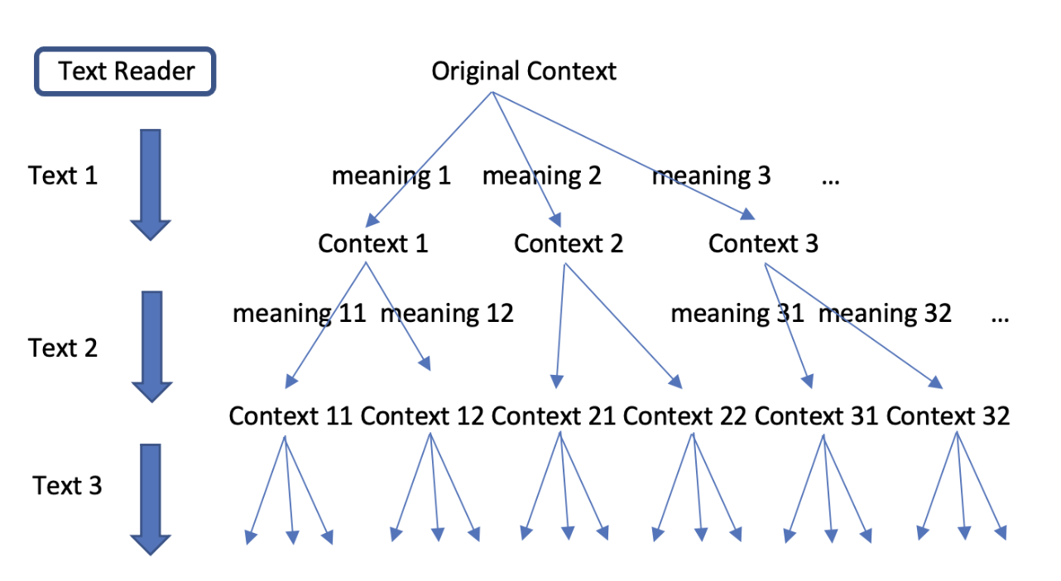
Core Engine
Goal: able to understand multiple texts
Notes:
30 min

Slide 46
Core Engine
Guess and go on strategy
Guess, remember the choice point, Go on, but be ready to backtrack and reconsider previous choices
For example:
Read “Yang has a mouse”
→ In context1, Yang has an animal mouse
In context2, Yang has a computer mouse
Take context1, and move on
Read “the mouse is a tool”
→ does not make sense, backtrack, take context2 and reread the text

Slide 47
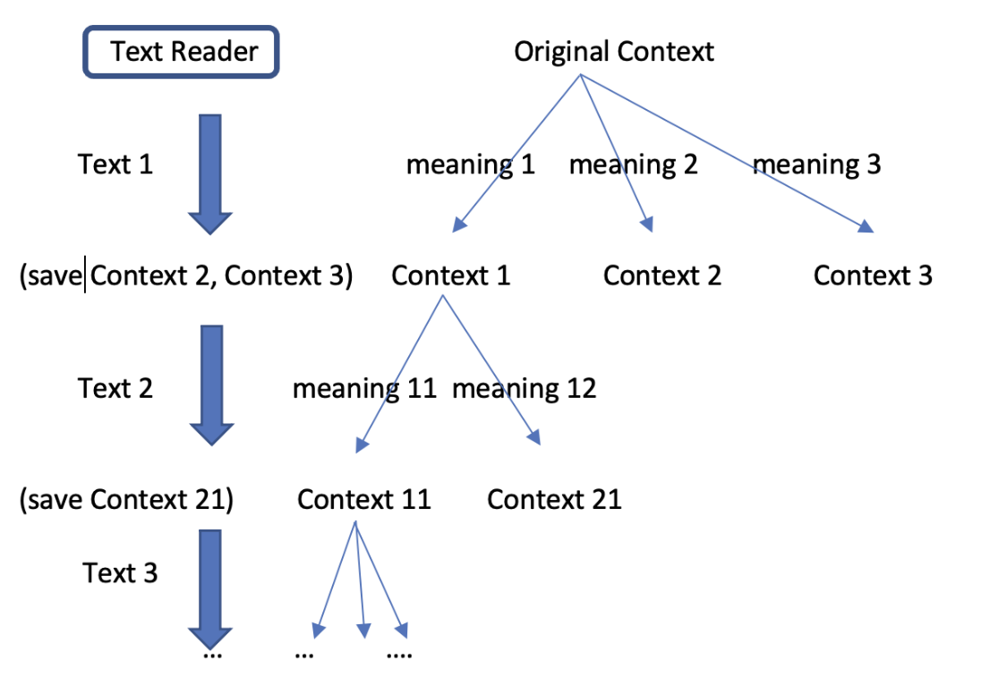
Core Engine
Guess and go on strategy

Slide 48
Agenda
Motivation
Scone Knowledge Base
Construction Grammar
NLU Engine
Example Implementation
Conclusion
Notes:
The purpose is to make the prototype able to understand simple sentences and give Scone a new way to input knowledge.

Slide 49
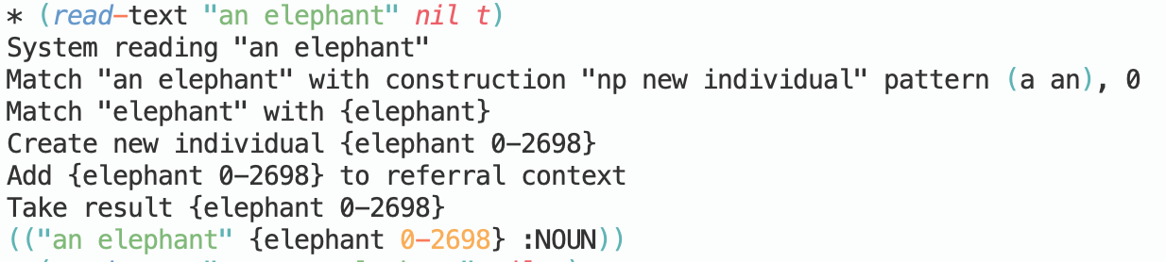
Example CxG Implementation
Noun phrase
Singular noun phrase

Slide 50
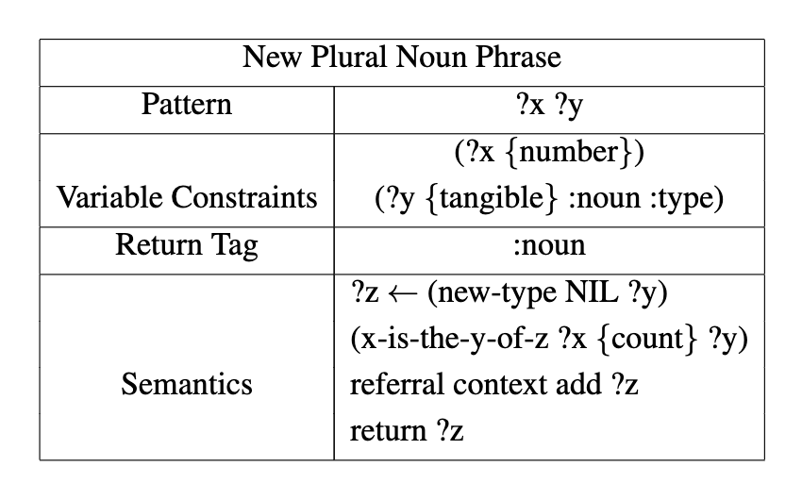
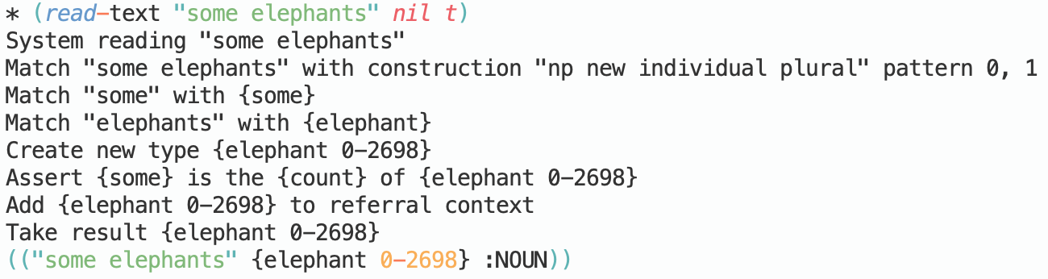
Example CxG Implementation
Noun phrase
Plural noun phrase
Scone use type node to represent a set of objects

Slide 51
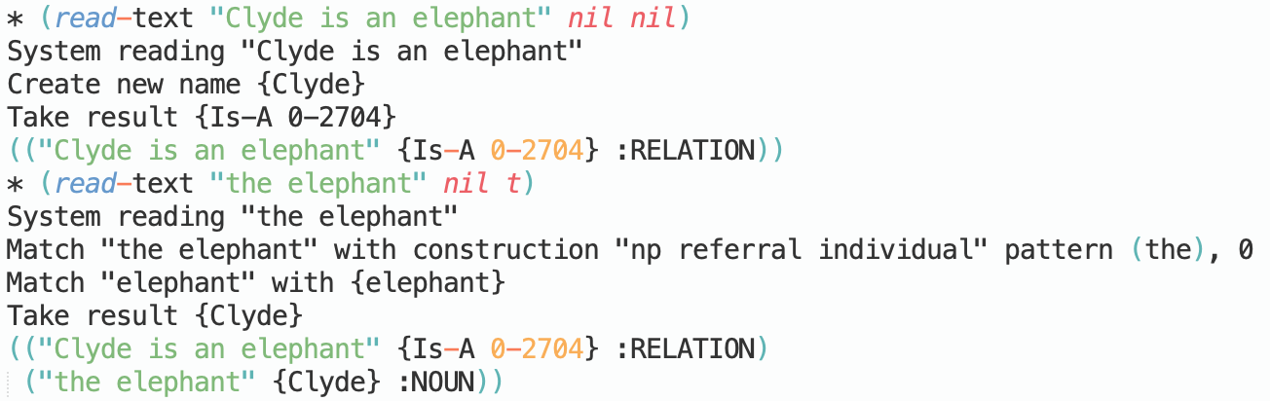
Example CxG Implementation
Noun phrase
Referral noun phrase

Slide 52
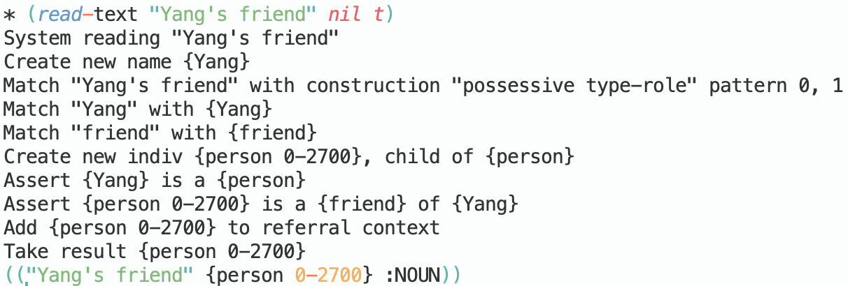
Example CxG Implementation
Noun phrase
Possessive noun phrase

Slide 53
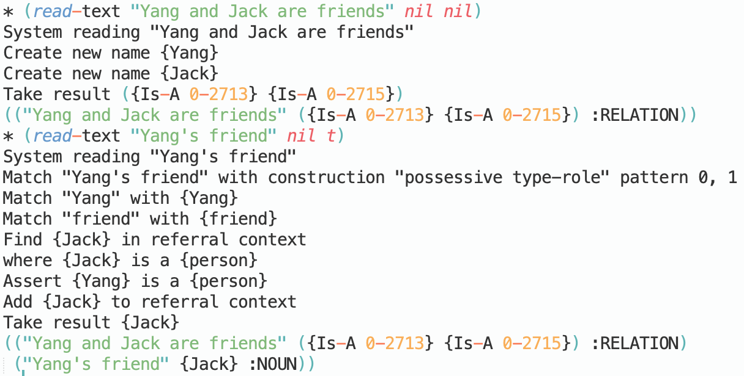
Example CxG Implementation
Noun phrase
Possessive noun phrase

Slide 54
Example CxG Implementation
Static Description
State of being verb based
?x (“is” “are”) ?y
- ?y is a type
create new IS-A link between ?x and ?y
- ?y is an individual
create new Eq link between ?x and ?y
Special case: ?x (“is a” “is an”) ?y :create new IS-A link
Notes:
"elephants are mammals"
"the elephant is Clyde"

Slide 55
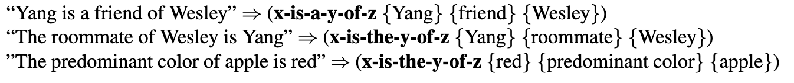
Example CxG Implementation
Static Description
Type-role description
type-role in Scone is usually used to describe “A of B”
Pattern: (?x ("is a") ?y ("of") ?z), (?x ("is the") ?y ("of") ?z)

Slide 56
Example CxG Implementation
Static Description
Type-role description
type-role in Scone is usually used to describe “A of B”
Pattern: (?x (“are”) ?y), where ?x is a list of nouns
e.g.
“Yang, Jack and Eric are friends”
{Yang} is a {friend} of {Jack}
{Yang} is a {friend} of {Eric}
{Jack} is a {friend} of {Eric}

Slide 57
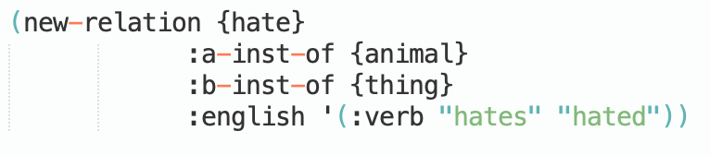
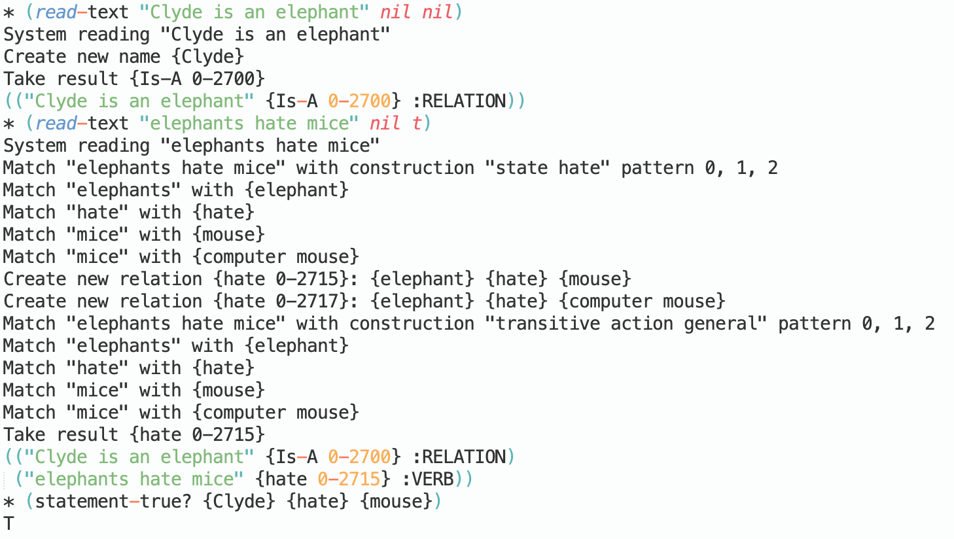
Example CxG Implementation
Static Description
Stative verb : “love”, “hate”, etc.

Slide 58
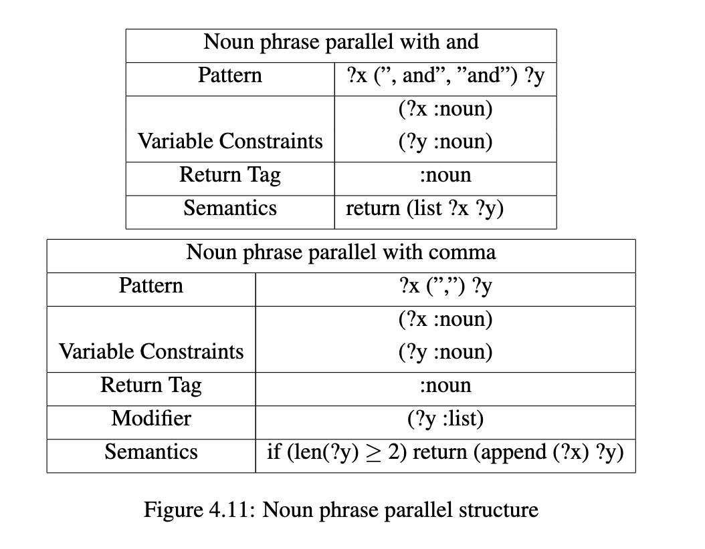
Example CxG Implementation
Parallel Structure
A, B, C, and D

Slide 59
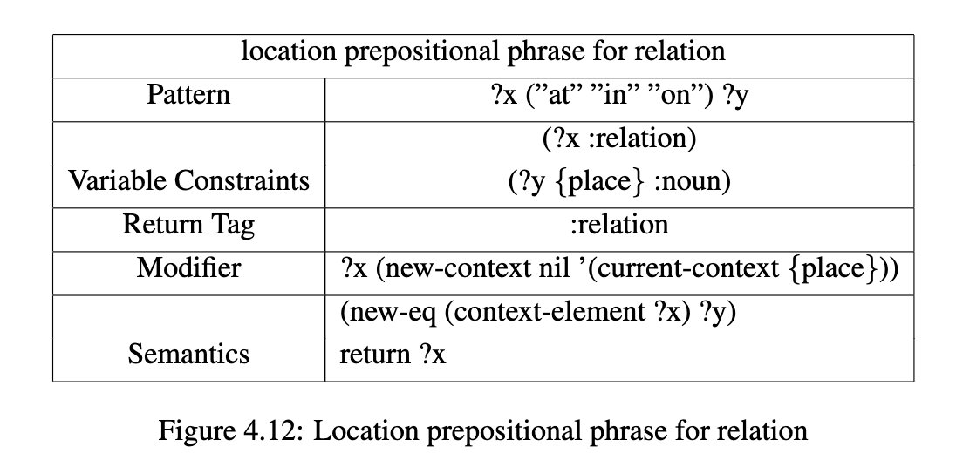
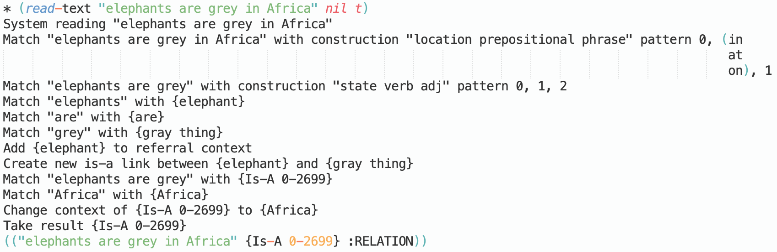
Example CxG Implementation
Prepositional phrase

Slide 60
Agenda
Motivation
Scone Knowledge Base
Construction Grammar
NLU Engine
Example Implementation
Conclusion
Notes:
40 min

Slide 61
Conclusion
An innovative way to build an actual natural language understanding system with construction grammar and Scone knowledge base.
An implemented proof of concept and set foundation for future work
Adopt Guess and Go on strategy to understand a sequence of texts
The system provides a platform for CxG researchers
The prototype system gives a new NLU-front-end to Scone

Slide 62
Future Work
More flexibility in defining constructions
Expand both the vocabulary (import from WordNet) and the set of constructions to cover more of English
Adopt and merge with existing large-scale CxG implementations, such as Fluid Construction Grammar
Automated construction creation, perhap via some data-drive process
Partial Matching
Introduce probability metrics in Matcher

Slide 63
The End
Thank you all for coming!
For more information about Scone and Natural Language Understanding:
Professor Scott Fahlman’s Knowledge Nuggets blog
https://fahlman-knowledge-nuggets.quora.com/
For more information about Construction Grammar:
Graeme Trousdale Thomas Hoffmann. The Oxford Handbook of Construction Grammar. New York: Oxford University Press, 2006. Implementation of the current prototype system:
https://github.com/YoungY0Y/Scone-CxG

Slide 64
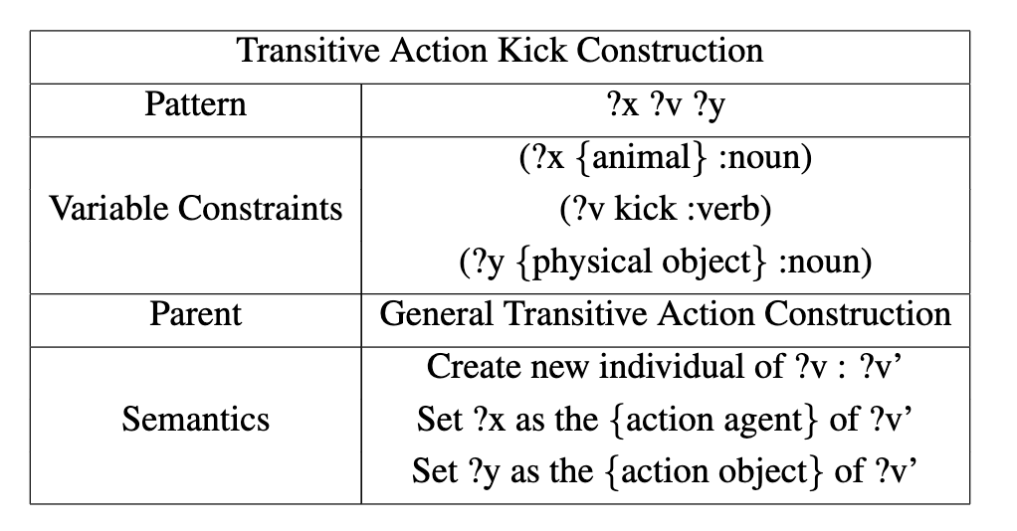
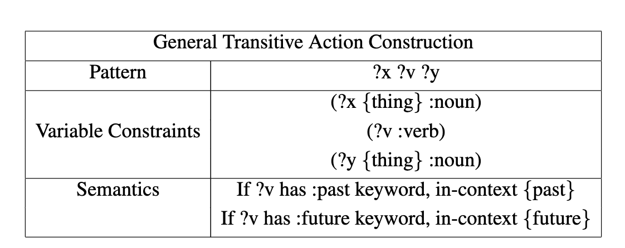
Construction Hierarchy

Slide 65
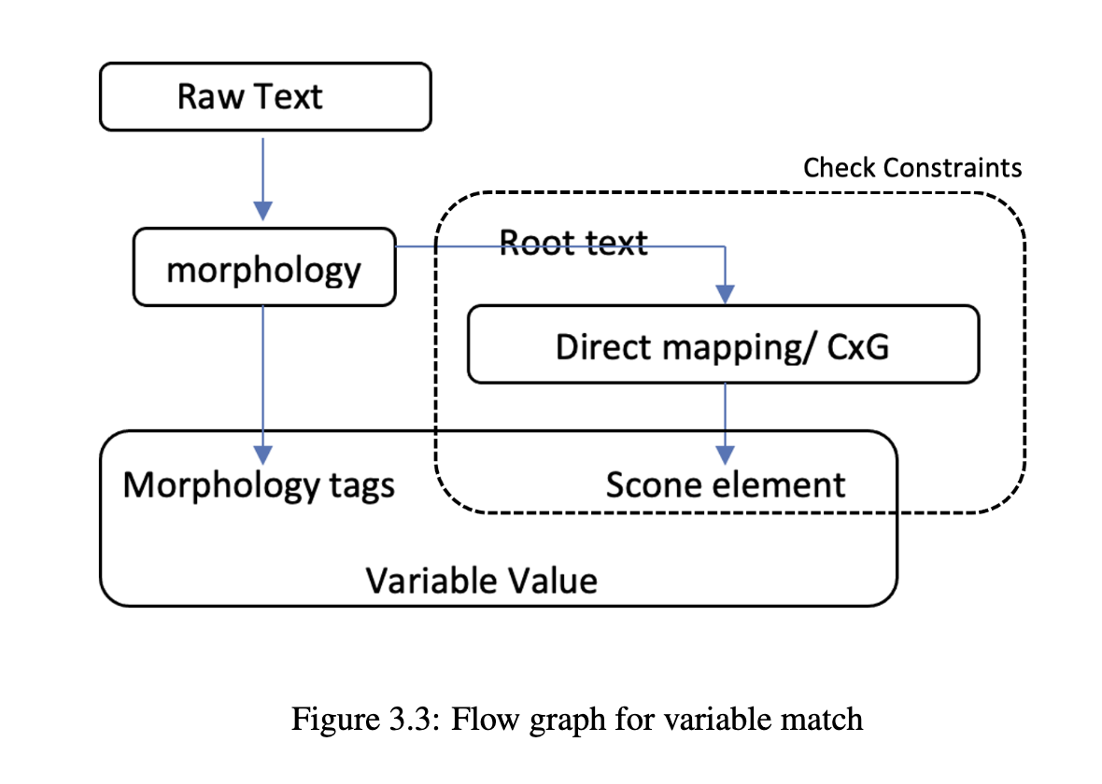
Matcher
Single Entity Match

Slide 66
Matcher
Main Matcher algorithm
Matcher (text, construction):
Text : (token1, token2, … )
Construction : (pattern1, pattern2, … )
for first-entity-text in token1, token1 token2, token1 token2 token3, … :
→ Single Entity Match (token1, pattern1)
Update context
Matcher (rest-text, (pattern2, …))

Slide 67
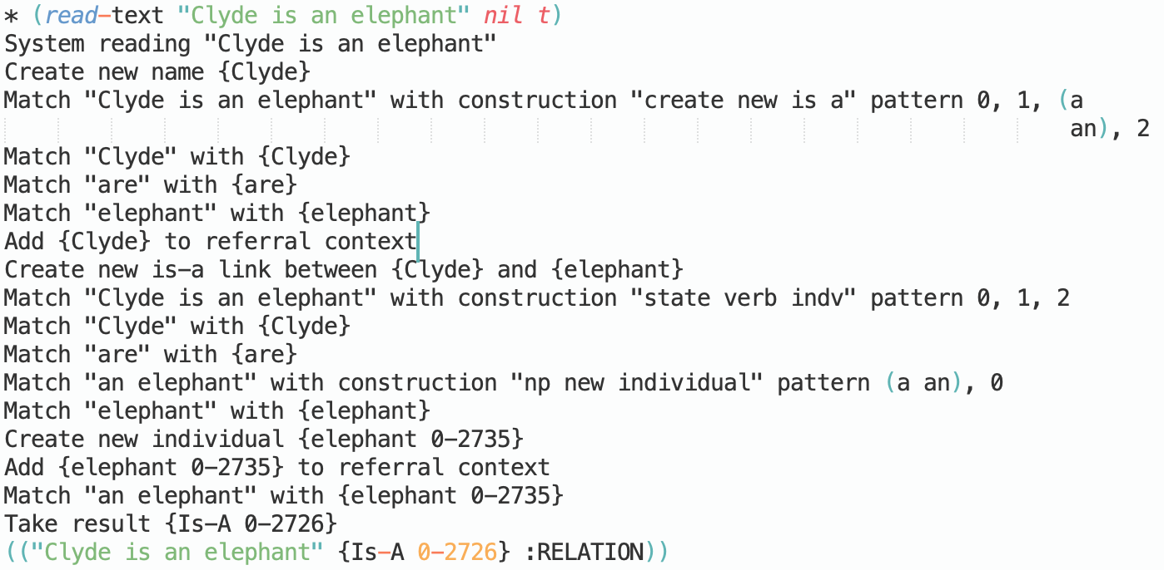
Example CxG Implementation
Static Description
State of being verb based
?x (“is” “are”) ?y
- ?y is a type
create new IS-A link between ?x and ?y
- ?y is an individual
create new Eq link between ?x and ?y
Special case: ?x (“is a” “is an”) ?y :create new IS-A link
Notes:
"elephants are mammals"
"the elephant is Clyde"

Slide 68
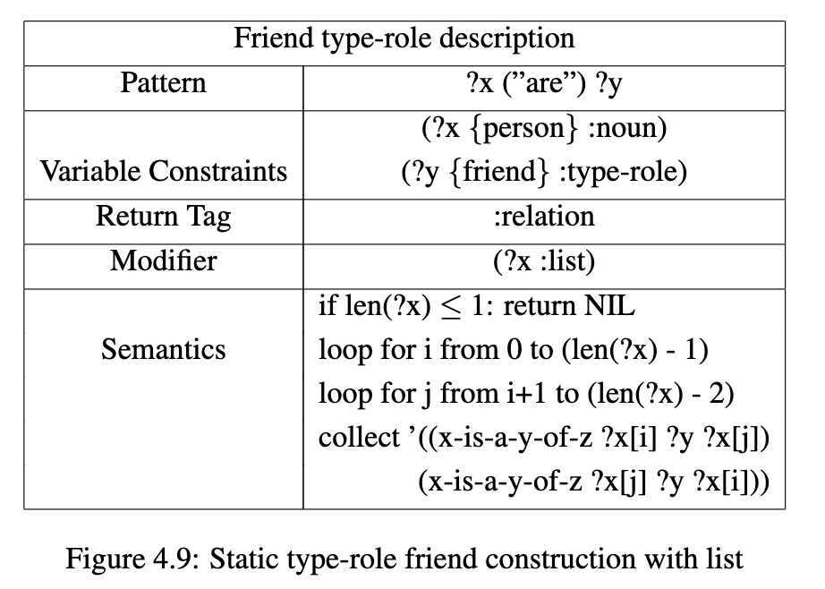
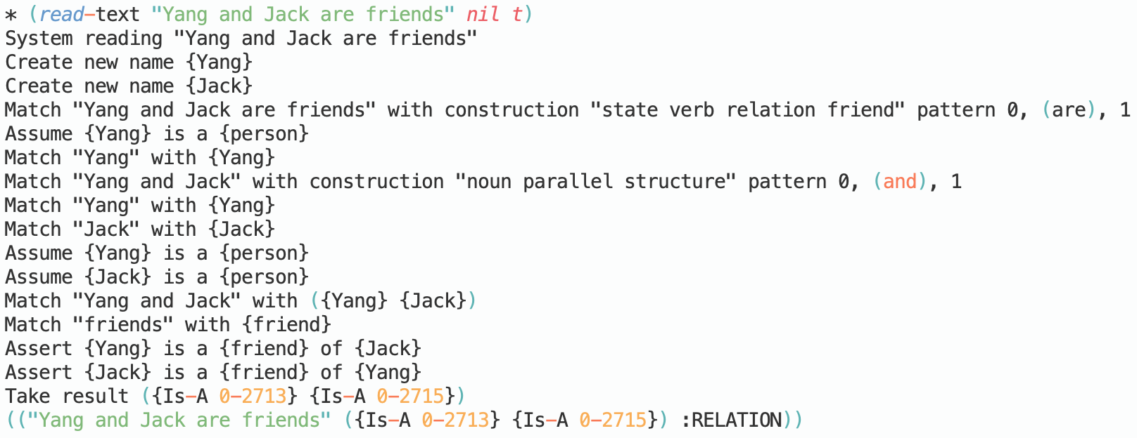
Example CxG Implementation
Static Description
Type-role description
type-role in Scone is usually used to describe “A of B”
Pattern: (?x (“are”) ?y), where ?x is a list of nouns

