Slide 1
Wumpus Explorers Game Pitch
GDM570-O Prototyping & Content Creation

Slide 2

Agenda
Concept
The X
Market
Alignment
3Ws
Risks
Organization Tools

Slide 3
Concept
Explore caves in search of lost treasure, but be fast because others are looking for the treasure

Slide 4
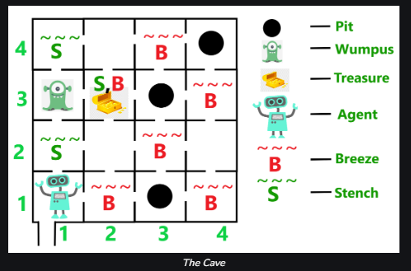
The X
Wumpus Explorers is a puzzle information game where the player must rely on various stimuli to navigate the ever-evolving terrain in the cave and obtain treasure

Slide 5
Market
James is a college student interested the AI craze and wants to put his gaming skills to the test against artificial intelligence agents competing against him.

Slide 6
Alignment
Genre: Puzzle/Information
Mood: Thrilling/Fear
Pace: Evolving based on other actors & interactions.

Slide 7
3Ws
What: Players will explore randomly generated caves composed of tiles and use stimuli to navigate around hazards.
Why: The player wants to collect the treasure before others and without dying so it can be sold for money
Where: Players are in caves exploring the terrain and looking for treasure to bring back out of the cave.

Slide 8
Risk
AI Behavior & Systems – functioning AI gives the game its pacing, otherwise it’s just a stroll in the park
Level Generation - Must work 100% of the time to have gameplay loop
Stimuli accuracy & visibility – Needs to be timed well & with correct proximity for player & AI to make well-informed decisions.

Slide 9
Organization
Stephen Main: Production, QA & Fixes
Demonte’ Taylor: Player Control Mechanics (Programming )
Jayden Patton: AI / Level Generation (Programming) & game audio
David Novotny: QA & Fixes
Chardonnay Young: Narrative, UI, and Level Design
Shelbi Short : Narrative, UI, Level Design, and programming level-specific logic

Slide 10
Tools
Unreal Engine (Engine)
Github (Source Control)
https://my.machinations.io/d/hungry-chart/b7aa4642fa6111ee900a0ad568087609 (Game Flow)

