Slide 1


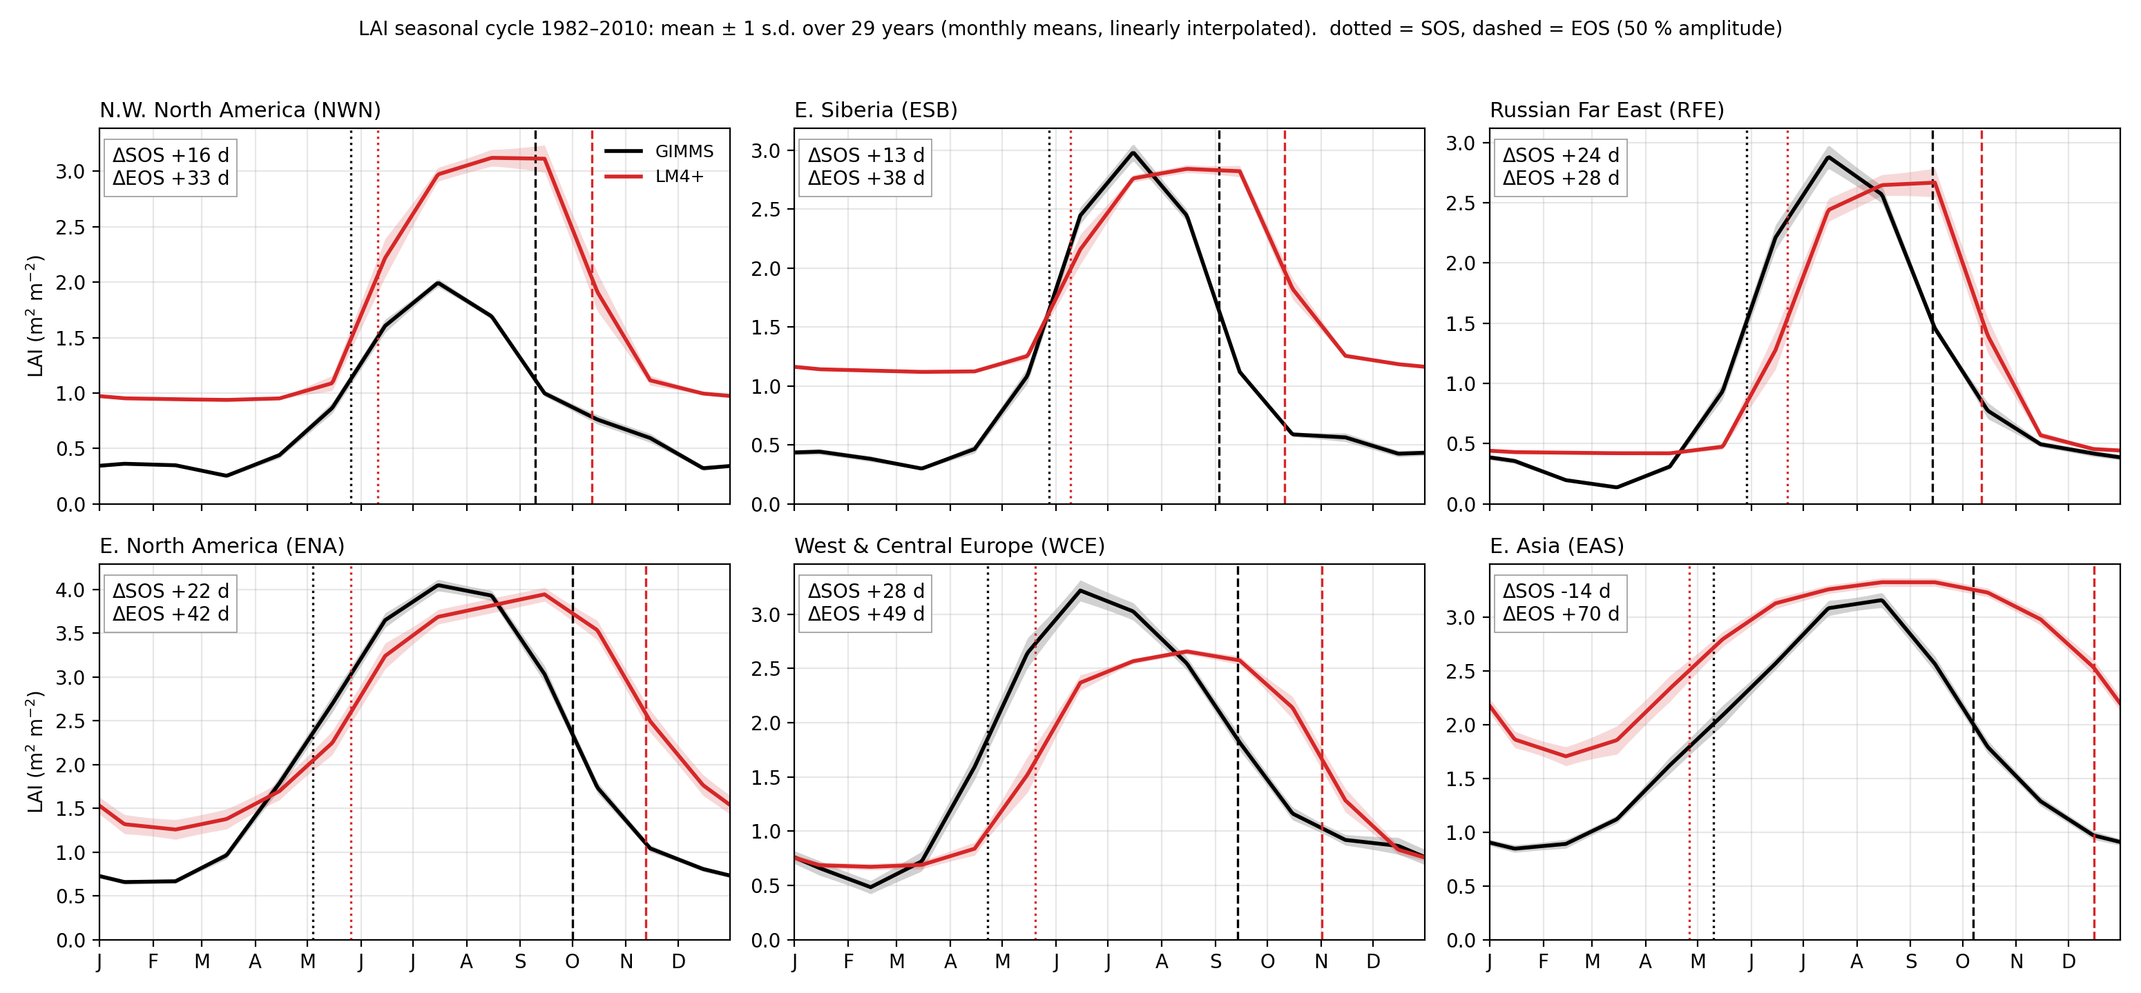
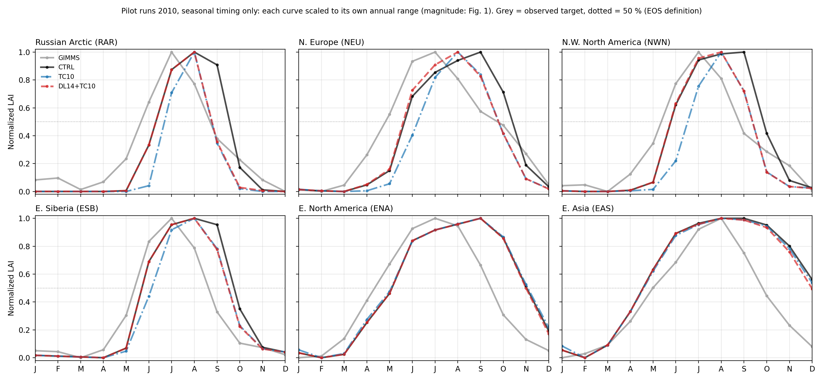

Evaluation of global leaf area index simulated by LM4+, the land component of KIOST-ESM2
ASIAN CONFERENCE on METEOROLOGY 2026
Youngdae Koh¹, Sanghyuk Park^{²,} Jee-Hoon Jeong²
¹Department of Oceanography, Chonnam National University, Gwangju, Republic of Korea
²Department of Environment and Energy, Sejong University, Seoul, Republic of Korea
Contact: youngdaekoh@gmail.com
INTRODUCTION
RESULTS 2: SEASONAL TIMING AND ITS CAUSE
Background: KIOST is developing KIOST-ESM2 for CMIP7 with GFDL's LM4+ (LM4 family) as its land component. LM4+ grows vegetation as size-structured cohorts (PPA), so leaf area, biomass and canopy structure evolve with climate.
Vegetation controls the land–atmosphere exchange of energy, water and carbon; a biased leaf area index (LAI) therefore feeds back on the coupled climate. Offline evaluation under observed forcing isolates the land model's own errors.
Key question: Does offline LM4+ reproduce the magnitude and the phenology of global LAI, and what causes the mismatch?
Objective 1: Benchmark 1982–2010 LAI against GIMMS LAI4g (pattern, magnitude, seasonal cycle).
Objective 2: Trace the autumn leaf-off delay to the phenology rule and test a day-length cue in pilot runs.
Figure 2. Climatological LAI seasonal cycle, 1982–2010, GIMMS vs LM4+ in six AR6 regions; markers: SOS/EOS at 50 % of the amplitude.
DATA & METHODS
Leaf-off (EOS) is 28–70 days too late in every region (NWN +33, ESB +38, RFE +28, ENA +42, WCE +49, EAS +70 d); boreal leaf-on is also late (+13–24 d).
Cause: leaves are dropped only when the 20-day smoothed canopy temperature falls below 5 °C (10 °C for broadleaf trees). Daily T < 5 °C is reached ≈20 d after the observed EOS and the smoothing adds ≈17 d: ESB observed 3 Sep → model 11 Oct.
The observed EOS instead clusters at a day length of 11.4–13.3 h regardless of temperature: a day-length cue is missing.
Dataset | Setup / variables | Period / resolution
LM4+ offline (KIOST-ESM2) | PPA cohorts, 6 species, fixed species map, N cycle off, CO₂ fixed | 1979–2023, C96 (≈1°) → 1°
WFDE5 forcing (Cucchi et al. 2020) | ERA5 bias-corrected with CRU/GPCC; T, q, wind, SW, LW, precip. | 1979–2023, 0.5° hourly → C96
Initial land state | KIOST-ESM2 ≈400-yr coupled piControl + 1 cycle WFDE5 1981–2010 | start 1979-01-01
GIMMS LAI4g (Cao et al. 2023) | AVHRR LAI, consolidated with MODIS | 1982–2010, 15-day 1/12° → monthly 1°
RESULTS 3: DAY-LENGTH LEAF-OFF PILOT RUNS
Evaluation: 1982–2010 monthly climatology on a common 1° grid; MJJAS mean and bias; seasonal cycles in six IPCC AR6 regions. SOS/EOS = dates at which the interpolated monthly cycle crosses 50 % of its amplitude.
Pilot runs (year 2010 from the 1 Jan 2010 CTRL state): TC10 raises the leaf-off temperature threshold 5 → 10 °C; DL14+TC10 adds a day-length (< 14 h) leaf-off condition (code patch; larch and C3 grass).
RESULTS 1: GROWING-SEASON LAI
Figure 3. Normalized 2010 LAI cycle, (LAI − min)/(max − min), in six regions: GIMMS, CTRL, TC10 and DL14+TC10.
Temperature threshold alone (TC10): the autumn drop moves little and spring leaf-on is delayed as a side effect.
DL14+TC10 removes 20–50 % of the Sep–Oct excess in boreal regions (NWN 38 %, ESB 20 %, RFE 50 %); the 50–70°N EOS bias falls from +33 to +16 d with spring unchanged.
Temperate regions are unchanged: the rule was applied only to larch and C3 grass; broadleaf trees need a ≈11.5 h cue.
Even the small TC10 shift changes Sep–Oct fluxes at 50–70°N: ET −4.5 %, GPP −11 %, runoff +4.7 %.
SUMMARY & CONCLUSIONS
Offline LM4+ reproduces the global LAI pattern but overestimates it (+41 % in MJJAS); in the extratropics the excess comes mainly from a 1–2 month delay of autumn leaf-off.
The delay follows from a temperature-only phenology rule (5 °C threshold on a 20-day smoothed temperature); observations point to day length as the missing cue.
A day-length leaf-off rule removes about half of the boreal EOS bias with no spring side effect; type-specific thresholds (larch 13.5 h, C3 grass 12.5 h, broadleaf 11.5 h) are being tested.
Next: replant species from an observed map (larch is nearly absent in the current state), time-varying CO₂ and the C–N version, then coupled KIOST-ESM2 experiments.
Figure 1. Growing-season (MJJAS) LAI, 1982–2010: (a) GIMMS LAI4g, (b) LM4+, (c) LM4+ − GIMMS. Side panels: zonal means. Polygons: the AR6 regions used in Figs. 2–3.
The large-scale pattern is reproduced, but LAI is too high almost everywhere: global MJJAS mean 2.77 vs 1.97 (+41 %); annual +54 %.
Largest excess over tropical and subtropical South America and Africa.
Boreal forest (50–70°N): the summer peak is only +15 % too high, yet the annual mean is +56 % too high — 87 % of the bias comes from the off-season (Sep–Apr). The extratropical excess is a timing problem.
REFERENCES & ACKNOWLEDGEMENTS
Cao, S., et al. (2023). ESSD, 15, 4877. • Cucchi, M., et al. (2020). ESSD, 12, 2097. • Shevliakova, E., et al. (2024). JAMES, 16. • Weng, E., et al. (2015). Biogeosciences, 12, 2655. • Iturbide, M., et al. (2020). ESSD, 12, 2959. • Zohner, C. M., et al. (2023). Science, 381, eadf5098.
Acknowledgements: This work was supported by Korea Environment Industry & Technology Institute (KEITI) through “Climate Change R&D Project for New Climate Regime.”, funded by Korea Ministry of Climate, Energy and Environment (MCEE) (RS-2022-KE002160). This research was supported by Korea Institute of Marine Science & Technology Promotion (KIMST) funded by the Ministry of Oceans and Fisheries (RS-2026-25543619).
Notes:
Poster template 90 x 140 cm (portrait). Font sizes: title 72 pt, authors 40, affiliations 30, section headers 48, body 30, captions 26, references 24. Figures: replace the dashed boxes with 300-dpi images. Logo circles: replace with university / lab logos. Print: export as PDF (File > Export) at actual size.

