Slide 1
AngularJS + Asp.Net Web Api + Signalr + EF6：前後端整合篇
開發技巧實戰系列(4/6) - Web 前後端整合
講師: 郭二文 (erhwenkuo@gmail.com)
Notes:
開發技巧實戰
1. AngularJS入門篇
2. AngularJS + HighChart：完美網頁圖表整合篇
3. AngularJS + Asp.Net WebApi 2 +SignalR：前後端整合篇
4. AngularJS + Asp.Net WebApi 2+ SignalR + Entity Framework 6 (ORM)：前後端整合篇
5. AngularJS + Asp.Net WebApi 2+ SignalR +Entity Framework 6 (ORM) + Redis (Nosql)：前後端整合篇
6. AngularJS + Asp.Net WebApi 2+ SignalR +Entity Framework 6 (ORM) + Redis (Nosql) + Elasticsearch (全文檢索)：前後端整合篇

Slide 2
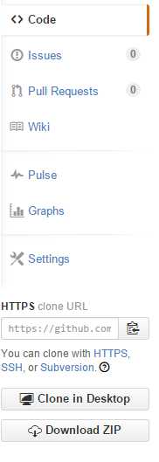
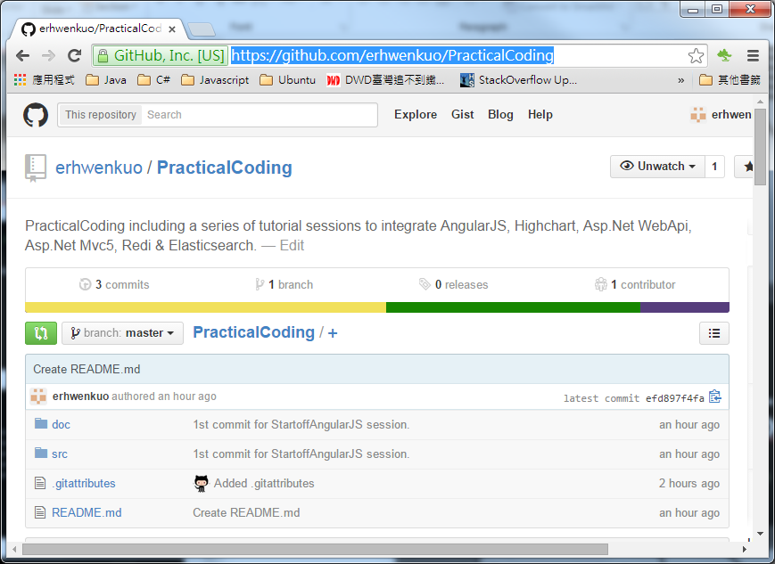

Document, Source code & Training Video (4/6)
https://github.com/erhwenkuo/PracticalCoding

Slide 3


Previous Training Session Document, Source code & Training Video (3/6)
https://www.youtube.com/watch?v=zUXYuCicBDc&feature=youtu.be
http://www.slideshare.net/erhwenkuo/03-integrate-webapisignalr
Notes:
本章節的內容會延續前一個Session的知識與內容, 如果對前一章節不熟悉的話, 可以在Yoube或Slideshare找到文件與教學錄影

Slide 4
Agenda
ORM Technologies – Basic Concepts
Entity Framework - Overview
Developing & Testing of ASP.Net EF6
Highchart , AngularJS ,Web API2 , SignalR2 + EF6 Integration

Slide 5
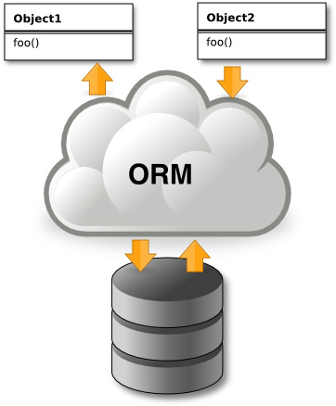
ORM Technologies – Basic Concepts

Slide 6
Introduction to Object-Relational Mapping (ORM)
Object-Relational Mapping (ORM) is a programming technique for automatic mapping and converting data
Between relational database tables and object-oriented classes and objects
ORM creates a "virtual object database“
Which can be used from within the programming language, e.g. C# or Java
ORM frameworks automate the ORM process
A.k.a. object-relational persistence frameworks

Slide 7
Functionality of ORM
ORM frameworks typically provide the following functionality:
Creating object model by database schema
Creating database schema by object model
Querying data by object-oriented API
Data manipulation operations
CRUD – create, retrieve, update, delete
ORM frameworks automatically generate SQL to perform the requested data operations

Slide 8
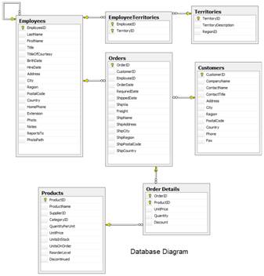
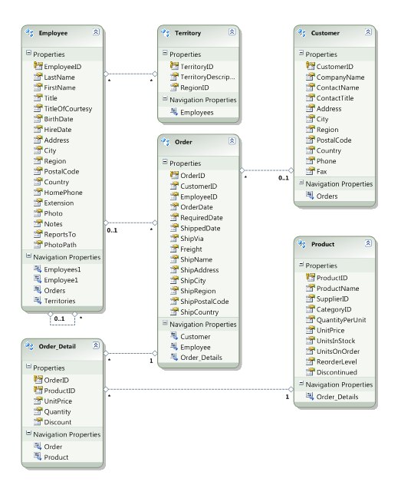




ORM Mapping - Example
Relational database schema
ORM Entities (C# Classes)
ORM
Framework

Slide 9
ORM Advantages
Developer productivity
Writing less code
Abstract from differences between object and relational world
Complexity hidden within ORM
Manageability of the CRUD operations for complex relationships
Easier maintainability

Slide 10
Entity Framework6

Slide 11
Overview of EF
Entity Framework (EF) is a standard ORM framework, part of .NET
Provides a run-time infrastructure for managing SQL-based database data as .NET objects
The relational database schema is mapped to an object model (classes and associations)
Visual Studio has built-in tools for generating Entity Framework SQL data mappings
Data mappings consist of C# classes and XML
A standard data manipulation API is provided

Slide 12
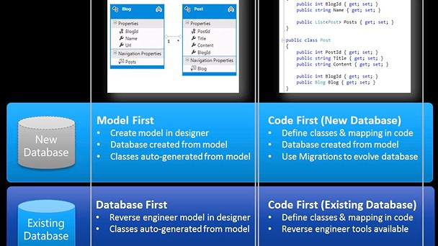
Different Ways EF Access Database

Slide 13
Developing & Testing of ASP.Net Entity Framework6

Slide 14
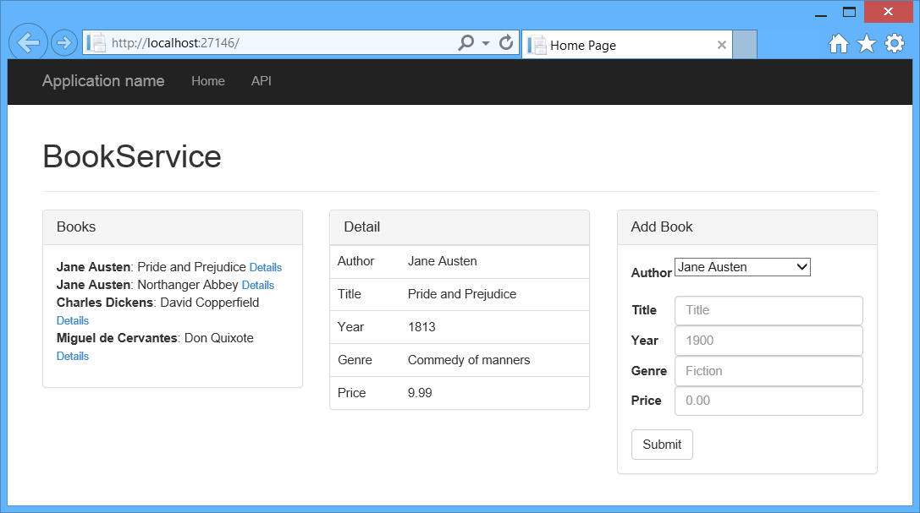
Develop WEP API with Entity Framework 6
This tutorial uses ASP.NET Web API 2 with Entity Framework 6 to create a web application that manipulates a back-end database.
“Code First” approach will be demonstrated

Slide 15
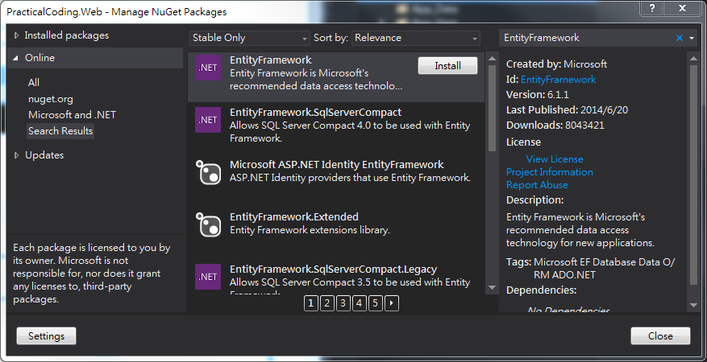
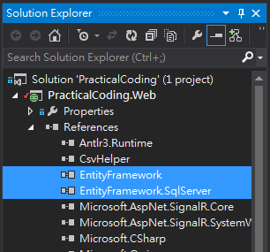
Environment Setup
Use NuGet to search “EntityFramework”
Click “Install”

Slide 16
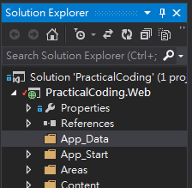
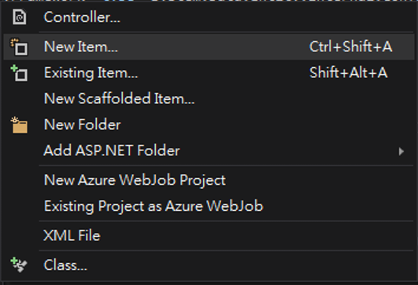

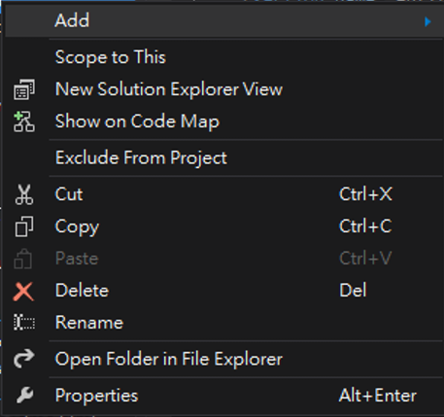
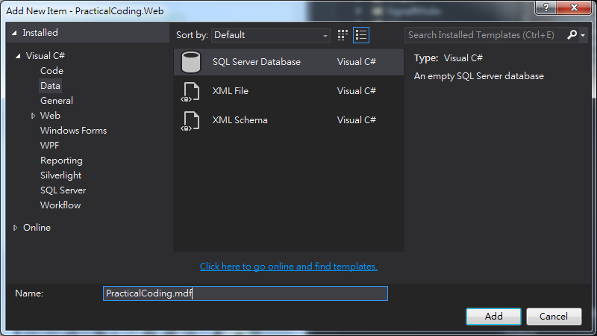

Environment Setup
Add a SQL Server Database “PracticalCoding.mdf” under “App_Data” folder

Slide 17
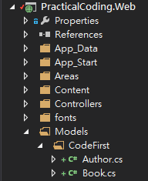
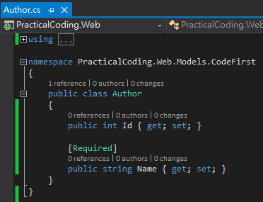
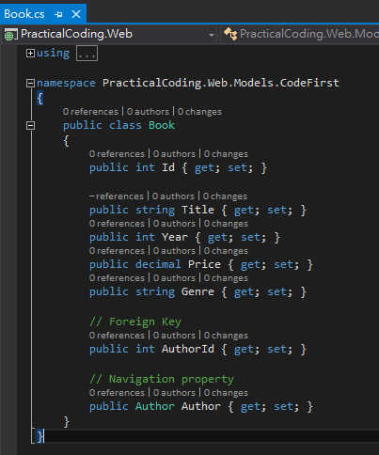
Add Models

Slide 18
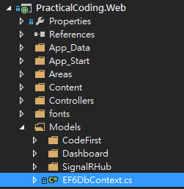
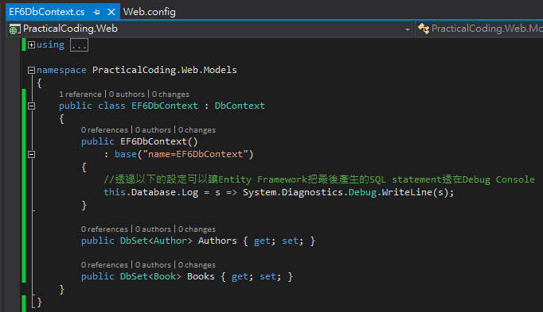
Add Entity Framework DbContext
Inheritance “DbContext”
Identify which connection setting will be used
Create “DbSet” for “Authors” & “Books”

Slide 19
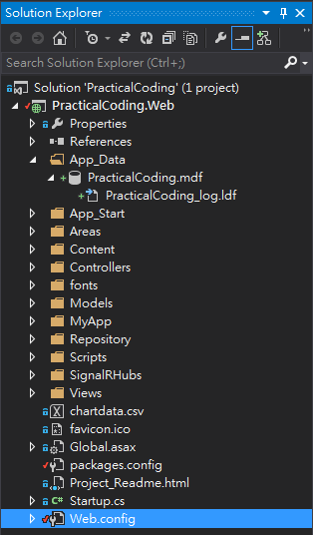
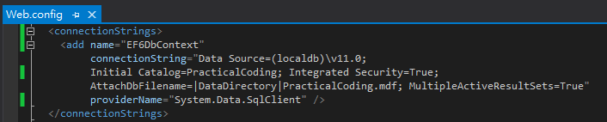
Add “ConnectionStrings” Setting
Add “connectionStrings” in “Web.config” to link “PracticalCoding.mdf” to “EF6DbContext”

Slide 20

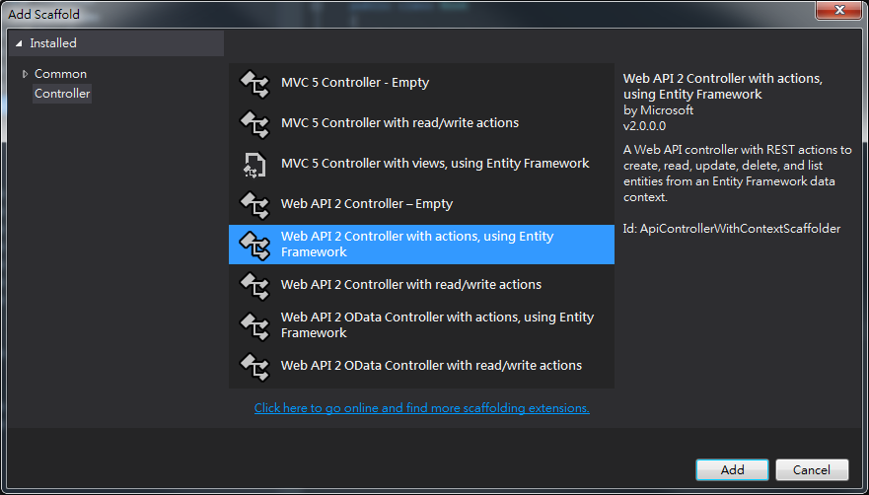
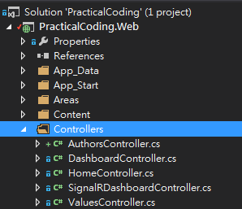
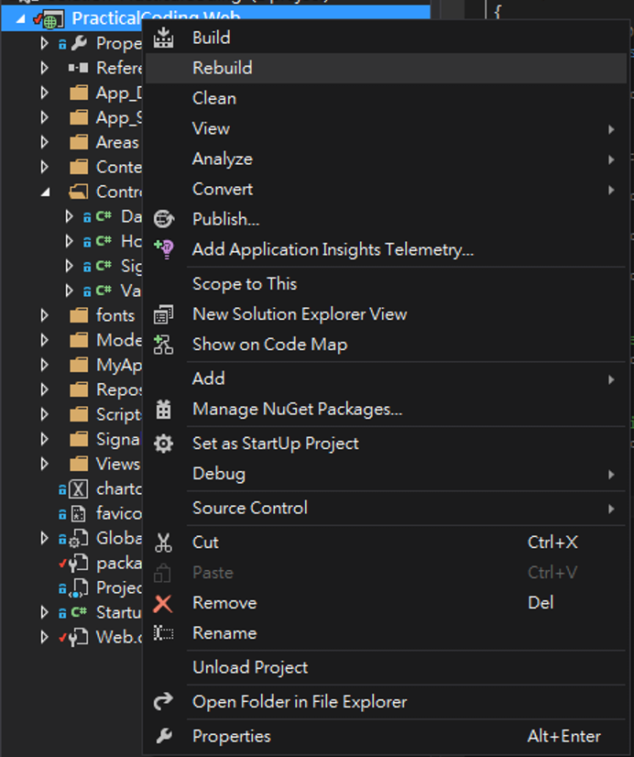
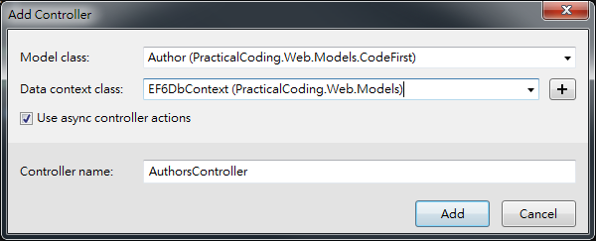
Add WebAPI Controller (Authors)
1
3
2
5
4

Slide 21
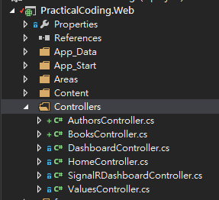
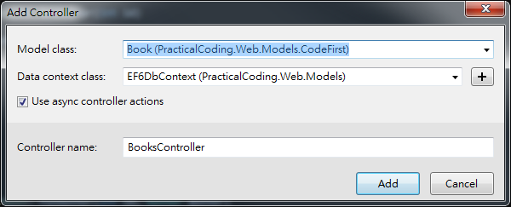
Add WebAPI Controller (Books)
1
3
5
2
4

Slide 22
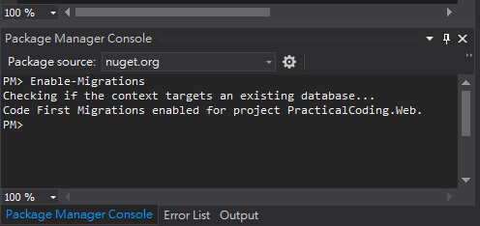
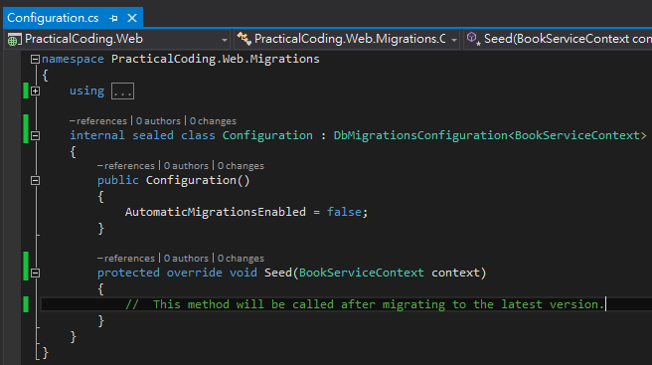
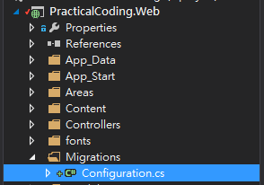
Code First - Migrations Features
“Tools” → “Library Package Manager”→”Package Manager Console”
Key in “Enable-Migrations” in “Package Manager Console”
3
1
2

Slide 23
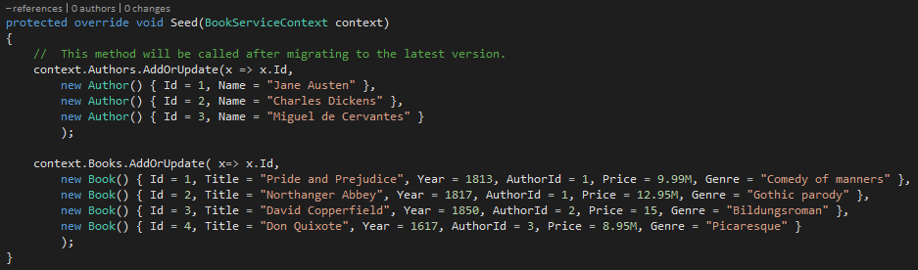
Code First – Seeding Database
Modify “Configuration.cs”
Add below code to initialize (seeding) Database

Slide 24
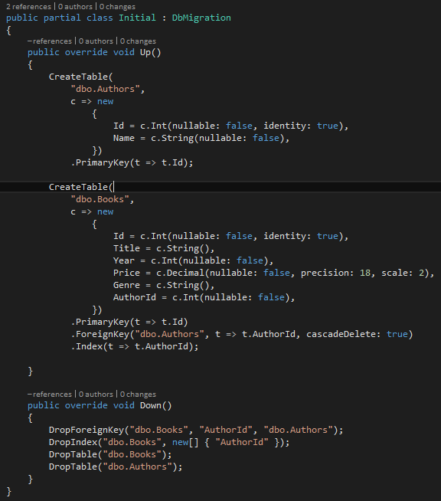
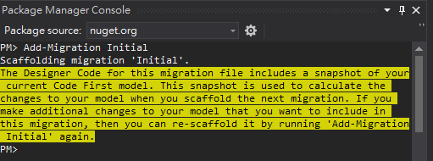
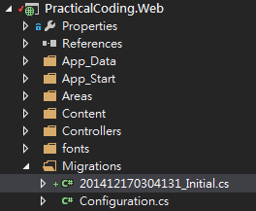
Code First - Migrations Features: Add-Migration & Update-Database
Key in “Add-Migration Initial” in “Package Manager Console” and Hit “Enter”
3
1
3
2

Slide 25
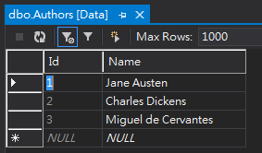
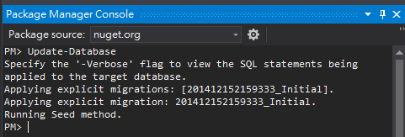
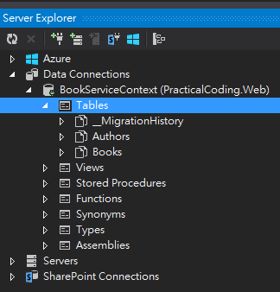
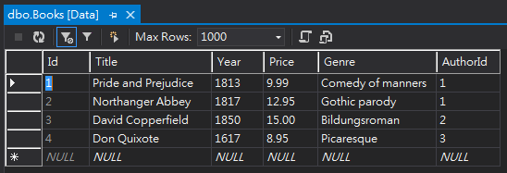
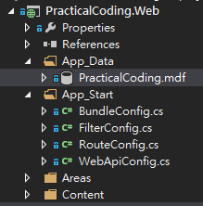
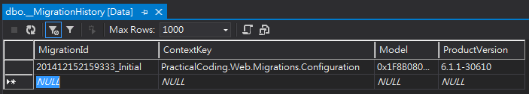
Code First - Migrations Features: Add-Migration & Update-Database
Key in “Update-Database” in “Package Manager Console”
4
1
4
3
2
4

Slide 26
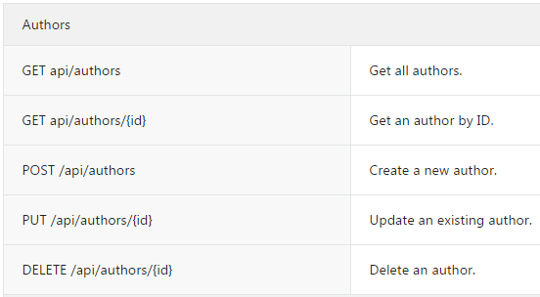
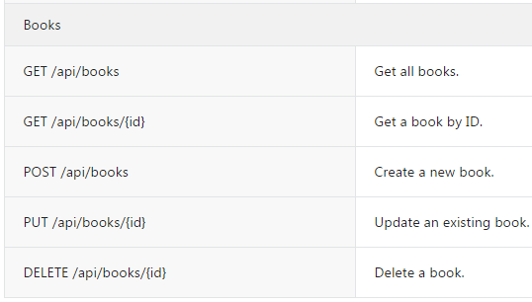
Explore & Test the Web API
Demo Page
Hit “F5” to run “PracticalCoding.Web”
Use “Fiddler2” to test below Web APIs

Slide 27
Code First – Migration Commands
Commands Reference:
http://coding.abel.nu/2012/03/ef-migrations-command-reference/#Update-Database
Most Frequent Used:
Enable-Migrations: Enables Code First Migrations in a project.
Add-Migration: Scaffolds a migration script for any pending model changes.
Update-Database: Applies any pending migrations to the database.
Get-Migrations: Displays the migrations that have been applied to the target database.

Slide 28
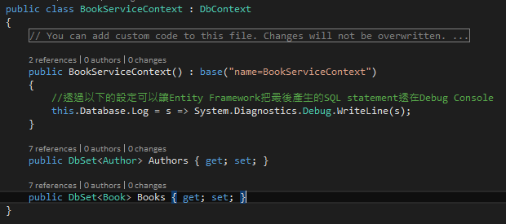
Handling Entity Relations
Eager Loading versus Lazy Loading
When using EF with a relational database, it's important to understand how EF loads related data
Enable SQL queries that EF generates & output to Debug Trace Console

Slide 29
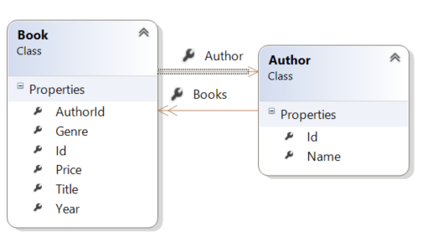
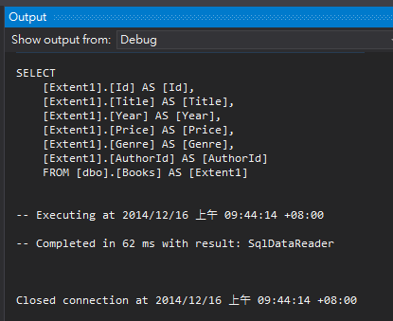
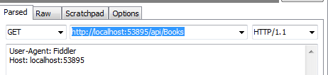
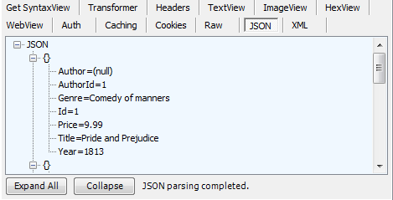
Use Fiddler2 to Get request /api/books
You can see that the Author property is null, even though the book contains a valid AuthorId
The “SELECT” statement takes from the Books tables, and does not reference Author table

Slide 30
Entity Framework Data Loading Strategy
Very important to know how Entity Framework loading related data
Eager Loading
Lazy Loading
Explicit Loading

Slide 31
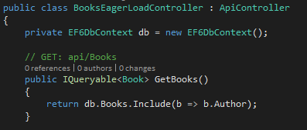
Entity Framework Data Loading Strategy (Eager Loading)
With eager loading, EF loads related entities as part of the initial database query
Copy “BooksController.cs” to “BooksEagerLoadController.cs”
To perform eager loading, use the System.Data.Entity.Include extension method as show below:
This tells EF to include the Author data in the query

Slide 32

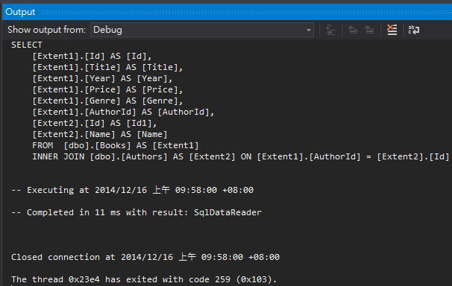
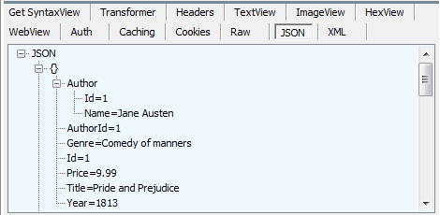
Use Fiddler2 to Get request /api/books (Eager Load)
The trace log shows that EF performed a join on the Book and Author tables.

Slide 33
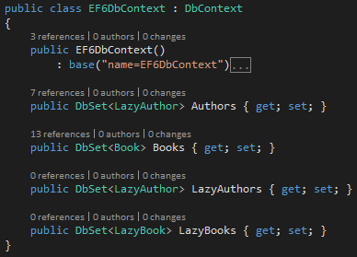


Entity Framework Data Loading Strategy (Lazy Loading)
With lazy loading, EF automatically loads a related entity when the navigation property for that entity is dereferenced.
To enable lazy loading, make the navigation property virtual. For example, in the Book class:
“virtual” tells EF to lazy load the Author property

Slide 34



Entity Framework Data Loading Strategy (Lazy Loading)
Key in “Add-Migration AddLazyAuthorBook” in “Package Manager Console”
Key in “Update-Datebase” in “Package Manager Console”
1
3
2

Slide 35



Use Fiddler2 to Get request /api/books (Lazy Load)
When lazy loading is enabled, accessing the Author property on books[0] causes EF to query the database for the author
Lazy loading requires multiple database trips, because EF sends a query each time it retrieves a related entity

Slide 36





Use Fiddler2 to Get request /api/books (Lazy Load)
The trace log shows that EF performed a join on the Book and Author tables.
3
2
1
4
6
5

Slide 37


Navigation Properties and Circular References
If there is “Circular References”, System will encounter problem while serialize the model

Slide 38


Navigation Properties and Circular References
Modify “EF6DBContext” to add DbSets for CirRefBook & CirRefAuthor
Key in “Add-Migration AddCirRefAuthorBook” in “Package Manager Console”
Key in “Update-Datebase” in “Package Manager Console”
Add New WebApi Controller “CirRefBooksNGController”

Slide 39


Navigation Properties and Circular References Unit Test with Fiddler2
Demo

Slide 40
Create Data Transfer Objects (DTOs)
Remove circular references
Hide particular properties that clients are not supposed to view.
Omit some properties in order to reduce payload size.
Flatten object graphs that contain nested objects, to make them more convenient for clients.
Avoid “over-posting” vulnerabilities.
Decouple service layer from database/data storage layer.

Slide 41


Create Data Transfer Objects (DTOs)

Slide 42


Domain Entity mapping to DTO (LINQ) – CirRefBooksLINQController.cs
Use LINQ to map from Entity to DTO Object.
It works, but … just tedious!!
POST the data via remote WebApi using angular $http service object

Slide 43




Navigation Properties and Circular References Unit Test with Fiddler2
Demo

Slide 44


Install “AutoMapper” 3rd Library
Use NuGet to search “AutoMapper”
Click “Install”

Slide 45



Domain Entity mapping to DTO (AutoMapper) – CirRefBooksController.cs
The code is much clean and programmer is happy!!
The code is much clean and easy. The programmer is happy again!!

Slide 46


Navigation Properties and Circular References Unit Test with Fiddler2
Demo

Slide 47
Highchart , AngularJS ,Web API2 , SignalR2 + Entity Framework 6 Integration

Slide 48
Integration with Entity Framework
Copy “08_AngularWithSignalR” to “09_IntegrationWithEF6 ”

Slide 49

Modify EF Context for Dashboard
Modify “EF6DbContext.cs” to add DbSet for “Chartdata” object
Create “DbSet” for “Chartdata”

Slide 50

Add Entity Framework Annotation
Modify “Models/Dashboard/Chartdata.cs” to add some EF annotation
It tell Database to automatically generate an Unique ID

Slide 51



Migration & Update Database
Key in “Add-Migration AddChartdata” in “Package Manager Console”
Key in “Update-Datebase” in “Package Manager Console”
1
3
2

Slide 52


Initial Chartdatas (Global.asax.cs)

Slide 53



Create New EF6DashboardRepo.cs

Slide 54


Switch “MemDashboardRepo” to “EF6DashboardRepo”
Copy “SignalRDashboardController.cs” to “EF6DashboardController.cs”
Switch our Repository from “Memory” to “Entity Framework”
Dispose “Entity Framework” context object to release database connection

Slide 55


Modify Our Angular “ChartDataFactory”
Switch angular $http communication end point to our new WebAPI url
Before
After

Slide 56



Integration with Entity Framework6
Demo
Select “09_Integration/index.html” and Hit “F5” to run
Open Multi-Browers to see charts reflect changes whenever C/U/D operations occurred

Slide 57

Next Session: AngularJS + Highchart + Asp.Net WebApi2 + SignalR2 + Entity Framework6 + Redis

