Slide 1
Database term project
202133829노현우, 201935114이현석,
202035381장지훈

Slide 2
index
Database
Login UI
Main UI
Following UI
Myboard UI
Changing password, logoutUI

Slide 3
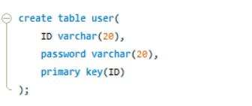
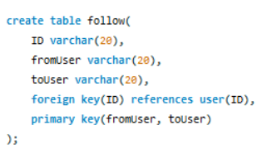
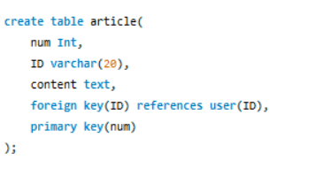
Database
In database, we have 3 tables.
User table is used for saving id and password of users.
For example,
When one person A follows B, then
(fromUser, toUser)=(A, B)
follow table is to save follow relationship.
fromUser is someone who follow other and toUser is someone who was followed by that person.
Last table is article table. Element num is to give articles registered order. And article will be listed with this num id, and article content.

Slide 4
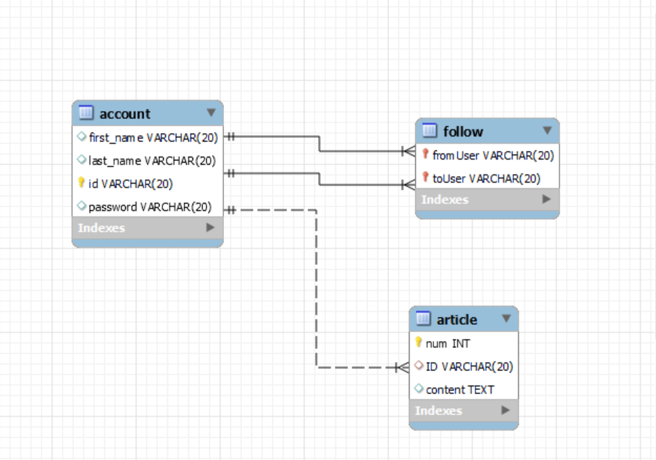
ERD

Slide 5
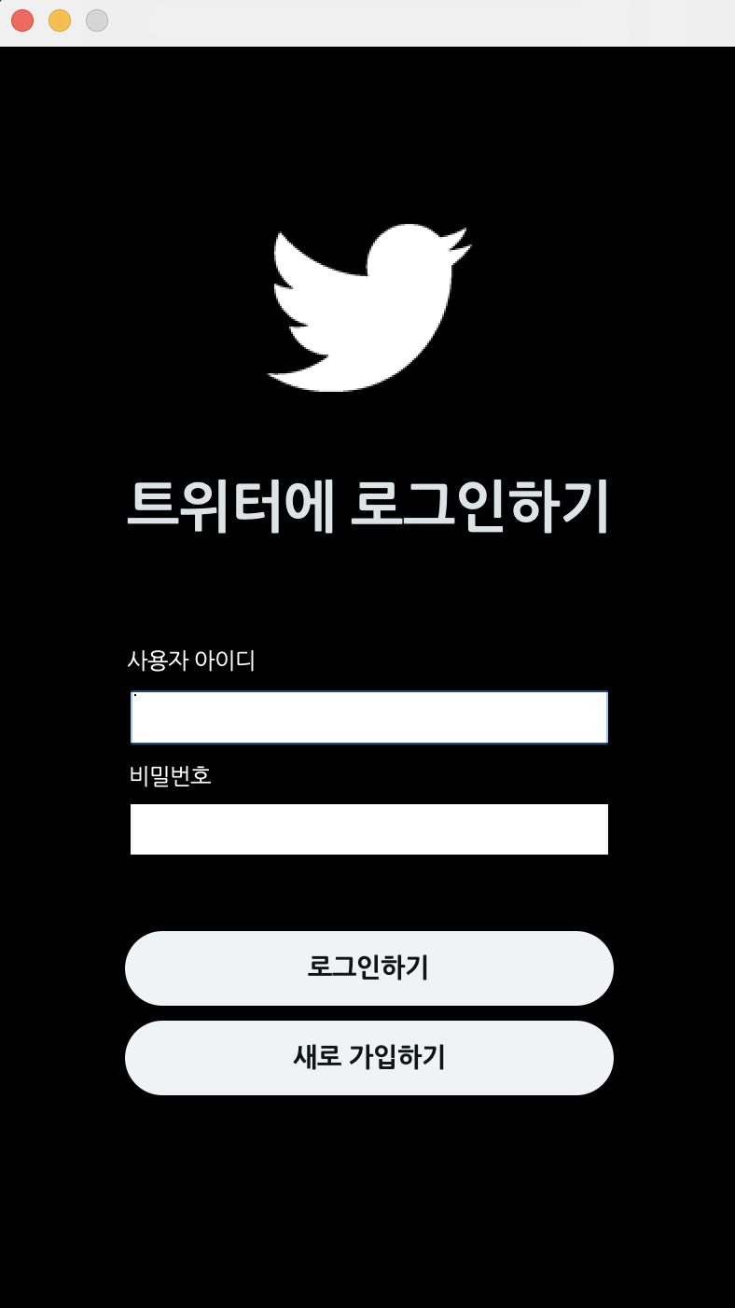

로그인 ui
If we are listed before, we can login using id and password. if user is not listed or input is wrong, then message that notices what you input is not signed is printed.
If we want to sign up we can use below button "새로 가입하기"

Slide 6
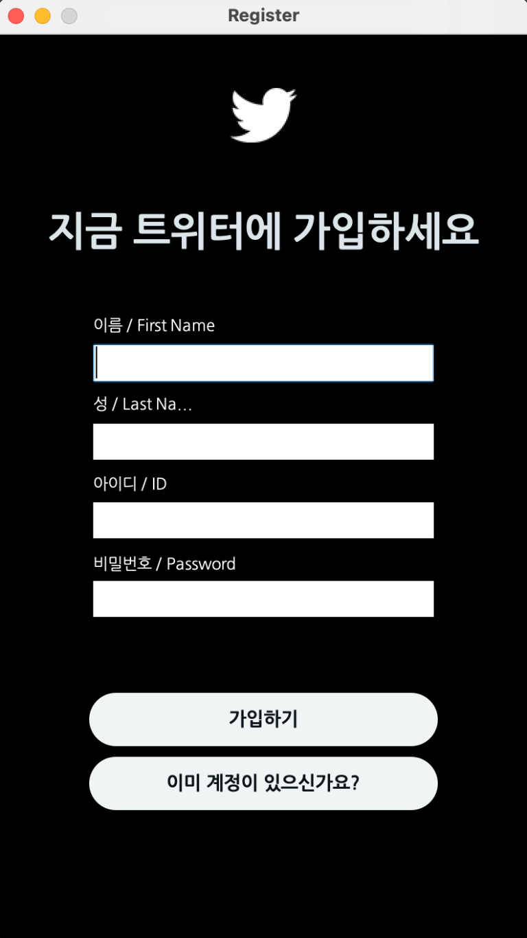
Sign up
If we click "새로 가입하기" button, then page will be changed into sign up page.
We can sign up with first name, last name, ID, and password.
ID and password should be more than or equal to 5 letters. Or it will print error message.

Slide 7
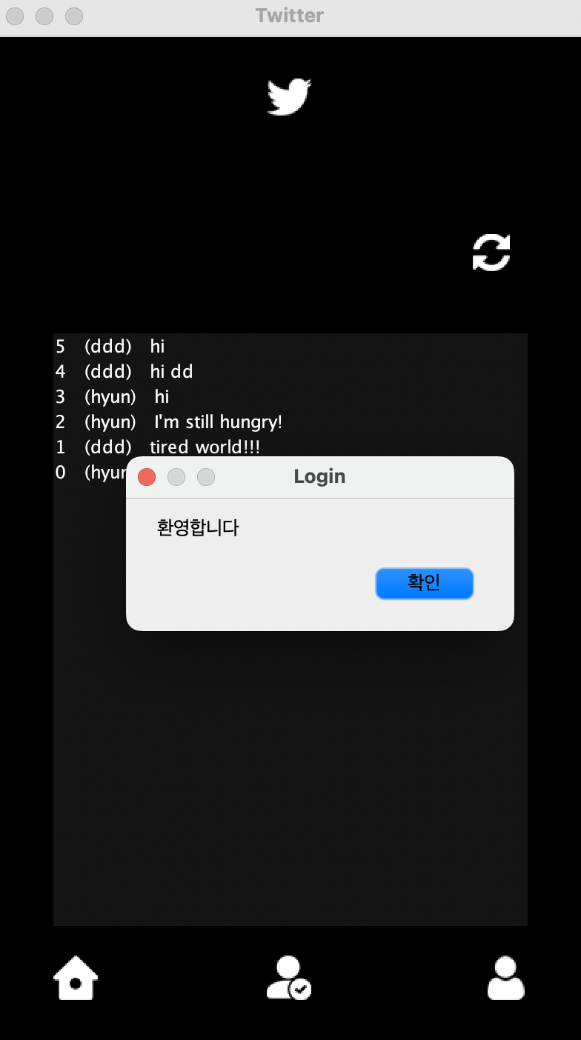
MainUI
If login succesed. Wecome message will print and we can access to the user's mainboard.

Slide 8
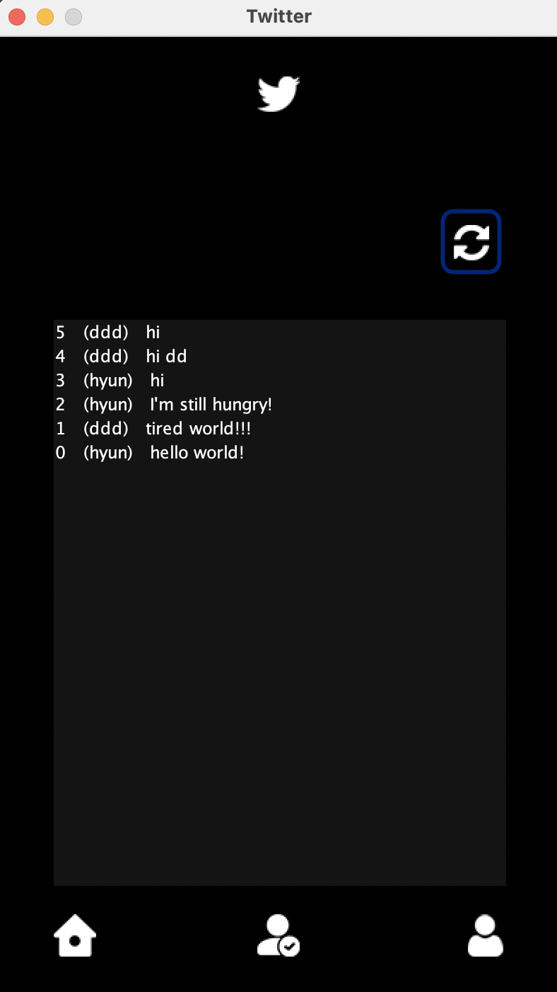




In mainUI
In center, there are articles that is listed in article table. In one article, list order, ID, and article content will be shown.
Above article, refresh button is located and by clicking this button article wil be refreshed.
Clicking right below button will load myboard page.
Clicking center below button will load follow page.
Clicking left below button will move page to this mainboard.

Slide 9
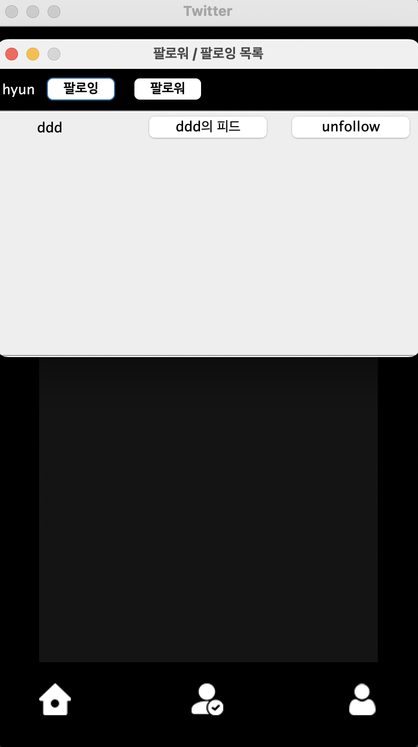
Following UI
This following page will show list of person that is registered except for my account and we can follow or see person’s information here.
We can follow person by clicking "follow" button.
Then this follow relationship will be saved into follow table that is in our database.
When clicking "follow" button, button will be changed into "unfollow" button. When we click "unfollow" button, follow relationship is removed.
Also, we can access to person's information by clicking his "xxx의 피드" button. This button will show the person's board.
"팔로잉" button will show logged in account's following list.
"팔로워"button will show logged in account's follower list.

Slide 10
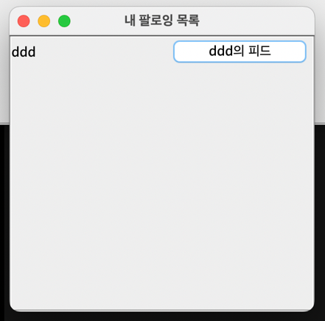
FollowUI-Following button
When clicking “팔로잉” button, logined account's following list will be shown.
In follow table, we will get list that has fromUser=name of logged in account and
Get toUser from the list to show my following.
Clicking "xxx의 피드" button is same as followingUI "xxx의 피드"button. This button will show the person's board.
Ex above) Logined account is following ddd

Slide 11
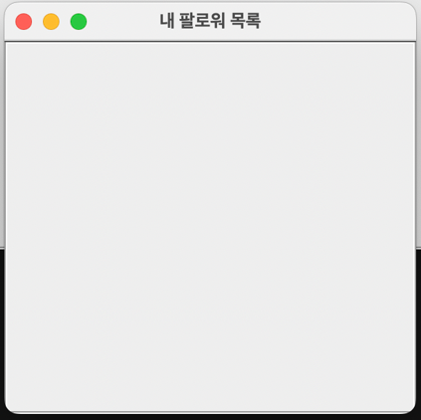
FollowUI-Follower button
When clicking follower button, logged in account's follower list will be shown.
In follow table, we will get list that has
toUser=name of logined account and
Get fromUser from the list to show my follower.
"xxx의 피드" button is shown when my follower exists.

Slide 12
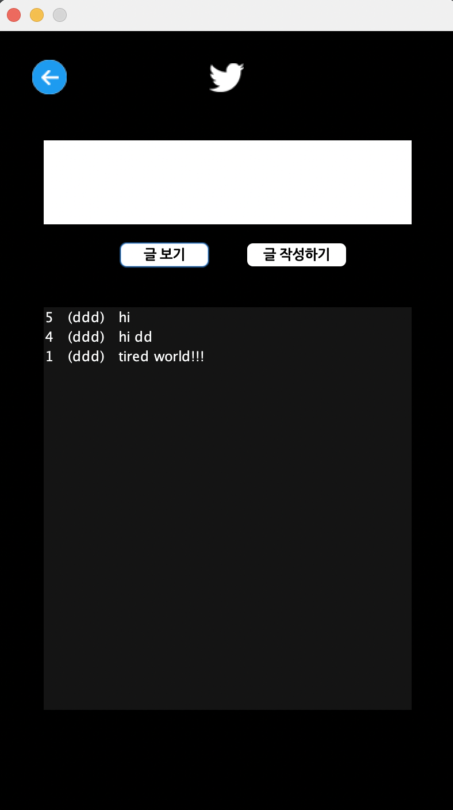
Other's board
By clicking "xxx의 피드"button, we can access to the person's board.
On board, the person's article will be listed.

Slide 13
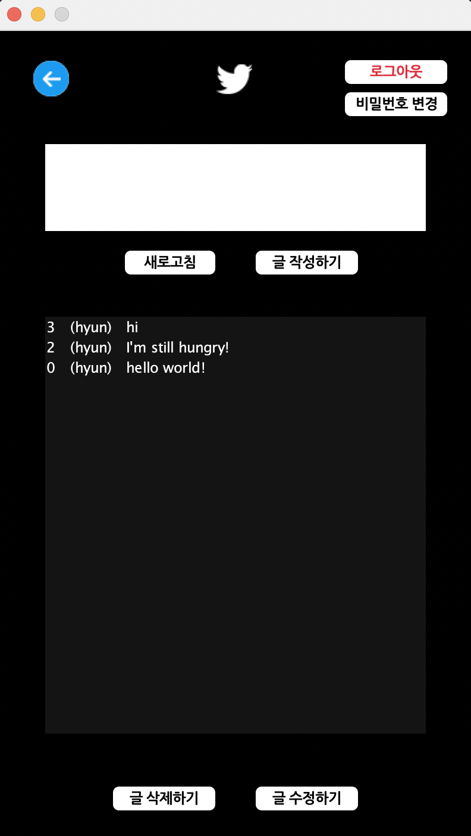
Myboard
We can post new article by writing article on above
Textfield and clicking "글 작성하기" button.
Article list of Logined account will be refreshed when
We click d button.
We can select article in shown list
And after selecting, we can delete article by clicking
"글 삭제하기" button. And also revise article clicking
"글 수정하기" button.
This change of article(posting, deleteing, reviseing) will
be saved Into table article.

Slide 14
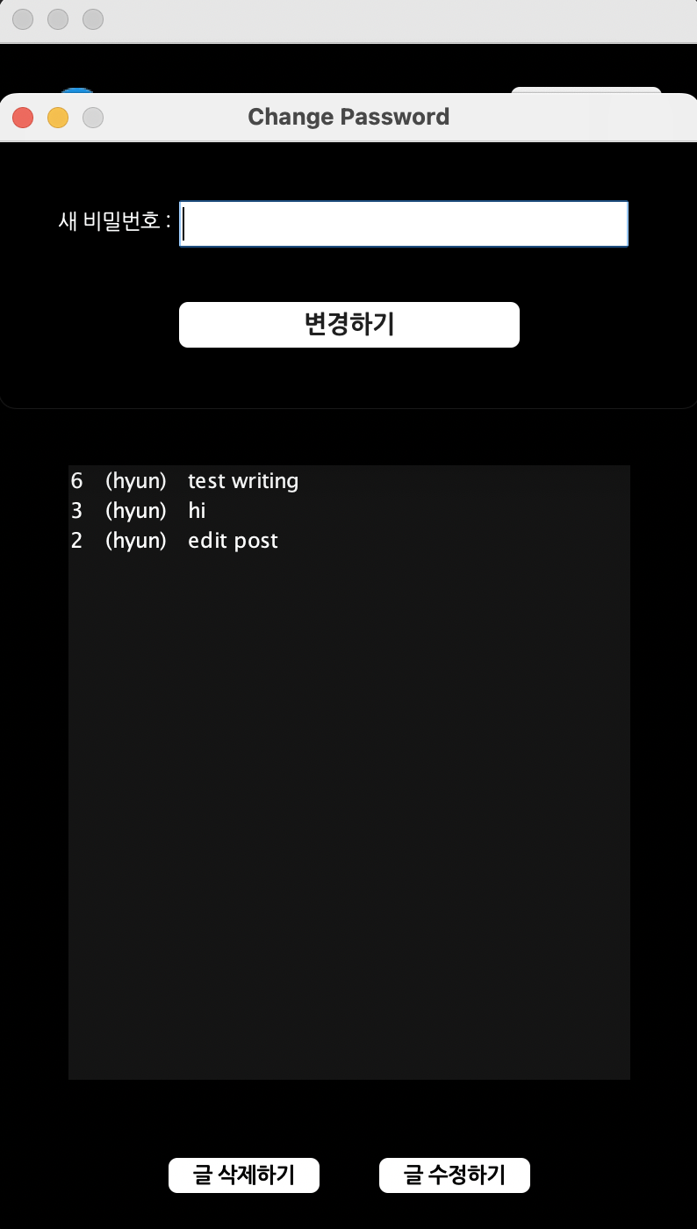
Change password
When we click button in myboard, change password screen will be shown.
When we input new password in passwordfield and click "변경하기" button, password change and
It will be stored in password of logined account in user table.

Slide 15
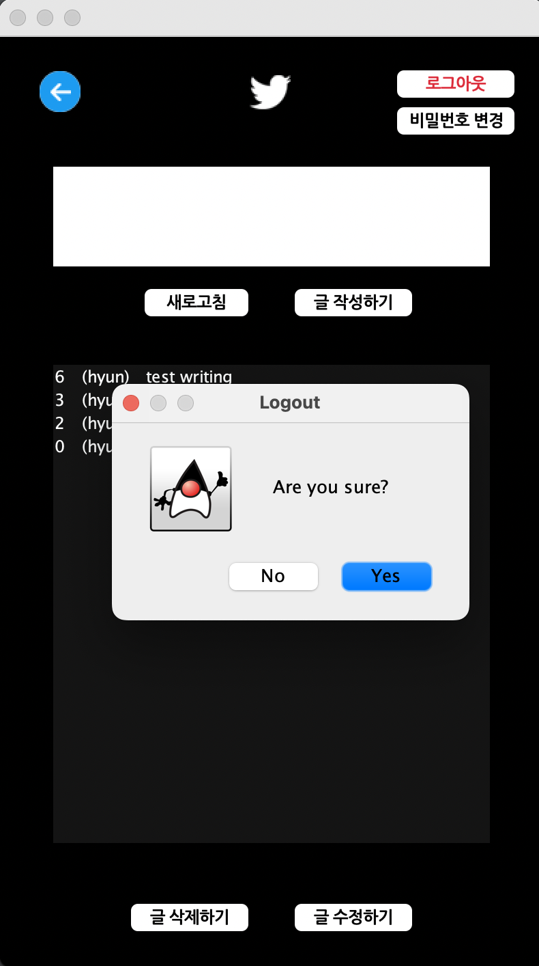
logout
When we click "로그아웃" button, new screen will display message that confirm logout again.
After clicking yes button,it will logout logged in account and
Make screen go back to loginUI.

Slide 16
Participation rate
노현우
이현석
장지훈 <=20

