Slide 1
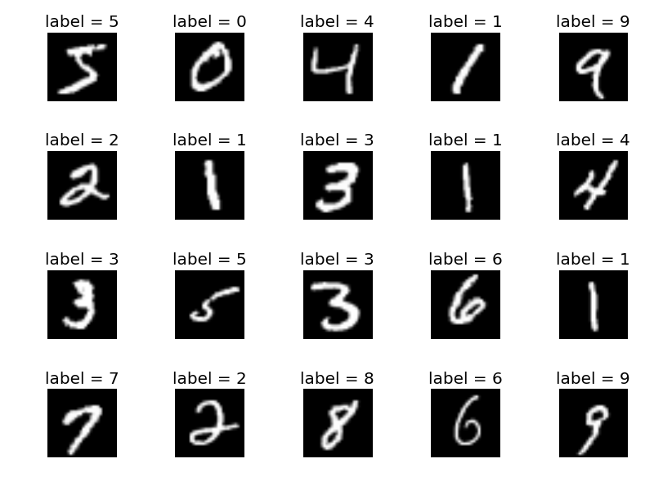
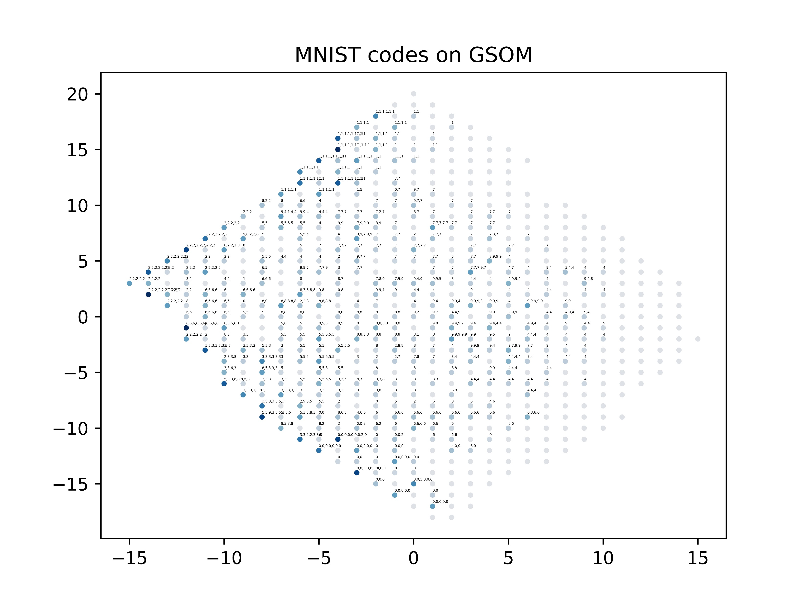
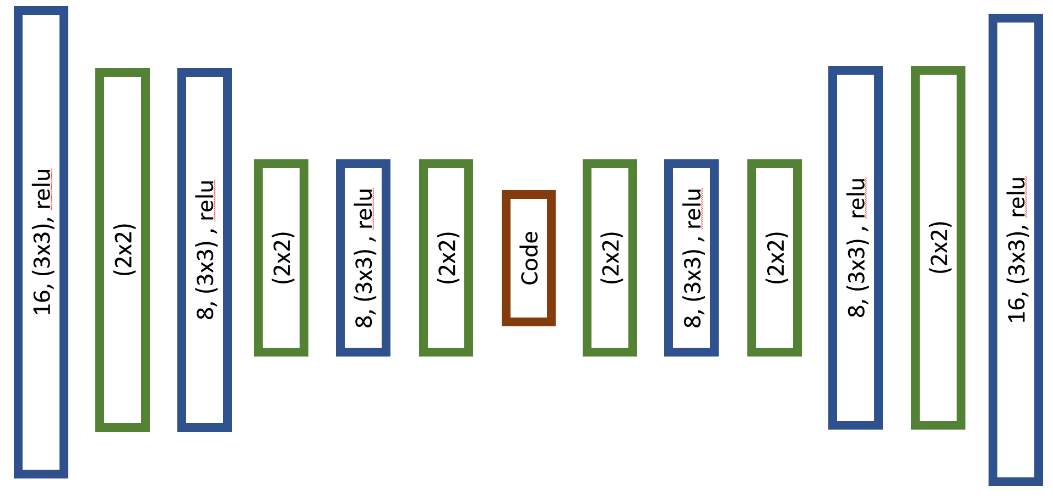
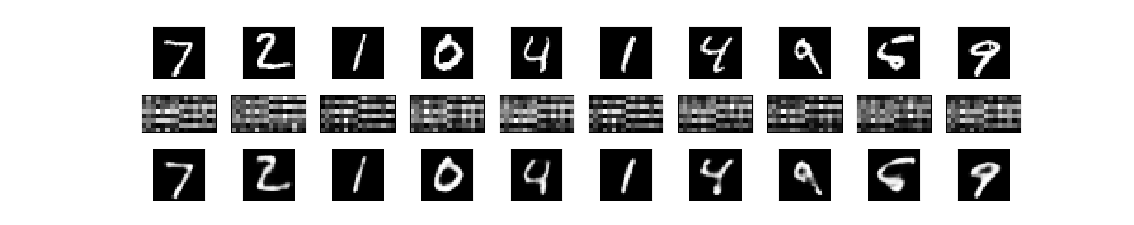
MNIST Experiment on GSOM with ConvAE code

Slide 2
Conv 2D
MaxPool
Conv 2D
MaxPool
Conv 2D
MaxPool
MaxPool
Conv 2D
MaxPool
Conv 2D
MaxPool
Conv 2D
16, (3x3), relu
16, (3x3), relu
(2x2)
8, (3x3) , relu
8, (3x3) , relu
(2x2)
(2x2)
8, (3x3) , relu
(2x2)
(2x2)
8, (3x3) , relu
(2x2)
Code
px: 28x28 (728)
Encoder
px: 8 x 16 (128)
Decoder
px: 28x28 (728)

Slide 3
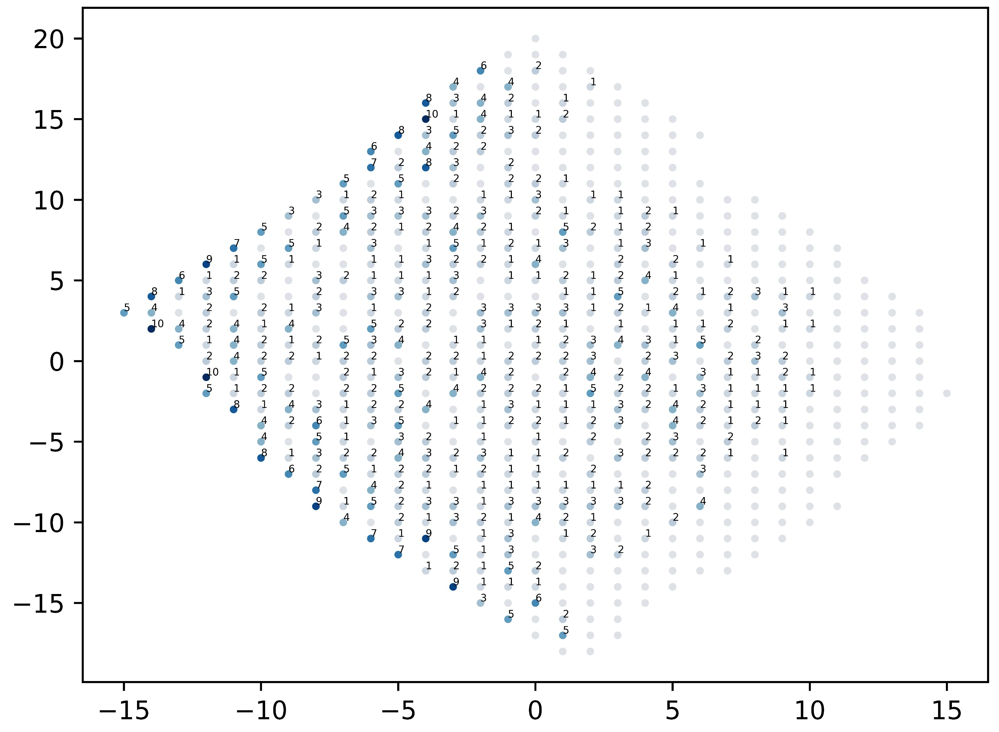
MNIST Coded (128x1000) – GSOM, SF=0.3
Node-map Tested
Hit-count intensity

Slide 4
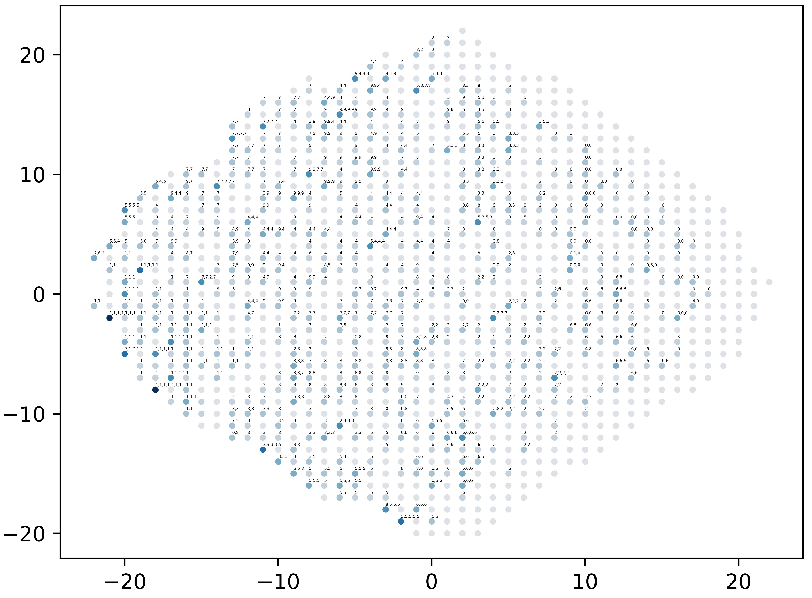
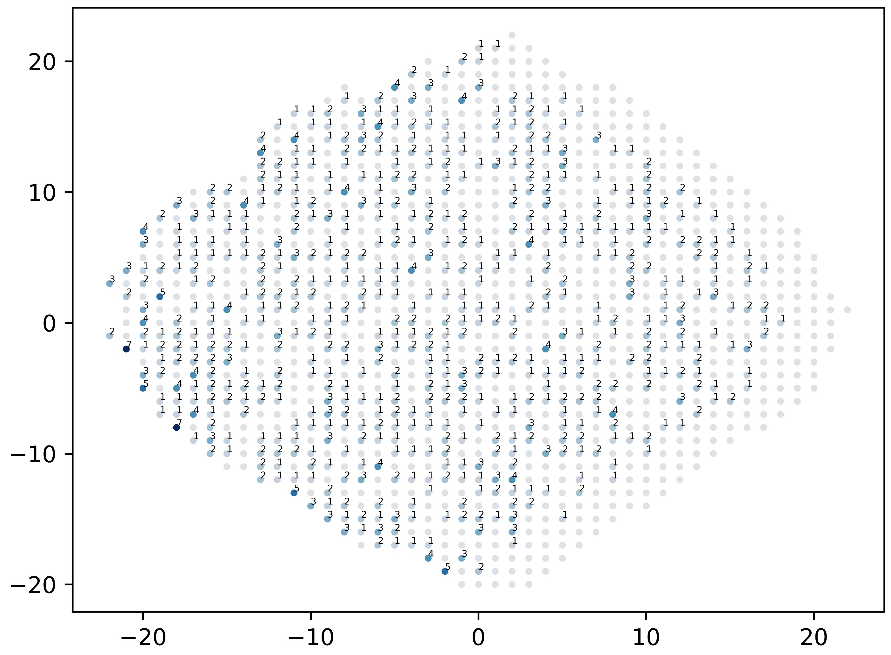
MNIST Coded (128x1000) – GSOM, SF=0.83
Node-map Tested
Hit-count intensity

Slide 5
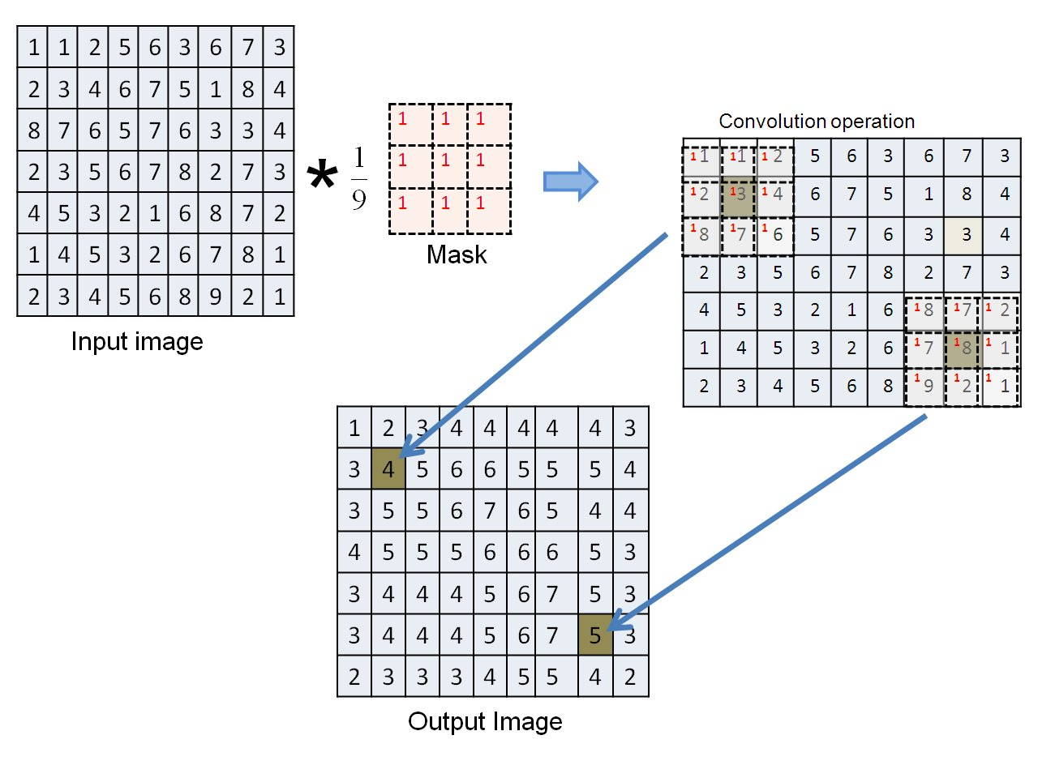
Convolution layer:
Convolutional layers apply a convolution operation to the input, passing the result to the next layer.

Slide 6
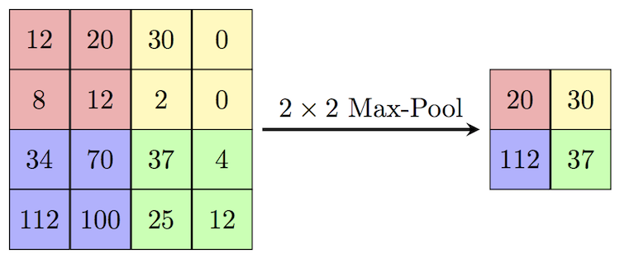
Pooling Layer:
Convolutional networks may include local or global pooling layers, which combine the outputs of neuron clusters at one layer into a single neuron in the next layer. For example, max pooling uses the maximum value from each of a cluster of neurons at the prior layer. Another example is average pooling, which uses the average value from each of a cluster of neurons at the prior layer.

