Slide 1
Playing Text-Adventure Games with Graph-Based Deep Reinforcement Learning (Ammanabrolu and Riedl, 2019)

Slide 2
Basic Approach
Q&A approach is adopted for the task
State is represented in the form of a knowledge graph
Such representation is effectively used to reduce an action space
The knowledge graph provides a persistent memory of the world over time
DQN method is combined with the knowledge graph (KG-DQN)

Slide 3
Knowledge Graph Representation
The agent learns a set of triples, <subject, relation, object>
These triples are extracted from the observations using Stanford’s Open Information Extraction (OpenIE)
The knowledge graph is updated after every agent action
A special node—designated “you”—represents the agent

Slide 4
KG representation example

Slide 5
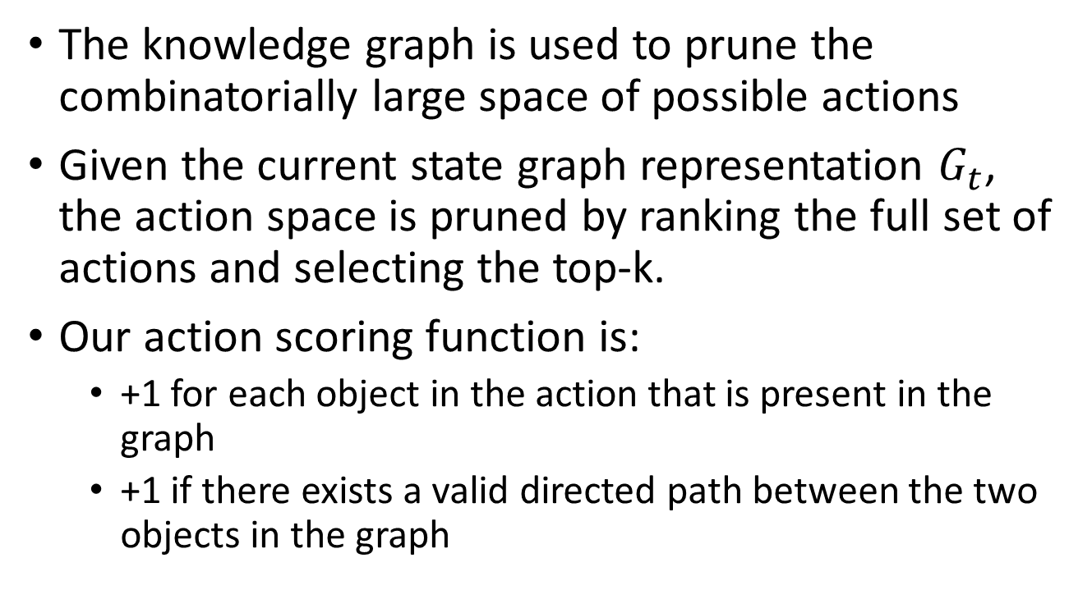
Action pruning
The knowledge graph is used to prune the combinatorially large space of possible actions
Given the current state graph representation $G_{t}$, the action space is pruned by ranking the full set of actions and selecting the top-k.
Our action scoring function is:
+1 for each object in the action that is present in the graph
+1 if there exists a valid directed path between the two objects in the graph

Slide 6
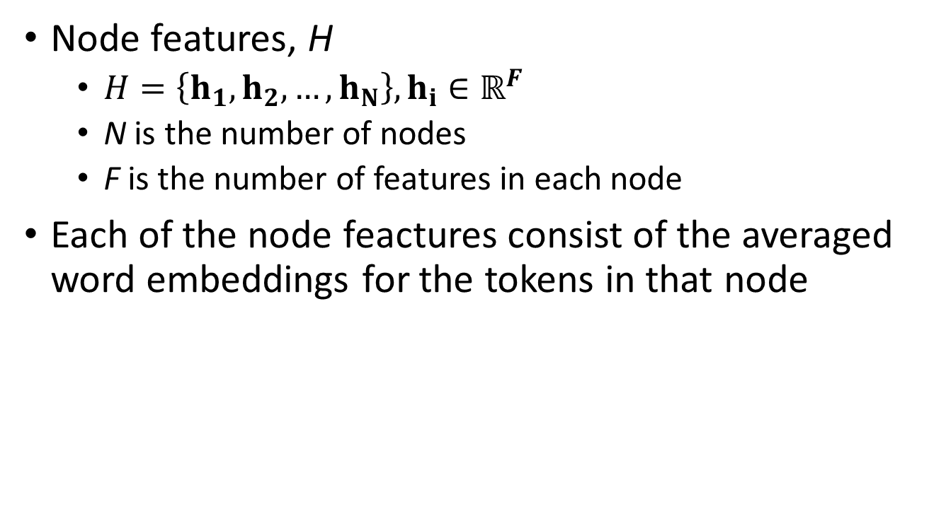
Node features
Node features, H
$H=\left\{h_{1},h_{2},…, h_{N}\right\}, h_{i}∈ℝ^{F}$
N is the number of nodes
F is the number of features in each node
Each of the node feactures consist of the averaged word embeddings for the tokens in that node

Slide 7
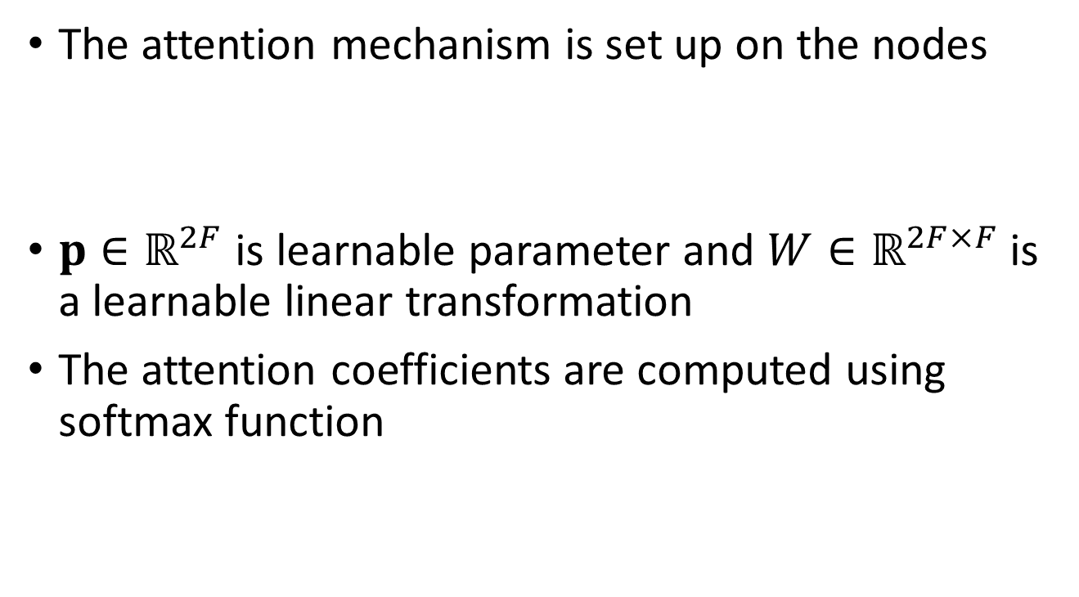
Graph attention weights
The attention mechanism is set up on the nodes
$p∈ℝ^{2F}$ is learnable parameter and $W∈ℝ^{2F×F}$ is a learnable linear transformation
The attention coefficients are computed using softmax function

Slide 8
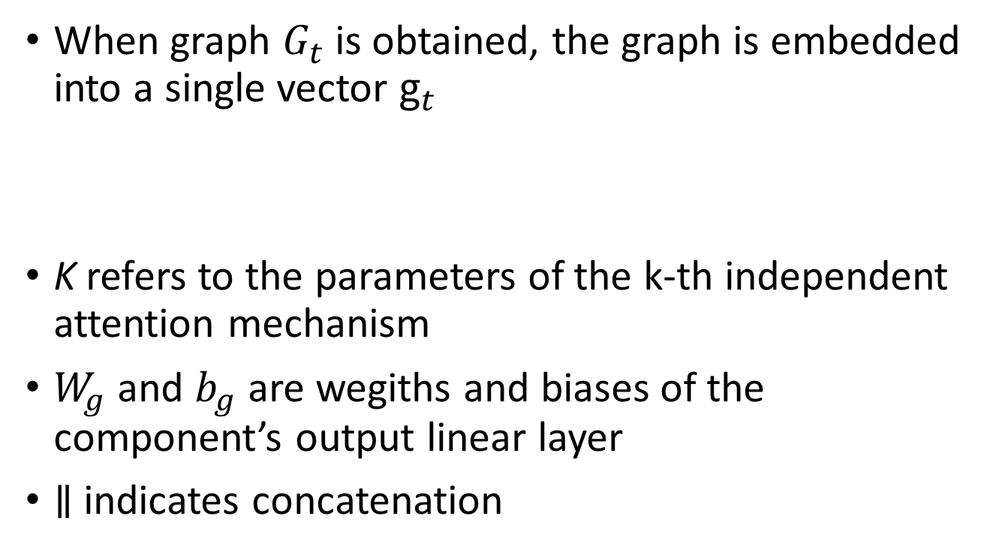
Graph attention embedding
When graph $G_{t}$ is obtained, the graph is embedded into a single vector $g_{t}$
K refers to the parameters of the k-th independent attention mechanism
$W_{g}$ and $b_{g}$ are wegiths and biases of the component’s output linear layer
$∥$ indicates concatenation

Slide 9
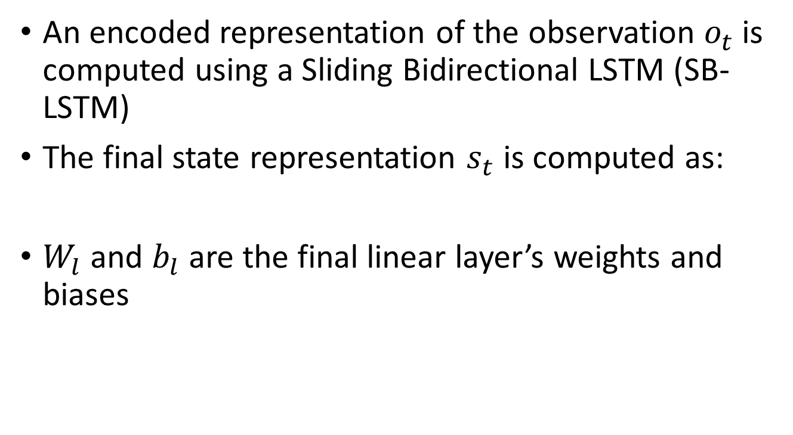
State representation
An encoded representation of the observation $o_{t}$ is computed using a Sliding Bidirectional LSTM (SB-LSTM)
The final state representation $s_{t}$ is computed as:
$W_{l}$ and $b_{l}$ are the final linear layer’s weights and biases

Slide 10
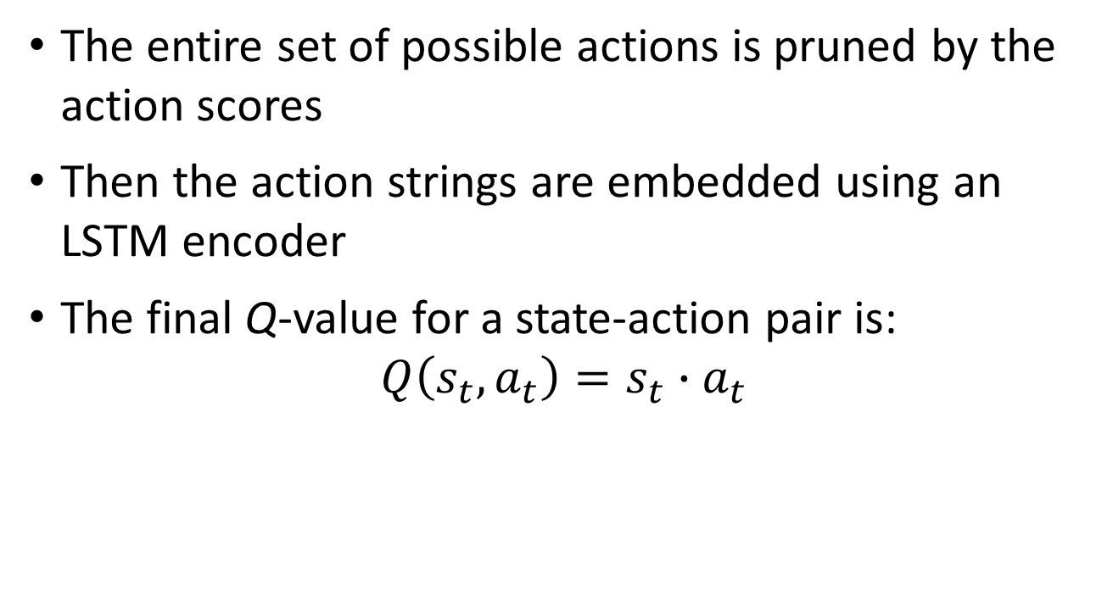
Action selection
The entire set of possible actions is pruned by the action scores
Then the action strings are embedded using an LSTM encoder
The final Q-value for a state-action pair is:
$$Q\left(s_{t},a_{t}\right)=s_{t}∙a_{t}$$

Slide 11
KG-DQN architecture
Blue shading indicates components that can be pre-trained and red indicates no pre-training. The solid lines indicate gradient flow for learnable components

Slide 12
Experiment environment
Games are generated with TextWorld
Agents are not allowed to access initial instructions
Two sets of games

Slide 13
Pre-training using Q&A library
Usesd DrQA method (Chen et al., 2017) to train a paired question encoder and an answer encoder
The weigths from the encoder in the DrQA system are used to initialize the weights of the SB-LSTM of the proposed system
DrQA embedding layers are initialized with GloVe

Slide 14
Experiment conditions
Three Baseline conditions
Random command selection from admissible actions
LSTM-DQN
Bag-of-Words DQN
Three versions of KG-DQN
Un-pruned actions with pre-training
Pruned actions without pre-training
Pruned actions with pre-training (full)

Slide 15
Experiment results (small)

Slide 16
Experiment results (large)

Slide 17
Summary of the results
On small and large maps, all versions of KG-DQN converged faster than baselines
KG-DQN converges 40% faster than baseline on the small game
The KG is the main factor helping convergence time
The ablated versions of KG-DQN require many more steps to complete quests

