Slide 1
Architecture of IoT Platform
2015.06.26.
Team 5

Slide 2
Agenda
Project Context
Architectural Driver
System Context
Architectural Design
Detail Design
Test
Project plan & Time log

Slide 3
Project Context
Business Context
Strategy
Building “IoT Ecosystem Infrastructure” to provide benefits to stakeholders.
. Easy installation for IoT nodes
. Utilizing cost competitive IoT products
Future direction
Provide a standard framework to facilitate 3rd party application development
Support future data mining & analysis
Profit Model
Receive fee from the app. developer according to their permission of access level
The expansion of ecosystem brings more profits
Market Context
Time to market
This product should be developed and delivered within 5 weeks.

Slide 4
Project Context
Technical Context
Should support machine-to-person interaction model(M2P) and machine-to-machine(M2M) interaction models.
The system has to support IoT nodes at least 10 years.
Privacy and security are required considerations for IoT Environment
System should make it easy to add emerging protocols.
Elements | Terminal | System | SA Node
Device Type | Mobile and PC | Server (PC) | Sensor, Actuator
Language | Java | Java | Arduino Language
Development Tools | Eclipse IDE | Eclipse IDE | Arduino IDE

Slide 5
Project Context
Organizational Context
The team is composed with 6 members
Design : all together
Test and verification : each member who developed the component will do unit test and verification
Integration test : all together
Responsibility
Organizational Culture
Members will be responsible and accountable for their individual area.
Stand-up meeting at each day before starting work.
Facilitate collaboration and team building through group lunch approach.
Work 5 days a week for 5 weeks
Management
Jongsoo Oh
Architectural Design
Architectural Design
Developer(Server)
Developer(Node)
Developer(Terminal)
Jinsuk Oh
Hoejung Yun
Youngsoo Choi
Sangjun Jung
Swapan Pati

Slide 6
Architectural Driver
Functional Requirement (1/2)
ID | Requirement | Description
R-01 | Control SA Nodes | Users can determine the temperature/humidity, turn on and off lights, open and close the door, turn on the alarm, and determine if anyone is home.
R-02 | Give the information about installed Nodes and sensors/actuators | User can get the information how many nodes are installed at the system and what sensors/actuators are installed on each node.
R-03 | Store the sensor value of node | System should store sensor values.
R-04 | Store log for user commands | System should log all user commands.
R-05 | Review stored data | User should review their sensor and command history.
R-06 | Send emergency message | The system should send an emergency message when the door is manually opened while alarmed or the house is suddenly occupied while alarmed.
R-07 | Disable door opening automatically | The system should not allow automatic door opening while the house is alarmed. The alarm must be disabled prior to opening the door.

Slide 7
Architectural Driver
Functional Requirement (2/2)
ID | Requirement | Description
R-08 | Support alarm message | The system should send a message to the user to inform them when the house is vacant and not alarmed.
R-09 | Ask for alarming home | When the house is vacant and not alarmed the system should ask users if they want to alarm the home.
R-10 | Locking automatically | When the house is vacant and not alarmed and the user do not respond within 5 minutes, the house will lock itself and close the door if opened.
R-11 | Automatically turn off the light | The system should automatically turn off the lights when no one is home and 10 minutes elapses.
R-12 | Add/Remove SA Node | Users can add and remove nodes the system without having to restart the system or other nodes

Slide 8
Architectural Driver
Quality Attribute
ID | Priority | Description | Attribute
QA-01 | High | Installer can add and remove nodes to the system easily. | Usability
QA-02 | Medium | System will be available always to do any IoT Based Operations | Availability
QA-03 | High | Do not allow unauthorized persons to register a sensor | Security
QA-04 | Medium | Only the authorized person can access the home sensors/actuators or access any data generated by them, or any data stored in the system. | Security
QA-05 | Low | The system should store sensor values and log all user commands for some period of time | Reliability
QA-06 | High | The system should make it easy for application developers | Extensibility
QA-07 | Medium | The system should make it easy to add emerging protocols | Modifiability

Slide 9
Architectural Driver
Quality Attribute Scenario
ID | QA-01
Scenario | Installer can add and remove nodes to the system easily
Raw quality attribute | Usability
Stimulus | Add/Remove Node to/from the System(Server)
Source(s) of the stimulus | Node
Relevant environmental conditions | The System(Server) shall be always online
Architectural elements | System(Server)
System response | The SA Node list of the System(Server) has to be updated by Add/Remove Node Operation
Response measure(s) | Node should be Added/Deleted to/from the System(Server) without System(Server) restart

Slide 10
Architectural Driver
Quality Attribute Scenario
ID | QA-02
Scenario | System(Server) will be available always to do any IoT Based Operations
Raw quality attribute | Availability
Stimulus | Add/Remove Node to/from the System(Server) Terminal access to the Server
Source(s) of the stimulus | system(Server)
Relevant environmental conditions | The System(Server) shall be always online
Architectural elements | Terminal, System(Server) & Node
System response | Server Fault Detection & Recover the Server with Auto-Recovery
Response measure(s) | Server Shouldn’t be restarted & be available online 99.99%. Processing should be resume within 30 Sec.

Slide 11
Architectural Driver
Quality Attribute Scenario
ID | QA-03
Scenario | Do not allow unauthorized persons to register a sensor that they do not own (think of the apartment case where a neighbor might be able to “see” your sensor).
Raw quality attribute | Security
Stimulus | Request for registration SA nodes
Source(s) of the stimulus | Unauthorized person
Relevant environmental conditions | The system and SA nodes are working properly.
Architectural elements | The system and SA nodes
System response | SA nodes should NOT be registered and request should be denied.
Response measure(s) | Denial for registration SA nodes by unauthorized person SHOULD be guaranteed.

Slide 12
Architectural Driver
Quality Attribute Scenario
ID | QA-04
Scenario | Only the authorized person(Terminal) can access the home sensors/actuators or access any data generated by them, or any data stored in the system
Raw quality attribute | Security
Stimulus | Access the Node or data in the System(Server)
Source(s) of the stimulus | Terminal
Relevant environmental conditions | System(Server) should give the access only the Authorized Terminal & work properly
Architectural elements | Terminal , System(Server)
System response | System gives the access permission to the user for sensors/actuators
Response measure(s) | Authorized User(Terminal) can access the sensors/actuators or data in the System(Server)

Slide 13
Architectural Driver
Quality Attribute Scenario
ID | QA-05
Scenario | The system should be store sensor values and log all user commands for some period of time
Raw quality attribute | Reliability
Stimulus | sensor values & user commands
Source(s) of the stimulus | Nodes & terminal
Relevant environmental conditions | The system is working properly. The store service could be implemented and the area for store is served.
Architectural elements | System
System response | The sensor value and log have to be stored during configured value
Response measure(s) | After change the sensor value and user command, all changes have to be stored correctly during configured time

Slide 14
Architectural Driver
Quality Attribute Scenario
ID | QA-06
Scenario | The system should make it easy for application developers (private persons, VARs, or other 3rd parties) to build custom apps, services, and/or make mashups from existing available services (you should describe how the design supports this).
Raw quality attribute | Extensibility
Stimulus | Develop a custom application or service
Source(s) of the stimulus | Private persons, VARs, or other 3rd parties developers
Relevant environmental conditions | The system has been designed, implemented and working properly.
Architectural elements | Custom application, service or nodes
System response | 3rd party application can receive events from other nodes and access to data in our system by their permissions.
Response measure(s) | 3rd party application can control and interact with other nodes.

Slide 15
Architectural Driver
Quality Attribute Scenario
ID | QA-07
Scenario | The system should make it easy to add emerging protocols
Raw quality attribute | Modifiability
Stimulus | Supporting emerging protocol
Source(s) of the stimulus | System
Relevant environmental conditions | The system does not support the emerging protocol
Architectural elements | System
System response | The system can adapt emerging protocol without changing other protocol which is already supported.
Response measure(s) | When the node with emerging protocol is installed, it has to be added in the node list.

Slide 16
Architectural Driver
Business Constraints
Technical Constraints
Consideration | Description
Schedule limitations | All features of functional requirements list should be implemented by 26th June.
Consideration | Description
Computer language(s) | The system only permits Java language.
Logistical Issues | The system should store sensor values and log all user command, and time limitation is up to max. 72 hours.
Communication | CMU Network should be always available

Slide 17
System Context
Project scope
Server
Home Security
Node
Terminal
Mail Box
Node
Node
Terminal
vendors
3rd party
SA node
Terminal
SA node
Terminal

Slide 18
Architectural Design

Slide 19
Detail Design - Protocol
Command | Sender | Intermediacy | Receiver | Value
Certificate user
Request login | Terminal |  | Server | ID/PW
Confirm login | Server |  | Terminal | Success or Fail
Register node
Request registration | Terminal | Server | Node | serial
Confirm registration | Node | Server | Terminal | (success, nodeinfo) or (fail, reason)
Confirm registration | Server |  | Terminal | fail, reason
Get node value
Get node value | Terminal |  | Node
Node value response | Node |  | Server | node value
Node value response | Server |  | Terminal | All node value

Slide 20
Detail Design - Protocol
Command | Sender | Intermediacy | Receiver | Value
Unregister node
Request unregistration | Terminal | Server | Node | nodeId
Confirm unregistration | Node | Server | Terminal | Success or Fail
Control acturator
Control acturator | Terminal | Server | Node | nodeId, name, value
Confirm control | Node | Server | Terminal | success or fail
Request logs
Request logs | Terminal |  | Server
Confirm logs | Server |  | Terminal | logs
Set alarm
Ask to set alarming | Node | Server | Terminal
Set alarm | Terminal | Server | Node | yes or no

Slide 21
Detail Design - Protocol
Command | Sender | Intermediacy | Receiver | Parameter
Send message
Send message | Node | Server | Terminal | (emergency, reason) or (normal, reason)
Set alarm timer
Set alarm timer | Terminal | Server | Node | time

Slide 22
Detail Design – Mata data
Certificate user
Register node
Confirm
1st level | 2nd level | Type | value
messageType |  | string | register, etc
id |  | srring
password |  | string
1st level | 2nd level | Type | value
messageType |  | string | register, etc
serial |  | number
1st level | 2nd level | Type | value
messageType |  | string | register, etc
result |  | srring | success or fail
reason |  | string

Slide 23
Detail Design – Mata data
Node information
1st level | 2nd level | Type | value | Command
messageType |  | string | register, etc
deviceType |  | string | node or terminal
nodeName |  | string | node name
nodeId |  | number | MACAddress | last 4 digit
sensor |  | array |  | optional
 | name | string | sensor name
 | valueType | number or array | vender define
acturator |  | array |  | optional
 | name | string | acturator name
 | valueType | number or array | vender define

Slide 24
Detail Design – Mata data
Get value response
Control acturator
1st level | 2nd level | Type | value | Command
messageType |  | string | register, etc
nodeId |  | number | MACAddress
equipmentType |  | string | sensor or acturator
name |  | string | sensor or acturator name
value |  | number or string | vender define
1st level | 2nd level | Type | value | Command
messageType |  | string | register, etc
name |  | string | sensor or acturator name
value |  | number or string | vender define

Slide 25
Detail Design – Sequence diagram
Node registration
Service:Terminal
Broker:Server
Node manager:Server
Node manager:Server
Request register
Request register
Check new node
Find new node
Request register
Check serial
Node information
Node information
Register confirm
Register confirm

Slide 26
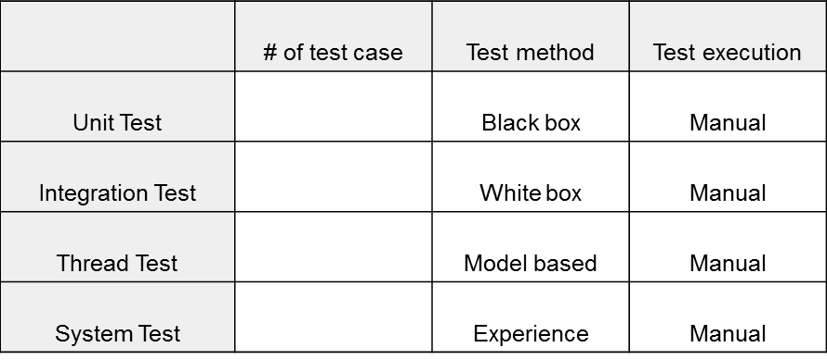
Test
Unit test
Developer has to make a test code to verify the component function & exceptional case
Integration Testing
Check the interaction between components
Thread Testing
Check the interaction between threads
System Testing
End-to-End functionality test
Functional requirement and Quality attribute have to be satisfied

Slide 27
Project plan & Time log
 | -2W | -1W | 1W(5/25~) | 2W(6/1~) | 3W(6/8~) | 4W(6/15~) | 5W(6/22~)
Schedule
output |  | Initial presentation (Draft) | Initial presentation Project Context Architect Driver Project plan Time log |  | Prototype Demo Architectural design(Draft) |  | Presentation Architectural design Detail Design Test result Time log Demo
Project analyze
Design
6/26
Final presentation
5/29
Initial presentation
6/12
Prototype demo
Implementation
Test

Slide 28
Project plan & Time log
Project resource
pre-caurse: 2 weeks, 5 members, korea
cause: 5 weeks, 6 members, CMU in USA
Resource plan
Total 672 hour works are planed
Architect: 356h(Planing, Require analysis, Design, Prototype)
Development: 181h(Detail design, Implement)
Test: 135h(component test, Integration Test)

Slide 29
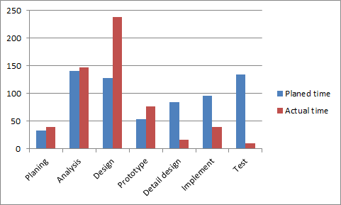
Project plan & Time log
Actual resource
Total xxx hour worked(xxx hours are overwork than plan)
Architect: xxxh(xxh more work than plan)
Especially decomposition in design takes long time
Development: xxxh(Detail design, Implement)
Test: xxxh(xxh less work than plan)

Slide 30
Lessons & Learned

Slide 31
Appendixs

Slide 32
Appendix

Slide 34
연도
릴리스
월
7월
8월
9월
10월
11월
12월
1월
2월
3월
4월
5월
6월
7월
8월
9월
10월
11월
12월
1월
2월
3월
4월
5월
6월
7월
8월
9월
주요
이벤트
파일럿시작
파일럿종료
인력투입
릴리즈 시작
월
7월
8월
9월
10월
11월
12월
1월
2월
3월
4월
5월
6월
7월
8월
9월
10월
11월
12월
1월
2월
3월
4월
5월
6월
7월
8월
9월
구분
프로젝트준비
프로젝트준비
마일스톤
기획
파일럿
수행업체선정
팀웍
대출시스템
채권,영업
서비스, 콜센터, Hpg
회계, 통계
일괄
일괄
프로젝트준비
아키텍처 설계 및 시행
대외인테페이스, 보안

