Slide 1


Rabbit Jump!
Team 1. 한창진 한현화 손영준 권영욱
ALLPPT.com _ Free PowerPoint Templates, Diagrams and Charts

Slide 2
Roles
한창진
손영준
권영욱
한현화
Programmer
Tester
Document writer
Designer
Tester
Document writer
Designer
Tester
Programmer
Document writer
Programmer
Tester
Document writer

Slide 3
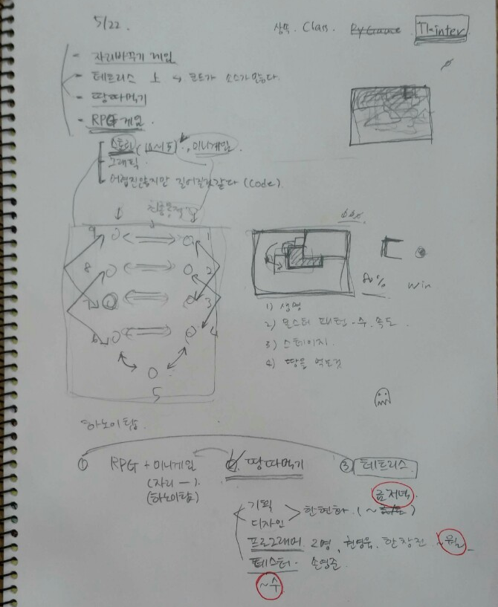
Initial Topic
땅따먹기
Ideas
Changing Seat Game
Tetris
Getting Territory Game (땅따먹기)
RPG Game
First idea meeting (May 22)

Slide 4
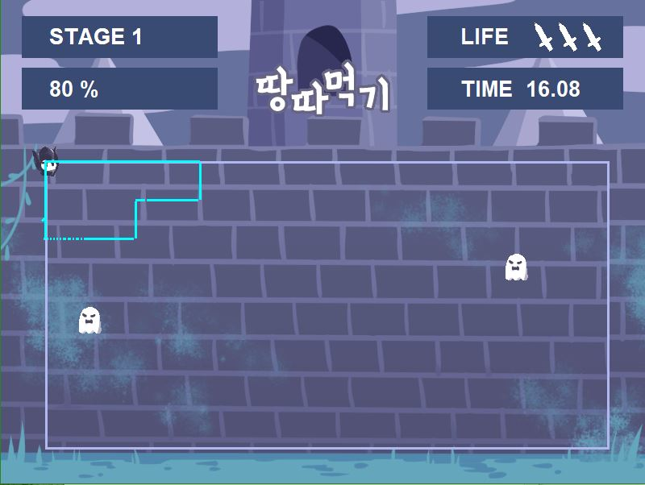
Initial Topic
땅따먹기

Slide 5
Initial Topic
땅따먹기
Idea Summary
Player can erase the game area when he make closing interval. Player should avoid ghost. When player erase the game area, background image come out.
When the fixed percent of background image come out, win!
What we made
Player move with keyboard (Arrow Buttons)
Ghost move randomly at the game area
When player touch the ghost, life decrease
When press Enter key, player can restart
When life is zero, game over
Time decrease
Why do we change the topic?
We cannot erase the game area in the shape that we think

Slide 6
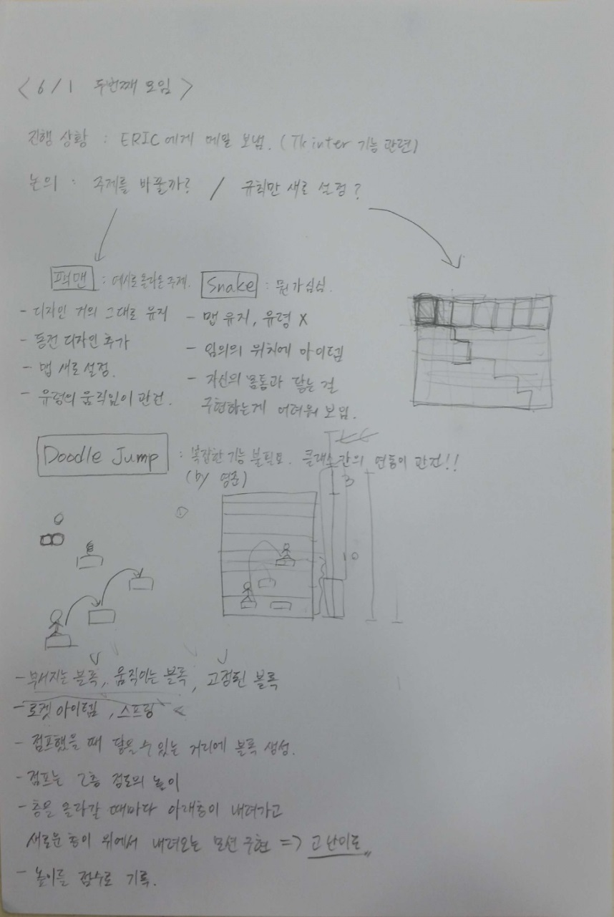
Final Topic
Rabbit Jump(Doodle Jump)
Discussion Subject
Changing Topic?
Changing Rules?
Ideas
Pac Man
Snake Game
Doodle Jump
Second idea meeting (June 1st)

Slide 7
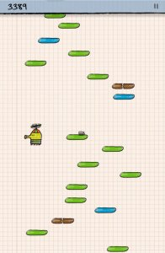
Final Topic
Rabbit Jump(Doodle Jump)
Doodle Jump
Reference : http://www.gogy.com/games/doodle-jump?gclid=CjwKEAjw7J3KBRCxv93Q3KSukXQSJADzFzVS1tBYj_4STZ3sOjhBkdSYxbPjMkx74X6368Dh-xqfYxoCyW_w_wcB

Slide 8
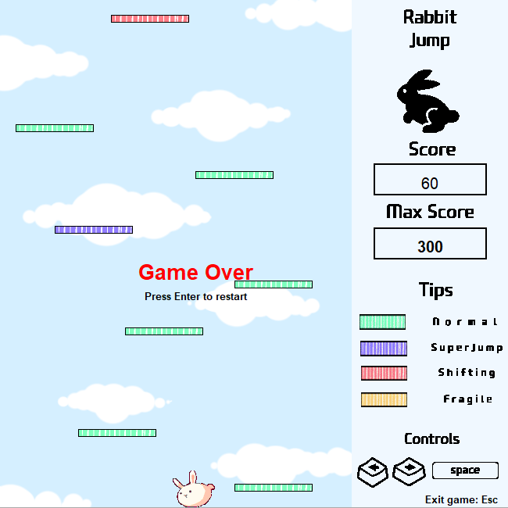
Final Topic
Rabbit Jump(Doodle Jump)
Idea Summary
Player should jump and step on the platform not touching the bottom

Slide 9
Rabbit Jump v.0.1.

Slide 10
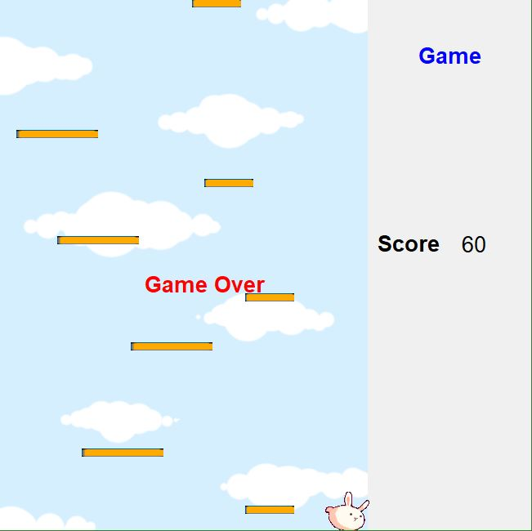
v.0.1.0
Platform
Game over message
Interface
Player

Slide 11
v.0.1.0
What we made
Player moves with keyboard (keymove method)
Player can step on the platform (move method)
Score is higher depending on player’s height (animation method)
If player touches bottom, game over
Where could we go from here?
Correct error ( platform did not appear at some area )
Make special platform
Restart when game is over
Design interface

Slide 12
v.0.1.0
<Present Program Structure>
Import : tkinter, random, time
Class(inheritance, method):
Game(mainloop)
Coords
Sprite(move, coords) : ABC
Platform(Sprite)
Figure(Sprite, keymove, animate, coords, move)
Function: within_x, within_y, collided bottom
Initial platform setting, program execution code

Slide 13
v.0.1.1
What we made
New interface (Game class)
New platform design
Show maximum score
Restart with pressing enter when game is over (chance, restart method)
Correct Error – platform is made at all area
Error occur!
We can restart but restart message did not disappear
Start message did not disappear when we start the game with arrow buttons
If we press enter continuously when restart, start message appear continuously

Slide 14
v.0.1.1
<Present Program Structure>
Import : tkinter, random, time
Class(inheritance, method):
Game(mainloop)
Coords
Sprite(move, coords) : ABC
Platform(Sprite)
Figure(Sprite, keymove, animate, coords, move, restart)
Function: within_x, within_y, collided bottom, initial_setting
program execution code

Slide 15
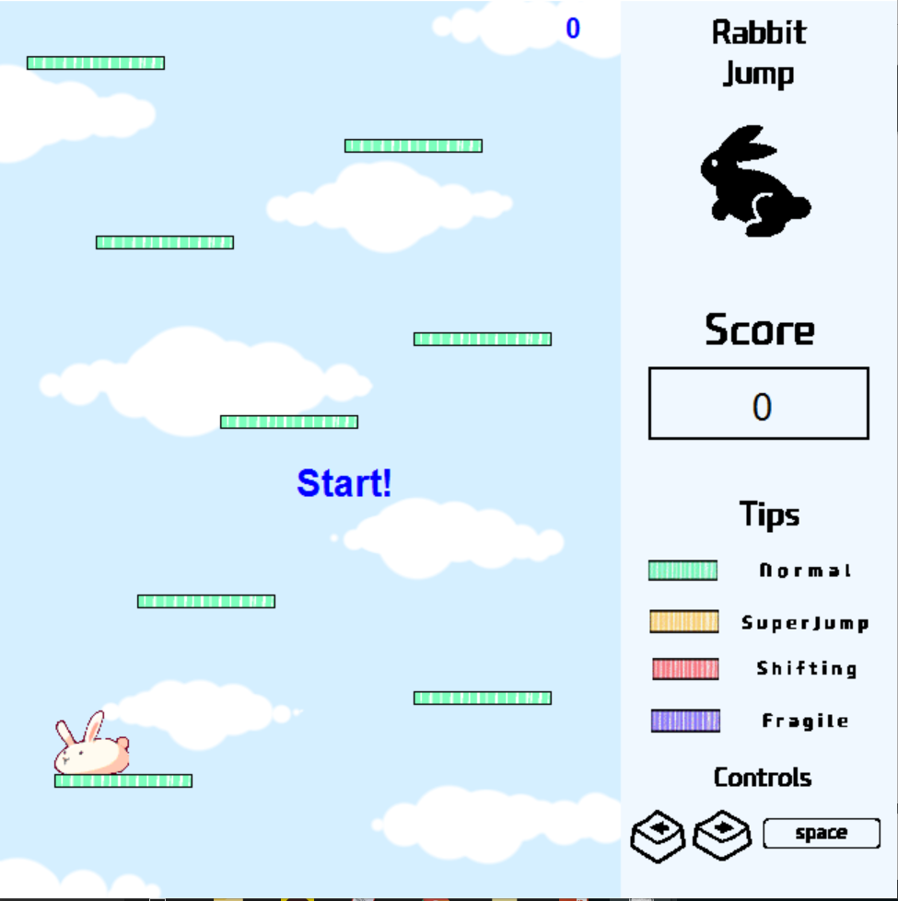
v.0.1.2
Max score
Correct Errors
Start/restart message disappear normally
Start message appear once.
New platform
New Interface

Slide 16
v.0.1.2
<Present Program Structure>
Import : tkinter, random, time
Class(inheritance, method):
Game(mainloop)
Coords
Sprite(move, coords) : ABC
Platform(Sprite)
Figure(Sprite, keymove, animate, coords, move, restart, chance)
Function: within_x, within_y, collided bottom, initial_setting
program execution code

Slide 17
Rabbit Jump v.0.2.

Slide 18
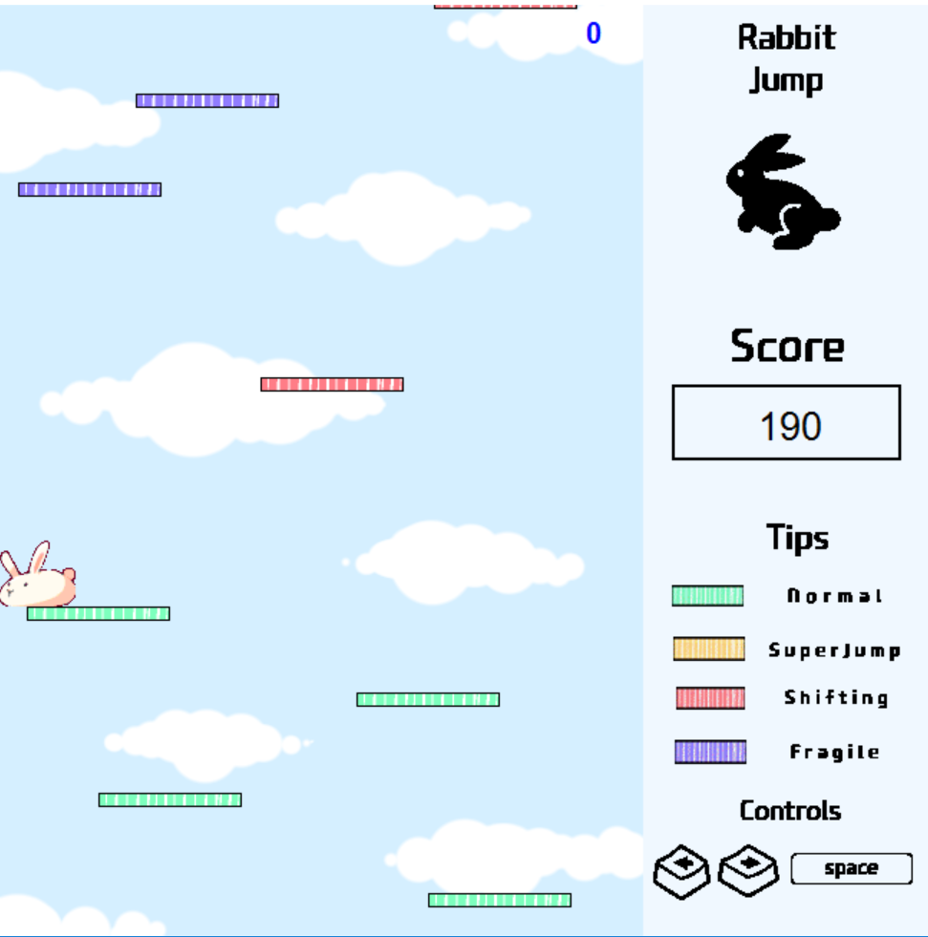
v.0.2.0
Shifting platform
What we made
Add shifting platforms. They move constantly from side to side.
(Shiftingplatform class)
Where could we go from here?
Add other functional platforms ( Super-jump & Fragile)

Slide 19
v.0.2.0
<Present Program Structure>
Import : tkinter, random, time
Class(inheritance, method):
Game(mainloop)
Coords
Sprite(move, coords) : ABC
Platform(Sprite)
Figure(Sprite, keymove, animate, coords, move, restart, chance)
ShiftingPlatform(Platfrom, coords, move)
Function: within_x, within_y, collided bottom, initial_setting
program execution code

Slide 20
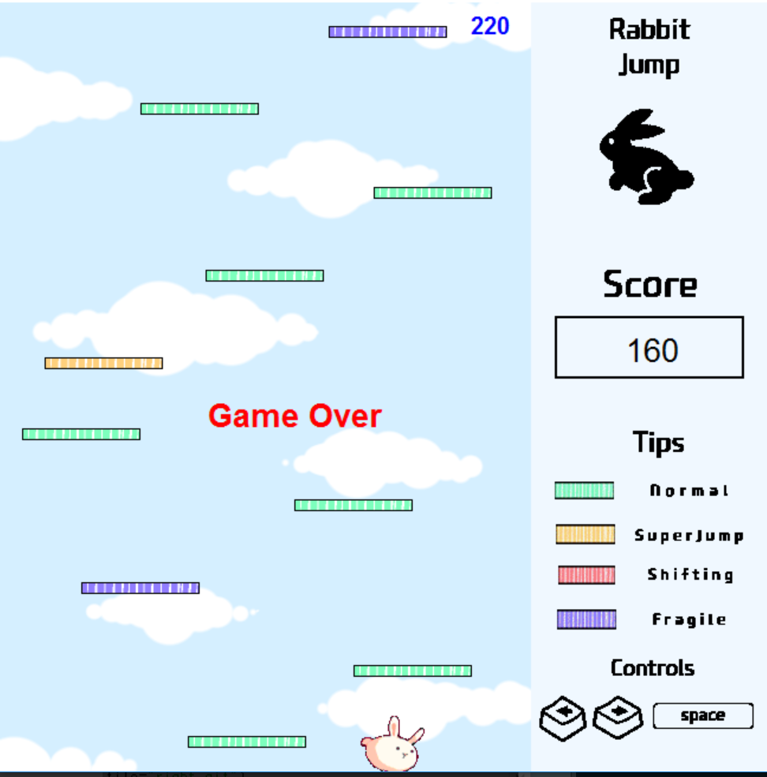
v.0.2.1
What we made
Super-jump
platform
Fragile
platform
Add super-jump platforms. If the rabbit is on it, rabbit can jump twice as high. (line253-254)
Add fragile platforms. If the rabbit is on it, it disappears. (line 255-258)

Slide 21
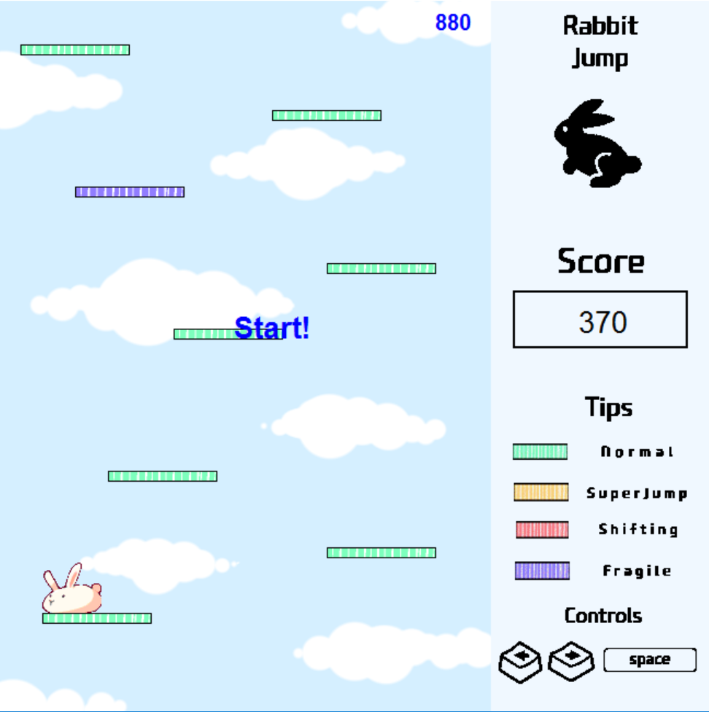
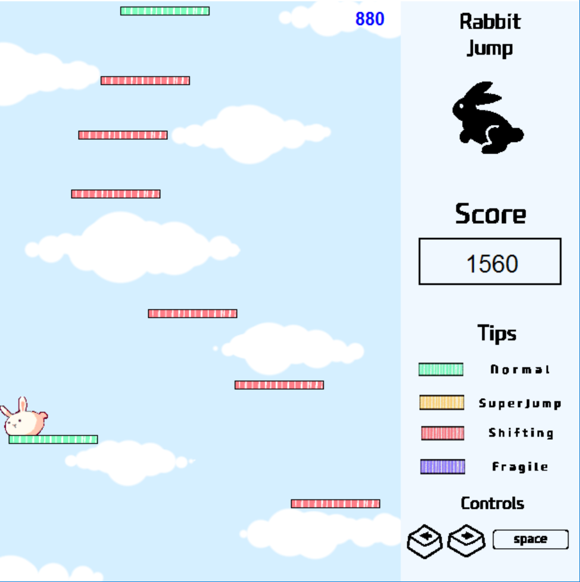
v.0.2.1
Where could we go from here?
It must be zero!
The previous score remains when you restart. Ensure that scores are reset as soon as the game over.
If the current score is higher than the max score, the max score will be updated simultaneously during the game.
Additionally, let ‘max score board’ and ‘score board’ place together.

Slide 22
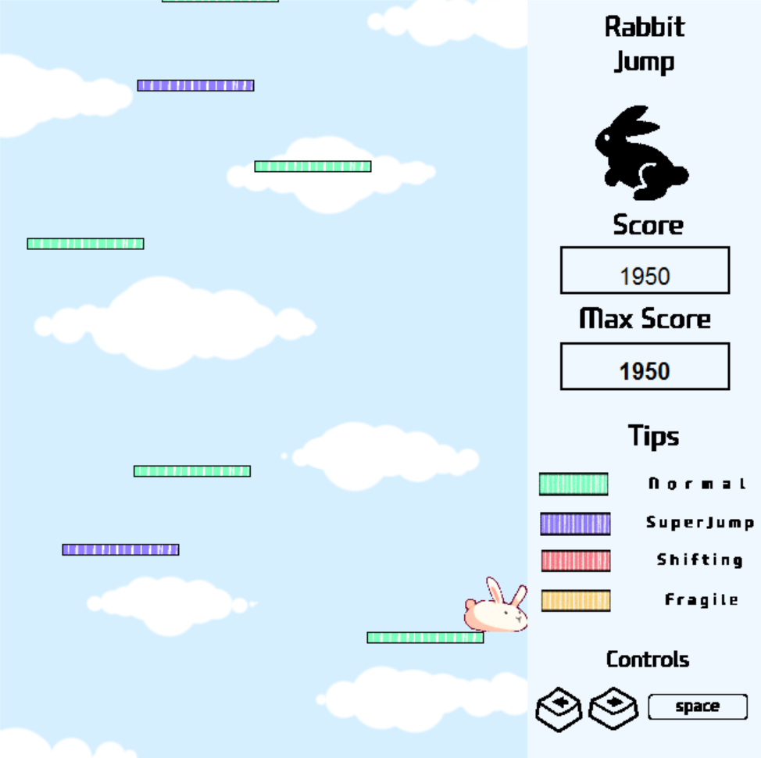
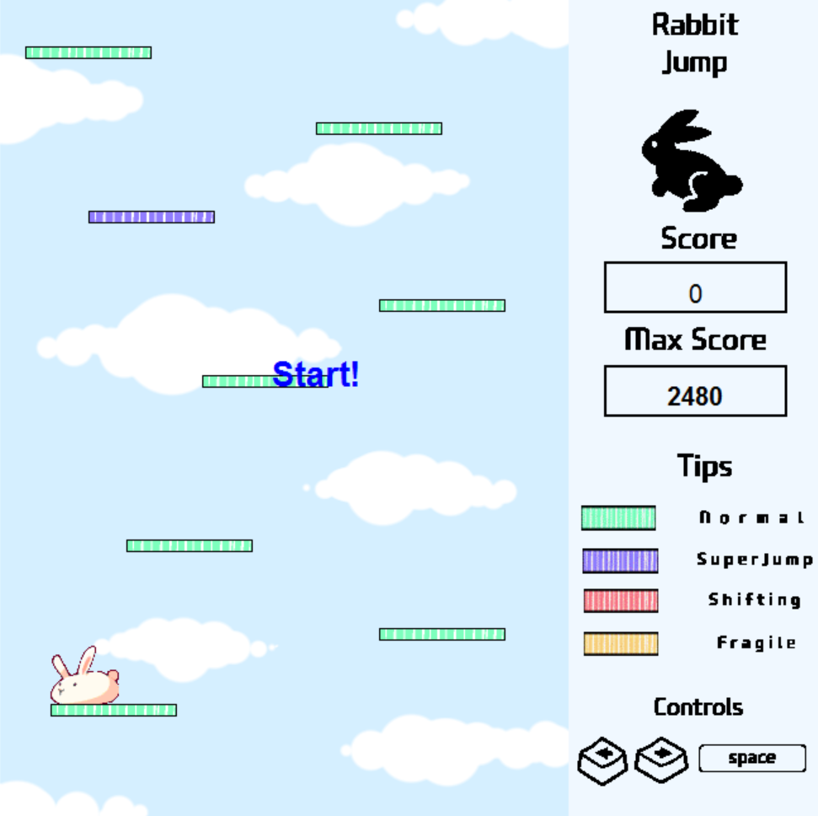
v.0.2.2
What we made
Adjust the function of ‘fragile platform’ – It does not disappear as soon as the rabbit reach it, but disappears after the rabbit jumps on it.
Change the color of super-jump and fragile. (purple- super jump / yellow – fragile)
Add ‘Max score board’ into the right side of the interface (line56-57)
If the current score is higher than the max score, the current score and the max score are updated simultaneously. (line312-316)
When restarting the score is reset to zero. (restart method)

Slide 23
v.0.2.2
Where could we go from here?
When the score reaches about 5000 points, the game speed is slowed down
When player step on the super-jump platform, sometimes score is not higher.

Slide 24
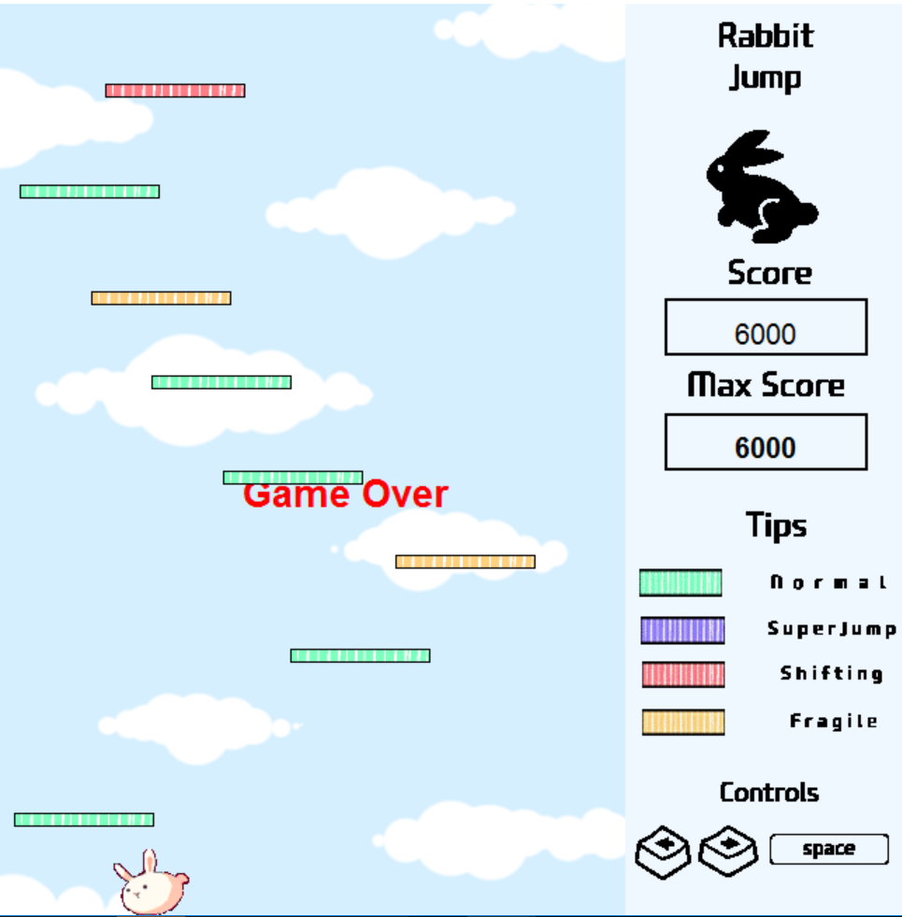
v.0.2.3
What we made
By deleting previous platform data, the game speed was improved.
(line 241-244)
Score is higher when player step on the super-jump platform

Slide 25
Rabbit Jump v.0.3.

Slide 26
v.0.3.0
What we made
Correct some lines on the code to meet the PEP-8 criterion
Add comment(#)
Add esc key to escape (line 46, line191-192)

Slide 27
Code Structure
Sprite
Platform
Shifting Platform
Figure
Game
call
move
coords
mainloop
inheritance
call
move
coords
keymove
animate
move
coords
chance
restart
Coords
move: Call move in mainloop

Slide 28
Future Direction
Where could we go from here?
Pause Function
Character movement improvement
Stage or level of difficulty depending on height
Game speed -still slowed down as sprite list become longer.

