Slide 1
文本绘制库中的显示流程
1.初始化surface
1）新建client及创建通信
sp<SurfaceComposerClient> client = new SurfaceComposerClient()；
const std::vector<PhysicalDisplayId> ids = SurfaceComposerClient::getPhysicalDisplayIds();
const sp<IBinder> dtoken = SurfaceComposerClient::getPhysicalDisplayToken(ids.front());
2）与事务关联
m_transaction.setDisplayLayerStack(dtoken, 0);
m_transaction.apply();
m_transaction.clear();
3）获取屏的screenmode，包括宽高等信息
SurfaceComposerClient::getActiveDisplayMode(dtoken, &config)
4）创建surface
m_surfaceControl = client->createSurface(String8("draw_surface"),
m_dispWidth, m_dispHeight, PIXEL_FORMAT_BGRA_8888, 0);

Slide 2
文本绘制库中的显示流程
1.初始化surface
5）配置surface
m_transaction.setLayerStack(m_surfaceControl, 0)
.setLayer(m_surfaceControl, 100000)
.setPosition(m_surfaceControl, 0, 0)
.setSize(m_surfaceControl, m_dispWidth, m_dispHeight)
.show(m_surfaceControl)
.setDataspace(m_surfaceControl, ui::Dataspace::V0_SRGB)
.apply()
6）获取实际surface
m_surface = m_surfaceControl->getSurface();
7）分配内存用来存放数据
m_tmp = calloc(1, m_dispWidth * m_dispHeight * SCREEN_PIXEL_BYTES);
m_tmpDraw = (uint32_t*)m_tmp;
m_tmpBackFill = (uint32_t*)m_tmp;

Slide 3
文本绘制库中的显示流程
2.获取ANativeWindowBuffer
1）初始化native_window
连接
native_window_api_connect(m_nativeWindow.get(),NATIVE_WINDOW_API_CPU)
设置usage
native_window_set_usage(m_nativeWindow.get(),
GRALLOC_USAGE_SW_READ_NEVER | GRALLOC_USAGE_SW_WRITE_OFTEN
| GRALLOC_USAGE_HW_TEXTURE )
设置scaling_mode
native_window_set_scaling_mode(m_nativeWindow.get(),
NATIVE_WINDOW_SCALING_MODE_SCALE_TO_WINDOW)
设置buffers_dimensions
native_window_set_buffers_dimensions(m_nativeWindow.get(),bufWidth, bufHeight)
设置buffers_format
native_window_set_buffers_format(m_nativeWindow.get(), halFormat)
2）dequeuer buffer
native_window_dequeue_buffer_and_wait(m_nativeWindow.get(), &m_buf)

Slide 4
文本绘制库中的显示流程
3.lock buffer后填充buffer
1）获取GraphicBufferMapper
GraphicBufferMapper &mapper = GraphicBufferMapper::get();
2）指定绘制尺寸
Rect bounds(m_dispWidth, m_dispHeight);
3）根据句柄获取虚拟地址
mapper.lock(drawbuf->handle, GRALLOC_USAGE_SW_WRITE_OFTEN, bounds, &dst)
4）显示内容绘制
5）拷贝
memcpy(dst, m_tmp, m_dispWidth * m_dispHeight * SCREEN_PIXEL_BYTES);
6）unlock handle
mapper.unlock(drawbuf->handle)

Slide 5
文本绘制库中的显示流程
4.推屏显示
1）dequeuer buffer
m_nativeWindow->queueBuffer(m_nativeWindow.get(), p, -1)
https://zhuanlan.zhihu.com/p/672358580
https://huaweicloud.csdn.net/64feb1e5993dd34278ee2551.html

Slide 6
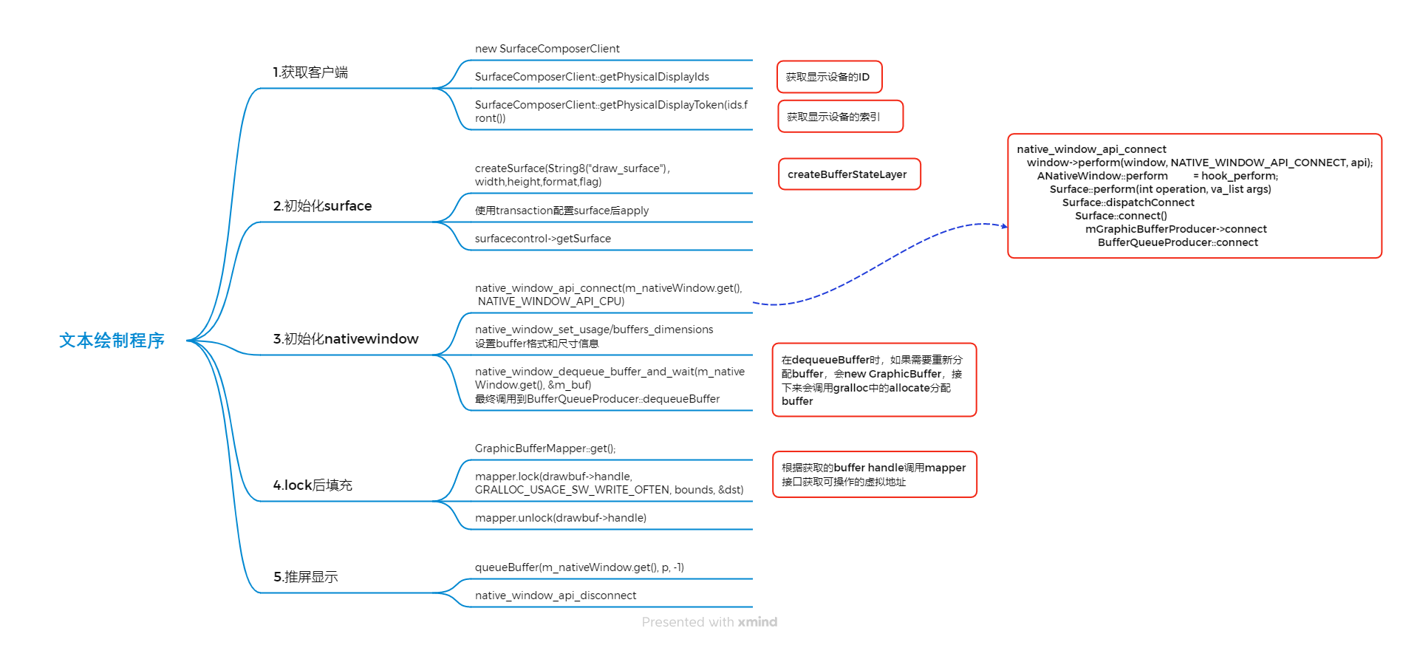
文本绘制库中的显示流程

Slide 7
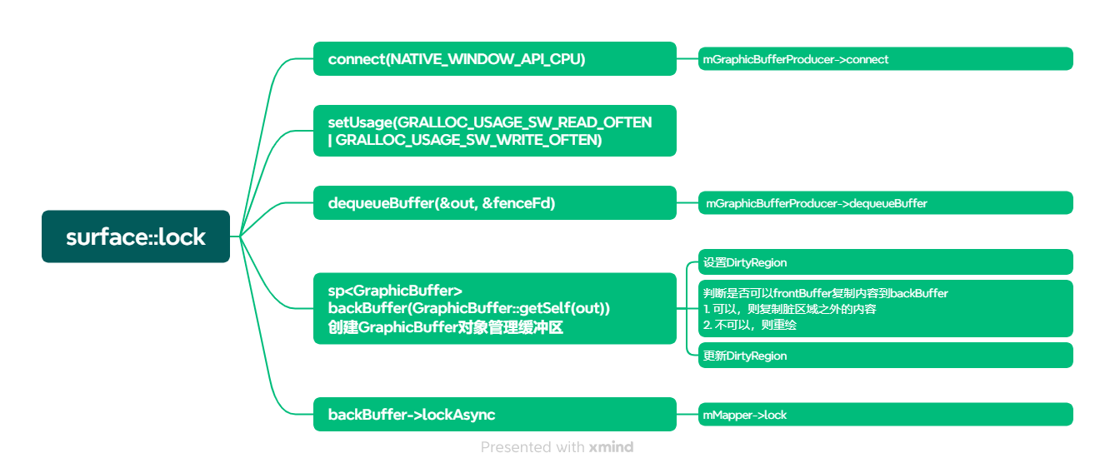
文本绘制库中的显示流程
Surface::lock
1）使用Surface中的lock函数可以综合前面“获取ANativeWindowBuffer”和“lock buffer”的操作

