Slide 1
MSCIT 5210: Knowledge Discovery and Data Mining
Acknowledgement: Slides modified by Dr. Lei Chen based on the slides provided by Jiawei Han, Micheline Kamber, and Jian Pei
©2012 Han, Kamber & Pei. All rights reserved.

Slide 2
Chapter 9. Classification: Advanced Methods
Classification by Backpropagation
Support Vector Machines
Additional Topics Regarding Classification
Summary

Slide 3
Biological Neural Systems
Neuron switching time : > 10⁻³ secs
Number of neurons in the human brain: ~10¹⁰
Connections (synapses) per neuron : ~10⁴–10⁵
Face recognition : 0.1 secs
High degree of distributed and parallel computation
  Highly fault tolerent
  Highly efficient
  Learning is key

Slide 4
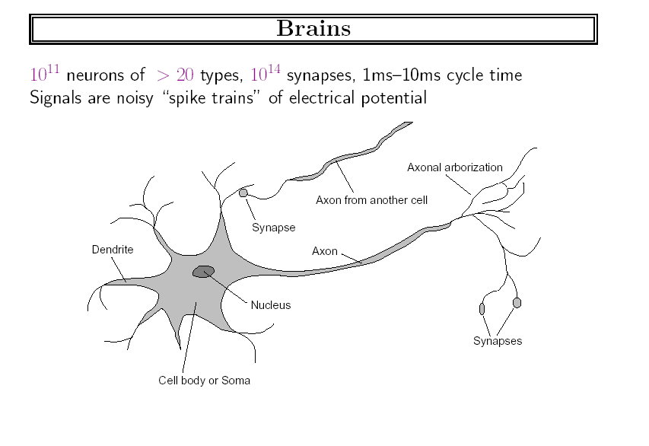
Excerpt from Russell and Norvig
http://faculty.washington.edu/chudler/cells.html

Slide 5
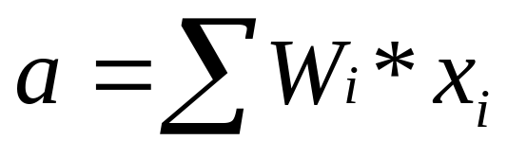
Modeling A Neuron on Computer
x_{i}
W_{i}
output
Input links
y
output links
∑
y = output(a)
Computation:
  input signals → input function(linear) → activation function(nonlinear) → output signal

Slide 6
Part 1. Perceptrons: Simple NN
inputs
weights
x₁
w₁
output
w₂
activation
x₂
Σ
y
.
.
.
θ
a=Σ_{i=1}^{n} w_{i} x_{i}
w_{n}
x_{n}
Xi’s range: [0, 1]
1 if a ≥ θ
y=
0 if a < θ
{

Slide 7
To be learned: W_{i} and
θ
1
1
Decision line
w₁ x₁ + w₂ x₂ = θ
x₂
w
1
0
0
0
x₁
1
0
0

Slide 8

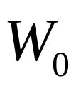
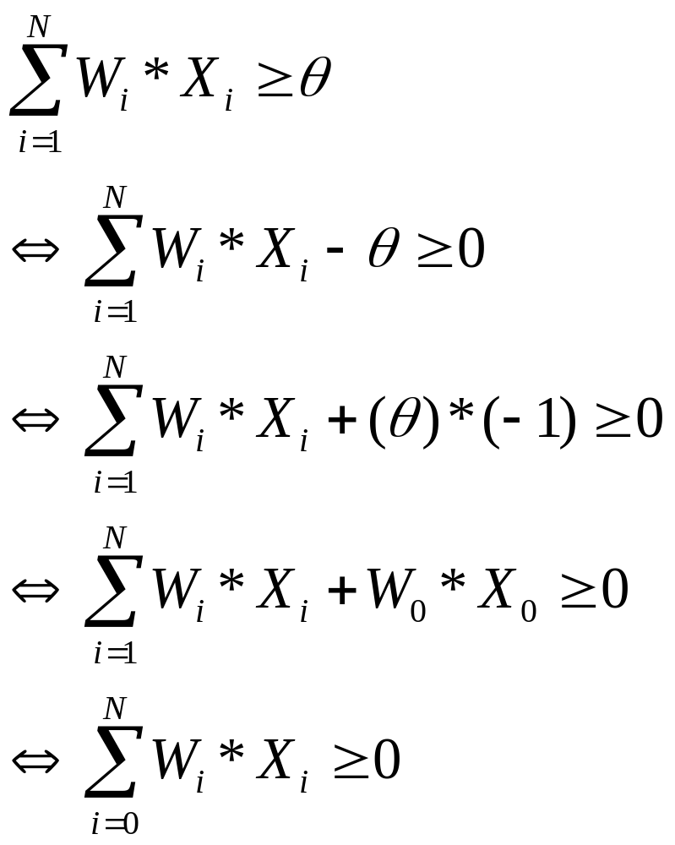
Converting To
(1)
(2)
(3)
(4)
(5)

Slide 9
Threshold as Weight: W₀
x₀=-1
x₁
w₁
w₀ =θ
w₂
x₂
Σ
y
.
.
.
a= Σ_{i=0}^{n} w_{i} x_{i}
w_{n}
1 if a ≥ 0
y=
0 if a <0
x_{n}
{

Slide 10
Linear Separability
x₂
w₁=1
w₂=1
θ=1.5
0
1
x₁
a= Σ_{i=0}^{n} w_{i} x_{i}
0
0
1 if a ≥ 0
y=
0 if a <0
{
Logical AND
x₁ | x₂ | a | y
0 | 0 | -1.5 | 0
0 | 1 | -0.5 | 0
1 | 0 | -0.5 | 0
1 | 1 | 0.5 | 1
t
0
0
0
1

Slide 11
XOR cannot be separated!
Logical XOR
w₁=?
w₂=?
θ= ?
x₁ | x₂ | t
0 | 0 | 0
0 | 1 | 1
1 | 0 | 1
1 | 1 | 0
0
1
x₁
1
0
Thus, one level neural network can only learn linear functions (straight lines)

Slide 12
Training the Perceptron
Training set S of examples {x,t}
  x is an input vector and
  T the desired target vector (Teacher)
  Example: Logical And
Iterative process
  Present a training example x , compute network output y , compare output y with target t, adjust weights and thresholds
Learning rule
  Specifies how to change the weights W of the network as a function of the inputs x, output Y and target t.
x₁ | x₂ | t
0 | 0 | 0
0 | 1 | 0
1 | 0 | 0
1 | 1 | 1

Slide 13
Perceptron Learning Rule
w_{i} := w_{i} + Δw_{i} = w_{i} + α (t-y) x_{i} (i=1..n)
The parameter α is called the learning rate.
  In Han’s book it is lower case L
  It determines the magnitude of weight updates Δw_{i} .
If the output is correct (t=y) the weights are not changed (Δw_{i} =0).
If the output is incorrect (t ≠ y) the weights w_{i} are changed such that the output of the Perceptron for the new weights w’_{i} is closer/further to the input x_{i}.

Slide 14
Perceptron Training Algorithm
Repeat
for each training vector pair (x,t)
evaluate the output y when x is the input
if y≠t then
form a new weight vector w’ according
to w’=w + α (t-y) x
else
do nothing
end if
end for
Until fixed number of iterations; or error less than a predefined value
α: set by the user; typically = 0.01

Slide 15
Example: Learning the AND Function : Step 1.
W₀ | W₁ | W₂
0.5 | 0.5 | 0.5
x₁ | x₂ | t
0 | 0 | 0
0 | 1 | 0
1 | 0 | 0
1 | 1 | 1
a=(-1)*0.5+0*0.5+0*0.5=-0.5,
Thus, y=0. Correct. No need to change W
α: = 0.1

Slide 16
Example: Learning the AND Function : Step 2.
x₁ | x₂ | t
0 | 0 | 0
0 | 1 | 0
1 | 0 | 0
1 | 1 | 1
W₀ | W₁ | W₂
0.5 | 0.5 | 0.5
a=(-1)*0.5+0*0.5 + 1*0.5=0,
Thus, y=1. t=0, Wrong.
ΔW₀= 0.1*(0-1)*(-1)=0.1,
ΔW₁= 0.1*(0-1)*(0)=0
ΔW₂= 0.1*(0-1)*(1)=-0.1
α: = 0.1
W₀=0.5+0.1=0.6
W₁=0.5+0=0.5
W₂=0.5-0.1=0.4

Slide 17
Example: Learning the AND Function : Step 3.
x₁ | x₂ | t
0 | 0 | 0
0 | 1 | 0
1 | 0 | 0
1 | 1 | 1
W₀ | W₁ | W₂
0.6 | 0.5 | 0.4
a=(-1)*0.6+1*0.5 + 0*0.4=-0.1,
Thus, y=0. t=0, Correct!
α: = 0.1

Slide 18
Example: Learning the AND Function : Step 2.
x₁ | x₂ | t
0 | 0 | 0
0 | 1 | 0
1 | 0 | 0
1 | 1 | 1
W₀ | W₁ | W₂
0.6 | 0.5 | 0.4
a=(-1)*0.6+1*0.5 + 1*0.4=0.3,
Thus, y=1. t=1, Correct
α: = 0.1

Slide 19
Final Solution:
x₂
w₁=0.5
w₂=0.4
w₀=0.6
0
1
x₁
a= 0.5x₁+0.4*x2 -0.6
0
0
1 if a ≥ 0
y=
0 if a <0
{
Logical AND
x₁ | x₂
0 | 0
0 | 1
1 | 0
1 | 1
y
0
0
0
1

Slide 20
Perceptron Convergence Theorem
The algorithm converges to the correct classification
  if the training data is linearly separable
  and learning rate is sufficiently small
(Rosenblatt 1962).
The final weights in the solution w is not unique: there are many possible lines to separate the two classes.

Slide 21
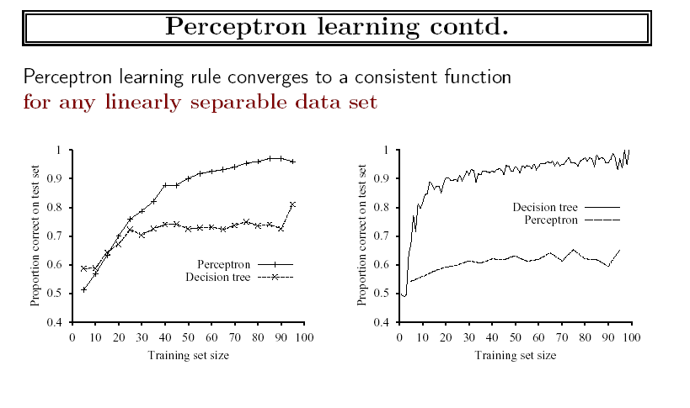
Experiments

Slide 22
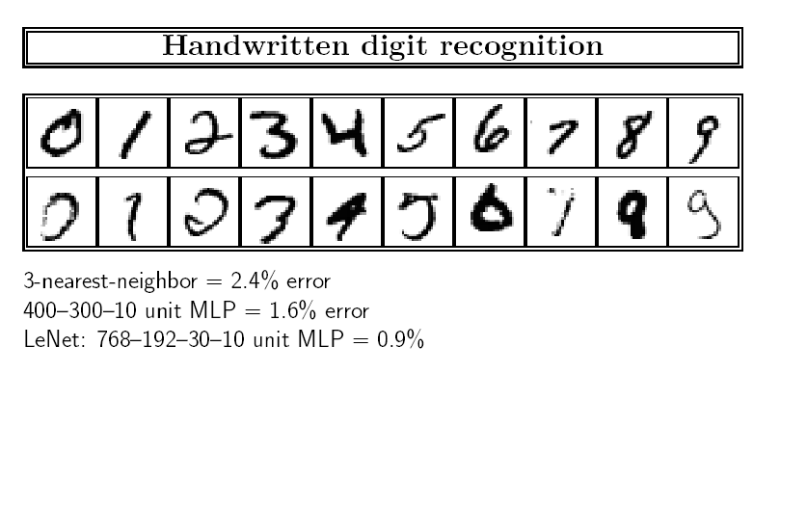
Handwritten Recognition Example

Slide 23
Each letter → one output unit y
x₁
w₁
w₂
x₂
Σ
.
.
.
w_{n}
x_{n}
weights (trained)
fixed
Input
pattern
Association
units
Summation
Threshold

Slide 24
Multiple Output Perceptrons
Handwritten alphabetic character recognition
  26 classes : A,B,C…,Z
  First output unit distinguishes between “A”s and “non-A”s, second output unit between “B”s and “non-B”s etc.
. . .
y₁
y₂
y₂₆
w_{ji} connects x_{i} with y_{j}
x₁
x₂
x₃
. . .
x_{n}
w’_{ji} = w_{ji} + α (t_{j}-y_{j}) x_{i}

Slide 25
Part 2. Multi Layer Networks
Output vector
Output nodes
Hidden nodes
Input nodes
Input vector

Slide 26
Sigmoid-Function for Continuous Output
inputs
weights
x₁
w₁
output
w₂
activation
x₂
Σ
O
.
.
.
a=Σ_{i=0}^{n} w_{i} x_{i}
w_{n}
x_{n}
O =1/(1+e^{-a})
Output between 0 and 1 (when a = negative
infinity, O = 0; when a= positive infinity, O=1.

Slide 27

Gradient Descent Learning Rule
For each training example X,
  Let O be the output (bewteen 0 and 1)
  Let T be the correct target value
Continuous output O
  a= w₁ x₁ + … + w_{n} x_{n} +
  O =1/(1+e^{-a})
Train the w_{i}’s such that they minimize the squared error
  E[w₁,…,w_{n}] = ½ Σ_{k∈D} (T_{k}-O_{k})²
  where D is the set of training examples

Slide 28
Explanation: Gradient Descent Learning Rule
O_{k}
w_{i}
x_{i}
Δw_{i} = α O_{k} (1-O_{k}) (T_{k}-O_{k}) x_{i}^{k}
activation of
pre-synaptic neuron
learning rate
derivative of
activation function
error δ_{k} of
post-synaptic neuron

Slide 29
Backpropagation Algorithm (Han, Figure 9.5)
Initialize each w_{i} to some small random value
Until the termination condition is met, Do
  For each training example <(x₁,…x_{n}),t> Do
    Input the instance (x₁,…,x_{n}) to the network and compute the network outputs O_{k}
    For each output unit k
      Err_{k}=O_{k}(1-O_{k})(t_{k}-O_{k})
    For each hidden unit h
      Err_{h}=O_{h}(1-O_{h}) Σ_{k} w_{h,k} Err_{k}
    For each network weight w_{i,j} Do
    w_{i,j}=w_{i,j}+Δw_{i,j} where
      Δw_{i,j}= α Err_{j*} O_{i,}
    θ_{j}=θ_{j}+Δθ_{j} where
      Δθ_{j} = α Err_{j,}
α: is learning rate, set by the user;

Slide 30
Example 6.9 (HK book, page 333)
X₁
1
4
Output: y
X₂
2
6
5
X₃
3
Eight weights to be learned:
W_{ij:} W₁₄, W₁₅, … W₄₆, W₅₆, …, and θ
Training example:
x1 | x2 | x3 | t
1 | 0 | 1 | 1
Learning rate: =0.9

Slide 31
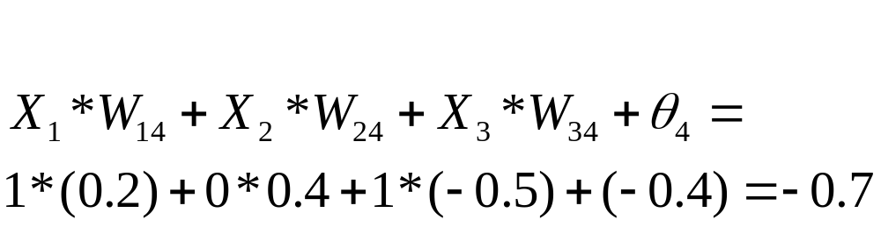
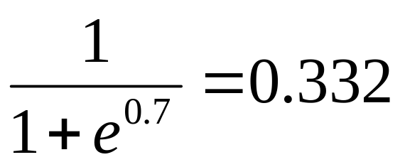
Initial Weights: randomly assigned (HK: Tables 7.3, 7.4)
x1 | x2 | x3 | w14 | w15 | w24 | w25 | w34 | w35 | w46 | w56 | θ4 | θ5 | θ6
1 | 0 | 1 | 0.2 | -0.3 | 0.4 | 0.1 | -0.5 | 0.2 | -0.3 | -0.2 | -0.4 | 0.2 | 0.1
Net input at unit 4:
Output at unit 4:

Slide 32
Feed Forward: (Table 7.4)
Continuing for units 5, 6 we get:
  Output at unit 6 = 0.474

Slide 33
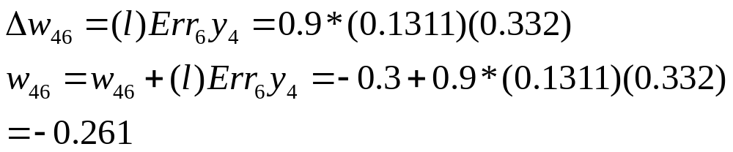
Calculating the error (Tables 7.5)
Error at Unit 6: (t-y)=(1-0.474)
Error to be backpropagated from unit 6:
Weight update :

Slide 34
Weight update (Table 7.6)
Thus, new weights after training with {(1, 0, 1), t=1}:
w14 | w15 | w24 | w25 | w34 | w35 | w46 | w56 | θ4 | θ5 | θ6
0.192 | -0.306 | 0.4 | 0.1 | -0.506 | 0.194 | -0.261 | -0.138 | -0.408 | 0.194 | 0.218
If there are more training examples, the same procedure
is followed as above.
Repeat the rest of the procedures.

Slide 35
Classification by Backpropagation
Backpropagation: A neural network learning algorithm
Started by psychologists and neurobiologists to develop and test computational analogues of neurons
A neural network: A set of connected input/output units where each connection has a weight associated with it
During the learning phase, the network learns by adjusting the weights so as to be able to predict the correct class label of the input tuples
Also referred to as connectionist learning due to the connections between units

Slide 36
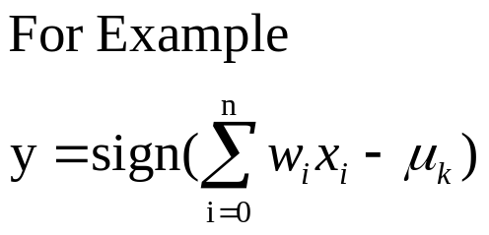
Neuron: A Hidden/Output Layer Unit
bias
μ_{k}
x₀
w₀
x₁
w₁
∑
f
output y
x_{n}
w_{n}
Input
vector x
weight
vector w
weighted
sum
Activation
function
An n-dimensional input vector x is mapped into variable y by means of the scalar product and a nonlinear function mapping
The inputs to unit are outputs from the previous layer. They are multiplied by their corresponding weights to form a weighted sum, which is added to the bias associated with unit. Then a nonlinear activation function is applied to it.
Notes:
MK Oct 2009: I removed “neuron = perceptron” from title since we do not use that term in the book.

Slide 37
How A Multi-Layer Neural Network Works
The inputs to the network correspond to the attributes measured for each training tuple
Inputs are fed simultaneously into the units making up the input layer
They are then weighted and fed simultaneously to a hidden layer
The number of hidden layers is arbitrary, although usually only one
The weighted outputs of the last hidden layer are input to units making up the output layer, which emits the network's prediction
The network is feed-forward: None of the weights cycles back to an input unit or to an output unit of a previous layer
From a statistical point of view, networks perform nonlinear regression: Given enough hidden units and enough training samples, they can closely approximate any function

Slide 38
Defining a Network Topology
Decide the network topology: Specify # of units in the input layer, # of hidden layers (if > 1), # of units in each hidden layer, and # of units in the output layer
Normalize the input values for each attribute measured in the training tuples to [0.0—1.0]
One input unit per domain value, each initialized to 0
Output, if for classification and more than two classes, one output unit per class is used
Once a network has been trained and its accuracy is unacceptable, repeat the training process with a different network topology or a different set of initial weights

Slide 39
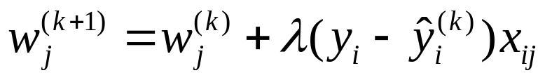
A Multi-Layer Feed-Forward Neural Network
Output vector
Output layer
Hidden layer
w_{ij}
Input layer
Input vector: X
Notes:
MK: Note – different notation than used in book. Will have to standardize notation.

Slide 40
Backpropagation
Iteratively process a set of training tuples & compare the network's prediction with the actual known target value
For each training tuple, the weights are modified to minimize the mean squared error between the network's prediction and the actual target value
Modifications are made in the “backwards” direction: from the output layer, through each hidden layer down to the first hidden layer, hence “backpropagation”
Steps
  Initialize weights to small random numbers, associated with biases
  Propagate the inputs forward (by applying activation function)
  Backpropagate the error (by updating weights and biases)
  Terminating condition (when error is very small, etc.)

Slide 41
Efficiency and Interpretability
Efficiency of backpropagation: Each epoch (one iteration through the training set) takes O(|D| * w), with |D| tuples and w weights, but # of epochs can be exponential to n, the number of inputs, in worst case
For easier comprehension: Rule extraction by network pruning
  Simplify the network structure by removing weighted links that have the least effect on the trained network
  Then perform link, unit, or activation value clustering
  The set of input and activation values are studied to derive rules describing the relationship between the input and hidden unit layers
Sensitivity analysis: assess the impact that a given input variable has on a network output. The knowledge gained from this analysis can be represented in rules

Slide 42
Neural Network as a Classifier
Weakness
  Long training time
  Require a number of parameters typically best determined empirically, e.g., the network topology or “structure.”
  Poor interpretability: Difficult to interpret the symbolic meaning behind the learned weights and of “hidden units” in the network
Strength
  High tolerance to noisy data
  Ability to classify untrained patterns
  Well-suited for continuous-valued inputs and outputs
  Successful on an array of real-world data, e.g., hand-written letters
  Algorithms are inherently parallel
  Techniques have recently been developed for the extraction of rules from trained neural networks

Slide 43
Chapter 9. Classification: Advanced Methods
Classification by Backpropagation
Support Vector Machines
Additional Topics Regarding Classification
Summary

Slide 44
Classification: A Mathematical Mapping
Classification: predicts categorical class labels
  E.g., Personal homepage classification
    x_{i} = (x₁, x₂, x₃, …), y_{i} = +1 or –1
    x₁ : # of word “homepage”
    x₂ : # of word “welcome”
Mathematically, x ∈ X = ℜ^{n}, y ∈ Y = {+1, –1},
  We want to derive a function f: X → Y
Linear Classification
  Binary Classification problem
  Data above the red line belongs to class ‘x’
  Data below red line belongs to class ‘o’
  Examples: SVM, Perceptron, Probabilistic Classifiers
x
x
x
x
x
x
x
x
x
o
o
x
o
o
o
o
o
o
o
o
o
o
o

Slide 45
Discriminative Classifiers
Advantages
  Prediction accuracy is generally high
    As compared to Bayesian methods – in general
  Robust, works when training examples contain errors
  Fast evaluation of the learned target function
    Bayesian networks are normally slow
Criticism
  Long training time
  Difficult to understand the learned function (weights)
    Bayesian networks can be used easily for pattern discovery
  Not easy to incorporate domain knowledge
    Easy in the form of priors on the data or distributions

Slide 46
SVM—Support Vector Machines
A relatively new classification method for both linear and nonlinear data
It uses a nonlinear mapping to transform the original training data into a higher dimension
With the new dimension, it searches for the linear optimal separating hyperplane (i.e., “decision boundary”)
With an appropriate nonlinear mapping to a sufficiently high dimension, data from two classes can always be separated by a hyperplane
SVM finds this hyperplane using support vectors (“essential” training tuples) and margins (defined by the support vectors)

Slide 47
SVM—History and Applications
Vapnik and colleagues (1992)—groundwork from Vapnik & Chervonenkis’ statistical learning theory in 1960s
Features: training can be slow but accuracy is high owing to their ability to model complex nonlinear decision boundaries (margin maximization)
Used for: classification and numeric prediction
Applications:
  handwritten digit recognition, object recognition, speaker identification, benchmarking time-series prediction tests

Slide 48
SVM—General Philosophy
Small Margin
Large Margin
Support Vectors

Slide 49


SVM—Margins and Support Vectors
Data Mining: Concepts and Techniques

Slide 50
SVM—When Data Is Linearly Separable
m
Let data D be (X₁, y₁), …, (X_{|D|}, y_{|D|}), where X_{i} is the set of training tuples associated with the class labels y_{i}
There are infinite lines (hyperplanes) separating the two classes but we want to find the best one (the one that minimizes classification error on unseen data)
SVM searches for the hyperplane with the largest margin, i.e., maximum marginal hyperplane (MMH)

Slide 51
SVM—Linearly Separable
A separating hyperplane can be written as
    W ● X + b = 0
  where W={w₁, w₂, …, w_{n}} is a weight vector and b a scalar (bias)
For 2-D it can be written as
    w₀ + w₁ x₁ + w₂ x₂ = 0
The hyperplane defining the sides of the margin:
    H₁: w₀ + w₁ x₁ + w₂ x₂ ≥ 1 for y_{i} = +1, and
    H₂: w₀ + w₁ x₁ + w₂ x₂ ≤ – 1 for y_{i} = –1
Any training tuples that fall on hyperplanes H₁ or H₂ (i.e., the
sides defining the margin) are support vectors
This becomes a constrained (convex) quadratic optimization problem: Quadratic objective function and linear constraints → Quadratic Programming (QP) → Lagrangian multipliers

Slide 52
Why Is SVM Effective on High Dimensional Data?
The complexity of trained classifier is characterized by the # of support vectors rather than the dimensionality of the data
The support vectors are the essential or critical training examples —they lie closest to the decision boundary (MMH)
If all other training examples are removed and the training is repeated, the same separating hyperplane would be found
The number of support vectors found can be used to compute an (upper) bound on the expected error rate of the SVM classifier, which is independent of the data dimensionality
Thus, an SVM with a small number of support vectors can have good generalization, even when the dimensionality of the data is high

Slide 53


SVM—Linearly Inseparable
Transform the original input data into a higher dimensional space
Search for a linear separating hyperplane in the new space

Slide 54
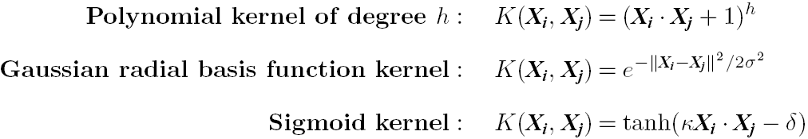
SVM: Different Kernel functions
Instead of computing the dot product on the transformed data, it is math. equivalent to applying a kernel function K(X_{i}, X_{j}) to the original data, i.e., K(X_{i}, X_{j}) = Φ(X_{i}) Φ(X_{j})
Typical Kernel Functions
SVM can also be used for classifying multiple (> 2) classes and for regression analysis (with additional parameters)

Slide 55
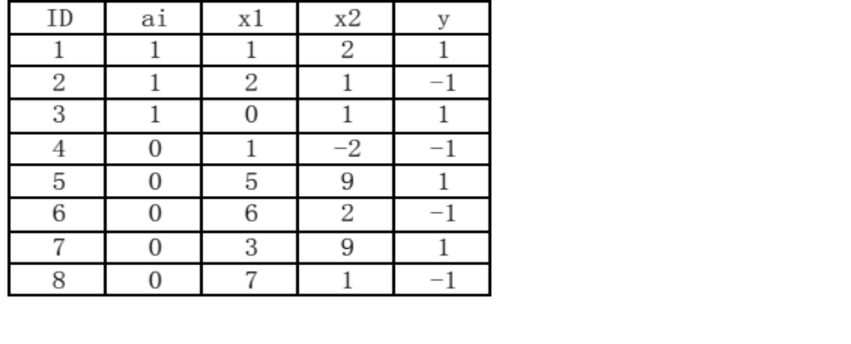
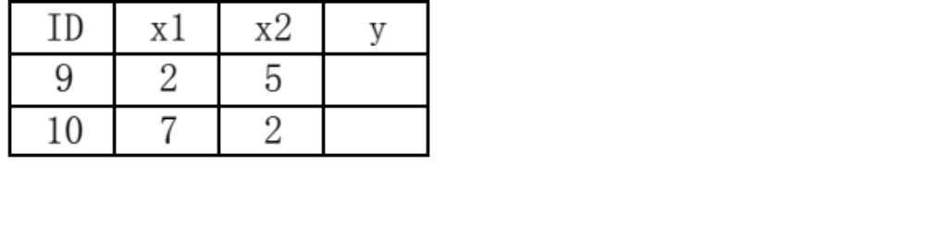
SVM
Consider the following data points. Please use SVM to train a classifier, and then classify these data points. Points with a_{i}=1 means this point is support vector. For example, point 1 (1,2) is the support vector, but point 5 (5,9) is not the support vector.
Training data:
Testing data:

Slide 56
SVM
Question:
  (a) Find the decision boundary, show detail calculation process.
  (b) Use the decision boundary you found to classify the Testing data. Show all calculation process in detail, including the intermediate result and the formula you used.

Slide 57
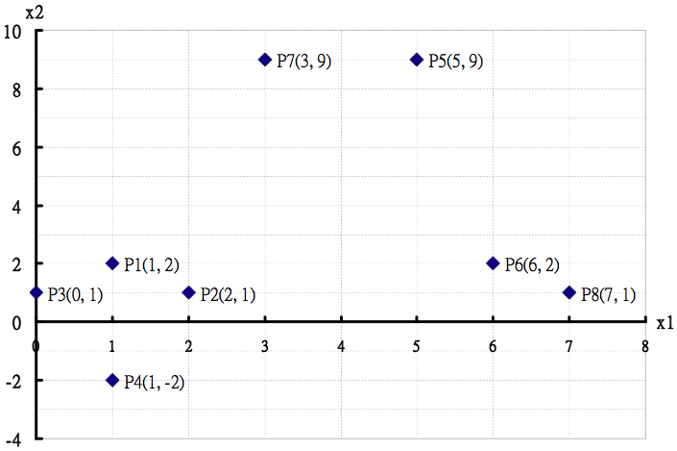
SVM
Answer:
a) As the picture shows, P1, P2, P3 are support vectors.

Slide 58
SVM
Suppose w is (w₁,w₂). Since both P1(1,2) and P3(0,1) have y = 1, while P2(2,1) has y =-1:
  w₁*1+w₂*2+b = 1
  w₁*0+w₂*1+b = 1
  w₁*2+w₂*1+b =-1
⇨w₁= -1, w₂ = 1, b = 0
then, the decision boundary is:
  w₁ * x₁+w₂ * x₂ + b =0
  ⇨-x1+x2 = 0
Showed in the picture next page.

Slide 59
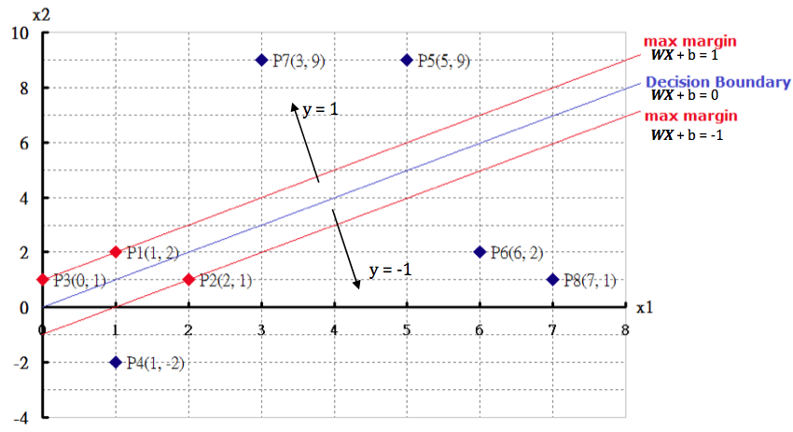
SVM

Slide 60
SVM
b) Use the decision boundary to classify the testing data:
  For the point P9 (2,5)
  -x₁+x₂ = -2+5 = 3 >= 1
  So we choose y = 1
  For the point P10 (7,2)
  -x₁+x₂ = -7+2 = -5 <= -1
  So we choose y = -1
Showed in the picture next page.

Slide 61
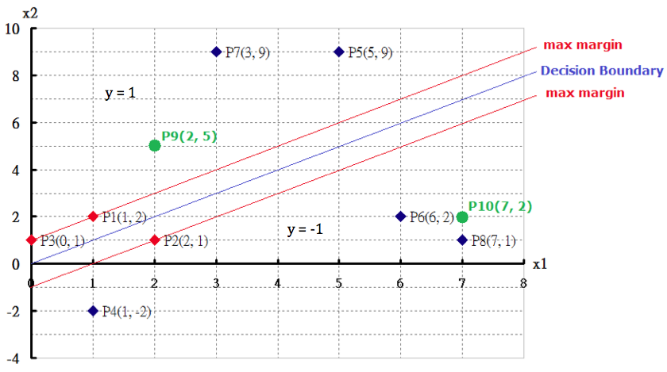
SVM

Slide 62
SVM vs. Neural Network
SVM
  Deterministic algorithm
  Nice generalization properties
  Hard to learn – learned in batch mode using quadratic programming techniques
  Using kernels can learn very complex functions
Neural Network
  Nondeterministic algorithm
  Generalizes well but doesn’t have strong mathematical foundation
  Can easily be learned in incremental fashion
  To learn complex functions—use multilayer perceptron (nontrivial)

Slide 63
SVM Related Links
SVM Website: http://www.kernel-machines.org/
Representative implementations
  LIBSVM: an efficient implementation of SVM, multi-class classifications, nu-SVM, one-class SVM, including also various interfaces with java, python, etc.
  SVM-light: simpler but performance is not better than LIBSVM, support only binary classification and only in C
  SVM-torch: another recent implementation also written in C

Slide 64
Chapter 9. Classification: Advanced Methods
Classification by Backpropagation
Support Vector Machines
Additional Topics Regarding Classification
Summary

Slide 65
Multiclass Classification
Classification involving more than two classes (i.e., > 2 Classes)
Method 1. One-vs.-all (OVA): Learn a classifier one at a time
  Given m classes, train m classifiers: one for each class
  Classifier j: treat tuples in class j as positive & all others as negative
  To classify a tuple X, the set of classifiers vote as an ensemble
Method 2. All-vs.-all (AVA): Learn a classifier for each pair of classes
  Given m classes, construct m(m-1)/2 binary classifiers
  A classifier is trained using tuples of the two classes
  To classify a tuple X, each classifier votes. X is assigned to the class with maximal vote
Comparison
  All-vs.-all tends to be superior to one-vs.-all
  Problem: Binary classifier is sensitive to errors, and errors affect vote count

Slide 66
Error-Correcting Codes for Multiclass Classification
Originally designed to correct errors during data transmission for communication tasks by exploring data redundancy
Example
  A 7-bit codeword associated with classes 1-4
Class | Error-Corr. Codeword
C₁ | 1 | 1 | 1 | 1 | 1 | 1 | 1
C₂ | 0 | 0 | 0 | 0 | 1 | 1 | 1
C₃ | 0 | 0 | 1 | 1 | 0 | 0 | 1
C₄ | 0 | 1 | 0 | 1 | 0 | 1 | 0
  Given a unknown tuple X, the 7-trained classifiers output: 0001010
  Hamming distance: # of different bits between two codewords
  H(X, C₁) = 5, by checking # of bits between [1111111] & [0001010]
  H(X, C₂) = 3, H(X, C₃) = 3, H(X, C₄) = 1, thus C₄ as the label for X
Error-correcting codes can correct up to (h-1)/h 1-bit error, where h is the minimum Hamming distance between any two codewords
If we use 1-bit per class, it is equiv. to one-vs.-all approach, the code are insufficient to self-correct
When selecting error-correcting codes, there should be good row-wise and col.-wise separation between the codewords

Slide 67
Semi-Supervised Classification
Semi-supervised: Uses labeled and unlabeled data to build a classifier
Self-training:
  Build a classifier using the labeled data
  Use it to label the unlabeled data, and those with the most confident label prediction are added to the set of labeled data
  Repeat the above process
  Adv: easy to understand; disadv: may reinforce errors
Co-training: Use two or more classifiers to teach each other
  Each learner uses a mutually independent set of features of each tuple to train a good classifier, say f₁
  Then f₁ and f₂ are used to predict the class label for unlabeled data X
  Teach each other: The tuple having the most confident prediction from f₁ is added to the set of labeled data for f₂, & vice versa
Other methods, e.g., joint probability distribution of features and labels

Slide 68
Active Learning
Class labels are expensive to obtain
Active learner: query human (oracle) for labels
Pool-based approach: Uses a pool of unlabeled data
  L: a small subset of D is labeled, U: a pool of unlabeled data in D
  Use a query function to carefully select one or more tuples from U and request labels from an oracle (a human annotator)
  The newly labeled samples are added to L, and learn a model
  Goal: Achieve high accuracy using as few labeled data as possible
Evaluated using learning curves: Accuracy as a function of the number of instances queried (# of tuples to be queried should be small)
Research issue: How to choose the data tuples to be queried?
  Uncertainty sampling: choose the least certain ones
  Reduce version space, the subset of hypotheses consistent w. the training data
  Reduce expected entropy over U: Find the greatest reduction in the total number of incorrect predictions

Slide 69
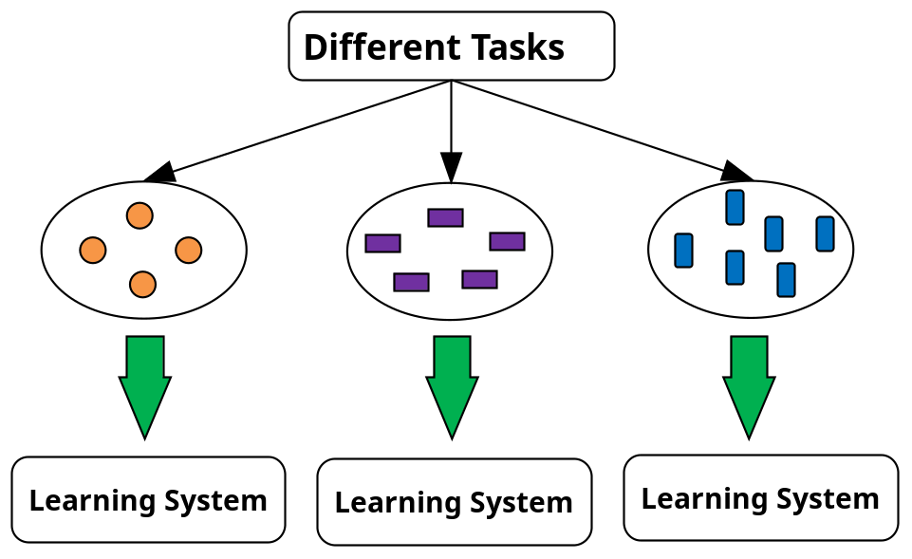
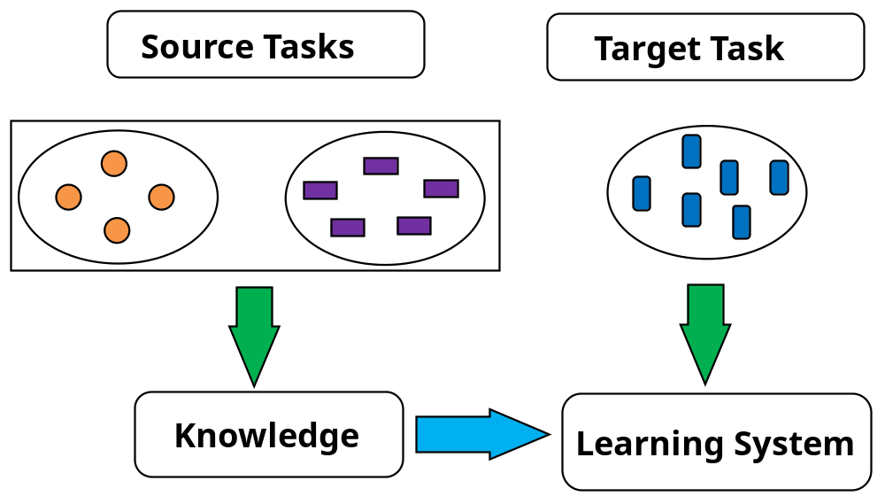
Transfer Learning: Conceptual Framework
Transfer learning: Extract knowledge from one or more source tasks and apply the knowledge to a target task
Traditional learning: Build a new classifier for each new task
Transfer learning: Build new classifier by applying existing knowledge learned from source tasks
Traditional Learning Framework
Transfer Learning Framework

Slide 70
Transfer Learning: Methods and Applications
Applications: Especially useful when data is outdated or distribution changes, e.g., Web document classification, e-mail spam filtering
Instance-based transfer learning: Reweight some of the data from source tasks and use it to learn the target task
TrAdaBoost (Transfer AdaBoost)
  Assume source and target data each described by the same set of attributes (features) & class labels, but rather diff. distributions
  Require only labeling a small amount of target data
  Use source data in training: When a source tuple is misclassified, reduce the weight of such tupels so that they will have less effect on the subsequent classifier
Research issues
  Negative transfer: When it performs worse than no transfer at all
  Heterogeneous transfer learning: Transfer knowledge from different feature space or multiple source domains
  Large-scale transfer learning

Slide 71
Chapter 9. Classification: Advanced Methods
Classification by Backpropagation
Support Vector Machines
Additional Topics Regarding Classification
Summary

Slide 72
Summary
Effective and advanced classification methods
  Bayesian belief network (probabilistic networks)
  Backpropagation (Neural networks)
  Support Vector Machine (SVM)
  Pattern-based classification
  Other classification methods: lazy learners (KNN, case-based reasoning), genetic algorithms, rough set and fuzzy set approaches
Additional Topics on Classification
  Multiclass classification
  Semi-supervised classification
  Active learning
  Transfer learning

Slide 73
SVM—Introductory Literature
“Statistical Learning Theory” by Vapnik: extremely hard to understand, containing many errors too.
C. J. C. Burges. A Tutorial on Support Vector Machines for Pattern Recognition. Knowledge Discovery and Data Mining, 2(2), 1998.
  Better than the Vapnik’s book, but still written too hard for introduction, and the examples are so not-intuitive
The book “An Introduction to Support Vector Machines” by N. Cristianini and J. Shawe-Taylor
  Also written hard for introduction, but the explanation about the mercer’s theorem is better than above literatures
The neural network book by Haykins
  Contains one nice chapter of SVM introduction
Data Mining: Concepts and Techniques

Slide 74
Notes about SVM—
Introductory Literature
“Statistical Learning Theory” by Vapnik: difficult to understand, containing many errors.
C. J. C. Burges. A Tutorial on Support Vector Machines for Pattern Recognition. Knowledge Discovery and Data Mining, 2(2), 1998.
  Easier than Vapnik’s book, but still not introductory level; the examples are not so intuitive
The book An Introduction to Support Vector Machines by Cristianini and Shawe-Taylor
  Not introductory level, but the explanation about Mercer’s Theorem is better than above literatures
Neural Networks and Learning Machines by Haykin
  Contains a nice chapter on SVM introduction
Notes:
MK: Do we need this slide here?? We don’t give references for other topics until the reference section

Slide 75
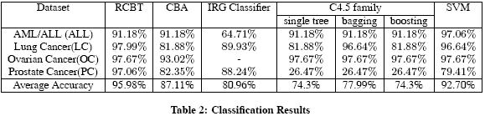
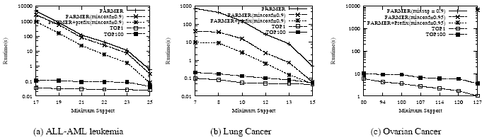
Associative Classification Can Achieve High Accuracy and Efficiency (Cong et al. SIGMOD05)

Slide 76
A Closer Look at CMAR
CMAR (Classification based on Multiple Association Rules: Li, Han, Pei, ICDM’01)
Efficiency: Uses an enhanced FP-tree that maintains the distribution of class labels among tuples satisfying each frequent itemset
Rule pruning whenever a rule is inserted into the tree
  Given two rules, R₁ and R₂, if the antecedent of R₁ is more general than that of R₂ and conf(R₁) ≥ conf(R₂), then prune R₂
  Prunes rules for which the rule antecedent and class are not positively correlated, based on a χ² test of statistical significance
Classification based on generated/pruned rules
  If only one rule satisfies tuple X, assign the class label of the rule
  If a rule set S satisfies X, CMAR
    divides S into groups according to class labels
    uses a weighted χ² measure to find the strongest group of rules, based on the statistical correlation of rules within a group
    assigns X the class label of the strongest group

