Slide 1
MSCIT 5210: Knowledge Discovery and Data Mining
Acknowledgement: Slides modified by Dr. Lei Chen based on the slides provided by Jiawei Han, Micheline Kamber, and Jian Pei
©2012 Han, Kamber & Pei. All rights reserved.
1
Notes:
1

Slide 2
Chapter 10. Cluster Analysis: Basic Concepts and Methods
Cluster Analysis: Basic Concepts
Partitioning Methods
Hierarchical Methods
Density-Based Methods
Grid-Based Methods
Evaluation of Clustering
Summary
2
2
Notes:
2

Slide 3
What is Cluster Analysis?
Cluster: A collection of data objects
similar (or related) to one another within the same group
dissimilar (or unrelated) to the objects in other groups
Cluster analysis (or clustering, data segmentation, …)
Finding similarities between data according to the characteristics found in the data and grouping similar data objects into clusters
Unsupervised learning: no predefined classes (i.e., learning by observations vs. learning by examples: supervised)
Typical applications
As a stand-alone tool to get insight into data distribution
As a preprocessing step for other algorithms

Slide 4
Clustering for Data Understanding and Applications
Biology: taxonomy of living things: kingdom, phylum, class, order, family, genus and species
Information retrieval: document clustering
Land use: Identification of areas of similar land use in an earth observation database
Marketing: Help marketers discover distinct groups in their customer bases, and then use this knowledge to develop targeted marketing programs
City-planning: Identifying groups of houses according to their house type, value, and geographical location
Earth-quake studies: Observed earth quake epicenters should be clustered along continent faults
Climate: understanding earth climate, find patterns of atmospheric and ocean
Economic Science: market resarch

Slide 5
Clustering as a Preprocessing Tool (Utility)
Summarization:
Preprocessing for regression, PCA, classification, and association analysis
Compression:
Image processing: vector quantization
Finding K-nearest Neighbors
Localizing search to one or a small number of clusters
Outlier detection
Outliers are often viewed as those “far away” from any cluster

Slide 6
Quality: What Is Good Clustering?
A good clustering method will produce high quality clusters
high intra-class similarity: cohesive within clusters
low inter-class similarity: distinctive between clusters
The quality of a clustering method depends on
the similarity measure used by the method
its implementation, and
Its ability to discover some or all of the hidden patterns

Slide 7
Measure the Quality of Clustering
Dissimilarity/Similarity metric
Similarity is expressed in terms of a distance function, typically metric: d(i, j)
The definitions of distance functions are usually rather different for interval-scaled, boolean, categorical, ordinal ratio, and vector variables
Weights should be associated with different variables based on applications and data semantics
Quality of clustering:
There is usually a separate “quality” function that measures the “goodness” of a cluster.
It is hard to define “similar enough” or “good enough”
The answer is typically highly subjective

Slide 8
Considerations for Cluster Analysis
Partitioning criteria
Single level vs. hierarchical partitioning (often, multi-level hierarchical partitioning is desirable)
Separation of clusters
Exclusive (e.g., one customer belongs to only one region) vs. non-exclusive (e.g., one document may belong to more than one class)
Similarity measure
Distance-based (e.g., Euclidian, road network, vector) vs. connectivity-based (e.g., density or contiguity)
Clustering space
Full space (often when low dimensional) vs. subspaces (often in high-dimensional clustering)

Slide 9
Requirements and Challenges
Scalability
Clustering all the data instead of only on samples
Ability to deal with different types of attributes
Numerical, binary, categorical, ordinal, linked, and mixture of these
Constraint-based clustering
User may give inputs on constraints
Use domain knowledge to determine input parameters
Interpretability and usability
Others
Discovery of clusters with arbitrary shape
Ability to deal with noisy data
Incremental clustering and insensitivity to input order
High dimensionality

Slide 10
Major Clustering Approaches (I)
Partitioning approach:
Construct various partitions and then evaluate them by some criterion, e.g., minimizing the sum of square errors
Typical methods: k-means, k-medoids, CLARANS
Hierarchical approach:
Create a hierarchical decomposition of the set of data (or objects) using some criterion
Typical methods: Diana, Agnes, BIRCH, CAMELEON
Density-based approach:
Based on connectivity and density functions
Typical methods: DBSACN, OPTICS, DenClue
Grid-based approach:
based on a multiple-level granularity structure
Typical methods: STING, WaveCluster, CLIQUE

Slide 11
Major Clustering Approaches (II)
Model-based:
A model is hypothesized for each of the clusters and tries to find the best fit of that model to each other
Typical methods: EM, SOM, COBWEB
Frequent pattern-based:
Based on the analysis of frequent patterns
Typical methods: p-Cluster
User-guided or constraint-based:
Clustering by considering user-specified or application-specific constraints
Typical methods: COD (obstacles), constrained clustering
Link-based clustering:
Objects are often linked together in various ways
Massive links can be used to cluster objects: SimRank, LinkClus

Slide 12
Chapter 10. Cluster Analysis: Basic Concepts and Methods
Cluster Analysis: Basic Concepts
Partitioning Methods
Hierarchical Methods
Density-Based Methods
Grid-Based Methods
Evaluation of Clustering
Summary
12
12
Notes:
12

Slide 13
Partitioning Algorithms: Basic Concept
Partitioning method: Partitioning a database D of n objects into a set of k clusters, such that the sum of squared distances is minimized (where c_{i} is the centroid or medoid of cluster C_{i})
Given k, find a partition of k clusters that optimizes the chosen partitioning criterion
Global optimal: exhaustively enumerate all partitions
Heuristic methods: k-means and k-medoids algorithms
k-means (MacQueen’67, Lloyd’57/’82): Each cluster is represented by the center of the cluster
k-medoids or PAM (Partition around medoids) (Kaufman & Rousseeuw’87): Each cluster is represented by one of the objects in the cluster

Slide 14
The K-Means Clustering Method
Given k, the k-means algorithm is implemented in four steps:
Partition objects into k nonempty subsets
Compute seed points as the centroids of the clusters of the current partitioning (the centroid is the center, i.e., mean point, of the cluster)
Assign each object to the cluster with the nearest seed point
Go back to Step 2, stop when the assignment does not change

Slide 15
An Example of K-Means Clustering
K=2
Arbitrarily partition objects into k groups
Update the cluster centroids
The initial data set
Loop if needed
Reassign objects
Partition objects into k nonempty subsets
Repeat
Compute centroid (i.e., mean point) for each partition
Assign each object to the cluster of its nearest centroid
Until no change
Update the cluster centroids

Slide 16
The K-Means Clustering Method
Example
10
10
9
9
8
8
7
7
6
6
5
5
4
Assign each objects to most similar center
Update the cluster means
4
3
3
2
2
1
1
0
0
0
1
2
3
4
5
6
7
8
9
10
0
1
2
3
4
5
6
7
8
9
10
reassign
reassign
K=2
Arbitrarily choose K object as initial cluster center
Update the cluster means

Slide 17
K-Means
Consider the following 6 two-dimensional data points:
x1: (0, 0), x2:(1, 0), x3(1, 1), x4(2, 1), x5(3, 1), x6(3, 0)
If k=2, and the initial means are (0, 0) and (2, 1), (using Euclidean Distance)
Use K-means to cluster the points.

Slide 18
K-Means
Now we know the initial means:
Mean_one(0, 0) and mean_two(2, 1),
We are going to use Euclidean Distance to calculate the distance between each point and each mean.
For example:
Point x1 (0, 0), point x1 is exactly the initial mean_one, so we can directly put x1 into cluster one.

Slide 19
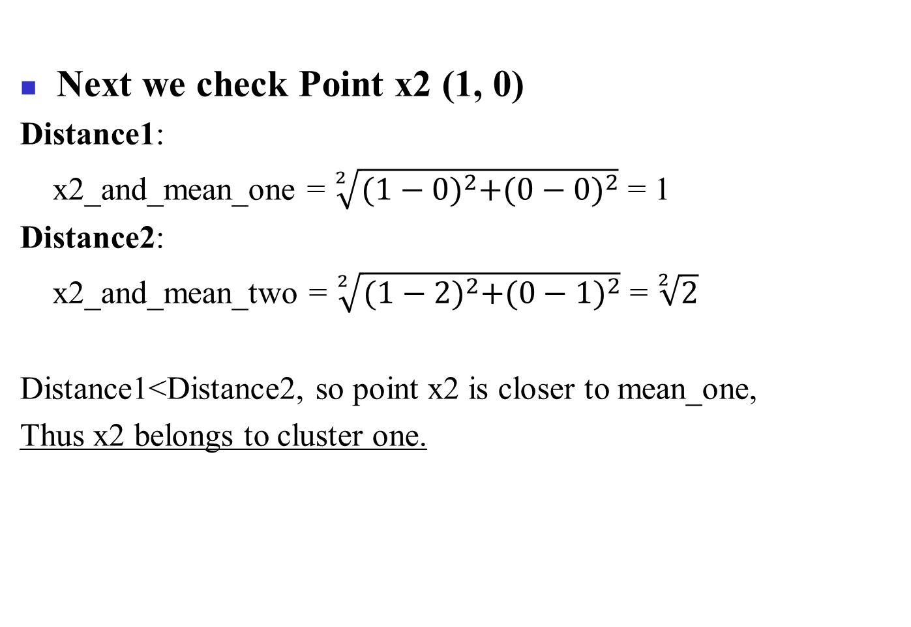
K-Means
Next we check Point x2 (1, 0)
Distance1:
x2_and_mean_one = $\sqrt[2]{{(1−0)}^{2}+{(0−0)}^{2}}$ = 1
Distance2:
x2_and_mean_two = $\sqrt[2]{{(1−2)}^{2}+{(0−1)}^{2}}$ = $\sqrt[2]{2}$
Distance1<Distance2, so point x2 is closer to mean_one,
Thus x2 belongs to cluster one.

Slide 20
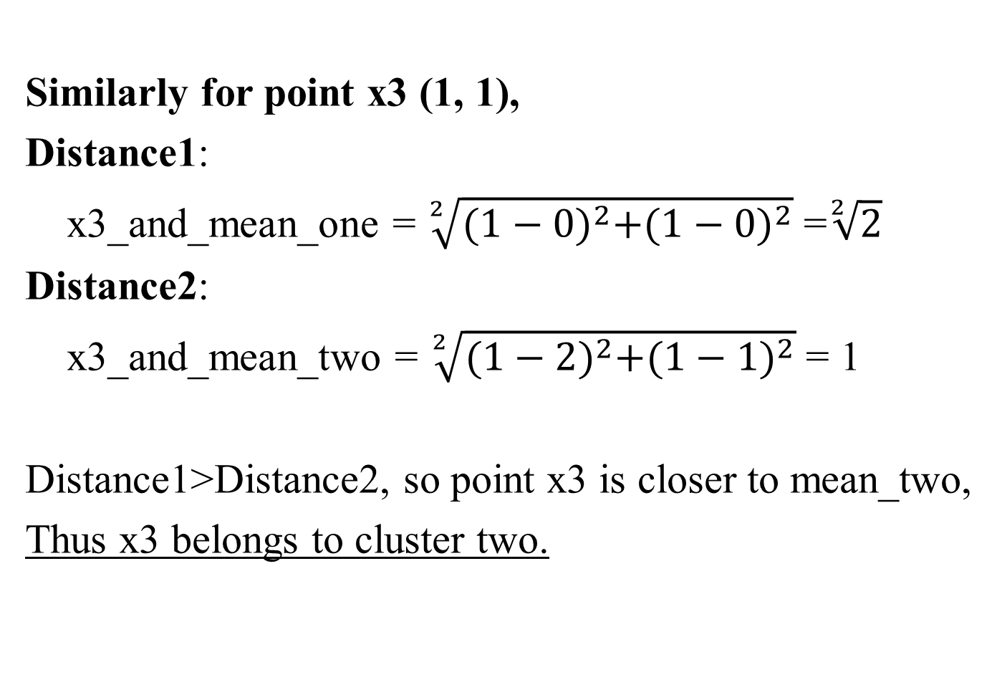
K-Means
Similarly for point x3 (1, 1),
Distance1:
x3_and_mean_one = $\sqrt[2]{{(1−0)}^{2}+{(1−0)}^{2}}$ =$\sqrt[2]{2}$
Distance2:
x3_and_mean_two = $\sqrt[2]{{(1−2)}^{2}+{(1−1)}^{2}}$ = 1
Distance1>Distance2, so point x3 is closer to mean_two,
Thus x3 belongs to cluster two.

Slide 21
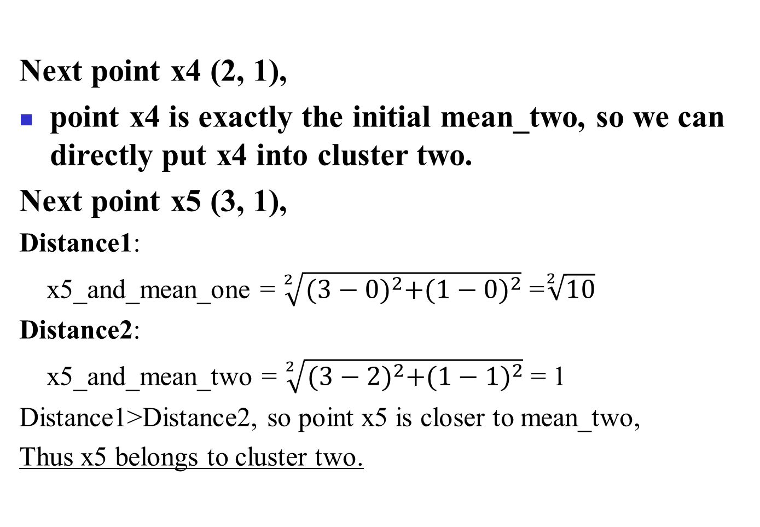
K-Means
Next point x4 (2, 1),
point x4 is exactly the initial mean_two, so we can directly put x4 into cluster two.
Next point x5 (3, 1),
Distance1:
x5_and_mean_one = $\sqrt[2]{{(3−0)}^{2}+{(1−0)}^{2}}$ =$\sqrt[2]{10}$
Distance2:
x5_and_mean_two = $\sqrt[2]{{(3−2)}^{2}+{(1−1)}^{2}}$ = 1
Distance1>Distance2, so point x5 is closer to mean_two,
Thus x5 belongs to cluster two.

Slide 22
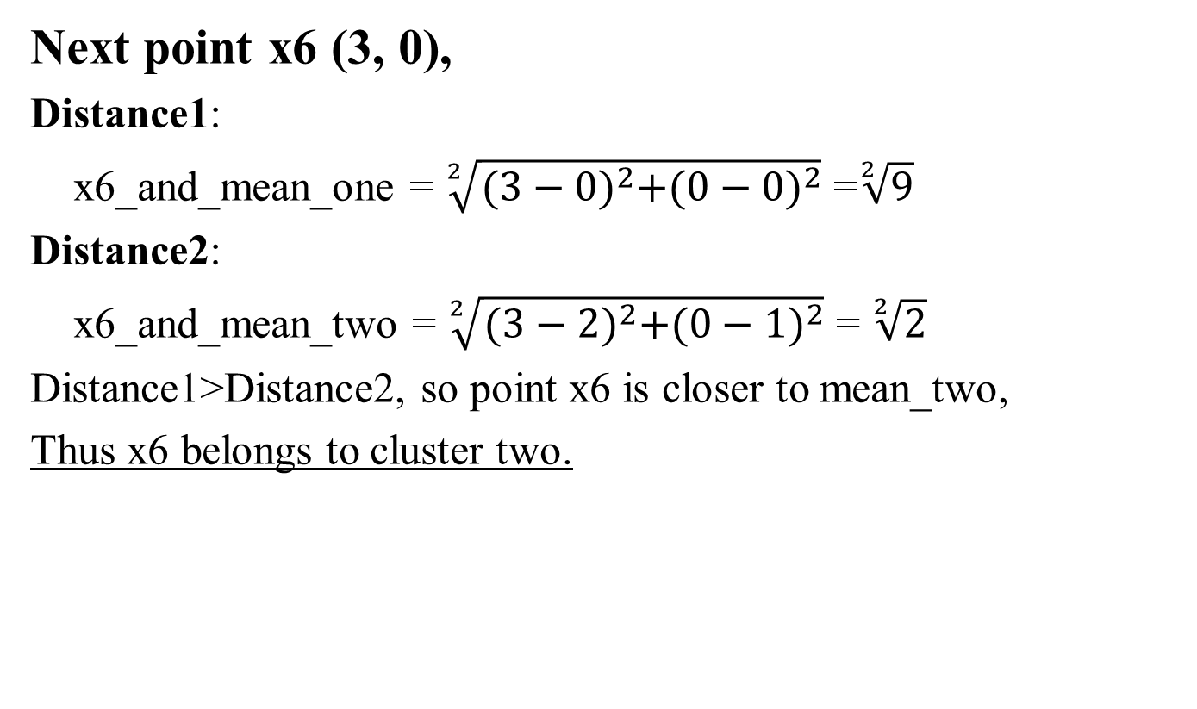
K-Means
Next point x6 (3, 0),
Distance1:
x6_and_mean_one = $\sqrt[2]{{(3−0)}^{2}+{(0−0)}^{2}}$ =$\sqrt[2]{9}$
Distance2:
x6_and_mean_two = $\sqrt[2]{{(3−2)}^{2}+{(0−1)}^{2}}$ = $\sqrt[2]{2}$
Distance1>Distance2, so point x6 is closer to mean_two,
Thus x6 belongs to cluster two.

Slide 23
K-Means
Now the two clusters are as follows:
Cluster_One:
x1(0, 0), x2(1, 0)
Cluster_Two:
x3(1, 1), x4(2, 1), x5(3, 1), x6(3, 0)
Now update the cluster means:
Mean of Cluster_One:
mean_one = ((0+1)/2, (0+0)/2) = (0.5, 0)
Mean of Cluster_Two:
mean_two = ((1+2+3+3)/4, (1+1+1+0)/4) = (2.25, 0.75)

Slide 24
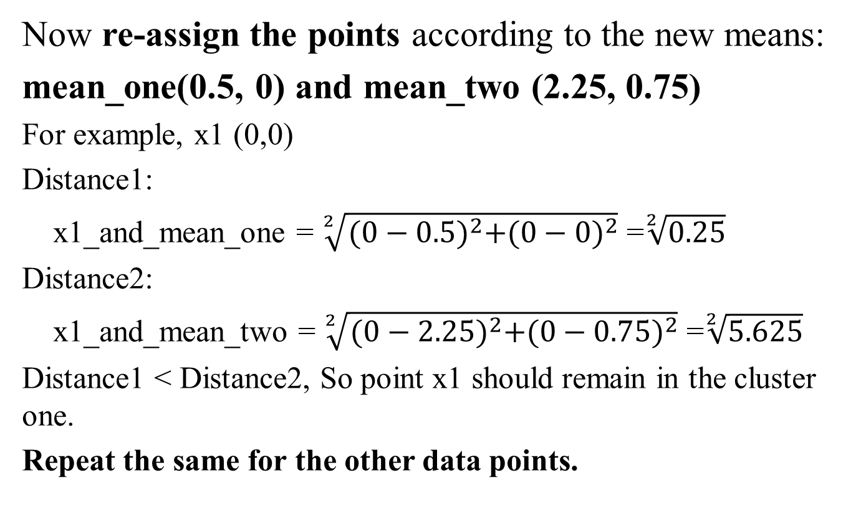
K-Means
Now re-assign the points according to the new means:
mean_one(0.5, 0) and mean_two (2.25, 0.75)
For example, x1 (0,0)
Distance1:
x1_and_mean_one = $\sqrt[2]{{(0−0.5)}^{2}+{(0−0)}^{2}}$ =$\sqrt[2]{0.25}$
Distance2:
x1_and_mean_two = $\sqrt[2]{{(0−2.25)}^{2}+{(0−0.75)}^{2}}$ =$\sqrt[2]{5.625}$
Distance1 < Distance2, So point x1 should remain in the cluster one.
Repeat the same for the other data points.

Slide 25
K-Means
After this re-assign iteration:
Cluster One:
x1(0, 0), x2(1, 0), x3(1, 1)
Cluster Two:
x4(2, 0), x5(3, 1), x6(3, 0)
Now update the cluster means:
Mean of Cluster_One:
mean_one = ((0+1+1)/3, (0+0+1)/3) = (0.667, 0.33)
Mean of Cluster_Two:
mean_two = ((2+3+3)/3, (0+1+0)/3) = (2.67, 0.33)

Slide 26
K-Means
Now re-assign the points according to the new means:
mean_one(0.667, 0.33) and mean_two (2.67, 0.33)
…
However, after the re-assign process, we find that the clusters remain the same, so we can stop here since there is no change at all.
So the final results are :
Cluster One:
x1(0, 0), x2(1, 0), x3(1, 1)
Cluster Two:
x4(2, 0), x5(3, 1), x6(3, 0)

Slide 27
Comments on the K-Means Method
Strength: Efficient: O(tkn), where n is # objects, k is # clusters, and t is # iterations. Normally, k, t << n.
Comparing: PAM: O(k(n-k)² ), CLARA: O(ks² + k(n-k))
Comment: Often terminates at a local optimal
Weakness
Applicable only to objects in a continuous n-dimensional space
Using the k-modes method for categorical data
In comparison, k-medoids can be applied to a wide range of data
Need to specify k, the number of clusters, in advance (there are ways to automatically determine the best k (see Hastie et al., 2009)
Sensitive to noisy data and outliers
Not suitable to discover clusters with non-convex shapes

Slide 28
Variations of the K-Means Method
Most of the variants of the k-means which differ in
Selection of the initial k means
Dissimilarity calculations
Strategies to calculate cluster means
Handling categorical data: k-modes
Replacing means of clusters with modes
Using new dissimilarity measures to deal with categorical objects
Using a frequency-based method to update modes of clusters
A mixture of categorical and numerical data: k-prototype method

Slide 29
What Is the Problem of the K-Means Method?
The k-means algorithm is sensitive to outliers !
Since an object with an extremely large value may substantially distort the distribution of the data
K-Medoids: Instead of taking the mean value of the object in a cluster as a reference point, medoids can be used, which is the most centrally located object in a cluster
10
10
9
9
8
8
7
7
6
6
5
5
4
4
3
3
2
2
1
1
0
0
1
2
3
4
5
6
7
8
9
10
0
0
1
2
3
4
5
6
7
8
9
10

Slide 30
PAM: A Typical K-Medoids Algorithm
Total Cost = 20
10
9
8
Arbitrary choose k object as initial medoids
Assign each remaining object to nearest medoids
7
6
5
4
3
2
1
0
0
1
2
3
4
5
6
7
8
9
10
K=2
Randomly select a nonmedoid object,O_{ramdom}
Total Cost = 26
Do loop
Until no change
10
10
9
Compute total cost of swapping
9
Swapping O and O_{ramdom}
If quality is improved.
8
8
7
7
6
6
5
5
4
4
3
3
2
2
1
1
0
0
1
2
3
4
5
6
7
8
9
10
0
0
1
2
3
4
5
6
7
8
9
10
30
Notes:
30

Slide 31
PAM (Partitioning Around Medoids) (1987)
PAM (Kaufman and Rousseeuw, 1987), built in Splus
Use real object to represent the cluster
Select k representative objects arbitrarily
For each pair of non-selected object h and selected object i, calculate the total swapping cost TC_{ih}
For each pair of i and h,
If TC_{ih} < 0, i is replaced by h
Then assign each non-selected object to the most similar representative object
repeat steps 2-3 until there is no change

Slide 32
PAM Clustering: Total swapping cost TC_{ih}=∑_{j}C_{jih}
t
j
t
j
i
h
h
i
h
j
i
i
t
h
j
t

Slide 40
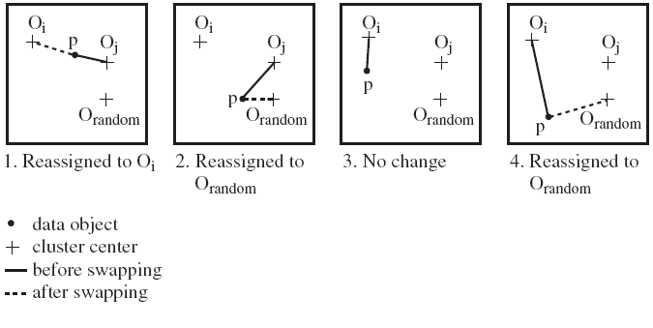
PAM Clustering: Finding the Best Cluster Center
Case 1: p currently belongs to o_{j}. If o_{j} is replaced by o_{random} as a representative object and p is the closest to one of the other representative object o_{i}, then p is reassigned to o_{i}

Slide 41
What Is the Problem with PAM?
Pam is more robust than k-means in the presence of noise and outliers because a medoid is less influenced by outliers or other extreme values than a mean
Pam works efficiently for small data sets but does not scale well for large data sets.
O(k(n-k)² ) for each iteration
where n is # of data,k is # of clusters
Sampling-based method
CLARA(Clustering LARge Applications)

Slide 42
CLARA (Clustering Large Applications) (1990)
CLARA (Kaufmann and Rousseeuw in 1990)
Built in statistical analysis packages, such as SPlus
It draws multiple samples of the data set, applies PAM on each sample, and gives the best clustering as the output
Strength: deals with larger data sets than PAM
Weakness:
Efficiency depends on the sample size
A good clustering based on samples will not necessarily represent a good clustering of the whole data set if the sample is biased

Slide 43
CLARANS (“Randomized” CLARA) (1994)
CLARANS (A Clustering Algorithm based on Randomized Search) (Ng and Han’94)
Draws sample of neighbors dynamically
The clustering process can be presented as searching a graph where every node is a potential solution, that is, a set of k medoids
If the local optimum is found, it starts with new randomly selected node in search for a new local optimum
Advantages: More efficient and scalable than both PAM and CLARA
Further improvement: Focusing techniques and spatial access structures (Ester et al.’95)

Slide 44
The K-Medoid Clustering Method
K-Medoids Clustering: Find representative objects (medoids) in clusters
PAM (Partitioning Around Medoids, Kaufmann & Rousseeuw 1987)
Starts from an initial set of medoids and iteratively replaces one of the medoids by one of the non-medoids if it improves the total distance of the resulting clustering
PAM works effectively for small data sets, but does not scale well for large data sets (due to the computational complexity)
Efficiency improvement on PAM
CLARA (Kaufmann & Rousseeuw, 1990): PAM on samples
CLARANS (Ng & Han, 1994): Randomized re-sampling

Slide 45
Chapter 10. Cluster Analysis: Basic Concepts and Methods
Cluster Analysis: Basic Concepts
Partitioning Methods
Hierarchical Methods
Density-Based Methods
Grid-Based Methods
Evaluation of Clustering
Summary
45
45
Notes:
45

Slide 46
Hierarchical Clustering
Use distance matrix as clustering criteria. This method does not require the number of clusters k as an input, but needs a termination condition
Step 0
Step 1
Step 2
Step 3
Step 4
agglomerative
(AGNES)
a
a b
b
a b c d e
c
c d e
d
d e
e
divisive
(DIANA)
Step 4
Step 3
Step 2
Step 1
Step 0

Slide 47
AGNES (Agglomerative Nesting)
Introduced in Kaufmann and Rousseeuw (1990)
Implemented in statistical packages, e.g., Splus
Use the single-link method and the dissimilarity matrix
Merge nodes that have the least dissimilarity
Go on in a non-descending fashion
Eventually all nodes belong to the same cluster

Slide 48
Dendrogram: Shows How Clusters are Merged
Decompose data objects into a several levels of nested partitioning (tree of clusters), called a dendrogram
A clustering of the data objects is obtained by cutting the dendrogram at the desired level, then each connected component forms a cluster

Slide 49
DIANA (Divisive Analysis)
Introduced in Kaufmann and Rousseeuw (1990)
Implemented in statistical analysis packages, e.g., Splus
Inverse order of AGNES
Eventually each node forms a cluster on its own

Slide 50
Distance between Clusters
X
X
Single link: smallest distance between an element in one cluster and an element in the other, i.e., dist(K_{i}, K_{j}) = min(t_{ip}, t_{jq})
Complete link: largest distance between an element in one cluster and an element in the other, i.e., dist(K_{i}, K_{j}) = max(t_{ip}, t_{jq})
Average: avg distance between an element in one cluster and an element in the other, i.e., dist(K_{i}, K_{j}) = avg(t_{ip}, t_{jq})
Centroid: distance between the centroids of two clusters, i.e., dist(K_{i}, K_{j}) = dist(C_{i}, C_{j})
Medoid: distance between the medoids of two clusters, i.e., dist(K_{i}, K_{j}) = dist(M_{i}, M_{j})
Medoid: a chosen, centrally located object in the cluster
50
Notes:
50

Slide 51
Centroid, Radius and Diameter of a Cluster (for numerical data sets)
Centroid: the “middle” of a cluster
Radius: square root of average distance from any point of the cluster to its centroid
Diameter: square root of average mean squared distance between all pairs of points in the cluster
51
Notes:
51

Slide 52
Dendrogram
Hierarchic grouping can be represented by two-dimensional diagram known as a dendrogram.
Dendrogram
3
4
5
2
1
5.0
4.0
3.0
2.0
1.0
0
Distance

Slide 53
Distance
Single Linkage
Complete Linkage
Group Average Linkage
Centroid Linkage
Median Linkage

Slide 54
Single Linkage
Also, known as the nearest neighbor technique
Distance between groups is defined as that of the closest pair of data, where only pairs consisting of one record from each group are considered
Cluster B
Cluster A

Slide 55
Find the smallest value, merge them
1
2
3
4
5
1
(12)
3
4
5
2
(12)
3
3
4
4
5
5
Dendrogram
2
Update Distance
1
5.0
4.0
3.0
2.0
1.0
0
Distance

Slide 56
1 and 2 as a whole
(12)
3
4
5
(12)
3
4
5
Dendrogram
2
1
5.0
4.0
3.0
2.0
1.0
0
Distance

Slide 57
Repeat: find the smallest one, merge
(12)
3
4
5
(12)
3
(4 5)
(12)
(12)
3
3
4
(4 5)
5
Dendrogram
5
4
2
1
5.0
4.0
3.0
2.0
1.0
0
Distance

Slide 58
(12)
3
(4 5)
(12)
3
(4 5)
Dendrogram
5
4
2
1
5.0
4.0
3.0
2.0
1.0
0
Distance

Slide 59
(12)
3
(4 5)
(12)
(3 4 5)
(12)
(12)
3
(3 4 5)
(4 5)
Dendrogram
5
4
3
2
1
5.0
4.0
3.0
2.0
1.0
0
Distance

Slide 60
(12)
(3 4 5)
(12)
(3 4 5)
Dendrogram
5
4
3
2
1
5.0
4.0
3.0
2.0
1.0
0
Distance

Slide 61
(12)
(3 4 5)
(12)
(3 4 5)
Dendrogram
5
4
3
2
1
5.0
4.0
3.0
2.0
1.0
0
Distance

Slide 62
Chapter 10. Cluster Analysis: Basic Concepts and Methods
Cluster Analysis: Basic Concepts
Partitioning Methods
Hierarchical Methods
Density-Based Methods
Grid-Based Methods
Evaluation of Clustering
Summary
62
62
Notes:
62

Slide 63
Density-Based Clustering Methods
Clustering based on density (local cluster criterion), such as density-connected points
Major features:
Discover clusters of arbitrary shape
Handle noise
One scan
Need density parameters as termination condition
Several interesting studies:
DBSCAN: Ester, et al. (KDD’96)
OPTICS: Ankerst, et al (SIGMOD’99).
DENCLUE: Hinneburg & D. Keim (KDD’98)
CLIQUE: Agrawal, et al. (SIGMOD’98) (more grid-based)

Slide 64
Density-Based Clustering: Basic Concepts
Two parameters:
Eps: Maximum radius of the neighbourhood
MinPts: Minimum number of points in an Eps-neighbourhood of that point
N_{Eps}(q): {p belongs to D | dist(p,q) ≤ Eps}
Directly density-reachable: A point p is directly density-reachable from a point q w.r.t. Eps, MinPts if
p belongs to N_{Eps}(q)
core point condition:
|N_{Eps} (q)| ≥ MinPts
p
MinPts = 5
Eps = 1 cm
q

Slide 65
Density-Reachable and Density-Connected
Density-reachable:
A point p is density-reachable from a point q w.r.t. Eps, MinPts if there is a chain of points p₁, …, p_{n}, p₁ = q, p_{n} = p such that p_{i+1} is directly density-reachable from p_{i}
Density-connected
A point p is density-connected to a point q w.r.t. Eps, MinPts if there is a point o such that both, p and q are density-reachable from o w.r.t. Eps and MinPts
p
p₁
q
p
q
o

Slide 66
DBSCAN: Density-Based Spatial Clustering of Applications with Noise
Relies on a density-based notion of cluster: A cluster is defined as a maximal set of density-connected points
Discovers clusters of arbitrary shape in spatial databases with noise
A point is a core point if it has more than a specified number of points (MinPts) within Eps
These are points that are at the interior of a cluster
A border point has fewer than MinPts within Eps, but is in the neighborhood of a core point
Outlier
Border
Eps = 1cm
MinPts = 5
Core

Slide 67
DBSCAN: The Algorithm
Arbitrary select a point p
Retrieve all points density-reachable from p w.r.t. Eps and MinPts
If p is a core point, a cluster is formed
If p is a border point, no points are density-reachable from p and DBSCAN visits the next point of the database
Continue the process until all of the points have been processed
If a spatial index is used, the computational complexity of DBSCAN is O(nlogn), where n is the number of database objects. Otherwise, the complexity is O(n²)

Slide 68
DBSCAN
b
c
d
a
e
Given a point p and a non-negative real number ε,
the ε-neighborhood of point p, denoted by N(p), is the set of points q (including point p itself) such that the distance between p and q is within ε.

Slide 69
DBSCAN
b
c
d
a
e
According to ε-neighborhood of point p, we classify all points into three types
core points
border points
noise points
Given a point p and a non-negative integer MinPts, if the size of N(p) is at least MinPts, then p is said to be a core point.
Given a point p, p is said to be a border point if it is not a core point but N(p) contains at least one core point.
Given a point p, p is said to be a noise point if it is neither a core point nor a border point.

Slide 70
Example
Consider the following 9 two-dimensional data points:
x1(0,0), x2(1,0), x3(1,1), x4(2,2), x5(3,1), x6(3,0),
x7(0,1), x8(3,2), x9(6,3)
Use the Euclidean Distance with Eps =1 and MinPts = 3
(Eps is short for epsilon: ε)
Find all core points, border points and noise points, and show the final clusters using DBCSAN algorithm.

Slide 71
Example

Slide 72
Calculate the N(p), ε-neighborhood of point p
N(x1) = {x1, x2, x7}
N(x2) = {x2, x1, x3}
N(x3) = {x3, x2, x7}
N(x4) = {x4, x8}
N(x5) = {x5, x6, x8}
N(x6) = {x6, x5}
N(x7) = {x7, x1, x3}
N(x8) = {x8, x4, x5}
N(x9) = {x9}

Slide 73
Find all core points according to N(p)
If the size of N(p) is at least MinPts, then p is said to be a core point.
Here the given MinPts is 3, thus the size of N(p) is at least 3.
We can find:
N(x1) = {x1, x2, x7}
N(x2) = {x2, x1, x3}
N(x3) = {x3, x2, x7}
N(x5) = {x5, x6, x8}
N(x7) = {x7, x1, x3}
N(x8) = {x8, x4, x5}

Slide 74
Find all core points according to N(p)
Thus core points are:
{x1, x2, x3, x5, x7, x8}
Then according to the definition of border points: given a point p, p is said to be a border point if it is not a core point but N(p) contains at least one core point.
N(x4) = {x4, x8}
N(x6) = {x6, x5} ,
here x8 and x5 are core points, So both x4 and x6 are border points.
Obviously, x9 is a noise point.

Slide 75
Core points, Border points, Noise points
Core Points are:
{x1, x2, x3, x5, x7, x8}
Border Points:
{x4, x6}
Noise Points:
{x9}

Slide 76
DBSCAN: The Algorithm
Arbitrary select a point p
Retrieve all points density-reachable from p w.r.t. Eps and MinPts
If p is a core point, a cluster is formed
If p is a border point, no points are density-reachable from p and DBSCAN visits the next point of the database
Continue the process until all of the points have been processed

Slide 77
DBSCAN: Example step by step
Arbitrary select a point p, now we choose x1
Retrieve all points density-reachable from x1:
{x2, x3, x7}
Here x1 is a core point, a cluster is formed.
So we have Cluster_1: {x1, x2, x3, x7}
Next we choose x5,
Retrieve all points density-reachable from x5:
{x8, x4, x6}

Slide 78
DBSCAN: Example step by step
Here x5 is a core point, a cluster is formed.
So we have Cluster_2: {x5, x4, x8, x6}
Next we choose x9, x9 is a noise point, noise points do NOT belong to any clusters.
Thus the algorithm stops here.

Slide 79
Final Clusters using DBSCAN

Slide 80
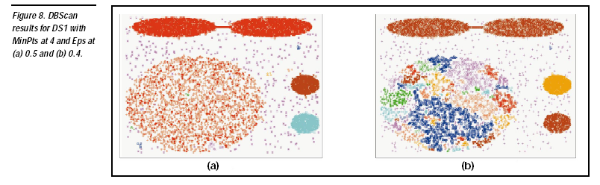

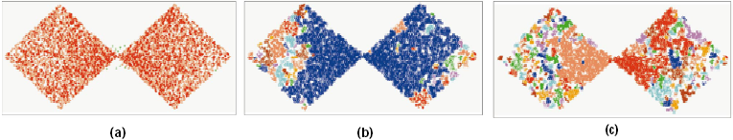
DBSCAN: Sensitive to Parameters

Slide 81
DBSCAN online Demo
http://webdocs.cs.ualberta.ca/~yaling/Cluster/Applet/Code/Cluster.html

Slide 82
Chapter 10. Cluster Analysis: Basic Concepts and Methods
Cluster Analysis: Basic Concepts
Partitioning Methods
Hierarchical Methods
Density-Based Methods
Grid-Based Methods
Evaluation of Clustering
Summary
82
82
Notes:
82

Slide 83
Grid-Based Clustering Method
Using multi-resolution grid data structure
Several interesting methods
STING (a STatistical INformation Grid approach) by Wang, Yang and Muntz (1997)
WaveCluster by Sheikholeslami, Chatterjee, and Zhang (VLDB’98)
A multi-resolution clustering approach using wavelet method
CLIQUE: Agrawal, et al. (SIGMOD’98)
Both grid-based and subspace clustering

Slide 84
STING: A Statistical Information Grid Approach
Wang, Yang and Muntz (VLDB’97)
The spatial area is divided into rectangular cells
There are several levels of cells corresponding to different levels of resolution

Slide 85
The STING Clustering Method
Each cell at a high level is partitioned into a number of smaller cells in the next lower level
Statistical info of each cell is calculated and stored beforehand and is used to answer queries
Parameters of higher level cells can be easily calculated from parameters of lower level cell
count, mean, s, min, max
type of distribution—normal, uniform, etc.
Use a top-down approach to answer spatial data queries
Start from a pre-selected layer—typically with a small number of cells
For each cell in the current level compute the confidence interval

Slide 86
STING Algorithm and Its Analysis
Remove the irrelevant cells from further consideration
When finish examining the current layer, proceed to the next lower level
Repeat this process until the bottom layer is reached
Advantages:
Query-independent, easy to parallelize, incremental update
O(K), where K is the number of grid cells at the lowest level
Disadvantages:
All the cluster boundaries are either horizontal or vertical, and no diagonal boundary is detected

Slide 87
CLIQUE (Clustering In QUEst)
Agrawal, Gehrke, Gunopulos, Raghavan (SIGMOD’98)
Automatically identifying subspaces of a high dimensional data space that allow better clustering than original space
CLIQUE can be considered as both density-based and grid-based
It partitions each dimension into the same number of equal length interval
It partitions an m-dimensional data space into non-overlapping rectangular units
A unit is dense if the fraction of total data points contained in the unit exceeds the input model parameter
A cluster is a maximal set of connected dense units within a subspace
87
Notes:
87

Slide 88
CLIQUE: The Major Steps
Partition the data space and find the number of points that lie inside each cell of the partition.
Identify the subspaces that contain clusters using the Apriori principle
Identify clusters
Determine dense units in all subspaces of interests
Determine connected dense units in all subspaces of interests.
Generate minimal description for the clusters
Determine maximal regions that cover a cluster of connected dense units for each cluster
Determination of minimal cover for each cluster
88
Notes:
88

Slide 89
Salary (10,000)
Vacation(week)
7
7
6
6
5
5
4
4
3
3
2
2
1
1
0
age
0
age
20
30
40
50
60
20
30
40
50
60
τ = 3
Vacation
Salary
30
50
age
89
Notes:
89

Slide 90
Strength and Weakness of CLIQUE
Strength
automatically finds subspaces of the highest dimensionality such that high density clusters exist in those subspaces
insensitive to the order of records in input and does not presume some canonical data distribution
scales linearly with the size of input and has good scalability as the number of dimensions in the data increases
Weakness
The accuracy of the clustering result may be degraded at the expense of simplicity of the method
90
Notes:
90

Slide 91
Chapter 10. Cluster Analysis: Basic Concepts and Methods
Cluster Analysis: Basic Concepts
Partitioning Methods
Hierarchical Methods
Density-Based Methods
Grid-Based Methods
Evaluation of Clustering
Summary
91
91
Notes:
91

Slide 92
Determine the Number of Clusters
Empirical method
# of clusters ≈√n/2 for a dataset of n points
Elbow method
Use the turning point in the curve of sum of within cluster variance w.r.t the # of clusters
Cross validation method
Divide a given data set into m parts
Use m – 1 parts to obtain a clustering model
Use the remaining part to test the quality of the clustering
E.g., For each point in the test set, find the closest centroid, and use the sum of squared distance between all points in the test set and the closest centroids to measure how well the model fits the test set
For any k > 0, repeat it m times, compare the overall quality measure w.r.t. different k’s, and find # of clusters that fits the data the best
92

Slide 93
Measuring Clustering Quality
Two methods: extrinsic vs. intrinsic
Extrinsic: supervised, i.e., the ground truth is available
Compare a clustering against the ground truth using certain clustering quality measure
Ex. BCubed precision and recall metrics
Intrinsic: unsupervised, i.e., the ground truth is unavailable
Evaluate the goodness of a clustering by considering how well the clusters are separated, and how compact the clusters are
Ex. Silhouette coefficient
93

Slide 94
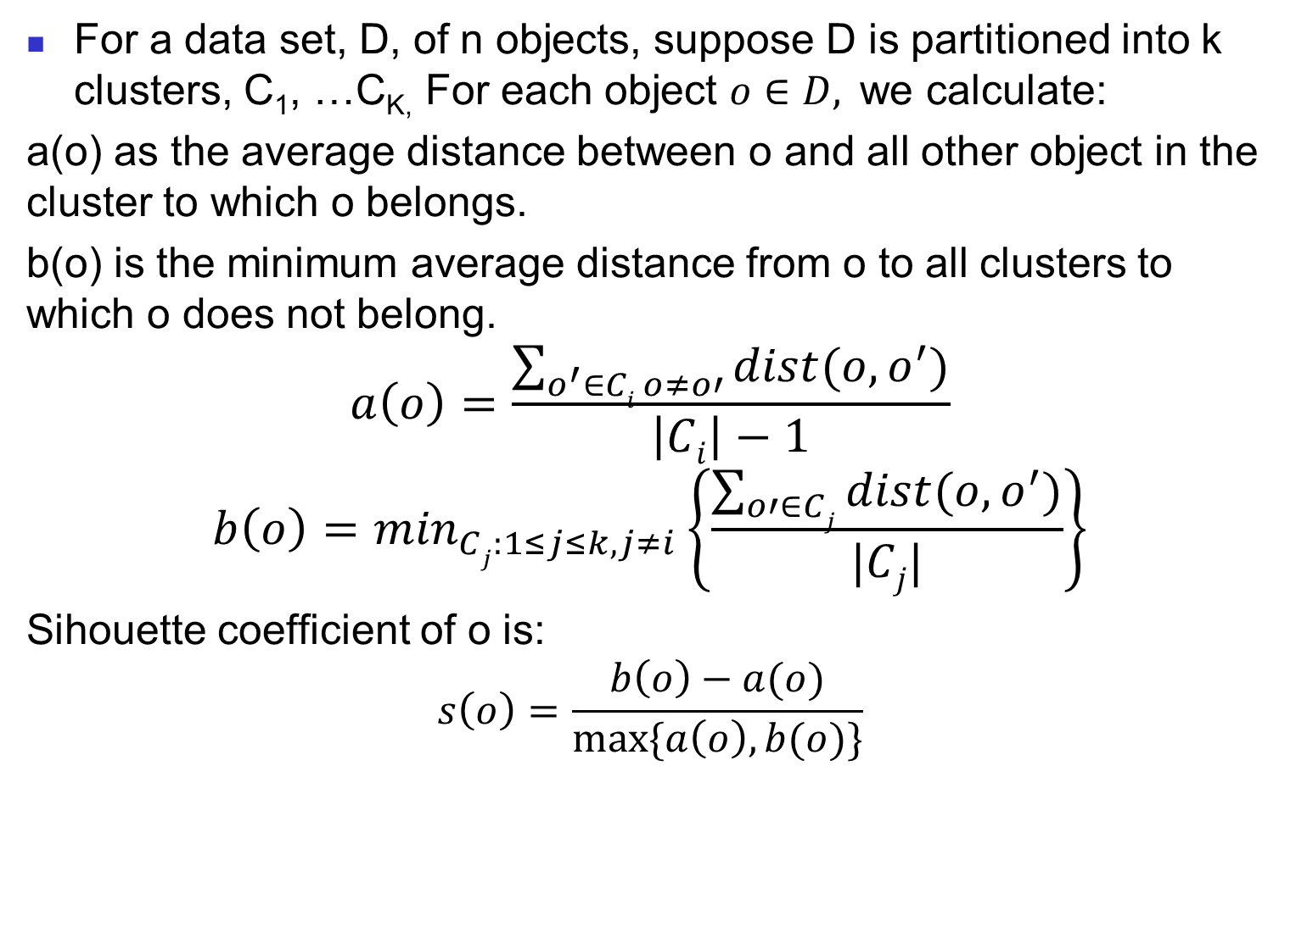
Sihouette coefficient
For a data set, D, of n objects, suppose D is partitioned into k clusters, C₁, …C_{K,} For each object $o∈D,$ we calculate:
a(o) as the average distance between o and all other object in the cluster to which o belongs.
b(o) is the minimum average distance from o to all clusters to which o does not belong.
$$a\left(o\right)=\frac{\sum_{o^{′}∈Ci o≠o′}{dist(o, o^{′})}}{\left|Ci\right|−1}$$
$$b\left(o\right)=\min_{Cj:1≤j≤k, j≠i}\left\{\frac{\sum_{o′∈Cj}{dist(o, o^{′})}}{|Cj|}\right\}$$
Sihouette coefficient of o is:
$$s\left(o\right)=\frac{b\left(o\right)−a(o)}{max⁡\{a\left(o\right), b(o)\}}$$

Slide 95
Measuring Clustering Quality: Extrinsic Methods
95
Clustering quality measure: Q(C, C_{g}), for a clustering C given the ground truth C_{g}.
Q is good if it satisfies the following 4 essential criteria
Cluster homogeneity: the purer, the better
Cluster completeness: should assign objects belong to the same category in the ground truth to the same cluster
Rag bag: putting a heterogeneous object into a pure cluster should be penalized more than putting it into a rag bag (i.e., “miscellaneous” or “other” category)
Small cluster preservation: splitting a small category into pieces is more harmful than splitting a large category into pieces

Slide 96
Chapter 10. Cluster Analysis: Basic Concepts and Methods
Cluster Analysis: Basic Concepts
Partitioning Methods
Hierarchical Methods
Density-Based Methods
Grid-Based Methods
Evaluation of Clustering
Summary
96
96
Notes:
96

Slide 97
Summary
Cluster analysis groups objects based on their similarity and has wide applications
Measure of similarity can be computed for various types of data
Clustering algorithms can be categorized into partitioning methods, hierarchical methods, density-based methods, grid-based methods, and model-based methods
K-means and K-medoids algorithms are popular partitioning-based clustering algorithms
Birch and Chameleon are interesting hierarchical clustering algorithms, and there are also probabilistic hierarchical clustering algorithms
DBSCAN, OPTICS, and DENCLU are interesting density-based algorithms
STING and CLIQUE are grid-based methods, where CLIQUE is also a subspace clustering algorithm
Quality of clustering results can be evaluated in various ways

Slide 98
References (1)
R. Agrawal, J. Gehrke, D. Gunopulos, and P. Raghavan. Automatic subspace clustering of high dimensional data for data mining applications. SIGMOD'98
M. R. Anderberg. Cluster Analysis for Applications. Academic Press, 1973.
M. Ankerst, M. Breunig, H.-P. Kriegel, and J. Sander. Optics: Ordering points to identify the clustering structure, SIGMOD’99.
Beil F., Ester M., Xu X.: "Frequent Term-Based Text Clustering", KDD'02
M. M. Breunig, H.-P. Kriegel, R. Ng, J. Sander. LOF: Identifying Density-Based Local Outliers. SIGMOD 2000.
M. Ester, H.-P. Kriegel, J. Sander, and X. Xu. A density-based algorithm for discovering clusters in large spatial databases. KDD'96.
M. Ester, H.-P. Kriegel, and X. Xu. Knowledge discovery in large spatial databases: Focusing techniques for efficient class identification. SSD'95.
D. Fisher. Knowledge acquisition via incremental conceptual clustering. Machine Learning, 2:139-172, 1987.
D. Gibson, J. Kleinberg, and P. Raghavan. Clustering categorical data: An approach based on dynamic systems. VLDB’98.
V. Ganti, J. Gehrke, R. Ramakrishan. CACTUS Clustering Categorical Data Using Summaries. KDD'99.

Slide 99
References (2)
D. Gibson, J. Kleinberg, and P. Raghavan. Clustering categorical data: An approach based on dynamic systems. In Proc. VLDB’98.
S. Guha, R. Rastogi, and K. Shim. Cure: An efficient clustering algorithm for large databases. SIGMOD'98.
S. Guha, R. Rastogi, and K. Shim. ROCK: A robust clustering algorithm for categorical attributes. In ICDE'99, pp. 512-521, Sydney, Australia, March 1999.
A. Hinneburg, D.l A. Keim: An Efficient Approach to Clustering in Large Multimedia Databases with Noise. KDD’98.
A. K. Jain and R. C. Dubes. Algorithms for Clustering Data. Printice Hall, 1988.
G. Karypis, E.-H. Han, and V. Kumar. CHAMELEON: A Hierarchical Clustering Algorithm Using Dynamic Modeling. COMPUTER, 32(8): 68-75, 1999.
L. Kaufman and P. J. Rousseeuw. Finding Groups in Data: an Introduction to Cluster Analysis. John Wiley & Sons, 1990.
E. Knorr and R. Ng. Algorithms for mining distance-based outliers in large datasets. VLDB’98.

Slide 100
References (3)
G. J. McLachlan and K.E. Bkasford. Mixture Models: Inference and Applications to Clustering. John Wiley and Sons, 1988.
R. Ng and J. Han. Efficient and effective clustering method for spatial data mining. VLDB'94.
L. Parsons, E. Haque and H. Liu, Subspace Clustering for High Dimensional Data: A Review, SIGKDD Explorations, 6(1), June 2004
E. Schikuta. Grid clustering: An efficient hierarchical clustering method for very large data sets. Proc. 1996 Int. Conf. on Pattern Recognition,.
G. Sheikholeslami, S. Chatterjee, and A. Zhang. WaveCluster: A multi-resolution clustering approach for very large spatial databases. VLDB’98.
A. K. H. Tung, J. Han, L. V. S. Lakshmanan, and R. T. Ng. Constraint-Based Clustering in Large Databases, ICDT'01.
A. K. H. Tung, J. Hou, and J. Han. Spatial Clustering in the Presence of Obstacles, ICDE'01
H. Wang, W. Wang, J. Yang, and P.S. Yu. Clustering by pattern similarity in large data sets, SIGMOD’ 02.
W. Wang, Yang, R. Muntz, STING: A Statistical Information grid Approach to Spatial Data Mining, VLDB’97.
T. Zhang, R. Ramakrishnan, and M. Livny. BIRCH : An efficient data clustering method for very large databases. SIGMOD'96.
Xiaoxin Yin, Jiawei Han, and Philip Yu, “LinkClus: Efficient Clustering via Heterogeneous Semantic Links”, in Proc. 2006 Int. Conf. on Very Large Data Bases (VLDB'06), Seoul, Korea, Sept. 2006.

