Slide 1

Social Networks and Social Media

Slide 2
Why do statistics
To understand the networks
Understand their topology and measure their properties
Study their evolution and dynamics
Create realistic models
Create algorithms that make use of the network structure
Notes:
So,people must do statistics to understand the networks. People want to study
What are the topology and properties of the networks.
How the networks evaluate and what are the dynamic characteristics
How to create realistic models for the social networks
How to create algorithms that make use of the network structure.

Slide 3
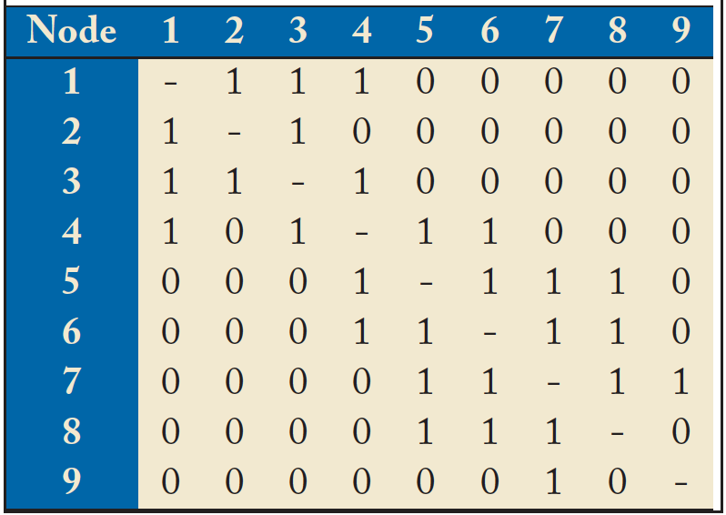
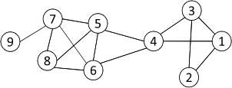
Networks and Representation
Social Network: A social structure made of nodes (individuals or organizations) and edges that connect nodes in various relationships like friendship, kinship etc.
Graph Representation
Matrix Representation
Notes:
Before we go into details, let us briefly review the basic concept of a social network.
A social network is “A social structure made of nodes (individuals or organizations) and edges that connect nodes in various relationships like friendship, kinship etc.”
If you have take the computer science core course “data structure” before, you may remember there are two basic representation method for a graph. The first is graph representation like this. We can use the adjacency list or a matrix to represent it.

Slide 4
Basic Concepts
A: the adjacency matrix
V: the set of nodes
E: the set of edges
v_{i}: a node v_{i}
e(v_{i}, v_{j}): an edge between node v_{i} and v_{j}
N_{i}: the neighborhood of node v_{i}
d_{i}: the degree of node v_{i}
geodesic: a shortest path between two nodes
geodesic distance
Notes:
The basic concepts related with a graph includes:
*****

Slide 5
Statistical Properties
Static analysis
Static snapshots of graphs
Dynamic analysis
A series of snapshots of graphs
Notes:
The statistical properties includes two parts, the static analysis and dynamic analysis.
The static analysis is to study the static snapshots of graphs
While the dynamic analysis is to study a series of snapshots of graphs

Slide 6
Statistical Properties
Static analysis
Static snapshots of graphs
Dynamic analysis
A series of snapshots of graphs
Notes:
Besides the static analysis, since networks are evaluating over time, another important statistical work is to do the dynamic analysis, which is based on a series of snapshots of grpahs.

Slide 7
Why do statistics
To understand the networks
Understand their topology and measure their properties
Study their evolution and dynamics
Create realistic models
Create algorithms that make use of the network structure
Notes:
So,people must do statistics to understand the networks. People want to study
What are the topology and properties of the networks.
How the networks evaluate and what are the dynamic characteristics
How to create realistic models for the social networks
How to create algorithms that make use of the network structure.

Slide 8
Networks and Representation
Social Network: A social structure made of nodes (individuals or organizations) and edges that connect nodes in various relationships like friendship, kinship etc.
Graph Representation
Matrix Representation
Notes:
Before we go into details, let us briefly review the basic concept of a social network.
A social network is “A social structure made of nodes (individuals or organizations) and edges that connect nodes in various relationships like friendship, kinship etc.”
If you have take the computer science core course “data structure” before, you may remember there are two basic representation method for a graph. The first is graph representation like this. We can use the adjacency list or a matrix to represent it.

Slide 9
Quality Estimation
How to measure the discovering results?
Normalized Cut
Conductance
Kernighan-Lin (KL) objective
Notes:
After getting communities, we must estimate how good is the discovering.
People have defined many metrics for it.
For example, the normalized cut estimate how good a cut between any two communities S and neg S by this formula. The numerator is the number of edges between these to community. The denominator is the sum of node degrees in each community.
The other metric is called Conductance, which uses the number of edges cross two communities to divide the minimal one of the some of node degrees in each community.
Another famous one is called Kernighan-Lin (KL) objective, which is used to discover the communities with the same size.

Slide 10

Quality Estimation: Modularity
Q(division) = #(internal edges) - E(#(internal edges) in a
RANDOM graph with same node degrees)
Trivial division: all vertices in one group ==> Q(trivial division) = 0
…
m is the number of edges in the network
Optimizing any of these objectives is NP-Hard
Notes:
There are also more complex meric. For example,
****
Note that optimizing any of these objectives is NP-Hard

Slide 11
The Kernighan-Lin (KL) algorithm
P₁
P₂
-2
0
v₁
v₇
+2
+1
v₂
v₆
-2
v₃
-1
+1
v₈
+1
v₄
v₅
CUT=5
IF V₂ MOVES GAIN=2 and TOT_GAIN=2
0
-2
v₁
v₇
v₂
-1
v₆
-2
v₃
-3
+1
v₈
+1
v₄
v₅
CUT=3
IF V₅ MOVES GAIN=1 and TOT_GAIN=3
Notes:
The kernighan-Lin (KL) algorithm is a famous top down algorithm.
It first randomly cut a community into two communities. Then, we can compute a gain value of each node. The gain value represent how much benefit we can get if move this node into the other community. So the gain is the number of cross community edges minus the number of inner community edges. For example, V2 has three cross community edges and 1 inner community edge. So moving V2 to P2 can reduce 2 edges in the cut. So V2’s gain is 2.
Next step, we select the nodes with largest gain and move it. After V2 is moved, we should updated the gain values. Of course, only the gains of nodes that connect V2 should be recomputed.
We repeate the process

Slide 12
The Kernighan-Lin (KL) algorithm con’t
0
-2
v₁
v₇
v₂
-1
v₆
v₅
-2
v₃
-3
v₈
v₄
-1
CUT=2
IF V1 MOVES GAIN=0 and TOT_GAIN=3
Notes:
Until no benefit can be get.

Slide 13
The Kernighan-Lin (KL) algorithm con’t
Back
Notes:
We do this cut for each community. This is a global view of the algorithm. It is clear that this is a recursive process. Finally, a group of small communities can be computed.

Slide 14
Edge Betweenness Method
The strength of a tie can be measured by edge betweenness
Edge betweenness: the number of shortest paths that pass along with the edge
The edge with higher betweenness tends to be the bridge between two communities.
The edge betweenness of e(1, 2) is 4 (=6/2 + 1), as all the shortest paths from 2 to {4, 5, 6, 7, 8, 9} have to either pass e(1, 2) or e(2, 3), and e(1,2) is the shortest path between 1 and 2
14
Notes:
The other method is called the Edge Betweenness Method
The strength of a tie can be measured by edge betweenness, which is the number of shortest paths that pass along with the edge. For example The edge betweenness of e(1, 2) is 4 (=6/2 + 1), as all the shortest paths from 2 to {4, 5, 6, 7, 8, 9} have to either pass e(1, 2) or e(2, 3), and e(1,2) is the shortest path between 1 and 2
Nodes 4-9 have two paths to reach Node2: e(1,2) and e(2,3), hence, 6/2 = 3, Node 3 can reach Node 2 directly, and Node 1 reaches Node 2 via e(1,2). Hence, edge betweenness of e(1,2) is 4.
We can see that the edge with higher betweenness tends to be the bridge between two communities
14

Slide 15
Edge Betweenness Method
Basic idea
Calculate betweenness score for all edges
Find the edge with the highest score and remove it from the network
Recalculate betweenness for all remaining edges
Repeat from step 2
Notes:
The basic idea of edge betweenness method is
Calculate betweenness score for all edges
Find the edge with the highest score and remove it from the network
Recalculate betweenness for all remaining edges
Repeat from step 2

Slide 16
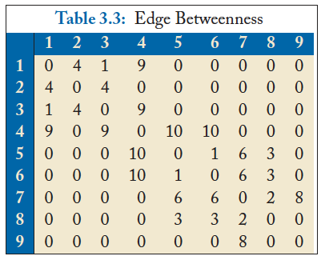
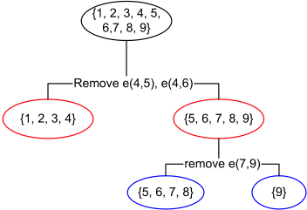
Edge Betweenness Method con’t
Initial betweenness value
After remove e(4,5), the betweenness of e(4, 6) becomes 20, which is the largest;
After remove e(4,6), the edge e(7,9) has the largest betweenness value 4, and should be removed.
Idea: progressively removing edges with the highest betweenness
16
Notes:
Let use see an example here. The initial betweenness value of edges are computed in this table.
We can see the largest one in it is 10 on e(4,5)
After removing e(4,5), the betweenness of e(4,6) becomes 20, which is the largest. We continue to remove e(4,6) After remove e(4,6), the edge e(7,9) has the largest betweenness value 4, and should be removed.
The working process is shown in the left tree. Finally, we get three communities, {1,2,3,4}, {5,6,7,8} and {9}

Slide 17

Modularity Matrix
Q = ∑(Aij - ki*kj/M | i,j in the same group)
17
Modularity matrix:
Modularity maximization can be reformulated as
Optimal solution: top eigenvectors of the modularity matrix
Apply k-means to S as a post-processing step to obtain community partition
Notes:
The other method is called Modularity Matrix method.
The modularity matrix of a graph can be computed from the adjacent matrix. In order to get the best effect with the modularity distance Q.
Modularity maximization can be reformulated as ****
Optimal solution is top eigenvectors of the modularity matrix.
Then, the k-means can be applied to S as a post-processing step to obtain community partition

Slide 18
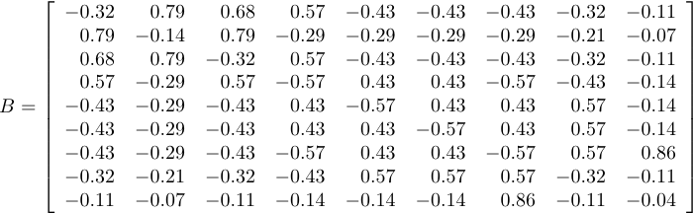
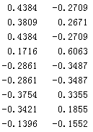
Modularity Maximization Example
Two Communities:
{1, 2, 3, 4} and {5, 6, 7, 8, 9}
k-means
Modularity Matrix
18

Slide 19



Spectral Clustering
graph Laplacian for ratio cut
normalized graph Laplacian
A diagonal matrix of degrees
19
Both ratio cut and normalized cut can be reformulated as
Where
Spectral relaxation:
Optimal solution: top eigenvectors with the smallest eigenvalues
Notes:
The other method is called the spectral clustering
Both ratio cut and normalized cut can be reformulated as **** (Tr(A): the trace of matrix A.)
Spectral relaxation of it is *****
Optimal solution is the top eigenvectors with the smallest eigenvalues

Slide 20
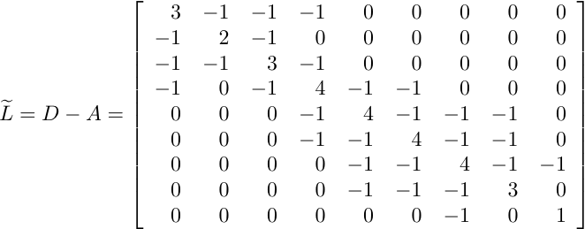
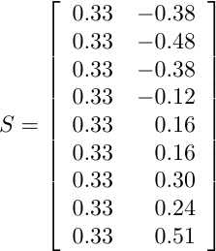
Spectral Clustering Example
Two communities:
{1, 2, 3, 4} and {5, 6, 7, 8, 9}
The 1st eigenvector means all nodes belong to the same cluster, no use
k-means
Centered matrix
20
Notes:
We first compute the Trace of the adjacent matrix
Then we can get a new matrix, and compute its eigenvalues
The 1st eigenvector is discarded. We do k-means on the smallest eigenvalues.
We can get two communities {1,2,3,4} and {5,6,7,8,9}
20

Slide 21
Multi-level Graph Partitioning
Logic flow
Produce a smaller graph that is similar to the original graph
A partitioning of the coarsest graph is performed.
the partitioning of the coarser graph is projected back to the original graph. The partition is further refined.
Notes:
Another algorithm is called Multi-Level Graph Partitioning
The basic idea is
Produce a smaller graph that is similar to the original graph
A partitioning of the coarsest graph is performed.
the partitioning of the coarser graph is projected back to the original graph. The partition is further refined.

Slide 22
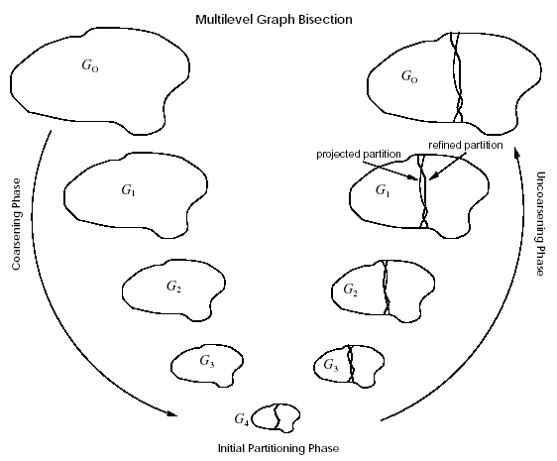
Multi-level Graph Partitioning
3 Phases
Coarsen
Partition
Uncoarsen
Notes:
This is a demo graph of this algorithms:
There are three steps: coarsen, partition and uncoase. We get a smaller graph, partition it and uncoase to the original graph.

Slide 23
Other works
Community Discovery in Dynamic Networks
How should community discovery algorithms be modified to dynamic networks?
How do communities get formed?
How persistent and stable are communities and their members?
How do they evolve over time?
Community discovery in Heterogeneous Networks
Coupling Content Relationship Information for Community Discovery

Slide 24
Link Prediction in Social Networks
Notes:
Today, let’s briefly review

Slide 25
Outline
Link Prediction Problems
Social Network
Recommender system
Algorithms of Link Prediction
Supervised Methods
Collaborative Filtering
Recommender System and The Netflixprize
References

Slide 26
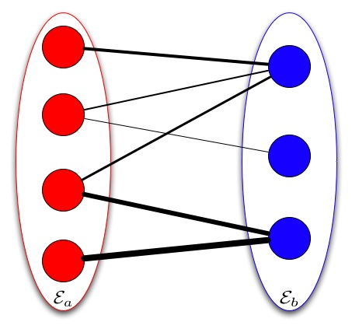
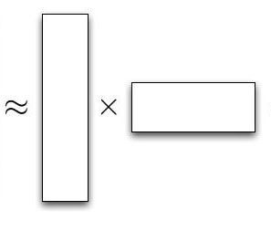
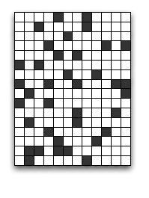
Link Prediction using Collaborative Filtering
Find the background model that can generate the link data

Slide 27
Challenges in Link Prediction
Data!!!
Cold Start Problem
Sparsity Problem

Slide 28
Link Prediction using Collaborative Filtering
Memory-based Approach
User-base approach [Twitter]
item-base approach [Amazon & Youtube]
Model-based Approach
Latent Factor Model [Google News]
Hybrid Approach

Slide 29
Memory-based Approach
Few modeling assumptions
Few tuning parameters to learn
Easy to explain to users
Dear Amazon.com Customer, We've noticed that customers who have purchased or rated How Does the Show Go On: An Introduction to the Theater by Thomas Schumacher have also purchased Princess Protection Program #1: A Royal Makeover (Disney Early Readers).

Slide 30
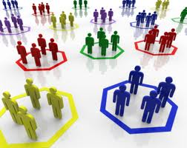
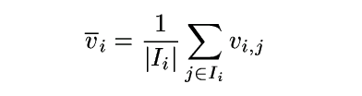
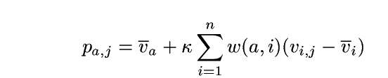
Algorithms: User-Based Algorithms (Breese et al, UAI98)
v_{i,j}= vote of user i on item j
I_{i} = items for which user i has voted
Mean vote for i is
Predicted vote for “active user” a is weighted sum
normalizer
weights of n similar users

Slide 31
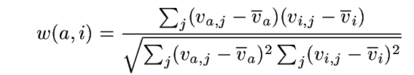
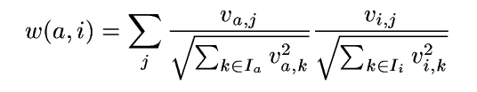
Algorithms: User-Based Algorithms (Breese et al, UAI98)
K-nearest neighbor
Pearson correlation coefficient (Resnick ’94, Grouplens):
Cosine distance (from IR)

Slide 32
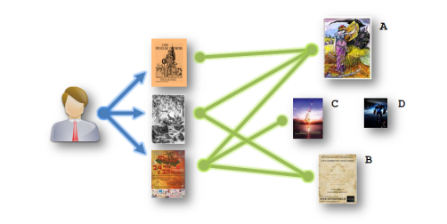
Algorithm: Amazon’s Method
Item-based Approach
Similar with user-based approach but is on the item side

Slide 33
Item-based CF Example: infer (user 1, item 3)
 | Item 1 | Item 2 | Item 3 | Item 4 | Item 5
User 1 | 8 | 1 | ? | 2 | 7
User 2 | 2 | ? | 5 | 7 | 5
User 3 | 5 | 4 | 7 | 4 | 7
User 4 | 7 | 1 | 7 | 3 | 8
User 5 | 1 | 7 | 4 | 6 | ?
User 6 | 8 | 3 | 8 | 3 | 7

Slide 34
How to Calculate Similarity (Item 3 and Item 5)?
 | Item 1 | Item 2 | Item 3 | Item 4 | Item 5
User 1 | 8 | 1 | ? | 2 | 7
User 2 | 2 | ? | 5 | 7 | 5
User 3 | 5 | 4 | 7 | 4 | 7
User 4 | 7 | 1 | 7 | 3 | 8
User 5 | 1 | 7 | 4 | 6 | ?
User 6 | 8 | 3 | 8 | 3 | 7

Slide 35
Similarity between Items
Item 3 | Item 4 | Item 5
? | 2 | 7
5 | 7 | 5
7 | 4 | 7
7 | 3 | 8
4 | 6 | ?
8 | 3 | 7
How similar are items 3 and 5?
How to calculate their similarity?
Notes:
Each row in the table are the ratings one user on the items
35

Slide 36
Similarity between items
Item 3 | Item 5
? | 7
5 | 5
7 | 7
7 | 8
4 | ?
8 | 7
Only consider users who have rated
both items
For each user: Calculate difference in ratings for the
two items
Take the average of this difference over
the users
Can also use Pearson Correlation Coefficients as in user-based approaches
sim(item 3, item 5) = cosine( (5, 7, 7), (5, 7, 8) )
= (5*5 + 7*7 + 7*8)/(sqrt(5²+7²+7²)* sqrt(5²+7²+8²))
Notes:
Each row in the table are the ratings one user on the items
36

Slide 37
Prediction: Calculating ranking r(user1,item3)
Item 2
8
1
Item 1
Item 3
Item 5
7
Where α is a normalization factor, which is
1/[the sum of all sim(item_{i},item₃)].
Item 4
2
Notes:
Showing five items, Item 3 is the one we need to know for User 1. Distances to Item 3 indicate similarity. Numbers in yellow boxes give ratings for User 1 for other items.
Blue area shows nearest neighbours, items that are most similar to Item 3 based on past ratings by other users.
37

Slide 38
Major Challenges
Size of data
Places premium on efficient algorithms
Stretched memory limits of standard PCs
99% of data are missing
Eliminates many standard prediction methods
Certainly not missing at random
Training and test data differ systematically
Test ratings are later
Test cases are spread uniformly across users
38

Slide 39
Major Challenges (cont.)
Countless factors may affect ratings
Genre, movie/TV series/other
Style of action, dialogue, plot, music et al.
Director, actors
Rater’s mood
Large imbalance in training data
Number of ratings per user or movie varies by several orders of magnitude
Information to estimate individual parameters varies widely
39
Notes:
The two challenges on this slide are central to the whole endeavor as they clearly conflict with each other.
Number 4 points us towards building very big models.
Number 5 tells us that it will be easy to over fit—at least for some users and some movies.

Slide 40
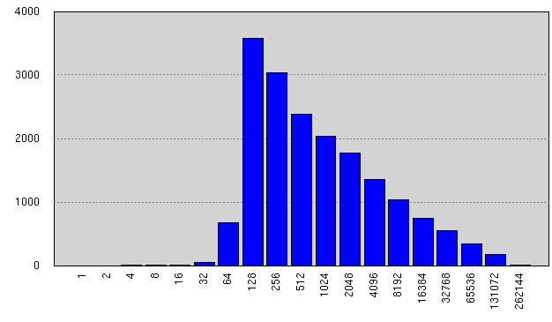
Ratings per Movie in Training Data
Avg #ratings/movie: 5627
Notes:
Although some movies were rated tens of thousands of times, most were rated fewer than 1,000 times and many were rated fewer than 200 times.
We are obviously limited in what we can learn about those movies.

Slide 41
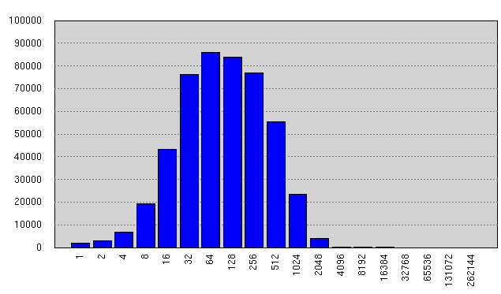
Ratings per User in Training Data
Avg #ratings/user: 208
Notes:
The problem is worse for users.
While the mean number of ratings per user is 208, about 15 percent of users rated fewer than 25 movies in the training data.
And those users contribute almost 15 percent of the test data.

