Slide 1
MSCBD 5002/MSCIT 5210: Knowledge Discovery and Data Mining
Acknowledgement: Slides modified based J. Han, D. Jing, W. Yan, Z. Xuan, M. Morzy, M. Chen, M. Brobbey, N. Somasetty, N. Niu, P. Sundaram, S. Sajja, S. Thota, H. Ahonen-Myka, R. Cooley, B. Mobasher, J. Srivastava,
Y. Even-Zohar, A. Rajaraman and others

Slide 2




Web Mining
Based on tutorials and presentations:J. Han, D. Jing, W. Yan, Z. Xuan, M. Morzy, M. Chen, M. Brobbey, N. Somasetty, N. Niu,
P. Sundaram, S. Sajja, S. Thota, H. Ahonen-Myka, R. Cooley, B. Mobasher, J. Srivastava,Y. Even-Zohar, A. Rajaraman and others

Slide 3


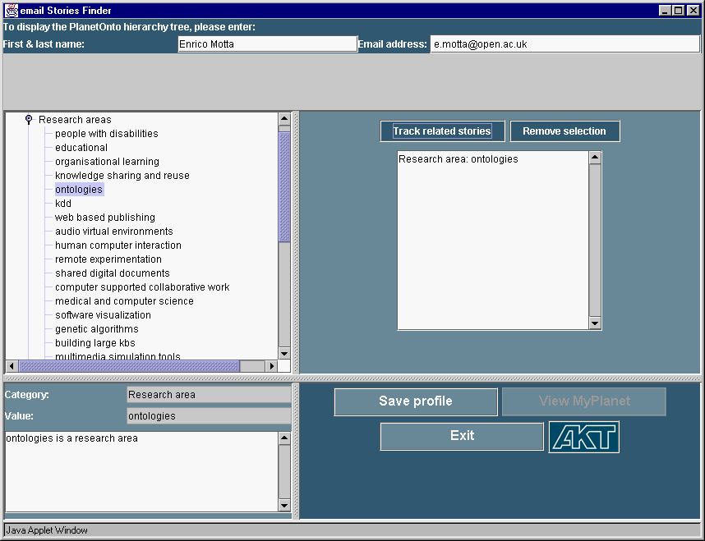
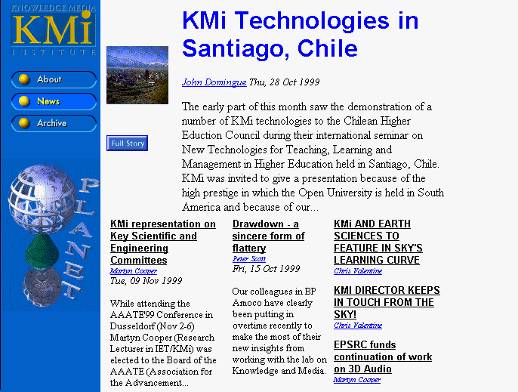
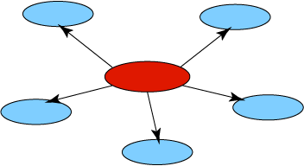
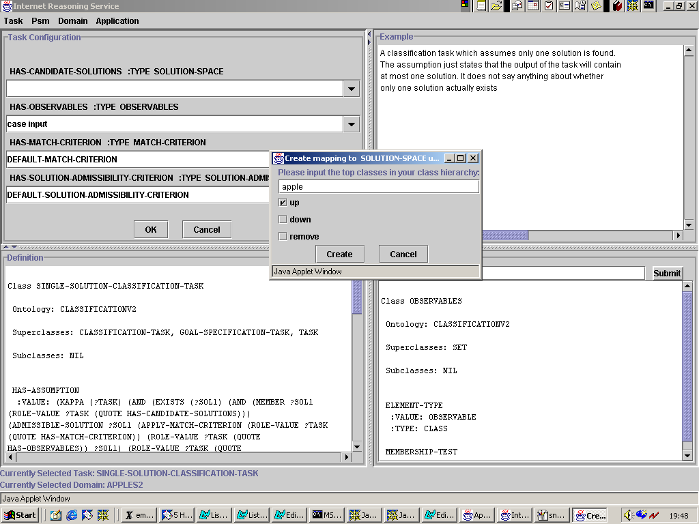
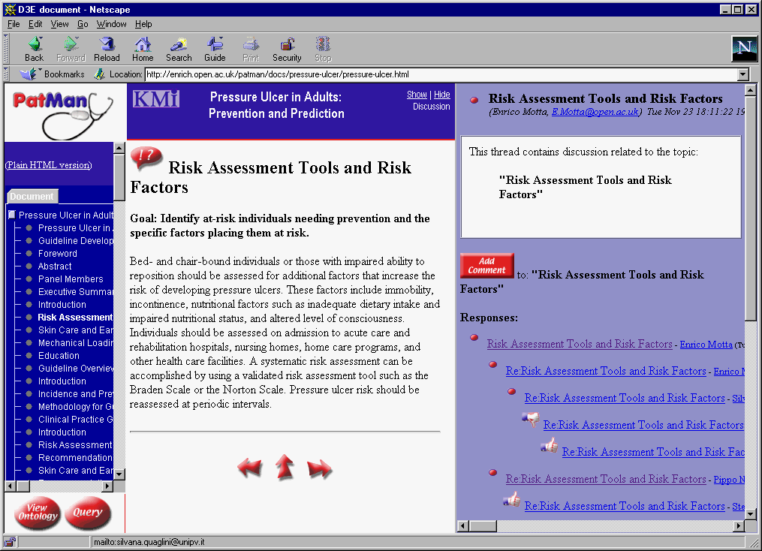
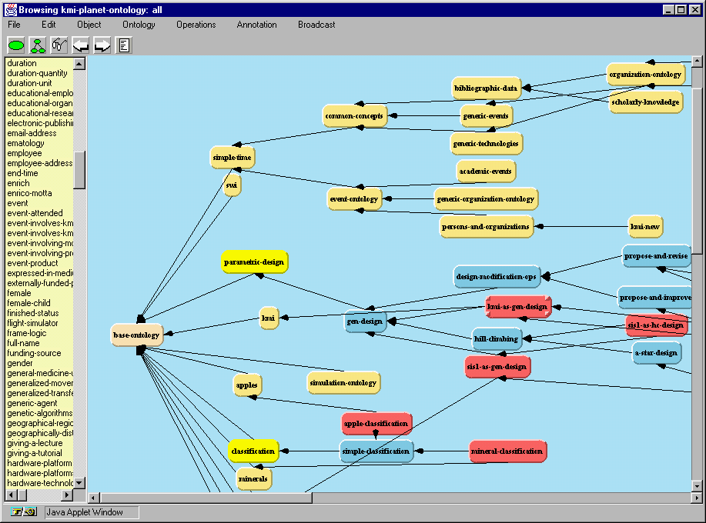
Discovering Knowledge from and about WWW - is one of the basic abilities of an intelligent agent
WWW
Knowledge

Slide 4
Contents
Introduction
Web content mining
Web structure mining
  Evaluation of Web pages
  HITS algorithm
  Discovering cyber-communities on the Web
Web usage mining
Search engines for Web mining
Multi-Layered Meta Web

Slide 5
Introduction

Slide 6
Data Mining and Web Mining
Data mining: turn data into knowledge.
Web mining is to apply data mining techniques to extract and uncover knowledge from web documents and services.

Slide 7
WWW Specifics
Web: A huge, widely-distributed, highly heterogeneous, semi-structured, hypertext/hypermedia, interconnected information repository
Web is a huge collection of documents plus
  Hyper-link information
  Access and usage information

Slide 8
A Few Themes in Web Mining
Some interesting problems on Web mining
  Mining what Web search engine finds
  Identification of authoritative Web pages
  Identification of Web communities
  Web document classification
  Warehousing a Meta-Web: Web yellow page service
  Weblog mining (usage, access, and evolution)
  Intelligent query answering in Web search

Slide 9
Web Mining taxonomy
Web Content Mining
  Web Page Content Mining
Web Structure Mining
  Search Result Mining
  Capturing Web’s structure using link interconnections
Web Usage Mining
  General Access Pattern Mining
  Customized Usage Tracking

Slide 10
Web Content Mining

Slide 11
What is text mining?
Data mining in text: find something useful and surprising from a text collection;
text mining vs. information retrieval;
data mining vs. database queries.

Slide 12
Types of text mining
Keyword (or term) based association analysis
automatic document (topic) classification
similarity detection
  cluster documents by a common author
  cluster documents containing information from a common source
sequence analysis: predicting a recurring event, discovering trends
anomaly detection: find information that violates usual patterns

Slide 13
Types of text mining (cont.)
discovery of frequent phrases
text segmentation (into logical chunks)
event detection and tracking

Slide 14

Information Retrieval
Documents
source
Given:
  A source of textual documents
  A user query (text based)
Query
IR
System
Find:
  A set (ranked) of documents that are relevant to the query
Document
Ranked
Documents
Document
Document

Slide 15
Intelligent Information Retrieval
meaning of words
  Synonyms “buy” / “purchase”
  Ambiguity “bat” (baseball vs. mammal)
order of words in the query
  hot dog stand in the amusement park
  hot amusement stand in the dog park
user dependency for the data
  direct feedback
  indirect feedback
authority of the source
  IBM is more likely to be an authorized source then my second far cousin

Slide 16
Intelligent Web Search
Combine the intelligent IR tools
  meaning of words
  order of words in the query
  user dependency for the data
  authority of the source
With the unique web features
  retrieve Hyper-link information
  utilize Hyper-link as input

Slide 17
What is Information Extraction?
Given:
  A source of textual documents
  A well defined limited query (text based)
Find:
  Sentences with relevant information
  Extract the relevant information and
  ignore non-relevant information (important!)
  Link related information and output in a predetermined format

Slide 18
Information Extraction: Example
Salvadoran President-elect Alfredo Cristiania condemned the terrorist killing of Attorney General Roberto Garcia Alvarado and accused the Farabundo Marti Natinal Liberation Front (FMLN) of the crime. … Garcia Alvarado, 56, was killed when a bomb placed by urban guerillas on his vehicle exploded as it came to a halt at an intersection in downtown San Salvador. … According to the police and Garcia Alvarado’s driver, who escaped unscathed, the attorney general was traveling with two bodyguards. One of them was injured.
Incident Date: 19 Apr 89
Incident Type: Bombing
Perpetrator Individual ID: “urban guerillas”
Human Target Name: “Roberto Garcia Alvarado”
...

Slide 19
Querying Extracted Information
Documents
source
Query 1
(E.g. job title)
Query 2
(E.g. salary)
Extraction
System
Combine
Query Results
Ranked
Documents
Relevant Info 1
Relevant Info 2
Relevant Info 3

Slide 20
What is Clustering ?
Given:
  A source of textual documents
  Similarity measure
    e.g., how many words are common in these documents
Documents
source
Similarity measure
Clustering
System
Find:
  Several clusters of documents that are relevant to each other
Doc
Doc
Doc
Doc
Doc
Doc
Doc
Doc
Doc
Doc

Slide 21
Text Classification definition
Given: a collection of labeled records (training set)
  Each record contains a set of features (attributes), and the true class (label)
Find: a model for the class as a function of the values of the features
Goal: previously unseen records should be assigned a class as accurately as possible
  A test set is used to determine the accuracy of the model. Usually, the given data set is divided into training and test sets, with training set used to build the model and test set used to validate it

Slide 22
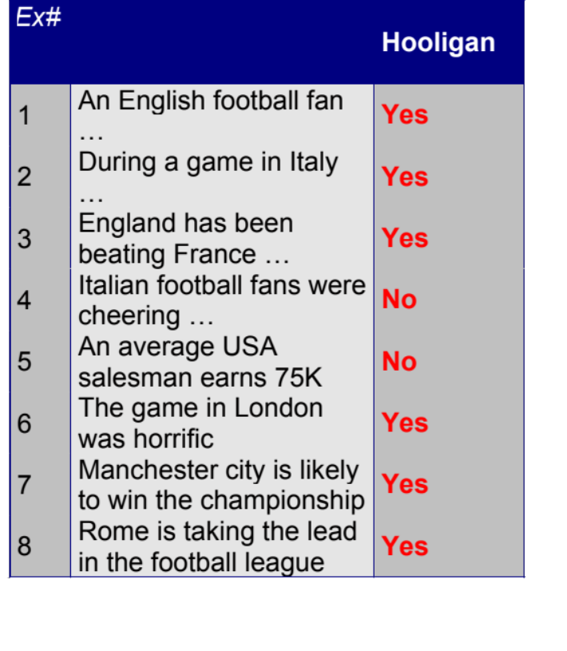
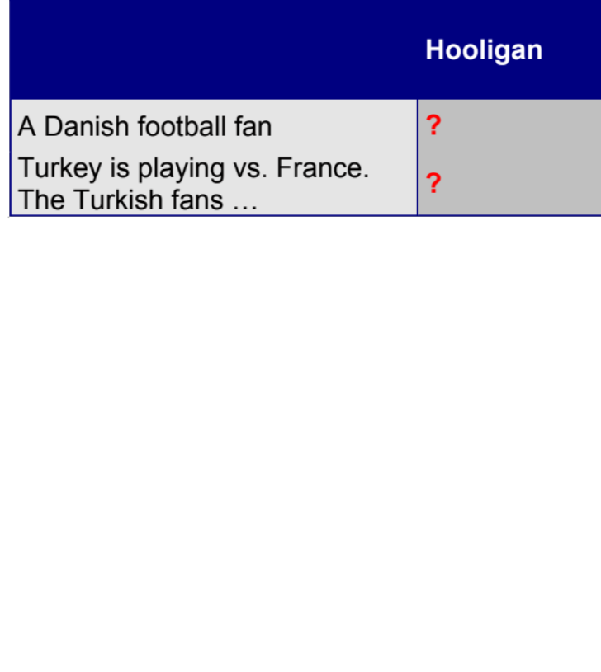
Text Classification: An Example
text
class
Test
Set
Learn
Classifier
Training
Set
Model

Slide 23
Discovery of frequent sequences (1)
Find all frequent maximal sequences of words (=phrases) from a collection of documents
  frequent: frequency threshold is given; e.g. a phrase has to occur in at least 15 documents
  maximal: a phrase is not included in another longer frequent phrase
  other words are allowed between the words of a sequence in text

Slide 24
Discovery of frequent sequences (2)
Frequency of a sequence cannot be decided locally: all the instances in the collection has to be counted
however: already a document of length 20 contains over million sequences
only small fraction of sequences are frequent

Slide 25
Basic idea: bottom-up
1. Collect all pairs from the documents, count them, and select the frequent ones
2. Build sequences of length p + 1 from frequent sequences of length p
3. Select sequences that are frequent
4. Select maximal sequences

Slide 26
Summary
There are many scientific and statistical text mining methods developed, see e.g.:
  http://www.cs.utexas.edu/users/pebronia/text-mining/
  http://filebox.vt.edu/users/wfan/text_mining.html
Also, it is important to study theoretical foundations of data mining.
  Data Mining Concepts and Techniques / J.Han & M.Kamber
  Machine Learning, / T.Mitchell

Slide 27
Web Structure Mining

Slide 28
Web Structure Mining
(1970) Researchers proposed methods of using citations among journal articles to evaluate the quality of reserach papers.
Customer behavior – evaluate a quality of a product based on the opinions of other customers (instead of product’s description or advertisement)
Unlike journal citations, the Web linkage has some unique features:
  not every hiperlink represents the endorsement we seek
  one authority page will seldom have its Web page point to its competitive authorities (CocaCola → Pepsi)
  authoritative pages are seldom descriptive (Yahoo! may not contain the description „Web search engine”)

Slide 29
Evaluation of Web pages

Slide 30
Web Search
There are two approches:
  page rank: for discovering the most important pages on the Web (as used in Google)
  hubs and authorities: a more detailed evaluation of the importance of Web pages
Basic definition of importance:
  A page is important if important pages link to it

Slide 31
Predecessors and Successors of a Web Page
Predecessors
Successors
…
…

Slide 32
Page Rank (1)
Simple solution: create a stochastic matrix of the Web:
Each page i corresponds to row i and column i of the matrix
If page j has n successors (links) then the ij^{th} cell of the matrix is equal to 1/n if page i is one of these n succesors of page j, and 0 otherwise.

Slide 33
Page Rank (2)
The intuition behind this matrix:
initially each page has 1 unit of importance. At each round, each page shares importance it has among its successors, and receives new importance from its predecessors.
The importance of each page reaches a limit after some steps
That importance is also the probability that a Web surfer, starting at a random page, and following random links from each page will be at the page in question after a long series of links.

Slide 34
Page Rank (3) – Example 1
Assume that the Web consists of only three pages - A, B, and C. The links among these pages are shown below.
Let [a, b, c] be
the vector of
importances for
these three pages
A
A B C
A 1/2 1/2 0
B 1/2 0 1
C 0 1/2 0
C
B

Slide 35
Page Rank – Example 1 (cont.)
The equation describing the asymptotic values of these three variables is:
a 1/2 1/2 0 a
b = 1/2 0 1 b
c 0 1/2 0 c
We can solve the equations like this one by starting with the assumption a = b = c = 1, and applying the matrix to the current estimate of these values repeatedly. The first four iterations give the following estimates:
a = 1 1 5/4 9/8 5/4 … 6/5
b = 1 3/2 1 11/8 17/16 … 6/5
c = 1 1/2 3/4 1/2 11/16 ... 3/5

Slide 36
Problems with Real Web Graphs
In the limit, the solution is a=b=6/5, c=3/5. That is, a and b each have the same importance, and twice of c.
Problems with Real Web Graphs
  dead ends: a page that has no succesors has nowhere to send its importance.
  spider traps: a group of one or more pages that have no links out.

Slide 37
Page Rank – Example 2
Assume now that the structure of the Web has changed. The new matrix describing transitions is:
A
a ½ ½ 0 a
b = ½ 0 0 b
c 0 1 0 c
C
B
The first four steps of the iterative solution are:
a = 1 1 3/4 5/8 1/2
b = 1 1/2 1/2 3/8 5/16
c = 1 1/2 1/4 1/4 3/16
Eventually, each of a, b, and c become 0.

Slide 38
Page Rank – Example 3
Assume now once more that the structure of the Web has changed. The new matrix describing transitions is:
A
a ½ ½ 0 a
b = ½ 0 0 b
c 0 1 1/2 c
C
B
The first four steps of the iterative solution are:
a = 1 1 3/4 5/8 1/2
b = 1 1/2 1/2 3/8 5/16
c = 1 3/2 7/4 2 35/16
c converges to 3, and a=b=0.

Slide 39
Google Solution
Instead of applying the matrix directly, „tax” each page some fraction of its current importance, and distribute the taxed importance equally among all pages.
Example: if we use 20% tax, the equation of the previous example becomes:
a = 0.8 * (½*a + ½ *b +0*c)
b = 0.8 * (½*a + 0*b + 0*c)
c = 0.8 * (0*a + ½*b + 1*c)
The solution to this equation is a=7/11, b=5/11, and c=21/11

Slide 40
Google Anti-Spam Solution
„Spamming” is the attept by many Web sites to appear to be about a subject that will attract surfers, without truly being about that subject.
Solutions:
  Google tries to match words in your query to the words on the Web pages. Unlike other search engines, Google tends to belive what others say about you in their anchor text, making it harder from you to appear to be about something you are not.
  The use of Page Rank to measure importance also protects against spammers. The naive measure (number of links into the page) can easily be fooled by the spammers who creates 1000 pages that mutually link to one another, while Page Rank recognizes that none of the pages have any real importance.

Slide 41
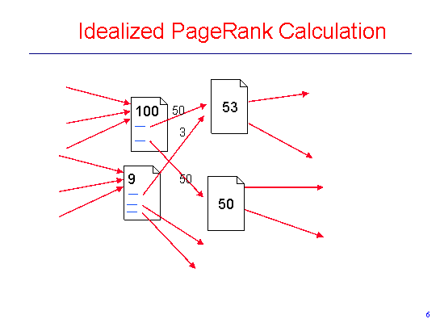
PageRank Calculation

Slide 42
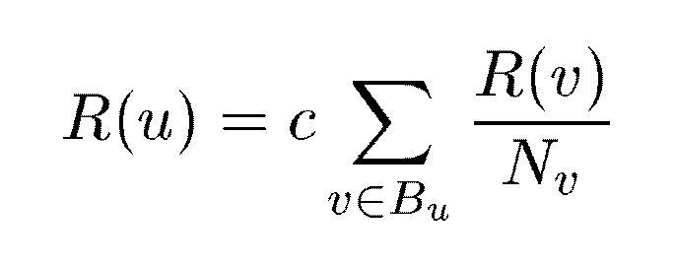
PageRank: A Simplified Version
u: a web page
B_{u}: the set of u’s backlinks
N_{v}: the number of forward links of page v
c: the normalization factor to make ||R||_{L1} = 1 (||R||_{L1}= |R₁ + … + R_{n}|)
Data Mining: Concepts and Techniques

Slide 43
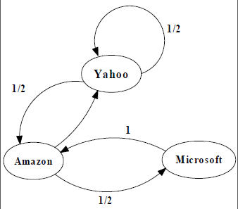
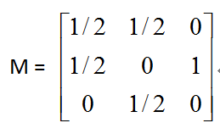

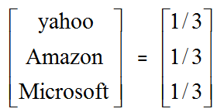
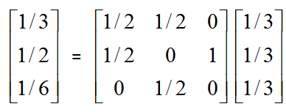
An example of Simplified PageRank
PageRank Calculation: first iteration
Data Mining: Concepts and Techniques

Slide 44
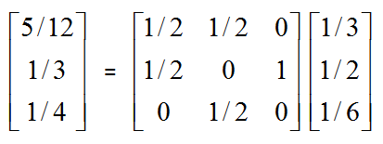
An example of Simplified PageRank
PageRank Calculation: second iteration
Data Mining: Concepts and Techniques

Slide 45
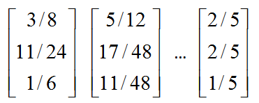
An example of Simplified PageRank
Convergence after some iterations
Data Mining: Concepts and Techniques

Slide 46
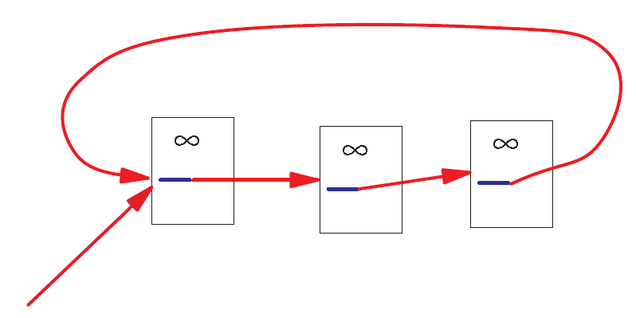
A Problem with Simplified PageRank
A loop:
During each iteration, the loop accumulates rank but never distributes rank to other pages!
Data Mining: Concepts and Techniques

Slide 47
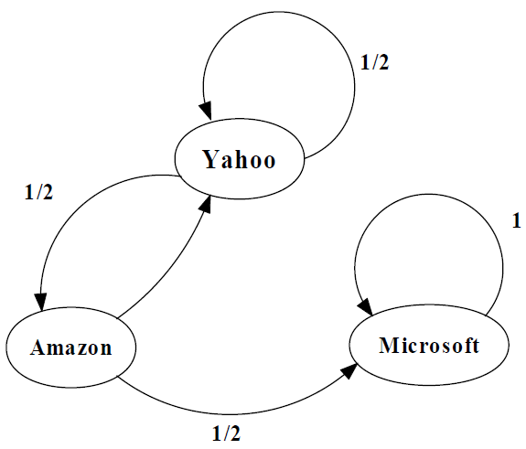
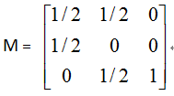
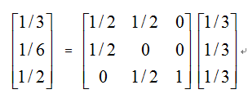
An example of the Problem

Slide 48
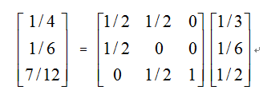
An example of the Problem

Slide 49
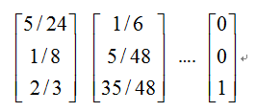
An example of the Problem

Slide 50
Random Walks in Graphs
The Random Surfer Model
  The simplified model: the standing probability distribution of a random walk on the graph of the web. simply keeps clicking successive links at random
The Modified Model
  The modified model: the “random surfer” simply keeps clicking successive links at random, but periodically “gets bored” and jumps to a random page based on the distribution of E

Slide 51
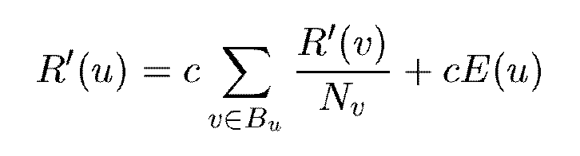


Modified Version of PageRank
E(u): a distribution of ranks of web pages that “users” jump to
when they “gets bored” after successive links at random.

Slide 52

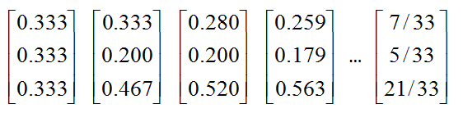
An example of Modified PageRank

Slide 53
Dangling Links
Links that point to any page with no outgoing links
Most are pages that have not been downloaded yet
Affect the model since it is not clear where their weight should be distributed
Do not affect the ranking of any other page directly
Can be simply removed before pagerank calculation and added back afterwards

Slide 54
PageRank Implementation
Convert each URL into a unique integer and store each hyperlink in a database using the integer IDs to identify pages
Sort the link structure by ID
Remove all the dangling links from the database
Make an initial assignment of ranks and start iteration
    Choosing a good initial assignment can speed up the pagerank
Adding the dangling links back.

Slide 55
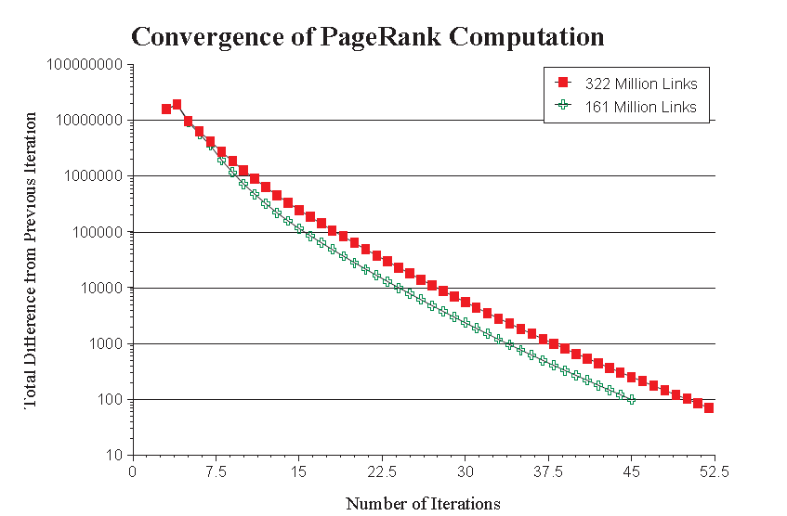
Convergence Property
PR (322 Million Links): 52 iterations
PR (161 Million Links): 45 iterations
Scaling factor is roughly linear in logn

Slide 56
Convergence Property
The Web is an expander-like graph
  Theory of random walk: a random walk on a graph is said to be rapidly-mixing if it quickly converges to a limiting distribution on the set of nodes in the graph. A random walk is rapidly-mixing on a graph if and only if the graph is an expander graph.
  Expander graph: every subset of nodes S has a neighborhood (set of vertices accessible via outedges emanating from nodes in S) that is larger than some factor α times of |S|. A graph has a good expansion factor if and only if the largest eigenvalue is sufficiently larger than the second-largest eigenvalue.

Slide 57
PageRank vs. Web Traffic
Some highly accessed web pages have low page rank possibly because
  People do not want to link to these pages from their own web pages (the example in their paper is pornographic sites…)
  Some important backlinks are omitted
  use usage data as a start vector for PageRank.

Slide 58
HITS Algorithm
--Topic Distillation on WWW
Proposed by Jon M. Kleinberg
Hyperlink-Induced Topic Search

Slide 59
Key Definitions
Authorities
Relevant pages of the highest quality on a broad topic
Hubs
Pages that link to a collection of authoritative pages on a broad topic

Slide 60
Hub-Authority Relations
Hubs
Authorities

Slide 61
Hyperlink-Induced Topic Search (HITS)
The approach consists of two phases:
It uses the query terms to collect a starting set of pages (200 pages) from an index-based search engine – root set of pages.
The root set is expanded into a base set by including all the pages that the root set pages link to, and all the pages that link to a page in the root set, up to a designed size cutoff, such as 2000-5000.
A weight-propagation phase is initiated. This is an iterative process that determines numerical estimates of hub and authority weights

Slide 62
Hypertext-Induced Topic Search(HITS)
To find a small set of most “authoritative’’ pages relevant to the query.
Authority – Most useful/relevant/helpful results of a query.
  “java’’ – java.com
  “harvard’’ – harvard.edu
  “search engine’’ – powerful search engines.
Data Mining: Concepts and Techniques

Slide 63
Hypertext-Induced Topic Search(HITS)
Or Authorities & Hubs, developed by Jon Kleinberg, while visiting IBM Almaden
IBM expanded HITS into Clever.
Authorities – pages that are relevant and are linked to by many other pages
Hubs – pages that link to many related authorities
Data Mining: Concepts and Techniques

Slide 64
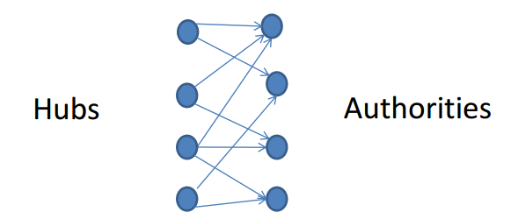
Authorities & Hubs
Intuitive Idea to find authoritative results using link analysis:
  Not all hyperlinks related to the conferral of authority.
  Find the pattern authoritative pages have:
    Authoritative Pages share considerable overlap in the sets of pages that point to them.
Data Mining: Concepts and Techniques

Slide 65
Authorities & Hubs
First Step:
  Constructing a focused subgraph of the WWW based on query
Second Step
  Iteratively calculate authority weight and hub weight for each page in the subgraph
Data Mining: Concepts and Techniques

Slide 66
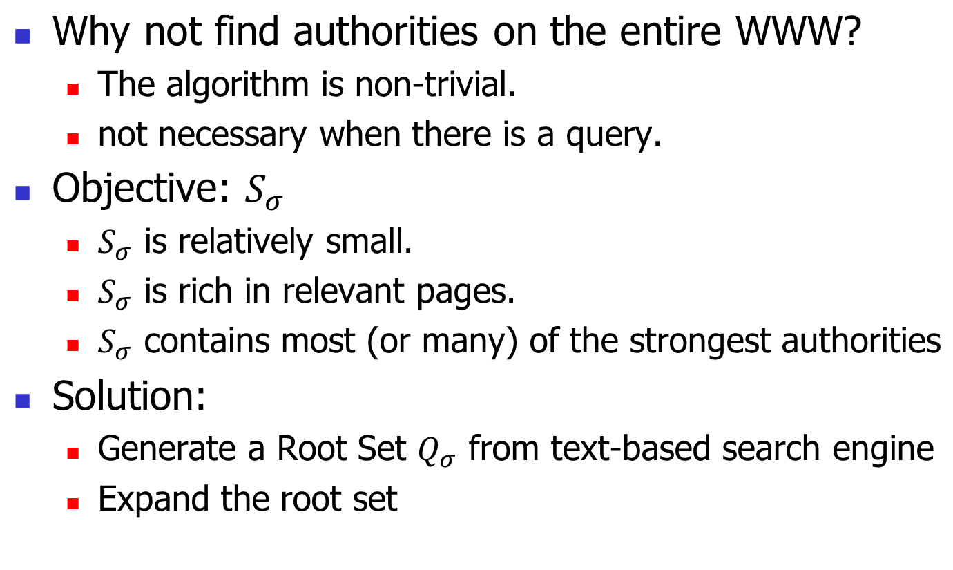
Constructing a focused subgraph
Data Mining: Concepts and Techniques

Slide 67
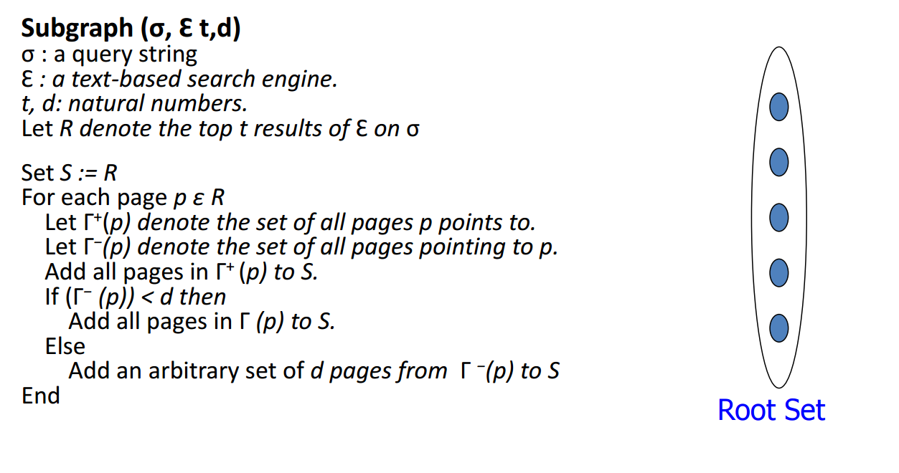
Constructing a focused subgraph
Data Mining: Concepts and Techniques

Slide 68
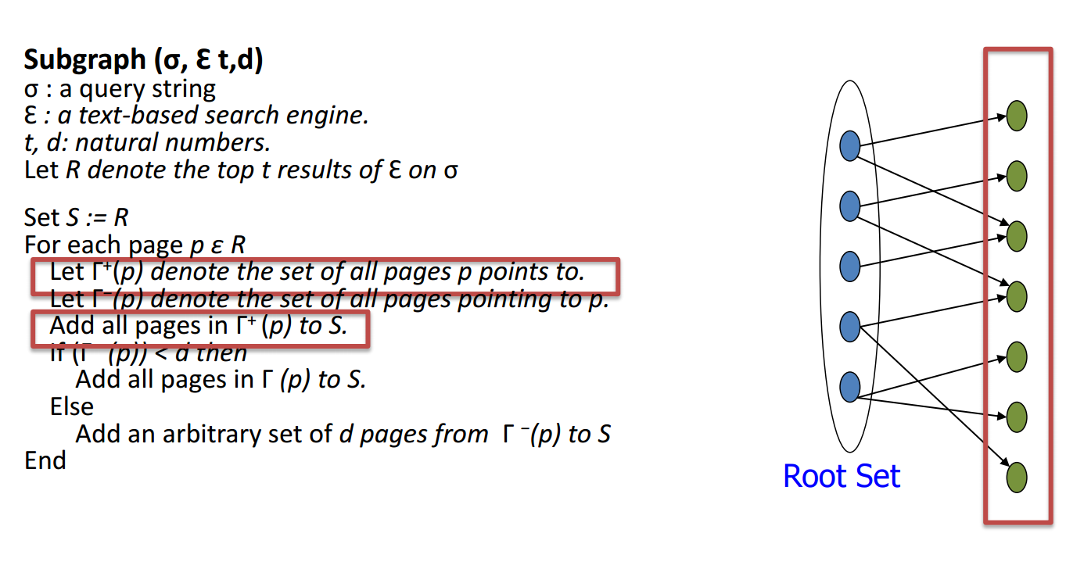
Constructing a focused subgraph
Data Mining: Concepts and Techniques

Slide 69
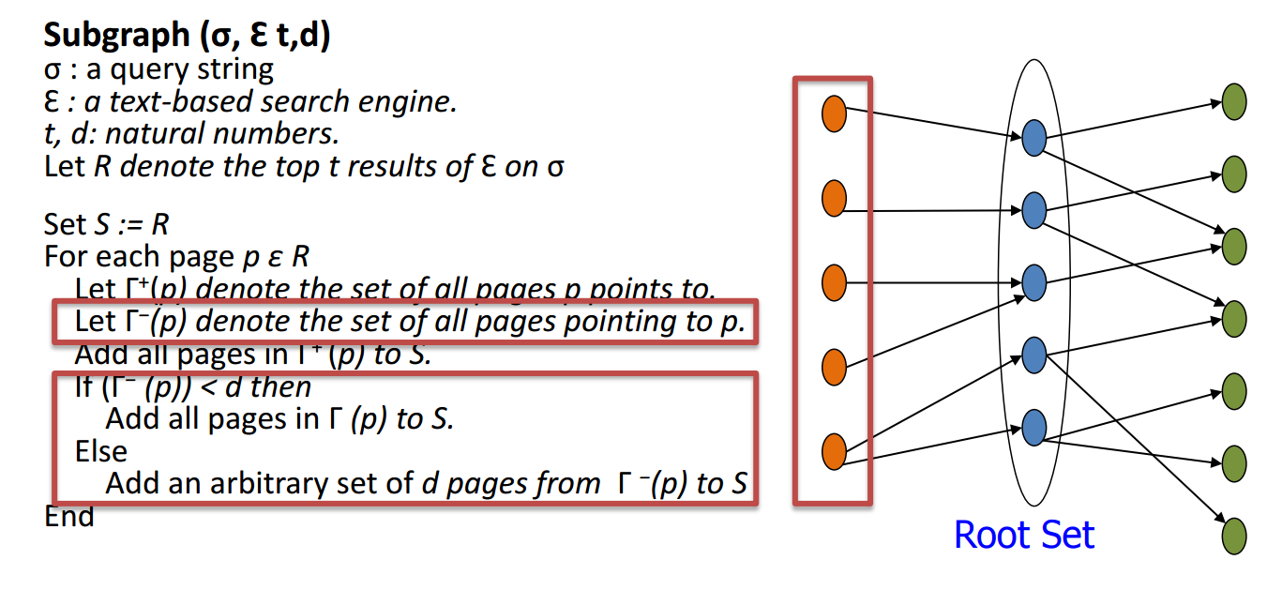
Constructing a focused subgraph
Data Mining: Concepts and Techniques

Slide 70
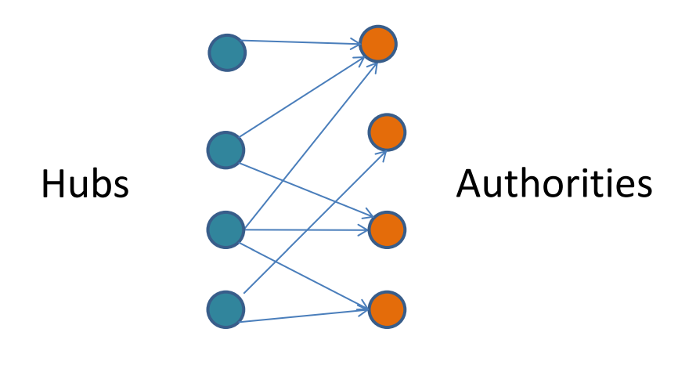
Computing Hubs and Authorities
Rules:
  A good hub points to many good authorities.
  A good authority is pointed to by many good hubs.
  Authorities and hubs have a mutual reinforcement relationship.
Data Mining: Concepts and Techniques

Slide 71
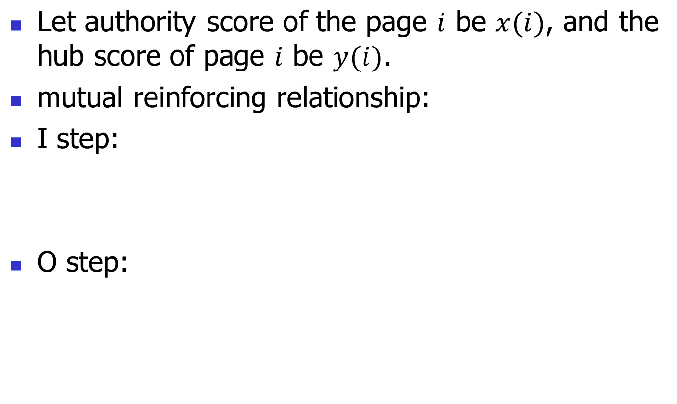
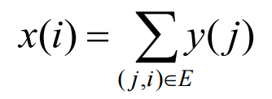
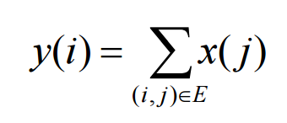
Computing Hubs and Authorities
Data Mining: Concepts and Techniques

Slide 72
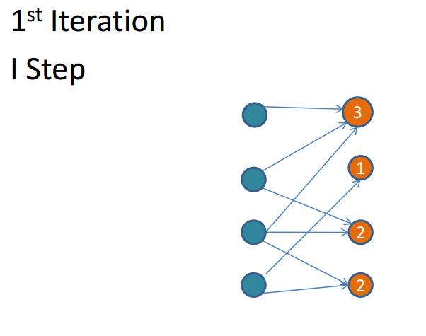
Example (no normalization)
Data Mining: Concepts and Techniques

Slide 73
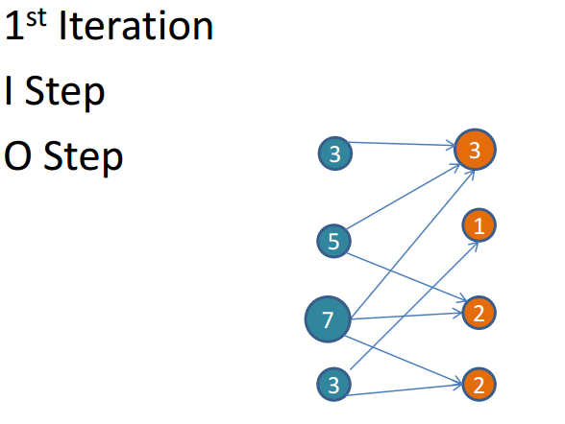
Example (no normalization)
Data Mining: Concepts and Techniques

Slide 74
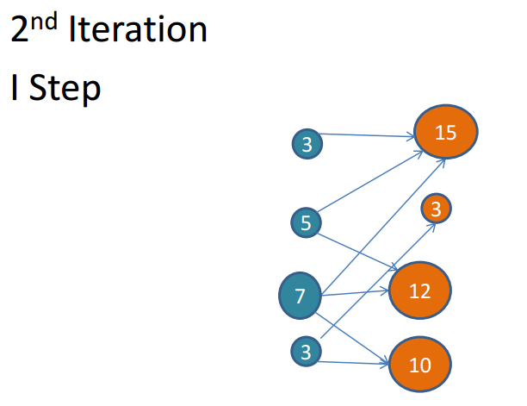
Example (no normalization)
Data Mining: Concepts and Techniques

Slide 75
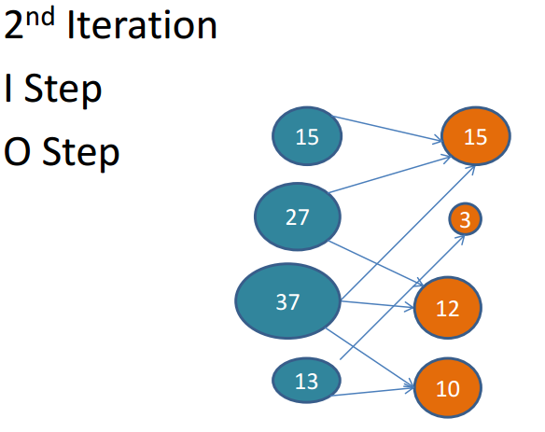
Example (no normalization)
Data Mining: Concepts and Techniques

Slide 76
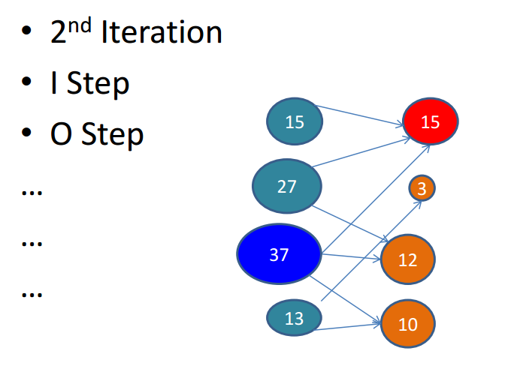
Example (no normalization)
Data Mining: Concepts and Techniques

Slide 77
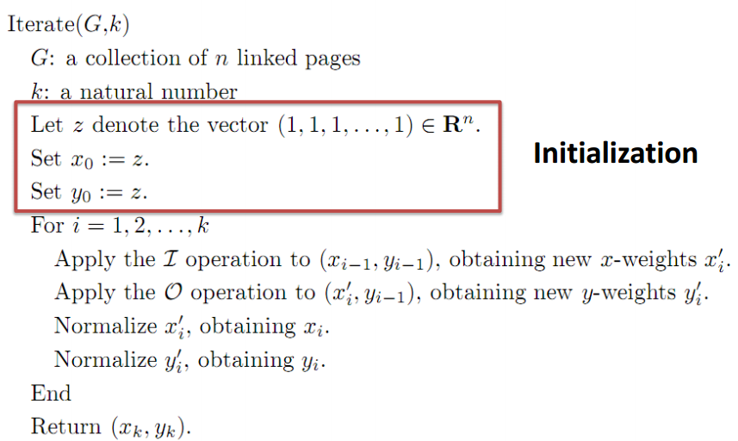
The Iterative Algorithm
Data Mining: Concepts and Techniques

Slide 78
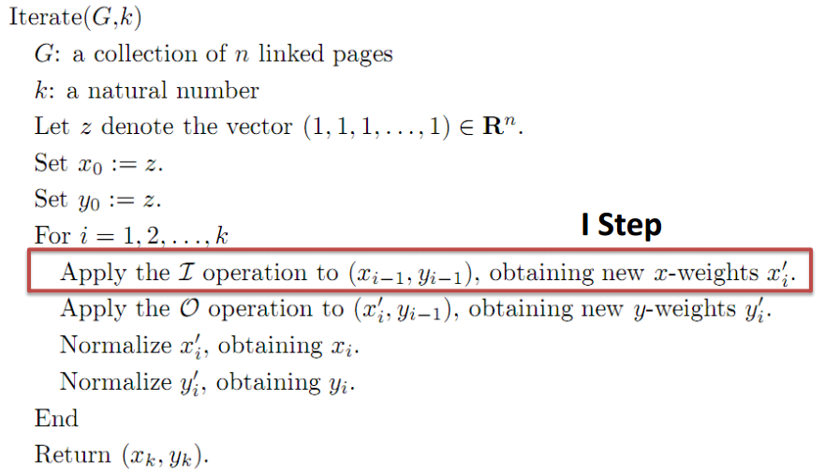
The Iterative Algorithm
Data Mining: Concepts and Techniques

Slide 79
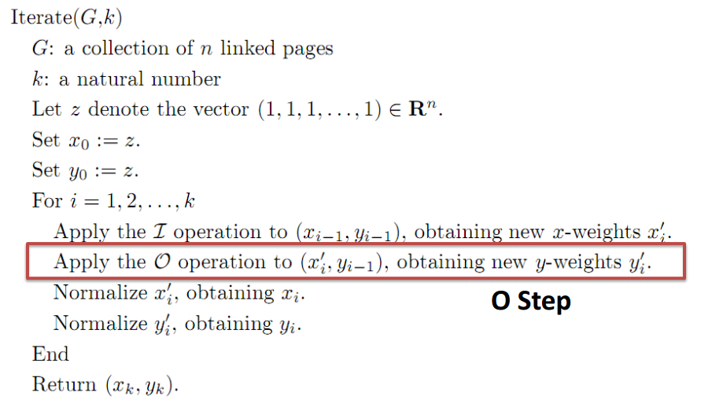
The Iterative Algorithm
Data Mining: Concepts and Techniques

Slide 80
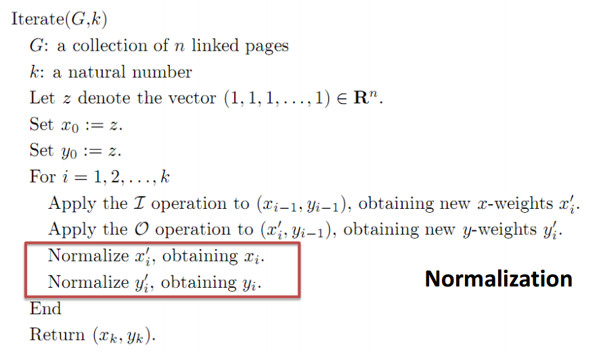
The Iterative Algorithm
Data Mining: Concepts and Techniques

Slide 81
Hub and Authorities
Define a matrix A whose rows and columns correspond to Web pages with entry A_{ij}=1 if page i links to page j, and 0 if not.
Let a and h be vectors, whose i^{th} component corresponds to the degrees of authority and hubbiness of the ith page. Then:
h = A × a. That is, the hubbiness of each page is the sum of the authorities of all the pages it links to.
a = A^{T} × h. That is, the authority of each page is the sum of the hubbiness of all the pages that link to it (A^{T} - transponed matrix).
Then, a = A^{T} × A × a h = A × A^{T} × h

Slide 82
Hub and Authorities - Example
Consider the Web presented below.
1 1 1
A = 0 0 1
1 1 0
A
B
1 0 1
A^{T} = 1 0 1
1 1 0
C
2 2 1
A^{T}A = 2 2 1
1 1 2
3 1 2
AA^{T} = 1 1 0
2 0 2

Slide 83
Hub and Authorities - Example
If we assume that the vectors
h = [ h_{a}, h_{b}, h_{c} ] and a = [ a_{a}, a_{b}, a_{c} ] are each initially [ 1,1,1 ], the first three iterations of the equations for a and h are the following:
a_{a} = 1 5 24 114
a_{b} = 1 5 24 114
a_{c} = 1 4 18 84
h_{a} = 1 6 28 132
h_{b} = 1 2 8 36
h_{c} = 1 4 20 96

Slide 84
Discovering cyber-communities on the web
Based on link structure

Slide 85
What is cyber-community
Defn: a community on the web is a group of web pages sharing a common interest
  Eg. A group of web pages talking about POP Music
  Eg. A group of web pages interested in data-mining
Main properties:
  Pages in the same community should be similar to each other in contents
  The pages in one community should differ from the pages in another community
  Similar to cluster

Slide 86
Recursive Web Communities
Definition: A community consists of members that have more links within the community than outside of the community.
Community identification is NP-complete task

Slide 87
Two different types of communities
Explicitly-defined communities
  They are well known ones, such as the resource listed by Yahoo!
Implicitly-defined communities
  They are communities unexpected or invisible to most users
eg.
Arts
Music
Painting
Classic
Pop
eg. The group of web pages interested in a particular singer

Slide 88
Similarity of web pages
Discovering web communities is similar to clustering. For clustering, we must define the similarity of two nodes
A Method I:
  For page and page B, A is related to B if there is a hyper-link from A to B, or from B to A
  Not so good. Consider the home page of IBM and Microsoft.
Page A
Page B

Slide 89
Similarity of web pages
Method II (from Bibliometrics)
  Co-citation: the similarity of A and B is measured by the number of pages cite both A and B
  Bibliographic coupling: the similarity of A and B is measured by the number of pages cited by both A and B.
Page A
Page B
The normalized degree of
overlap in inbound links
Page A
Page B
The normalized degree of
overlap in outbound links

Slide 90
Simple Cases (co-citations and coupling)
Page C
Page A
Page B
Better not to account self-citations
Page A
Page B
Number of pages for similarity decision should be big enough

Slide 91
Example method of clustering
The method from R. Kumar, P. Raghavan, S. Rajagopalan, Andrew Tomkins
  IBM Almaden Research Center
They call their method communities trawling (CT)
They implemented it on the graph of 200 millions pages, it worked very well

Slide 92
Basic idea of CT
Bipartite graph: Nodes are partitioned into two sets, F and C
Every directed edge in the graph is directed from a node in F to a node in C
F
C
F
C

Slide 93
Basic idea of CT
Definition Bipartite cores
  a complete bipartite subgraph with at least i nodes from F and at least j nodes from C
  i and j are tunable parameters
  A (i, j) Bipartite core
Every community have such a core with a certain i and j
A (i=3, j=3) bipartite core

Slide 94
Basic idea of CT
A bipartite core is the identity of a community
To extract all the communities is to enumerate all the bipartite cores on the web

Slide 95
Web Communities

Slide 96
Read More
http://webselforganization.com/

Slide 97
Web Usage Mining

Slide 98
What is Web Usage Mining?
A Web is a collection of inter-related files on one or more Web servers.
Web Usage Mining.
  Discovery of meaningful patterns from data generated by client-server transactions.
Typical Sources of Data:
  automatically generated data stored in server access logs, referrer logs, agent logs, and client-side cookies.
  user profiles.
  metadata: page attributes, content attributes, usage data.

Slide 99

Web Usage Mining (WUM)
The discovery of interesting user access patterns from Web server logs
Generate simple statistical reports:
  A summary report of hits and bytes transferred
  A list of top requested URLs
  A list of top referrers
  A list of most common browsers used
  Hits per hour/day/week/month reports
  Hits per domain reports
Learn:
  Who is visiting you site
  The path visitors take through your pages
  How much time visitors spend on each page
  The most common starting page
  Where visitors are leaving your site

Slide 100
Web Usage Mining – Three Phases
Pre-Processing
Pattern Discovery
Pattern Analysis
Raw
Sever log
User session
File
Rules and Patterns
Interesting Knowledge

Slide 101
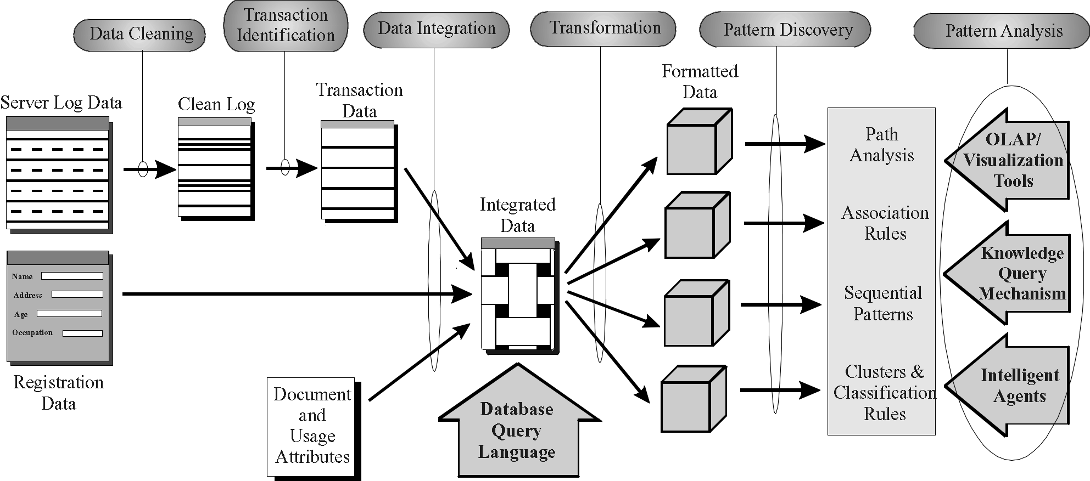
The Web Usage Mining Process
- General Architecture for the WEBMINER -

Slide 102
Web Server Access Logs
Typical Data in a Server Access Log
looney.cs.umn.edu han - [09/Aug/1996:09:53:52 -0500] "GET mobasher/courses/cs5106/cs5106l1.html HTTP/1.0" 200
mega.cs.umn.edu njain - [09/Aug/1996:09:53:52 -0500] "GET / HTTP/1.0" 200 3291
mega.cs.umn.edu njain - [09/Aug/1996:09:53:53 -0500] "GET /images/backgnds/paper.gif HTTP/1.0" 200 3014
mega.cs.umn.edu njain - [09/Aug/1996:09:54:12 -0500] "GET /cgi-bin/Count.cgi?df=CS home.dat\&dd=C\&ft=1 HTTP
mega.cs.umn.edu njain - [09/Aug/1996:09:54:18 -0500] "GET advisor HTTP/1.0" 302
mega.cs.umn.edu njain - [09/Aug/1996:09:54:19 -0500] "GET advisor/ HTTP/1.0" 200 487
looney.cs.umn.edu han - [09/Aug/1996:09:54:28 -0500] "GET mobasher/courses/cs5106/cs5106l2.html HTTP/1.0" 200
. . . . . . . . .
Access Log Format
IP address userid time method url protocol status size

Slide 103
Example: Session Inference with Referrer Log
IP
Time
URL
Referrer
Agent
1 www.aol.com 08:30:00 A # Mozillar/2.0; AIX 4.1.4
2 www.aol.com 08:30:01 B E Mozillar/2.0; AIX 4.1.4
3 www.aol.com 08:30:02 C B Mozillar/2.0; AIX 4.1.4
4 www.aol.com 08:30:01 B # Mozillar/2.0; Win 95
5 www.aol.com 08:30:03 C B Mozillar/2.0; Win 95
6 www.aol.com 08:30:04 F # Mozillar/2.0; Win 95
7 www.aol.com 08:30:04 B A Mozillar/2.0; AIX 4.1.4
8 www.aol.com 08:30:05 G B Mozillar/2.0; AIX 4.1.4
Identified Sessions:
S₁: # ==> A ==> B ==> G from references 1, 7, 8
S₂: E ==> B ==> C from references 2, 3
S₃: # ==> B ==> C from references 4, 5
S₄: # ==> F from reference 6

Slide 104
Data Mining on Web Transactions
Association Rules:
  discovers similarity among sets of items across transactions
  X =====> Y
  where X, Y are sets of items, α = confidence or P(X v Y),
  σ = support or P(X^Y)
Examples:
  60% of clients who accessed /products/, also accessed /products/software/webminer.htm.
  30% of clients who accessed /special-offer.html, placed an online order in /products/software/.
  (Actual Example from IBM official Olympics Site)
  {Badminton, Diving} ===> {Table Tennis} (α = 69.7%, σ = 0.35%)
α, σ

Slide 105
Other Data Mining Techniques
Sequential Patterns:
  30% of clients who visited /products/software/, had done a search in Yahoo using the keyword “software” before their visit
  60% of clients who placed an online order for WEBMINER, placed another online order for software within 15 days
Clustering and Classification
  clients who often access /products/software/webminer.html tend to be from educational institutions.
  clients who placed an online order for software tend to be students in the 20-25 age group and live in the United States.
  75% of clients who download software from /products/software/demos/ visit between 7:00 and 11:00 pm on weekends.

Slide 106
Path and Usage Pattern Discovery
Types of Path/Usage Information
  Most Frequent paths traversed by users
  Entry and Exit Points
  Distribution of user session duration
Examples:
  60% of clients who accessed /home/products/file1.html, followed the path /home ==> /home/whatsnew ==> /home/products ==> /home/products/file1.html
  (Olympics Web site) 30% of clients who accessed sport specific pages started from the Sneakpeek page.
  65% of clients left the site after 4 or less references.

Slide 107
Search Engines for Web Mining

Slide 108
The number of Internet hosts exceeded...
1.000 in 1984
10.000 in 1987
100.000 in 1989
1.000.000 in 1992
10.000.000 in 1996
100.000.000 in 2000

Slide 109

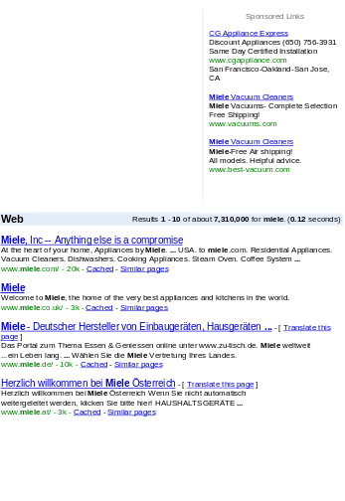

Web search basics
User
Web crawler
Search
Indexer
The Web
Indexes
Ad indexes

Slide 110
Search engine components
Spider (a.k.a. crawler/robot) – builds corpus
  Collects web pages recursively
    For each known URL, fetch the page, parse it, and extract new URLs
    Repeat
  Additional pages from direct submissions & other sources
The indexer – creates inverted indexes
  Various policies wrt which words are indexed, capitalization, support for Unicode, stemming, support for phrases, etc.
Query processor – serves query results
  Front end – query reformulation, word stemming, capitalization, optimization of Booleans, etc.
  Back end – finds matching documents and ranks them

Slide 111
Web Search Products and Services
Alta Vista
DB2 text extender
Excite
Fulcrum
Glimpse (Academic)
Google!
Inforseek Internet
Inforseek Intranet
Inktomi (HotBot)
Lycos
PLS
Smart (Academic)
Oracle text extender
Verity
Yahoo!

Slide 112
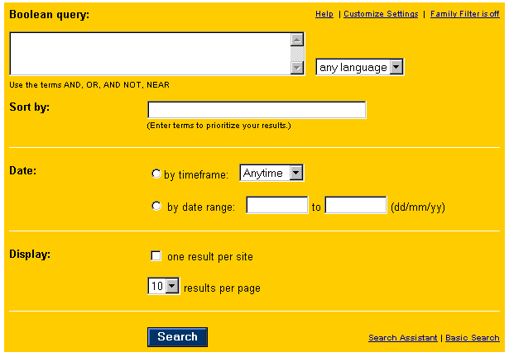
Boolean search in AltaVista

Slide 113
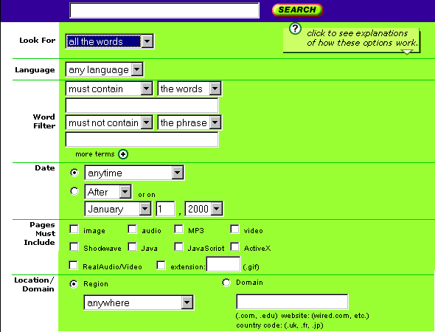
Specifying field content in HotBot

Slide 114
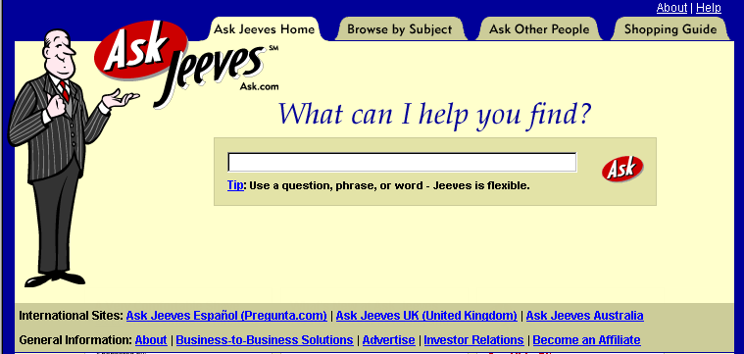
Natural language interface in AskJeeves

Slide 115
Three examples of search strategies
Rank web pages based on popularity
Rank web pages based on word frequency
Match query to an expert database
All the major search engines use a mixed strategy in ranking web pages and responding to queries

Slide 116
Rank based on word frequency
Library analogue: Keyword search
Basic factors in HotBot ranking of pages:
  words in the title
  keyword meta tags
  word frequency in the document
  document length

Slide 117
Alternative word frequency measures
Excite uses a thesaurus to search for what you want, rather than what you ask for
AltaVista allows you to look for words that occur within a set distance of each other
NorthernLight weighs results by search term sequence, from left to right

Slide 118
Rank based on popularity
Library analogue: citation index
The Google strategy for ranking pages:
  Rank is based on the number of links to a page
  Pages with a high rank have a lot of other web pages that link to it
  The formula is on the Google help page ☺

Slide 119
More on popularity ranking
The Google philosophy is also applied by others, such as NorthernLight
HotBot measures the popularity of a page by how frequently users have clicked on it in past search results

Slide 120
Expert databases: Yahoo!
An expert database contains predefined responses to common queries
A simple approach is subject directory, e.g. in Yahoo!, which contains a selection of links for each topic
The selection is small, but can be useful

Slide 121
Expert databases: AskJeeves
AskJeeves has predefined responses to various types of common queries
These prepared answers are augmented by a meta-search, which searches other SEs
Library analogue: Reference desk

Slide 122
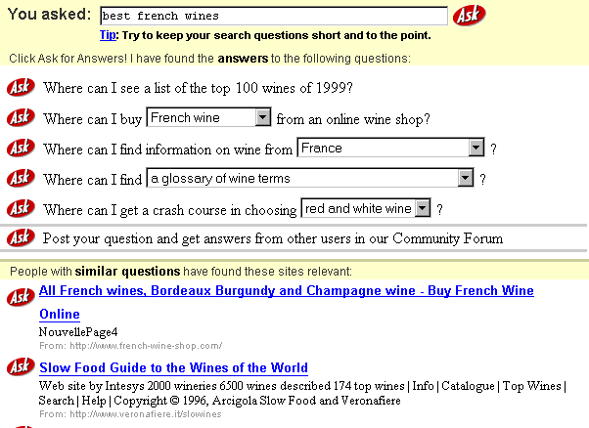
Best wines in France: AskJeeves

Slide 123
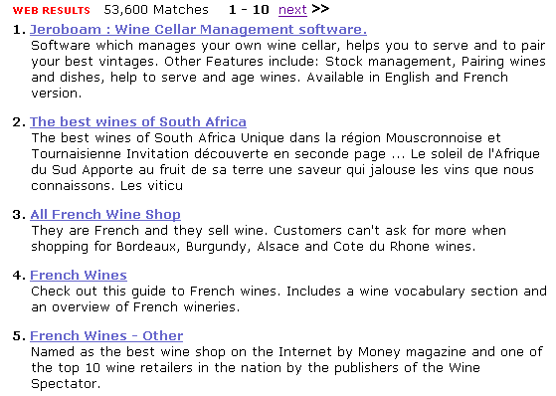
Best wines in France: HotBot

Slide 124

Best wines in France: Google

Slide 125
Some possible improvements
Automatic translation of websites
More natural language intelligence
Use meta data on trusty web pages

Slide 126
Predicting the future...
Association analysis of related documents (a popular data mining technique)
Graphical display of web communities (both two- and three dimensional)
Client-adjusted query responses

Slide 127
Multi-Layered Meta-Web

Slide 128
What Role will XML Play?
XML provides a promising direction for a more structured Web and DBMS-based Web servers
Promote standardization, help construction of multi-layered Web-base.
Will XML transform the Web into one unified database enabling structured queries like:
  “find the cheapest airline ticket from NY to Chicago”
  “list all jobs with salary > 50 K in the Boston area”
It is a dream now but more will be minable in the future!

Slide 129
Web Mining in an XML View
Suppose most of the documents on web will be published in XML format and come with a valid DTD.
XML documents can be stored in a relational database, OO database, or a specially-designed database
To increase efficiency, XML documents can be stored in an intermediate format.

Slide 130
Mine What Web Search Engine Finds
Current Web search engines: convenient source for mining
  keyword-based, return too many answers, low quality answers, still missing a lot, not customized, etc.
Data mining will help:
  coverage: using synonyms and conceptual hierarchies
  better search primitives: user preferences/hints
  linkage analysis: authoritative pages and clusters
  Web-based languages: XML + WebSQL + WebML
  customization: home page + Weblog + user profiles

Slide 131
Warehousing a Meta-Web:
An MLDB Approach
Meta-Web: A structure which summarizes the contents, structure, linkage, and access of the Web and which evolves with the Web
Layer₀: the Web itself
Layer₁: the lowest layer of the Meta-Web
  an entry: a Web page summary, including class, time, URL, contents, keywords, popularity, weight, links, etc.
Layer₂ and up: summary/classification/clustering in various ways and distributed for various applications
Meta-Web can be warehoused and incrementally updated
Querying and mining can be performed on or assisted by meta-Web (a multi-layer digital library catalogue, yellow page).

Slide 132







A Multiple Layered Meta-Web Architecture
More Generalized Descriptions
Layer_{n}
...
Generalized Descriptions
Layer₁
Layer₀

Slide 133
Construction of Multi-Layer Meta-Web
XML: facilitates structured and meta-information extraction
Hidden Web: DB schema “extraction” + other meta info
Automatic classification of Web documents:
  based on Yahoo!, etc. as training set + keyword-based correlation/classification analysis (AI assistance)
Automatic ranking of important Web pages
  authoritative site recognition and clustering Web pages
Generalization-based multi-layer meta-Web construction
  With the assistance of clustering and classification analysis

Slide 134
Use of Multi-Layer Meta Web
Benefits of Multi-Layer Meta-Web:
  Multi-dimensional Web info summary analysis
  Approximate and intelligent query answering
  Web high-level query answering (WebSQL, WebML)
  Web content and structure mining
  Observing the dynamics/evolution of the Web
Is it realistic to construct such a meta-Web?
  Benefits even if it is partially constructed
  Benefits may justify the cost of tool development, standardization and partial restructuring

Slide 135
Conclusion
Web Mining fills the information gap between web users and web designers

