Slide 1
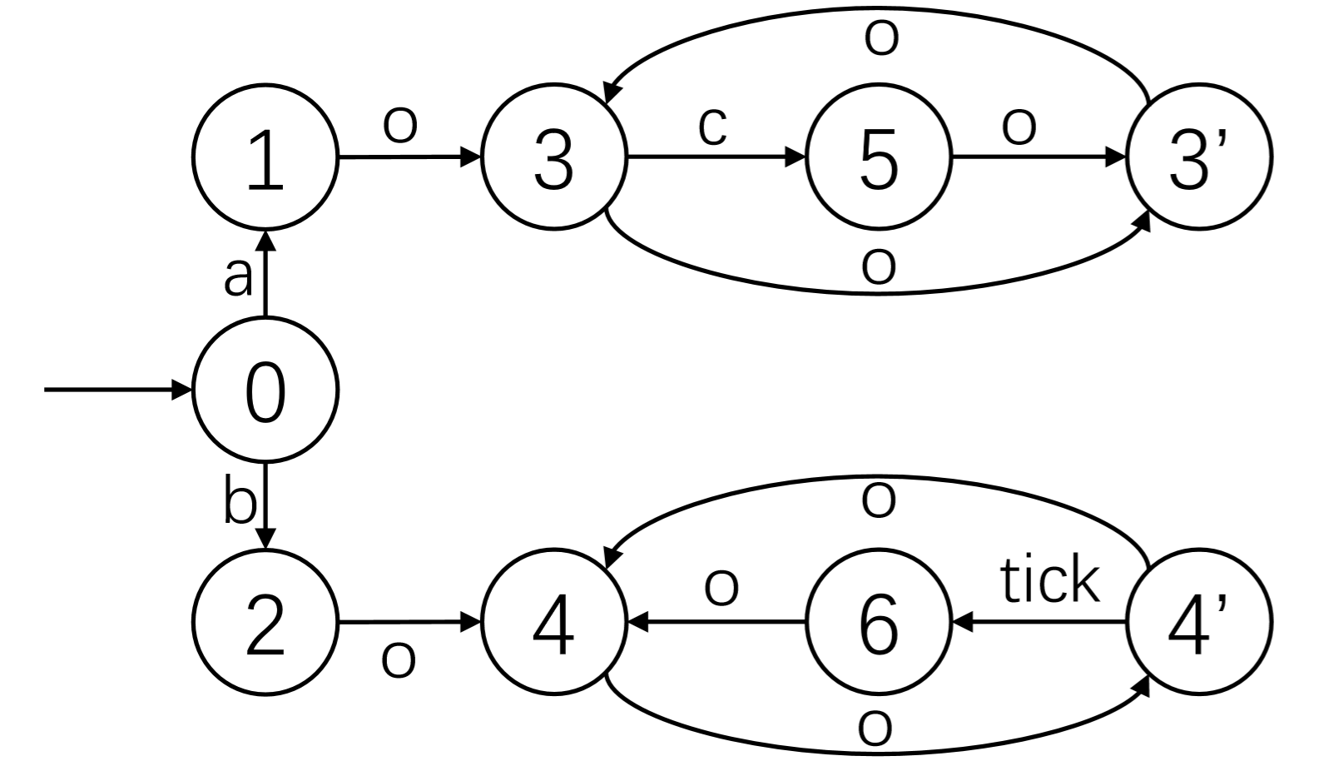
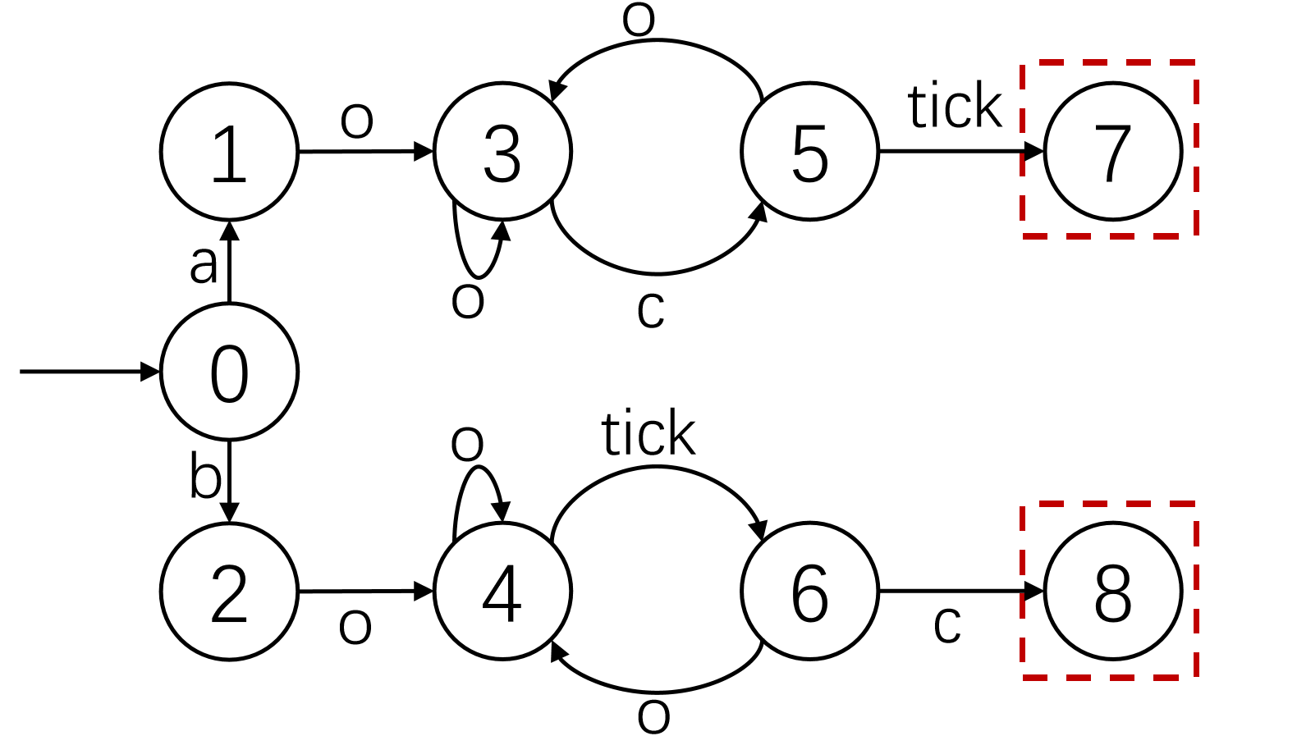
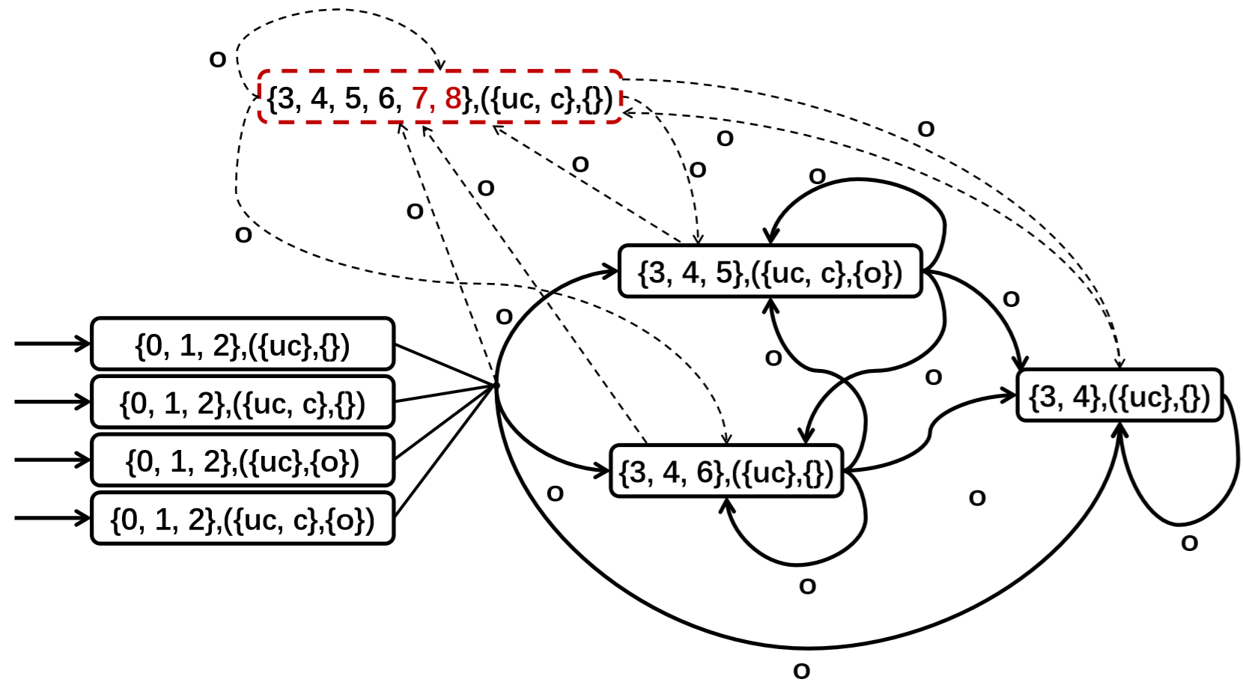
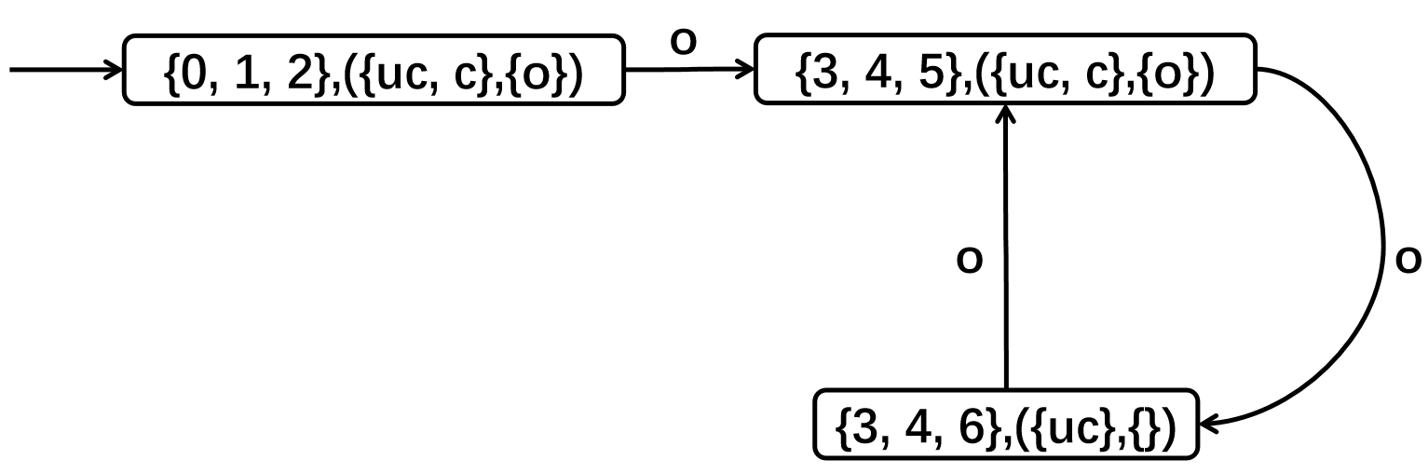
Timed Discrete Event System G (TDES)
Automaton (generates the closed-loop language L(S*/G) )
Synthesis
Product Composition
Extraction
Supervisor S* (safe, maximally permissive)
Inclusive Controllers

