Slide 1
Space Group Prediction for Trenary Compounds
Yunus Alamri

Slide 2
TABLE OF CONTENTS
01
Idea Explaination
02
Datasets & Features
03
EDA & Models
04
Final Remarks & Q/A

Slide 3
01
IDEA

Slide 4
Interest !
Materials applications are results of their properties

Slide 5
Fact
Physics tells us that the properties of materials are results of their structure

Slide 6
Aim?
Determining the structure to determine the properties

Slide 7
How to determine the structure?
Analytically
Experimentally
Only one physical law can tell
the structure of the atoms,
the Schrödinger equation
Using X-Ray Diffraction (XRD)
for molecular structure

Slide 8
Structure Challenges
Analytical
Experimental
Schrödinger equation almost impossible to be solved
Experiments are expensive in terms of money and time and bound to err.

Slide 9
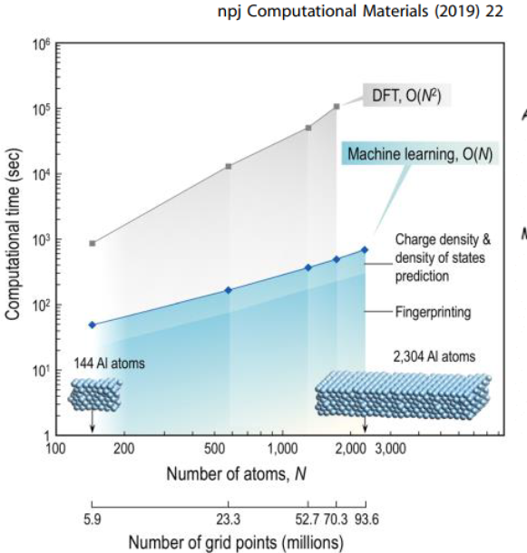
What is the current trend?
Schrödinger equation is not easy to solve; some approximation methods are used such as Density Functional Theory (DFT), ab initio, ..etc.
Aside from the elder's way (experiments), computational simulations are:
They are computationally expensive
They are filled with assumptions

Slide 10
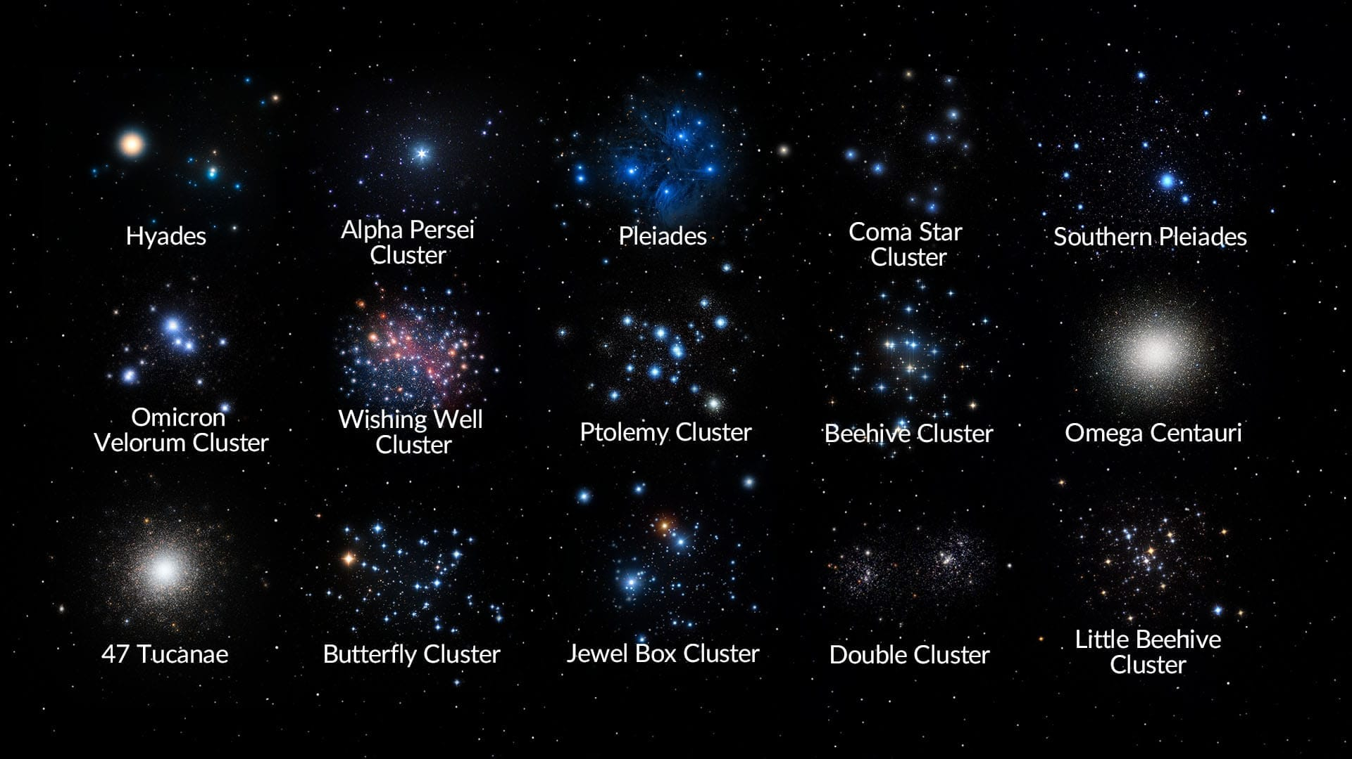
What are space groups?
They are not this ->
They are structures!

Slide 11
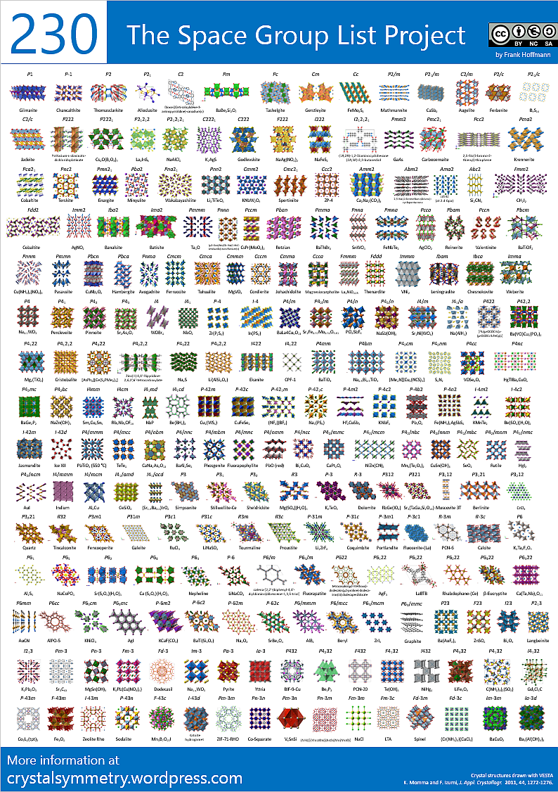
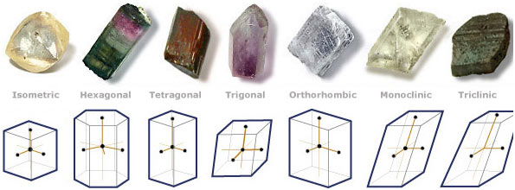
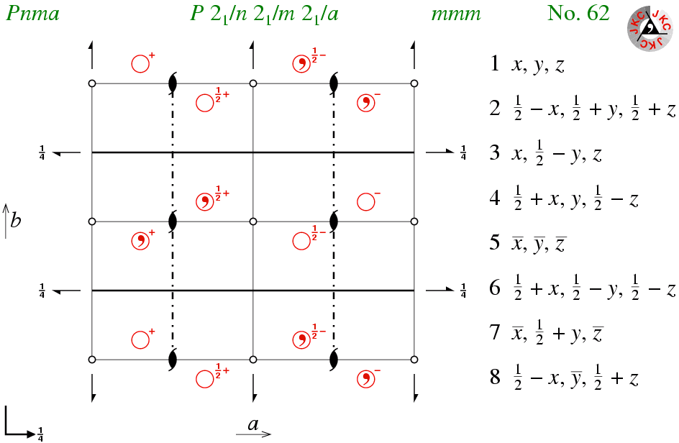
What is structure?
Materials structure are categorized into 7 crystal systems.
In 2D space, there are 32 unique configuration for atoms, known as Point Groups.
In 3D Space, there are 230 unique configuration for atoms, these are Space Groups.

Slide 12
02
Datasets & Features

Slide 13

Dataset
Source
Material Space
Size
Data was retrieved from NOMAD data repository
Only trenary compound for the first 85 elements
(181054, 69)

Slide 14
Features
Ionic Radii
stoichiometry
First Ionization Potentials
Oxidation State
Element Coefficient
Ionic Radius
First Ionization Energy
Oxidation Number

Slide 15
03
EDA & Models

Slide 16

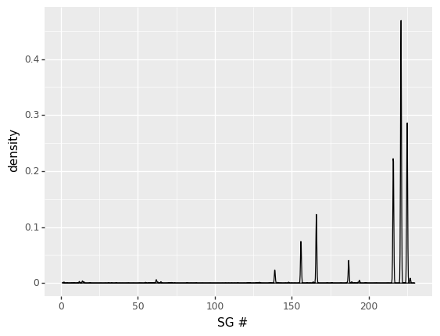
Pre-processing
Only 178 out of 230 space groups are present ->
Dataset is imbalance ->

Slide 17
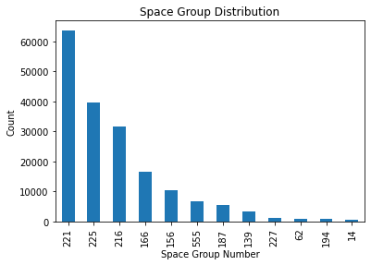
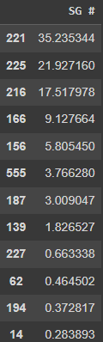
Pre-processing
To counter the imbalance, lumping was applied to combine all categories that has less than 500 instances in one category (555)
168 space groups (94.4%) were represented by 6819 instances (3.77%)

Slide 18
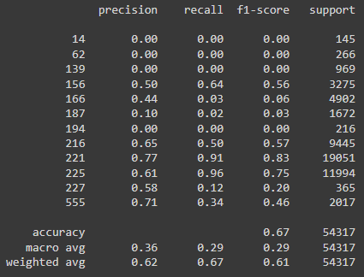
LogisticRegression Classifier
Default parameters

Slide 19
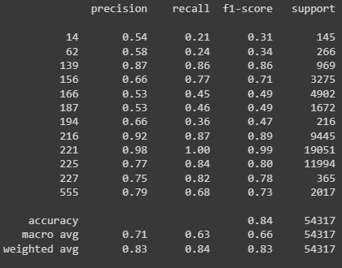
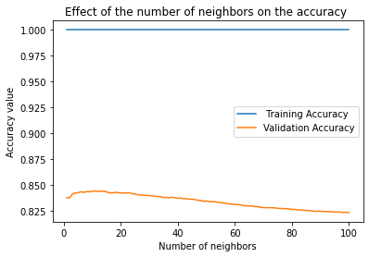
KNN Classifier
Default parameters, only changing the K neighbors

Slide 20
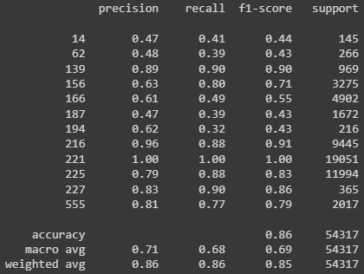
Decision Tree Classifier
Comparable to KNN

Slide 21
04
Final Remarks

Slide 22
Challenges & Limitations
Data imbalance.
Time limitation.
More features are needed.

Slide 23
Future Work
There is still room for more work for improvement, such as:
Sampling to over come data imbalance.
More data collection.
Multi-target classification to predict Point Groups and Space Groups.
Generalization over more materials space.

Slide 24
Future Work
More data is needed to balance the data.
Sampling could be utilized.

Slide 25

THANKS!
Do you have any questions?
Dr. Rick Scavetta
Mrs. Lujain Felemban
My dear colleagues

Slide 26
Refrences
NOMAD Database: https://nomad-lab.eu/
Sci-kit learn: https://scikit-learn.org/stable/index.html
Solving the electronic structure with machine learning: https://rdcu.be/cUiS6
Crystalsymmetry: https://crystalsymmetry.wordpress.com/

Slide 27

—SOMEONE FAMOUS
“This is a quote. Words full of wisdom that someone important said and can make the reader get inspired.”

