Slide 1
Exploring neighbourhoods in Overijssel, the Netherlands
Capstone Project
03/03/2021
Younjung Choi

Slide 2

introduction
Findning a house in big cities in the Netherlands is challenging to young people and internationals in the Netherlands.
Steeply increasing house prices in major cities like Amsterdam and Utrecht
Shortage of housing supply in the cities
‘Overijssel’, the east side of the Netherlands, could be an alternative to house-seekers.
However, due to the insufficient information on cities and neighbourhoods in Overijssel, house-seekers might hesitate to consider living in Overijssel.
Therefore, this paper aims providing a GIS-based information presenting clustered neighbourhoods in Overijssel, the Netherlands

Slide 3
data Acquisition
Geographic data of each neighbourhood in Overijssel
Postal code comes from a website “https://www.metatopos.eu/overijssel2.html”
Latitude and longitude is provided by Bing Map API
Venues in neighbourhoods (e.g. restaurant, gym, etc.)
Foursquare API offers the following information on a venue: name, latitude, longitude, and venue category
Instructions for the coding are mainly provided by the Coursera course “Applied Data Science Capstone”, as well as other online materials

Slide 4
Methodology
Scraping the list of postal codes of neighbourhoods in Overijssel
1
Used modules: pandas, numpy, requests, BeautifulSoup
Acquiring the latitude and longitude of each postal code using Bing Map API
2
Used module: geocoder
Exploring neighbourhoods in the Overijssel using Foursquare API
3
Used modules: matplotlib, folium
Clustering neighbourhoods in the Overijssel using a machine learning tool
4
Used machine learning tool: KMeans
The number of clusters: 5

Slide 5
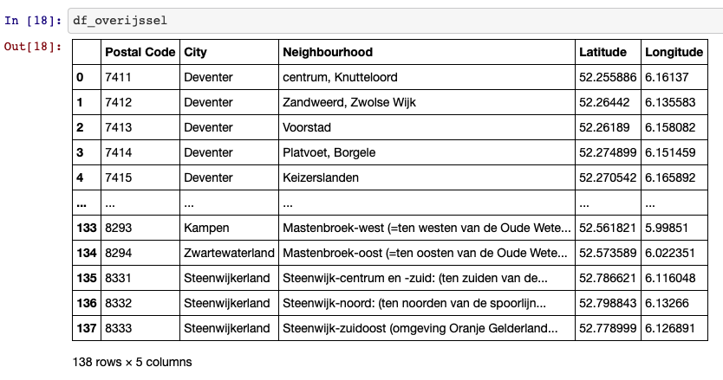
Overijssel geographic data

Slide 6
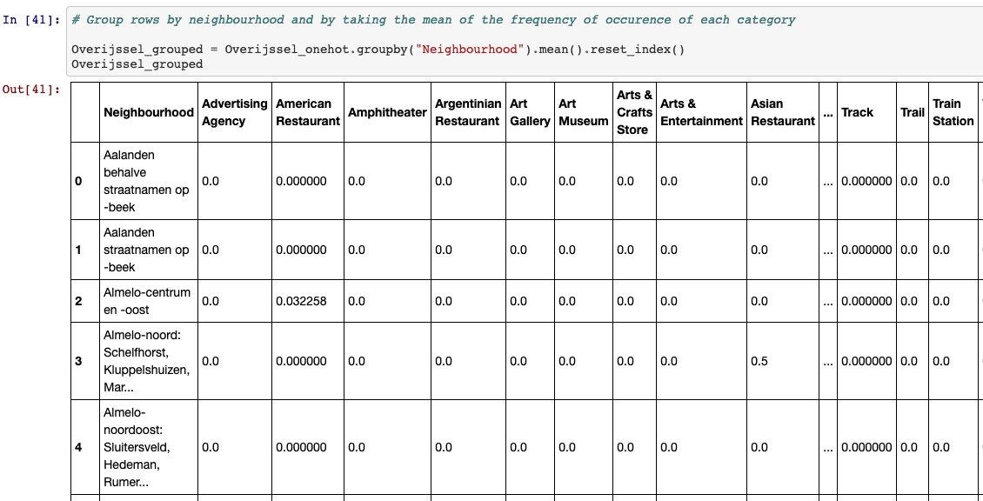
Overijssel venue data

Slide 7
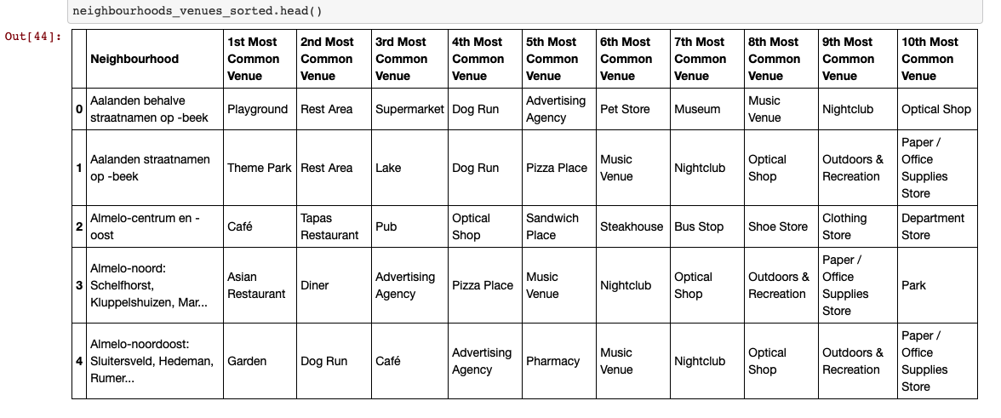
Sorted venue data

Slide 8
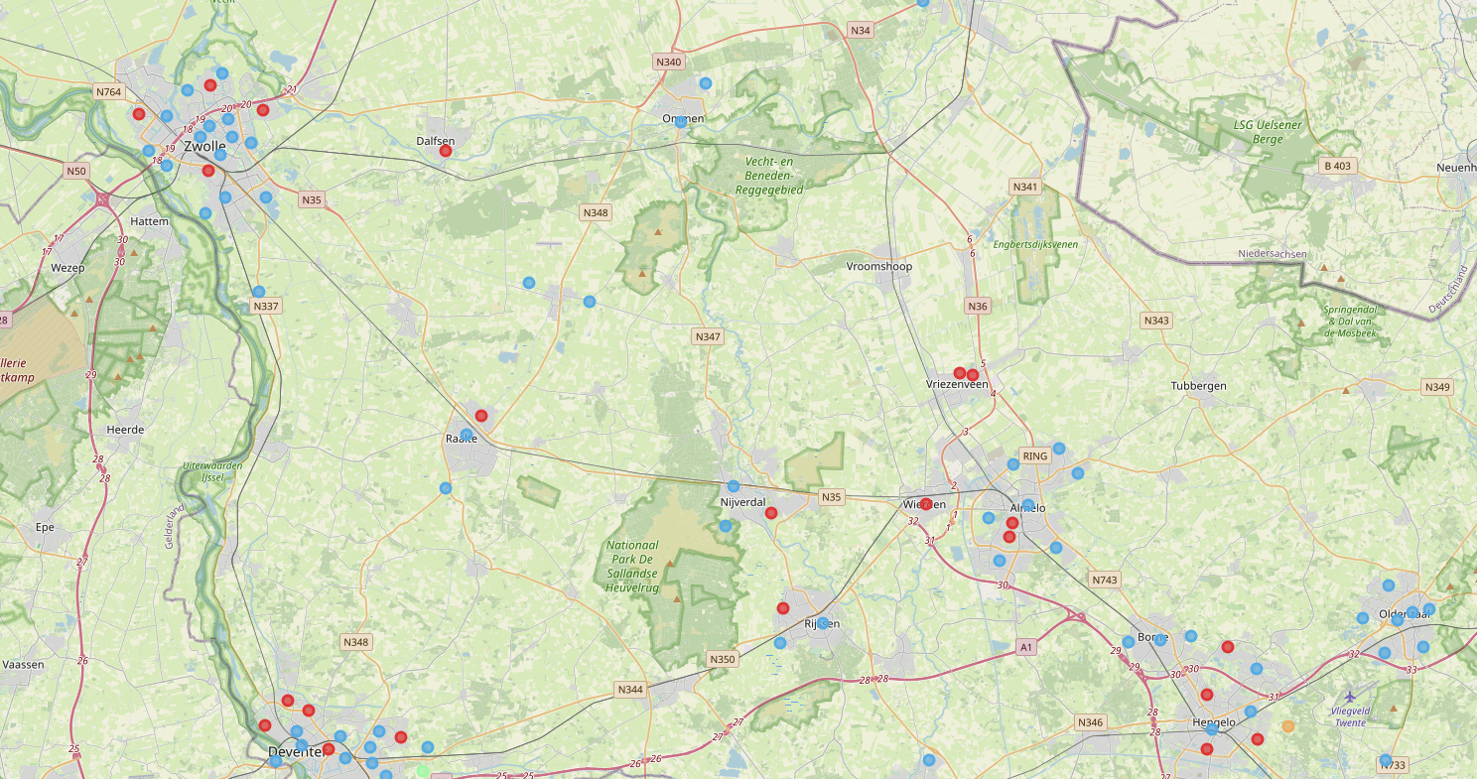
Visualized clustered neighbourhoods

