Slide 1
PROJECT TITLE
CAPSTONE PROJECT
Presented By: MOHAMMED YOUNUS M
Student Name : MOHAMMED YOUNUS M
College Name & Department : Sri Siddhartha Institute of Technology
CSE(CYBERSECURITY)

Slide 2
OUTLINE
Problem Statement
Technology used
Wow factor
End users
Result
Conclusion
Git-hub Link
Future scope

Slide 3
Problem Statement
In today's digital world, sensitive information is at risk of being intercepted. Traditional encryption methods make data secure but also make it obvious that encryption is being used.
Challenges:
1)Need for a secure way to hide information without drawing attention
2)Risk of unauthorized access to sensitive messages
3)Traditional encryption methods can be detected easily
Solution:
Steganography allows data to be hidden inside images, making it invisible while being protected with a password

Slide 4
Technology used
Platform:
VS Code, GitHub (for version control)
Programming Language:
Python
Libraries:
tkinter – GUI for user interaction
Pillow (PIL) – Image processing
stegano – Hiding and revealing messages
hashlib – Secure password hashing
os – File handling and system operations

Slide 5

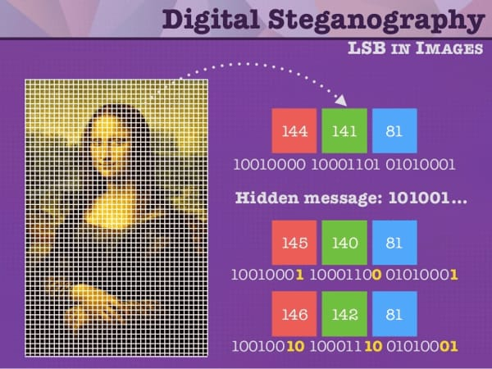
Wow factors
Hides secret messages inside normal-looking images so they are virtually undetectable
Uses password hashing to secure hidden information
Provides a simple and intuitive GUI for encryption and decryption
Automatically converts JPG images to PNG for better compatibility
Built with lightweight Python libraries making it easy to deploy and modify

Slide 6
End users
1. Government & Military – Secure communication and intelligence operations.
2. Cybersecurity Professionals – Protecting sensitive data from cyber threats.
3. Journalists & Whistleblowers – Safe transmission of confidential information.
4. Banks & Financial Institutions – Secure transactions and fraud prevention.
5. Forensic Experts & Law Enforcement – Investigating hidden data in criminal cases

Slide 7
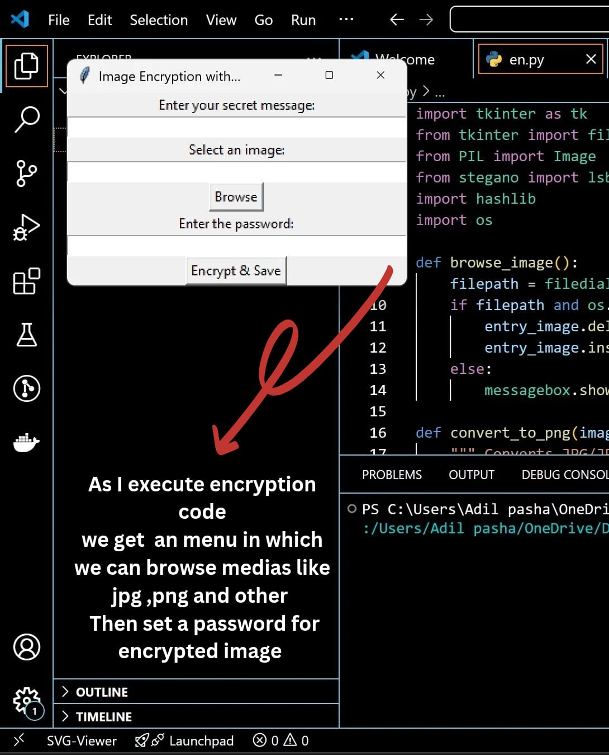
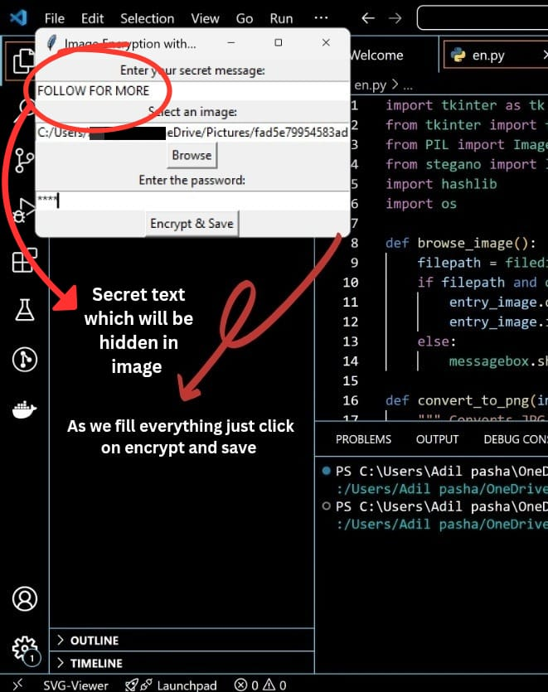
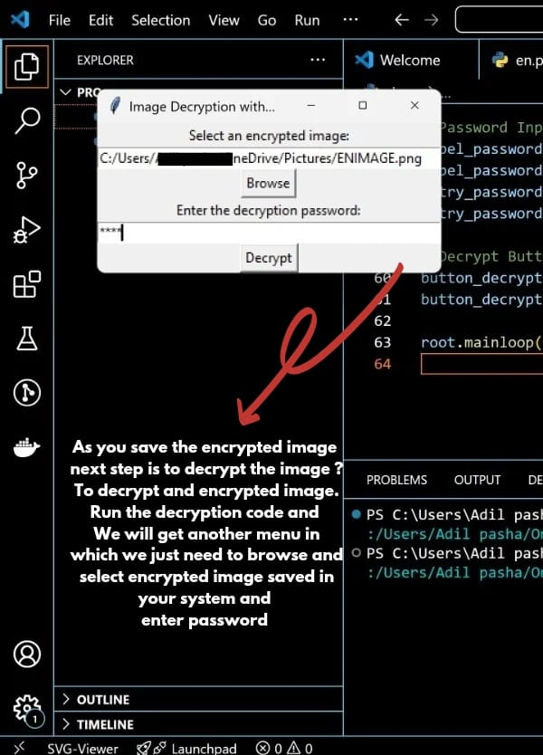
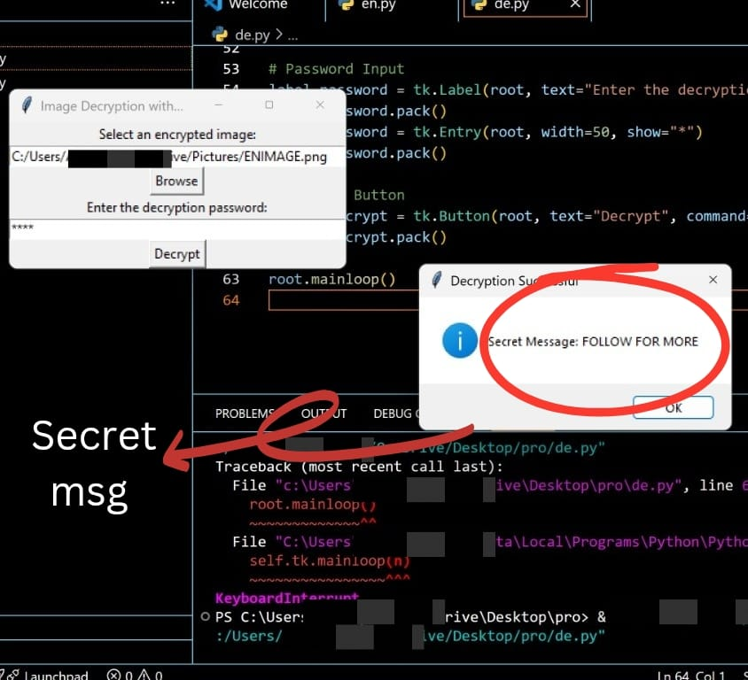
Results
The encryption code hides a secret message inside an image using a password. The decryption code extracts the message when the correct password is provided, keeping the data secure if an incorrect password is entered.

Slide 8

Conclusion
Steganography provides a secure way to hide sensitive information inside images, making it invisible to outsiders. By combining encryption with password protection, this project ensures that only authorized users can access the hidden data. It offers a simple yet effective solution for secure communication and data protection
IN THIS IMAGE THERE IS SMALL MSG HIDDEN
PASSWORD= ibm

Slide 9
GitHub Link
MY GITHUB LINK
https://github.com/YounusAmz/IBM_INTERN

Slide 10
Future scope(optional)
Quantum Cryptography Integration – Future-proof security against quantum attacks.
Real-time Steganography – Instant data hiding in live video streams.
Voice & Audio Steganography – Secure communication through calls and audio files.
Multi-layered Steganography – Combining multiple hiding techniques for stronger security.
Dark Web Applications – Enhancing anonymous data exchange.
Cloud Storage Security – Embedding encrypted data in cloud-stored images.
AI-Powered Automatic Detection & Prevention – Identifying steganography misuse in cybersecurity.
Mobile & Embedded Systems – Expanding steganography for mobile devices and IoT.
Augmented Reality (AR) & Virtual Reality (VR) – Concealing data within AR/VR environments.
Steganography in Messaging Apps – Secure conversations through hidden texts in shared images.
Cross-Platform Compatibility – Making steganography work seamlessly across different operating systems.
Personal Data Protection – Encrypting and hiding sensitive personal data for privacy.

Slide 11
THANK YOU

