Slide 1
MatterTrace
Client said
AI-assisted case timelines for a personal-injury law office
From a document
The problem: staff rebuild case timelines by hand from scattered documents, and lose track of where each fact came from and whether anyone has checked it.
Checked by a person
Mismatch or unclear
Ena Tarumi | CEN 4010 Final Project

Slide 2
Stakeholder value
Paralegal
Reviews every AI suggestion in one place instead of rebuilding timelines by hand.
Attorney
Gets a current timeline where every entry shows its source and who checked it. Keeps every legal decision.
Office and IT
Role-based access, case-only visibility, and a full activity log of every action.
Every fact shows where it came from and whether a person has checked it.

Slide 3
The implemented solution
1. AI suggests
Reads documents, proposes entries with a source link and label
2. Paralegal checks
Approve, fix, reject, or mark unclear
3. Risky items escalate
Mismatches and court/deadline items go up
4. Attorney approves
Only an attorney can approve the timeline
Built: document intake, AI extraction, review workbench, attorney queue, export, activity log
The AI never approves anything. Only a signed-in person can.

Slide 4
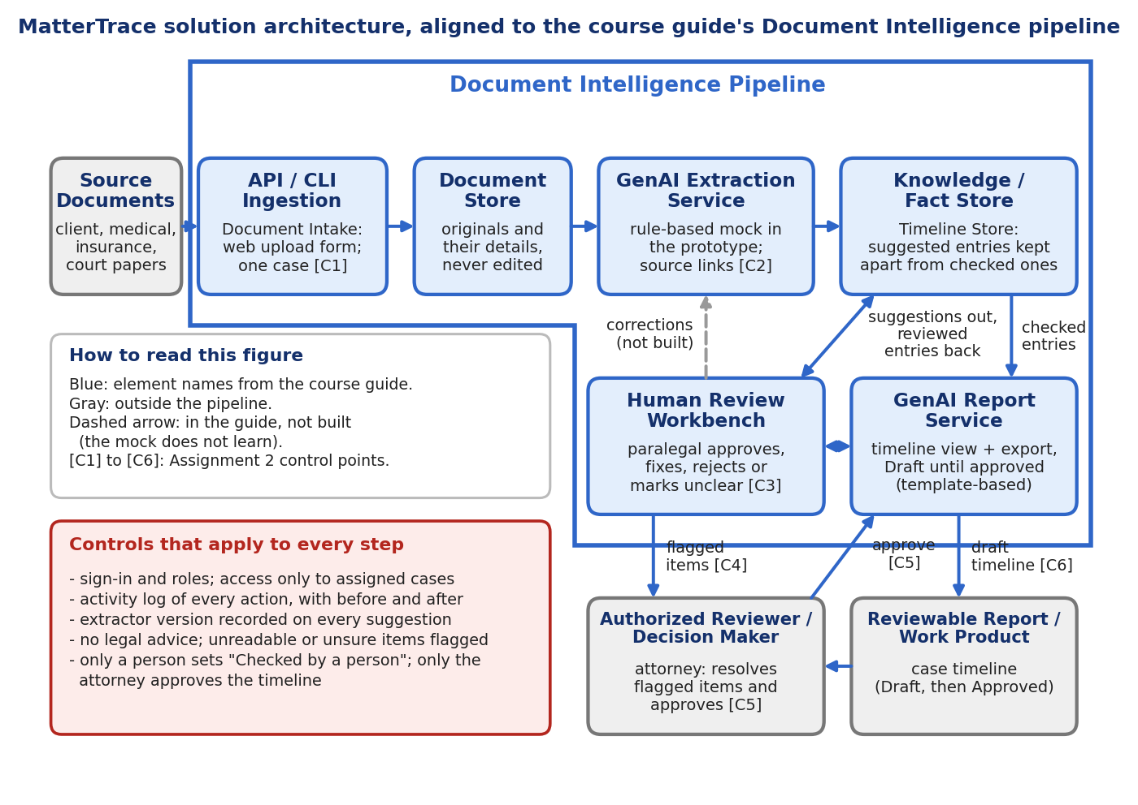
Architecture
Document Intelligence pipeline from the course guide
Same element names as the guide, plus six control points (C1-C6)
Suggested and checked entries kept separate
Extraction is a mock; a real LLM can replace it

Slide 5
Validation results
32 / 32
automated tests passing
5
defects found in testing and fixed
0
entries approved without a person
Two independent checks: pytest against the control logic, plus a manual browser walkthrough of every role, normal and exception paths
Bugs found by running the app (meaningless parties, wrong badge color) were fixed and re-verified

Slide 6
AI assistance
Claude helped with
Module structure and Flask code
The pytest suite
The mocked-extraction design
Drafting the updated report
I owned
Running every role in a real browser
Running the tests and reading the output
Reporting the defects that got fixed
Choosing the bounded scope
Creating and pushing the repository

Slide 7
Limitations
Rule-based mock, not a real LLM (deterministic, free, reproducible)
Mismatch detection covers same-date, conflicting-amount cases only
FR-11 (re-flag earlier entries on new contradicting documents) not built
Role-picker login and in-memory data: no real auth or database
NFR-06 (label usability), NFR-07 (timed benchmarks), NFR-09 (accuracy) not measured
No stakeholder interview: grounded in the instructor's scenario

Slide 8
Next steps and links
Swap in a real LLM that only suggests and cites sources
Build FR-11 re-flagging
Broaden mismatch rules to people and descriptions
Add a real database and authentication
Inspect it
GitHub
github.com/YourAznGurl/cen4010-final-project
Run locally
python3 -m app.main
Report and demo
Report PDF is linked at the top of the repo README; click-by-click demo steps are in README section 6

