Slide 1
GCB Risk Model Development
Bayesian Optimization
October 2020

Slide 2
Agenda
Hyper-Parameter Tuning
Bayesian Optimization
Overview
Surrogate model
Acquisition Function
Illustration
Practical Implementation
PIL model Use Case
UW model – optimization problem
Number of iterations
Model Selection
Effect of Kappa
Grid Search vs BOT
Conclusion
Appendix
Bayesian Optimization
Notes:
Headers for the Agenda table ?
Slide 2 is Pil – does not match with the agenda
Update

Slide 3
Hyper-Parameter Tuning
In machine learning, hyper-parameter optimization is the problem of choosing a set of optimal hyper-parameters for a learning algorithm
Model Hyper-Parameter
A model hyper-parameter is a configuration that is external to the model and whose value cannot be estimated from data
Hyper-Parameters are used in processes to help estimate model parameters
Some examples of model hyper-parameters include:
Learn rate, Max depth, Minimum rows
Alpha, Lambda, Gamma
Hyper-Parameters Optimization Algorithms
Algorithm | Description
Grid Search | Trains the algorithm on each possible configuration of a specified set of hyper-parameters, choosing the hyper-parameter configuration that gives the best performance.
Random Search | Random search trains the algorithm by navigating the grid of hyper-parameters randomly, choosing the hyper-parameter configuration that gives the best performance.
Bayesian Optimization | Automatic hyper-parameter tuning forms knowledge about the relation between the prior hyper-parameter settings and model performance in order to make a smarter choice for the next parameter settings

Slide 4
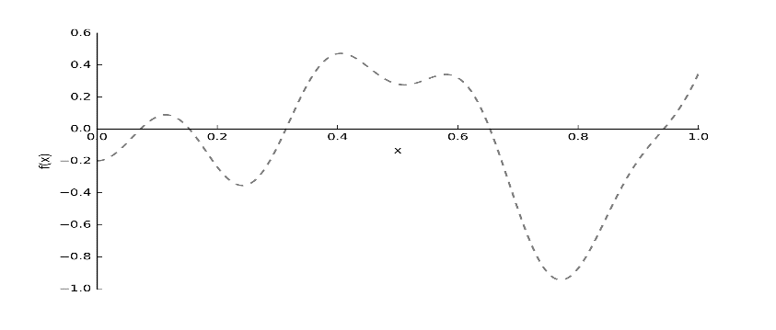
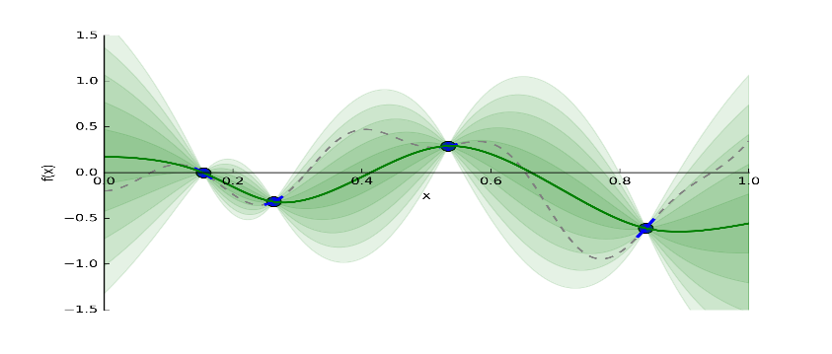
Bayesian Optimization: Surrogate Model
Bayesian Optimization incorporates prior beliefs about f, updates the prior beliefs using actual sample points from f to get a posterior that better approximates f
Gaussian Process, a popular surrogate model for Bayesian Optimization uses a set of previously evaluated parameters and resulting accuracy to predict regions of the hyper-parameter space that might give better results and also models the uncertainty of that prediction
Unknown Objective function
Initial sampled data points
1
2
Surrogate model
3
1
The dotted lines imply we can't see this function - we may only choose to evaluate it at certain points.
The solid green line is our guess of the true function. Each additional band of green is another half standard deviation on the output distribution.
3

Slide 5
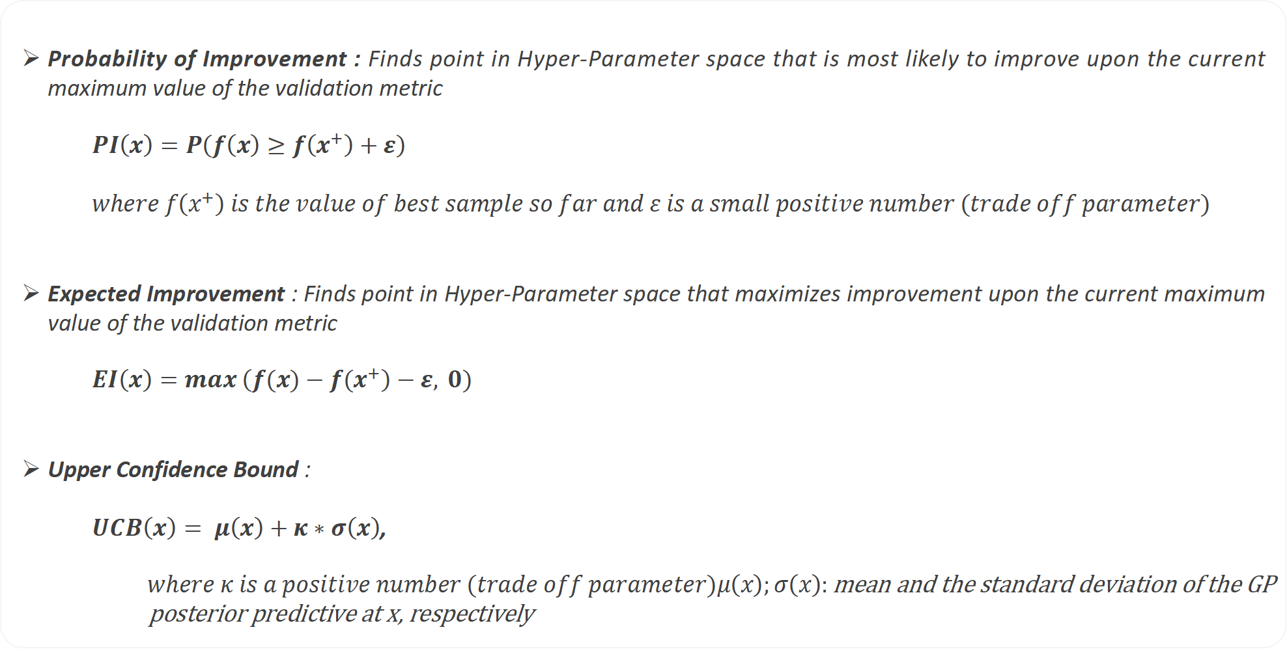
Bayesian Optimization: Acquisition Function
Acquisition function is used to select a point in the Hyper-Parameter space for consecutive iterations
The Acquisition function is responsible for trade off between exploitation and exploration.
To find the next point in Hyper-Parameter space, exploitation favors areas which have high value for the Objective function
To find the next point in Hyper-Parameter space, exploration favors areas which have higher prediction uncertainty
The goal is to maximize the acquisition function to determine the next sampling point
Popular Acquisition Functions
Probability of Improvement : Finds point in Hyper-Parameter space that is most likely to improve upon the current maximum value of the validation metric
$$PI\left(x\right)=P\left(f\left(x\right)≥f\left(x^{+}\right)+ε\right)$$
$$where f\left(x^{+}\right) is the value of best sample so far and ε is a small positive number (trade off parameter)$$
Expected Improvement : Finds point in Hyper-Parameter space that maximizes improvement upon the current maximum value of the validation metric
$$EI\left(x\right)=max \left(f(x)−{f(x}^{+}\right)−ε, 0)$$
Upper Confidence Bound :
$UCB\left(x\right)= μ\left(x\right)+κ∗σ\left(x\right)$,
$$where κ is a positive number \left(trade off parameter\right)μ\left(x\right);σ\left(x\right):\text{mean} \text{and} \text{the} \text{standard} \text{deviation} \text{of} \text{the} \text{GP} \text{posterior} \text{predictive} \text{at} \text{x}\text{, }\text{respectively}$$

Slide 6
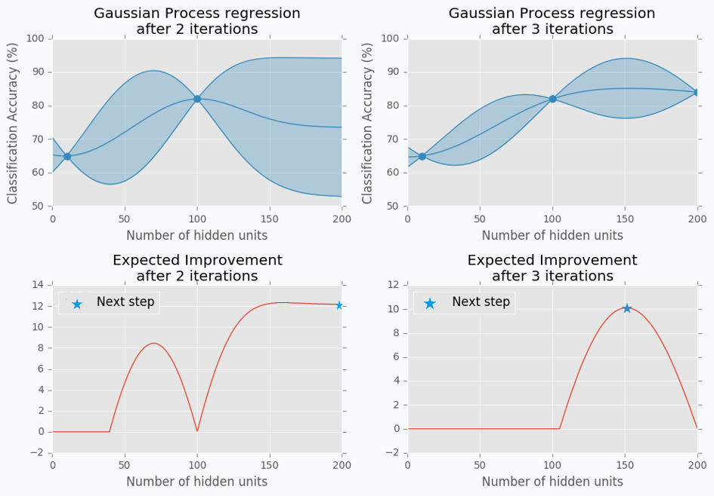
Bayesian Optimization Illustration
1
3
4
2
Surrogate model after 2 Iterations
Select hyper-parameter for next iteration by maximizing the acquisition function
Evaluating objective function on selected hyper-parameter and update the Surrogate Model
Repeat steps 2 and 3 to select hyper-parameter for next iteration
1
2
3
4

Slide 7
Practical Implementation of Bayesian Optimization
Additional Hyper-parameters need to be optimized when using Bayesian Optimization for Hyper-parameter tuning
Package ‘rBayesianOptimization’
Function:
The function that needs to be optimized, eg. AUC, RMSE, KS.
Bounds:
Range of hyper-parameters to be optimized.
Initial Points (init_points):
These are the random points that will be chosen and model will be run before Bayesian Optimization is triggered. These are run so that Gaussian Process can be run to approximate the functions and a closed form boundary can be created. This can be randomly done by process or combinations can be provided by user.
Iterations (n_iter):
Number of iterations that Bayesian Optimization will run to find the best solution.
Acquisition Function (acq):
Acquisition Function type to be used. UCB, Expected Improvement, Probability of Improvement
Acquisition Function Parameters (kappa, eps):
The hyper-parameters for Acquisition Functions – to help balance exploitation vs exploration
Kernel
Controls the shape that the fitted surrogate function can adopt. Default value is Square Exponential

Slide 8
Bayesian Optimization Use Case I: UW model
Use case for evaluating Bayesian Optimization : Underwriting Model for Personal Loans
Optimization Problem
BOT Output
Optimization Problem
Obj Function : h2o.xgboost
Metric : Validation AUC
Hyper-Parameters range
Minimum Rows : 500L -2000L
Learn Rate : 0.03-0.1
Depth : 4-8
BOT Parameters
Initial Points : 10
BOT Iterations : 20
Acq Function: UCB
Kappa : 3
Validation Metric
AUC Validation : 0.7814
Final Model Hyper-Parameters
Minimum Rows : 514
Learn Rate : 0.0466
Depth : 7
10 random iterations are used to approximate Objective function for the first iteration of BOT
BOT iterations are used find the optimal (local or global)
Post the Random Iterations, there is a trade off between exploitation and exploration guided by the Kappa value
Random Iterations
BOT Iterations

Slide 9
Bayesian Optimization Use Case I: Model Selection
Round | Depth | Min Rows | Learn Rate | Development AUC | Validation AUC | Development KS | Validation KS | # Trees | # Variables | Overfit
11 | 4 | 500 | 0.0999 | 0.7878 | 0.7801 | 0.4301 | 0.4199 | 295 | 99 | 0.98%
12 | 7 | 555 | 0.0342 | 0.7891 | 0.7813 | 0.4348 | 0.4218 | 600 | 107 | 1.00%
13 | 7 | 507 | 0.0497 | 0.7897 | 0.7813 | 0.4342 | 0.4222 | 487 | 106 | 1.07%
14 | 7 | 554 | 0.0428 | 0.7893 | 0.7812 | 0.4346 | 0.4220 | 502 | 109 | 1.02%
15 | 8 | 510 | 0.0431 | 0.7896 | 0.7813 | 0.4343 | 0.4218 | 497 | 105 | 1.05%
16 | 7 | 556 | 0.0365 | 0.7893 | 0.7813 | 0.4357 | 0.4222 | 592 | 108 | 1.02%
17 | 5 | 511 | 0.0595 | 0.7892 | 0.7811 | 0.4343 | 0.4215 | 430 | 106 | 1.02%
18 | 8 | 535 | 0.0366 | 0.7894 | 0.7813 | 0.4356 | 0.4220 | 565 | 107 | 1.03%
19 | 8 | 533 | 0.0373 | 0.7895 | 0.7814 | 0.4353 | 0.4220 | 585 | 106 | 1.03%
20 | 8 | 534 | 0.0545 | 0.7894 | 0.7813 | 0.4353 | 0.4233 | 427 | 106 | 1.03%
21 | 8 | 536 | 0.0641 | 0.7898 | 0.7812 | 0.4358 | 0.4217 | 405 | 106 | 1.09%
22 | 7 | 500 | 0.0387 | 0.7896 | 0.7813 | 0.4353 | 0.4226 | 540 | 105 | 1.05%
23 | 7 | 514 | 0.0466 | 0.7894 | 0.7814 | 0.4339 | 0.4213 | 482 | 107 | 1.01%
24 | 6 | 522 | 0.0350 | 0.7893 | 0.7813 | 0.4347 | 0.4220 | 590 | 107 | 1.01%
25 | 8 | 680 | 0.0441 | 0.7886 | 0.7811 | 0.4343 | 0.4219 | 507 | 106 | 0.95%
26 | 4 | 520 | 0.0466 | 0.7879 | 0.7805 | 0.4326 | 0.4202 | 490 | 103 | 0.93%
27 | 8 | 519 | 0.0600 | 0.7896 | 0.7812 | 0.4361 | 0.4222 | 405 | 106 | 1.07%
28 | 8 | 661 | 0.0390 | 0.7887 | 0.7811 | 0.4348 | 0.4232 | 570 | 106 | 0.96%
29 | 7 | 500 | 0.0624 | 0.7898 | 0.7813 | 0.4353 | 0.4222 | 422 | 107 | 1.08%
30 | 7 | 554 | 0.0469 | 0.7891 | 0.7812 | 0.4345 | 0.4227 | 467 | 104 | 1.00%
The performance of the model in round 11 is very similar to the maximum performance seen across the list of BOT Iterations, however it has lower complexity in terms of the number of trees, depth of each tree
The model selected on the basis of performance with additional constraint of complexity has a performance very similar to the model that might have been selected from a grid search post applying similar constraints

Slide 10
Bayesian Optimization Use Case I: Effect of Kappa
In Bayesian Optimization, exploration vs exploitation trade off is managed by Kappa/Epsilon hyper-parameters
Exploration increases with increasing the value of Kappa/Epsilon (based on the Acquisition function selected)
Small Kappa value prefers exploitation and a large Kappa values prefer exploration
Kappa = 3
Kappa = 6
1
2
Exploitation
Exploration
Key Takeaways:
1
For a small value of Kappa, the algorithm exploits the known regions of the surrogate function
At high kappa value, iteration explores values in the uncertain regions of the surrogate function
2

Slide 11
Bayesian Optimization Use Case I: Grid Search vs BOT
Bayesian Optimization reduced computational time by approximately 70% as compared to Grid Search.
Same range of hyper-parameters were used for optimization using both Grid Search and Bayesian Optimization
Three hyper-parameters were optimized fir the analysis: Minimum Child Weight, Learn Rate and Depth of the trees
Early stopping was applied on both techniques to arrive at the optimal number of trees
XGBoost algorithm was used for this comparison
Similar performance on Development, Validation and out of time samples observed
Bayesian Optimization allowed us to reach the same performance as observed in Grid Search using substantially lesser number of Iterations
Approx 63% lesser number of models run leading to a ~70% reduction in computational time by using Bayesian Optimization

Slide 12
APPENDIX

Slide 13
Bayesian Optimization Use Case I: PIL Acquisition Model
Bayesian Optimization is an elegant framework for approaching problems to find the global minimum in the smallest number of steps
Three Hyper-parameters were optimized for this use case, namely min rows, depth and learn rate
The values for the Hyper-Parameters explored during the BOT Iterations use information gathered from the random iterations
The Hyper-Parameters and the resultant Validation Metric hover around the optimal region identified during the random iterations

Slide 14
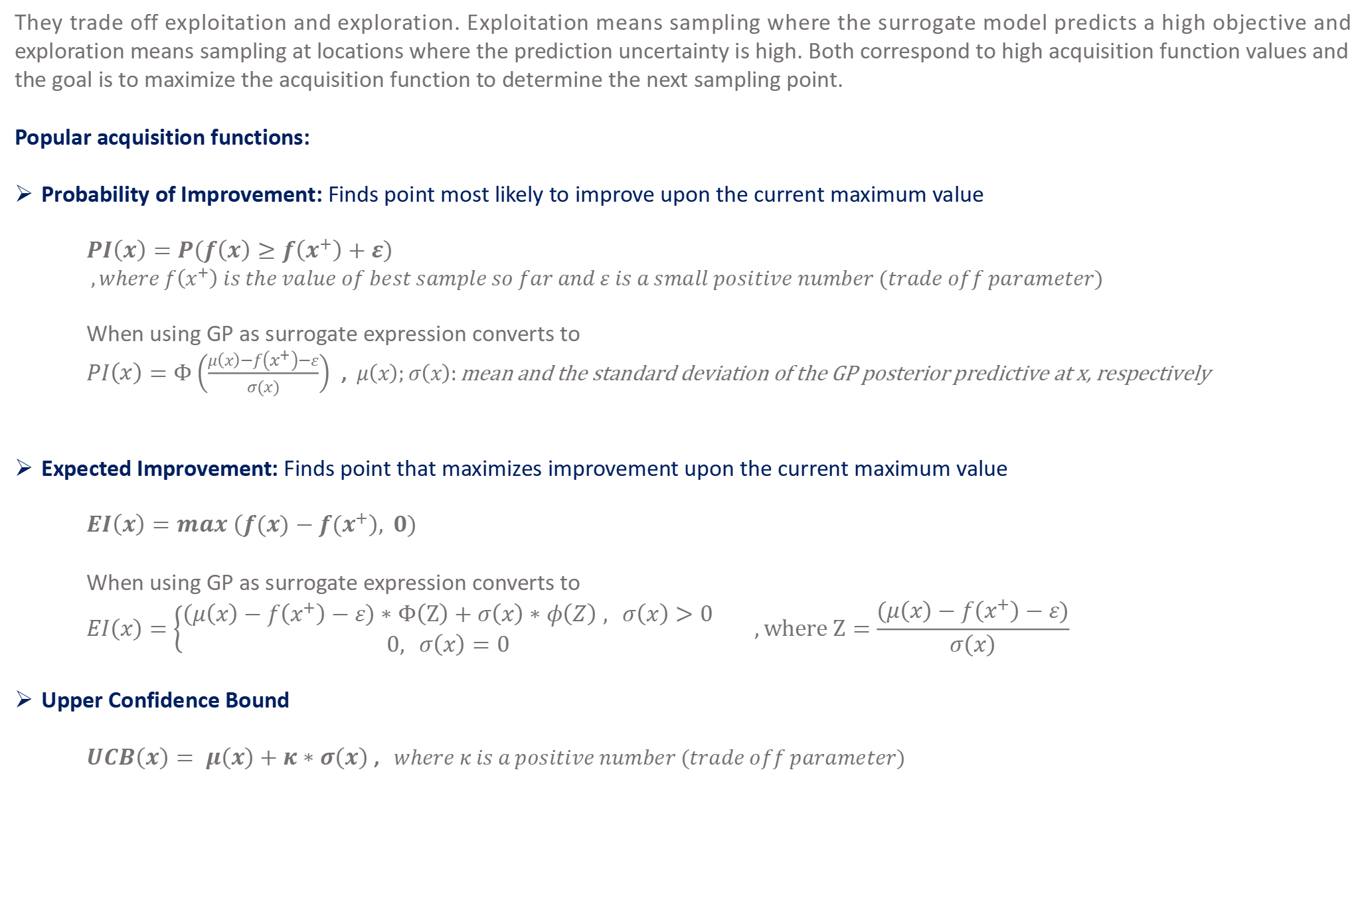
Bayesian Optimization: Acquisition Function
Proposing sampling points in the search space is done by acquisition functions.
They trade off exploitation and exploration. Exploitation means sampling where the surrogate model predicts a high objective and exploration means sampling at locations where the prediction uncertainty is high. Both correspond to high acquisition function values and the goal is to maximize the acquisition function to determine the next sampling point.
Popular acquisition functions:
Probability of Improvement: Finds point most likely to improve upon the current maximum value
$$PI\left(x\right)=P\left(f\left(x\right)≥f\left(x^{+}\right)+ε\right)$$
$$,where f\left(x^{+}\right) is the value of best sample so far and ε is a small positive number (trade off parameter)$$
When using GP as surrogate expression converts to
$PI\left(x\right)=Φ\left(\frac{μ\left(x\right)−f\left(x^{+}\right)−ε}{σ(x)}\right)$ , $μ\left(x\right);σ\left(x\right):\text{mean} \text{and} \text{the} \text{standard} \text{deviation} \text{of} \text{the} \text{GP} \text{posterior} \text{predictive} \text{at} \text{x}\text{, }\text{respectively}$
Expected Improvement: Finds point that maximizes improvement upon the current maximum value
$$EI\left(x\right)=max \left(f(x)−{f(x}^{+}\right), 0)$$
When using GP as surrogate expression converts to
$$EI\left(x\right)=\left\{\begin{aligned}\left(μ\left(x\right)−f\left(x^{+}\right)−ε\right)∗Φ\left(Z\right)+σ\left(x\right)∗φ\left(Z\right) , σ\left(x\right)>0 \\ &0, σ\left(x\right)=0\end{aligned}\right. ,where Z=\frac{(μ\left(x\right)−f\left(x^{+}\right)−ε)}{σ\left(x\right)}$$
Upper Confidence Bound
$UCB\left(x\right)= μ\left(x\right)+κ∗σ\left(x\right)$ ,$where κ is a positive number (trade off parameter)$
$$Note− Φ;φ:CDF and PDF of standard normal distribution, respectively$$

Slide 15
Grid Search Output
Round | Depth | Min Rows | Learn Rate | Development AUC | Validation AUC | Development KS | Validation KS | # Trees | # Variables | Overfit
1 | 6 | 500 | 0.03 | 0.7893 | 0.7814 | 43.46% | 42.21% | 685 | 106 | 1.01%
2 | 6 | 500 | 0.05 | 0.7894 | 0.7814 | 43.45% | 42.32% | 472 | 107 | 1.02%
3 | 7 | 500 | 0.03 | 0.7896 | 0.7814 | 43.44% | 42.20% | 687 | 109 | 1.04%
4 | 7 | 500 | 0.05 | 0.7896 | 0.7814 | 43.44% | 42.27% | 460 | 107 | 1.04%
5 | 8 | 500 | 0.03 | 0.7896 | 0.7813 | 43.48% | 42.15% | 652 | 109 | 1.04%
6 | 8 | 500 | 0.05 | 0.7896 | 0.7813 | 43.46% | 42.23% | 457 | 106 | 1.04%
7 | 5 | 500 | 0.05 | 0.7889 | 0.7812 | 43.42% | 42.19% | 457 | 105 | 0.97%
8 | 5 | 500 | 0.03 | 0.7889 | 0.7812 | 43.35% | 42.16% | 675 | 105 | 0.98%
9 | 8 | 500 | 0.07 | 0.7899 | 0.7812 | 43.55% | 42.24% | 370 | 106 | 1.10%
10 | 6 | 500 | 0.07 | 0.7898 | 0.7811 | 43.48% | 42.30% | 382 | 106 | 1.10%
11 | 7 | 500 | 0.07 | 0.7898 | 0.7811 | 43.49% | 42.25% | 372 | 107 | 1.10%
12 | 5 | 500 | 0.07 | 0.7891 | 0.7810 | 43.32% | 42.27% | 377 | 106 | 1.03%
13 | 6 | 500 | 0.1 | 0.7896 | 0.7809 | 43.37% | 42.23% | 285 | 103 | 1.11%
14 | 7 | 500 | 0.1 | 0.7896 | 0.7808 | 43.44% | 42.15% | 285 | 107 | 1.11%
15 | 4 | 500 | 0.03 | 0.7879 | 0.7808 | 43.15% | 42.00% | 707 | 104 | 0.90%
16 | 5 | 500 | 0.1 | 0.7890 | 0.7807 | 43.31% | 42.19% | 280 | 106 | 1.05%
17 | 8 | 500 | 0.1 | 0.7898 | 0.7807 | 43.43% | 42.21% | 282 | 106 | 1.15%
18 | 4 | 500 | 0.05 | 0.7881 | 0.7806 | 43.15% | 42.04% | 480 | 102 | 0.95%
19 | 4 | 500 | 0.07 | 0.7882 | 0.7806 | 43.18% | 42.15% | 392 | 101 | 0.97%
20 | 6 | 1000 | 0.05 | 0.7872 | 0.7805 | 43.22% | 42.31% | 510 | 101 | 0.84%
21 | 5 | 1000 | 0.05 | 0.7869 | 0.7805 | 43.17% | 42.33% | 510 | 101 | 0.82%
22 | 7 | 1000 | 0.05 | 0.7872 | 0.7805 | 43.28% | 42.30% | 500 | 103 | 0.86%
23 | 8 | 1000 | 0.05 | 0.7872 | 0.7804 | 43.19% | 42.30% | 500 | 102 | 0.86%
24 | 7 | 1000 | 0.07 | 0.7876 | 0.7803 | 43.32% | 42.39% | 435 | 103 | 0.93%
25 | 6 | 1000 | 0.07 | 0.7876 | 0.7803 | 43.43% | 42.28% | 445 | 102 | 0.93%
26 | 7 | 1000 | 0.03 | 0.7872 | 0.7803 | 43.19% | 42.30% | 745 | 104 | 0.89%
27 | 6 | 1000 | 0.03 | 0.7873 | 0.7803 | 43.26% | 42.21% | 747 | 105 | 0.89%
28 | 8 | 1000 | 0.07 | 0.7876 | 0.7803 | 43.39% | 42.31% | 415 | 103 | 0.93%
29 | 8 | 1000 | 0.03 | 0.7871 | 0.7802 | 43.22% | 42.32% | 720 | 104 | 0.88%
30 | 5 | 1000 | 0.07 | 0.7873 | 0.7802 | 43.30% | 42.21% | 432 | 101 | 0.91%
Selecting a model with complexity constraints gives us a performance similar to the that achieved in the Bayesian optimization models

