Slide 1
Vodafone – Tech for Good
YourTechAngels – HelpWhoNeeds
TechReturners

Slide 2
Introduction
Kusum
Natalie
Lakshmi
Ferhiz

Slide 3
Goal
The primary goal is to Match & Deploy
Match a Volunteer with a Vulnerable person who is Shielding
Look for Volunteers closest to their location
Help with everyday needs such as Shopping, Dog walking etc

Slide 4
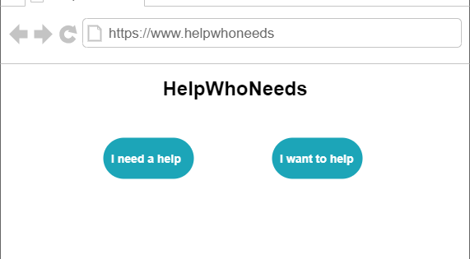
Landing Page

Slide 5
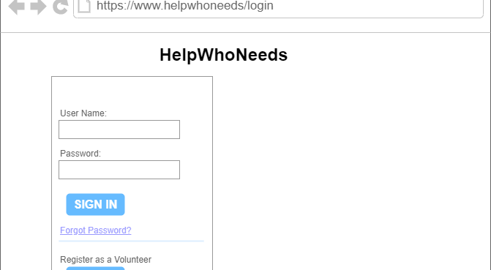
Login/Registration Page

Slide 6
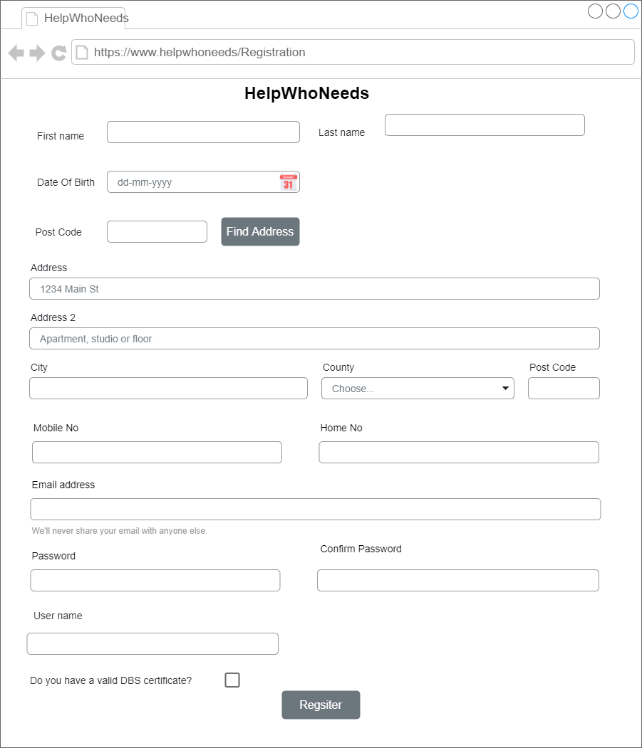

Slide 7
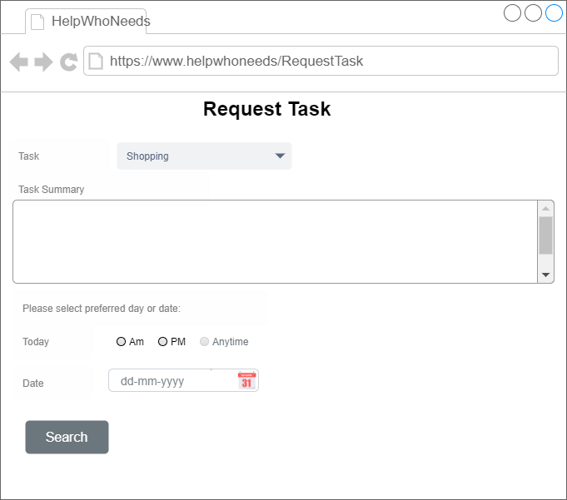

Slide 8
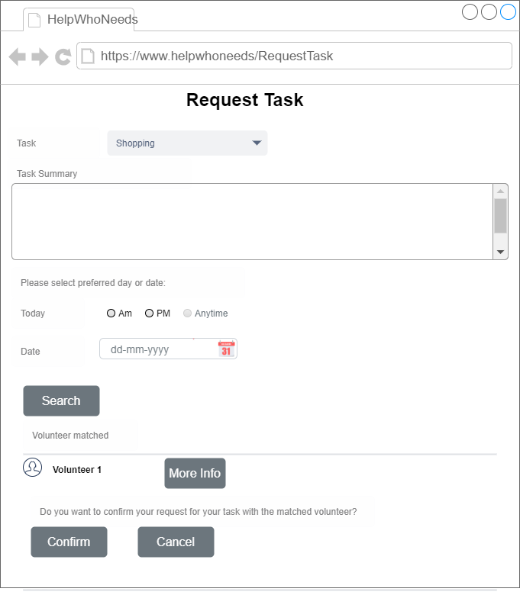

Slide 9
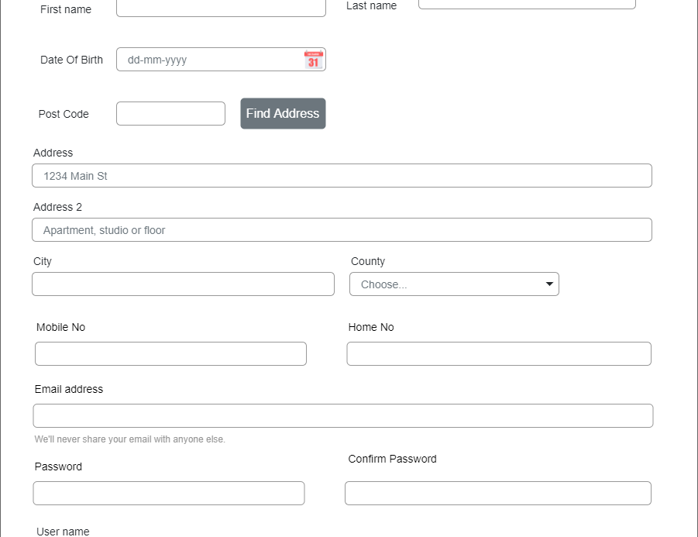

Slide 12
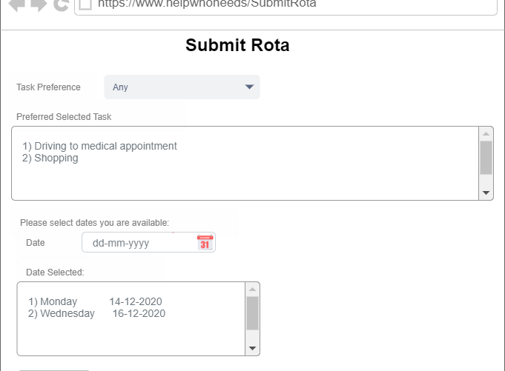

Slide 13
Technical Architecture
Client
(React)
Server
(SQL, Python)
Database
Responsive Web App DJANGO Template
D
Django Framework
App Logic
View Logic
Model

