Slide 1






Batch Normalization using an SVD Layer
Abdulmohsen Mohammedsaleh • Majed Alsulami • Yousef Alogiley
Mentor: Jad Mounayer • KAUST Academy Summer Program 2026 • University of Oxford stage
Code: github.com/Yousef10p/RR-Layer

Slide 2
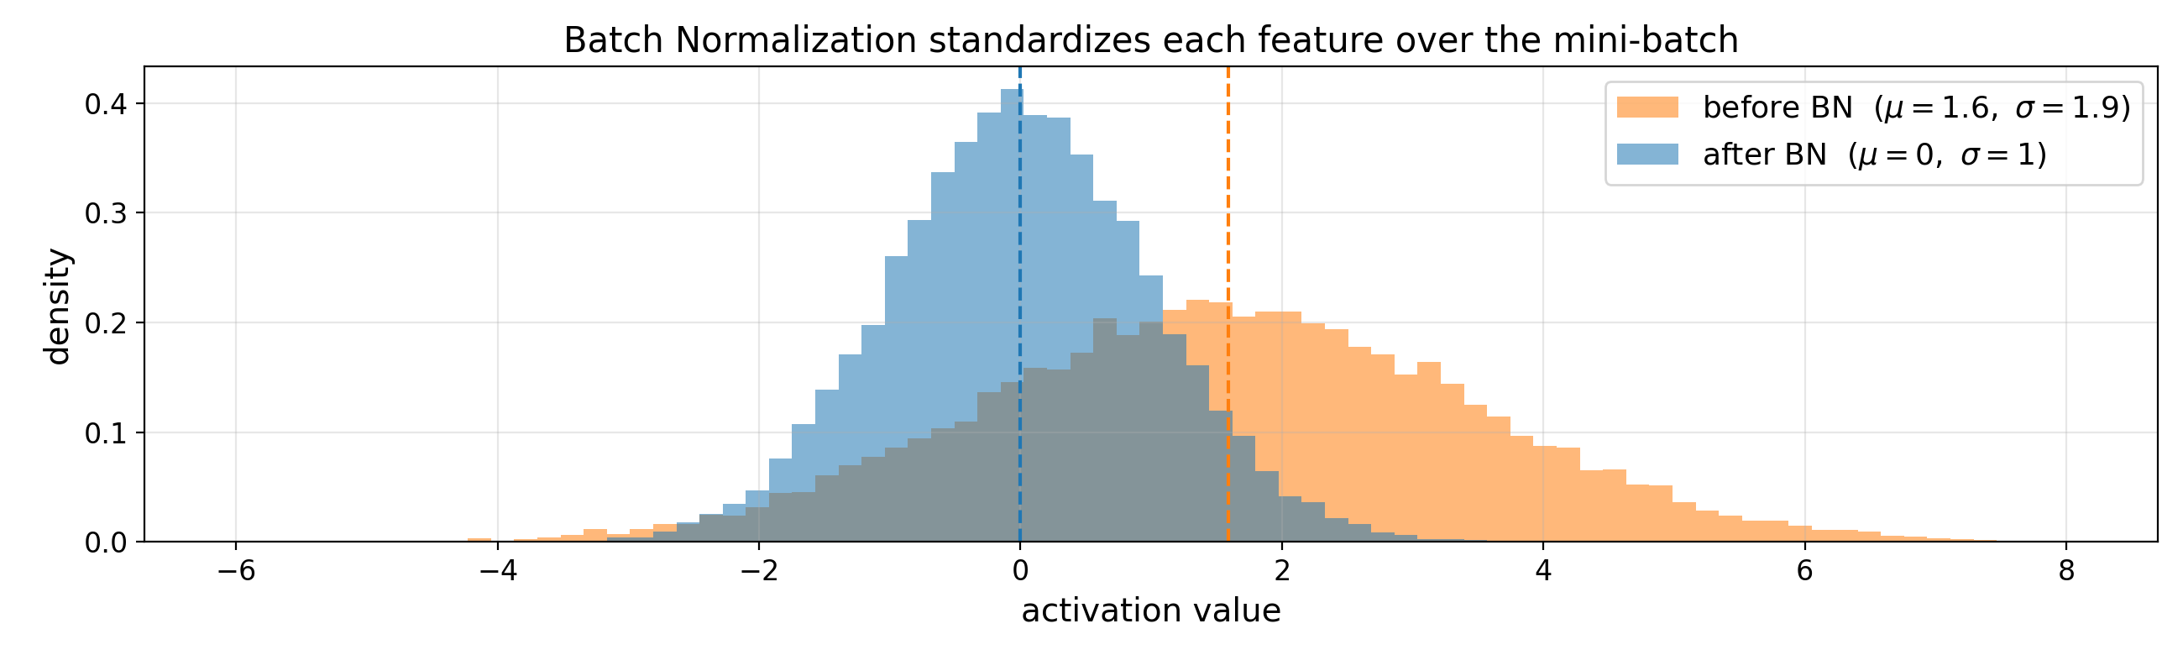
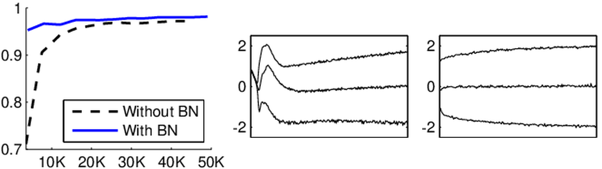
Background: Batch Normalization
y = γ (x - μ_{B}) / σ_{B} + β
• BN rescales every feature of a mini-batch to mean 0 and variance 1, then applies a learned affine map.
• It makes networks train faster, reach higher accuracy, and keeps activation distributions stable, which is why it is a standard layer in deep learning.
• Its statistics come from the mini-batch itself: BN is a batch-level operation, not a per-sample one.
From Ioffe and Szegedy (2015): faster training with BN (left); an activation stays stable through training with BN (right).
2

Slide 3
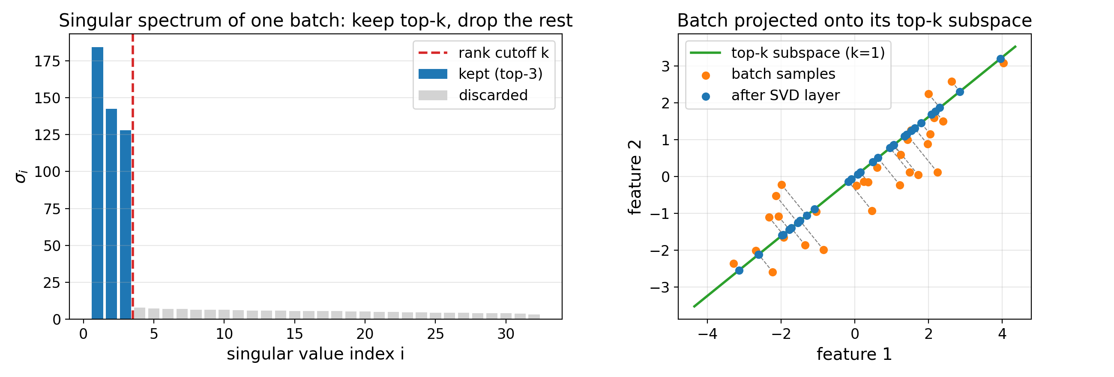
The Idea: Normalize with a Truncated SVD
Rank Reduction Autoencoders (Mounayer et al., 2024)
showed that the truncated SVD can regularize an autoencoder with no extra loss term.
Like BN, it is a batch-level operation. Unlike BN, its constraint is geometric (a rank constraint), not moment-based (mean and variance).
The batch, rebuilt from only its top-k singular components (right: k = 1 example).
Can the truncated SVD alone normalize a batch as well as BN does?
We build it into a standalone, drop-in SVD layer to find out.
X = U Σ V^{T} → X̂ = U_{k} Σ_{k} V_{k}^{T}
3

Slide 4
The SVD Layer: Train and Eval Modes
Training mode
A truncated SVD is computed on every mini-batch and the rank-k reconstruction is passed on. Gradients flow through the SVD.
The basis U_{k} of each batch is stored in a small rolling bank (the last 20 bases).
Evaluation mode
The stored bases are merged into one frozen inference basis; test inputs are projected onto it.
This mirrors BN's running statistics: batch-independent behavior at test time.
The rank k is a strength dial
The directions are found automatically by the SVD; only how many survive is chosen by the user.
The frozen basis costs almost nothing
Per-batch SVD 0.0004, basis bank 0.0007, full-data basis 0.0006 test MSE (clean data, 4 seeds).
Placed exactly where BN would go: conv → SVD layer (flatten, truncate, unflatten) → ReLU
4

Slide 5
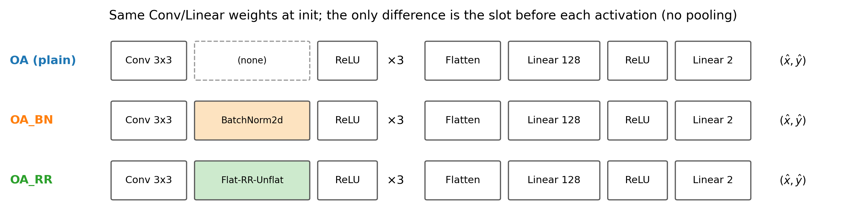
Setup: Point-Source Localization
Three architectures with identical initial Conv/Linear weights; only the slot between each convolution and its ReLU changes.
Task
Regress the center (x0, y0) of a Gaussian source in a 64×64 image, as in astrometry and single-molecule microscopy. Optionally under noise or on real background clutter.
Controlled comparison
Plain (OA) vs BatchNorm2d (OA_BN) vs SVD layer (OA_RR), trained from identical initial weights, up to 32 seeds per reported point.
Configuration
Rank k = 8, batch size 32, Adam lr 0.001, MSE loss, 20 epochs (scaled up for small training sets), PyTorch.
5

Slide 6
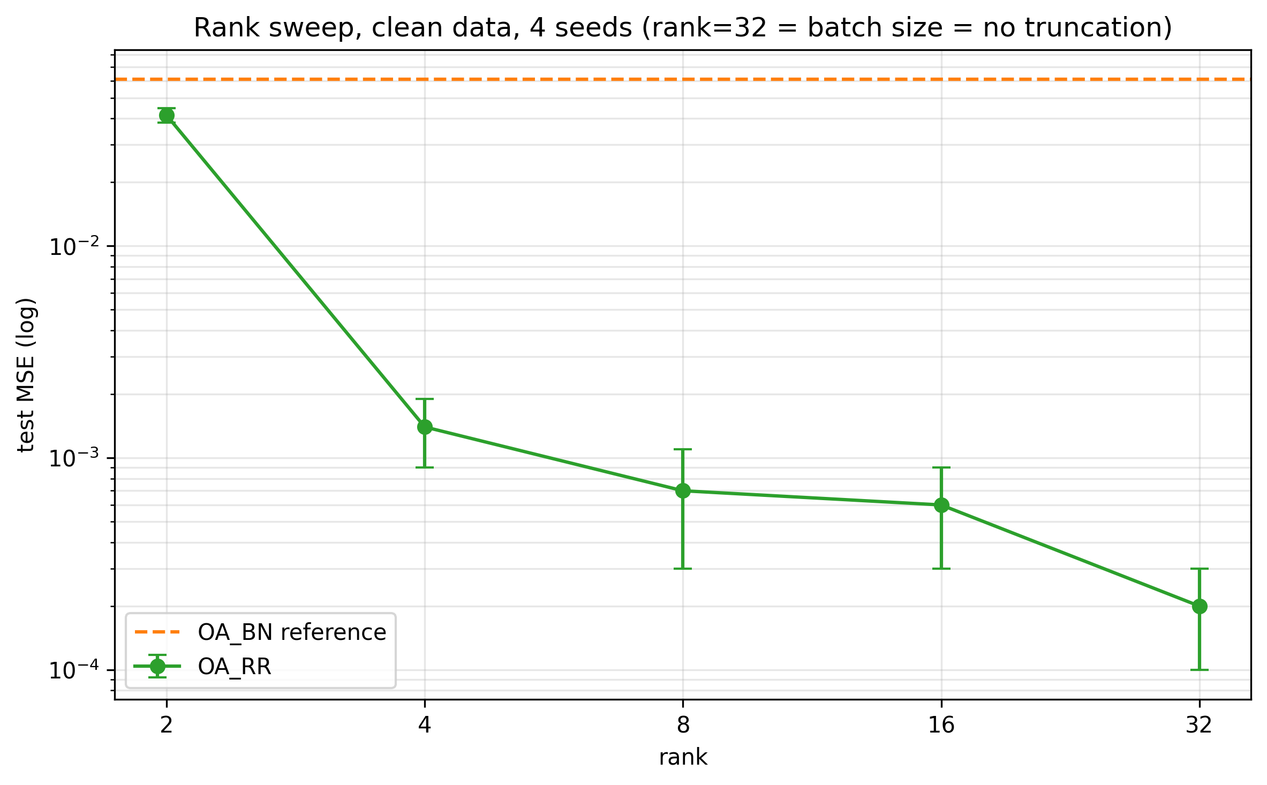
Rank Is a Strength Dial
• Error falls monotonically with k: 0.0414 at k = 2 down to 0.0002 at k = 32 (= batch size, no truncation).
• Even the worst setting (k = 2) still beats BN on the same clean data (0.0611).
• We fix k = 8: the smallest rank that solves the task comfortably.
60×
Clean data, per-layer placement, 4 seeds. Dashed: per-layer BN reference.
the cost of setting the rank too small (k = 2 vs k = 8)
6

Slide 7
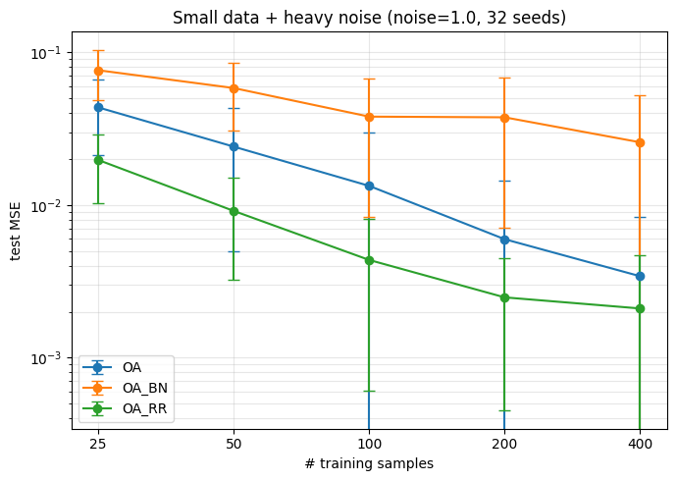
Headline Result: Small Data + Heavy Noise
3.9–15×
better than BN at every training-set size
1.6–3×
better than the plain network at every training-set size
32 seeds
tightest variance and smallest train/test gap of the three
Test MSE (log) vs training-set size, noise std 1.0, 32 seeds, mean ± std.
Why it works: i.i.d. pixel noise is spread across all singular directions while the smooth source is low-rank, so the top-k projection strips noise faster than signal at every layer.
7

Slide 8
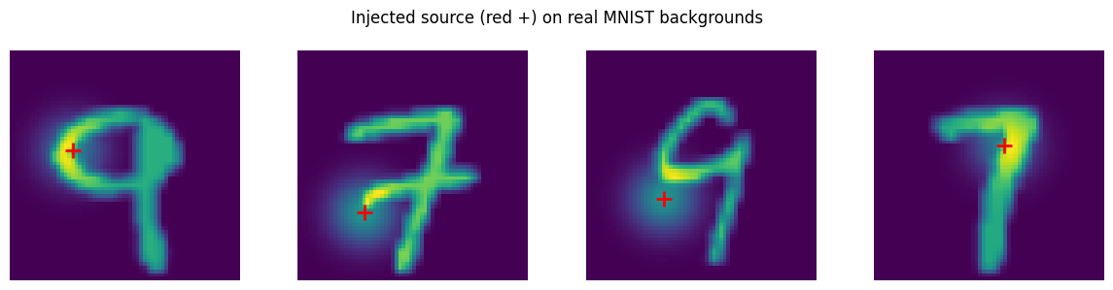
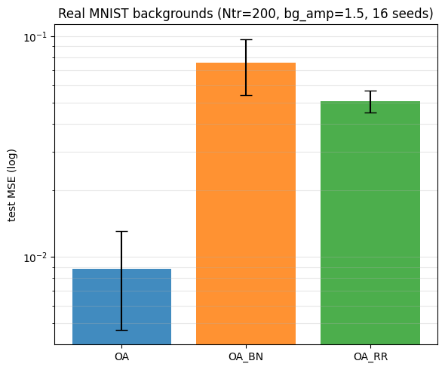
The Failure Mode: Structured Backgrounds
Plain 0.0089 < SVD 0.0509 < BN 0.0755
• The ranking flips: the plain network wins; the SVD layer still beats BN by 1.5×.
• MNIST digits are themselves roughly low-rank and strong (1.5× the source peak), so they dominate the batch variance.
• Keeping the top singular components keeps the clutter as faithfully as the signal.
• The layer's advantage is specific to noise-like nuisance and inverts for structure-like nuisance.
A known source (red +) injected on real MNIST backgrounds: exact ground truth, real clutter.
Test MSE (log), 16 seeds.
8

Slide 9
A Practical Lesson: Gradients Through the SVD
Hand-written analytic backward
The textbook formula contains 1/(σ_{i} - σ_{j}) factors that blow up whenever two singular values come close, which is frequent for structured feature maps.
Per-layer training diverged within a few epochs and never recovered.
PyTorch native autograd
Stable at every position in the network.
Per-layer training loss 2.68 → 0.0003 over 20 epochs; over 8 seeds, test MSE 0.0003 ± 0.0002 (plain 0.0000, BN 0.0009).
All final results use this backend.
The backward pass through the SVD is the numerically dangerous part: prefer the battle-tested library implementation.
9

Slide 10
Conclusion
• The SVD layer beat BN in every comparison we ran (clean, noisy, small-data, real backgrounds), by 1.5–15×.
• Under heavy input noise it beat even the unregularized network at every dataset size tested (1.6–3×), with the tightest seed variance and the smallest train/test gap.
• Its weakness is equally clear: when the nuisance is itself low-rank and strong (real structured backgrounds), the top-k projection preserves the clutter and the plain network wins.
• The early instability was a gradient bug, not the layer: with native SVD autograd it trains stably at every position in the network.
10

Slide 11
Future Work and Code
• Normalize the singular values. The layer constrains the rank of the batch but not its scale; pushing retained singular values toward 1 (or soft-shrinking the tail) would make it a true normalizer in BN's sense.
• Handle structured nuisance. Reject the top components (robust-PCA / KLIP style) or pick the rank from an energy threshold.
• Scale up. Real data where the noise-like vs structure-like character of the nuisance is unknown in advance.
from svd_layer import RRLayer
block = nn.Sequential(
nn.Conv2d(8, 16, 3, padding=1),
RRLayer(rank=8), # where BN would go
nn.ReLU(),
)
github.com/Yousef10p/RR-Layer
svd_layer.py (standalone module) + the experiment notebook that produced every figure shown.
Thank you!
11

