Slide 1
Risk Classification Model

Slide 2
UNDERSTAND THE DATA
1.
Information about each column

Slide 3
DATA
Features | Description
Serious | Person experienced 90 days past due delinquency or worse.
Age | Age of borrowers in years.
Dependents | Number of dependents in the family.
Utilization | Total balance of credit cards and credit lines except number of installment debt divided by the sum of credit limits.
MonthlyIncome | Monthly Income of borrowers.
DebtRatio | Monthly debt payments and living costs divided by monthly gross income.
Loans | Number of Open loans (installments) and Lines of credit (e.g. Credit cards).
RealStateLoans | Number of mortgage and real estate loans including home equity line of credits.

Slide 4
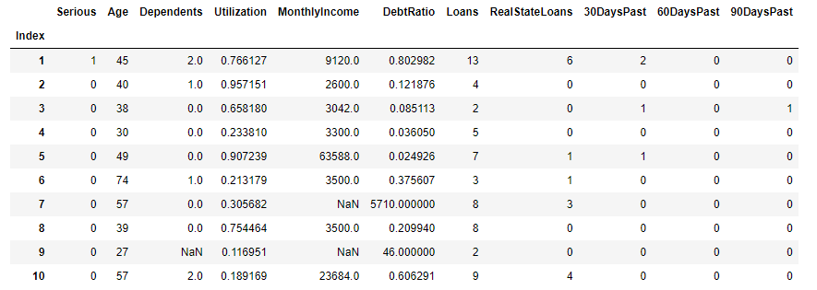
DATA
DATA SAMPLE

Slide 5
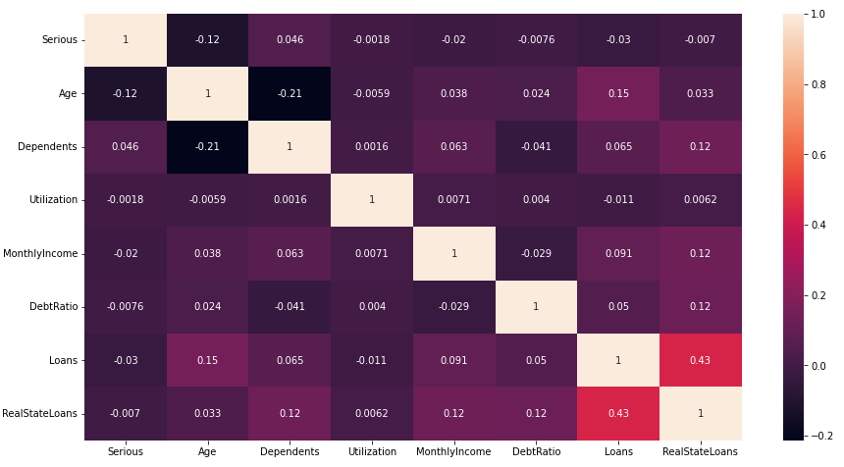
CORRELATIONS

Slide 6
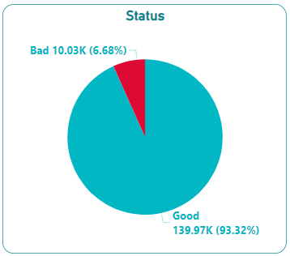
SERIOUS (STATUS)
Person experienced 90 days past due delinquency or worse.

Slide 7
AGE
Mean
52.29
Min | Max
21 | 109
Age of borrowers in years.
Percentiles | Age
25% | 41
50% | 52
75% | 63

Slide 8
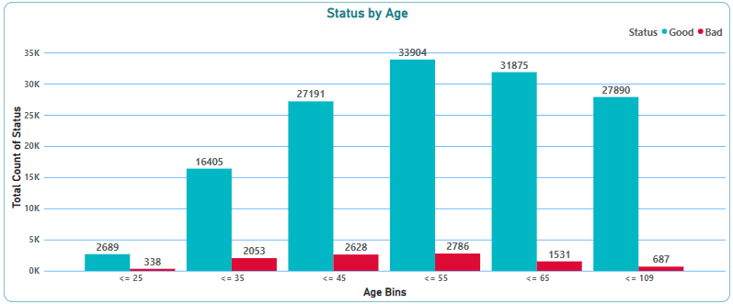
AGE

Slide 9
DEPENDENTS
Mean
0.74
Min | Max
0 | 20
Number of dependents in the family.
Percentiles | Dependents
25% | 0
50% | 0
75% | 1
Missing Values
3924

Slide 10
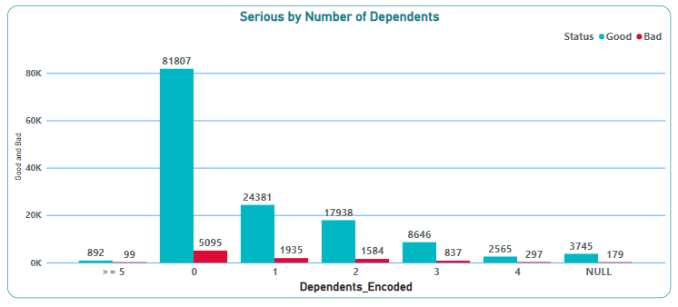
DEPENDENTS

Slide 11
MONTHLYINCOME
Percentiles | MonthlyIncome
25% | 3820
50% | 5492
75% | 7828
Monthly Income of borrowers.
Min | Max
0 | 300875
Mean
6521
Missing Values
29731

Slide 12
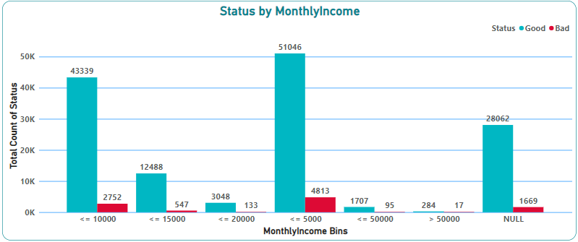
MONTHLYINCOME

Slide 13
DEBTRATIO
Mean
353
Min | Max
0 | 329664
Monthly debt payments and living costs divided by monthly gross income.
Percentiles | DebtRatio
25% | 0.175
50% | 0.366
75% | 0.868

Slide 14
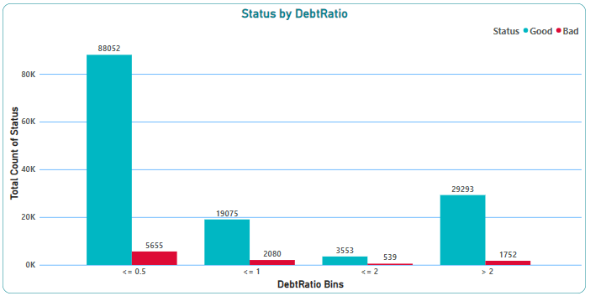
DEBTRATIO

Slide 15
UTILIZATION
Total balance of credit cards and credit lines except number of installment debt divided by the sum of credit limits.
Mean
6.04
Min | Max
0 | 50708
Percentiles | Utilization
25% | 0.029
50% | 0.154
75% | 0.559

Slide 16
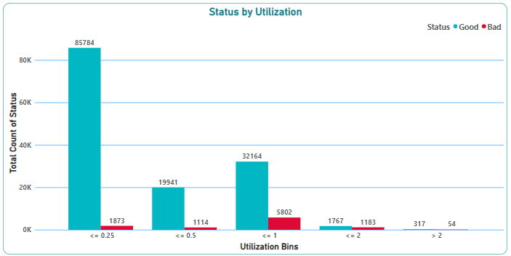
UTILIZATION

Slide 17
LOANS
Mean
8.45
Min | Max
0 | 58
Number of Open loans (installments) and Lines of credit (e.g. Credit cards).
Percentiles | Loans
25% | 5
50% | 8
75% | 11

Slide 18
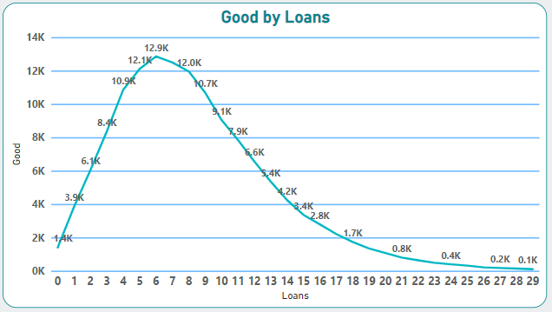
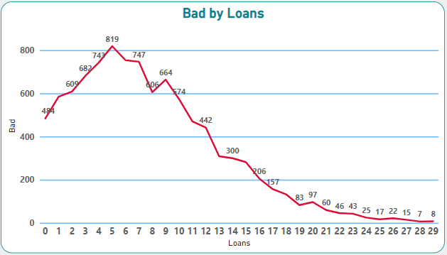
LOANS

Slide 19
REALESTATELOANS
Mean
353
Min | Max
0 | 54
Number of mortgage and real estate loans including home equity line of credits.
Percentiles | RealEstateLoans
25% | 0
50% | 1
75% | 2

Slide 20
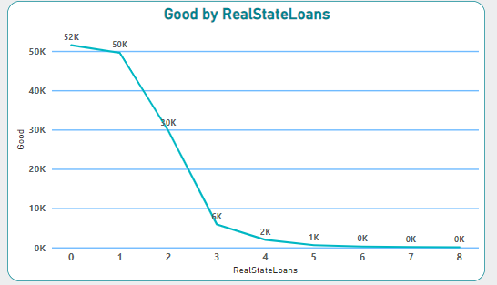
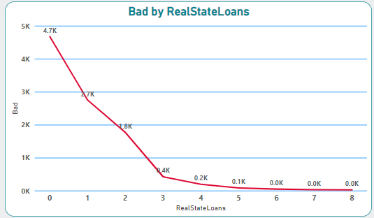
REALESTATELOANS

Slide 21
CLEANING THE DATA
2.
Handling the missing values

Slide 22
DEPENDENTS MISSING VALUES
Ranges | Replacement Method | Records Affected
Age < 25 | Most Frequent Value: 0 | 167
Age >= 25 and Age < 60 | Mean: 1 | 1624
Age >= 60 and Age < 90 | Mean: 0 | 2012
Age >= 90 | Most Frequent Value: 0 | 121
3924

Slide 23
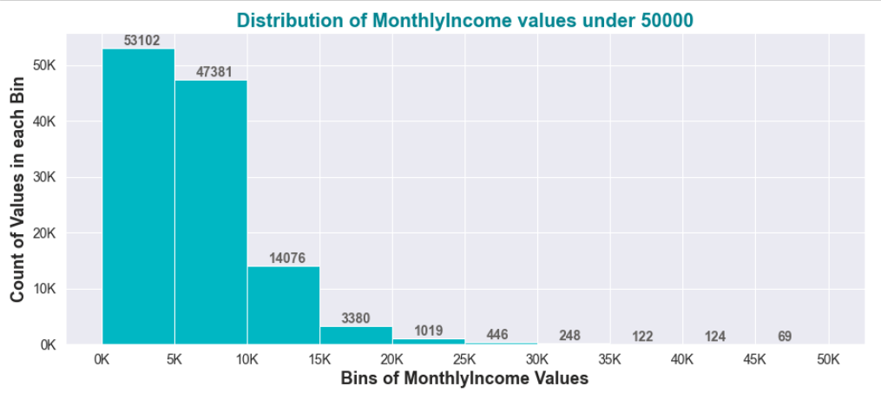
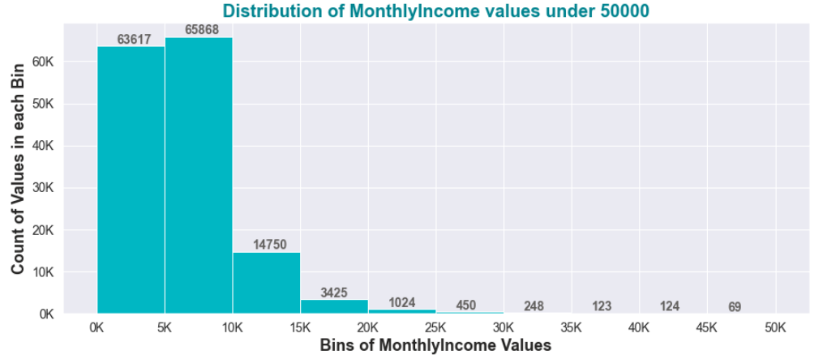
MONTHLYINCOME MISSING VALUES USING MICE
Before
After
+ 18487
+ 10515
+ 674
+ 45
+ 5
+ 4
+ 1

Slide 24
Discretization
3.
Binning the columns.

Slide 25
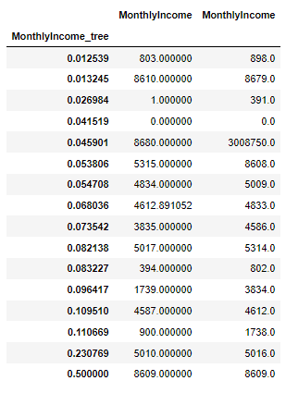
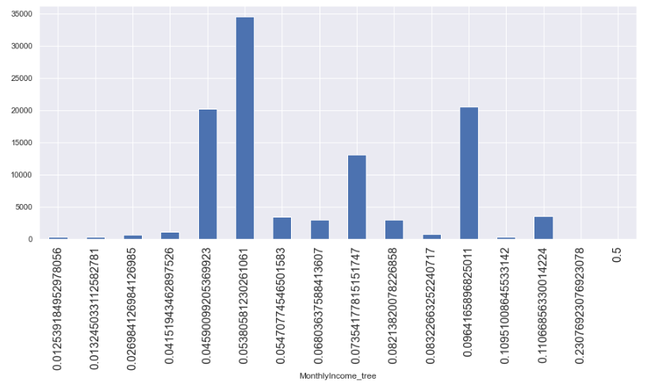
MONTHLYINCOME

Slide 26
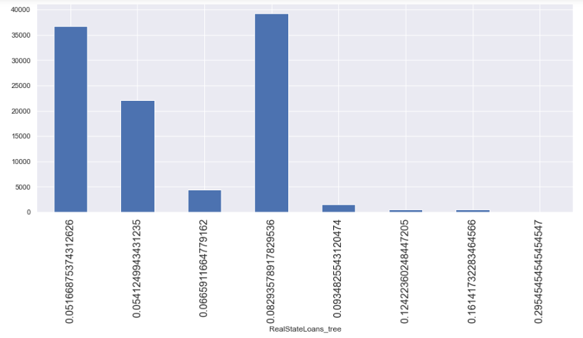

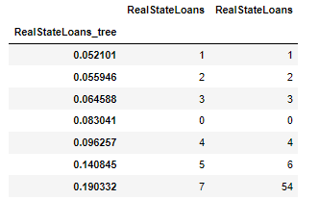
REALESTATELOANS

Slide 27
Modeling
4.
Using Logistic Regression.

Slide 28
BASIC LOGESTIC REGRESSION

Slide 29
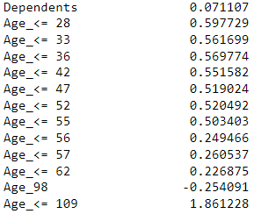
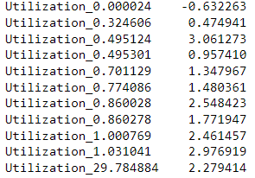
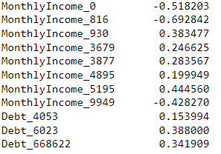
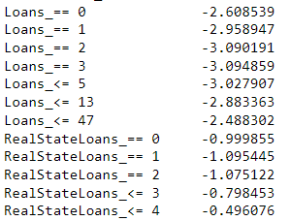
COEFFICEINTS

Slide 30
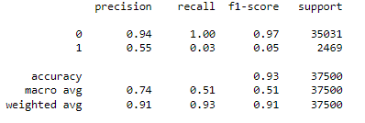
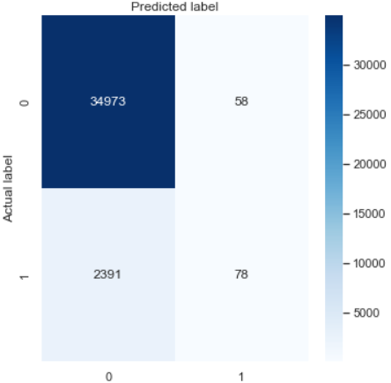
SUMMARY
Classification Report
Confusion Matrix

Slide 31
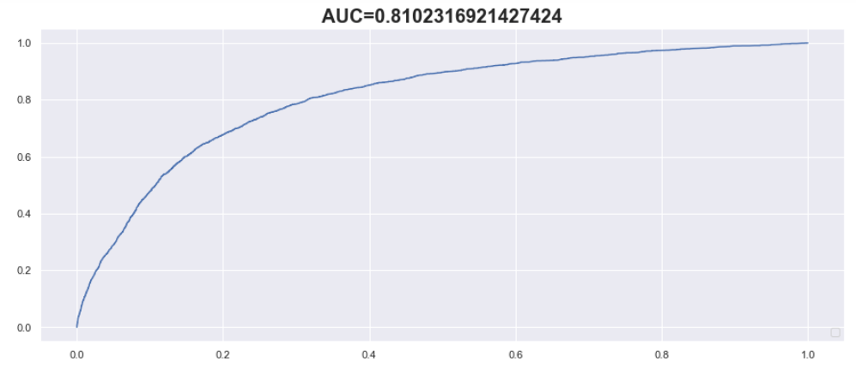
AUC

Slide 32
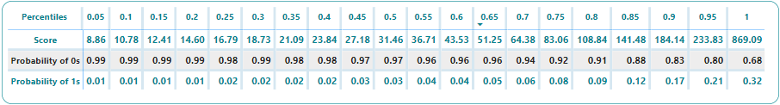
PERCENTILES

Slide 33
OVERSAMPLING LOGESTIC REGRESSION

Slide 34
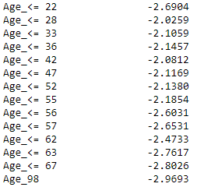
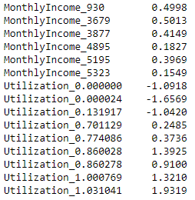
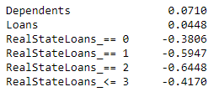
COEFFICEINTS

Slide 35
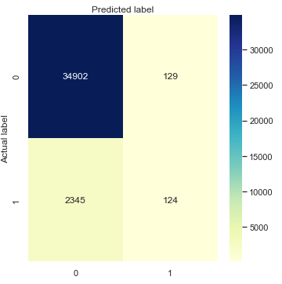
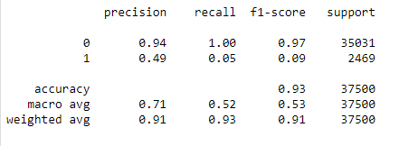
SUMMARY
Classification Report
Confusion Matrix

Slide 36
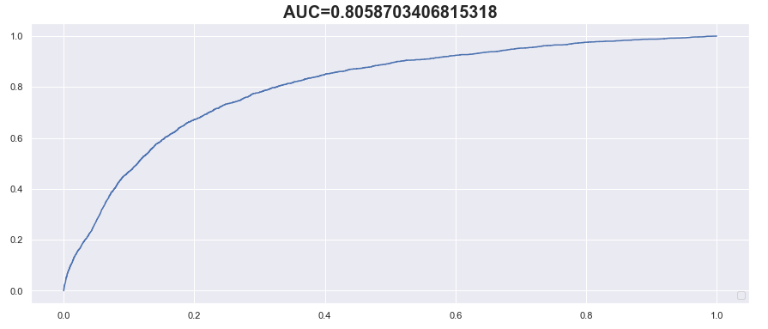
AUC

Slide 37
UNDERSAMPLING LOGESTIC REGRESSION

Slide 38
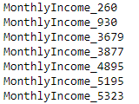

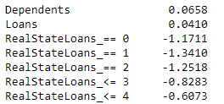
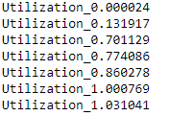
COEFFICEINTS

Slide 39
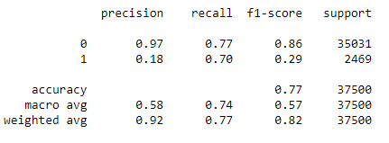
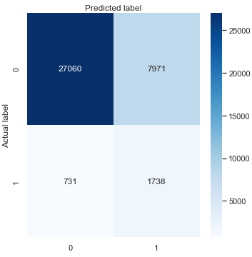
SUMMARY
Classification Report
Confusion Matrix

Slide 40
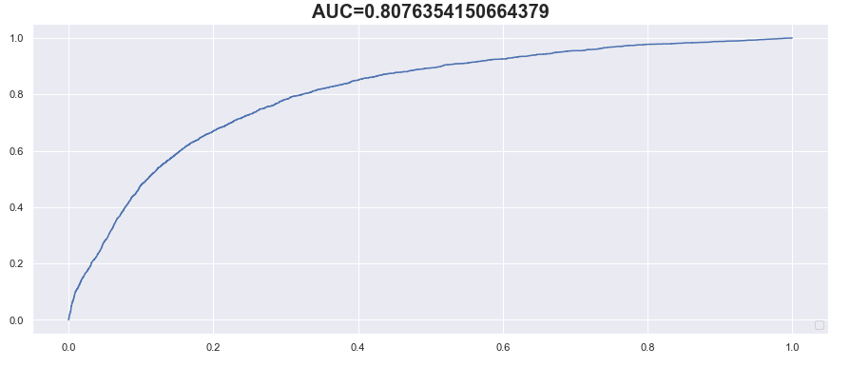
AUC

Slide 41
RANDOM FOREST

Slide 42
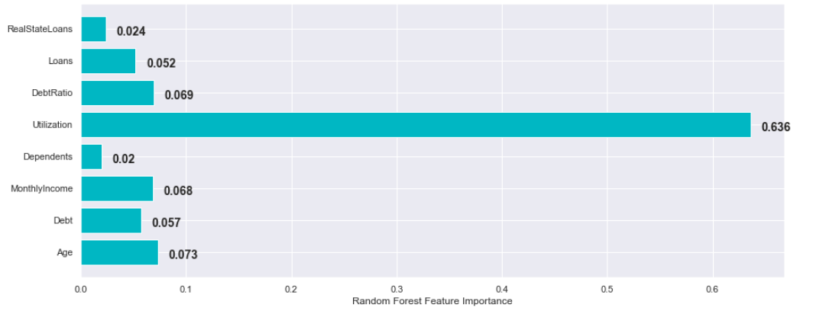
RANDOM FOREST FEATURE IMPORTANCE

Slide 43
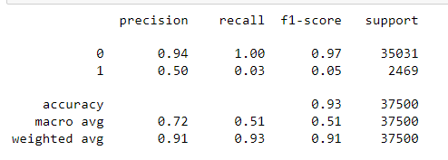
SUMMARY
Classification Report
Confusion Matrix

Slide 44
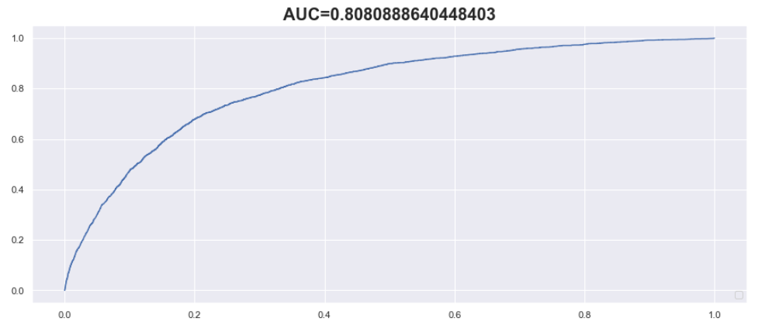
AUC

