Slide 1

Capstone Project Progress Report
YOUSEF AL OTaibi

Slide 2
Topics covered
Web Scraping
- Data collected from yallamotor.com
Data Cleaning
- No. observations After cleaning & pre-processing: 4260
EDA & Initial model building
- No. observations before cleaning & pre-processing: 8715
- No. features before cleaning & pre-processing: 12
- Distribution of data
- No. features after cleaning, pre-processing and encoding categorical variables: 368
- Outliers detection and removal
- Linearity
- KNN Imputer for NaN values
- Encoding categorical variables

Slide 3
Web Scraping
Libraries used:
cloudscraper
BeautifulSoup
requests
randint
sleep

Slide 4
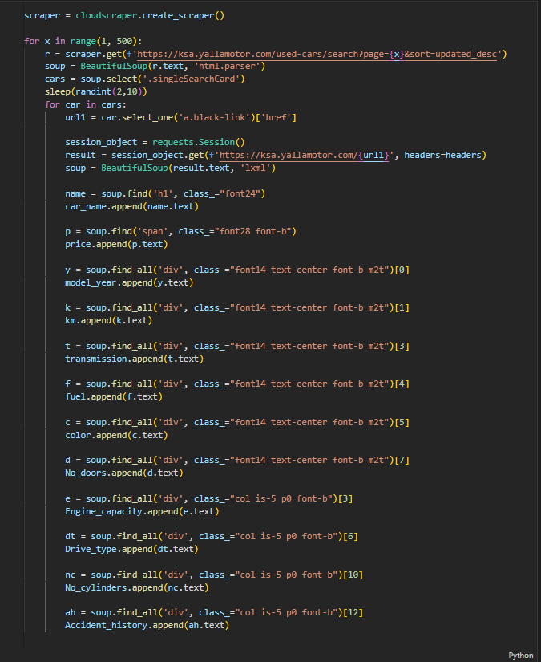
Web Scraping
I managed to scrape 3 different datasets with a total of 8715 observations, the reason I ended up with 3 datasets is because every time I try to web scrape the site an error rises and I would have 5800-5900 records out of 9000 retrieved, so I changed the range of pages 3 times: first iteration from 1-500 pages, second iteration from 250-500 pages and then from 400-500 pages.
Error : AttributeError: 'NoneType' object has no attribute 'text'

Slide 5
Data Cleaning
Libraries used:
Pandas
Re
numpy
matplotlib_iline
seaborn

Slide 6
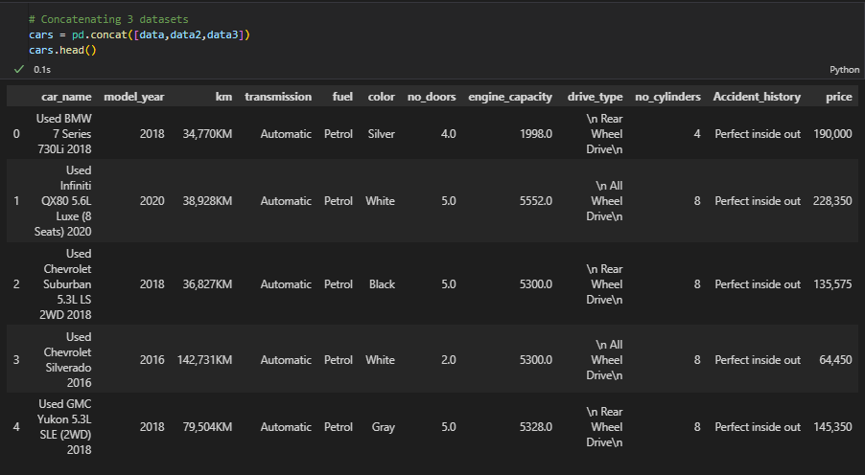
Data Cleaning
Scraped Data (Before cleaning):

Slide 7
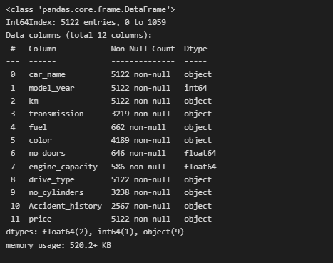
Data Cleaning
Data Info (Before cleaning):
Shown info of data is after dropping duplicates
Duplicates sum : 3593

Slide 8
Data Cleaning
Cleaning done:
Renaming/ changing values of car_name, km, drive_type, price and no_cylinders
Splitting car_name into make and model
removing car_make with value count less than 5
Filling missing values in transmission, color and Accident_history with most frequent values
Dealing with engine_capacity NaN values

Slide 9
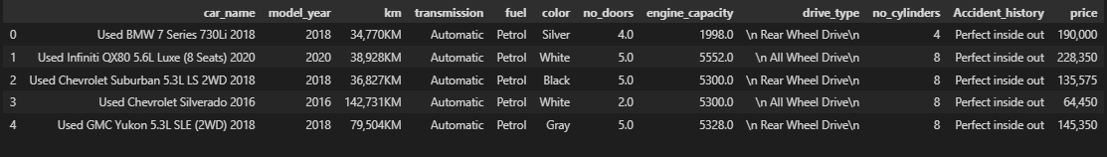
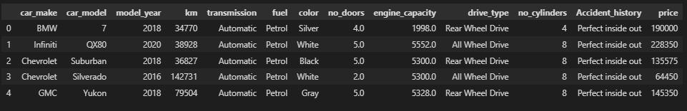
Renaming/ changing values of car_name, km, drive_type, price and no_cylinders
Splitting car_name into make and model
Before :
After :

Slide 10
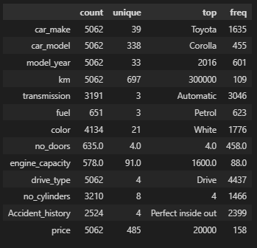
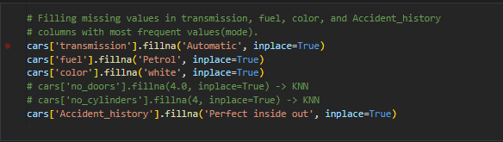
Filling missing values in transmission, color and Accident_history with most frequent values
Frequency :
Code to fill NA values :

Slide 11
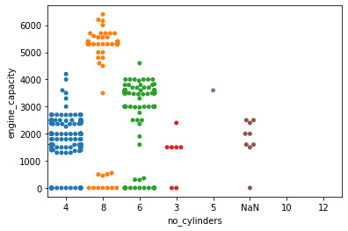
Dealing with engine_capacity NaN values
Swarm Plot for engine_capacity and no_cylinders
Swarm plot shows that a lot of our engine_capacity values are entered wrong.
Values with engine capacity less than a 1000 is mistyped, as it’s nearly impossible to have and engine capacity less than 1000.
It's known that engine capacity increases with more number of cylinders, but in our graph it didn't, an engine with 4-cylinders had an engine capacity more than 4000 which lead me to conclude that the quality of the data is poor in terms of engine capacity.

Slide 12
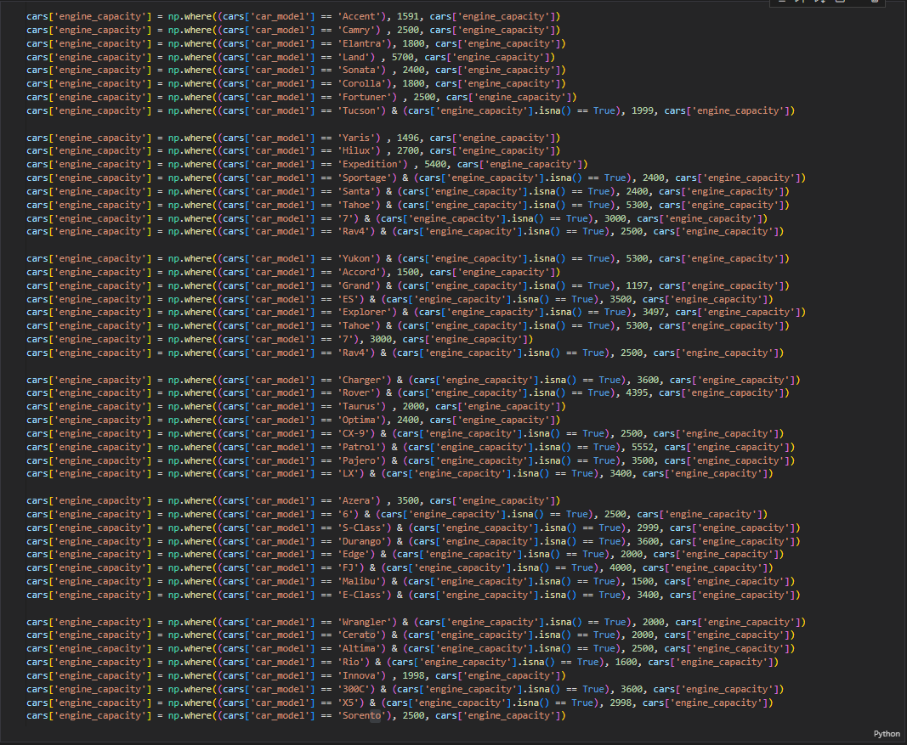
Dealing with engine_capacity NaN values
1.
To resolve this issue I’ve done two things:
Replace engine capacities one by one for the car models that have NaN and value count more than 20, drop any engine_capacity less than 1000.
Note : cars with missing engine capacity don't specify the class of the car_model which makes me assume that it's standard (standard engine_capacity), also some car models come in one engine capacity, so I changed all their values including Nan

Slide 13
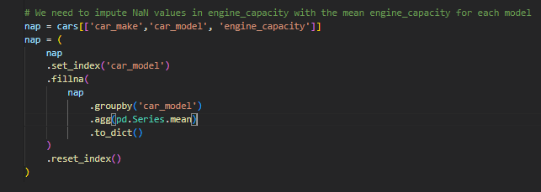
Dealing with engine_capacity NaN values
2.
Filling engine_capacity NaN values with the mean in each car_model
To resolve this issue I’ve done two things:
Replace engine capacities one by one for the car models that have NaN and value count more than 20, drop any engine_capacity less than 1000.
Filling the rest of the NaN values in engine_capacity with the mean engine_capacity for each model.
There are around 500 NaN values of models with all engine_capacity values as NaN, So we replace them with the mean

Slide 14
EDA & Initial model building
Libraries used:
Pandas
numpy
matplotlib_iline
seaborn
KNNImputer
sklearn
xgboost

Slide 15
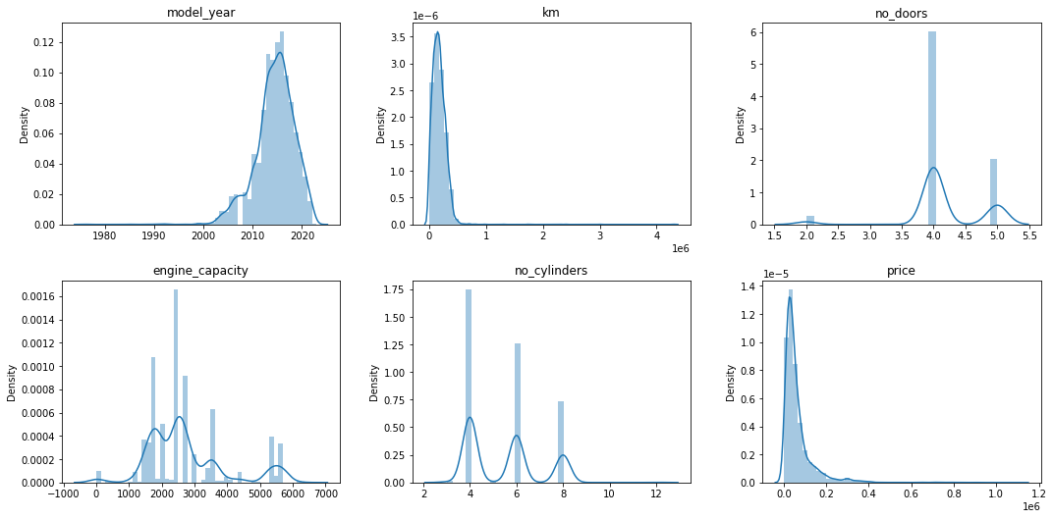
EDA & Initial model building
Data distribution (Before removing outliers) :

Slide 16
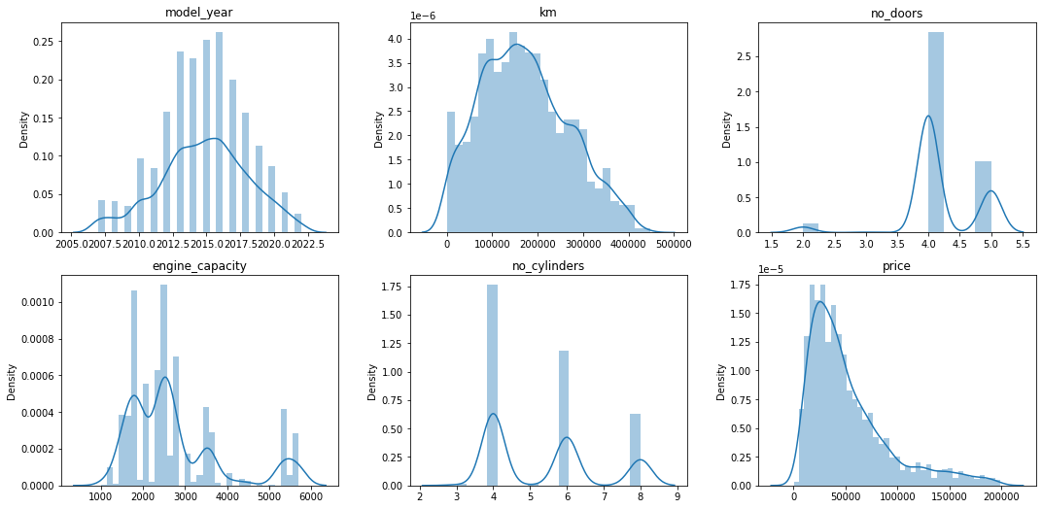
EDA & Initial model building
Data distribution (After removing outliers) :

Slide 17
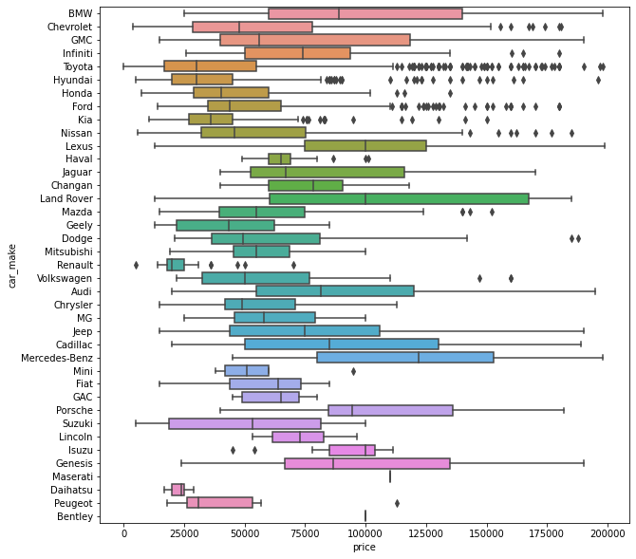
Outliers detection and removal
After taking a quick glimpse at the excel sheet, I found that there's mistyped observations for the price feature, an example is Toyota (Yaris) with a price of 125k which is wrong
We have to remove outliers of every car_model

Slide 18
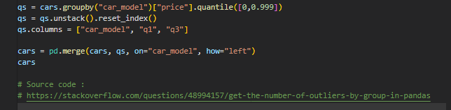
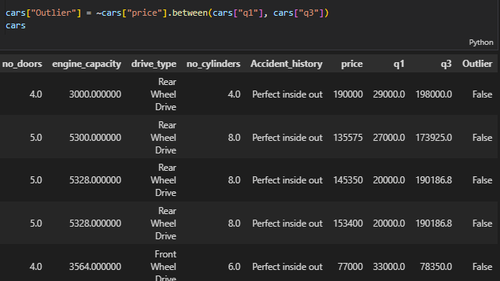
Outliers detection and removal
1. Identifying 1st and 3rd quartiles
2. True if

Slide 19
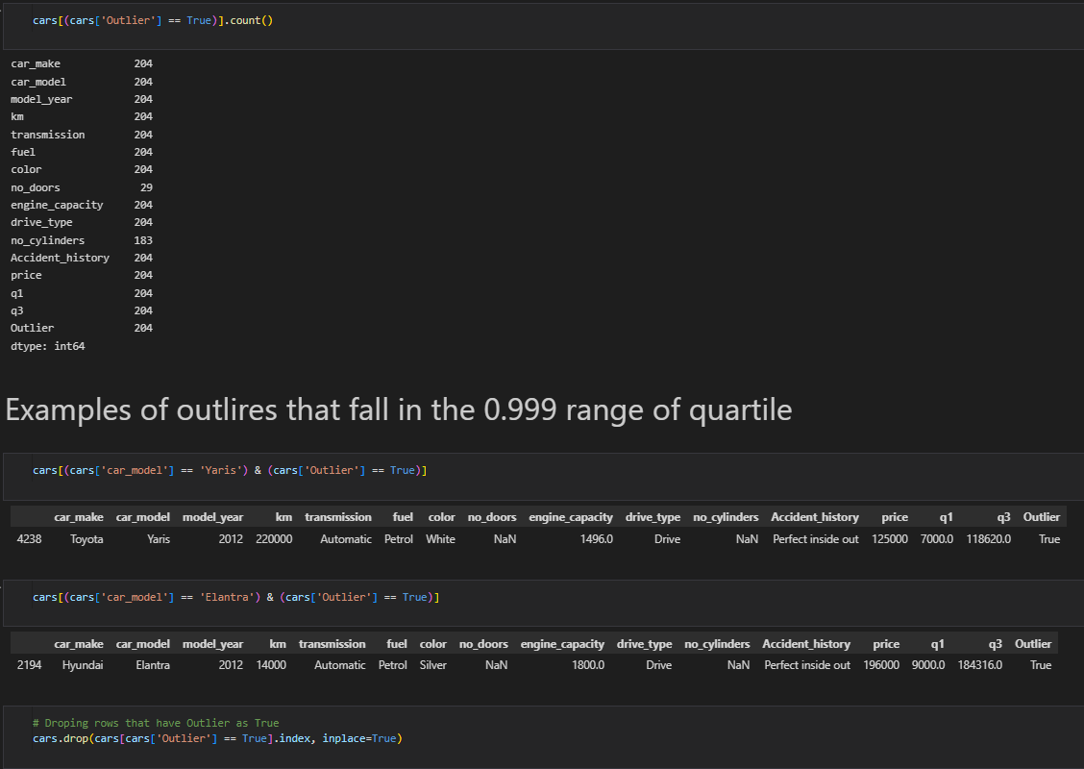
Outliers detection and removal

Slide 20
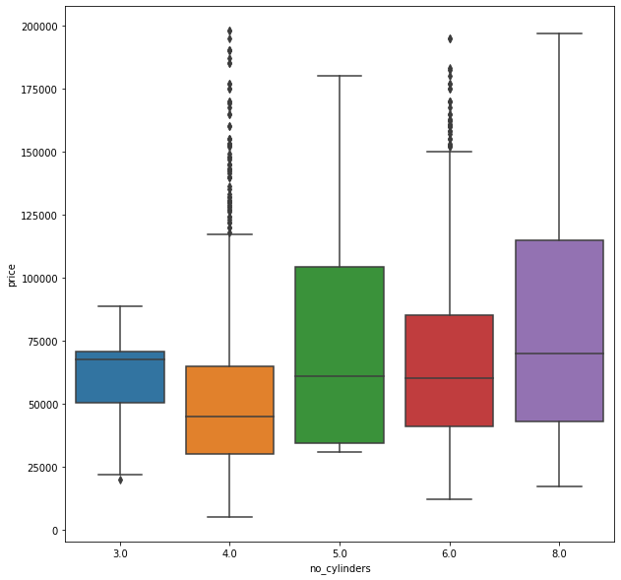
Outliers detection and removal
price with no_cylinders
an explanation behind price outliers in V4 and V6 cars is that most of German cars (BMW, Audi, etc..) come in V4 and V6 engines and they are expensive in price.

Slide 21
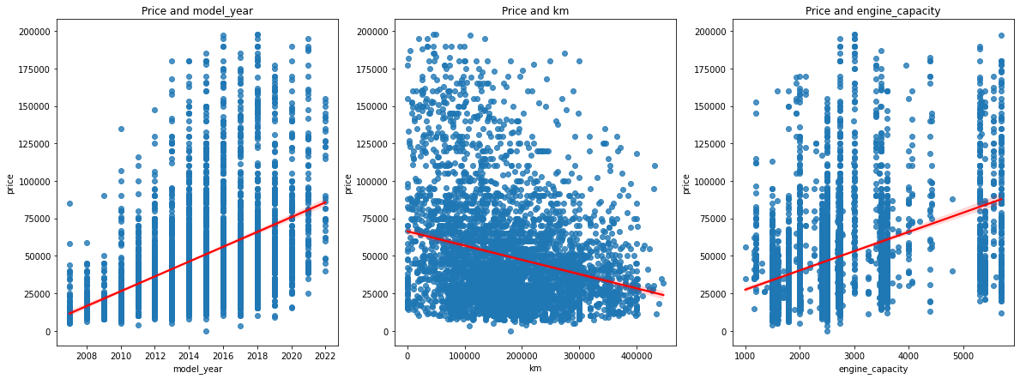
Linearity (does it need transformation?)

Slide 22
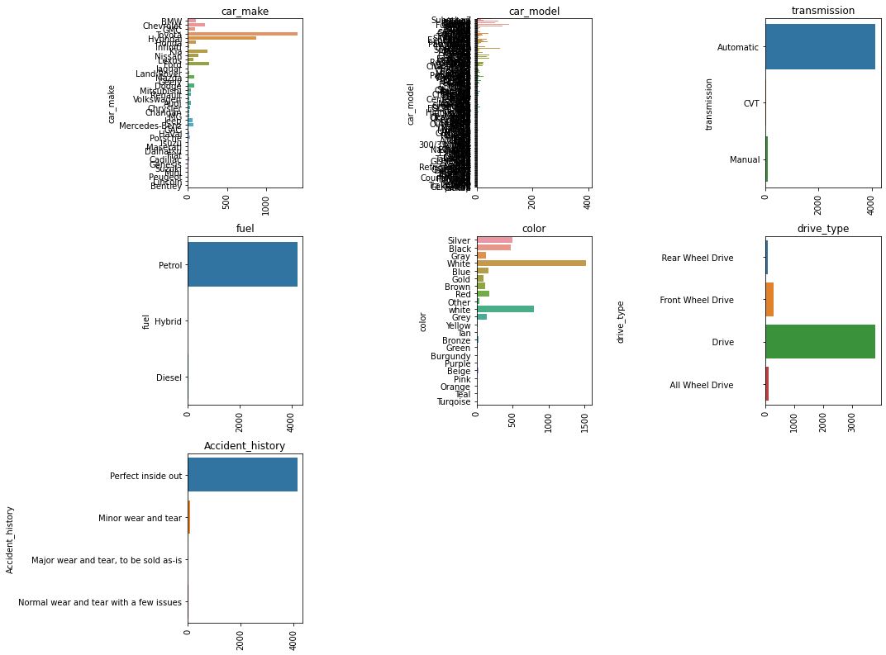
- drive_type feature has a mistyped observation 'drive' with a count more than 4000, It doesn't tell us anything about the drive type, so we might have to drop the entire column as it wouldn't help us much unless we knew the true value of the observation. - There's two feature values for color white on with upper case and one with lower

Slide 23
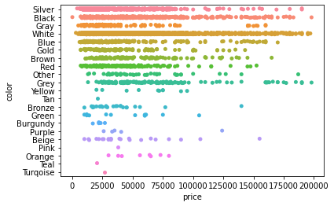
price and color stripplot
Due to the dusty weather in KSA light colors are the most desirable especially 'white', and that can result in an increased price for light color cars.

Slide 24
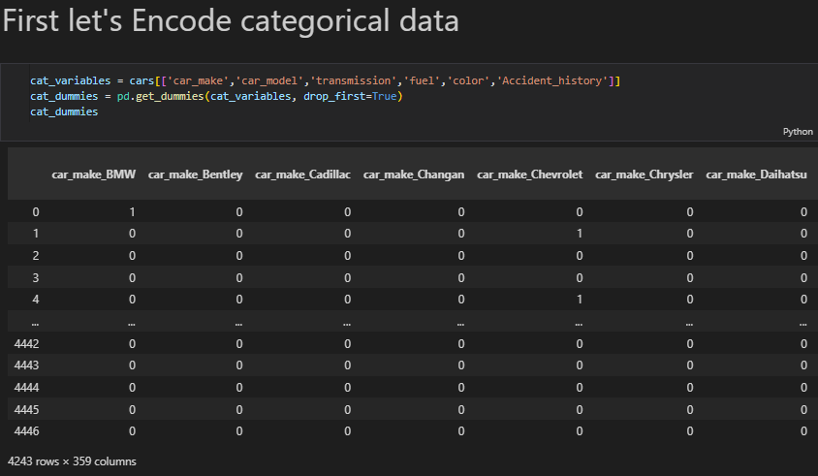

KKN Imputer for no_doors and no_cylinders

Slide 25
Initial Model Building
Cleaning done:
XGBRegressor (without scaling) R2 = 0.78
XGBRegressor (with scaling) R2 = 0.72

