Slide 1
CS112 – Level 1
Programming Languages 1
Lecture 11
Revision; Basic / Simple Solved Examples [ 3 ]
Course & Lectures are based on their counterparts in the following courses:
Harvard University's CS50; An introduction to the intellectual enterprises of computer science and the art of programming, Harvard School of Engineering and Applied Sciences.
UNSW's CS1: Higher Computing, by Richard Buckland – The University of New South Wales.
MIT's 6.087 Practical Programming in C (2010), 6.096 Introduction to C++ (2011), and 6.S096 Introduction to C and C++ (2013), MIT (Massachusetts Institute of Technology) OpenCourseWare.

Slide 2
Outline
Solved Examples
11.1: Write a C Program to Calculate .. Permutation (^{n}P_{r}) and Combination (^{n}C_{r}).
11.2: Write a C Program to find the Transpose of a given Matrix.
11.3: In regards to Command-Line Arguments .. What is the output of the following C Program for each of the given cases.
11.4: Write a C Program to Check whether an array is a subset of another array.
11.5: Write a C Program to sort an array of 0s, 1s and 2s.
11.6: Write a C Program to find the Binary Representation of an Integer using Bitwise Operators.
11.7: Write a C Program to Compare the Contents of Two Files (their names should be passed as Command-Line Arguments)
11.8: Write a C Program to Read and Print a Student’s Details using a Structure Pointer.
Outline
2

Slide 3

Revision .. Solved Examples [ 3 ]

Slide 4
11.1: Write a C Program to Calculate .. Permutation (^{n}P_{r}) .. and .. Combination (^{n}C_{r})
^{n}C_{r} and ^{n}P_{r} are statistical quantities regarding possible subsets of a set of objects, and they are defined as:
^{n}P_{r}( n, r ) = n! / ( n − r )!
^{n}C_{r}( n, r ) = ^{n}P_{r}( n, r ) / r! = n! / ( r! ( n − r )! )
Using sets to help define them:
^{n}P_{r} is the formula to find permutations of n objects taking r at a time. This answers the question of how many possible groups of r objects from a set of n objects. And, ..
^{n}C_{r} is the formula to find the unique permutations, otherwise known as combinations, of n objects taking r at a time. This answers the question of how many unique possible groups of r objects can be made from n objects.

Slide 5
11.1: Write a C Program to Calculate .. Permutation (^{n}P_{r}) .. and .. Combination (^{n}C_{r})
Example: Take the set { 1, 2, 3, 4} and find all combinations and permutations taking 2 at a time:
We can make this set of sets making every possible combination of the 4 objects in the set taking 2 at a time (we aren't allowed to reuse an object once we've use it):
------- {2, 1} {3, 1} {4, 1}
{1, 2} ------- {3, 2} {4, 2}
{1, 3} {2, 3} ------- {4, 3}
{1, 4} {2, 4} {3, 4} -------
This result of 12 sets is the calculation of ^{n}P_{r}( 4, 2), the total number of permutations of 4 objects taking 2 at a time. We can confirm that the formula produces 12:
^{n}P_{r}( 4, 2) = 4! / ( 4 − 2 )! = ( 4 ∗ 3 ∗ 2 ∗ 1 ) / ( 2 ∗ 1 ) = 24 / 2 = 12

Slide 6
11.1: Write a C Program to Calculate .. Permutation (^{n}P_{r}) .. and .. Combination (^{n}C_{r})
Example: Take the set { 1, 2, 3, 4} and find all combinations and permutations taking 2 at a time:
Now, if we want to look at unique sets, then { 1, 2} = { 2, 1} and likewise for all sets with the same numbers in them. Or, for this case, we can remove half of the grid we've created.
------- {2, 1} {3, 1} {4, 1}
------- ------- {3, 2} {4, 2}
------- ------- ------- {4, 3}
------- ------- ------- -------
This leaves us with 6 unique groups, and we can confirm with the ^{n}C_{r} formula that we get 6:
^{n}C_{r}( 4, 2) = ^{n}P_{r}( 4, 2) / r! = 12 / ( 2 ∗ 1 ) = 12 / 2 = 6

Slide 7
11.1: Write a C Program to Calculate .. Permutation (^{n}P_{r}) .. and .. Combination (^{n}C_{r})
#include<stdio.h>
// Function Prototype Declarations
long factorial( int );
long find_npr( int, int );
long find_ncr( int, int );
int main() {
int n, r;
long npr, ncr;
printf("Enter the value of n and r respectively: \n");
scanf("%d%d", &n, &r);
// Function Calls
npr = find_npr( n, r );
ncr = find_ncr( n, r );
printf("\n\t %dC%d = %ld\n", n, r, ncr );
printf("\n\t %dP%d = %ld\n", n, r, npr );
return 0;
}
Enter the values of n and r respectively :
4 2
4C2 = 6
4P2 = 12

Slide 8
// Function for Calculating nCr
long find_ncr( int a, int b )
{
return ( factorial( a ) / ( factorial( b ) * factorial( a - b ) ) );
}
// Function for Calculating nPr
long find_npr( int a, int b )
{
return ( factorial( a ) / factorial( a - b ) );
}
// Recursive Function for Calculating the Factorial
long factorial( int c )
{
if( c == 1 || c == 0 )
return 1;
else
return c * factorial( c - 1 );
}

Slide 9
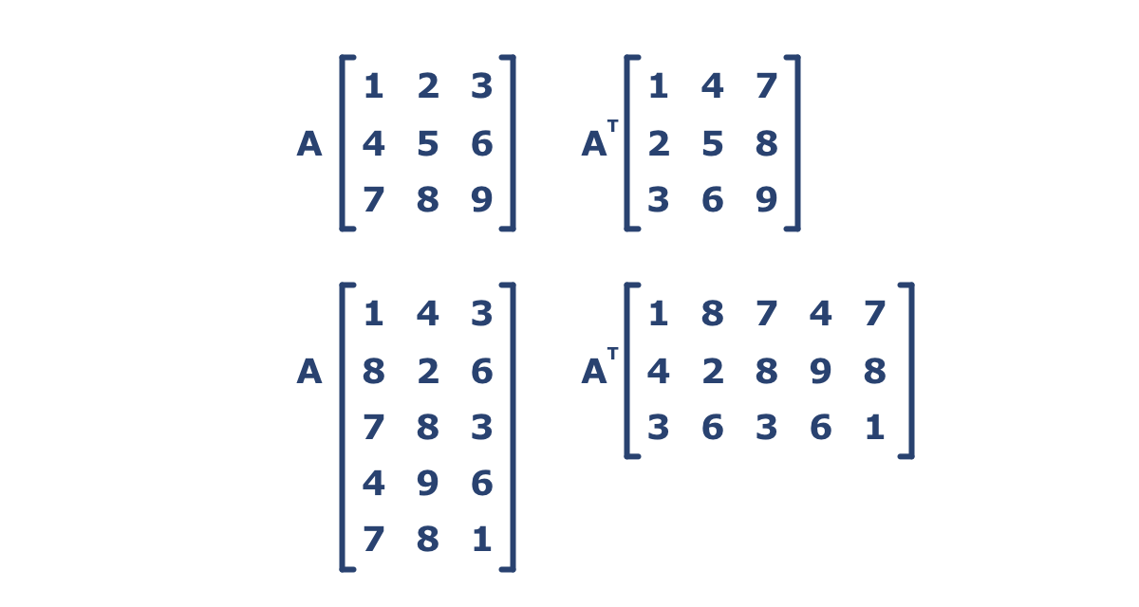
11.2: Write a C Program to find the Transpose of a given Matrix.
In linear algebra, the transpose of a matrix is an operator which flips a matrix over its diagonal, that is, it switches the row and column indices of the matrix by producing another matrix denoted as A^{T} ..

Slide 10
11.2: Write a C Program to find the Transpose of a given Matrix.
Input the number of rows and columns of the matrix : 2 2 Input the elements of the first matrix : Element - [0], [0] : 1 Element - [0], [1] : 2 Element - [1], [0] : 3 Element - [1], [1] : 4 The matrix is : 1 2 3 4 The transpose of the matrix is : 1 3 2 4

Slide 11
#include <stdio.h>
int main(void)
{
int arr1[ 50 ][ 50 ], brr1[ 50 ][ 50 ], i, j, r, c;
printf("\nInput the number of rows and columns of the matrix : ");
scanf("%d %d", &r, &c);
printf("Input the elements of the first matrix :\n");
for( i = 0; i < r; i++ )
{
for( j = 0; j < c; j++ )
{
printf("Element - [%d], [%d] : ", i, j);
scanf("%d", &arr1[ i ][ j ] );
}
}
printf("\nThe matrix is :\n");
for( i = 0; i < r; i++ )
{
printf("\n");
for( j = 0; j < c; j++ )
printf("%d\t", arr1[ i ][ j ] );
}

Slide 12
for( i = 0; i < r; i++ )
{
for( j = 0; j < c; j++ )
{
brr1[ j ][ i ] = arr1[ i ][ j ];
}
}
printf("\n\nThe transpose of the matrix is : ");
for( i = 0; i < c; i++ )
{
printf("\n");
for( j = 0; j < r; j++ )
{
printf("%d\t", brr1[ i ][ j ] );
}
}
}

Slide 13
11.3: In regards to Command-Line Arguments .. What is the output of the following C Program for each of the given cases:
// C program to illustrate Command-Line Arguments
^{#include<stdio.h>}
int main( int argc, char* argv[] )
{
^{int counter;}
printf(" Program Name Is: %s", argv[0] );
^{if( argc == 1 )}
printf("\n No Extra Command-Line Arguments Passed Other Than the Program's Name");
^{if( argc >= 2 )}
{
printf("\n Number Of Arguments Passed: %d", argc );
printf("\n ---- Following Are The Command-Line Arguments Passed ----");
for( counter = 0; counter < argc; counter++ )
printf("\n argv[ %d ]: %s", counter, argv[ counter ] );
}
^{return 0;}
}
C:\Users\Admin˃MyProgram.exe
C:\Users\Admin˃MyProgram.exe First Second Third
C:\Users\Admin˃MyProgram.exe “First Second Third”

Slide 14
C:\Users\Admin˃MyProgram.exe
Program Name Is: MyProgram.exe
No Extra Command-Line Arguments Passed Other Than the Program's Name
C:\Users\Admin˃MyProgram First Second Third
Program Name Is: MyProgram
Number Of Arguments Passed: 4
---- Following Are The Command-Line Arguments Passed ----
argv[ 0 ]: MyProgram
argv[ 1 ]: First
argv[ 2 ]: Second
argv[ 3 ]: Third
C:\Users\Admin˃MyProgram.exe “First Second Third”
Program Name Is: MyProgram.exe
Number Of Arguments Passed: 2
---- Following Are The Command-Line Arguments Passed ----
argv[ 0 ]: MyProgram.exe
argv[ 1 ]: First Second Third

Slide 15
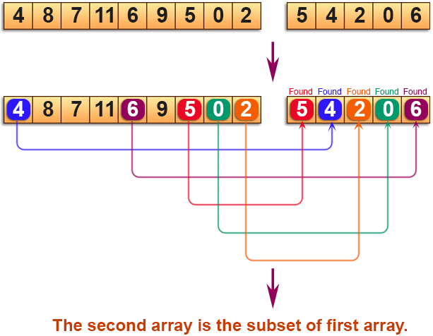
11.4: Write a C Program to Check whether an array is a subset of another array ..

Slide 16
#include <stdio.h>
int chkSubsetArray( int *arr1, int arr1_size, int *arr2, int arr2_size ) ;
int main()
{
int arr1[] = {4, 8, 7, 11, 6, 9, 5, 0, 2}; int arr2[] = {5, 4, 2, 0, 6};
int n1 = sizeof( arr1 ) / sizeof( arr1[ 0 ] ); int n2 = sizeof( arr2 ) / sizeof( arr2[ 0 ] );
int i;
//------------- Print the First Array ------------------
printf("The given First Array is : ");
for( i = 0; i < n1; i++ ) { printf("%d ", arr1[ i ] ); }
printf("\n");
//------------- Print the Second Array ------------------
printf("The given Second Array is : ");
for( i = 0; i < n2; i++ ) { printf("%d ", arr2[ i ] ); }
printf("\n");
//------------------------------------------------------
if( chkSubsetArray( arr1, n1, arr2, n2 ) )
printf("The Second Array is a Subset of the First Array.");
else
printf("The Second Array is Not a Subset of the First Array");
return 0;
}

Slide 17
int chkSubsetArray( int *arr1, int arr1_size, int *arr2, int arr2_size )
{
int i, j;
for ( i = 0; i < arr2_size; i++ )
{
for ( j = 0; j < arr1_size; j++ )
{
if( arr2[i] == arr1[j] )
break;
}
if( j == arr1_size )
return 0;
}
return 1;
}

Slide 18
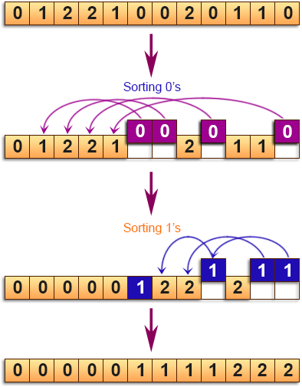
11.5: Write a C Program to sort an array of 0s, 1s and 2s ..
The Given Array is :
0 1 2 2 1 0 0 2 0 1 1 0
After Sorting, the Elements of the Array are:
0 0 0 0 0 1 1 1 1 2 2 2

Slide 19
#include <stdio.h>
void swap( int arr1[], int i, int j );
int sortElements( int arr1[], int end );
int main()
{
int arr1[] = { 0, 1, 2, 2, 1, 0, 0, 2, 0, 1, 1, 0 };
int n = sizeof( arr1 ) / sizeof( arr1[ 0 ] );
int i;
//------------- Print the Original Array ------------------
printf("The Given Array is :\n\n");
for( i = 0; i < n; i++ ) { printf("%d ", arr1[ i ] ); } printf("\n\n\n");
//-------------- Print the Sorted Array ------------------
sortElements( arr1, n - 1 );
printf("After Sorting, the Elements of the Array are: \n\n");
for( i = 0; i < n; i++ ) { printf("%d ", arr1[ i ] ); } printf("\n\n\n");
return 0;
}
void swap( int arr1[], int i, int j )
{
int tmp = arr1[ i ];
arr1[ i ] = arr1[ j ];
arr1[ j ] = tmp;
}

Slide 20
int sortElements( int arr1[], int end )
{
int start = 0, mid = 0;
int pivot = 1;
while( mid <= end )
{
if ( arr1[ mid ] < pivot )
{
swap( arr1, start, mid );
++start, ++mid;
}
else if ( arr1[ mid ] > pivot )
{
swap( arr1, mid, end );
--end;
}
else
{
++mid;
}
}
}

Slide 21
11.6: Write a C Program to find the Binary Representation of an Integer using Bitwise Operators
In this C program, we will read an integer (decimal) number, and print its Binary Value (Binary Representation).
In this program, we are finding the Binary values of 16 bits numbers. The logic is very simple – we have to just traverse each bit using the Bitwise AND operator. To traverse each bit – we will run loop from 15 to 0 (we are doing this to print the Binary representation in a proper format).
Enter an Integer Number : 13
The Binary Value of 13 is = 0000000000001101

Slide 22
#include <stdio.h>
void getBinary( int );
int main()
{
int num = 0;
printf("Enter an Integer Number : ");
scanf("%d", &num );
printf("\nThe Binary Value of %d is = ", num );
getBinary( num );
return 0;
}
void getBinary( int n ) /* Function Definition : getBinary() */
{
int loop;
/* loop = 15, for representing a 16 bits value, 15th bit to 0th bit */
for( loop = 31; loop >= 0; loop-- )
{
if( ( 1 << loop ) & n )
printf("1");
else
printf("0");
}
}

Slide 23
11.7: Write a C Program to Compare the Contents of Two Files (their names should be passed as Command-Line Arguments)
#include <stdio.h>
int main( int argc, char *argv[] )
{
FILE *fp1, *fp2; int cnt1 = 0, cnt2 = 0, flg = 0;
if( argc < 3 )
{
printf("Insufficient Arguments!!!\n");
printf("Please use \"program-name file-name1 file-name2\" format.\n");
return -1;
}
fp1 = fopen( argv[ 1 ], "r" );
if( fp1 == NULL )
{ printf("\n%s could not be opened.\n", argv[ 1 ] ); return -1; }
fp2 = fopen( argv[ 2 ], "r" );
if( fp2 == NULL )
{ printf("\n%s could not be opened.\n",argv[ 2 ] ); return -1; }

Slide 24
// Move the file pointer to the end, and get the total number of bytes per file
fseek( fp1, 0, SEEK_END ); cnt1 = ftell( fp1 );
fseek( fp2, 0, SEEK_END ); cnt2 = ftell( fp2 );
// Check if the total number of bytes (of both files) are equal
if( cnt1 != cnt2 ) { printf("\nThe contents of both files are not the same.\n"); }
else // Check if the contents of both files are the same
{
fseek( fp1, 0, SEEK_SET );
fseek( fp2, 0, SEEK_SET );
while( ! feof( fp1 ) )
{
if( fgetc( fp1 ) != fgetc( fp2 ) )
{
flg = 1;
break;
}
}
if( flg ) printf("\nThe contents of both files are not the same.\n");
else printf("\nThe contents of both files are the same.\n");
}
fclose( fp1 ); fclose( fp2 );
return 0;
}

Slide 25
11.8: Write a C Program to Read and Print a Student’s Details using a Structure Pointer.
#include <stdio.h>
struct student{
char name[30];
int id;
float perc;
};
int main()
{
struct student std; // Structure Variable
struct student *ptr; // Pointer to a Student Structure
ptr = &std; // Assigning a value to the Pointer (the Address of a Structure Variable)
printf("Enter the Details of a Student: ");
printf("\nName? :"); gets( ptr->name );
printf("ID No.? :"); scanf("%d", &ptr->id );
printf("Percentage? :"); scanf("%f", &ptr->perc );
printf("\nThe Entered details are: \n");
printf("Name: %s\nID. No: %d \nPercentage: %.02f\n", ptr->name, ptr->id, ptr->perc );
return 0;
}

Slide 26
Thanks! .. Questions?

