Slide 1
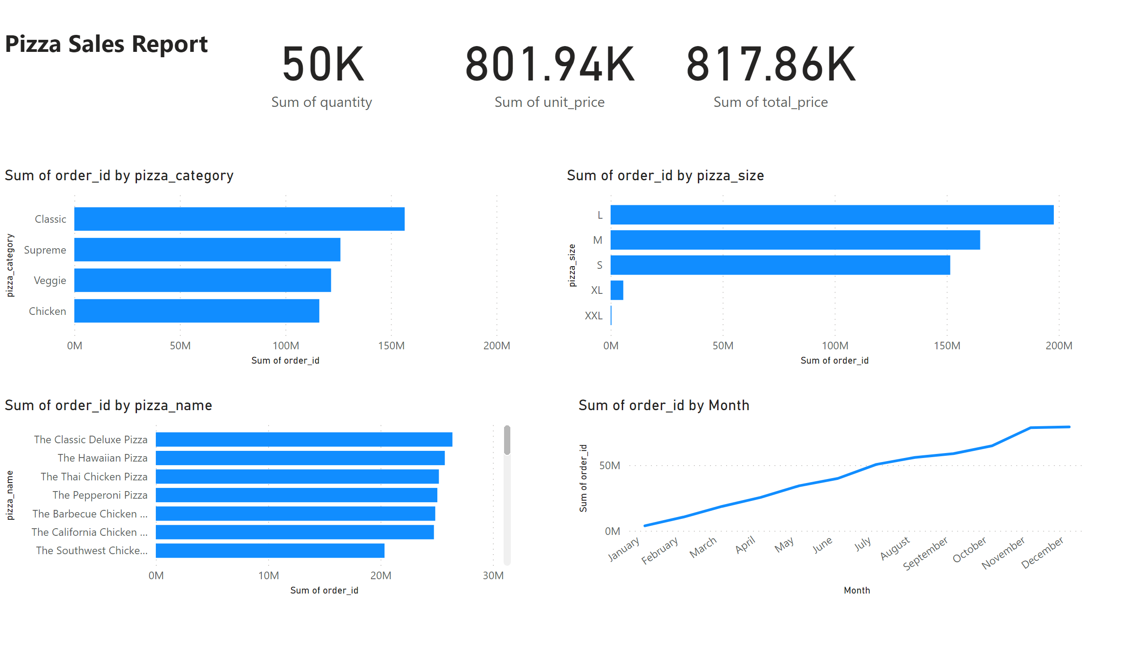
Pizza Sales
Notes:
textbox
No alt text provided
card
No alt text provided
card
No alt text provided
card
No alt text provided
clusteredBarChart
No alt text provided
clusteredBarChart
No alt text provided
clusteredBarChart
No alt text provided
lineChart
No alt text provided

