Slide 1
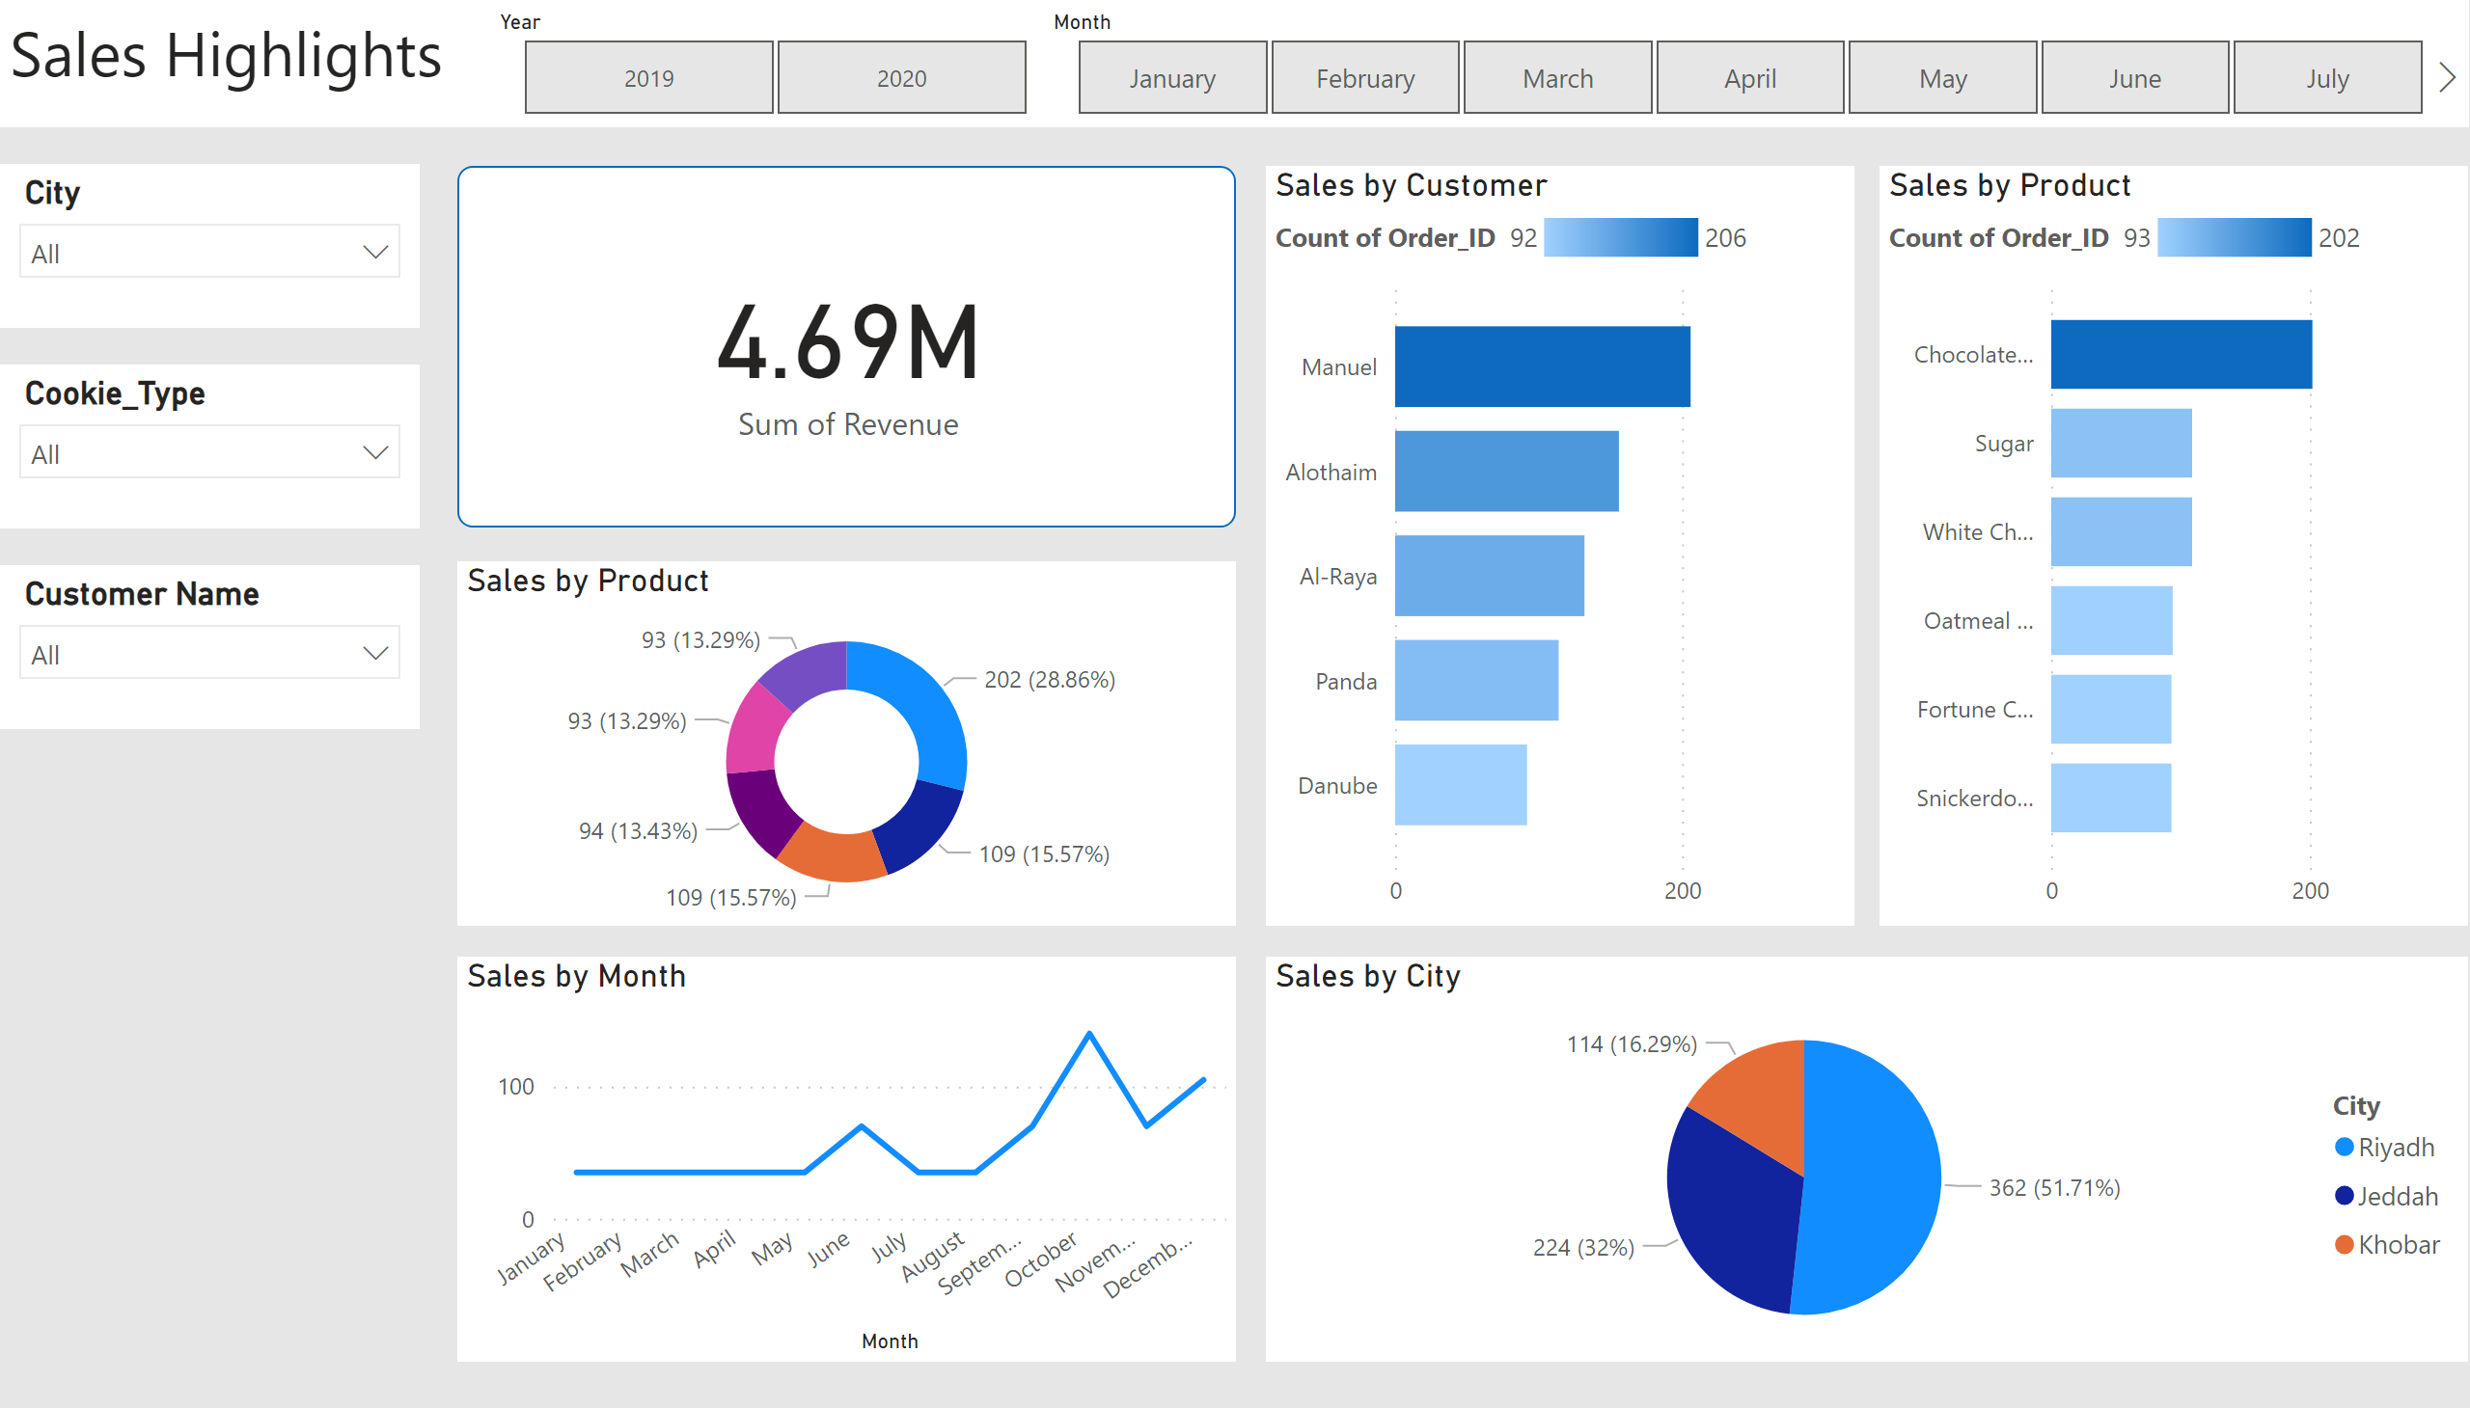
Sales
Notes:
textbox
No alt text provided
slicer
No alt text provided
slicer
No alt text provided
slicer
No alt text provided
slicer
No alt text provided
slicer
No alt text provided
card
No alt text provided
Sales by Product
No alt text provided
Sales by Month
No alt text provided
Sales by Customer
No alt text provided
Sales by Product
No alt text provided
Sales by City
No alt text provided

Slide 2
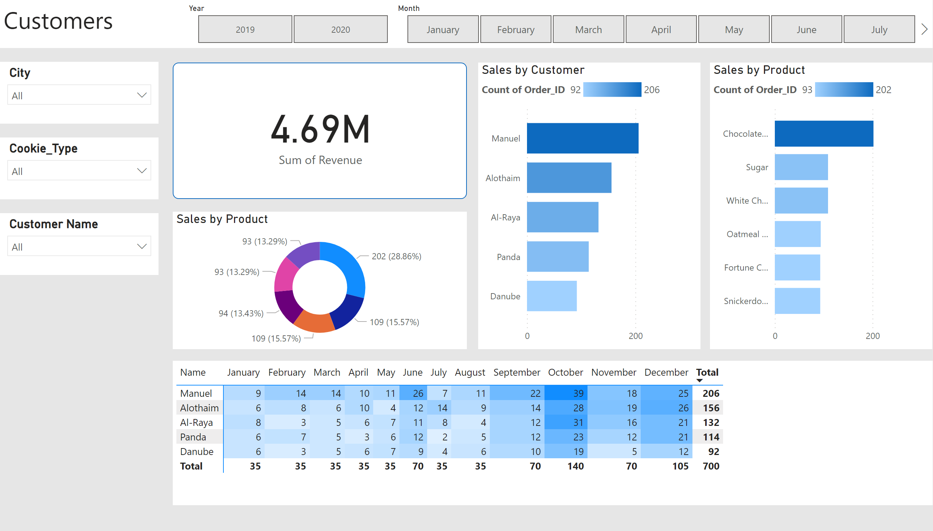
Customers Details
Notes:
textbox
No alt text provided
slicer
No alt text provided
slicer
No alt text provided
slicer
No alt text provided
slicer
No alt text provided
slicer
No alt text provided
card
No alt text provided
Sales by Product
No alt text provided
Sales by Customer
No alt text provided
Sales by Product
No alt text provided
pivotTable
No alt text provided

