Slide 1



WEB
APP FIREWALL
PRESENTED TO:
Web Application Firewall
Fcai

Slide 2

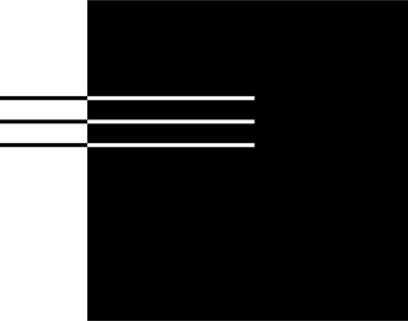
03 | What is WAF
04 | What is OWasp
05 | Vulnerabilities
06 | Cross-Site Scripting
07 | SQL Injection
08 | Path Traversal
09 | Server side request forgery
10 | Nginx
Agenda
Khaled Mohamed 20226040
Ziad Medhat 20226044
Youssef Shrief 20226117
Fady Nagy 20226074

Slide 3
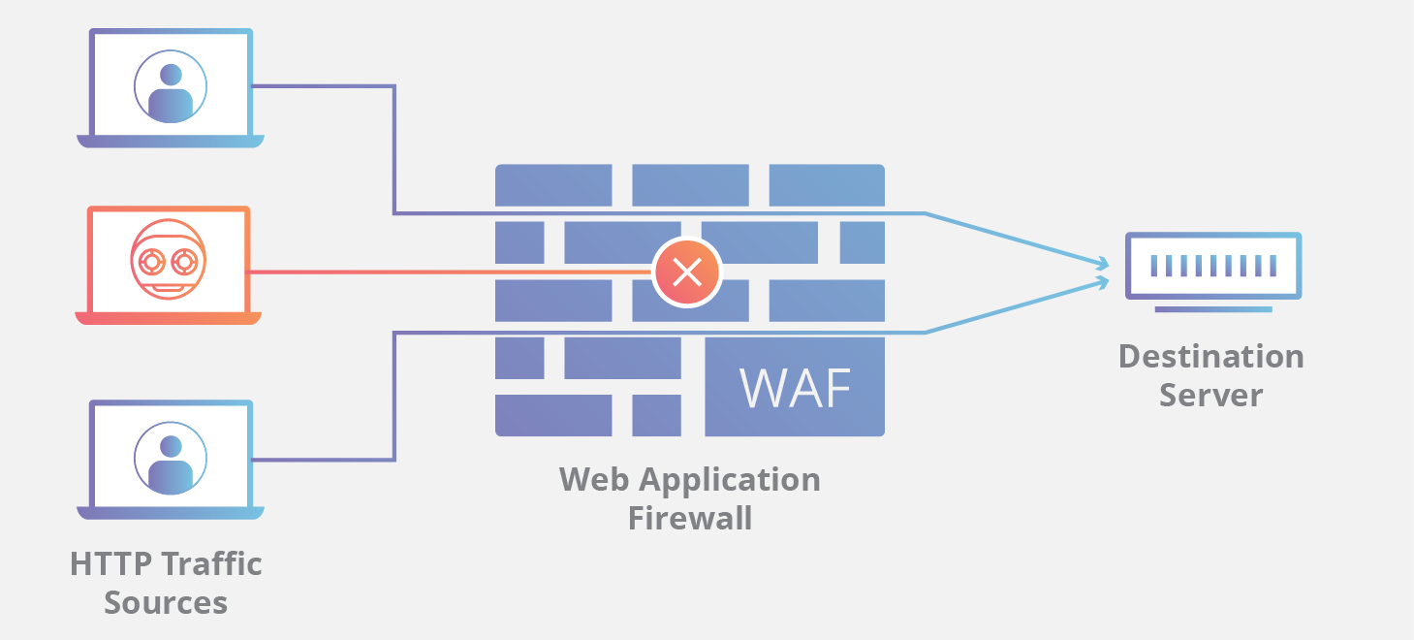
3/
01
It sits in front of the web application, often deployed as a reverse proxy, network-based appliance, or cloud service.
WAF
A WAF is a security solution that monitors, filters, and blocks HTTP traffic to and from a web application.
02
It protects against common attacks like SQL injection, XSS, and path traversal by inspecting the HTTP requests before they reach the application.
03
WAFs operate based on a set of rules, often called policies or signatures, that define what traffic is considered malicious.

Slide 4

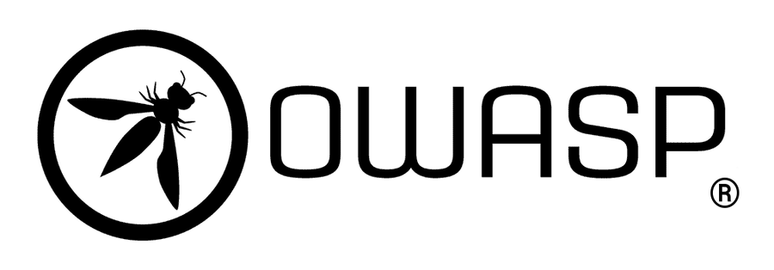
04/10
The Open Worldwide Application Security Project (OWASP) is a non-profit foundation that works to improve software security through a community-driven, open-source approach. Its mission is to make application security visible, allowing organizations and developers to make educated risk decisions. OWASP achieves this by providing free, world-class educational materials, methodologies, documentation, and tools, effectively serving as the global standard-bearer for application security knowledge and best practices.
The OWASP Top 10 is the organization's flagship awareness document, representing a broad consensus among security experts about the most critical security risks facing web applications. It is not an exhaustive list of all vulnerabilities but a vital guide for developers, security professionals, and organizations to prioritize their security efforts and allocate resources to mitigate the most prevalent and high-impact threats, making it the essential first step in any application security program.

Slide 5


Vulnerabilities
05/10
A vulnerability is a weakness in a web application’s code, design, or configuration that can be exploited by an attacker to gain unauthorized access, manipulate data, or disrupt the application’s normal behavior
For example, an attacker could exploit a vulnerability to steal users’ login credentials or cookies session IDs using exploits like XSS (Cross-site scripting)
# 2
# 3
# 4
# 1
Serverside Request Foregery
Cross-Site Scripting
SQL Injection
Block Path Traversal

Slide 6

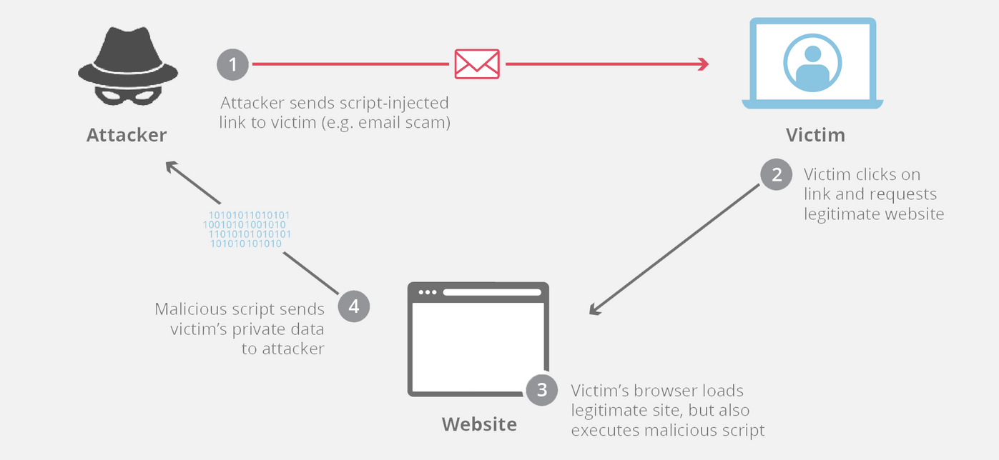
06/10
Cross-Site Scripting
    Attacker injects malicious client-side scripts into a web page viewed by another user.
    The application trusts user input too much. An attacker submits a script into a comment field, search bar, or URL parameter.
    Session hijacking, redirection to malicious sites, stealing cookies, or defacing a website.

Slide 7
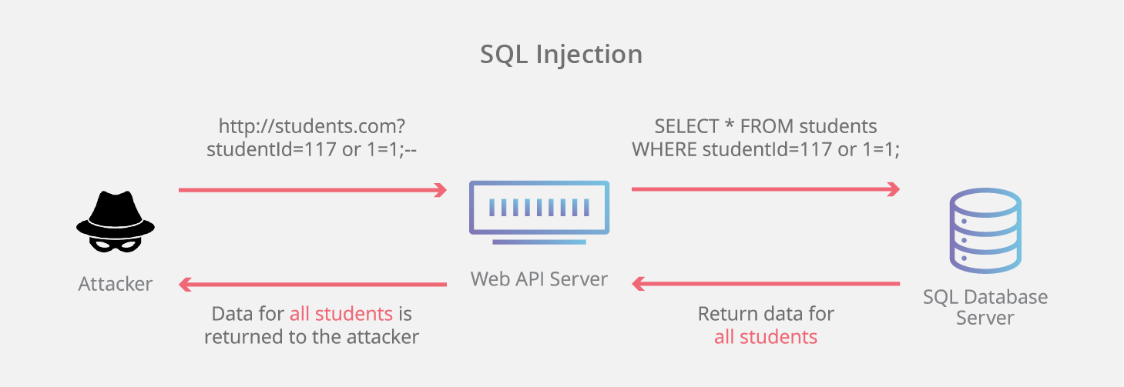
07/10
SQL Injection
    SQLi works by targeting a vulnerable Application Programming Interface or API. An API in this case is the software interface through which a server receives and responds to requests.
    Impact: View, modify, or delete sensitive data from the database, or even execute commands on the database server.

Slide 8
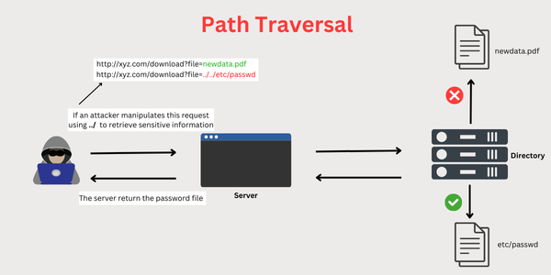

Path Traversal
08/10
  Attacker Tries to access arbitrary files and directories stored on the application's file system, including source code, configuration files, and system files. By manipulating file paths in an input parameter to reference files outside of the intended directory, often using ../ sequences.
  Impact: Disclosure of sensitive system information, or in some cases, remote code execution.

Slide 9
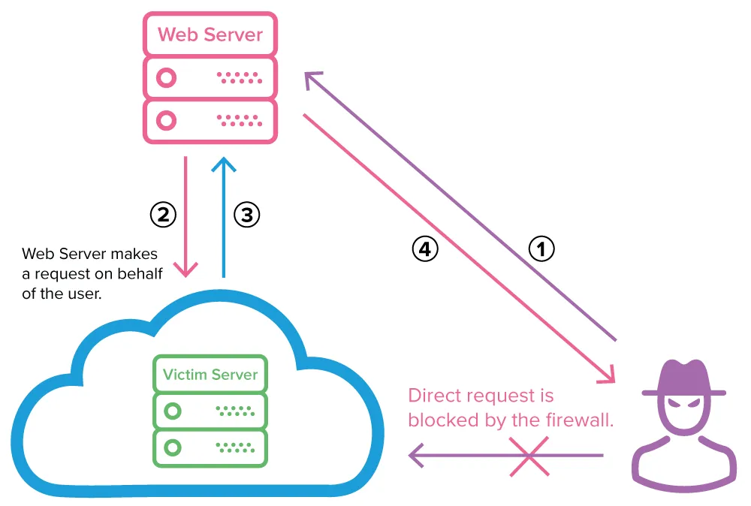
Server-Side Request Forgery
09/10
  Attacker tries to abuse a server's functionality to make it issue an arbitrary HTTP request to an internal or external resource chosen by the attacker.
  The application has a feature that fetches a URL provided by a user (e.g., fetching an image from a third-party website). The attacker provides an internal IP address or URL instead.
  Port scanning internal networks, accessing metadata services (like on AWS/GCP), or interacting with internal APIs not meant to be exposed publicly.

Slide 10
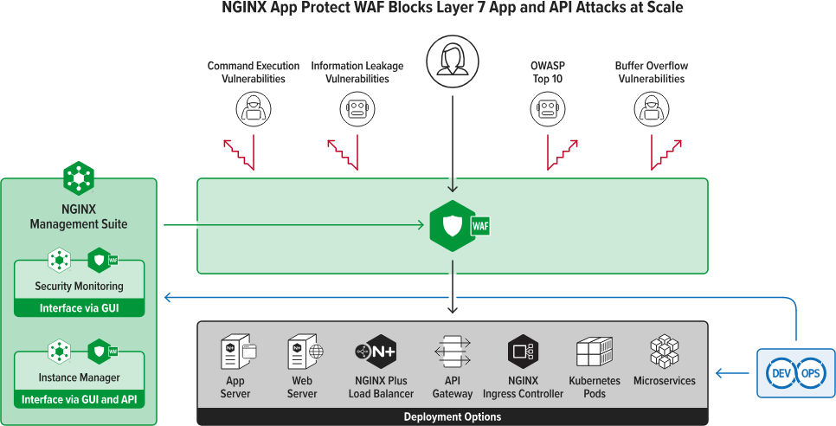
Nginx
10/10
It is an open-source web server, reverse proxy, load balancer, and HTTP cache. It's known for its high performance and low resource usage. In a modern architecture, Nginx often acts as a Reverse Proxy. This means it sits between the public internet and the application servers.
Nginx is the platform where many open-source or commercial WAF solutions are integrated.
Nginx is a platform and a gateway where it secures the network flow.

Slide 11
Thank you

