Slide 1
Project Overview
Your Logo
Smart Waste Classification and Recycling Assistant by Ahmed Fathy Badawy
MM/DD/20XX

Slide 2
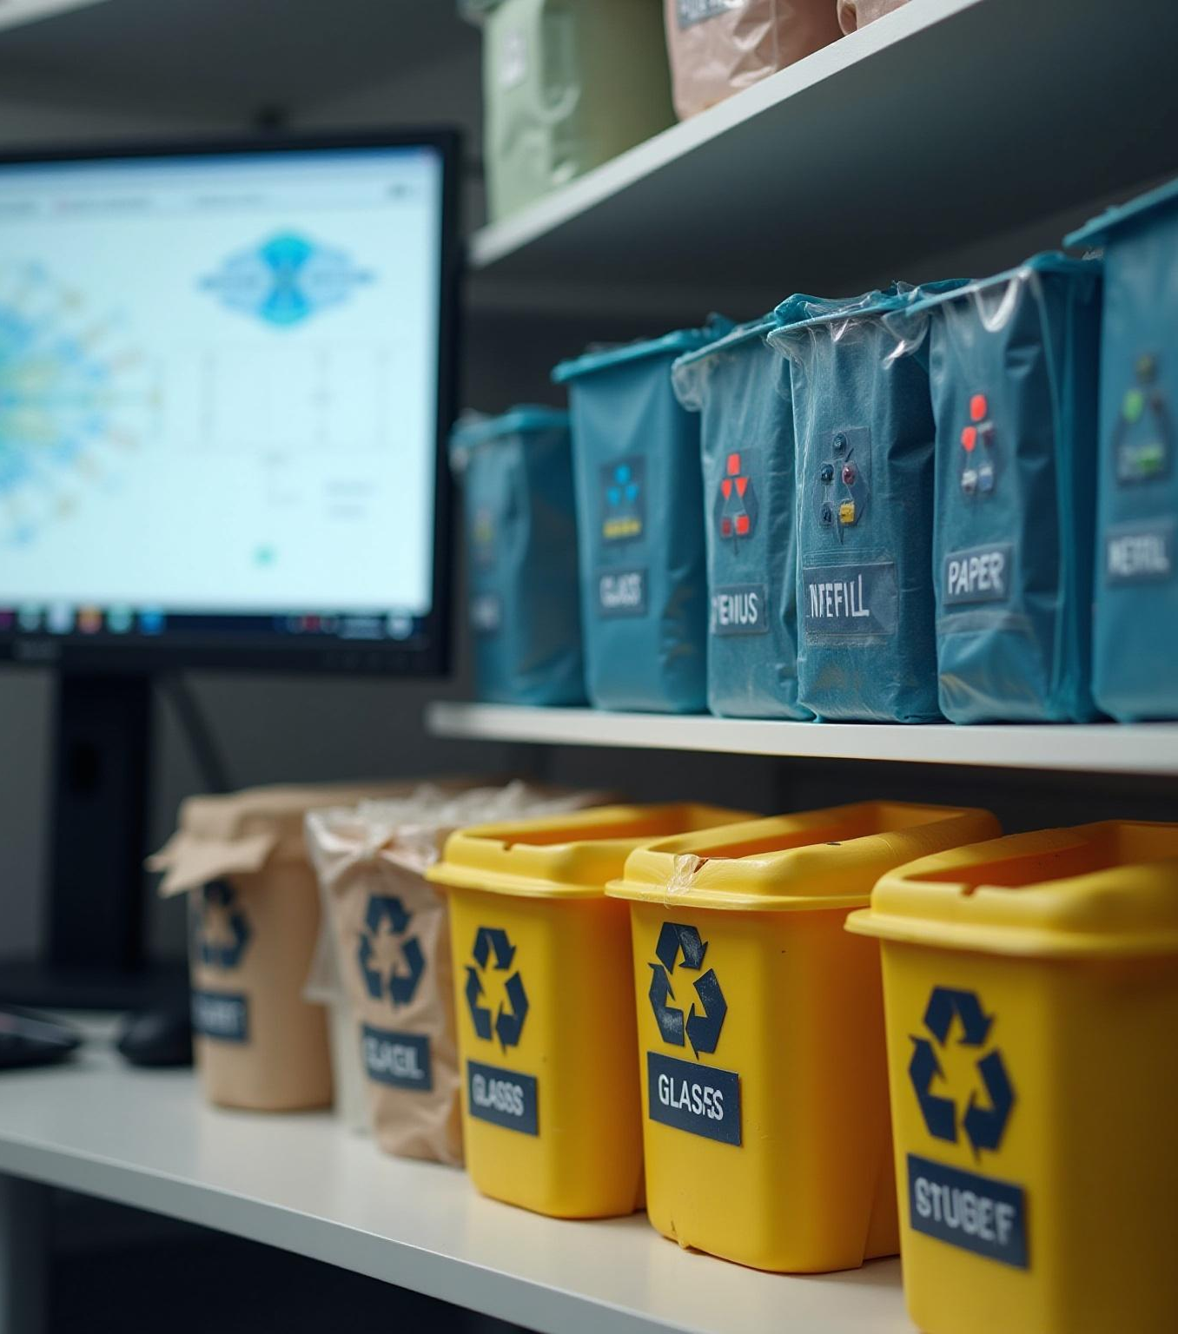
Introduction
This project develops a multi-class automated waste classification system using six classes: cardboard, glass, metal, paper, plastic, and trash. It explores several deep learning models and complementary techniques to improve robustness and deployment feasibility.

Slide 3
Executive summary and key outcomes
The project compares MobileNetV2 transfer learning with a custom CNN trained from scratch. Denoising Autoencoders and GANs improve input quality and augment under-represented classes respectively. A multimodal CLIP pipeline combines image and text embeddings. The web app enables real-time model demos and inference.

Slide 4
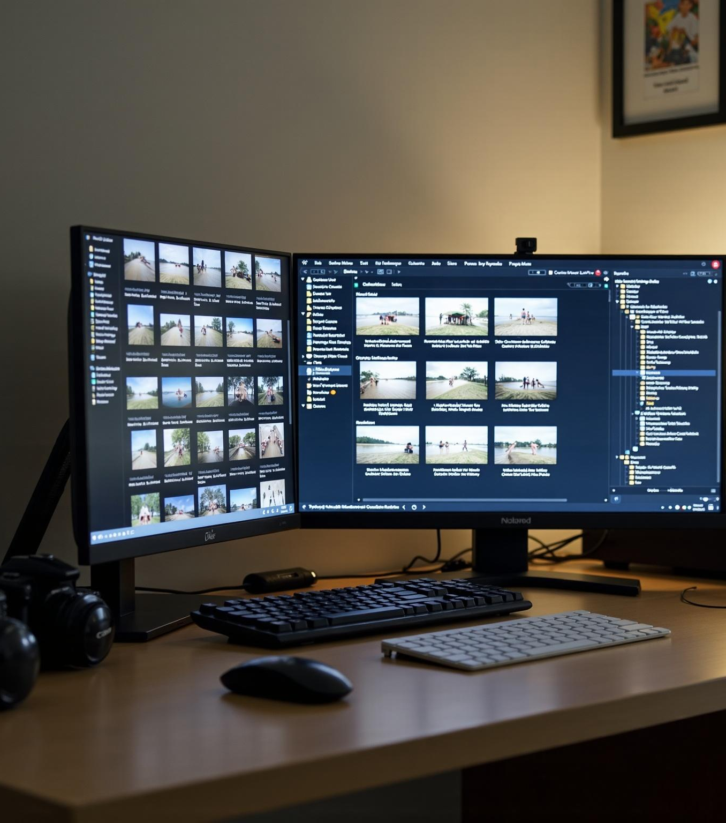
Dataset description and problem statement
The dataset contains six waste classes with images organized in separate folders. A stratified split creates training and testing sets. Preprocessing includes resizing, normalization, and data augmentations such as flips and rotations to enhance model generalization.

Slide 5
Preprocessing and data splits
Images are resized to 224x224 for MobileNetV2 and 150x150 for the custom CNN. Normalization scales pixels to [0,1]. Stratified splits ensure balanced class distributions in training (85%) and testing (15%) subsets. Data augmentation is applied on-the-fly during training to alleviate overfitting.

Slide 6
MobileNetV2 transfer learning details
MobileNetV2 uses pretrained ImageNet weights, input size 224x224x3, and appends new dense classification layers. Most base layers are frozen except the last three. Trained with Adam optimizer and early stopping. It offers efficiency and accuracy suitable for edge deployment.

Slide 7
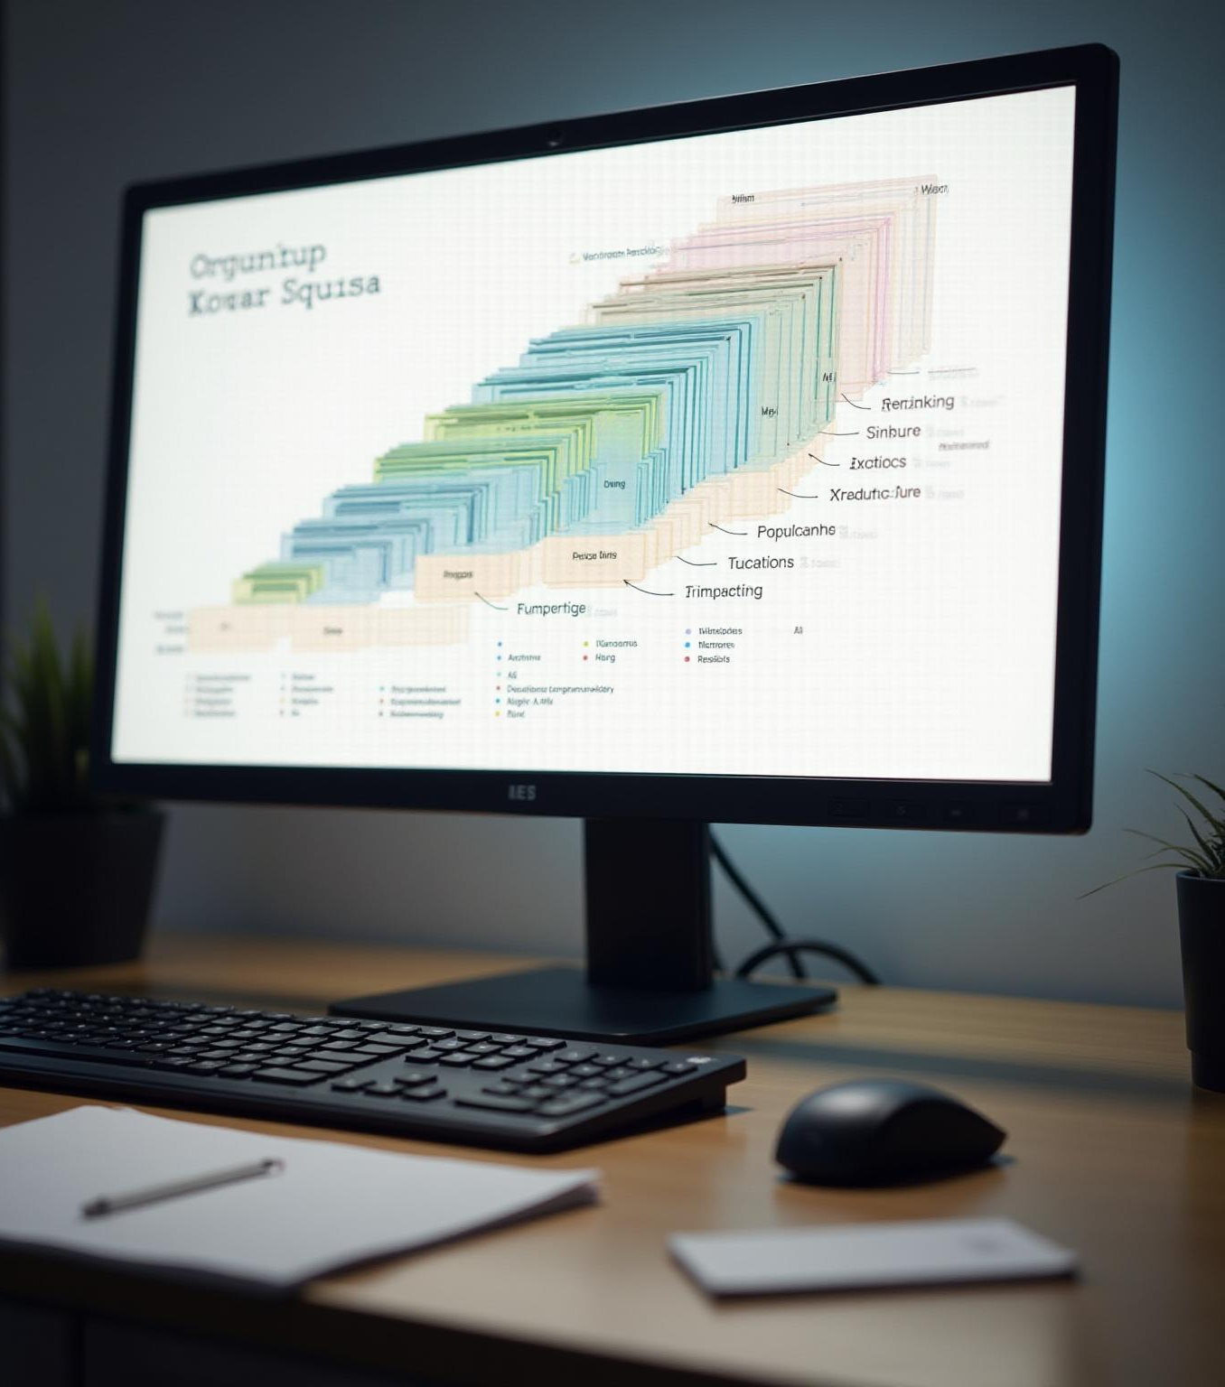
Custom CNN architecture and training details
Custom CNN processes 150x150 images with stacked convolutional and max-pooling layers, increasing filters from 64 to 512. Followed by dense layers with dropout for regularization. Trained from scratch using categorical crossentropy loss and Adam optimizer for 30 epochs.

Slide 8
Denoising Autoencoder overview
A PyTorch convolutional encoder-decoder removes noise and mild blur from images to enhance input quality. It trains on 64x64 crops with synthetic Gaussian noise and blur. Preprocessed outputs improve downstream classification performance when integrated as a preprocessing step.

Slide 9
GANs for data augmentation
A conditional DCGAN synthesizes 64x64 images per class for augmenting scarce classes. The GAN is trained using adversarial loss and label smoothing over hundreds of epochs. Generated images require curation to prevent label noise before inclusion in training sets.

Slide 10
Multimodal CLIP pipeline
Combines CLIP-based 224x224 image embeddings with generated short text descriptions. Embeddings are concatenated and fed into a lightweight MLP classifier. This multi-input approach enhances robustness and accuracy when textual metadata is available.

Slide 11
YOLO object detection extension
The classification dataset is converted to YOLO format with full-image bounding boxes. YOLOv8 is trained for waste object detection, enabling localization and integration with classifiers in a two-stage pipeline. It enhances performance in multi-object scenes.

Slide 12
Streamlit app demo features
An interactive UI loads pretrained MobileNetV2 and custom CNN models. Users can upload or select sample images to run inference and view class probabilities. The app displays model summaries and status, supporting quick visual demonstrations and evaluation.

Slide 13
Evaluation & results placeholders
Metrics include test accuracy, per-class precision/recall, confusion matrices, and training curves. Visualization aids qualitative assessment. Numeric results can be reproduced by running notebooks.

Slide 14
Recommendations and next steps
Prioritized actions include dataset curation, fine-tuning MobileNetV2, pruning and quantization for deployment, joint denoiser-classifier training, and packaging the Streamlit app with Docker or edge-compatible model exports.

Slide 15
Risks and limitations
Limitations stem from dataset size, computational resource dependency (GPU recommended), and synthetic data caveats including GAN output curation and model generalization challenges.

Slide 16
Appendix / reproducibility notes
Run commands include environment setup with pip, launching Streamlit app with specified path, and Jupyter nbconvert commands for notebook exports. Required artifact files include trained models, notebooks, generated samples, and scripts.

Slide 17

Conclusions
MobileNetV2 transfer learning offers an efficient, accurate baseline adaptable to edge devices. Custom CNN achieves competitive results with more data and careful training. Denoising autoencoders enhance input quality, and GANs augment scarce classes. Future work includes dataset expansion, fine-tuning, and integrating multimodal models for improved robustness and deployment readiness.

