Slide 1
Toxic Comment
Classification
Multi-Label Deep Learning System

Slide 2

Project Overview
Key Features
Problem Statement
Advanced text preprocessing
Emoji-to-text conversion
Negation preservation
Per-label threshold tuning
Class imbalance handling
Interactive Gradio deployment
Detect multiple types of toxicity in online comments simultaneously using multi-label classification
Toxicity Categories (6)
Models Implemented
73%
Best F1-Score (CNN)

Slide 3
Dataset & Class Imbalance
Class Imbalance Challenge
Initial dataset heavily skewed toward non-toxic comments. Without balancing, models achieve high accuracy by predicting everything as non-toxic.
Balancing Strategy
Downsampled non-toxic comments to match toxic count, creating 50 50 balanced dataset for fair model training.
Toxic vs Non-Toxic Distribution (After Balancing)

Slide 4

Multi-Label Complexity
Key Correlations
 | tox | sev | obs | thr | ins | ih
toxic | 1.0 | 0.31 | 0.68 | 0.16 | 0.65 | 0.27
severe | 0.31 | 1.0 | 0.40 | 0.13 | 0.38 | 0.21
obscene | 0.68 | 0.40 | 1.0 | 0.14 | 0.72 | 0.29
threat | 0.16 | 0.13 | 0.14 | 1.0 | 0.15 | 0.12
insult | 0.65 | 0.38 | 0.72 | 0.15 | 1.0 | 0.33
id_hate | 0.27 | 0.21 | 0.29 | 0.12 | 0.33 | 1.0
Toxic-Obscene: Strong co-occurrence
Toxic-Insult: Frequently overlap
Threat & Identity Hate: Rare but severe
Multi-Label Statistics
Label Correlation Heatmap

Slide 5
Exploratory Data Analysis
Text Length Distribution
Average characters
394
Average words
67
Emoji Analysis
Max length
5000+ chars
Rows with emojis: ~5%
Unique emojis found: 200+ different types requiring demojization for sentiment preservation
Outlier Detection
Box plots reveal significant outliers in text length. Some comments exceed 2000 words, requiring careful handling during preprocessing.

Slide 6
Text Preprocessing Pipeline
1
Lowercasing & punctuation handling
2
URL, mention, hashtag removal
3
Emoji-to-text conversion (😡 → "angry_face")
4
Stopword removal (preserve negations)
5
Contraction expansion (don't → do not)
6
Number normalization & lemmatization

Slide 7

TF-IDF Feature Extraction
TF-IDF Configuration
Max Features: 10,000
N-gram Range: (1, 2)
Min DF: Default
Max DF: Default
Tokenizer: Word-based
TF-IDF vs Bag-of-Words
TF-IDF (Used)
Weights terms by importance, reduces common word dominance
BoW (Not Used)
Simple frequency count, common words dominate
Output Matrix
Sparse matrix: (n_samples, 10000)
Why Bi-grams?
Each row represents a comment, each column a unique term/bi-gram with TF-IDF weight
Uni-grams alone miss context. Bi-grams capture phrases like "not good" vs "good", crucial for negation handling in toxicity detection.

Slide 8
Classical Machine Learning Models
Logistic Regression
Support Vector Machine
Configuration
Configuration
OneVsRestClassifier strategy
Max iterations: 1000
Class weight: balanced
Solver: liblinear
LinearSVC (linear kernel)
OneVsRestClassifier strategy
Class weight: balanced
Dual: auto
Performance
Performance
F1-Score: 68%
F1-Score: 66%
Accuracy: 69%
Accuracy: 67%
ROC-AUC: 86%
ROC-AUC: 85%

Slide 9

Training & Validation Strategy
Training Process
Data Splitting
Random seed: 42 for reproducibility
Stratified split maintains label distribution
Validation guides hyperparameter tuning
Early stopping prevents overfitting
Test set untouched until final evaluation
Training Set
80%
Validation Set
10%
Test Set
10%
Class Weight Balancing
Applied balanced class weights to handle remaining label imbalance within toxic categories. Prevents model bias toward frequent labels.
Validation Metrics
Monitored validation loss and AUC score during training. Models showed convergence around epoch 3-5 with minimal overfitting.

Slide 10



Deep Learning Models
CNN
LSTM
GRU
Convolutional layers detect toxic patterns
Sequential dependency modeling
Simplified gating mechanism
F1: 73%
F1: 70%
F1: 71%
All models: Embedding (20K vocab, 128-dim) → Architecture → Dense (6, Sigmoid)

Slide 11

CNN Architecture Details
Layer Architecture
Training Configuration
Embedding Layer
Loss Function
Binary Crossentropy
Vocab: 20,000 | Dimensions: 128
Optimizer
Adam
Conv1D Layer
Batch Size
64
Filters: 128 | Kernel Size: 5 | ReLU
Epochs
5
Metrics
AUC (multi-label)
GlobalMaxPooling1D
Extracts most important features
Why CNN for Text?
Dense + Dropout
Convolutional filters act as n-gram detectors, identifying local patterns and toxic phrases regardless of position in text.
64 units ReLU | Dropout: 0.5
Output Layer
Total Parameters: ~2.7M
6 units | Sigmoid activation
Trainable: All layers

Slide 12


LSTM & GRU Architectures
LSTM
GRU
Embedding(20K, 128) → LSTM(64) → Dense(6, Sigmoid)
Embedding(20K, 128) → GRU(64) → Dense(6, Sigmoid)
F1-Score:
F1-Score:
70%
71%
Both models capture sequential dependencies in text. GRU achieves similar performance with faster training due to simpler gating mechanism.

Slide 13

Hyperparameter Tuning
Logistic Regression Grid Search
SVM Grid Search
Search Space
Search Space
C: [0.01, 0.1, 1, 10]
C: [0.01, 0.1, 1, 10]
Penalty: [l1, l2]
Best: C=1, penalty=l2
Best: C=1
CV: 3-fold
CV: 3-fold
Scoring: f1_micro
Scoring: f1_micro
CNN Configurations Tested
Config 1 (Selected)
Config 2
Config 3
Filters: 128, Kernel: 5, Dropout: 0.5
Filters: 256, Kernel: 5, Dropout: 0.5
Filters: 128, Kernel: 3, Dropout: 0.3

Slide 14
Threshold Tuning Methodology
Algorithm
for each label in [toxic, severe_toxic, obscene, threat, insult, identity_hate]:
best_f1 = 0
best_threshold = 0.5
for threshold in range(0.1, 0.9, 0.05):
y_pred = (y_prob[:, label_index] >= threshold)
f1 = f1_score(y_true[:, label_index], y_pred)
if f1 > best_f1:
best_f1 = f1
best_threshold = threshold

Slide 15
Threshold Tuning Breakthrough
Problem
Solution
Default 0.5 threshold fails for rare labels like threat (0.3% frequency)
Per-label threshold optimization maximizes F1-score independently
Optimized Thresholds (CNN)
toxic
severe_toxic
obscene
threat
insult
identity_hate
0.45
0.30
0.50
0.15
0.40
0.20

Slide 16
Detailed Performance Metrics
CNN Model (Best Performer)
Accuracy Metrics
Precision & Recall
F1 & AUC
Subset Accuracy
75%
Precision (Micro)
76%
F1-Score (Macro)
73%
Hamming Loss
0.12
Recall (Micro)
74%
ROC-AUC (Macro)
89%
Per-Label F1-Scores
toxic
78%
Interpretation
insult
76%
High Performance: Toxic, insult, obscene labels show excellent detection (>75% F1)
obscene
75%
severe_toxic
48%
Challenges: Rare labels (threat, identity_hate) limited by training data despite threshold optimization
identity_hate
42%
threat
37%

Slide 17

Gradio Deployment
Example Input
"Wow great job 👏 you totally ruined everything 😂😂😂"
Probabilities
Predictions
toxic: 0.97
✓ toxic
insult: 0.63
✓ insult
obscene: 0.40
✓ obscene
Real-time toxicity detection with full preprocessing pipeline
Response time: <100ms on standard hardware

Slide 18
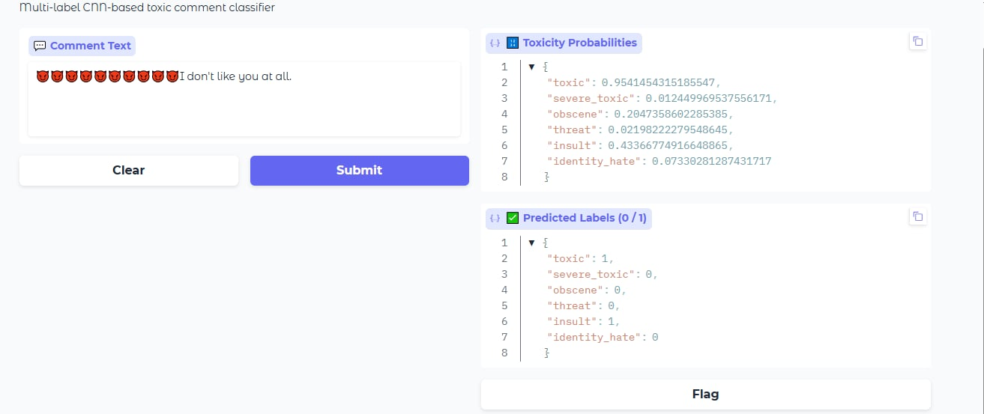

Slide 19
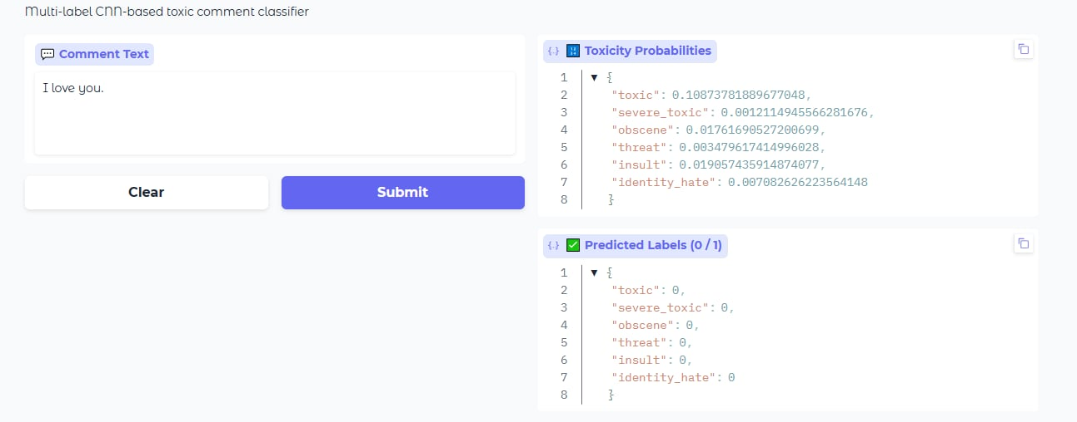

Slide 20
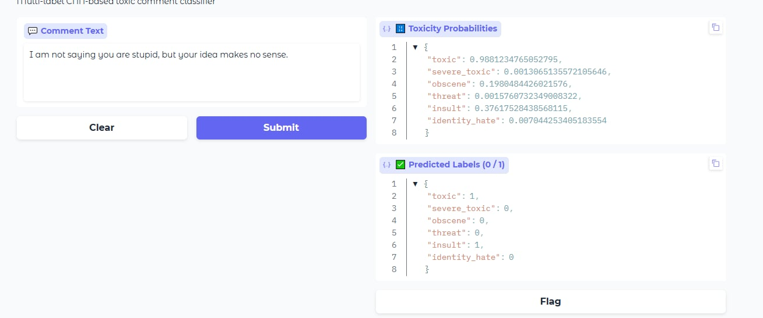

Slide 21
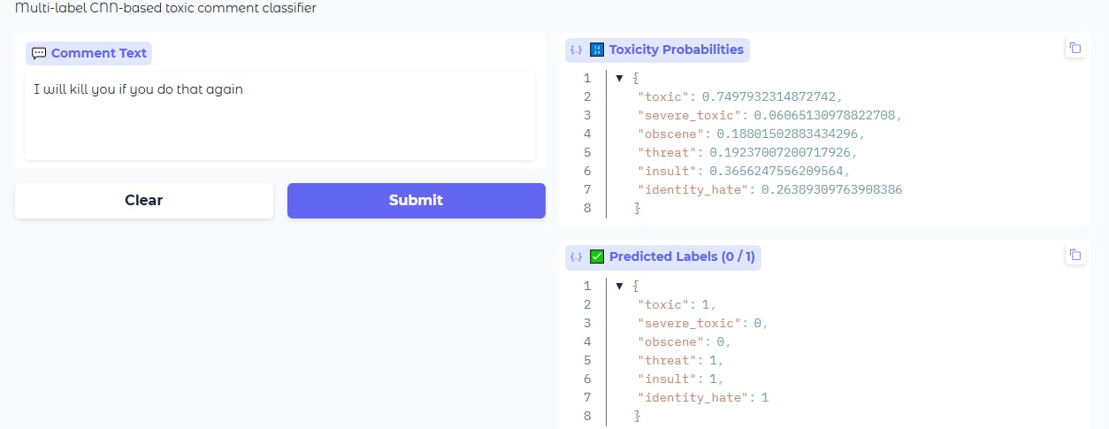

Slide 22
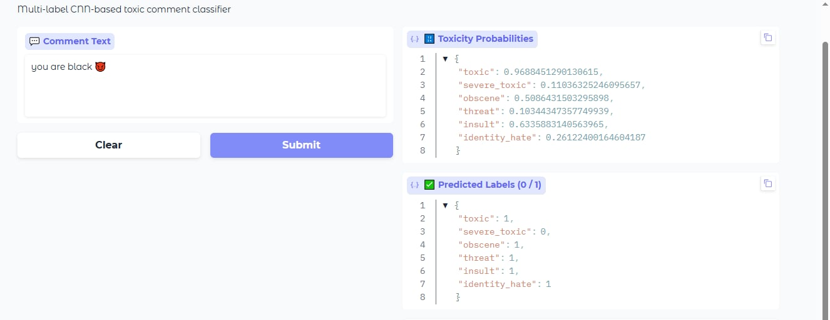

Slide 23
Challenges & Limitations
Current Limitations
Technical Challenges
Data Imbalance
Computational Cost
Despite balancing, rare categories (threat 0.3%, identity_hate 0.8%) remain extremely underrepresented
Deep learning models require GPU for training. Inference manageable on CPU but slower
Context Understanding
Model Interpretability
Model lacks broader conversational context - single comment analysis misses thread dynamics
Black-box nature makes it difficult to explain decisions to users or moderators
Language Coverage
Real-world Drift
English-only training limits deployment in multilingual environments
Language and toxicity patterns evolve - model needs continuous retraining

Slide 24

Future Improvements
Data Augmentation
Transformer Models
BERT: Bidirectional context understanding
RoBERTa: Robustly optimized BERT
XLNet: Permutation language modeling
Pre-trained on massive corpora
Transfer learning advantages
Back-Translation
Translate to another language and back to create variations
Paraphrasing
GPT-based generation of semantic equivalents
Synthetic Data
Generate examples for rare categories (threat, identity_hate)
Expected Impact
Multi-lingual Expansion
Estimated 5-10% F1-score improvement especially on complex context-dependent cases
Train on multilingual datasets or use cross-lingual models (XLM-R, mBERT) for global deployment

Slide 25


Key Achievements & Future Work
Achievements
Future Directions
73% F1-score with CNN
Successful multi-label classification
Per-label threshold tuning
Real-world Gradio deployment
Transformer models (BERT, RoBERTa)
Data augmentation for rare categories
Model explainability (LIME, SHAP)
Multi-lingual support
Complete ML Pipeline: Data → Preprocessing → Models → Deployment

