Slide 1
SMART SHOPPING
BEHAVIOR ANALYZER
Using Unsupervised Learning Techniques
A store-friendly analytics dashboard that groups customers, discovers product patterns, and detects unusual behavior from transaction data.
GMM Clustering
t-SNE Map
Apriori Rules
Isolation Forest
6-minute presentation
Smart Shopping Behavior Analyzer | Data Mining Final Project
01

Slide 2
Problem & Objective
Why this project matters for real store owners
The Problem
Our Objective
Stores collect many transactions but cannot easily understand patterns.
Customer groups are hidden inside raw sales data.
Product relationships are difficult to discover manually.
Unusual customers may be missed without analysis.
Build a dashboard that explains store data automatically.
Use unsupervised learning because the dataset has no labels.
Show results in business-friendly language.
Help decision-making with groups, rules, and anomalies.
Core idea: upload a CSV → get understandable insights.
Smart Shopping Behavior Analyzer | Data Mining Final Project
02

Slide 3
Dataset & System Flow
From raw transactions to business insights
Dataset Columns
Processing Pipeline
CustomerID
InvoiceNo
Description
Quantity
UnitPrice
InvoiceDate
CSV
Clean
Features
Scale
Uploaded sales file
Remove invalid values
Customer behavior summary
Normalize feature ranges
GMM
t-SNE
Apriori
Forest
Customer groups
Customer map
Product patterns
Unusual customers
Derived feature: TotalPrice = Quantity × UnitPrice
Feature engineering creates: TotalSpent, NumTransactions, UniqueProducts, RecencyDays, AvgTransactionValue.
Smart Shopping Behavior Analyzer | Data Mining Final Project
03

Slide 4
Data Mining Techniques
The 4 unsupervised methods used in the system
Customer Groups
Customer Map
GMM Clustering
t-SNE Visualization
Groups similar customers and gives a confidence probability for each group.
Converts customer features into a 2D map where nearby points behave similarly.
Product Patterns
Unusual Customers
Apriori Rules
Isolation Forest
Finds products frequently bought together using support, confidence, and lift.
Detects customers whose behavior is very different from the majority.
Smart Shopping Behavior Analyzer | Data Mining Final Project
04

Slide 5
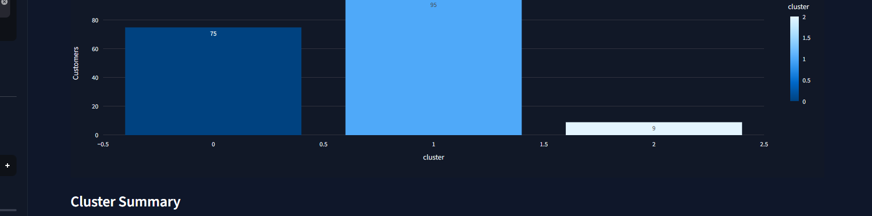
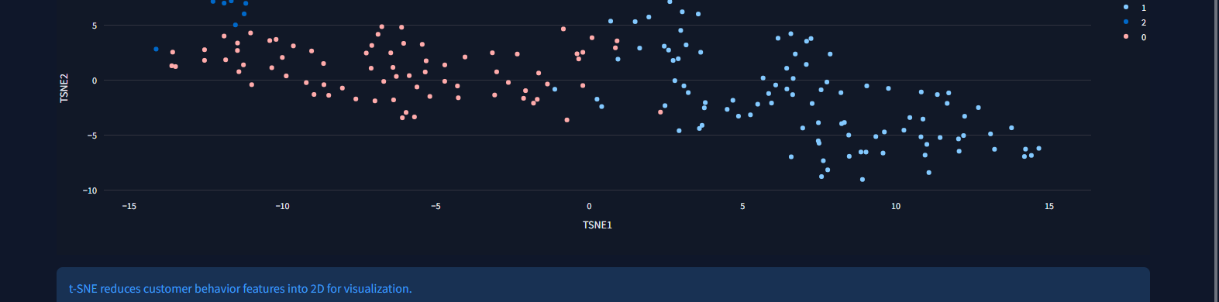
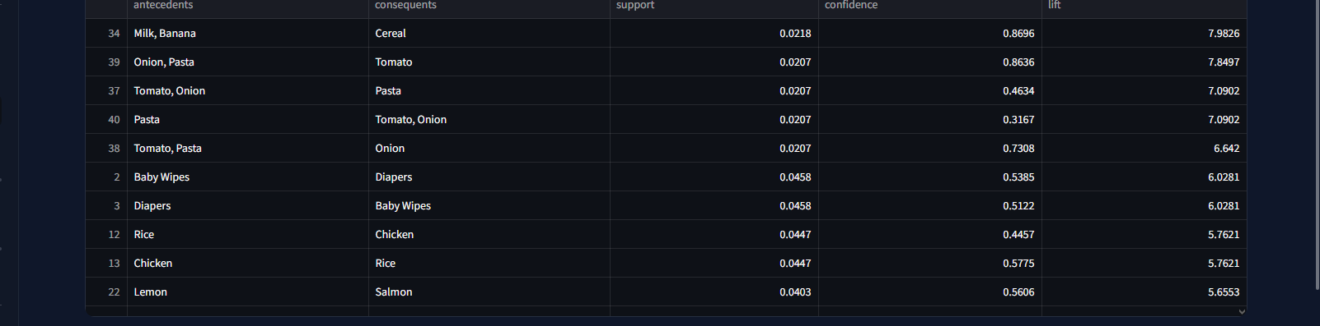
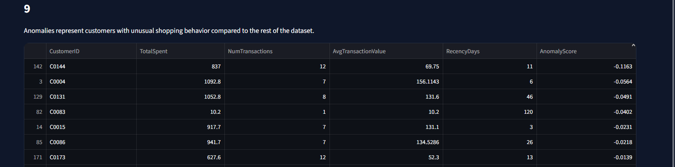
Results Dashboard
Main outputs from the final application
Customer Groups
Customer Map
Products Bought Together
Unusual Customers
Example results: Group 2 = highest spenders • Milk + Banana → Cereal • 9 unusual customers detected
Smart Shopping Behavior Analyzer | Data Mining Final Project
05

Slide 6
Conclusion & Future Work
What the project achieved and what comes next
Conclusion
Future Work
Built a complete unsupervised retail analytics dashboard.
Grouped customers and visualized behavior similarity.
Discovered product relationships and unusual customers.
Designed the interface for non-technical store owners.
Use larger real-world retail datasets.
Add product recommendation features.
Deploy the dashboard online.
Improve explanations for unusual customers.
Thank you — Questions?
Smart Shopping Behavior Analyzer | Data Mining Final Project
06

