Slide 1
Egyptian Used Car
Market Analysis 2025
What drives used car prices in Egypt?

Slide 2
PROJECT OVERVIEW
Research Question: "What are the most influential factors on used car prices in Egypt?"
Dataset
Objective
Tools
Scale
Used Cars in Egypt 2025
Find what drives prices
Python + Pandas (EDA)
24,128 clean records
Source: hatla2ee.com
Build market insights
Power BI (Dashboard)
11 variables studied
via Kaggle — Mohamed Sewid
Support buyers & sellers
Excel / Power Query

Slide 3
DATA CLEANING — What We Fixed
24,688
560
24,128
11
Raw Records
Errors Removed
Clean Records
Variables
01
Price & Mileage
Removed "EGP" & "Km" text — converted to real numbers for analysis
02
Year Validation
Removed impossible years (<1900 or >2025) — e.g. Peugeot 3008/5008 model numbers mistaken for years
03
Transmission
Original column was 99% empty — extracted Automatic/Manual from the features column
04
Location Cleaning
Removed car model names wrongly entered in the location/city field
05
Price Outliers
Dropped listings below EGP 30,000 — physically impossible in Egypt's current market

Slide 4
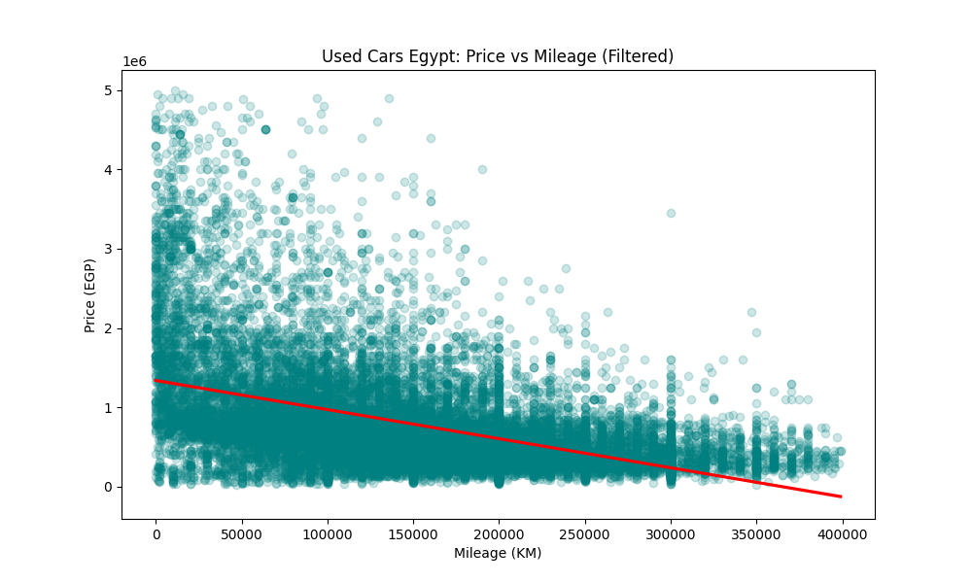
FINDING 1 — The Higher the Mileage, the Lower the Price
-0.47
Correlation Score
Moderate Negative
As mileage increases, price goes down
Cars under 50K km sell for ~4x more than 300K+ km cars
Mileage alone doesn't determine price — brand matters more

Slide 5
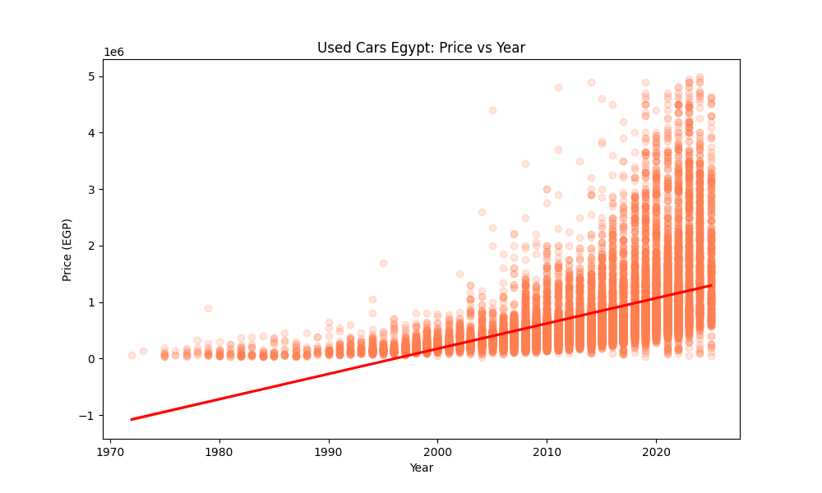
FINDING 2 — Newer Cars Command Higher Prices
+0.53
Correlation Score
Moderate Positive
Newer model year = significantly higher price
2022-2025 cars avg ~9x more than pre-2000 cars
Year is a stronger price driver than mileage

Slide 6
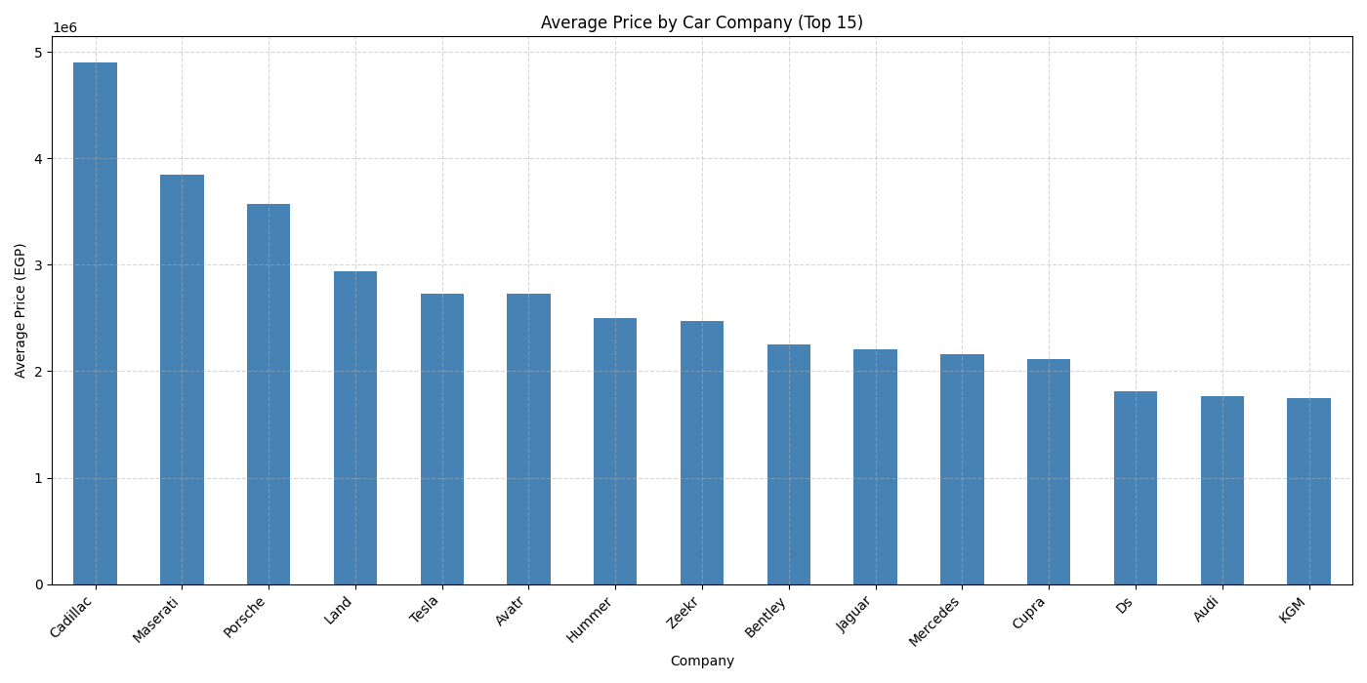
FINDING 3 — Brand is the #1 Price Driver
#1
Biggest Price Factor
Categorical variable
Cadillac avg ~4.9M EGP — 7x more than Hyundai
European luxury (Porsche, Maserati) dominate top 3
Tesla & Chinese brands (Zeekr, Avatr) entering market

Slide 7
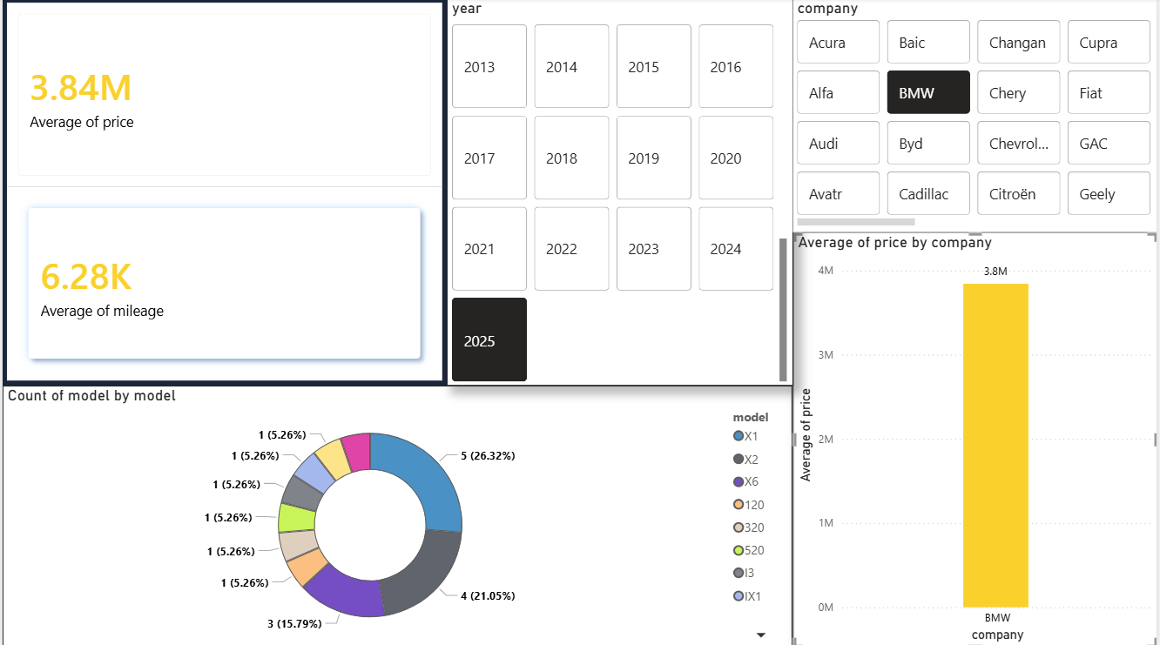
DASHBOARD OVERVIEW

Slide 8
SUMMARY — Answering the Research Question
What drives used car prices in Egypt?
#1
Brand
Cadillac vs Hyundai = 7x price difference
Very High
#2
Model Year
Newer = higher price (Correlation: +0.53)
High
#3
Mileage
More km = lower price (Correlation: -0.47)
Moderate
#4
Location
New Cairo & Sheikh Zayed command premium prices
Moderate
#5
Transmission
Automatic cars sell higher than Manual cars
Low-Mod
For buyers: Target 2015-2019 Japanese/Korean cars under 100K km | For sellers: Highlight year + mileage

Slide 9
Thank You
"Brand, Year, and Mileage are the three pillars
that shape used car prices in Egypt."

