Slide 1
Keywords, Aggregation Functions , Group by ,Join, & nested Queries
Session 5

Slide 2
Data Query Language

Slide 3
DQL
Data Query Language (DQL) is a subset of SQL that focuses on retrieving data from one or more database tables. It primarily uses the SELECT statement to query and fetch data.
Retrieve Specific Data: Fetch data from one or more columns or entire rows.
Filter Data: Use conditions to retrieve only the rows that meet certain criteria (WHERE clause).
Group Data: Use the GROUP BY clause to organize data into groups based on a column.
Sort Results: Use the ORDER BY clause to display data in ascending or descending order.
Combine Data: Use JOINs to combine data from multiple related tables.

Slide 4
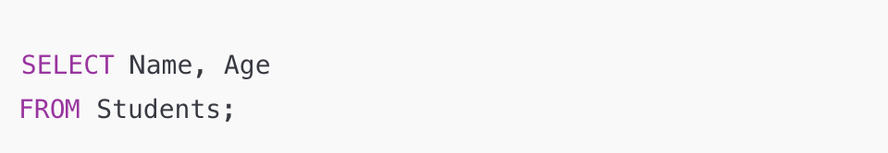
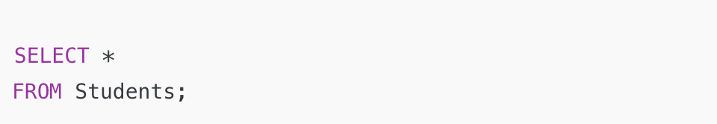
Select Data From ONE Table

Slide 5
Keywords

Slide 6
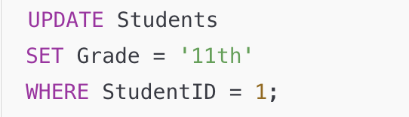
WHERE Keyword
Used to filter records based on conditions.
Example:
SELECT <column_name> FROM <table_name> WHERE condition;
Notes:
The WHERE keyword helps filter the data to retrieve only the records that meet specific criteria.

Slide 7
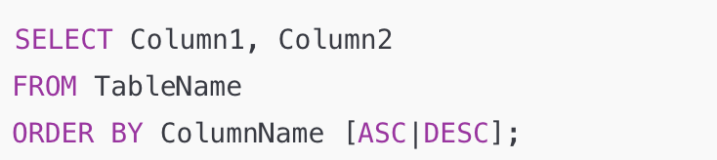
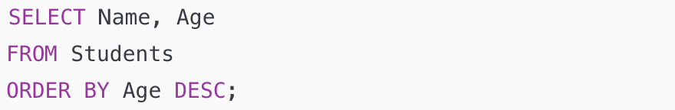
ORDER BY Keyword
Used to sort the result set in Ascending or Descending order.

Slide 8
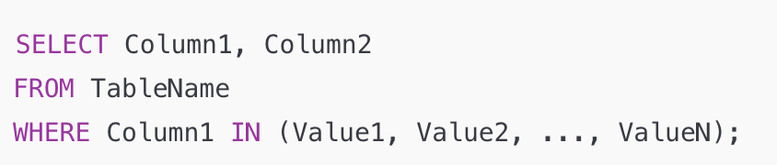
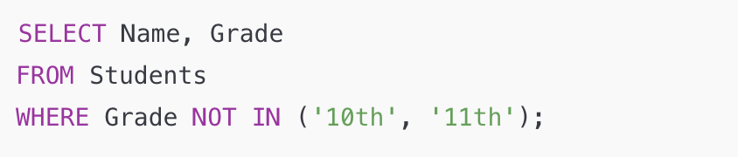
IN Keyword
Used to specify multiple values in a WHERE clause.
To check if a column's value matches any value in a specified list.

Slide 9
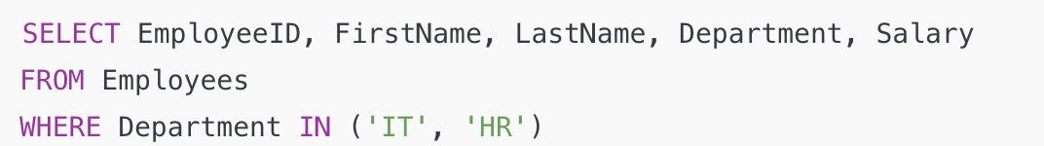
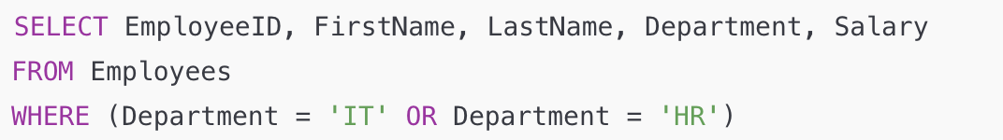
IN Keyword
IN is easier to read when checking if a column matches multiple values

Slide 10
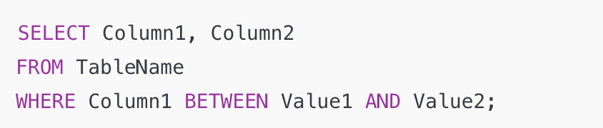
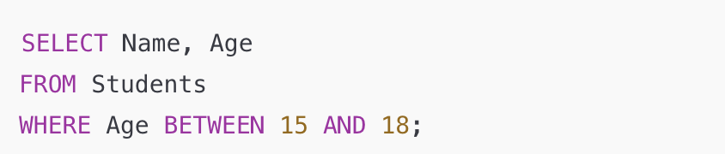
Between Keyword
Used to filter records within a range of values (inclusive), used with WHERE clause

Slide 11
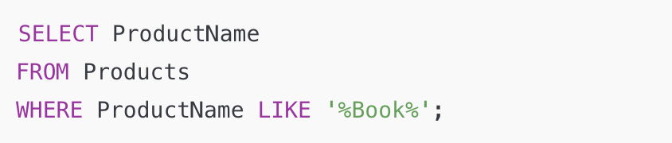
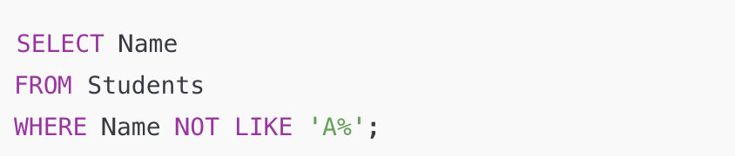
Like Keyword
Used to search for a specified pattern in a column inside text data.
Used with WHERE clause

Slide 12
String Comparison
LIKE 'BR%' Every name beginning with the letters BR
LIKE '%een' Every name ending with the letters een
LIKE '%en%' Every name containing the letters en
LIKE '_en' Every three-letter name ending in the letters en
LIKE '[CK]%' Every name beginning with the letter C or K
LIKE '[S-V]ing' Every four-letter name ending in the letters ing and beginning with any single letter from S to V

Slide 13
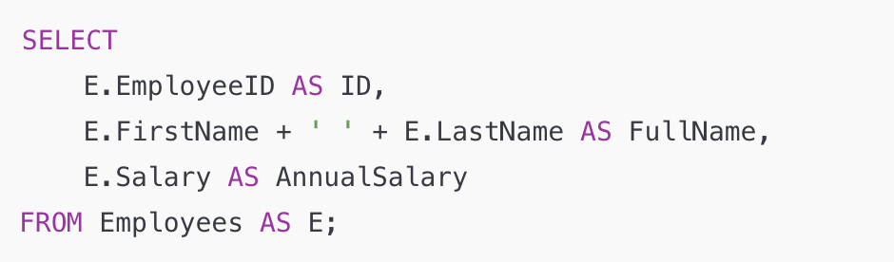
AS Keyword
Used to assign an alias to a column or table to make the query easier to read or to give a temporary name for better understanding.
You cannot use the short cut name in different select statement

Slide 14
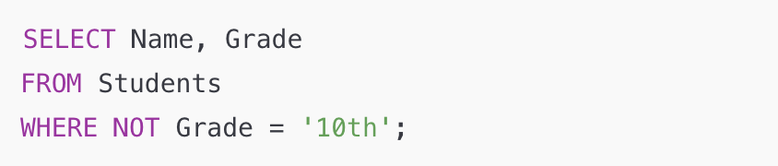
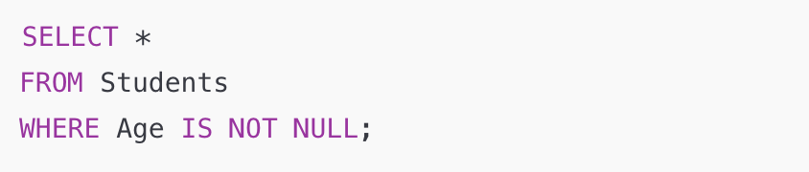
NOT Keyword
Used to reject a condition in a query.

Slide 15
Important to know

Slide 16
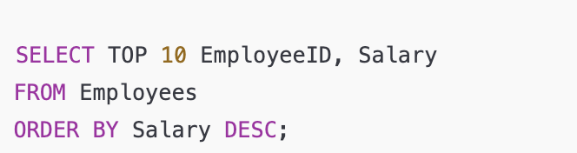
Top ( )
Used to limit the number of rows returned in a result set. You can specify the number of rows to return (e.g., TOP 10).
Return the top 10 highest salaries
Notes:
The WHERE keyword helps filter the data to retrieve only the records that meet specific criteria.

Slide 17
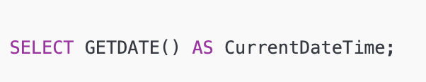
GETDATE ( )
Return current date and time
Notes:
The WHERE keyword helps filter the data to retrieve only the records that meet specific criteria.

Slide 18
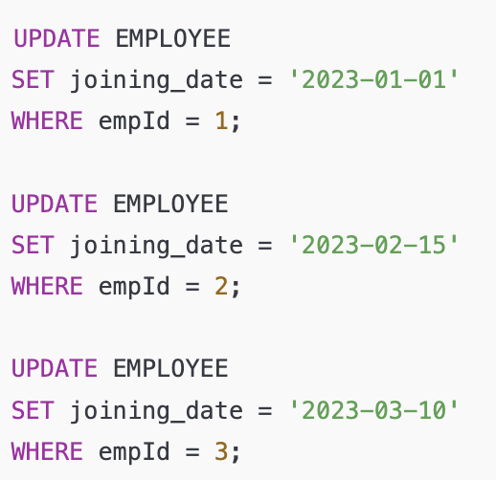
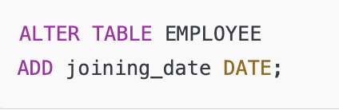
Alter Table

Slide 19
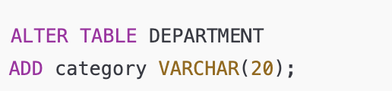
Alter Table
General, General, admin

Slide 20
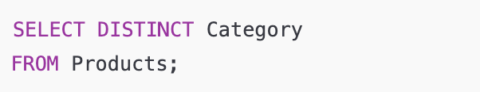
DISTINCT
Used to return unique values in the result set, removing duplicates.
Retrieves unique categories from the Products table.
Notes:
The WHERE keyword helps filter the data to retrieve only the records that meet specific criteria.

Slide 21
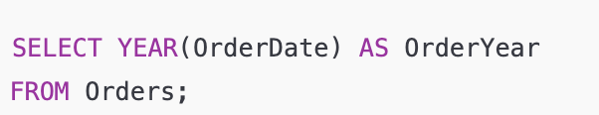
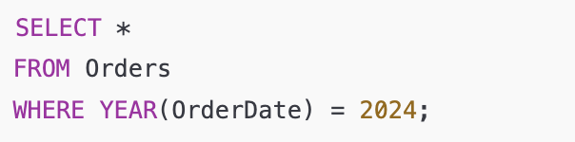
YEAR
Extracts the year from a date value.
Returns the year part of the OrderDate
Get all orders placed in the year 2024.
Notes:
The WHERE keyword helps filter the data to retrieve only the records that meet specific criteria.

Slide 22
CAST
function used to explicitly convert one data type to another.
Notes:
The WHERE keyword helps filter the data to retrieve only the records that meet specific criteria.

Slide 23
Aggregation Functions

Slide 24
Aggregate Functions
select count (*) from employee
select max(salary) from EMPLOYEE
select min(salary) from EMPLOYEE
select avg(salary) from EMPLOYEE
select sum(salary) from EMPLOYEE

Slide 25
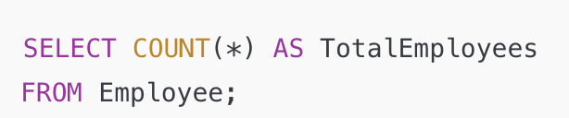
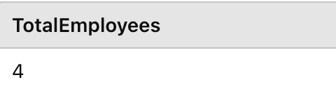
Count (*)
Counts the total number of rows in a table

Slide 26
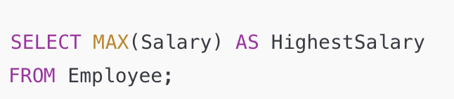
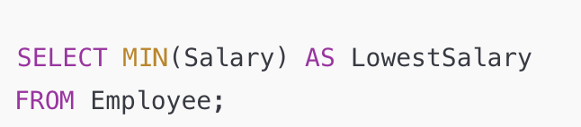
MAX ( )/ MIN ( )
Finds the maximum/Minimum value in a column with numeric column

Slide 27
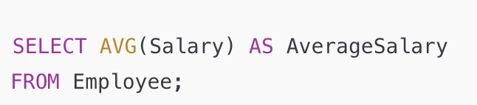
AVG ( )
Calculates the average value of a numeric column

Slide 28
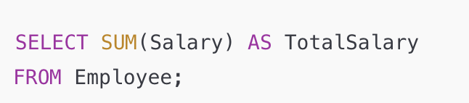
SUM ( )
Adds up all the values in a numeric column
Notes:
I can use more than aggregation function like count and sum

Slide 29
GROUP BY

Slide 30
GROUP BY Statement
Group By used to organize data into groups based on shared values and to apply aggregate functions like SUM, COUNT, AVG, MIN, or MAX on those groups.
It uses the split-apply-combine strategy for data analysis.
Split: The data is split into groups based on some criteria (e.g., categories in a column like "Region" or "Product Type").
Apply: A specific operation or function (e.g., sum, mean, count) is applied independently to each group.
Combine: The results of the applied operation are combined into a new structure

Slide 31
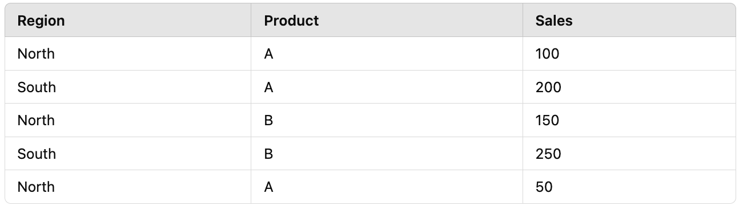
GROUP BY
Sales Table: Group total Sales by Region
Notes:
Split: Group rows based on the Region column.Group 1: North
Group 2: South
Apply: Apply SUM(Sales) to each group.North: 100 + 150 + 50 = 300
South: 200 + 250 = 450
Combine: Combine the results into a summary table

Slide 32
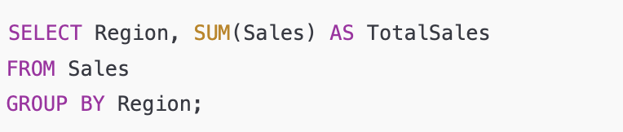
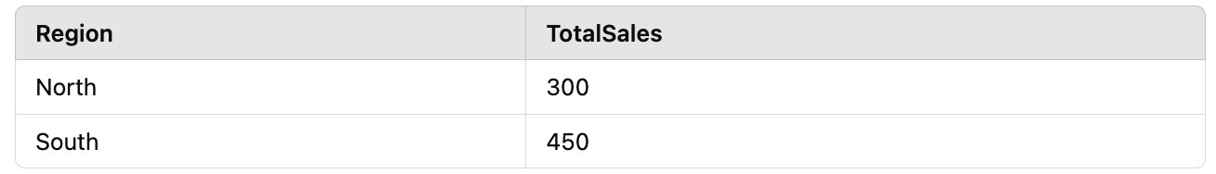
GROUP BY

Slide 33
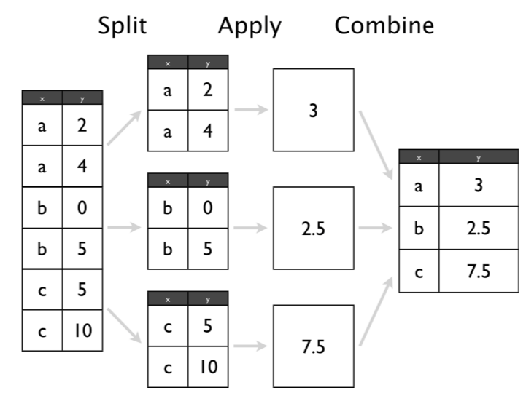

Slide 34
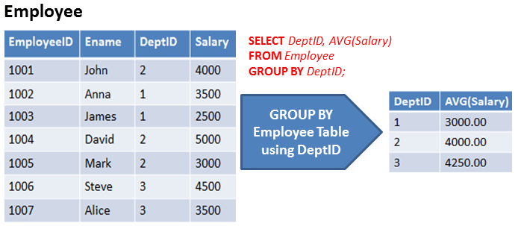
Example

Slide 35
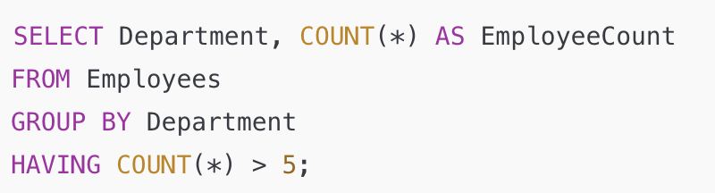
Having Clause
HAVING Clause always utilized in combination with GROUP BY Clause.
After grouping data, you can use HAVING to filter groups based on aggregate results.

Slide 36
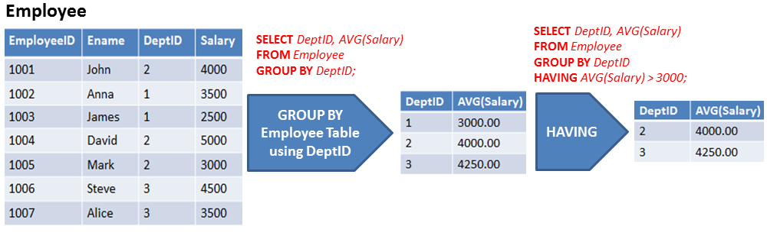
Example

Slide 37
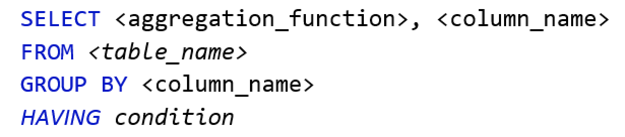
GROUP BY

Slide 38
Points to Remember
GROUP BY Clause is utilized with the SELECT statement.
GROUP BY aggregates the results on the basis of selected column: COUNT, MAX, MIN, SUM, AVG, etc.
GROUP BY returns only one result per group of data.
GROUP BY Clause always follows the WHERE Clause.
GROUP BY Clause always precedes the ORDER BY
GROUP BY Clause use Having Clause to apply a condition

Slide 39
Joins

Slide 40
Joins
Combine rows from two or more tables based on a related column, enabling you to work with data distributed across multiple tables.
INNER JOIN
LEFT JOIN
RIGHT JOIN
FULL JOIN

Slide 41
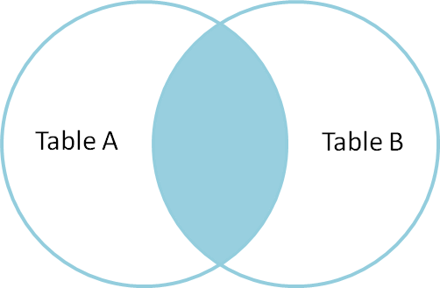
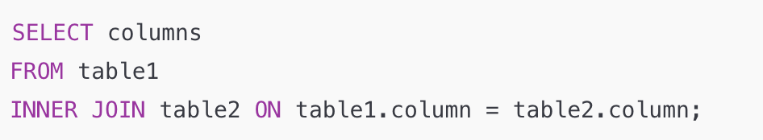
INNER JOIN
Combines rows with matching values in both tables.

Slide 42
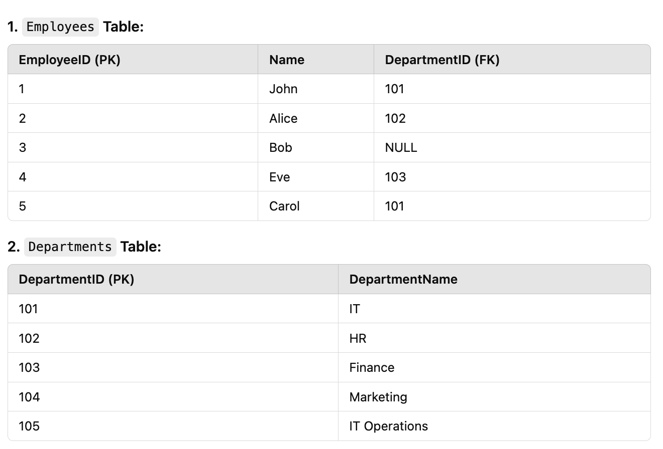

Slide 43
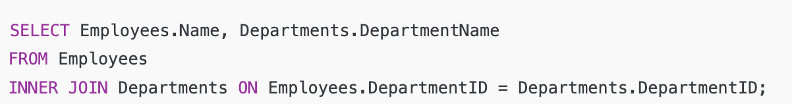
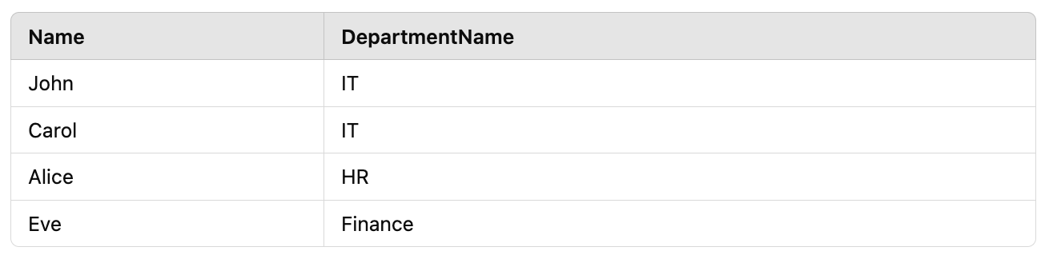
INNER JOIN
Notes:
Explanation: Rows with matching DepartmentID in both tables are returned.
Bob is excluded because DepartmentID is NULL.

Slide 44
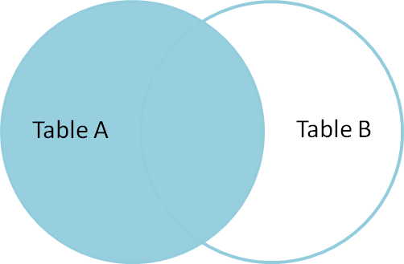
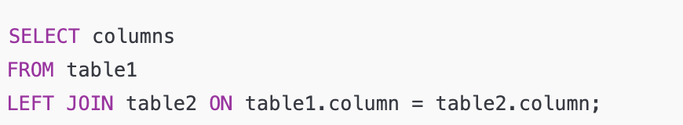
LEFT OUTER JOIN
Includes all rows from the left table and matches from the right table, filling unmatched rows with NULL.

Slide 45
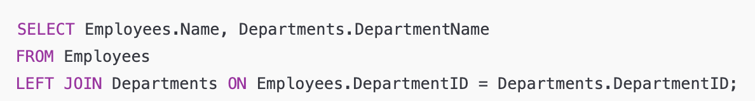
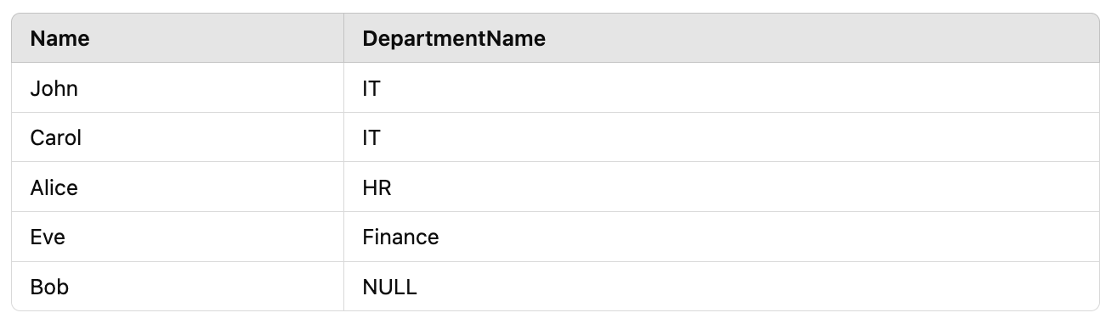
LEFT OUTER JOIN
Notes:
All rows from Employees are included.
Bob has no DepartmentID, so DepartmentName is NULL.

Slide 46
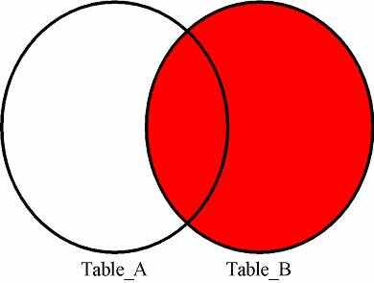
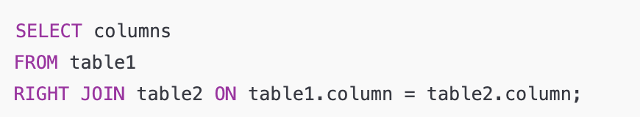
RIGHT OUTER JOIN
Includes all rows from the right table and matches from the left table.

Slide 47
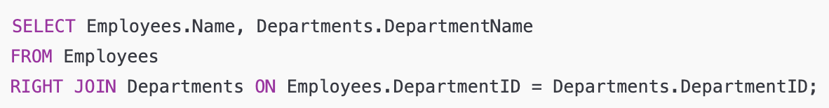

RIGHT OUTER JOIN
Notes:
All rows from Departments are included.
Marketing and IT Operations have no employees, so Name is NULL.

Slide 48


FULL OUTER JOIN
Combines rows when there’s a match in either table, filling unmatched rows with NULL.

Slide 49


FULL OUTER JOIN
Notes:
Combines all rows from both LEFT JOIN and RIGHT JOIN.
Includes unmatched rows from both Employees and Departments tables.

Slide 50

NESTED QUERIES-SUB QUERIES
A query where one join operation is performed inside another, often using subqueries. It involves combining rows from multiple tables in a layered way, where the output of one join serves as input for the next.

Slide 51


NESTED QUERIES
Get Emyplyee names inside IT and HR Department Only

Slide 52

Exercise

Slide 53
Exercise
Q1) Write a query to calculate the total salary paid to employees in each department. Include the department name in the result.

Slide 54
Exercise
Q2) Write a query to display the names of employees, their salaries, and their department names, for employees who earn more than the average salary of all employees. Sort the results by salary in descending order.

Slide 55


Answer Q 1

Slide 56



Answer Q2

Slide 57


Answer Q2

Slide 58
SELECT column list, function(), function(), ...
FROM table1
INNER JOIN table2
...
ON table1.col1 = table2.col2
...
WHERE criteria for row selection
[AND criteria for row selection] [OR criteria for row selection]
GROUP BY column list
HAVING criteria for function results /*not necessarily with group by*/
ORDER BY column list

