Slide 1
QA Online Academy test report
Yousif Hibi

Slide 2
Overview
This report provides a summary of the testing process conducted for the QA Online Academy website. The testing focused on functionality, user experience, and responsiveness across multiple features, identifying critical defects and ensuring the platform meets its requirements.

Slide 3
Test Objectives
Validate core functionalities (Chatbot, Search Bar, Dropdown Menu, Questionnaire, UI responsiveness).
1
Identify and document any defects or usability issues.
2
Ensure the website provides a smooth user experience
3

Slide 4
Test Execution Summary
Test Case | Test Name | Status | Comments
1 | Chatbot functionality | ✅ Pass | No major issues found
2 | Search bar functionality | ✅ Pass | Search feature works as expected
3 | Dropdown Menu | ✅ Pass | All menu items navigate properly
4 | Questionnaire form | ✅ Pass | Form submission is successful

Slide 5
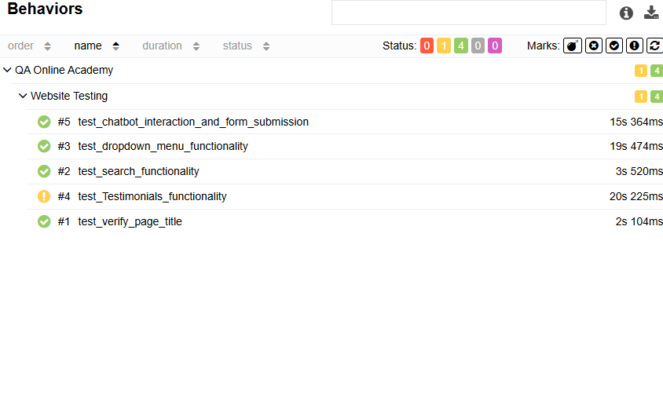
Behaviors

Slide 6
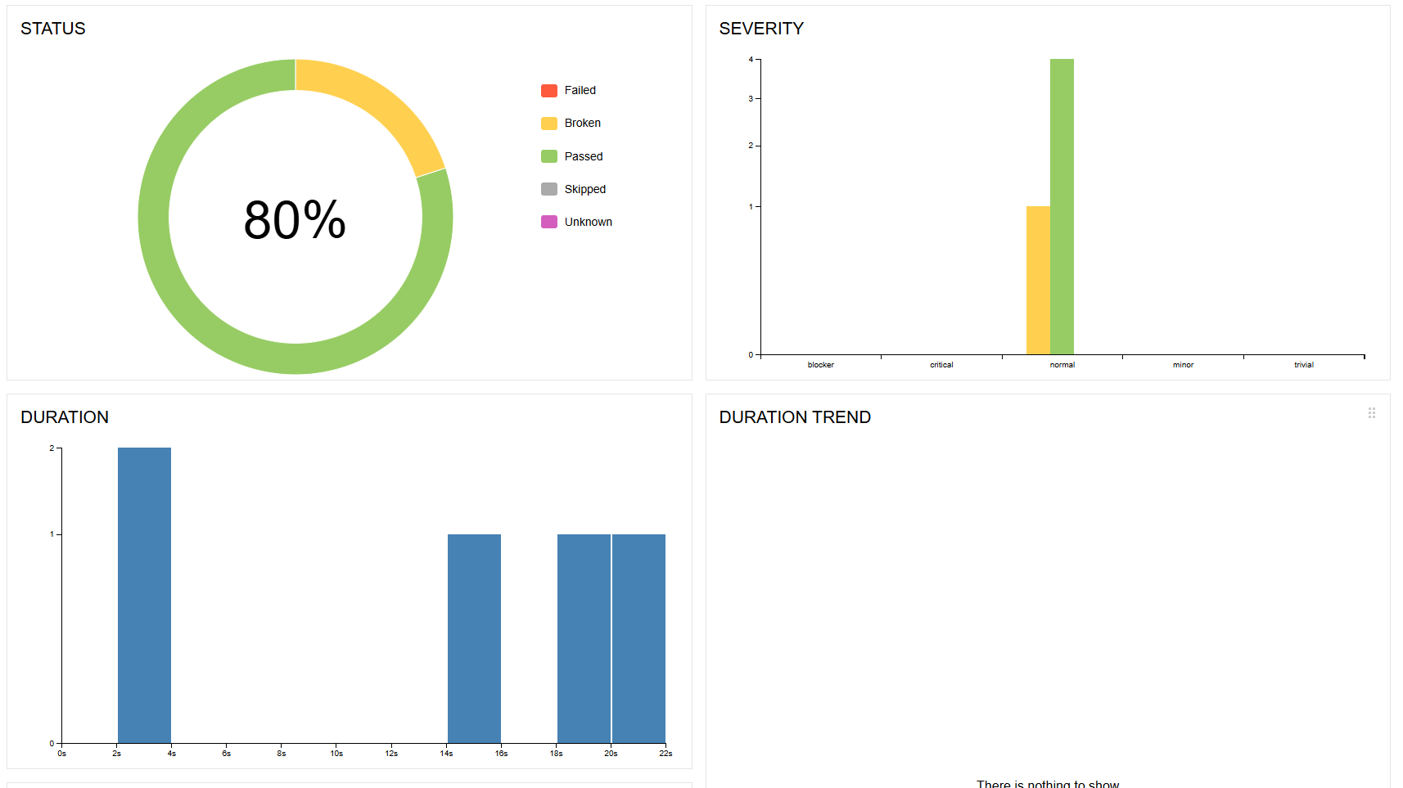
Graphs

Slide 7
Defect Summary
Bug ID | Bug Name | Severity | Status
1 | Course button not working | Low | Open
1 | Course button not working | Low | Open
1 | Course button not working | Low | Open

Slide 8
Recommendations
Fix the chatbot issue so that it responds after the first use.
01
Improve UI responsiveness for different screen sizes.
02
Ensure all buttons in the header are functional.
03

