Slide 1


DATA STRUCTURES MODULE
Dictionaries in Python & Its Functions
Data Structures Module
A comprehensive guide to understanding and using dictionaries in Python programming.
Department of Computer Science
Benazir Bhutto Shaheed Human Resource Research and Development Board (BBSHRRDB) | IMCS, University of Sindh

Slide 2
What is a Dictionary?
Definition & Characteristics
Python Data Structure: Used to store collections of data.
Key-Value Pairs: Data is mapped using a unique key attached to a specific value.
Python Example
Defining a dictionary using curly braces:
student = {"name": "Ali", "age": 20}
Note: Keys in a dictionary must be unique and immutable, providing efficient data retrieval.
Benazir Bhutto Shaheed Human Resource Research and Development Board (BBSHRRDB) | IMCS, University of Sindh

Slide 3
Why Use Dictionaries?
Key Benefits
Meaningful Labels:
Ideal when data requires descriptive names instead of numerical indices.
Structured Data:
Perfect for representing real-world entities (like a user profile).
Code Implementation
Dictionaries use key-value pairs to store information intuitively:
student = {
"name": "Ali",
"age": 20,
"department": "AI"
}
Benazir Bhutto Shaheed Human Resource Research and Development Board (BBSHRRDB) | IMCS, University of Sindh

Slide 4
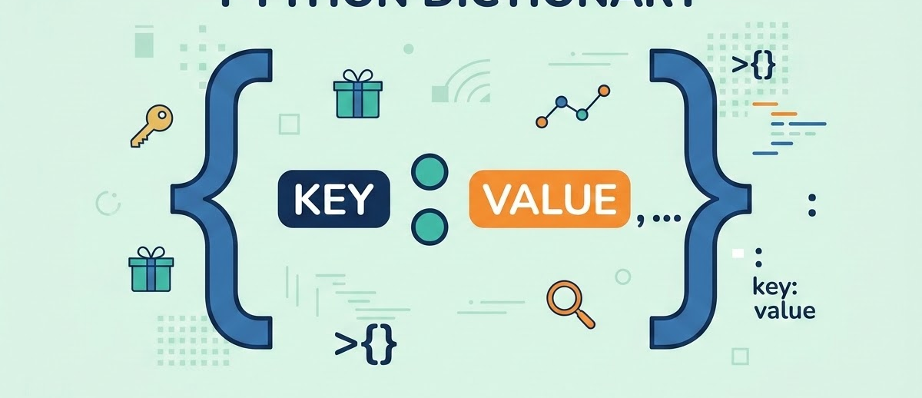
Creating a Dictionary
Syntax & Rules
Core Definition:
Defined using curly brackets {}.
Structure: key: value pairs.
Items are separated by commas.
Python Syntax:
dict_name = { "key": "value" }
Code Showcase
Example Implementation:
car = { "brand": "Toyota", "model": "Corolla", "year": 2020 }
Benazir Bhutto Shaheed Human Resource Research and Development Board (BBSHRRDB) | IMCS, UNIVERSITY OF SINDH

Slide 5
Dictionary Properties
Core Characteristics
Ordered: Items maintain their insertion order (Python 3.7+).
Mutable: Items can be changed, added, or removed.
No Duplicates: Keys must be unique. Duplicate keys overwrite existing values.
Format: Stores data strictly as key-value pairs.
Practical Example
Handling duplicate keys in a dictionary declaration:
data = {"name": "Ahmed", "name": "Ali"}
Result: "name" becomes "Ali"
Benazir Bhutto Shaheed Human Resource Research and Development Board (BBSHRRDB) | IMCS, UNIVERSITY OF SINDH

Slide 6
Accessing Dictionary Values
Method
Values are accessed by referring to their key name inside square brackets [].
Python Code
student = {"name": "Ali", "age": 20}
print(student["name"])
# Output: Ali
Benazir Bhutto Shaheed Human Resource Research and Development Board (BBSHRRDB) | IMCS, University of Sindh

Slide 7

Using get() Function
Concept Explanation
Purpose: Access a value safely.
Benefit: Prevents errors if the key does not exist (returns None instead of crashing).
Python Implementation
student = {"name": "Ali", "age": 20}
print(student.get("name"))
# Output: Ali
Benazir Bhutto Shaheed Human Resource Research and Development Board (BBSHRRDB) | IMCS, University of Sindh

Slide 8
Adding New Items
Methodology
Method: Assign a value to a new index key.
Result: The new key-value pair is appended to the dictionary.
Python Code Example
student = {"name": "Ali", "age": 20}
student["city"] = "Hyderabad"
# Dictionary now includes "city": "Hyderabad"
Benazir Bhutto Shaheed Human Resource Research and Development Board (BBSHRRDB) | IMCS, University of Sindh

Slide 9

Updating Dictionary Values
Concept
Dictionaries are mutable, meaning their content can be changed after creation.
Simply reassign a new value to an existing key using the square bracket [] syntax.
Python Implementation
student = {"name": "Ali", "age": 20}
student["age"] = 21
# The value of 'age' is now updated to 21
Benazir Bhutto Shaheed Human Resource Research and Development Board (BBSHRRDB) | IMCS, UNIVERSITY OF SINDH

Slide 10
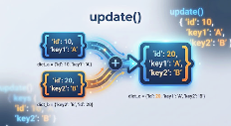
update() Function
Core Behavior
Purpose: Updates the dictionary with items from a given argument.
Mechanism: Replaces values for existing keys or adds new key-value pairs if keys are missing.
Python Syntax Showcase
student = {"name": "Ali", "age": 20}
student.update({"age": 22, "grade": "A"})
# Output: {"name": "Ali", "age": 22, "grade": "A"}
Benazir Bhutto Shaheed Human Resource Research and Development Board (BBSHRRDB) | IMCS, University of Sindh

Slide 11
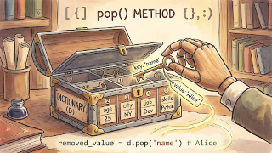
Removing Items Using pop()
Method Definition
Function: pop()
Purpose: Removes a specific item using its key name from a dictionary.
Python Implementation
student = {"name": "Ali", "age": 20}
student.pop("age")
# Result: {"name": "Ali"}
Benazir Bhutto Shaheed Human Resource Research and Development Board (BBSHRRDB) | IMCS, University of Sindh

Slide 12
Removing Last Item Using popitem()
Method Overview
Function: popitem()
Removes the last inserted key-value pair from the dictionary.
Python Implementation
student = {"name": "Ali", "age": 20, "city": "Hyderabad"}
student.popitem()
# Result: "city" key-value pair is removed.
Benazir Bhutto Shaheed Human Resource Research and Development Board (BBSHRRDB) | IMCS, UNIVERSITY OF SINDH

Slide 13
Using del Keyword
Keyword: del
Removes a specific item from a dictionary.
Deletes the entire dictionary object from memory.
Python Code Implementation
student = {"name": "Ali", "age": 20}
del student["age"] # Removes 'age'
del student # Deletes entire dictionary
Benazir Bhutto Shaheed Human Resource Research and Development Board (BBSHRRDB) | IMCS, University of Sindh

Slide 14

clear() Function
Function Details
Function: clear()
Purpose: Empties the dictionary completely.
Result: Dictionary exists, but contains no items {}.
Python Implementation
student = {"name": "Ali", "age": 20}
student.clear()
# Result: {}
Benazir Bhutto Shaheed Human Resource Research and Development Board (BBSHRRDB) | IMCS, UNIVERSITY OF SINDH

Slide 15
keys() Function
Retrieving Keys
Function: keys()
Purpose: Returns a view object containing all the keys from the dictionary.
Python Code Example
student = {"name": "Ali", "age": 20}
print(student.keys())
# Output: dict_keys(['name', 'age'])
Benazir Bhutto Shaheed Human Resource Research and Development Board (BBSHRRDB) | IMCS, University of Sindh

Slide 16
values() Function
Function: values()
Returns a view object containing all the values from the dictionary.
The values() method is essential for iterating over data stored in dictionaries when keys are not required.
Python Implementation
student = {"name": "Ali", "age": 20}
print(student.values())
# Output: dict_values(['Ali', 20])
Benazir Bhutto Shaheed Human Resource Research and Development Board (BBSHRRDB) | IMCS, University of Sindh

Slide 17

items() Function
Function: items()
Purpose:
Returns a view object containing all key-value pairs as tuples in a list. This allows for easy iteration over dictionary entries.
Visual Map:
The items() method effectively maps dictionary keys to their values within discrete tuple structures.
Python Code Example
student = {"name": "Ali", "age": 20}
print(student.items())
# Output: dict_items([('name', 'Ali'), ('age', 20)])
Benazir Bhutto Shaheed Human Resource Research and Development Board (BBSHRRDB) | IMCS, UNIVERSITY OF SINDH

Slide 18
Looping Through Dictionary Keys
Concept & Default Behavior
Use a for loop to iterate over the dictionary.
Looping directly on the dictionary returns its keys.
Python Implementation
student = {"name": "Ali", "age": 20}
for x in student:
print(x)
# Output: name, age
Benazir Bhutto Shaheed Human Resource Research and Development Board (BBSHRRDB) | IMCS, UNIVERSITY OF SINDH

Slide 19
Looping Through Values
Concept
Combine a for loop with the values() function.
Iterates only through the data values within the dictionary.
Python Code Example
student = {"name": "Ali", "age": 20}
for x in student.values():
print(x)
# Output: Ali, 20
Benazir Bhutto Shaheed Human Resource Research and Development Board (BBSHRRDB) | IMCS, University of Sindh

Slide 20

Looping Through Key-Value Pairs
Concept Overview
Use the items() function to loop through keys and values simultaneously.
Requires two variables defined in the loop header (e.g., k and v).
Python Implementation
student = {"name": "Ali", "age": 20}
for k, v in student.items():
print(k, v)
# Output: name Ali, age 20
Benazir Bhutto Shaheed Human Resource Research and Development Board (BBSHRRDB) | IMCS, University of Sindh

Slide 21
Checking Key in Dictionary
Membership Operator Concept
Keyword: in
Purpose: Checks whether a specific key exists within the dictionary.
Returns: Boolean (True/False).
Python Implementation
student = {"name": "Ali", "age": 20}
if "name" in student:
print("Key exists!")
Benazir Bhutto Shaheed Human Resource Research and Development Board (BBSHRRDB) | IMCS, University of Sindh

Slide 22
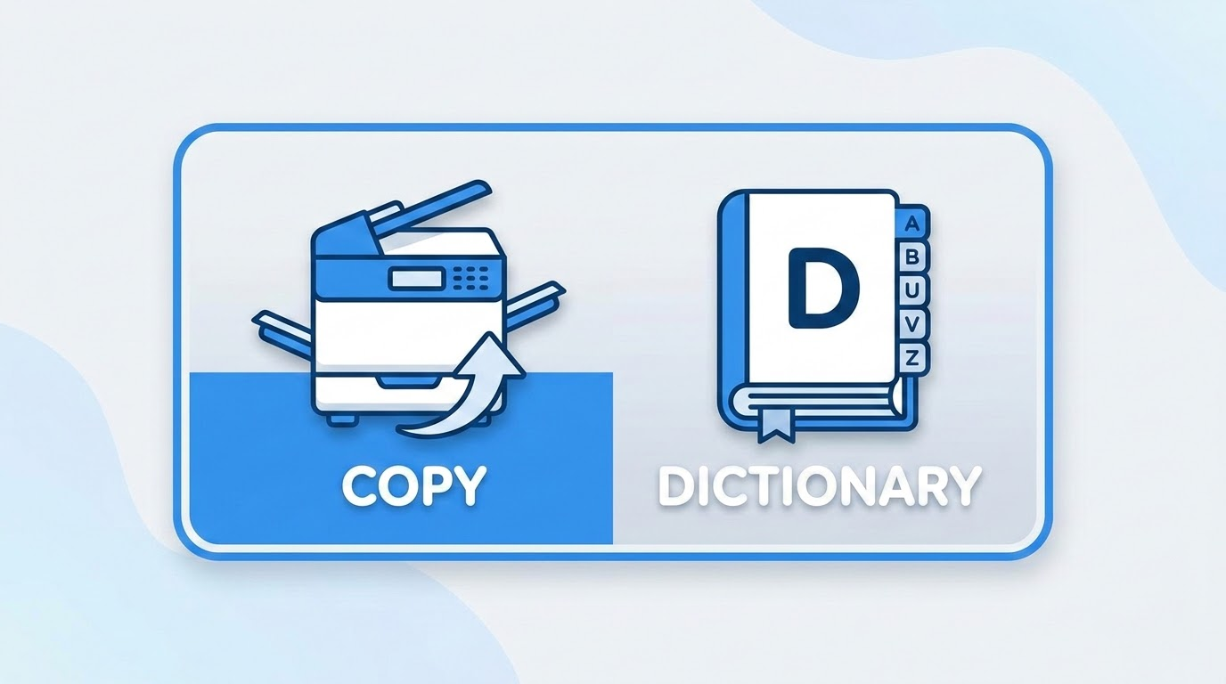
copy() Function
Purpose & Logic
Creates an independent copy of a dictionary.
Note: Simply using dict2 = dict1 only creates a reference (shallow link), not a true copy.
Independent Reproduction
Python Implementation
student = {"name": "Ali", "age": 20}
new_student = student.copy()
Deep vs. Shallow: The .copy() method ensures that changes to the new dictionary do not affect the original.
Benazir Bhutto Shaheed Human Resource Research and Development Board (BBSHRRDB) | IMCS, University of Sindh

Slide 23

Nested Dictionary
Python Implementation
Storing complex, hierarchical data efficiently.
students = {
"student1": {
"name": "Ali", "age": 20
},
"student2": {
"name": "Sara", "age": 21
}
}
# Hierarchical data access: students["student1"]["name"]
Concept: A dictionary that contains other dictionaries as its values.
Benazir Bhutto Shaheed Human Resource Research and Development Board (BBSHRRDB) | IMCS, University of Sindh

Slide 24

Practical Example
Student Profile Data
Using a dictionary to store a comprehensive student profile.
Python Code:
student = {
"name": "Yousif",
"age": 21,
"department": "Artificial Intelligence"
}
print(f"Profile: {student['name']}, {student['department']}")
Benazir Bhutto Shaheed Human Resource Research and Development Board (BBSHRRDB) | IMCS, University of Sindh

Slide 25
Dictionary Summary
Structure
Core Structure:
Stores data in key: value pairs.
Properties:
Mutable
Ordered (Python 3.7+)
Keys must be unique
Access Methods
Ways to retrieve data from a dictionary:
Square Brackets:
dict['key']
Function:
dict.get('key')
Note: get() returns None instead of an error if the key is missing.
Key Functions
Modifying:
update(), pop(), popitem(), clear()
Viewing/Utility:
keys(), values(), items(), copy()
Benazir Bhutto Shaheed Human Resource Research and Development Board (BBSHRRDB) | IMCS, University of Sindh

