Slide 1


PYTHON PROGRAMMING COURSE
Inheritance & Polymorphism
in Python
PRESENTED BY
DATE OF SESSION
Muhammd Yousif Memon
July 2026

Slide 2

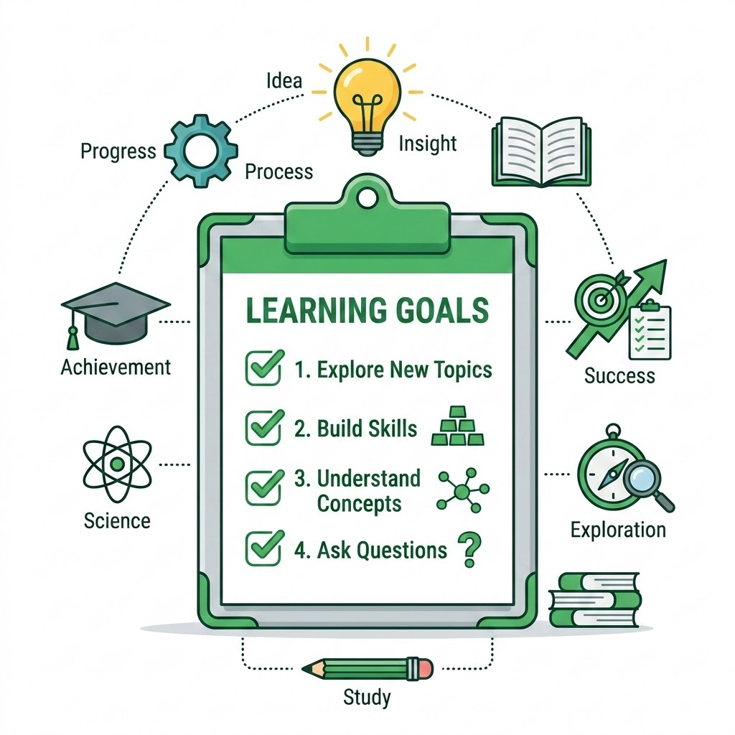
Mastering Code Reusability and Flexibility
By the end of this session, you will be able to:
Understand the concept of Inheritance in Python
Implement Single and Multiple Inheritance
Grasp the concept of Polymorphism
Apply Method Overriding and Duck Typing
Recognize real-world applications in robotics and automation
Python Programming Course | Inheritance & Polymorphism

Slide 3
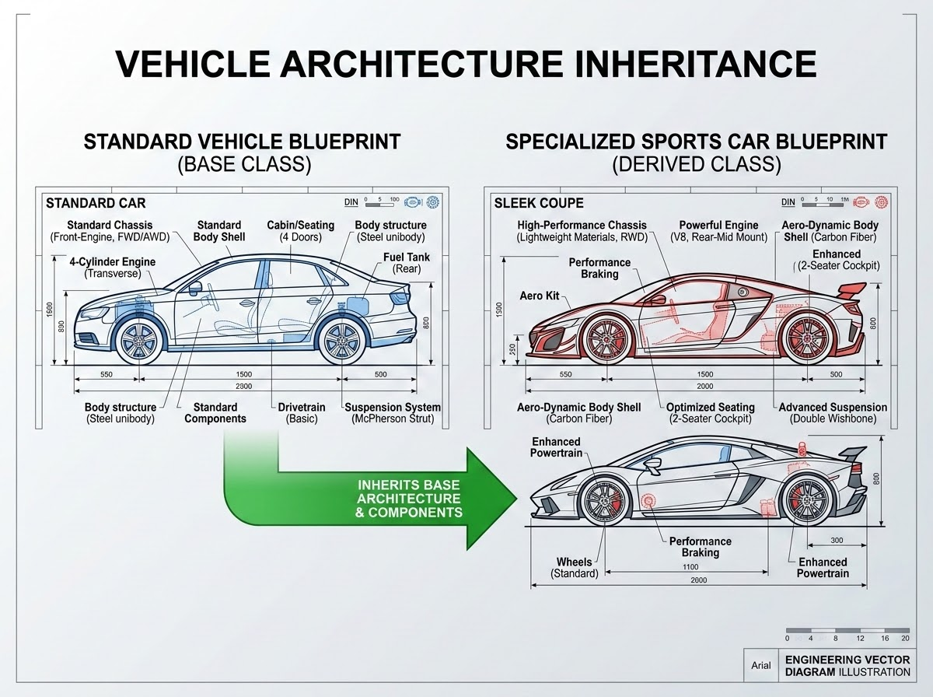
Parent-Child Relationships
THE BLUEPRINT
General Concept: Imagine a general blueprint for a vehicle. It defines core characteristics like wheels, an engine, and doors that all standard vehicles share.
THE SPECIALIZED VERSION
Inherited Context: A sports car inherits these basic vehicle features but adds unique, specialized elements like an aerodynamic spoiler or a high-performance engine.
CODE APPLICATION (OOP)
Parent & Child Classes: In OOP, the general blueprint is the Parent (Base) class, and the specialized version is the Child (Derived) class. The child automatically inherits common code to maximize reuse.
Vehicle Architecture & Inheritance Concept Diagram
Object-Oriented Programming in Python | Parent-Child Relationships

Slide 4
Python Programming Course | Inheritance & Polymorphism
Syntax and Mechanics of Base & Derived Classes
CODE SNIPPET
EXPLANATION
class Animal: # Base Class
def speak(self):
print("Animal sound")
class Dog(Animal): # Derived Class inheriting from Animal
def bark(self):
print("Woof!")
my_dog = Dog()
my_dog.speak() # Inherited method
my_dog.bark() # Specific method
Class Hierarchies
Base Class (Parent)
The class whose properties and methods are inherited.
Derived Class (Child)
The class that inherits from the base class.

Slide 5
Creating Specialized Child Classes
PYTHON CODE
SINGLE INHERITANCE
class Sensor:
def __init__(self, name):
self.name = name
def read_data(self):
pass
class TemperatureSensor(Sensor):
def read_data(self):
return 25.5 # Simulated reading
Single inheritance involves one child class inheriting from exactly one parent class.
Simplicity: It's the most straightforward form of inheritance.
Clear Hierarchy: Creates a direct, linear relationship.
Code Reusability: Promotes reusing the parent's logic without duplication.
Python Programming Course | Inheritance & Polymorphism

Slide 6
Multiple Inheritance & MRO
MULTIPLE INHERITANCE SYNTAX
METHOD RESOLUTION ORDER (MRO)
class Camera:
def take_picture(self): pass
class Lidar:
def scan(self): pass
class AdvancedRover(Camera, Lidar):
pass
# AdvancedRover inherits both take_picture and scan
Single vs. Multiple: Single inheritance maps one child to one parent class. Multiple inheritance allows a subclass to derive from multiple parent classes simultaneously.
Conflict Management: If multiple parent classes declare a method with the exact same name, Python must decide which base implementation to execute.
The Search Order: Python relies on the Method Resolution Order (MRO), scanning classes from left-to-right as specified in the class definition.
Python Programming Course | Inheritance & Polymorphism

Slide 7
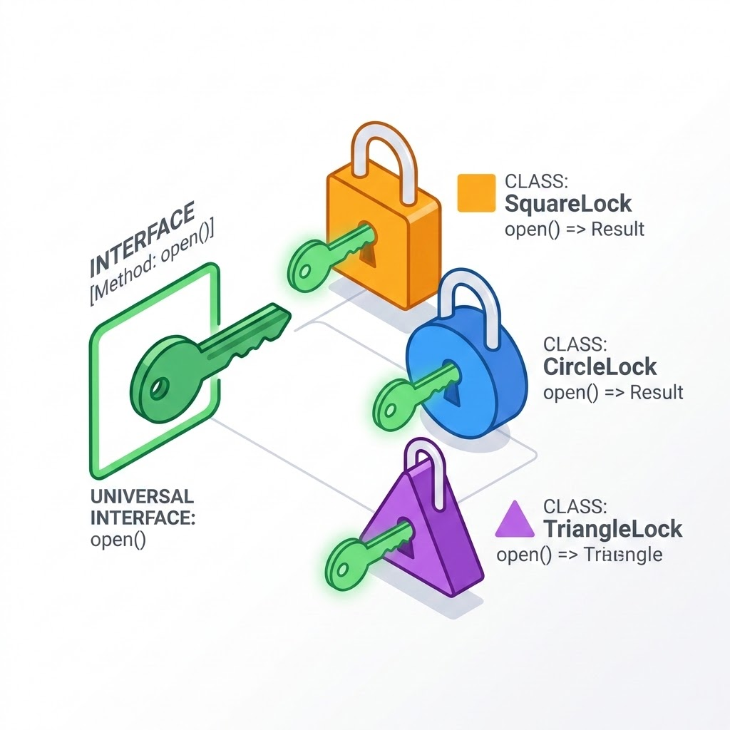
The Concept of Multiple Forms
KEY CONCEPTS
CONCEPT VISUALIZATION
Definition: Polymorphism means "many forms." In programming, it refers to the ability of different objects to respond to the same method call in their own specific way.
Flexibility: It allows us to write more generic code that can handle different types of objects without needing to know their exact class.
Key Idea: A single interface can represent different underlying forms (data types or classes).
Python Programming Course | Inheritance & Polymorphism

Slide 8
Polymorphism in Practice: Method Overriding and Duck Typing
PYTHON CODE SNIPPETS
CONCEPTUAL EXPLANATION
# Method Overriding Example
class Bird:
def fly(self): print("Flying")
class Penguin(Bird):
def fly(self): print("Cannot fly")
# Duck Typing Example
def make_it_fly(entity):
entity.fly() # Works as long as fly() exists
Method Overriding
A child class provides a specific implementation for a method that is already defined in its parent class. This redefines inheritance behavior on-demand.
Duck Typing
"If it walks like a duck and quacks like a duck, it must be a duck." Python prioritizes whether an object exhibits a specific capability over its literal class type.
Developer Takeaway
Focus on object interface capability over concrete class types. Coding to interfaces rather than explicit types decouples codebase architecture and enhances scalability.
Python Programming Course | Inheritance & Polymorphism

Slide 9
Inheritance in Robotic Arm Controllers
RoboticJoint (Base)
ElbowJoint (Derived)
WristJoint (Derived)
PROPERTIES id, current_angle
METHODS move_to_angle(angle)
INHERITS Movement logic
SPECIFIC CONSTRAINTS Elbow range of motion limits
INHERITS Movement logic
SPECIFIC CONSTRAINTS Wrist rotation range limits
ENGINEERING BENEFITS OF INHERITANCE
Common movement logic is written once in RoboticJoint, while specific joint constraints (range limits and degrees of freedom) are handled gracefully within the derived subclasses.
Python Programming Course | Inheritance & Polymorphism

Slide 10
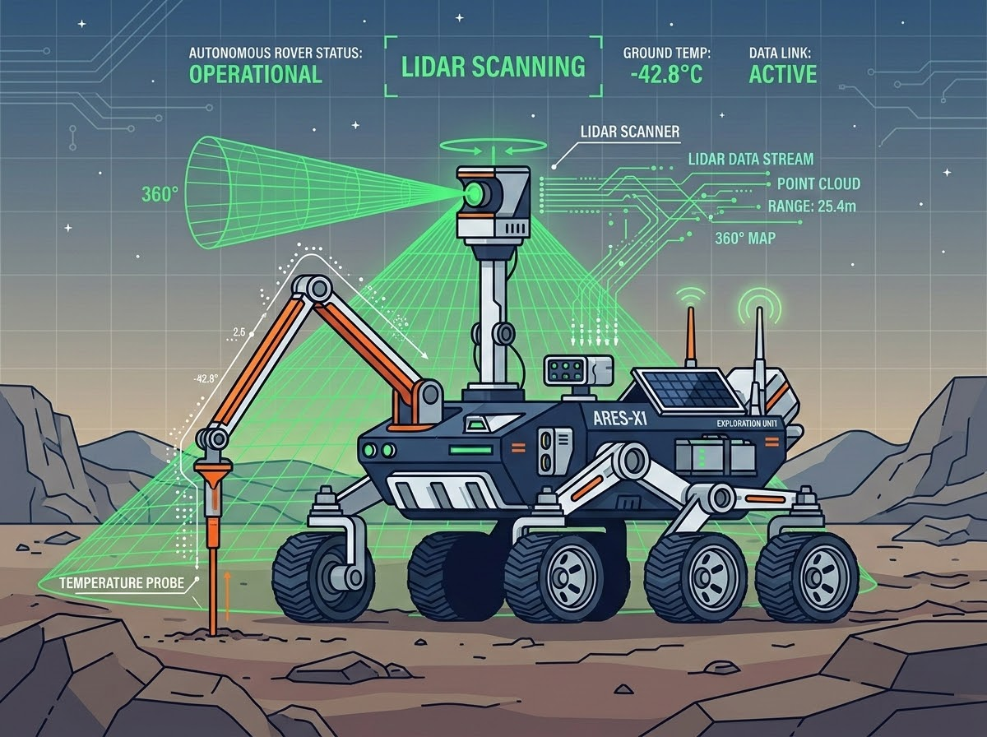
Polymorphism in Automated Sensor Systems
SYSTEM SCENARIO
ROVER SENSOR SUITE SCAN PATTERN
Scenario: An autonomous rover reading data from multiple, different sensors.
POLYMORPHIC INTERFACE
Unified Method: All sensor classes implement a common get_reading() method.
LidarSensor.get_reading() → Returns a point cloud array.
TemperatureSensor.get_reading() → Returns a float value.
SYSTEM EXECUTION
Execution: The main control loop can iterate through a list of generic sensor objects and call get_reading() on each, regardless of their specific type.
Python Programming Course | Inheritance & Polymorphism

Slide 11
Safe Object-Oriented Design in Python
DESIGN PRINCIPLE
INITIALIZATION
Favor Composition Over Inheritance
If a relationship is "has-a" rather than "is-a", use composition (including objects as attributes) instead of inheritance.
Use super() Correctly
Always use super() to call parent class methods to ensure proper initialization and method resolution.
INHERITANCE WARNINGS & ANTI-PATTERNS
Keep Inheritance Trees Shallow: Deep inheritance hierarchies become extremely difficult to manage, reason about, and understand.
Beware of Multiple Inheritance: It can lead to complex method resolution order (MRO) issues, specifically the Diamond Problem. Use it sparingly and prefer Mixins if necessary.
Python Development Essentials | Object-Oriented Programming

Slide 12
Summary, Questions, and What's Next
Inheritance: We covered reusing code via parent/child relationships to structure our applications efficiently.
Classroom Q&A
Thank You.
The classroom is now open for your questions, feedback, and discussion.
Polymorphism: We explored dynamic flexibility achieved through implementing multiple forms and duck typing.
Next Steps
Applying these concepts to build robust hardware control interfaces.
Python Programming Course | Inheritance & Polymorphism

