Slide 1
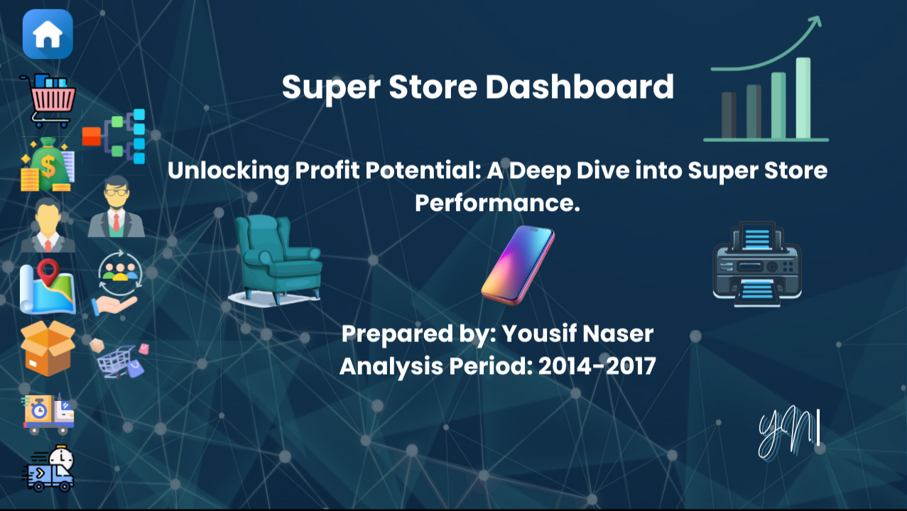

Slide 2

Business Problem
The Challenge:
The company had access to sales data but lacked:
Clear visibility into profit drivers.
Understanding of loss-making products.
A unified analytical view for decision-makers.
Objective:
Analyze sales and profitability performance.
Identify growth drivers and risk areas.
Support data-driven business decisions.

Slide 3

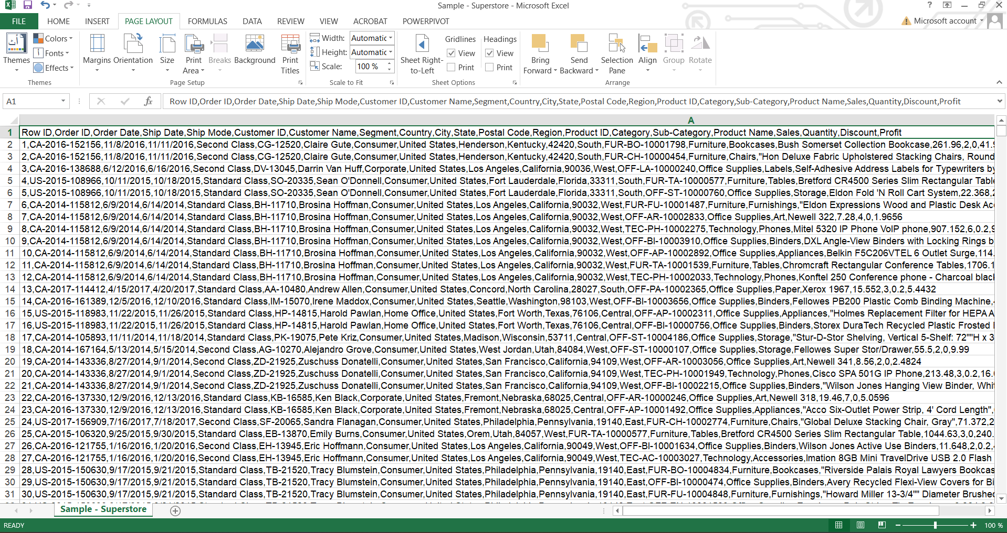
Raw Data Source – Excel
Raw transactional sales data.
No calculated metrics.
Not analysis-ready.
This data represents raw business transactions before any transformation or analysis.

Slide 4
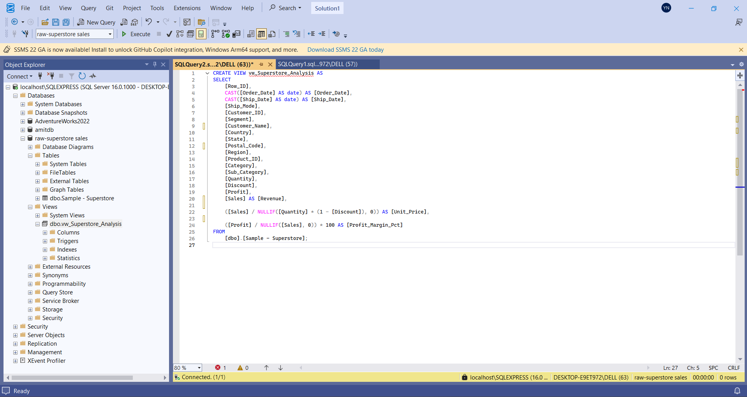
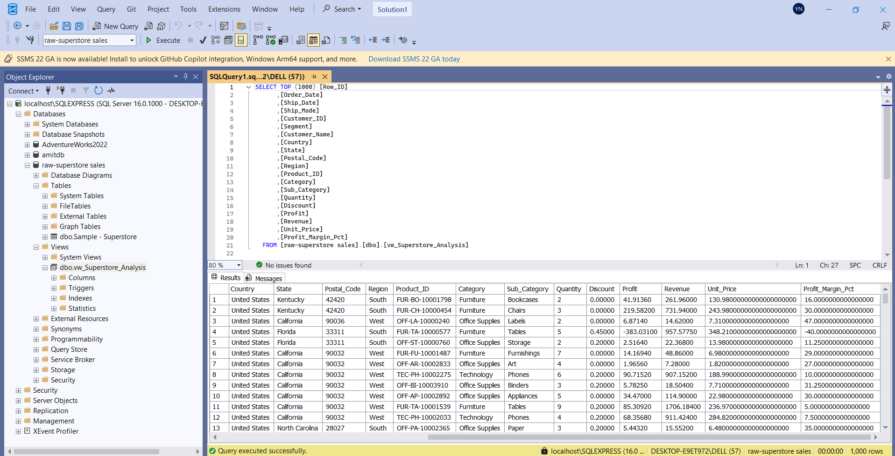
Data Transformation – SQL Server
Data imported into SQL Server.
Analytical SQL View created.
Business logic handled at database level.
Metrics calculated in SQL:
Revenue.
Unit Price.
Profit Margin %
Data transformation was handled in SQL to ensure consistency, scalability, and better Power BI performance.

Slide 5
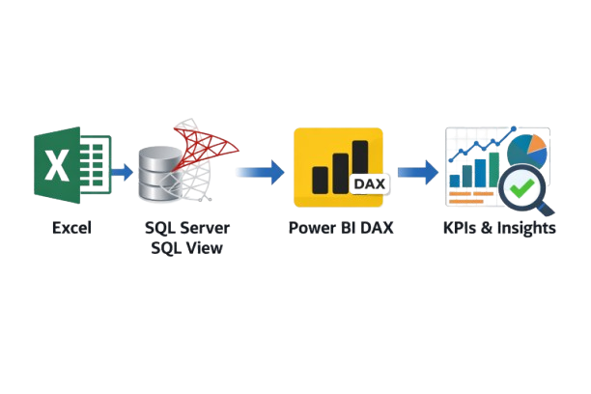
End-to-End BI Pipeline
Separation between data preparation and visualization improves performance and maintainability.

Slide 6

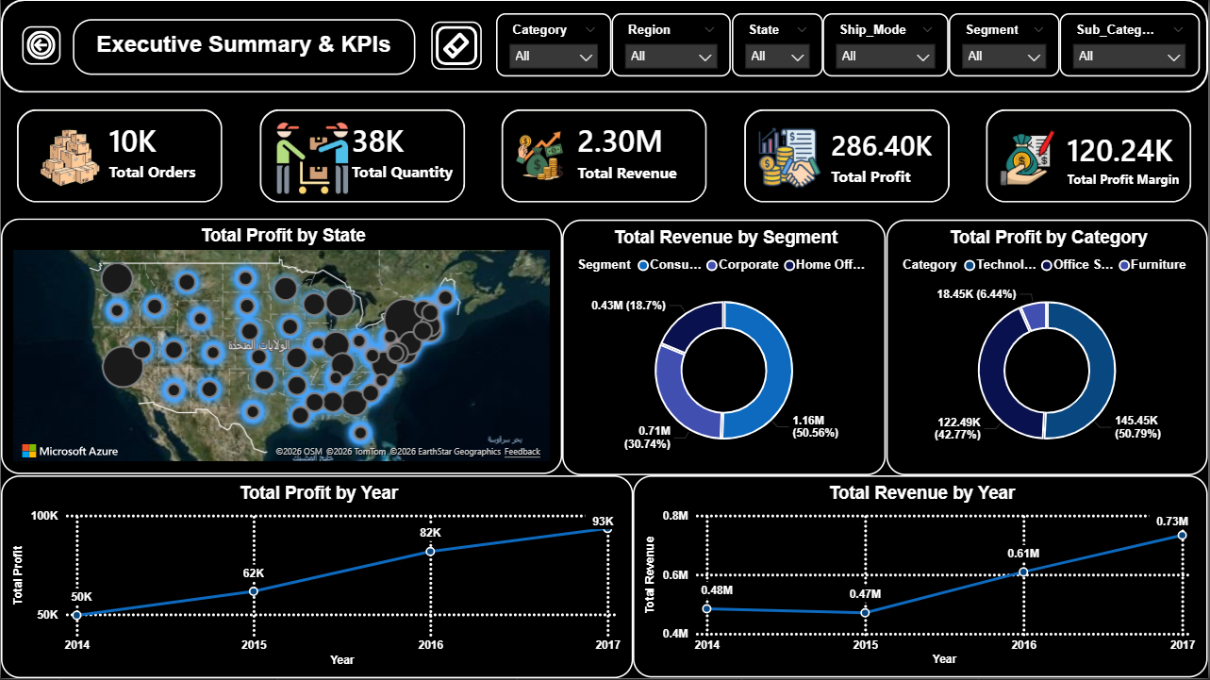
Executive Overview
Key KPIs:
Total Orders: ~10K.
Total Revenue: 2.3M.
Total Profit: 286K.
Average Profit per Order.
Analysis:
Revenue shows steady upward trend.
Profit is more volatile compared to revenue.
Strong improvement after 2015.
Insight:
Overall business shows positive growth.
Profit growth is not always aligned with revenue growth.
Growth exists, but profitability stability requires deeper analysis.

Slide 7

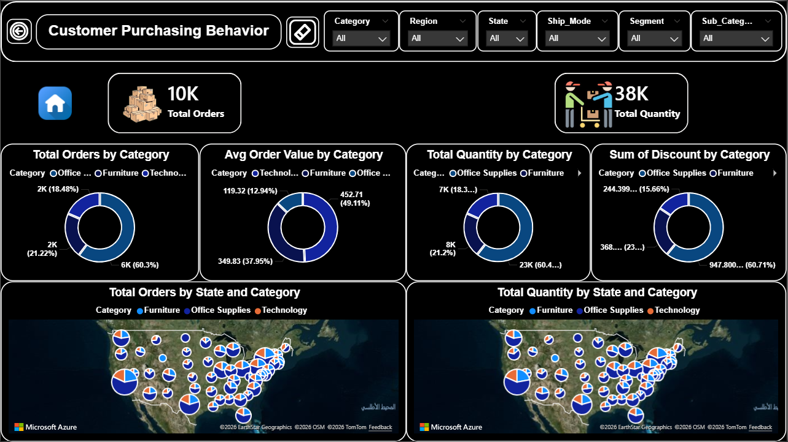
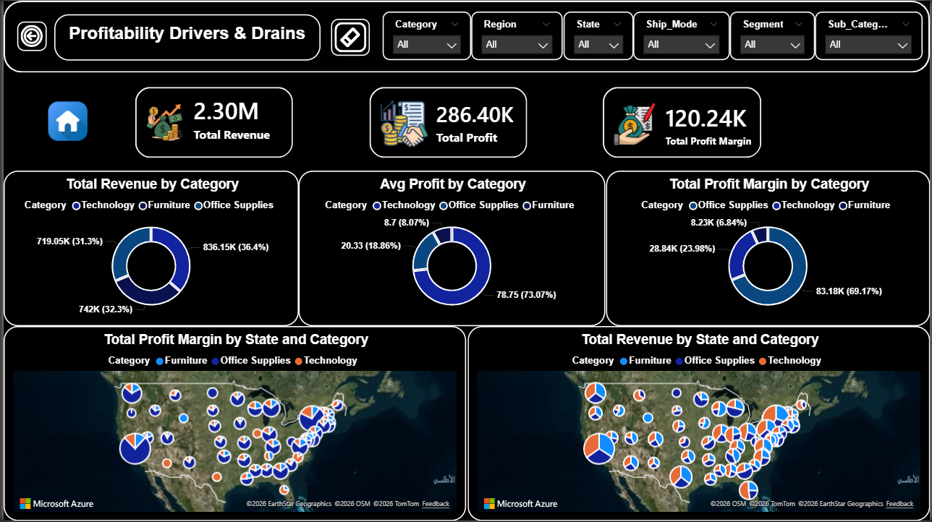
Category Performance
What we analyzed ?
Sales and profit distribution by category.
Key Findings:
Technology is the highest profit contributor.
Office Supplies has high volume with stable margins.
Furniture shows weaker profitability despite strong sales.
Insight:
High sales volume ≠ High profit.

Slide 8

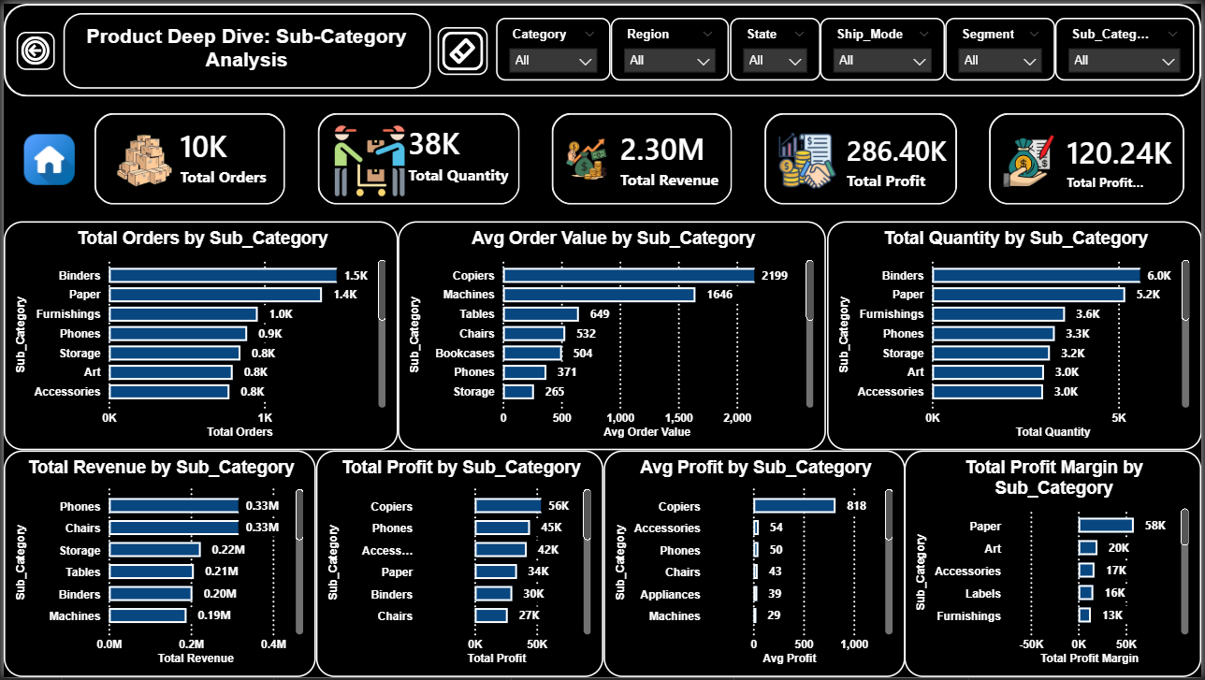
Sub-Category Deep Dive
Product-Level Analysis:
Copiers and Phones generate strong profit.
Tables and Furnishings show low or negative margins.
Some high-volume products are loss-making.
Business Value:
Identifies products that need pricing or discount review.

Slide 9
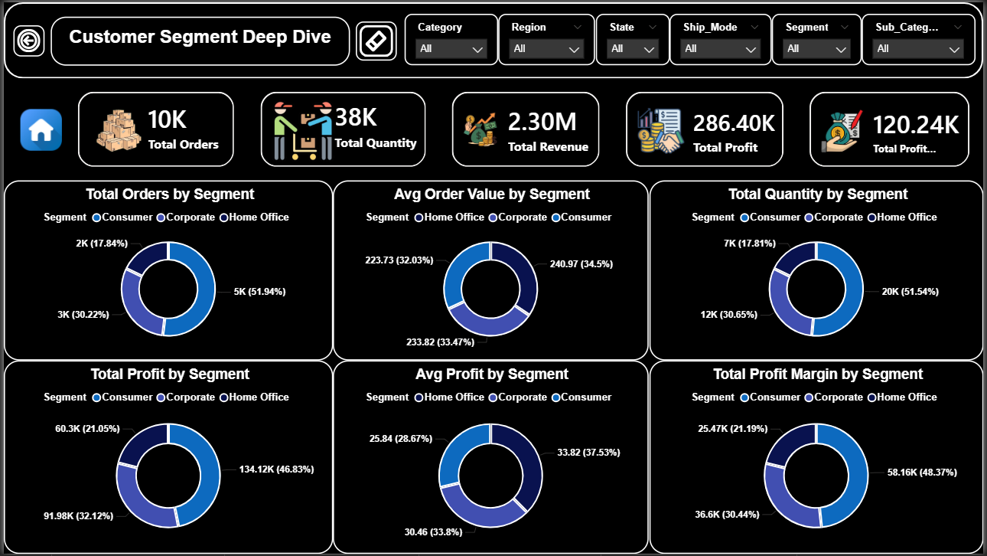
Customer Segment Analysis
Segment Insights:
Consumer segment drives most revenue.
Corporate segment shows higher average order value.
Home Office is smaller but relatively profitable.
Conclusion:
Different customer segments require different pricing strategies.

Slide 10
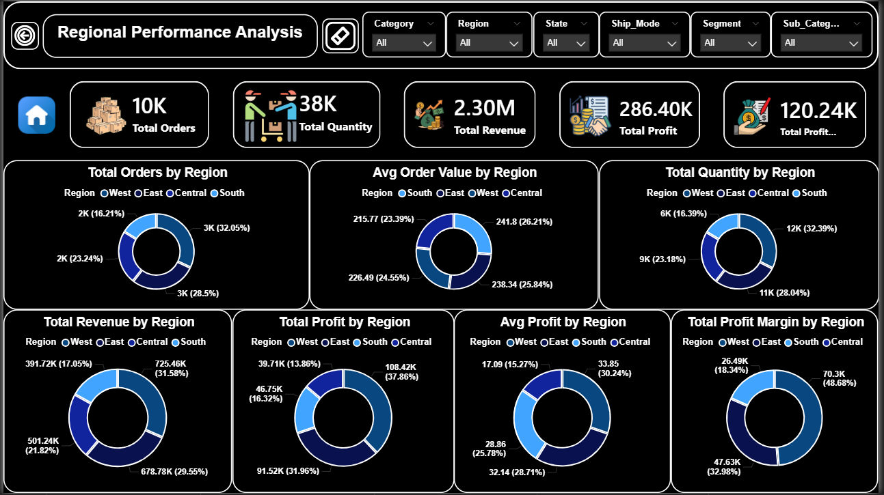
Regional Performance
Geographic Insights:
West & East regions lead in revenue.
Central region shows margin pressure.
South region has growth potential.
Insight:
Profitability varies significantly by region.

Slide 11
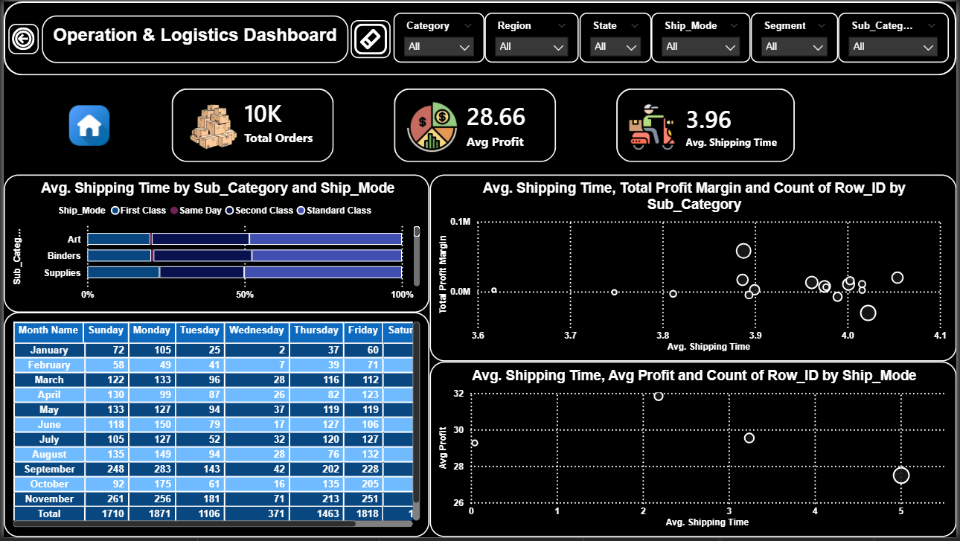
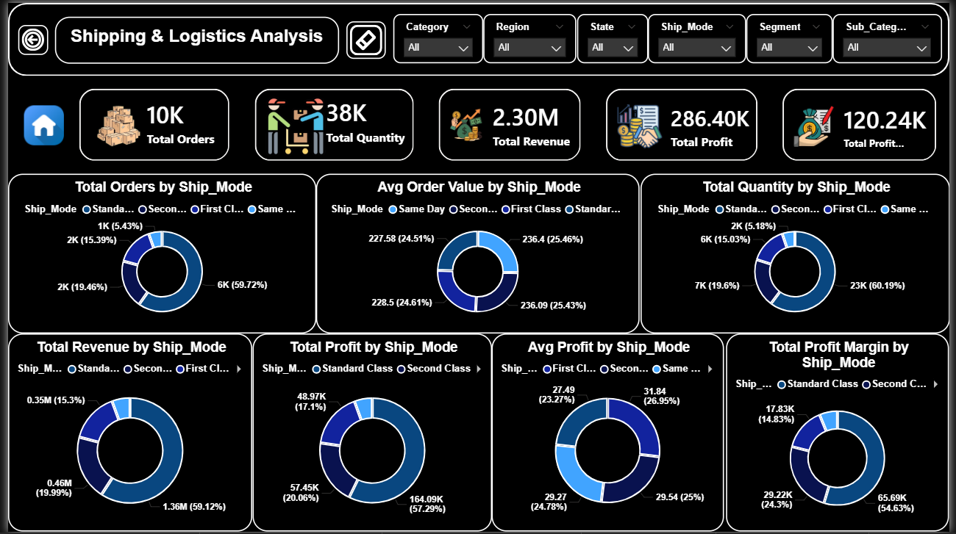
Shipping & Operations
Operational Analysis:
Standard Class dominates order volume.
Faster shipping does not guarantee higher profit.
Average shipping time ≈ 3.96 days.
Operational Impact:
Shipping decisions directly affect margins.

Slide 12

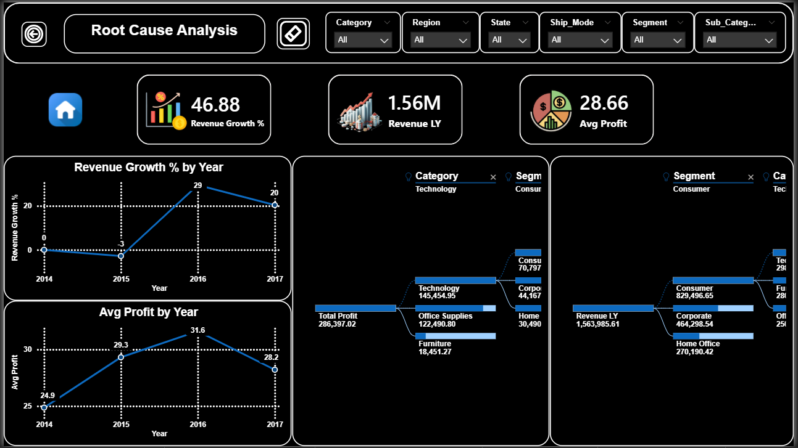
Orders & Profit Behavior
Behavioral Insights:
Order volume increased year over year.
Average profit per order fluctuates.
Growth driven more by volume than value.
Key Takeaway:
Discount-driven growth may harm profitability.

Slide 13
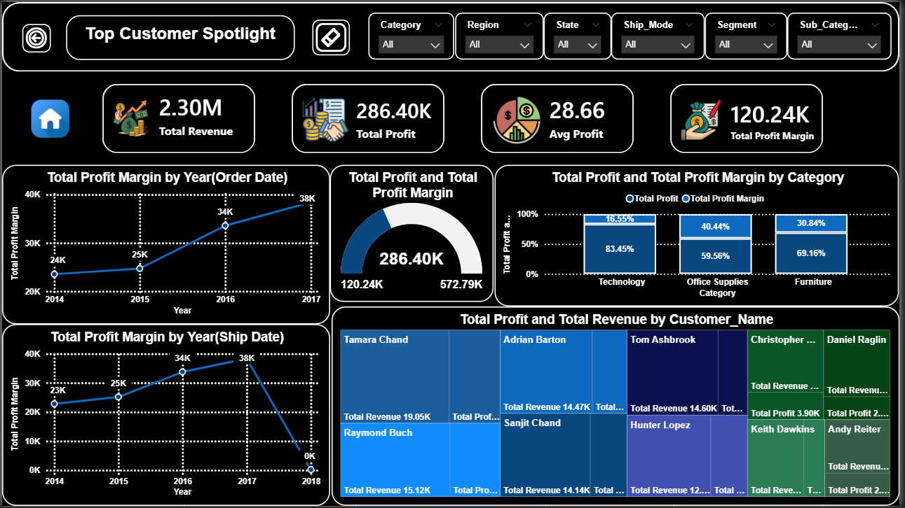
Customer Deep Dive
Customer Concentration:
A small group of customers contributes a large share of profit.
Top customers are critical to overall performance.
Opportunity:
Loyalty programs.
Key account management.

Slide 14
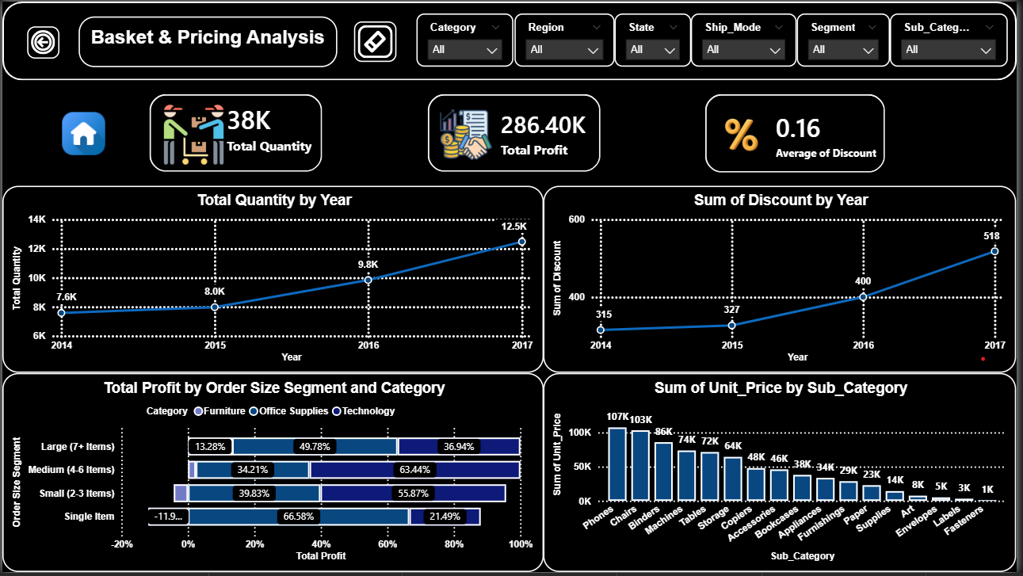
Discount & Pricing Impact
Pricing Insights:
Average discount ≈ 16%.
Higher discounts increase order volume.
Excessive discounts reduce profit margins.
Insight:
Discount optimization is a major profit lever.

Slide 15
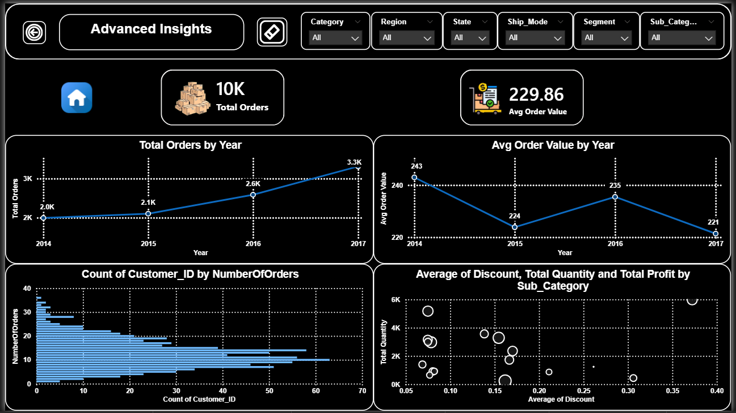
Basket Size & Order Value
Order Value Analysis:
Medium and large baskets generate higher profit.
Single-item orders are less profitable.
Opportunity:
Bundling strategies can increase profitability.

Slide 16

Advanced Insights Summary
What drives performance?
Technology category.
Consumer segment.
Medium-to-large basket sizes.
What hurts performance?
High discounts.
Low-margin furniture products.
Inefficient shipping choices.

Slide 17

Business Recommendations
Strategic Actions:
Optimize discount policies by category.
Focus on high-margin products.
Revisit pricing for loss-making sub-categories.
Improve shipping efficiency for low-margin orders.

Slide 18

Tools & Skills
Tools Used:
Excel (Raw data).
SQL Server (Views & transformations).
Power BI (Modeling, DAX, Visualization).
Skills Demonstrated.
Business analysis.
Data storytelling.
Performance optimization.

Slide 19
THANKS
🔗Interactive Dashboard (Power BI)

