Slide 1

Samsung
Innovation
Campus
Presented By:
Artificial Intelligence Course

Slide 2

Presented By:
Yousr Ashraf Hejy
https://www.linkedin.com/in/yousrhejy
Supervised By:
DR. Doaa Mahmoad
ENG. Shimaa

Slide 3
AGENDA
Introduction
Data Analysis
Some Information about the data
Some visualization to discover the data
Data Preprocessing
Modelling
Predictions based on given data
How to make data available for modelling

Slide 4

Introduction about Data
01

Slide 5
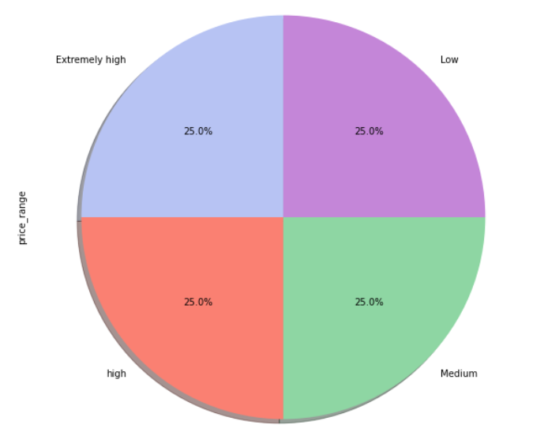
Data Informations:
Bob started his own mobile company and he
wants to give a tough fight to big companies
like Apple and Samsung.
He gathered data about different mobile Features to identify the price range of mobiles to his
company.
The data is highly balanced and consists of 2000 rows and 21 columns.

Slide 6
Features
01
battery_power: Total energy a battery can store at a time
02
blue: If the mobile is supported with bluetooth or not
clock_speed: Speed of mobile processor in executing commands
03
04
dual_sim: has two SIM cards (1) or not (0)
05
fc: Front camera pixel
06
four_g: has 4G support (1) or not (0)
07
int_memory: Internal Memory (Gigabyte)
08
m_dep: Mobile Depth (cm)
06
09
n_cores: Cores number of microprocessor
mobile_wt:
Weight of mobile

Slide 7
Features
10
mobile_wt: wieght of mobile
11
pc: primary camera mega pixels
12
px_height: height of pixels resolution
13
px_width: width of pixels resolution
14
ram: random access memory (Megabytes)
15
sc_h: height of mobile screen(cm)
16
talk_time: longest time that a single battery charge will last when you are constantly talking on the phone
17
three_g: has 3G support (1) or not (0)
06
18
touch_screen: has touch screen (1) or not (0)

Slide 8
2. Data
Visualization

Slide 9
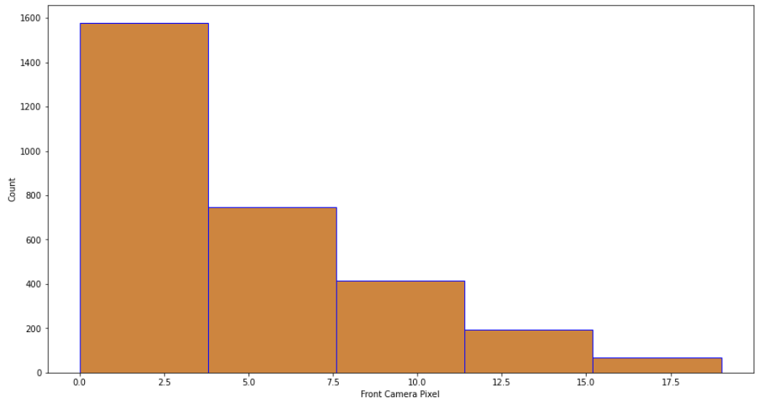
Price Range & Front Camera Pixel
To display an image in UHD screen you only need about 8.3MP image and 12MP is the minimum resolution you need to record 4k UHD videos. So to have this feature companies pushed their cameras from 8 to 12MP, So anything above it is just plain overkill.

Slide 10
Price Range & Front Camera Pixel
It should be understood that a high megapixel count does not guarantee a high-quality image. However, it collects more information for a more detailed image, So When we capture an image and want to zoom on a subject, Higher megapixels cameras come handy.

Slide 11
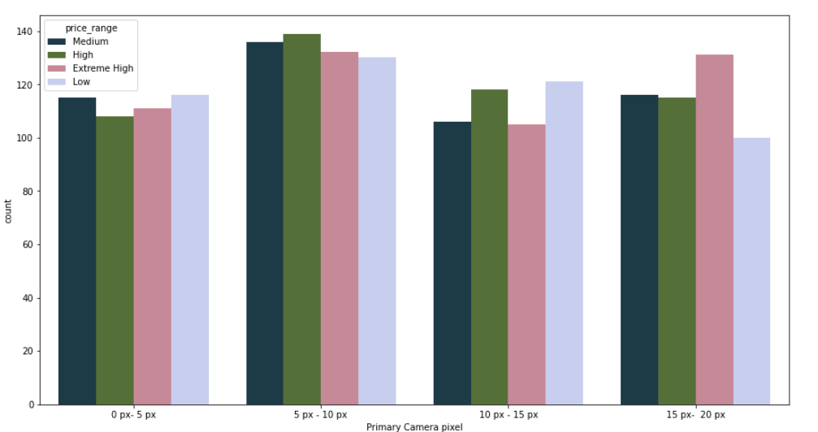
Price Range & Primary camera
It is clear that the higher pixels a primary camera of mobile gives, the higher its price. Nowadays, Most people search for high-quality images, especially after the social media work market increase.

Slide 12
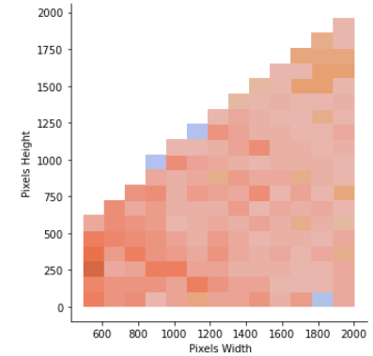

Price range & Pixels Resolution
As the pixels dimension a mobile provides increases, the price range increases due to the high-quality vision and high memory use.

Slide 13
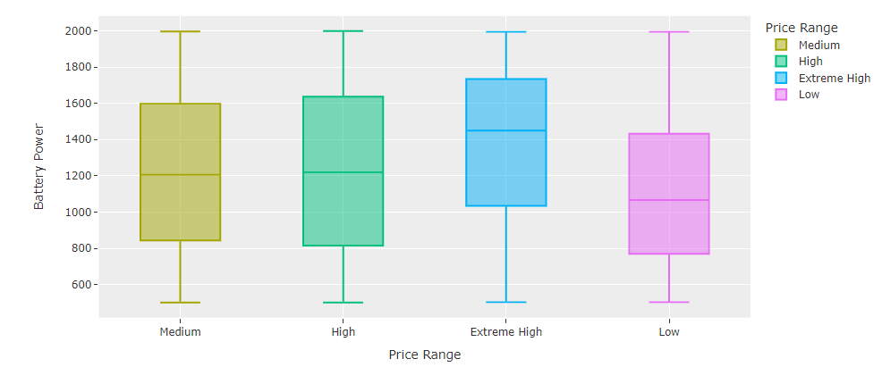
Price Range & Battery Power
To ensure a reliable long-term operation of smart devices, we should consider battery type, peak power consumption, wireless connectivity protocol, latency, throughput, and data transfer requirements.

Slide 14
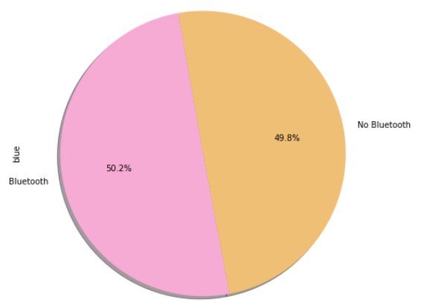
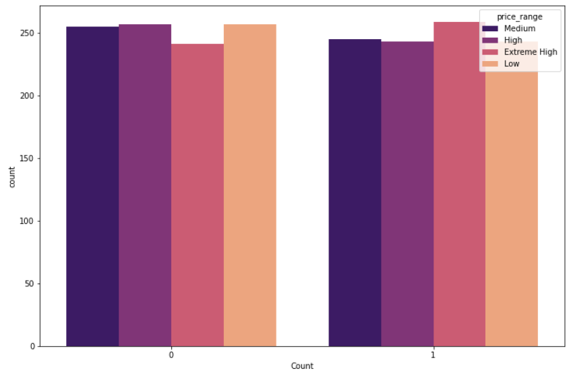
Price Range & Bluetooth
Bluetooth is mainly used as an alternative to wired connections, to transfer files between adjacent portable devices, and to pair wireless headphones and smartwatches with cell phones. (https://www.esrgear.com/blog/why-choose-a-dual-sim-smartphone-know-the-advantages-disadvantages/ )

Slide 15
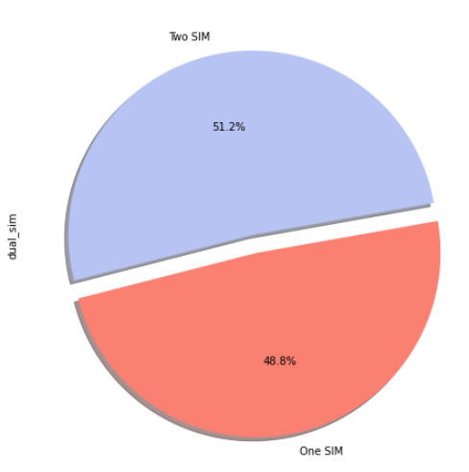
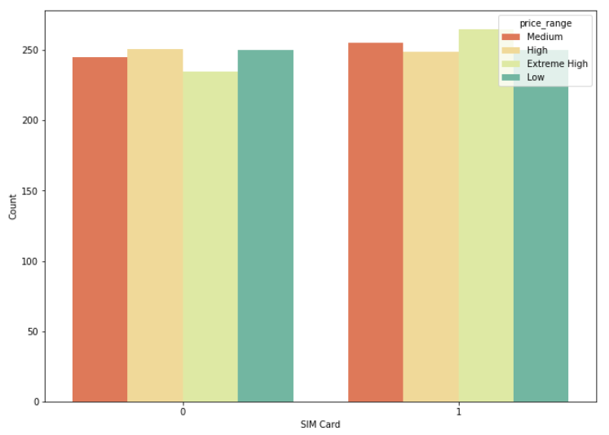
Price Range & SIM Card
The main advantage of dual SIM mobile is allowing you to carry two mobile in one. However, it is not essential to most the people which express the equilibrium in this feature.

Slide 16
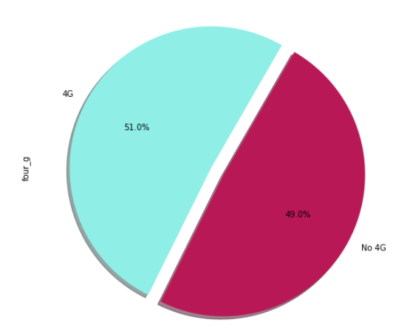
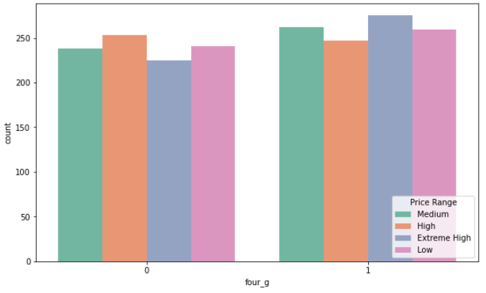
Price Range & 4G Property
This property supports interactive multimedia, voice, video, wireless internet and high speed, high capacity and low cost per bit.

Slide 17
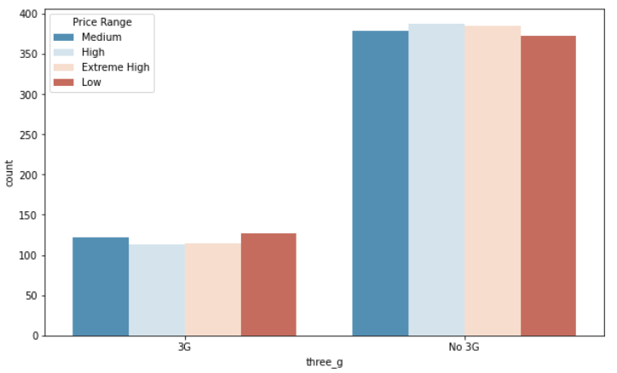
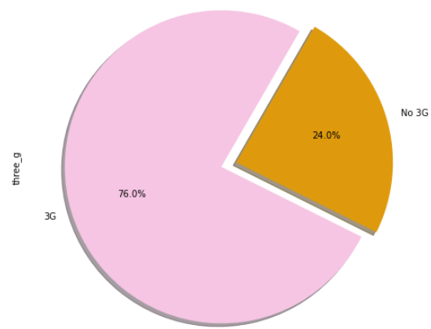
Price Range & 3G Property
3G and 4G are both mobile data connections, but 3G is an older technology associated with the first wave of touch-screen smartphones. 4G is a newer technology that delivers much faster speeds and supports more intensive mobile activit.

Slide 18
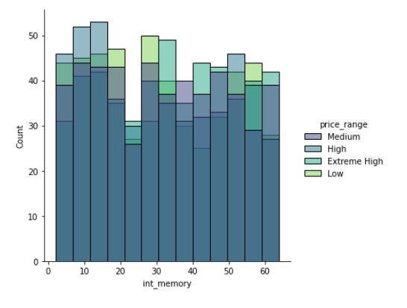
Price Range & Internal memory
Flash memory is the one that store your programs, messages, contacts, appointments.
If you want to download some games or applications then you'd need to take care about the memory issues, which can be not enough.

Slide 19
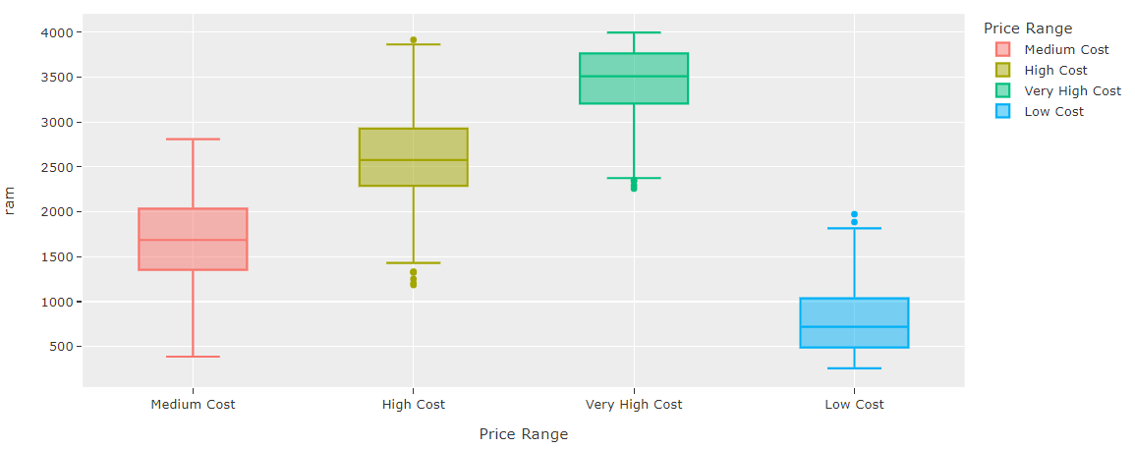
Price Range & Ram
RAM is a temporary memory used to run applications and programs. The stored data can be accessed in any order. Its random character refers to the idea that any piece of data can be quickly restored, no matter where it is located. (https://www.businessinsider.com/what-is-ram-and-why-it-matters-on-smartphones-2018-12)

Slide 20
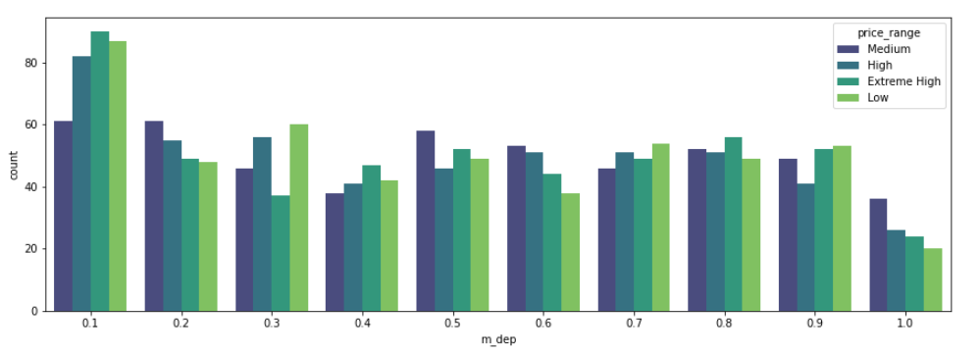
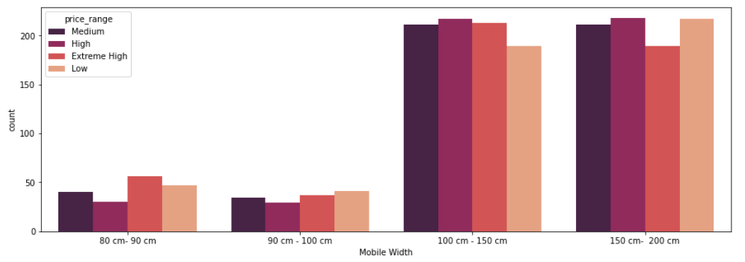
Price Range & Mobile Dimension
Most people prefer low-thickness mobile as it is easier to carry and hold, especially for the youth.
Also high width mobiles are highly preferred due to clear sight, Easier in reading articles and fantasy of watching movies.

Slide 21
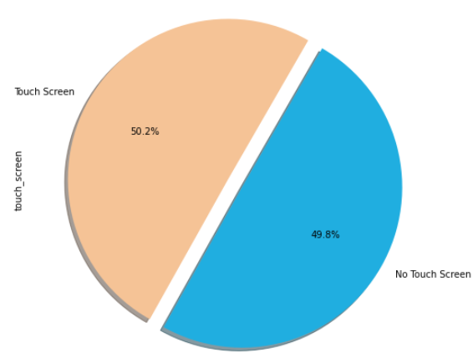
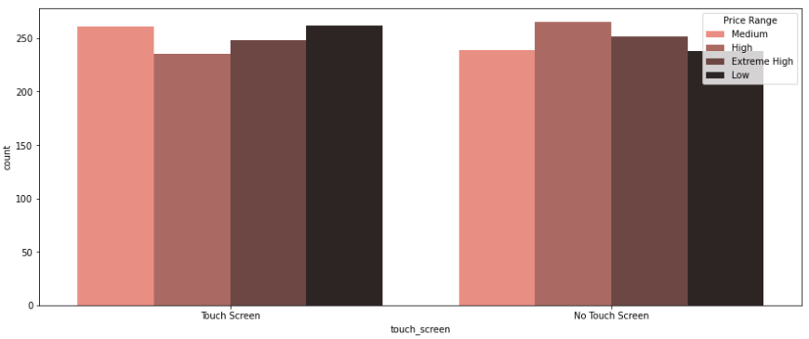
Price Range & Touch Screen

Slide 22
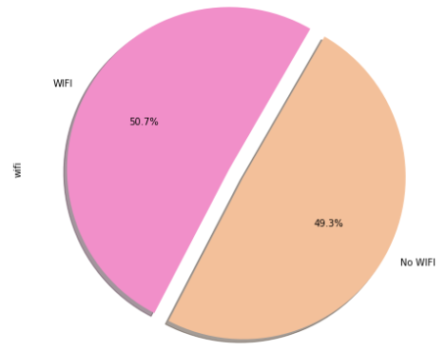
Price Range & WIFI property
WIFI has become an important feature nowadays due to:
Online learning
Online Marketing and jobs
Distance Shortening
And other main parts that makes a mobile with this feature a valuable one.
(https://www.nibusinessinfo.co.uk/content/pros-and-cons-wireless-networking)

Slide 23
Data Preprocessing
01

Slide 24
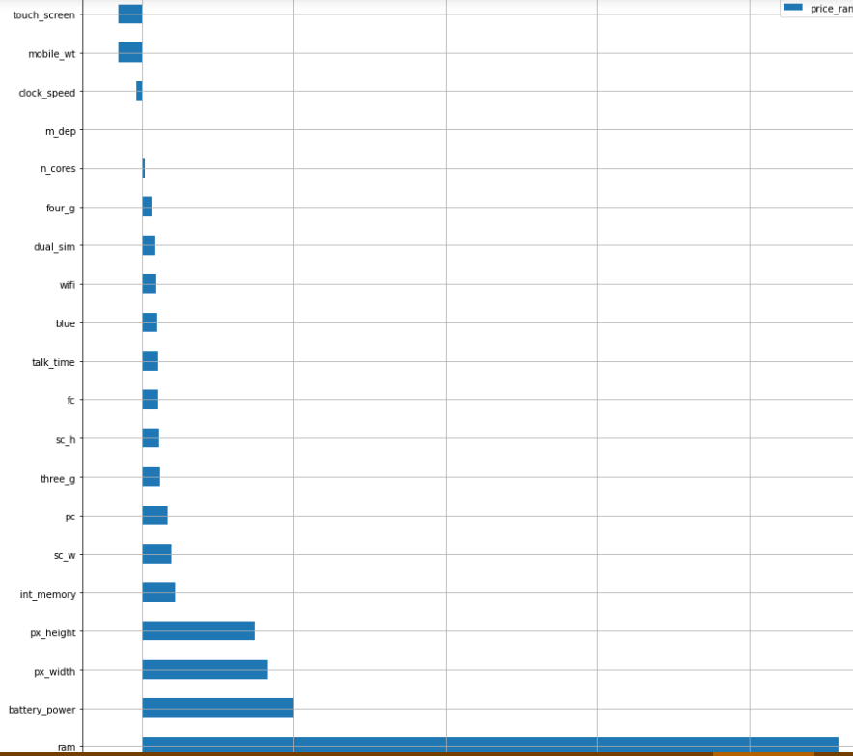
MAIN STEPS
Missing Data Handling
No missing data
2. Handling Outliers
Bare outliers
3. Correlation Check
Remove 3 features
4. Data Splitting and Scaling
Using Robust Scaler

Slide 25
MODELLING AND
PREDICTION
01

Slide 26
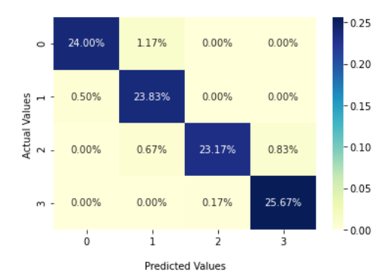
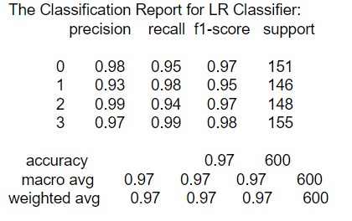
Logistic Regression:
It is the best model for prediction with:
Accuracy: 96.67%

Slide 27
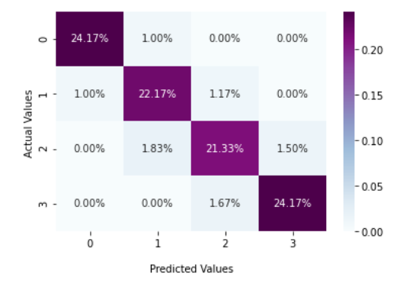
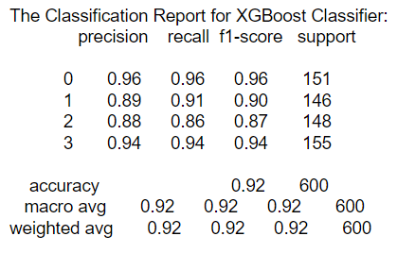
XGBOOST:
It is the best model for prediction with:
Accuracy: 91.83%

Slide 28
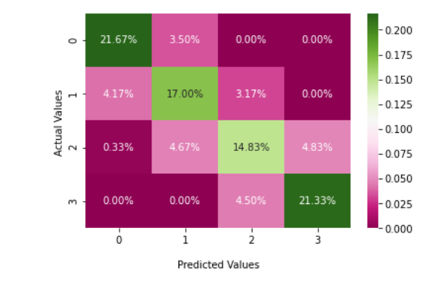
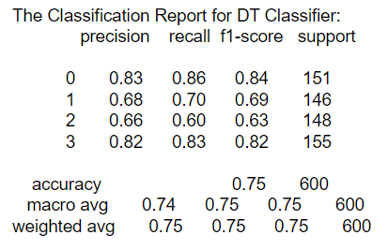
DECISION TREE:
It is the best model for prediction with:
Accuracy: 74.83%

Slide 29

THANKS

