Slide 1


ATM SMART ZONING
ENHANCING ZONE EFFICIENCY WITH AI-POWERED OPTIMIZATION
PRESENTATON
01

Slide 2

INTRODUCTION
Problem Statement: sales managers manually assigned points of sale (PDVs) to field representatives, often leading to imbalanced workloads and inefficient coverage.
Solution: We are introducing an intelligent, AI-powered model that automates zone assignment while ensuring clusters are optimized based on predefined business requirements.
Business requirements are defined by the managers of Mobilis, and our intelligent model uses them as the foundation for automated, optimized zone assignments.
02

Slide 3
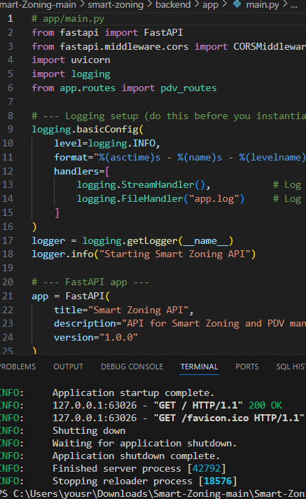
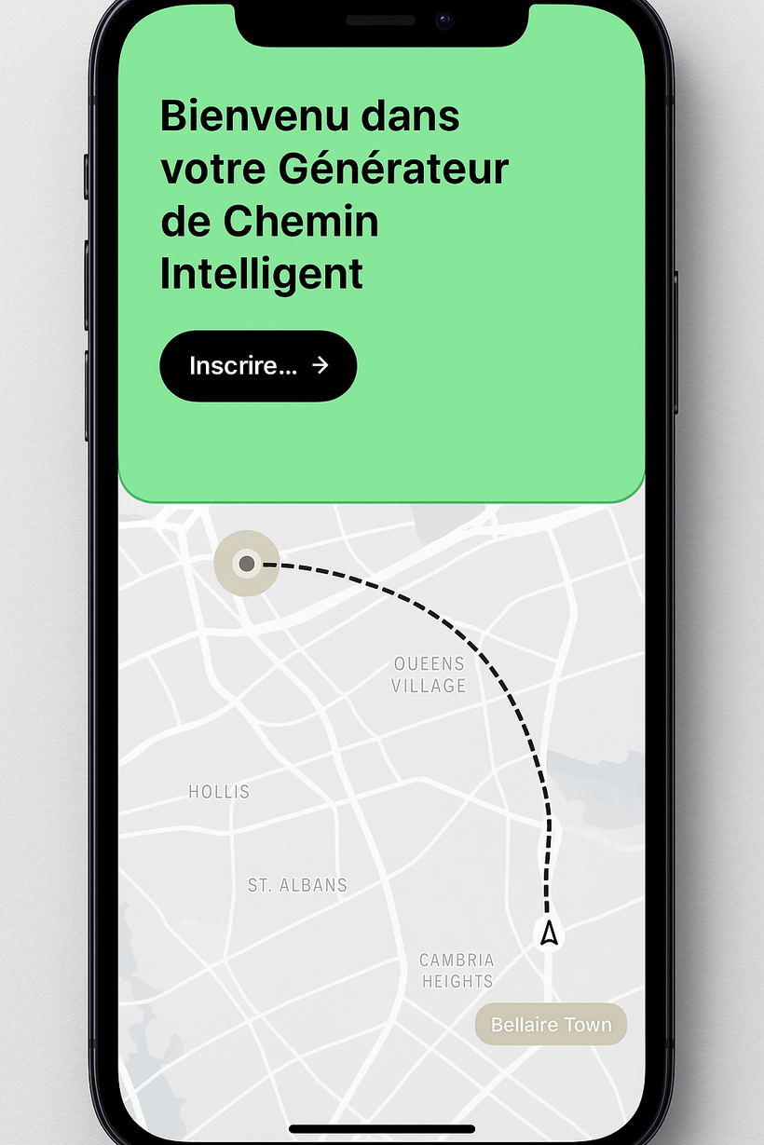
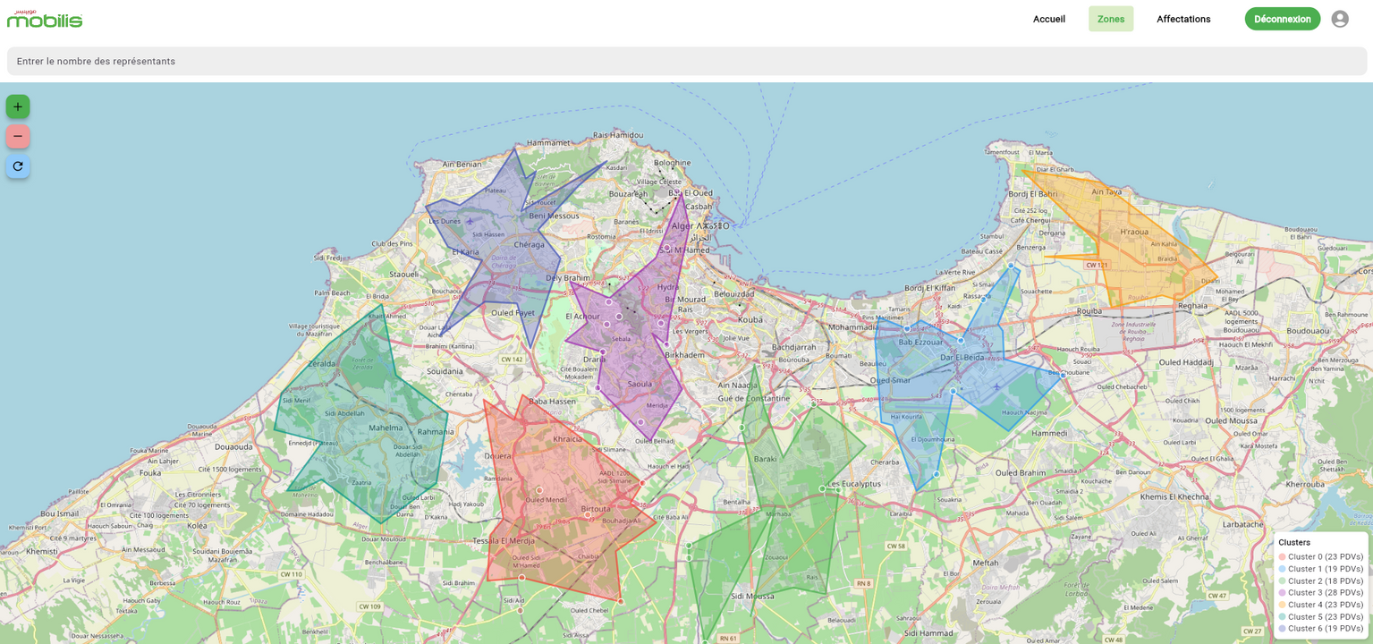
BUSINESS REQUIREMENT
  Web Platform:
A centralized dashboard for managers to view zones, add or remove PDVs, assign zones to representatives, and manually select specific PDVs for assignment.
  AI Optimization Model:
To generate automated zoning and the update
  Mobile Application:
A user-friendly app for field representatives to receive assignments, check in/out at PDVs(QR Code) and get optimized daily routes with GPS support.
03

Slide 4
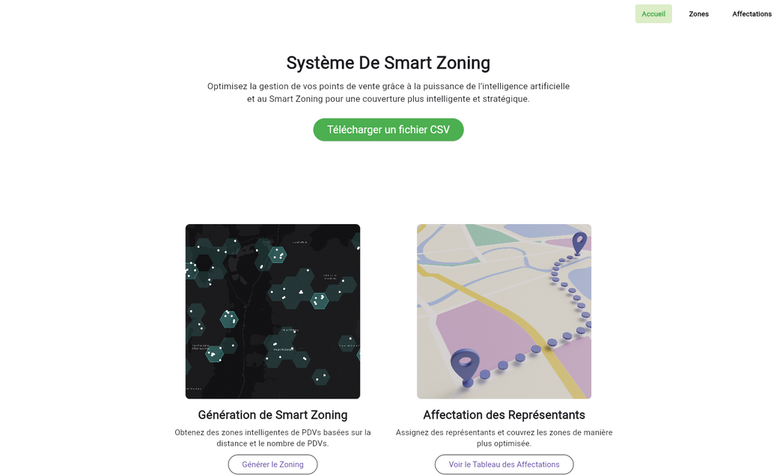
WEB PLATFORM
  CSV Upload: Managers can upload a CSV file containing PDV (Point of Sale) data for bulk processing.
  Customizable K Value: Managers can define the number of sales representatives (K value) to generate the optimal number of zones
  Dynamic Zone Updates: Managers can add or remove PDVs on the fly, and the system will automatically update and reassign zones accordingly.
04
PRESENT DESIGN

Slide 5
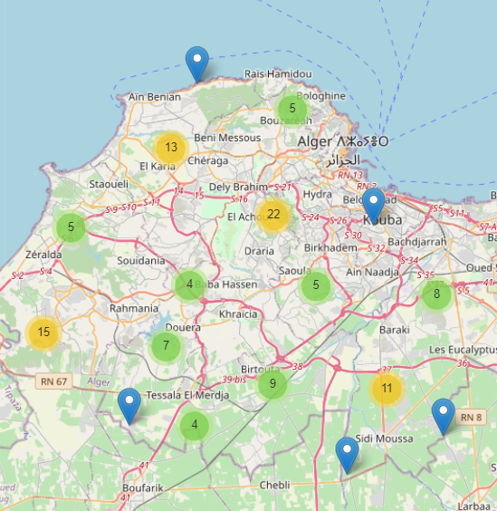
AI MODEL
Case Study: Algiers Wilaya
We consider Algiers Wilaya as a reference example for our model demonstration.
We will present a Jupyter Notebook showcasing the following steps:
  Data Preprocessing
  Initial Clustering
  Balanced Clusters
  Cluster Update Logic
JUPITER NOTEBOOK
05

Slide 6
MOBILE APP
  Optimized Visit Route
Automatically displays the best route and PDV visit order, starting from the nearest or most efficient point.
  QR Code Scanning
Allows the representative to scan a QR code at each PDV to confirm their visit and mark it as completed in real time
  Progress Tracking
View personal statistics such as:
- Number of PDVs visited
LOCAL
OVERSEAS
06
VIDEO

Slide 7
THANK YOU
09

