Slide 1

Email Campaign Analysis
BY: Youssef wael

Slide 2
AGENDA
KPIs
Campaign Audience
Revenue Generated
Dashboard
Pie Chart Insights
Recommendations

Slide 3
KPIs
Open Rates
Click-Through Rates
Conversion Rates
Unsubscribe Rates

Slide 4
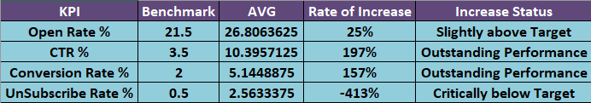
continue: KPIs

Slide 5
KPIs (Performance Metrics)
Open Rate increased by 25% → Subject lines are improving
CTR (Click-Through Rate) improved massively by 197% → Campaigns are engaging once emails are opened.
Conversion Rate rose by 157% → Campaigns are driving stronger customer actions (purchases, signups).
Unsubscribe Rate worsened dramatically (-413%) → Too many users are opting out, indicating email fatigue, poor targeting, or excessive frequency.

Slide 6
Campaign Audience

Slide 7
Campaign Audience (Emails Sent vs Count of Campaigns)
Holiday Discounts, Flash Sales, and Newsletter reach larger audiences (over 33M emails each).
Exclusive Offers and New Product Launch target smaller audiences (closer to 31M emails). Insight: Larger audience campaigns do not always correlate to higher revenue — segmentation may need refinement.

Slide 8
Revenue Generated

Slide 9
Revenue Generated (by Campaign Type)
Highest Revenue: Flash Sales & Newsletters (~$7.2M each)
Lowest Revenue: Exclusive Offers (~$6.0M).
Insight: Flash Sales and Newsletters are the most profitable strategies, while Exclusive Offers underperform despite sending millions of emails.

Slide 10
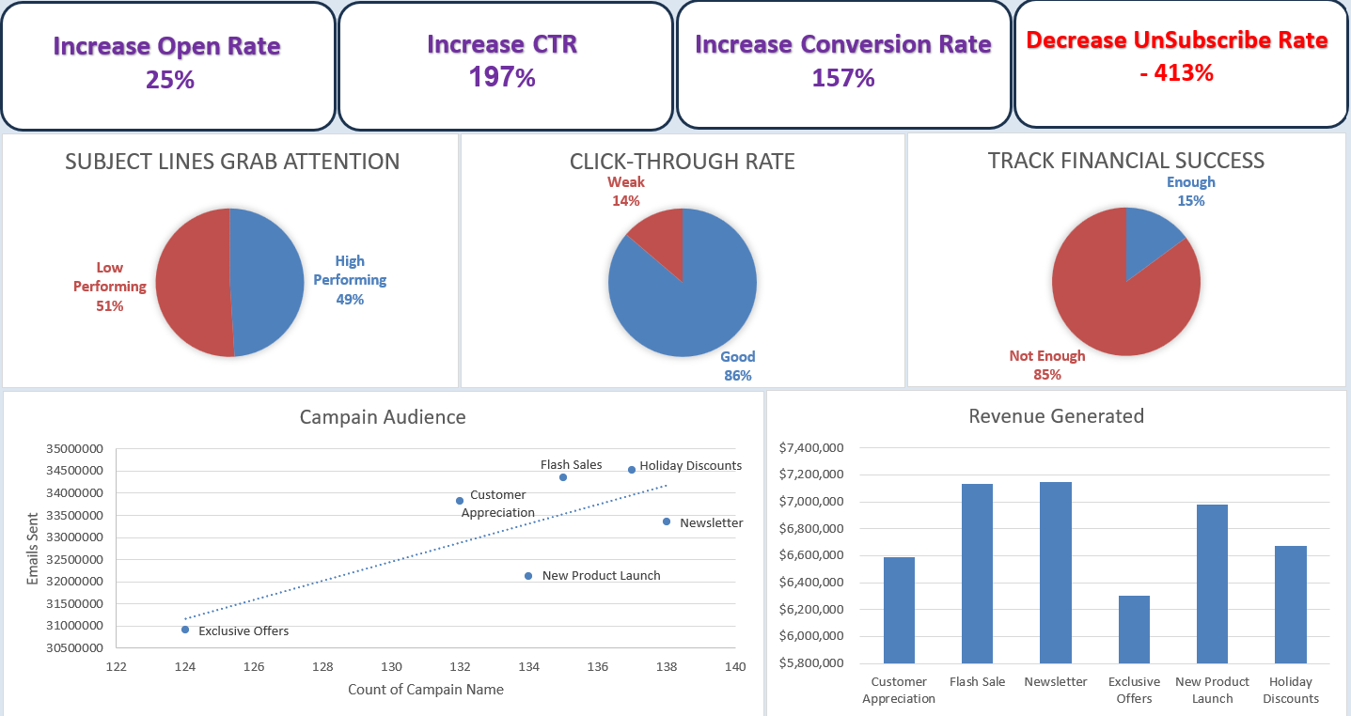

Slide 11
Pie Chart Insights
1) Subject Lines (Grabbing Attention)
49% High-Performing vs 51% Low-Performing : Almost half of subject lines fail to engage. Insight: Subject line optimization is crucial to increase open rates further.
2) Click-Through Rate
86% Good vs 14% Weak : Once users open emails, most engage well. Insight: Content relevance and CTA placement are strong, but improvement is needed for the 14% weak-performing campaigns.
3) Financial Tracking
85% “Not Enough” vs 15% “Enough” : Despite high engagement, most campaigns are not translating into sufficient financial success. Insight: There’s a gap between clicks and actual revenue conversion — possibly due to weak offers, pricing, or checkout experience.

Slide 12
Recommendations
Reduce Unsubscribe Rate: Revisit email frequency, improve targeting, and personalize content to prevent audience fatigue.
Optimize Subject Lines: Since 51% underperform, A/B testing and personalization can improve open rates beyond 25%.
Improve Revenue Conversion: Despite high CTR and conversions, financial performance is “Not Enough” for 85% of campaigns. Investigate checkout funnel, pricing strategy, and offer relevance.
Focus on High ROI Campaigns: Flash Sales and Newsletters deliver the most revenue - scale these while rethinking Exclusive Offers.
Better Segmentation: Sending mass emails doesn’t guarantee revenue. Tailor content to different audience groups for stronger ROI.

Slide 13
THE END

