Slide 1

Distributed Log analyzer

Slide 2
Introduction
In distributed systems, multiple servers produce continuous logs.
Collecting and analyzing these logs manually is inefficient.
Our goal: build an automated, distributed pipeline to analyze them efficiently.

Slide 3
Project Objective
Simulate multiple nodes producing logs.
Stream these logs in real-time using Kafka.
Store them reliably in HDFS.
Analyze them using Hadoop MapReduce.
View summary results (total requests, errors, etc.).

Slide 4
Simulating multiple nodes
We created three Python producers (producer.py) simulating different nodes.
Each producer generates random logs with timestamps, IP addresses, and status codes (200, 404, 500).
Each producer sends logs to a Kafka topic instead of writing to a local file.
This simulates real-world servers sending logs to a central system.

Slide 5
Collecting logs
Apache Kafka is used as the communication layer.
Producers send logs to Kafka brokers, which temporarily store them in topics.
A consumer script (consumer.py) subscribes to the topic and continuously reads logs.
The consumer then uploads the logs to HDFS (Hadoop Distributed File System).
This ensures reliable, ordered, and distributed log collection.

Slide 6
Storing logs
HDFS (Hadoop Distributed File System) stores all the log files.
It divides data into blocks and distributes them across multiple DataNodes.
Logs are stored under /user/hdoop/dis_logs/input directory.
HDFS provides fault tolerance and can handle large amounts of distributed data.

Slide 7
Processing logs
We use Hadoop Streaming with two Python scripts:
  mapper.py – reads log lines and emits key-value pairs (e.g., TOTAL 1, ERROR 1, etc.)
  reducer.py – aggregates these counts to produce the final summary.

Slide 8
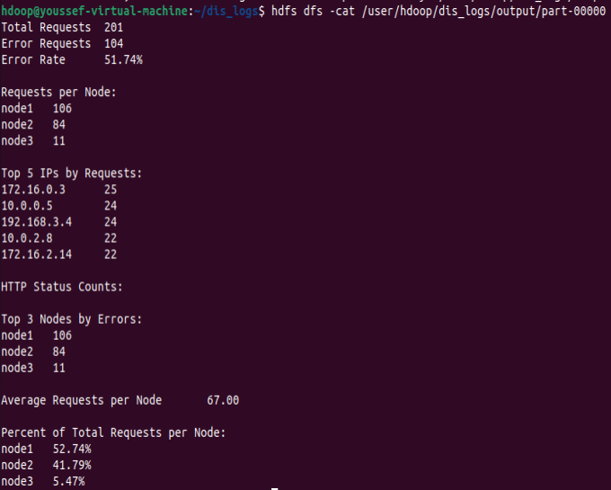
Output & results
The output gives a clear summary of:
  Total requests handled
  Error count
  Node-level distribution
  Most frequent IPs

Slide 9
Conclusion
We successfully simulated a distributed log analysis system.
Combined Kafka (for streaming) and Hadoop (for storage & analysis).
Created a workflow that mimics how real organizations monitor distributed systems.
Future improvements:
  Add real-time dashboards
  Use Spark for faster stream processing
  Integrate alert systems for high error rates

Slide 10
Thank you

