Slide 1


Team 1
A Computational Exploration of Analytical and Iterative CT Reconstruction Methods
Imaging 2 - Final Project
Presented to : Prof. AbdEl-Monem El-Sharkawy , Eng. Aya Eyad

Slide 2
Motivation
1. Exploring reconstruction techniques and their limitations
2. Discovering Iterative Solutions: ART , SART
3. Acquisition settings for iterative solutions

Slide 3
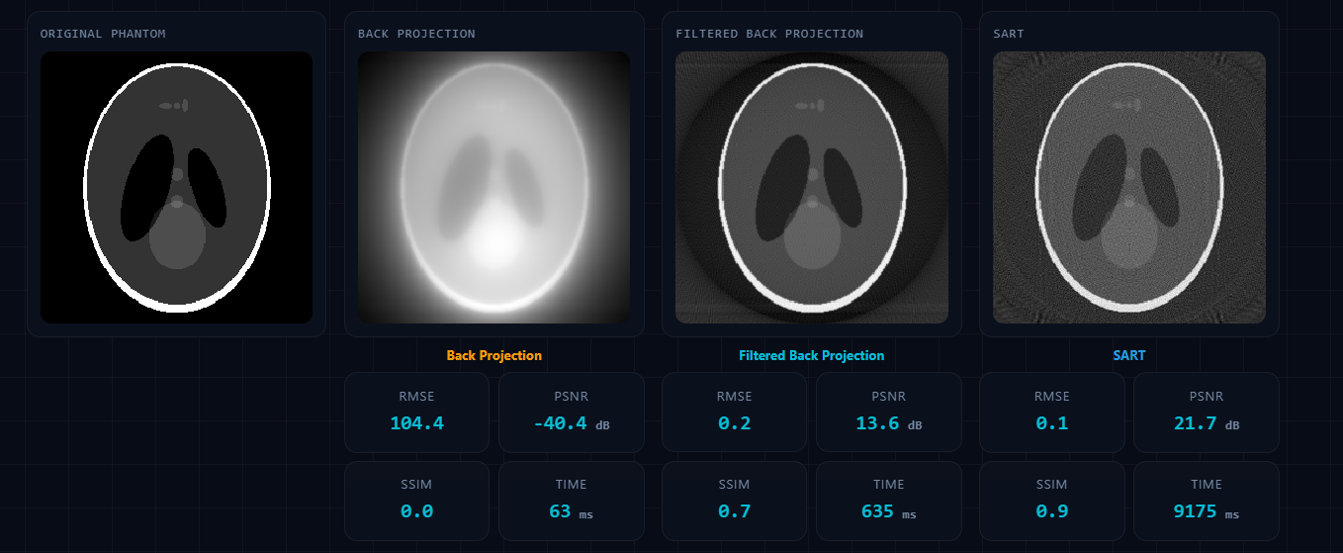
Trial 1
Reference Case:
180 Projections, 180 Degrees, Consistent Step Angles, No Noise, 10 SART iterations.

Slide 4
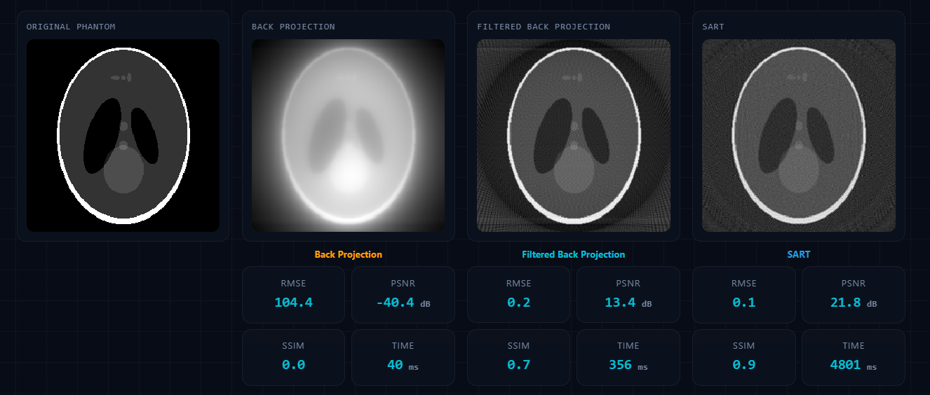
Trial 2
Trial Case:
100 Projections, 180 Degrees, Consistent Step Angles, No Noise, 10 SART iterations

Slide 5
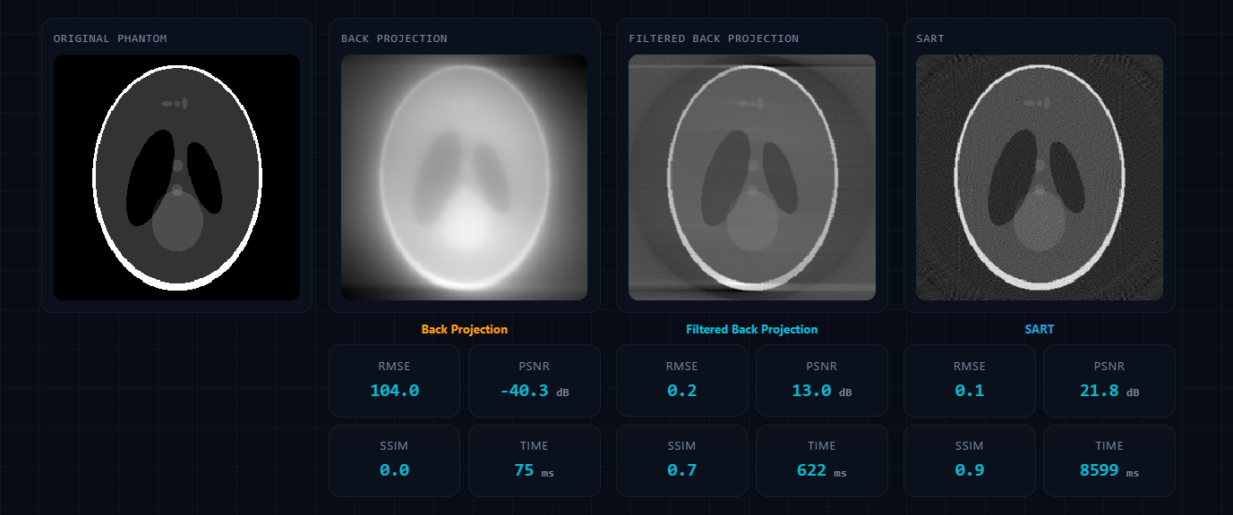
Trial 3
Trial Case:
180 Projections, 180 Degrees, Variable Step Angles, No Noise, 10 SART iterations

Slide 6
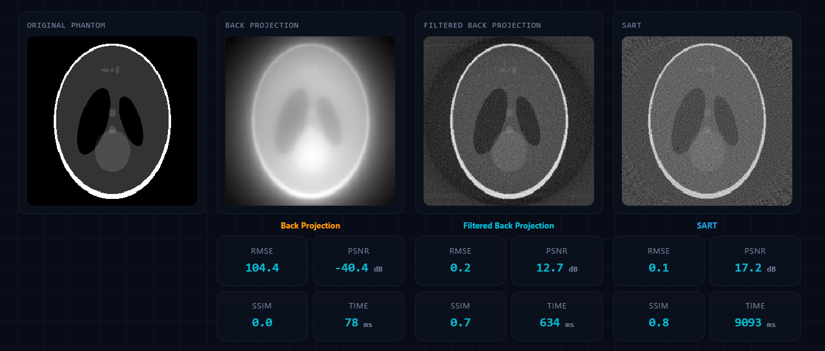
Trial 4
Trial Case:
180 Projections, 180 Degrees, Consistent Step Angles, Gaussian Noise SNR 30dB, 10 SART iterations

Slide 7
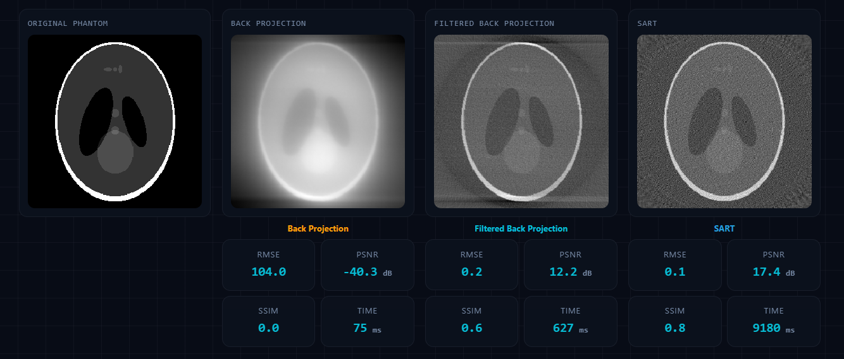
Trial 5
Trial Case:
180 Projections, 180 Degrees, Variable Step Angles, Gaussian Noise SNR 30dB, 10 SART iterations

Slide 8
Extra Features
Multiple Phantom Options as (e.g. Free hand draw, Geometric Shapes )
Multiple Color Schemas (e.g. Greyscale, Hot)
Multiple Filtering Options (e.g. Ramp, Shepp-Loggan, Cosine)
Fourier Reconstruction Method
Projection and Sinogram Simulator
Quality Metrics (e.g. RMSE, PSNR (dB) )

Slide 9
Take Home Message
Iterative methods overperform Filtered Back-projection when the spacing between angles of projection is not uniform

Slide 10
Thank You
Kareem Abdelnabi
Louai Khaled
Youssef Abo El Ela
Ali Younis

