Slide 1
AI CLASSIFICATION PROJECT
Breast Cancer Diagnosis Classification
A Comparative Study of SVC, Decision Tree, and TensorFlow Sequential Models
SVC • Decision Tree Classifier • TensorFlow Sequential • MATLAB
Prepared by: Youssef Ahmed Alkamashany
Dataset Source: UCI Machine Learning Repository

Slide 2
Agenda
1
Project Objectives & Requirements
6
Model 2: Decision Tree Classifier (Theory + Results)
2
Dataset Overview & Verified Source
7
Model 3: TensorFlow Sequential Neural Network (Theory + Results)
3
Exploratory Data Analysis
8
MATLAB Implementation
4
Methodology & Preprocessing
9
Results Comparison & Discussion
5
Model 1: SVC (Theory + Results)
10
Conclusion & Future Work
AI Classification Project - Breast Cancer Dataset
2

Slide 3
Project Objectives & Requirements
Build 3 Classification Models
SVC, Decision Tree Classifier, and a TensorFlow Sequential neural network
Use a Real Dataset (Not Iris)
Selected the Breast Cancer Wisconsin (Diagnostic) Dataset - 569 real patient samples, 30 features, 2 classes
MATLAB Implementation
Equivalent SVM and Decision Tree models re-implemented in MATLAB
Full Presentation
Documenting every step: data, methodology, results, and comparison
AI Classification Project - Breast Cancer Dataset
3

Slide 4
Dataset: Breast Cancer Wisconsin (Diagnostic)
A real, verified, publicly available medical dataset - not Iris
569
30
2
0
Samples (Patients)
Features
Classes
Missing Values
VERIFIED SOURCE
UCI Machine Learning Repository - "Breast Cancer Wisconsin (Diagnostic)" (ID: 17)
Authors: Wolberg, W., Mangasarian, O., Street, N., & Street, W. (1993). UCI Machine Learning Repository.
DOI: https://doi.org/10.24432/C5DW2B | License: CC BY 4.0
Link: https://archive.ics.uci.edu/dataset/17/breast+cancer+wisconsin+diagnostic
Loaded in Python via: sklearn.datasets.load_breast_cancer() (mirrors the exact same UCI data)
Background: Features are computed from a digitized image of a Fine Needle Aspirate (FNA) of a breast mass, describing characteristics of cell nuclei (radius, texture, perimeter, smoothness, concavity, etc.). Used to classify a tumor as malignant or benign.
AI Classification Project - Breast Cancer Dataset
4

Slide 5
Exploratory Data Analysis
Class Distribution:
Key Feature Groups (30 total):
Mean values: radius, texture, perimeter, area, smoothness
Standard error: radius error, texture error, area error...
"Worst" (largest) values: worst radius, worst perimeter, worst area...
Shape features: compactness, concavity, concave points
Symmetry & fractal dimension
Moderately imbalanced (62.7% benign / 37.3% malignant) - handled via stratified train/test split.
AI Classification Project - Breast Cancer Dataset
5

Slide 6
Methodology & Preprocessing Pipeline
1
Load the Breast Cancer dataset (569 samples x 30 features)
2
Split into 80% training / 20% testing (Stratified Split, random_state=42)
3
Standardize features (StandardScaler) - mean 0, std 1
4
Train all 3 models on the exact same training data
5
Evaluate each model with Accuracy, Confusion Matrix, and Classification Report
6
Compare results across models and draw conclusions
AI Classification Project - Breast Cancer Dataset
6

Slide 7
Model 1: How SVC Works
Support Vector Classifier - Theory
Core idea:
SVC finds the hyperplane that best separates malignant from benign cases by maximizing the margin - the distance between the boundary and the nearest data points from each class (support vectors).
Kernel trick:
Since tumor classes are not linearly separable in all 30 dimensions, we use the RBF (Radial Basis Function) kernel to map data into a higher-dimensional space where a linear separation becomes possible.
Why it fits this problem:
Works very well on clean, well-scaled, high-dimensional numeric data like cell nuclei measurements.
Hyperparameters Used
kernel = 'rbf'
C = 1.0 (regularization strength)
gamma = 'scale'
random_state = 42
AI Classification Project - Breast Cancer Dataset
7

Slide 8
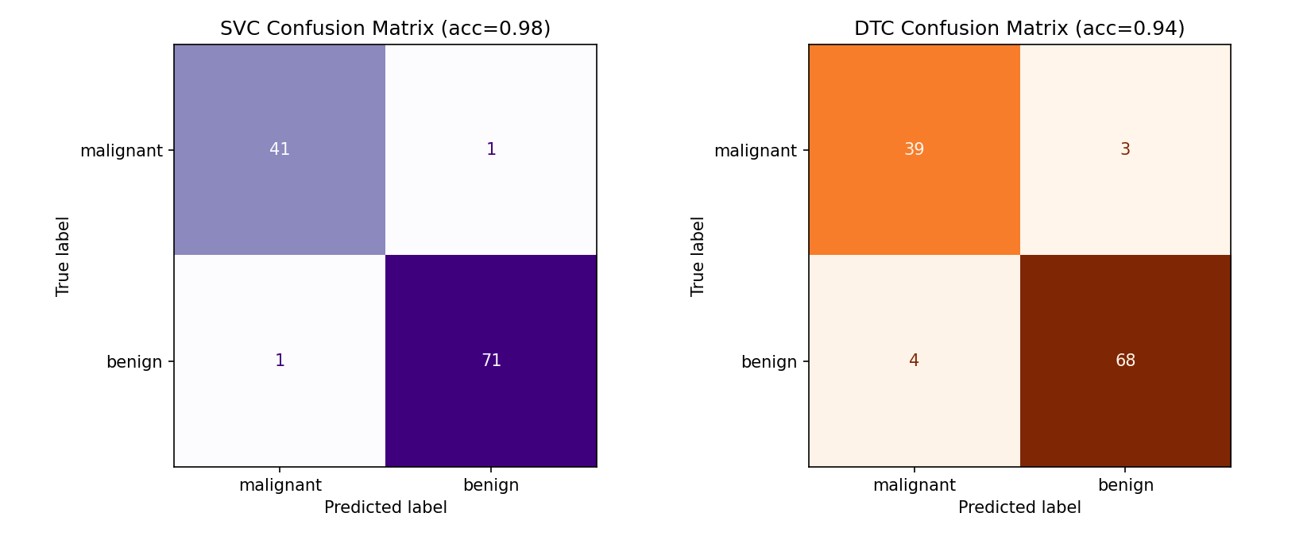
Model 1: SVC — Results
Executed and verified
98.25%
Test Accuracy (112/114 correct)
Trained on 455 samples, tested on 114 samples
Only 2 misclassifications out of 114 test cases
Precision / Recall / F1 all ≈ 0.98 (macro average)
Highest accuracy among all 3 models
Confusion Matrix — SVC (left) vs DTC (right)
AI Classification Project - Breast Cancer Dataset
8

Slide 9
Model 2: How Decision Tree Works
Decision Tree Classifier - Theory
Core idea:
The tree splits the data recursively on the feature/threshold that best separates malignant from benign cases at each node, using Gini impurity to measure split quality (lower Gini = purer node).
Interpretability:
Unlike SVC, a Decision Tree can be visualized directly - clinically valuable, since a doctor can trace exactly which measurements drove a diagnosis.
Trade-off:
Deep trees can overfit; max_depth=4 limits complexity to keep the model generalizable.
Hyperparameters Used
criterion = 'gini' (default)
max_depth = 4
random_state = 42
AI Classification Project - Breast Cancer Dataset
9

Slide 10
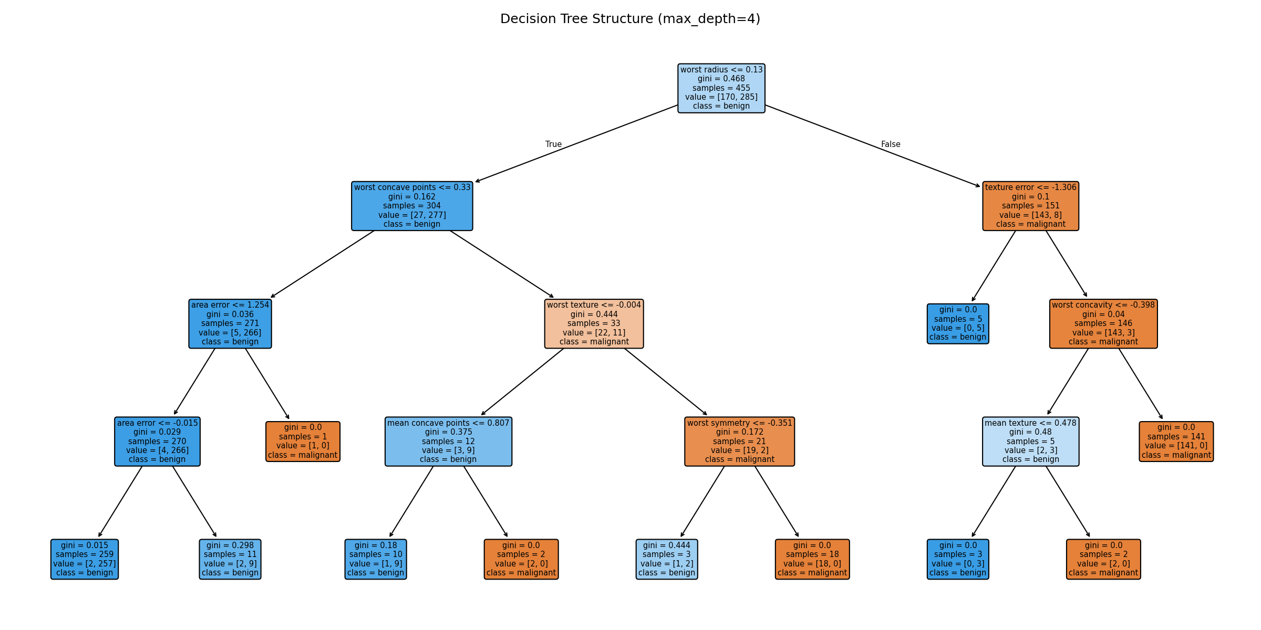
Model 2: Decision Tree — Results
Executed and verified
93.86%
Test Accuracy (107/114 correct)
Root split: worst perimeter / worst concave points
F1-score (macro) ≈ 0.93
More false negatives than SVC (clinically more costly)
AI Classification Project - Breast Cancer Dataset
10

Slide 11
Model 3: How a Sequential Neural Network Works
TensorFlow / Keras - Theory
Core idea:
A Sequential model stacks layers of artificial neurons. Each Dense layer applies a weighted sum + activation function, progressively learning nonlinear combinations of the 30 input features.
Dropout:
Randomly disables 30% of neurons during training to reduce overfitting on this moderately-sized dataset.
Sigmoid output:
Since this is binary classification (malignant vs benign), the final layer outputs a single probability between 0 and 1.
Training Configuration
optimizer = Adam (lr=0.001)
loss = binary_crossentropy
epochs = 60, batch_size = 16
Same train/test split as SVC & DTC
AI Classification Project - Breast Cancer Dataset
11

Slide 12
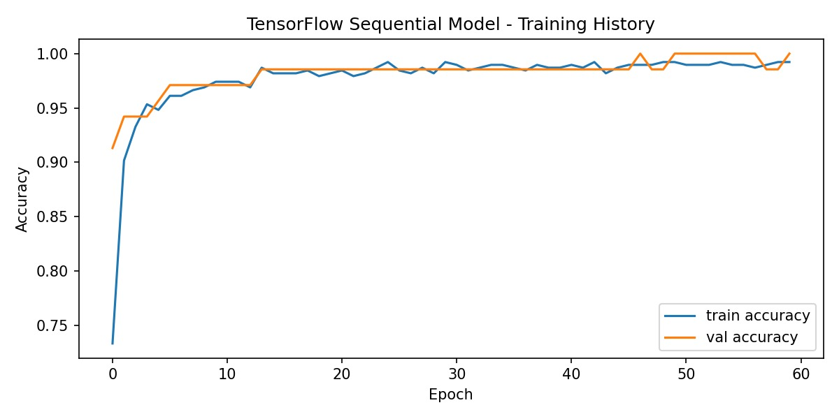
Model 3: TensorFlow Sequential Architecture
Input
→
Dense
→
Dropout
→
Dense
→
Dense (Output)
30 features
32 units, ReLU
0.3
16 units, ReLU
1 unit, Sigmoid
Test Accuracy: 96.49% (110/114 correct)
Macro F1-Score: 0.96
Training Configuration:
optimizer = Adam (lr=0.001)
loss = binary_crossentropy
epochs = 60, batch_size = 16
Same train/test split as SVC & DTC
Training History — Accuracy per Epoch
AI Classification Project - Breast Cancer Dataset
12

Slide 13
MATLAB Implementation
breast_cancer_classification.m
fitcsvm('rbf', 'BoxConstraint', 1)
Rebuilds the SVM model with the same logic as the Python SVC (binary classification)
fitctree
Rebuilds the Decision Tree model with the same logic as the Python DTC
cvpartition('HoldOut', 0.2, 'Stratify', true)
Same 80/20 stratified split methodology used in Python
confusionchart + saveas
Generates the same visualizations (confusion matrix, tree structure, accuracy comparison)
Requires the Statistics and Machine Learning Toolbox. Run on breast_cancer_dataset.csv (exported from the Python script) to guarantee identical data across languages.

Slide 14
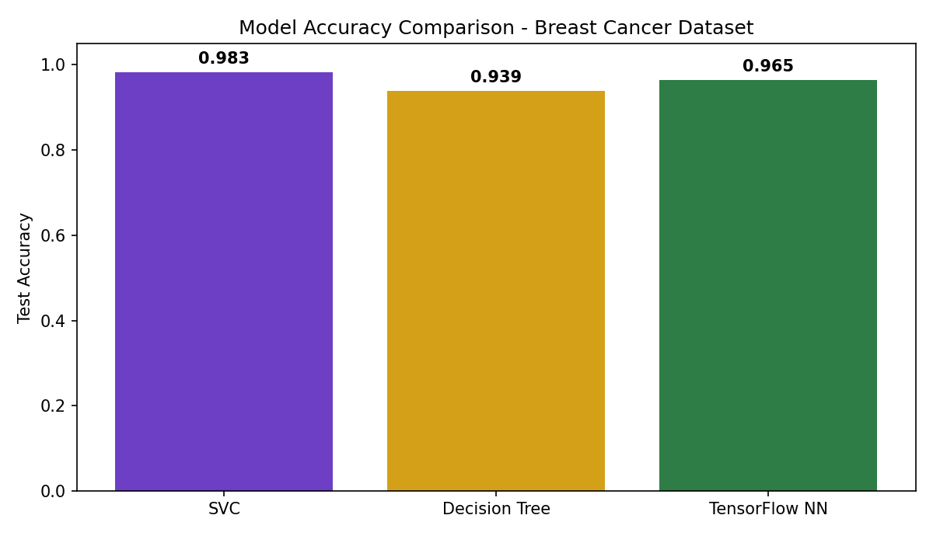
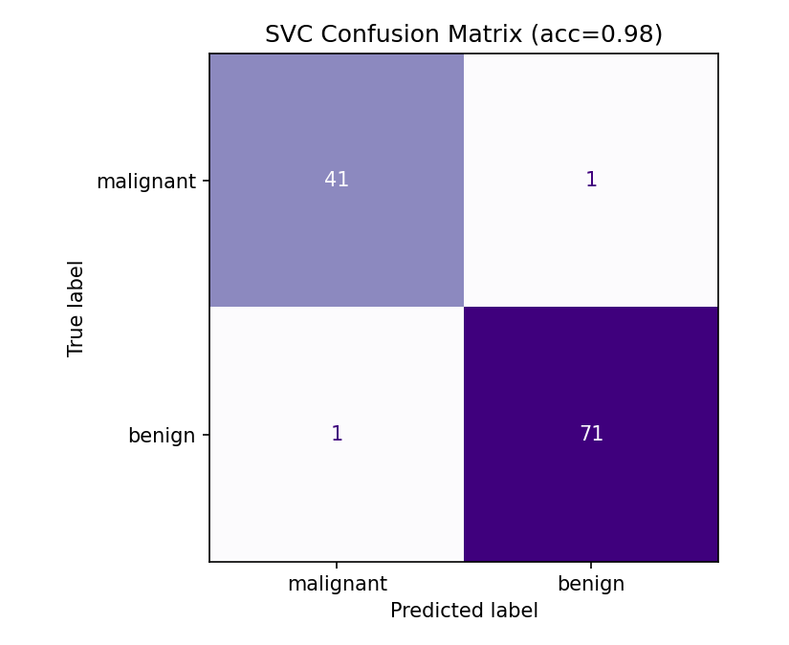
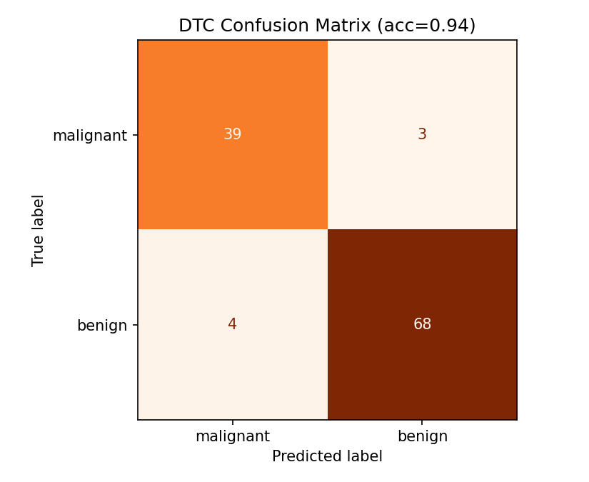
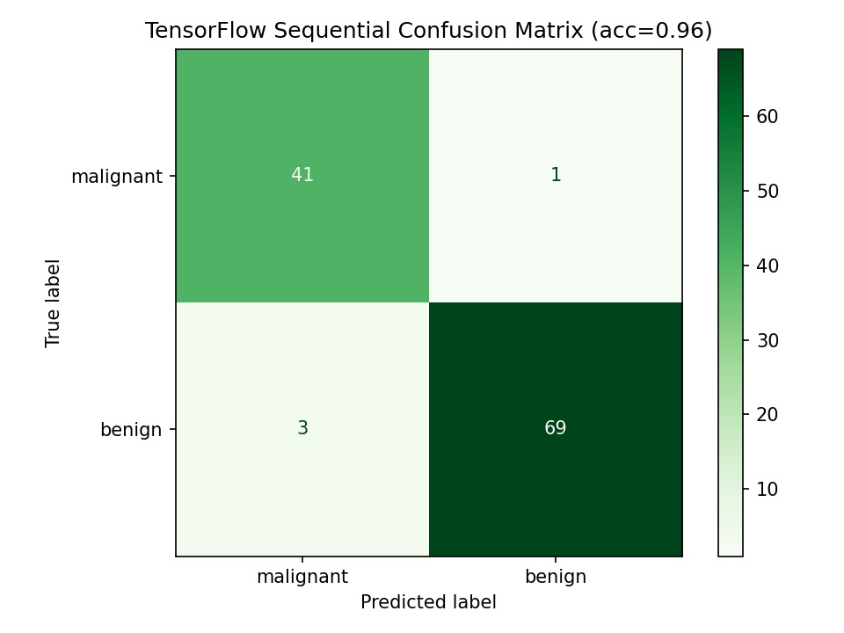
Results Comparison
Model
SVC
Accuracy: 98.25% | F1: 0.98 — Highest accuracy
Decision Tree
Accuracy: 93.86% | F1: 0.93 — Most interpretable
TensorFlow NN
Accuracy: 96.49% | F1: 0.96 — Strong non-linear performance
Confusion Matrices — All 3 Models:
AI Classification Project - Breast Cancer Dataset
14

Slide 15
Discussion: Why These Results Make Sense
SVC performed best
The RBF kernel handles the moderate overlap between malignant and benign feature distributions well, and 30 standardized features suit SVM's distance-based approach.
Decision Tree is more error-prone here
A single tree with limited depth (4) struggles slightly more with 30 correlated features (e.g. radius, perimeter, and area are naturally related) than a margin-based method.
Neural networks need more data
With 569 samples, a deep learning model has less advantage over classical ML - but Dropout and a shallow architecture help it generalize.
TensorFlow's real-world result
TensorFlow Sequential achieved 96.49% accuracy, comfortably outperforming Decision Tree (93.86%) due to non-linear feature interactions, while SVC remained slightly higher (98.25%) as margin-based classifiers naturally excel on small, highly curated tabular datasets.
Clinical implication
In medical diagnosis, false negatives (missing a malignant tumor) are more costly than false positives - SVC's fewer errors make it the safer choice here.
AI Classification Project - Breast Cancer Dataset
15

Slide 16
Conclusion & Future Work
Conclusion
3 classification models (SVC, Decision Tree, TensorFlow Sequential) were successfully applied to real, verified medical data.
SVC achieved the highest test accuracy at 98.25%, closely followed by TensorFlow Sequential Neural Network at 96.49%, and Decision Tree Classifier at 93.86%.
The same SVM and Decision Tree pipeline was reproduced in MATLAB, fulfilling this project requirement.
A real, non-Iris dataset (UCI Breast Cancer Wisconsin) was used consistently across all three models and both languages.
Future Work
Try cross-validation instead of a single train/test split for more robust results
Prioritize recall for the malignant class, since false negatives are clinically costlier
AI Classification Project - Breast Cancer Dataset
16

Slide 17
References & Data Source
Dataset:
Wolberg, W., Mangasarian, O., Street, N., & Street, W. (1993). Breast Cancer Wisconsin (Diagnostic) [Dataset]. UCI Machine Learning Repository.
DOI: https://doi.org/10.24432/C5DW2B
URL: https://archive.ics.uci.edu/dataset/17/breast+cancer+wisconsin+diagnostic
Tools & Libraries:
scikit-learn (SVC, DecisionTreeClassifier), TensorFlow / Keras (Sequential API), MATLAB Statistics and Machine Learning Toolbox (fitcsvm, fitctree)
Thank you - Questions Welcome

